Slide 1
Section 5.4
Derivatives of Exponential Functions

Slide 2
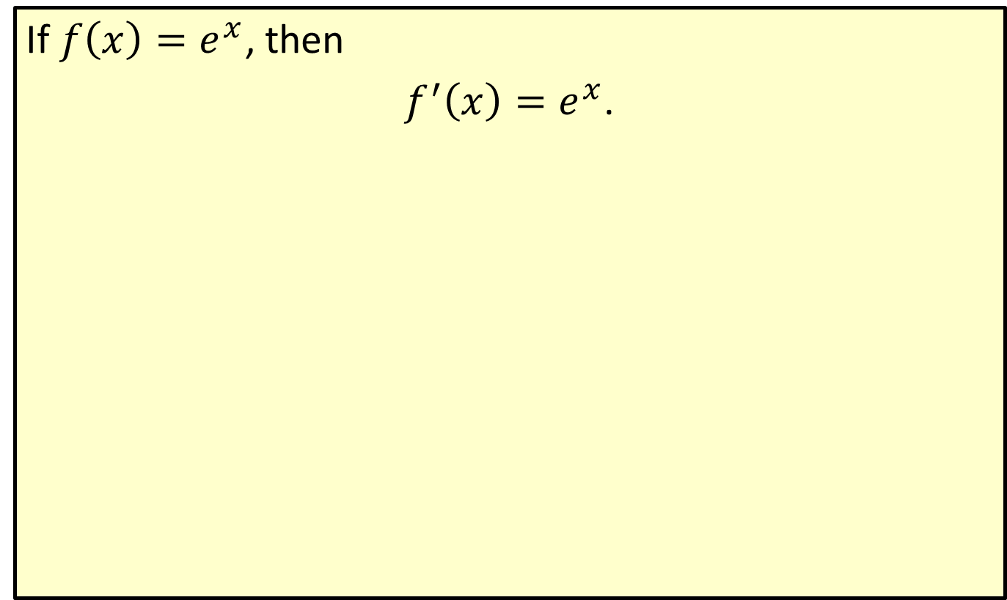
Derivative of the Exponential Function
If $f\left(x\right)=e^{x}$, then
$f^{′}\left(x\right)=e^{x}$.

Slide 3
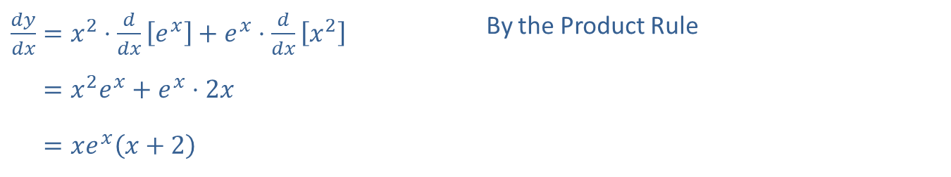

Example 1: Finding the Derivative
​Find $\frac{dy}{dx}$ for $y=x^{3}+e^{x}$.
​Solution
​$\frac{dy}{dx}=3x^{2}+e^{x}$ By the Sum and Difference Rule
​Find $\frac{dy}{dx}$ for $y=x^{2}e^{x}$.
​Solution
​
​$\frac{dy}{dx}=x^{2}⋅\frac{d}{dx}\left[e^{x}\right]+e^{x}⋅\frac{d}{dx}\left[x^{2}\right]$ | By the Product Rule
​𝑑𝑦𝑑𝑥=𝑥2𝑒𝑥+𝑒𝑥⋅2𝑥
​𝑑𝑦𝑑𝑥=𝑥𝑒𝑥𝑥+2

Slide 4
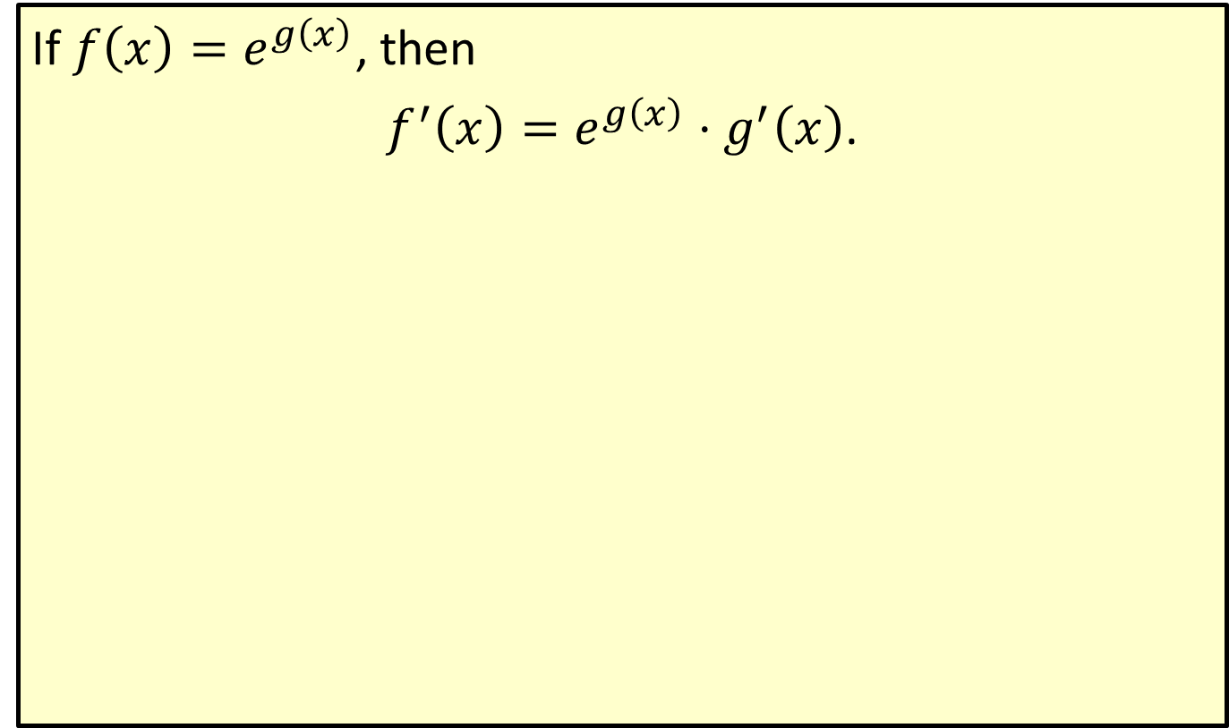
Chain Rule for Exponential Functions
If $f\left(x\right)=e^{g\left(x\right)}$, then
$f^{′}\left(x\right)=e^{g\left(x\right)}⋅g^{′}\left(x\right)$.

Slide 5
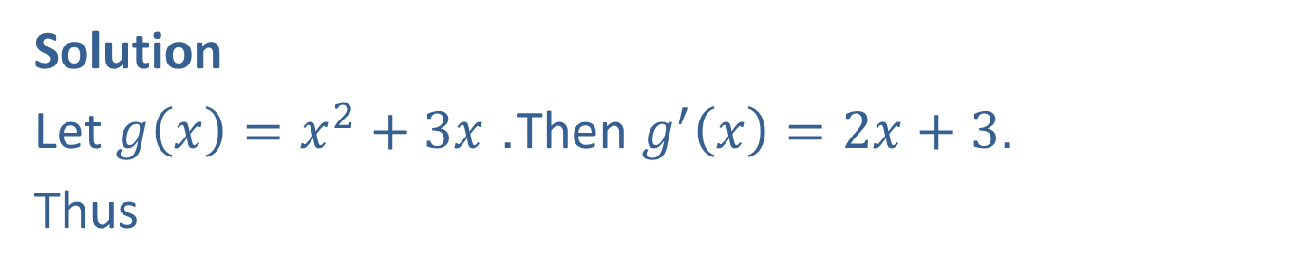



Example 2: Using the Chain Rule
Find $\frac{dy}{dx}$ if $y=e^{x^{2}+3x}$.
Solution
Let $g\left(x\right)=x^{2}+3x$. Then $g^{′}\left(x\right)=2x+3$.
Thus
$$\frac{dy}{dx}=e^{g\left(x\right)}⋅g^{′}\left(x\right)=e^{x^{2}+3x}\left(2x+3\right)$$
$=\left(2x+3\right)e^{x^{2}+3x}$.

Slide 6

Example 3: Using the Chain Rule
For $f\left(x\right)=xe^{−x}$, find
​$f^{′}⁡\left(x\right)$,
​$f^{″}⁡\left(x\right)$, and
​the equation of the tangent line to $f⁡\left(x\right)$ at the point where $x=−1$.

Slide 7
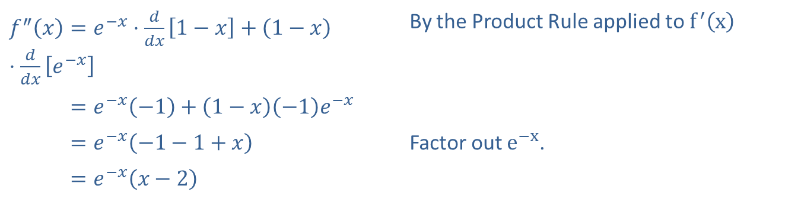
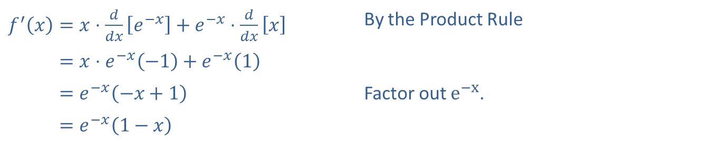
Example 3: Using the Chain Rule (cont.)
Solution
​
​$f^{′}\left(x\right)=x⋅\frac{d}{dx}\left[e^{−x}\right]+e^{−x}⋅\frac{d}{dx}\left[x\right]$ | By the Product Rule
​𝑓′⁡𝑥=𝑥⋅𝑒−𝑥−1+𝑒−𝑥1
​𝑓′⁡𝑥=𝑒−𝑥−𝑥+1 | Factor out $e^{−x}$.
​𝑓′⁡𝑥=𝑒−𝑥1−𝑥
​$f^{″}\left(x\right)=e^{−x}⋅\frac{d}{dx}\left[1−x\right]+\left(1−x\right)⋅\frac{d}{dx}\left[e^{−x}\right]$ | By the Product Rule applied to $f^{′}⁡\left(x\right)$
​𝑓″⁡𝑥=𝑒−𝑥−1+1−𝑥−1𝑒−𝑥
​𝑓″⁡𝑥=𝑒−𝑥−1−1+𝑥 | Factor out $e^{−x}$.
​𝑓″⁡𝑥=𝑒−𝑥𝑥−2

Slide 8
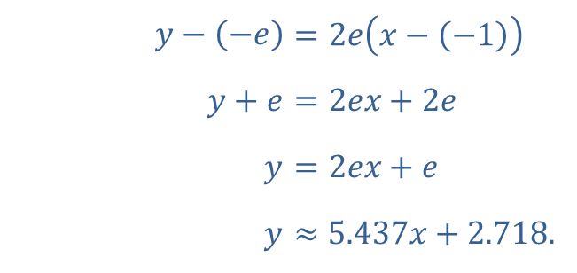
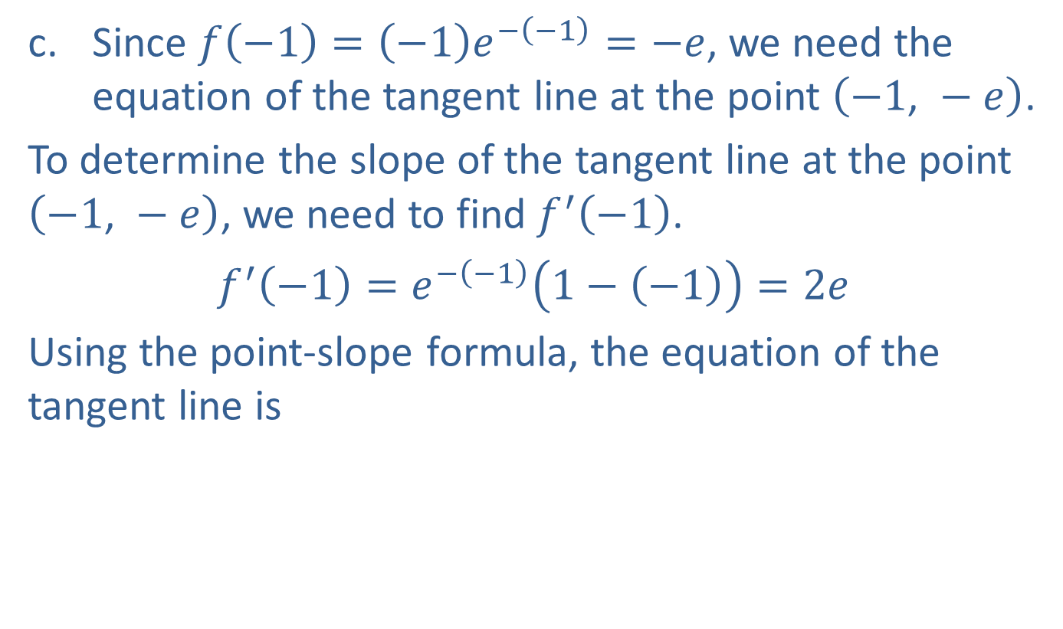
Example 3: Using the Chain Rule (cont.)
​Since $f\left(−1\right)=\left(−1\right)e^{−\left(−1\right)}=−e$, we need the equation of the tangent line at the point $\left(−1\text{, }−e\right)$.
​To determine the slope of the tangent line at the point $\left(−1\text{, }−e\right)$, we need to find $f^{′}⁡\left(−1\right)$.
​$f^{′}\left(−1\right)=e^{−\left(−1\right)}\left(1−\left(−1\right)\right)=2e$
​Using the point-slope formula, the equation of the tangent line is
​
​$y−\left(−e\right)$ | ​$=2e\left(x−\left(−1\right)\right)$
​$y+e$ | ​$=2ex+2e$
​$y$ | ​$=2ex+e$
​$y$ | ​$≈5.437x+2.718\text{.}$

Slide 9

Example 4: Graphing Exponential Functions
Let $f\left(x\right)=xe^{−x}$.
​Find any critical values.
​Find any hypercritical values.
​Sketch the graph of the function.

Slide 10
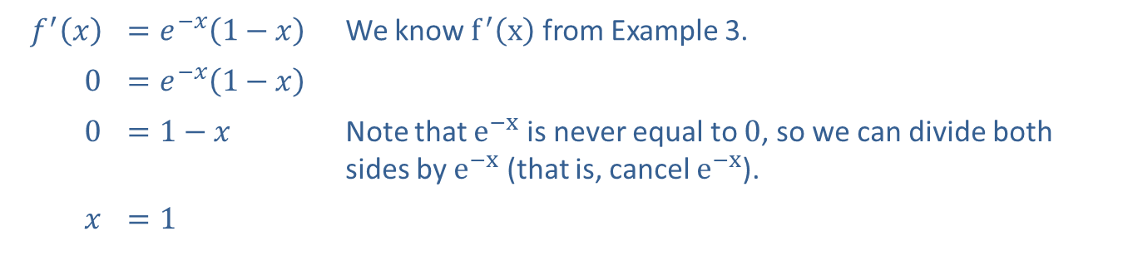


Example 4: Graphing Exponential Functions (cont.)
Solution
​To find critical values, set $f^{′}\left(x\right)=0$.
​
​$f^{′}⁡\left(x\right)$ | ​$=e^{−x}\left(1−x\right)$ | We know $f^{′}⁡\left(x\right)$ from Example 3.
​0 | ​$=e^{−x}\left(1−x\right)$
​0 | ​$=1−x$ | Note that $e^{−x}$ is never equal to 0, so we can divide both sides by $e^{−x}$ (that is, cancel $e^{−x}$).
$$x$$ | ​$=1$
​The only critical value is $x=1$, since there are no values where $f^{′}⁡\left(x\right)$ is undefined.

Slide 11
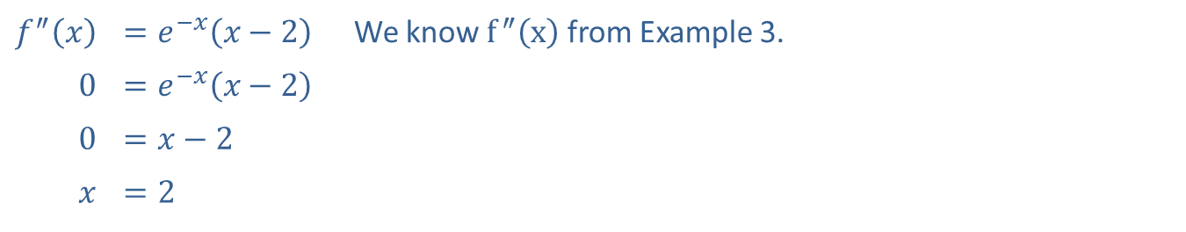

Example 4: Graphing Exponential Functions (cont.)
​To find hypercritical values, set $f^{″}\left(x\right)=0$.
​
​$f^{″}⁡\left(x\right)$ | ​$=e^{−x}\left(x−2\right)$ | We know $f^{″}⁡\left(x\right)$ from Example 3.
​0 | ​$=e^{−x}\left(x−2\right)$
​0 | ​$=x−2$
$$x$$ | ​$=2$
​The only hypercritical value is $x=2$.

Slide 12
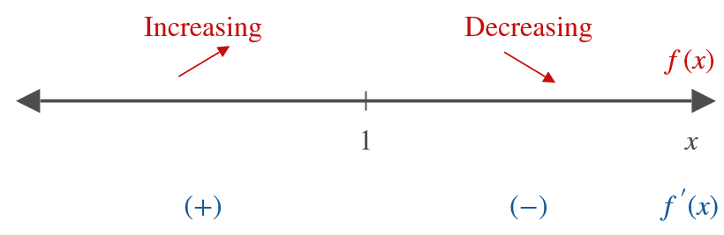
Example 4: Graphing Exponential Functions (cont.)
​Using the critical value and the hypercritical value found in parts a. and b., we can find the local extrema and the points of inflection.
​

Slide 13
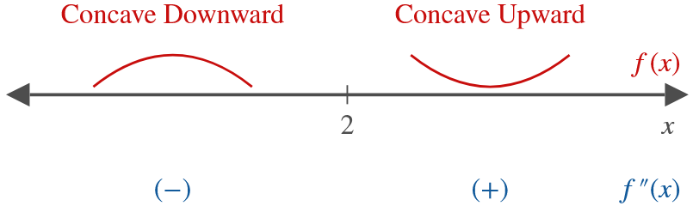

Example 4: Graphing Exponential Functions (cont.)
​So there is a local max at $\left(1\text{, }e^{−1}\right)$.
​

Slide 14
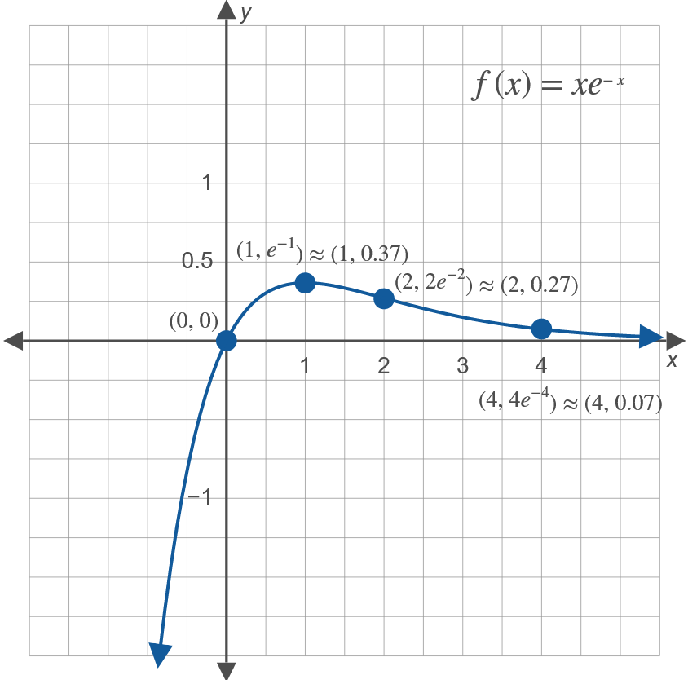

Example 4: Graphing Exponential Functions (cont.)
​There is a point of inflection at $\left(2\text{, }2e^{−2}\right)$.
​

Slide 15
Example 4: Graphing Exponential Functions (cont.)

Slide 16
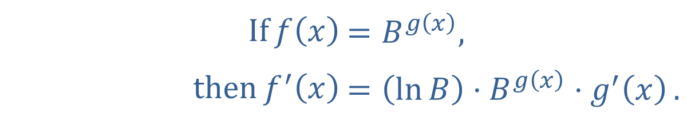
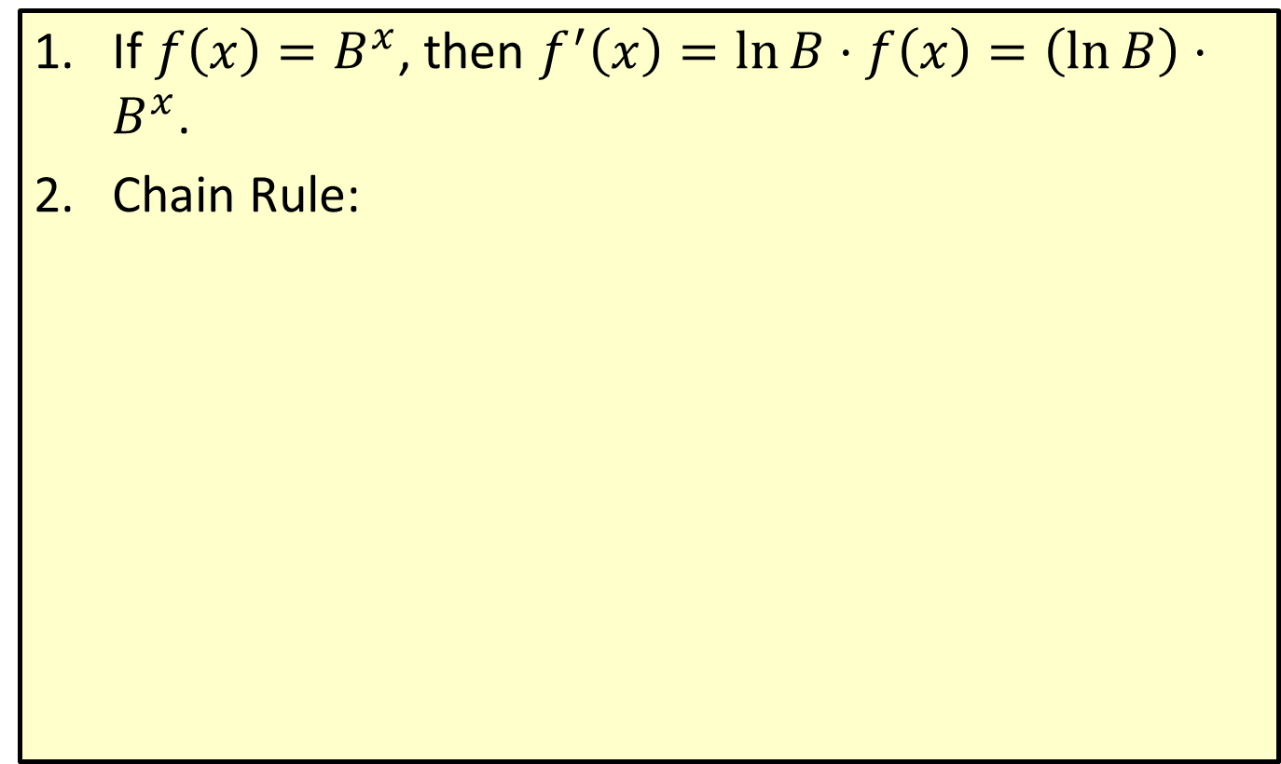
General Exponential Derivative
​If $f\left(x\right)=B^{x}$, then $f^{′}\left(x\right)=\ln{B}⋅f\left(x\right)=\left(\ln{B}\right)⋅B^{x}$.
​Chain Rule:
​$\text{If}f\left(x\right)$ | ​$=B^{g\left(x\right)}\text{,}$
​$\text{then}f^{′}\left(x\right)$ | ​$=\left(\ln{B}\right)⋅B^{g\left(x\right)}⋅g^{′}\left(x\right)\text{.}$

Slide 17
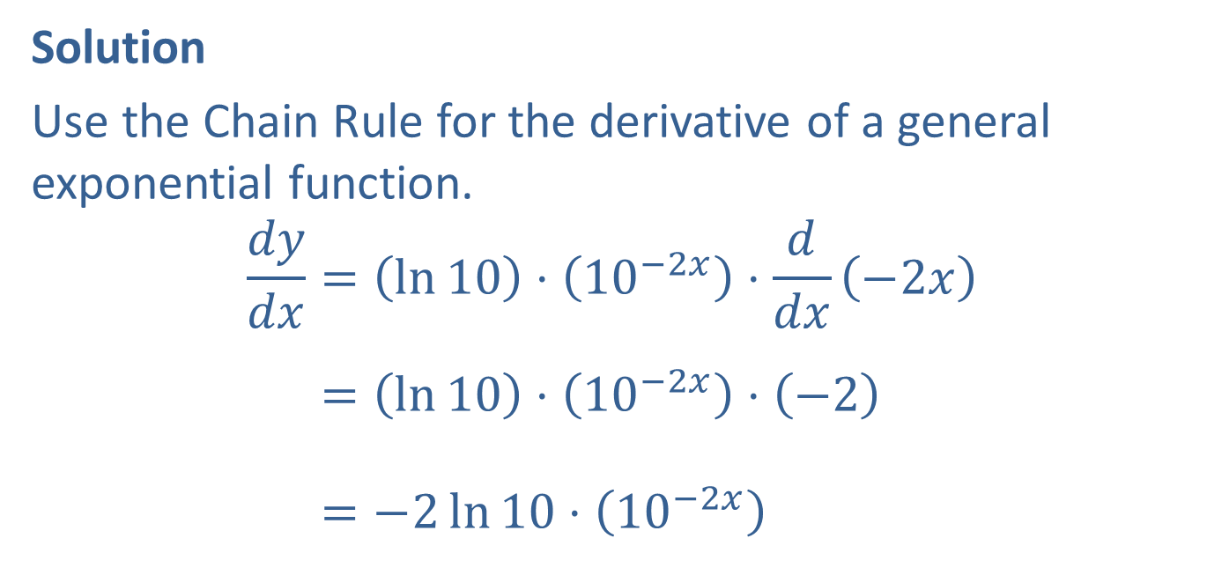

Example 5: Using the Chain Rule
Given $y={10}^{−2x}$, find $\frac{dy}{dx}$.
Solution
Use the Chain Rule for the derivative of a general exponential function.
𝑑𝑦𝑑𝑥=ln10⋅10−2𝑥⋅𝑑𝑑𝑥−2𝑥𝑑𝑦𝑑𝑥=ln10⋅10−2𝑥⋅−2𝑑𝑦𝑑𝑥=−2ln10⋅10−2𝑥

