Slide 1
Section 5.5
Growth and Decay

Slide 2
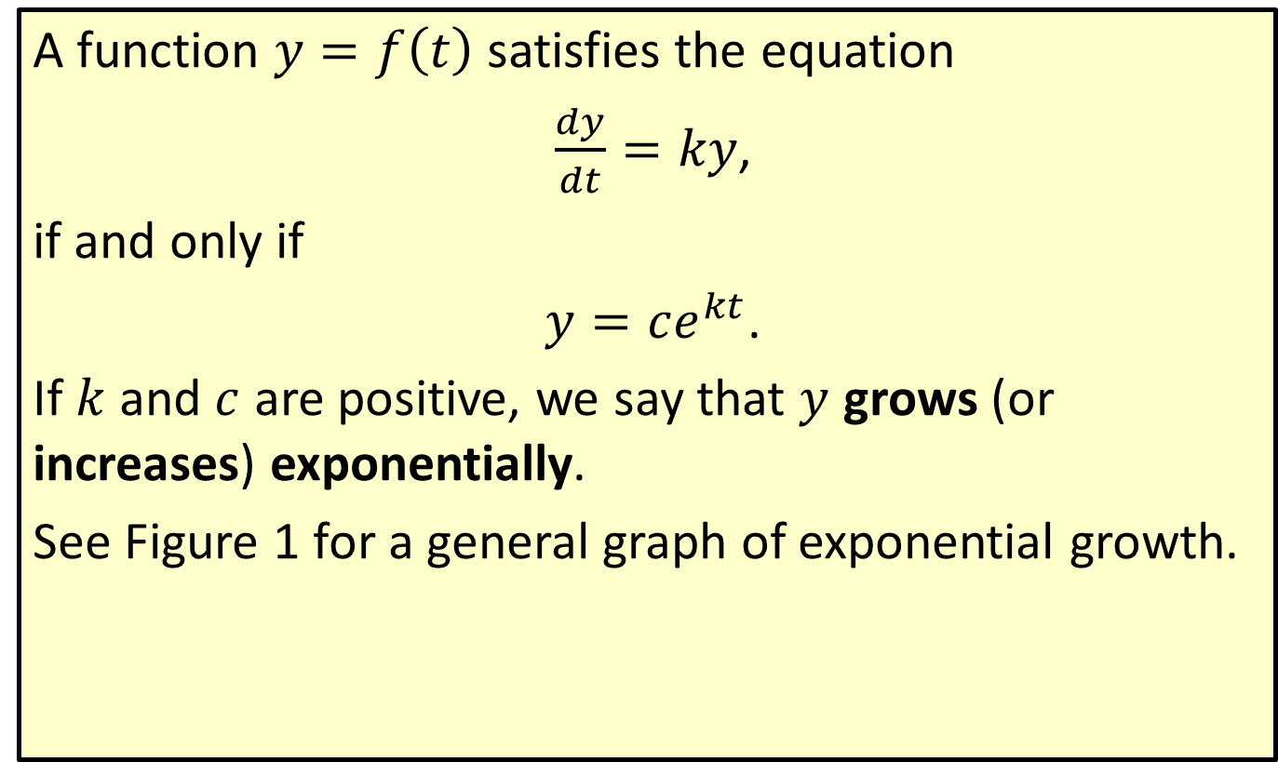
Exponential Growth
A function $y=f\left(t\right)$ satisfies the equation
$\frac{dy}{dt}=ky$,
if and only if
$y=ce^{kt}$.
If $k$ and $c$ are positive, we say that $y$ grows (or increases) exponentially.
See Figure 1 for a general graph of exponential growth.

Slide 3
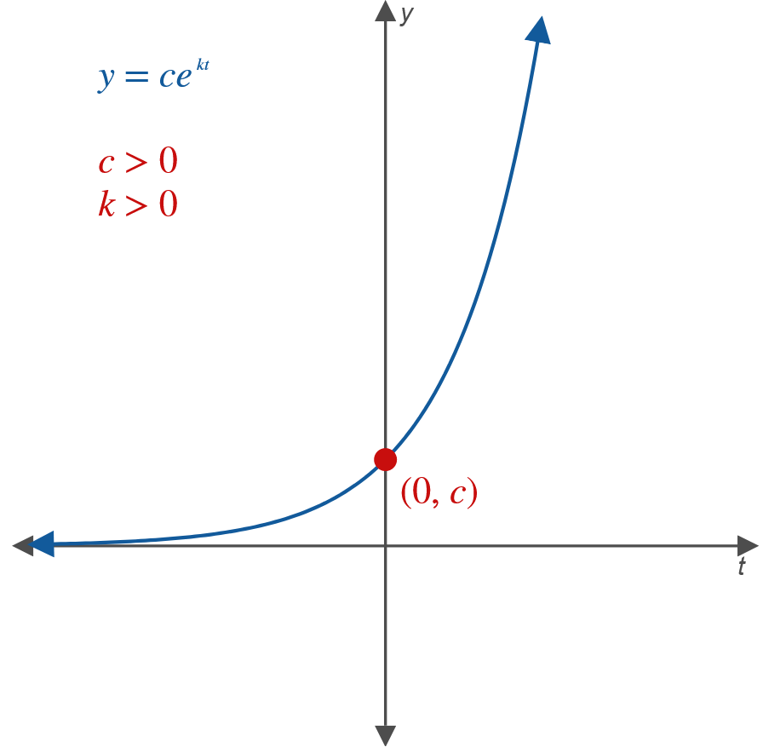
Exponential Growth (cont.)
Figure 1: Exponential Growth

Slide 4
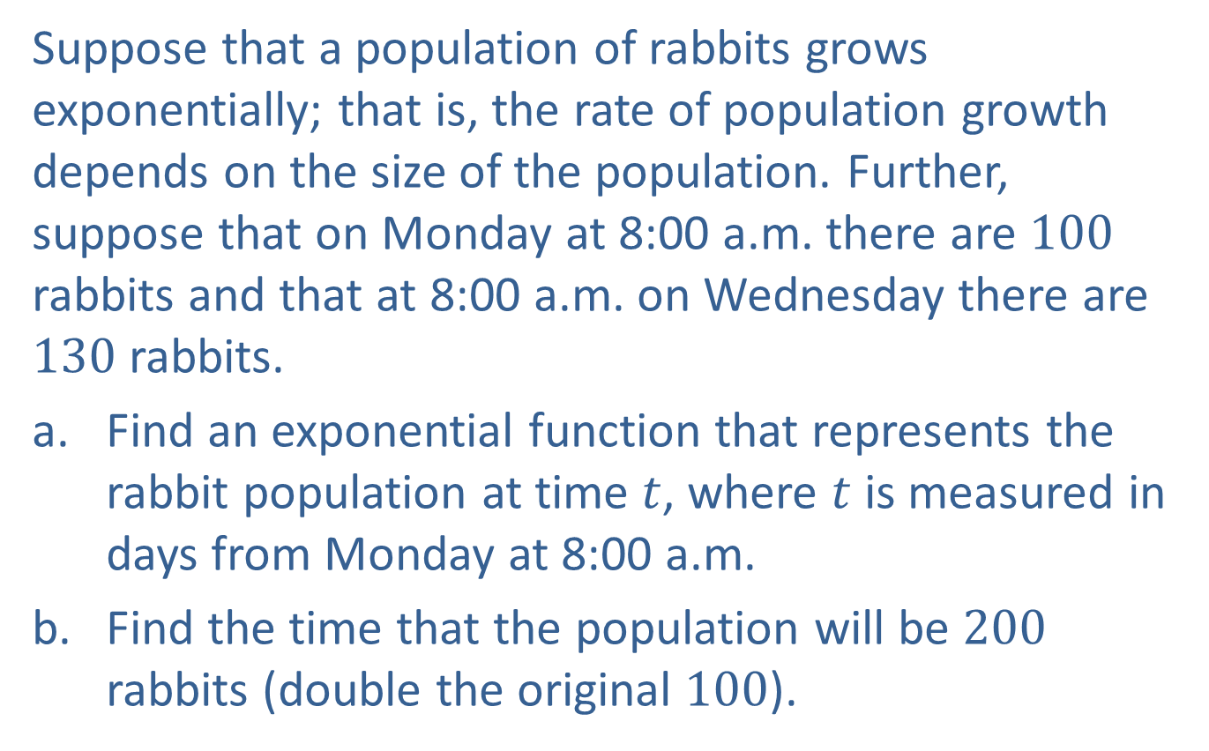
Example 1: Population Growth
Suppose that a population of rabbits grows exponentially; that is, the rate of population growth depends on the size of the population. Further, suppose that on Monday at 8:00 a.m. there are 100 rabbits and that at 8:00 a.m. on Wednesday there are 130 rabbits.
​Find an exponential function that represents the rabbit population at time $t$, where $t$ is measured in days from Monday at 8:00 a.m.
​Find the time that the population will be 200 rabbits (double the original 100).

Slide 5
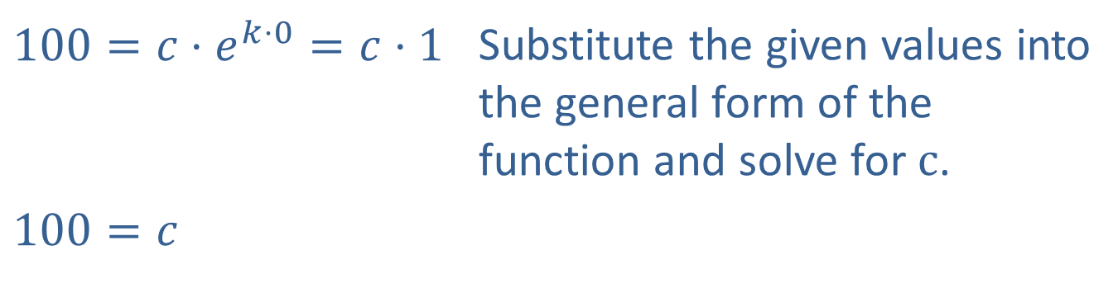

Example 1: Population Growth (cont.)
Solution
​The general form of the function is
​$y=ce^{kt}$.
​When $t=0$ (Monday at 8:00 a.m.), $y=100$.
​
​$100=c⋅e^{k⋅0}=c⋅1$ | Substitute the given values into the general form of the function and solve for $c$.
​$100=c$

Slide 6
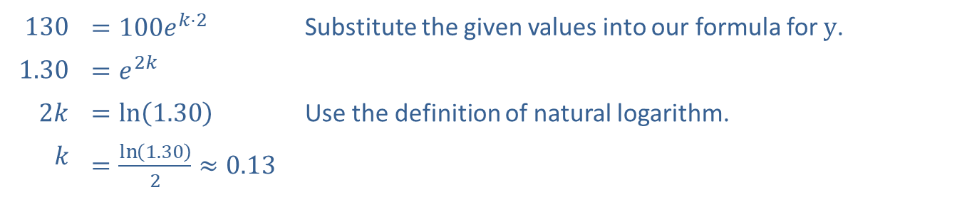

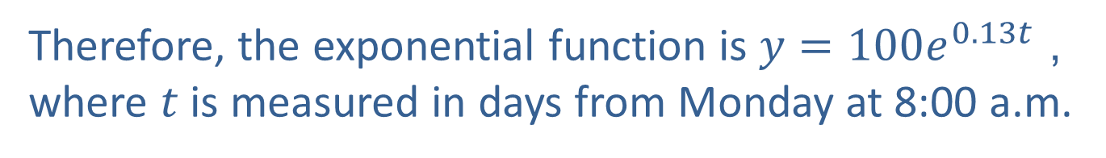
Example 1: Population Growth (cont.)
​This gives
​$y=100e^{kt}$. Substitute $c=100$ into the general form of the function.
​Now, when $t=2$ (Wednesday at 8:00 a.m.), $y=130$.
​
​130 | ​$=100e^{k⋅2}$ | Substitute the given values into our formula for $y$.
​1.30 | ​$=e^{2k}$
​$2k$ | ​$=\ln\left(1.30\right)$ | Use the definition of natural logarithm.
$$k$$ | ​$=\frac{\ln\left(1.30\right)}{2}≈0.13$
Therefore, the exponential function is $y=100e^{0.13t}$, where $t$ is measured in days from Monday at 8:00 a.m.

Slide 7


Example 1: Population Growth (cont.)
​Setting $y=200$ and solving for $t$, we have
​
​
which is approximately 3:00 p.m. on Saturday.
​$200$ | ​$=100e^{0.13t}$
​$2$ | ​$=e^{0.13t}$
​$0.13t$ | ​$=\ln{2}$
​$t$ | ​$=\frac{\ln{2}}{0.13}≈5.3\text{days}\text{,}$

Slide 8

Example 2: Continuous Compounding Interest
Suppose that $\$2000$ is invested in an account that earns 8 percent compounded continuously.
​What will be the balance in 1 year?
​When will the original investment be doubled?

Slide 9

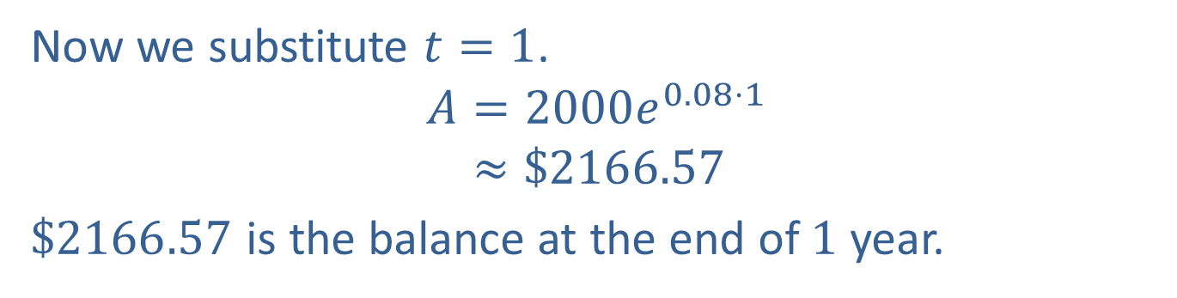
Example 2: Continuous Compounding Interest (cont.)
Solution
​We know that the growth is exponential because the interest is compounded continuously. Thus, the account balance after $t$ years is determined by the following formula.
​
$$A=Pe^{rt}=2000e^{0.08t}$$ | Substitute $P=2000$ and $r=0.08$ into the formula for continuously compounded interest.
Now we substitute $t=1$.
𝐴=2000𝑒0.08⋅1𝐴≈$2166.57
​$\$2166.57$ is the balance at the end of 1 year.

Slide 10
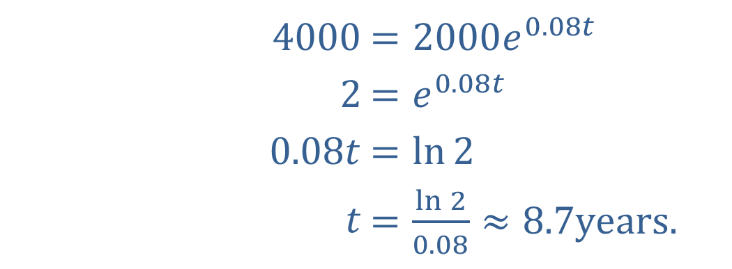

Example 2: Continuous Compounding Interest (cont.)
​Setting $A=4000$ and solving for $t$, we obtain
​
​The original investment of $\$2000$ will double in approximately 8.7 years.
​$4000$ | ​$=2000e^{0.08t}$
​$2$ | ​$=e^{0.08t}$
​$0.08t$ | ​$=\ln{2}$
​$t$ | ​$=\frac{\ln{2}}{0.08}≈8.7\text{years}\text{.}$

Slide 11
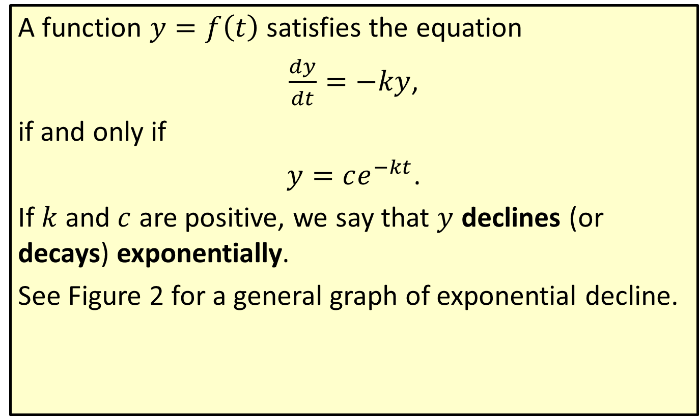
Exponential Decline
A function $y=f\left(t\right)$ satisfies the equation
$\frac{dy}{dt}=−ky$,
if and only if
$y=ce^{−kt}$.
If $k$ and $c$ are positive, we say that $y$ declines (or decays) exponentially.
See Figure 2 for a general graph of exponential decline.

Slide 12
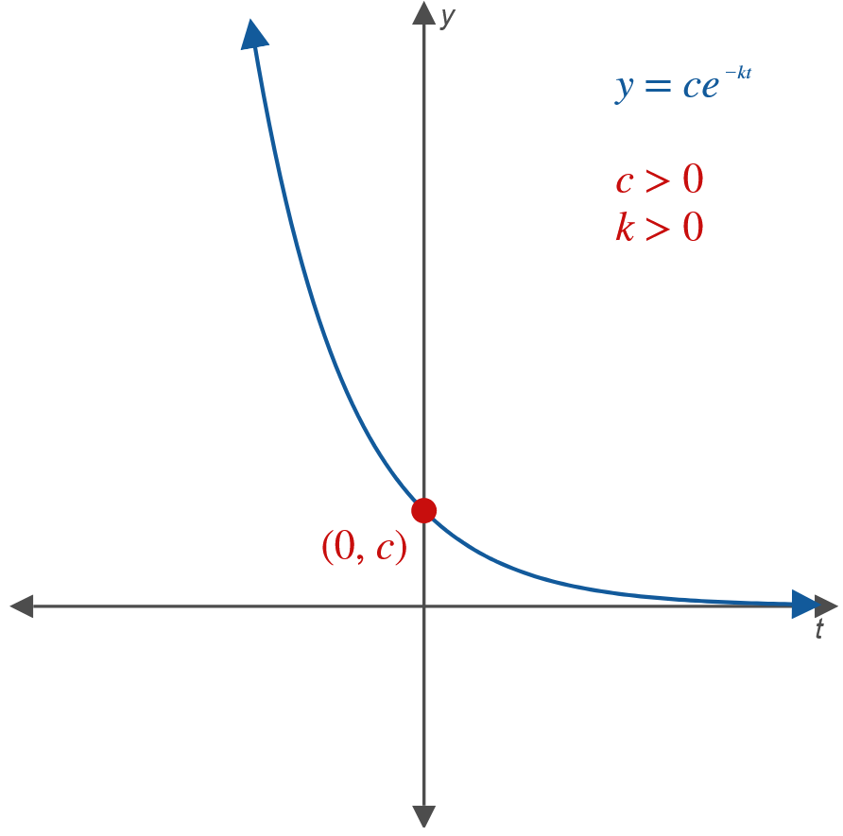
Exponential Decline (cont.)
Figure 2: Exponential Decline

Slide 13
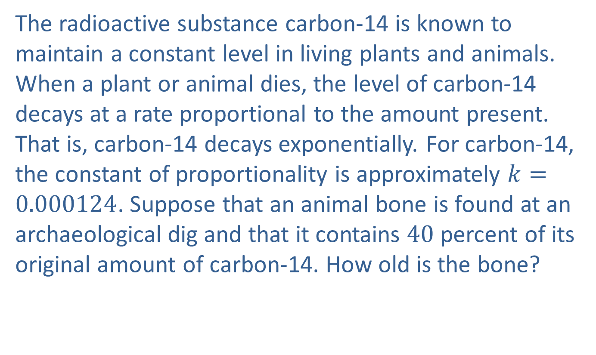
Example 3: Carbon-14
The radioactive substance carbon-14 is known to maintain a constant level in living plants and animals. When a plant or animal dies, the level of carbon-14 decays at a rate proportional to the amount present. That is, carbon-14 decays exponentially. For carbon-14, the constant of proportionality is approximately $k=0.000124$. Suppose that an animal bone is found at an archaeological dig and that it contains 40 percent of its original amount of carbon-14. How old is the bone?

Slide 14
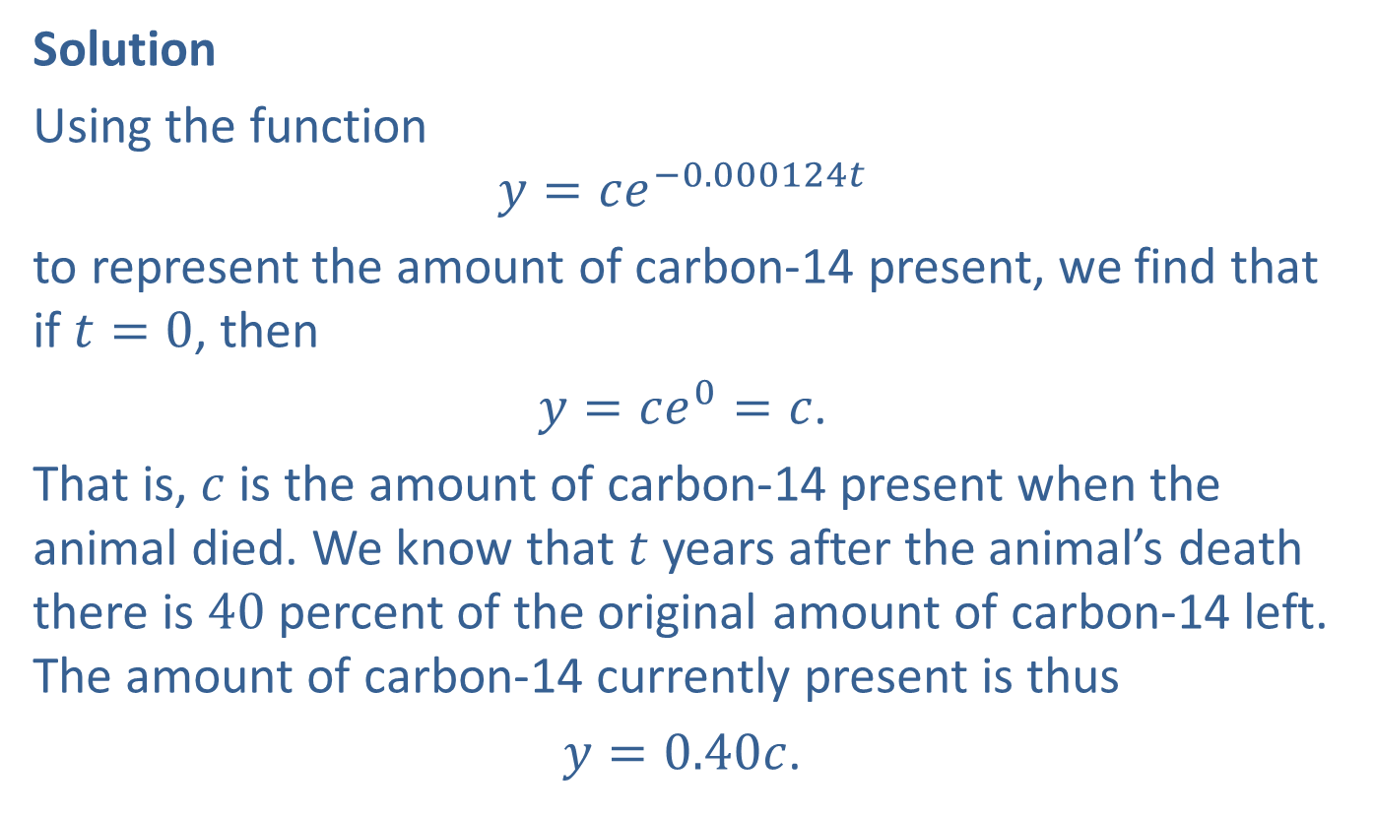
Example 3: Carbon-14 (cont.)
Solution
Using the function
$$y=ce^{−0.000124t}$$
to represent the amount of carbon-14 present, we find that if $t=0$, then
$y=ce^{0}=c$.
That is, $c$ is the amount of carbon-14 present when the animal died. We know that $t$ years after the animal’s death there is 40 percent of the original amount of carbon-14 left. The amount of carbon-14 currently present is thus
$y=0.40c$.

Slide 15
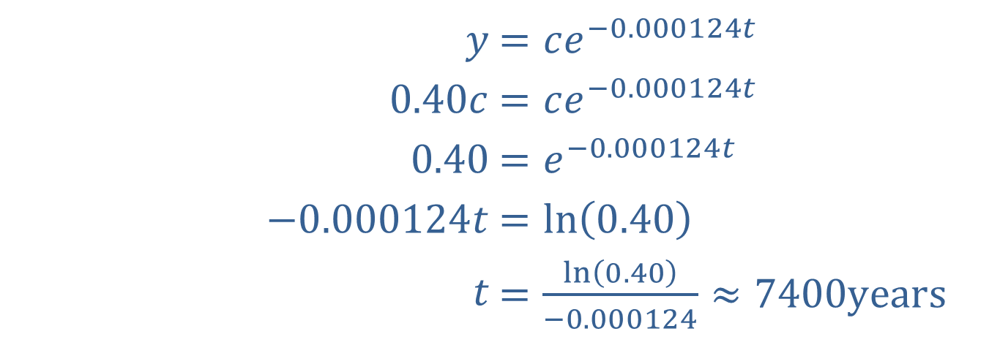

Example 3: Carbon-14 (cont.)
Now, to find the age of the bone $t$, we substitute $y=0.40c$ into our original equation and solve for $t$.
​
The bone is approximately 7400 years old.
​$y$ | ​$=ce^{−0.000124t}$
​$0.40c$ | ​$=ce^{−0.000124t}$
​$0.40$ | ​$=e^{−0.000124t}$
​$−0.000124t$ | ​$=\ln\left(0.40\right)$
​$t$ | ​$=\frac{\ln\left(0.40\right)}{−0.000124}≈7400\text{years}$

Slide 16
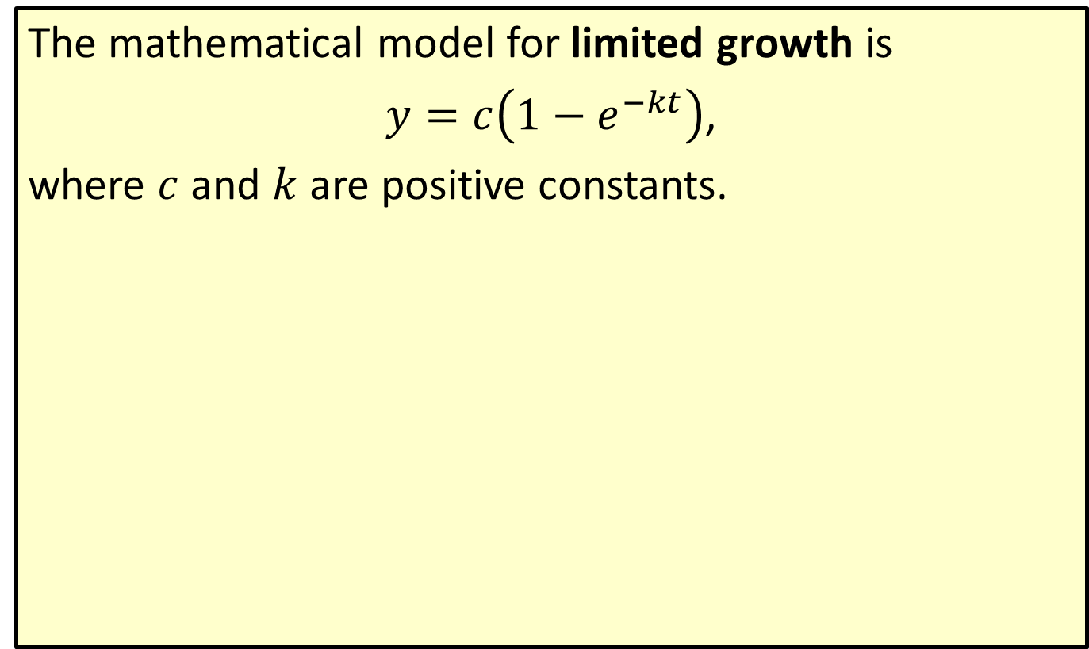
Limited Growth
The mathematical model for limited growth is
$y=c\left(1−e^{−kt}\right)$,
where $c$ and $k$ are positive constants.

Slide 17
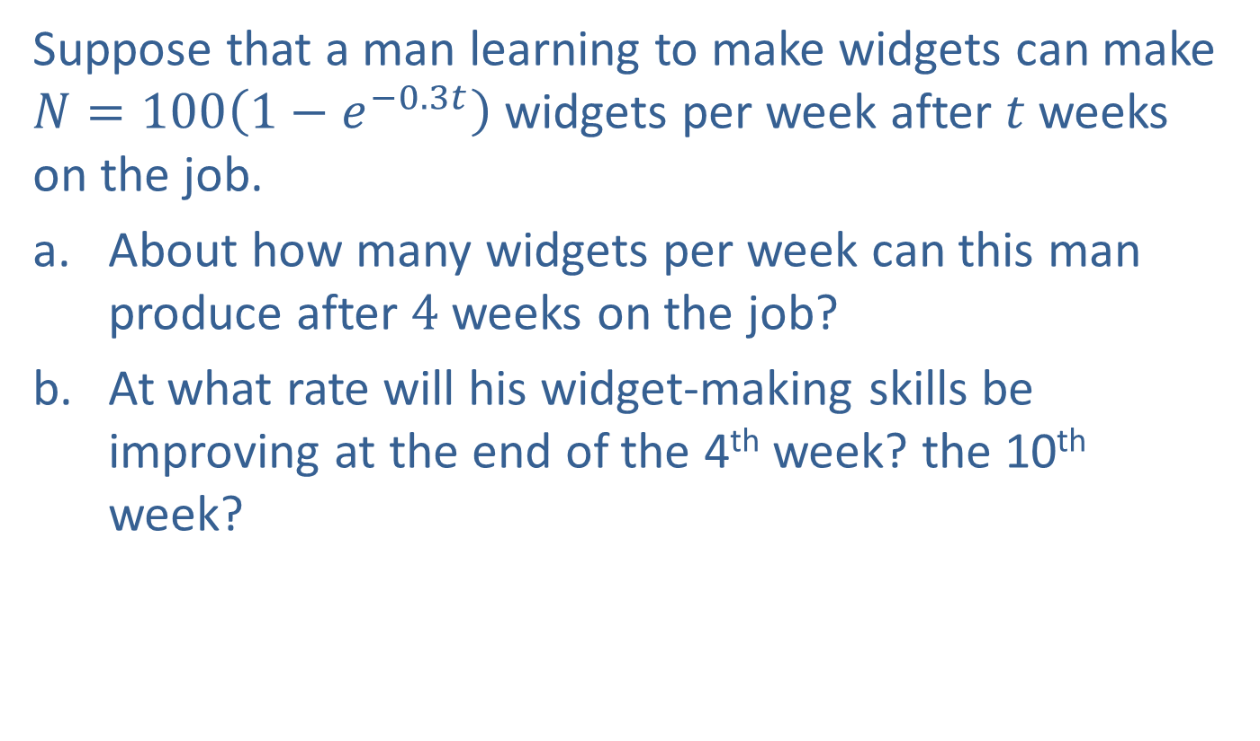
Example 4: Limited Growth
Suppose that a man learning to make widgets can make $N=100\left(1−e^{−0.3t}\right)$ widgets per week after $t$ weeks on the job.
​About how many widgets per week can this man produce after 4 weeks on the job?
​At what rate will his widget-making skills be improving at the end of the 4th week? the 10th week?

Slide 18
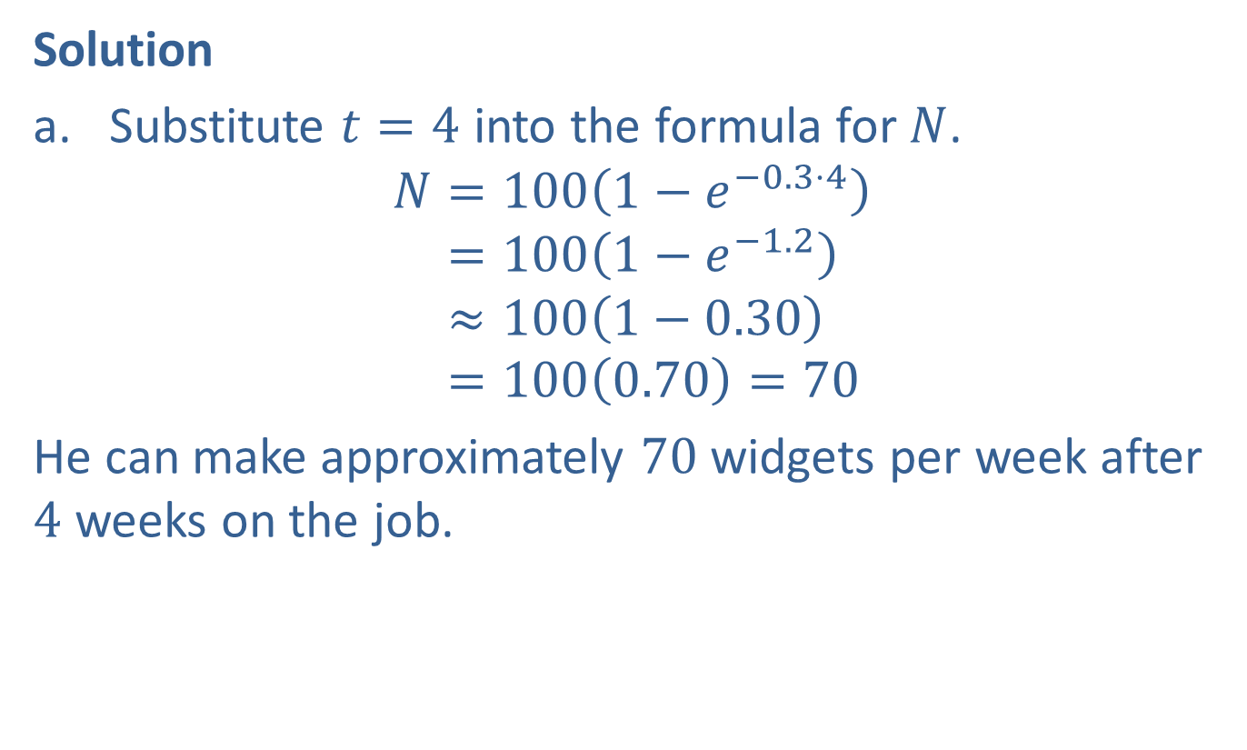
Example 4: Limited Growth (cont.)
Solution
​Substitute $t=4$ into the formula for $N$.
𝑁=1001−𝑒−0.3⋅4𝑁=1001−𝑒−1.2𝑁≈1001−0.30𝑁=1000.70=70
​He can make approximately 70 widgets per week after 4 weeks on the job.

Slide 19
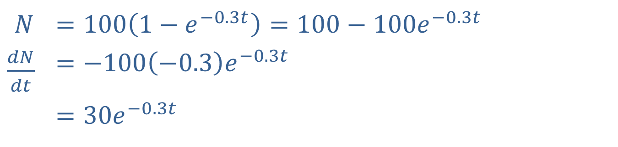

Example 4: Limited Growth (cont.)
​To find his rate of learning (or rate of improvement), we need $\frac{dN}{dt}$.
​
$$N$$ | ​$=100\left(1−e^{−0.3t}\right)=100−100e^{−0.3t}$
​$\frac{dN}{dt}$ | ​$=−100\left(−0.3\right)e^{−0.3t}$
 | ​$=30e^{−0.3t}$

Slide 20
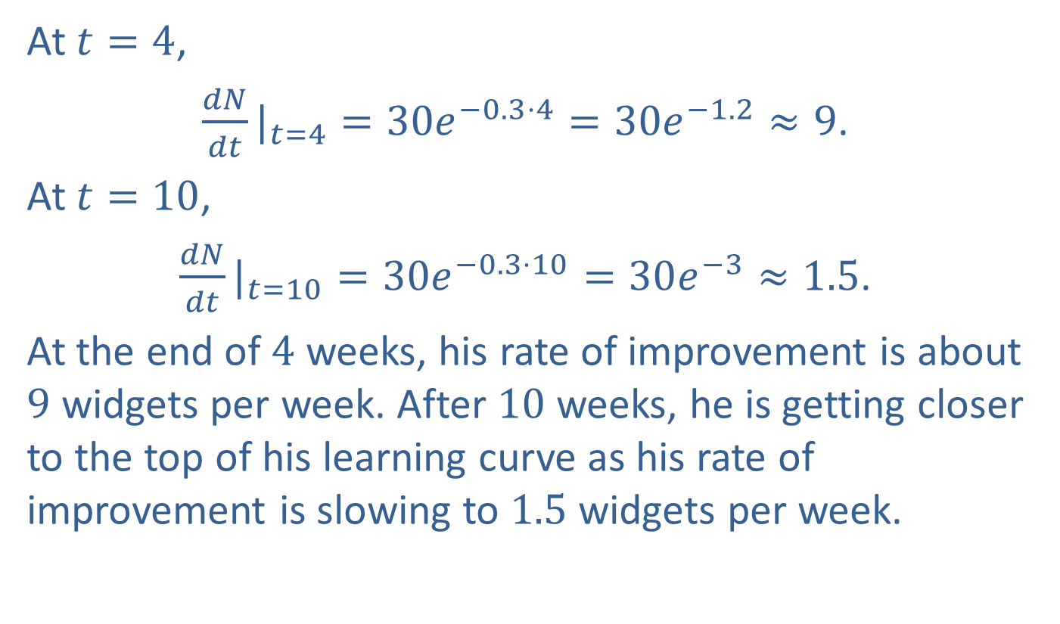
Example 4: Limited Growth (cont.)
​At $t=4$,
​${\frac{dN}{dt}|}_{t=4}=30e^{−0.3⋅4}=30e^{−1.2}≈9$.
​At $t=10$,
​${\frac{dN}{dt}|}_{t=10}=30e^{−0.3⋅10}=30e^{−3}≈1.5$.
​At the end of 4 weeks, his rate of improvement is about 9 widgets per week. After 10 weeks, he is getting closer to the top of his learning curve as his rate of improvement is slowing to 1.5 widgets per week.

Slide 21

Example 5: Half-Life
Suppose that the decay of a particular radioactive isotope is described by the equation
$y=200e^{−0.05t}$,
where $y$ is the amount of the isotope in grams and $t$ is time in years. Find the half-life of this isotope.

Slide 22
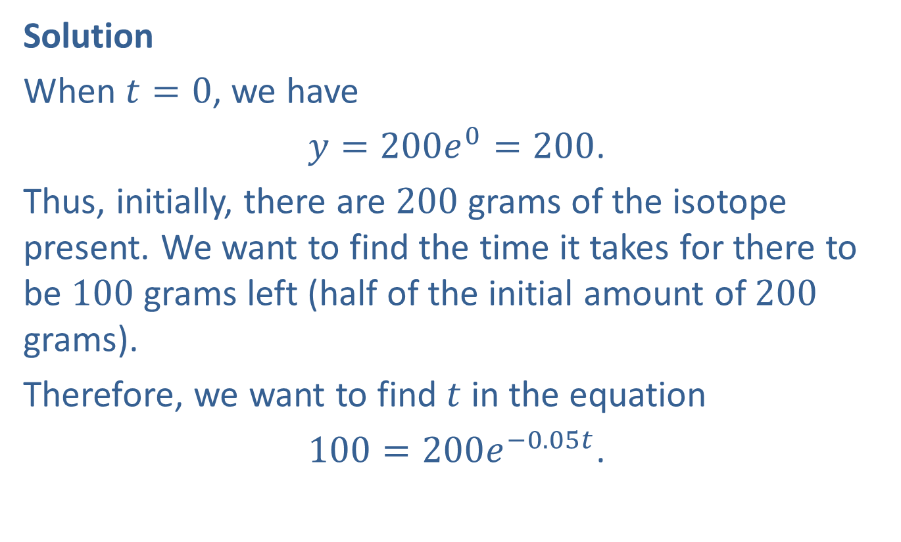
Example 5: Half-Life (cont.)
Solution
When $t=0$, we have
$y=200e^{0}=200$.
Thus, initially, there are 200 grams of the isotope present. We want to find the time it takes for there to be 100 grams left (half of the initial amount of 200 grams).
Therefore, we want to find $t$ in the equation
$100=200e^{−0.05t}$.

Slide 23
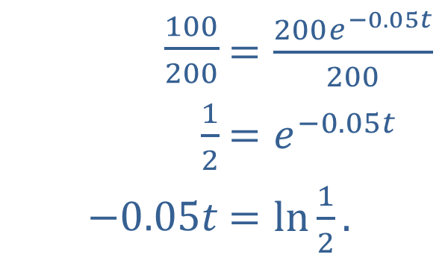
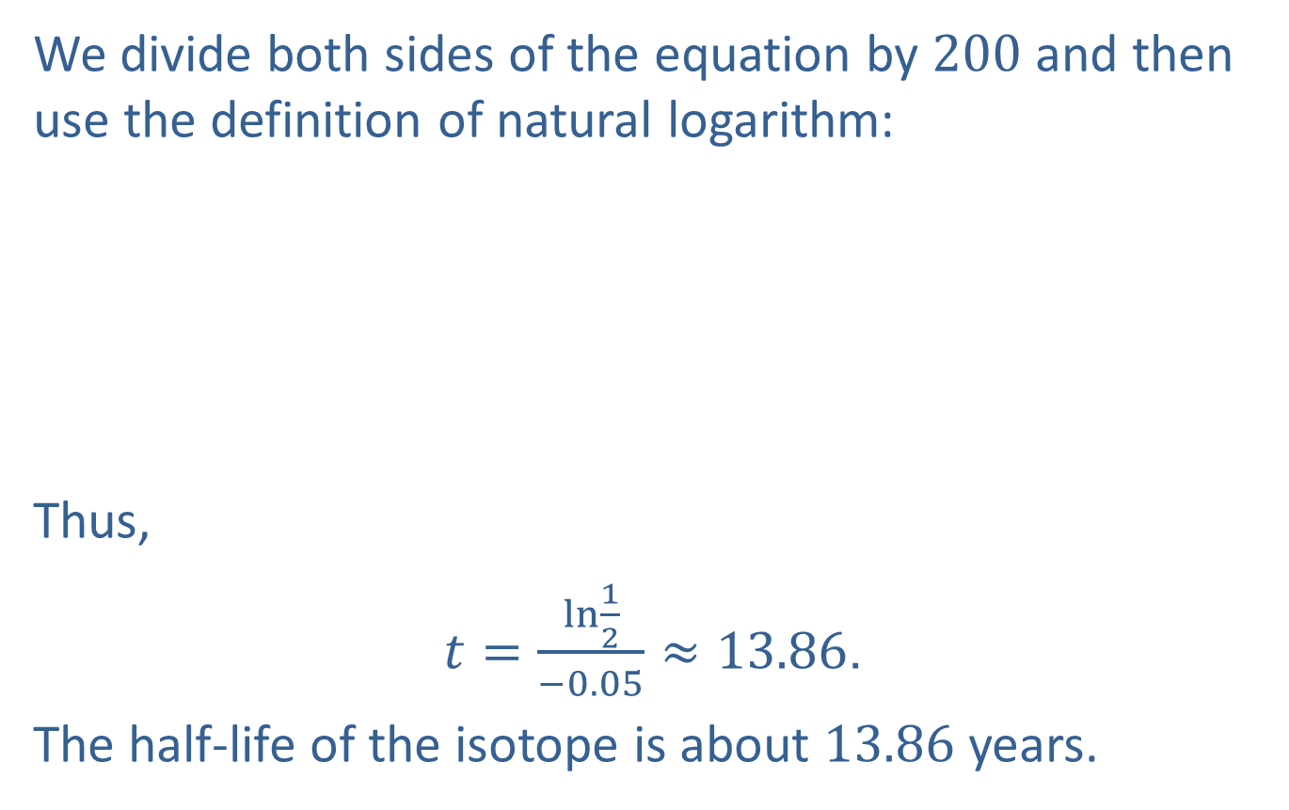
We divide both sides of the equation by 200 and then use the definition of natural logarithm:
​
Thus,
$t=\frac{\ln{\frac{1}{2}}}{−0.05}≈13.86$.
The half-life of the isotope is about 13.86 years.
​$\frac{100}{200}$ | ​$=\frac{200e^{−0.05t}}{200}$
​$\frac{1}{2}$ | ​$=e^{−0.05t}$
​$−0.05t$ | ​$=\ln{\frac{1}{2}}\text{.}$

