Slide 1
Section 5.6
Elasticity of Demand

Slide 2
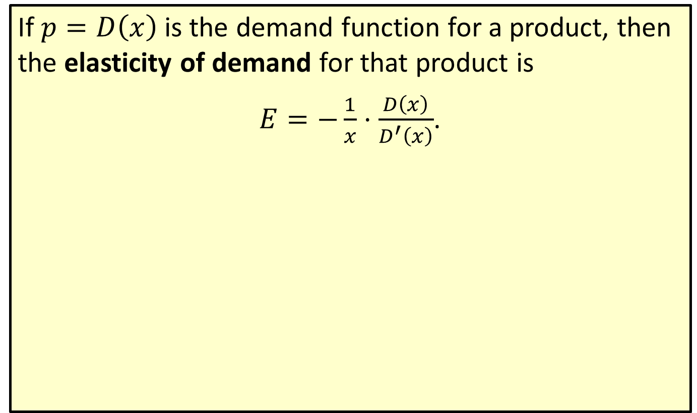
Elasticity of Demand
If $p=D\left(x\right)$ is the demand function for a product, then the elasticity of demand for that product is
$E=−\frac{1}{x}⋅\frac{D\left(x\right)}{D^{′}\left(x\right)}$.

Slide 3
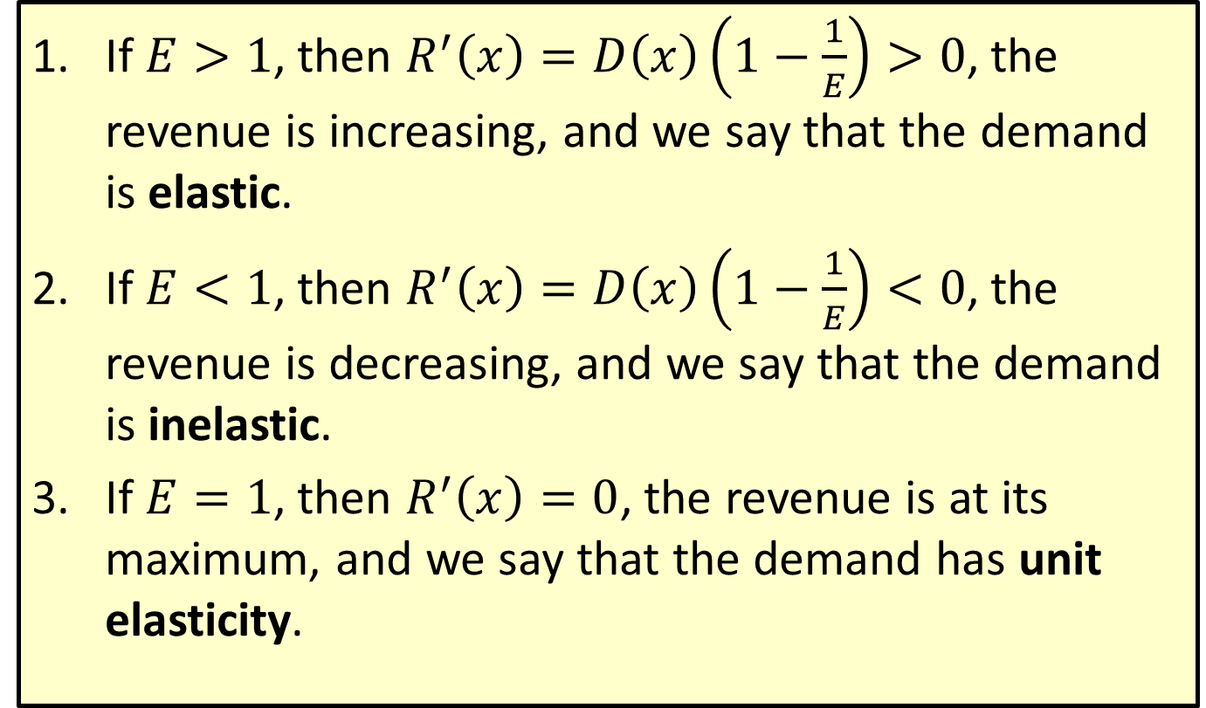
Properties of Elasticity of Demand
​If $E>1$, then $R^{′}\left(x\right)=D\left(x\right)\left(1−\frac{1}{E}\right)>0$, the revenue is increasing, and we say that the demand is elastic.
​If $E<1$, then $R^{′}\left(x\right)=D\left(x\right)\left(1−\frac{1}{E}\right)<0$, the revenue is decreasing, and we say that the demand is inelastic.
​If $E=1$, then $R^{′}\left(x\right)=0$, the revenue is at its maximum, and we say that the demand has unit elasticity.

Slide 4
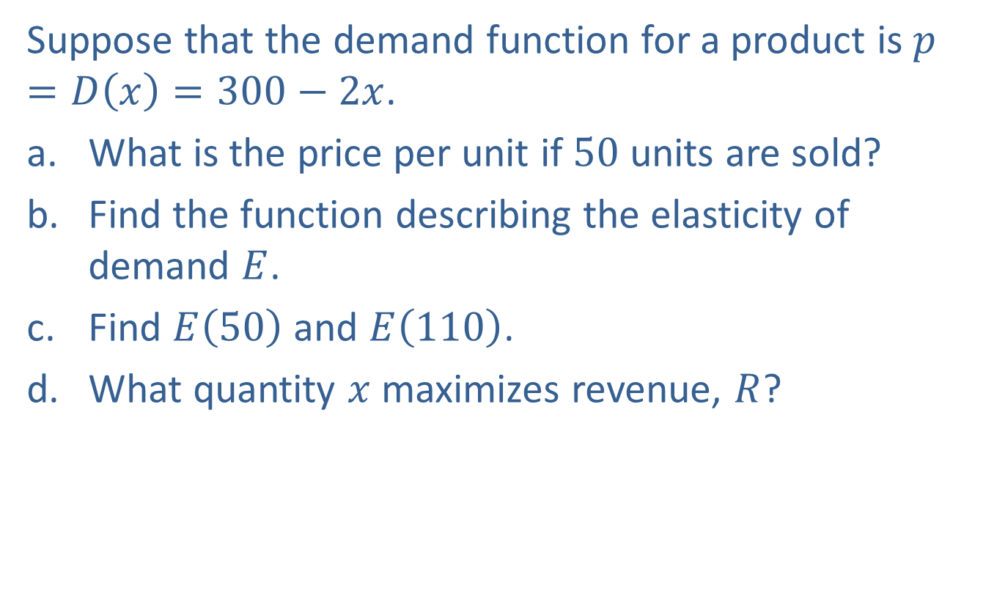
Example 1: Elasticity of Demand
Suppose that the demand function for a product is $p=D\left(x\right)=300−2x$.
​What is the price per unit if 50 units are sold?
​Find the function describing the elasticity of demand $E$.
​Find $E⁡\left(50\right)$ and $E⁡\left(110\right)$.
​What quantity $x$ maximizes revenue, $R$?

Slide 5
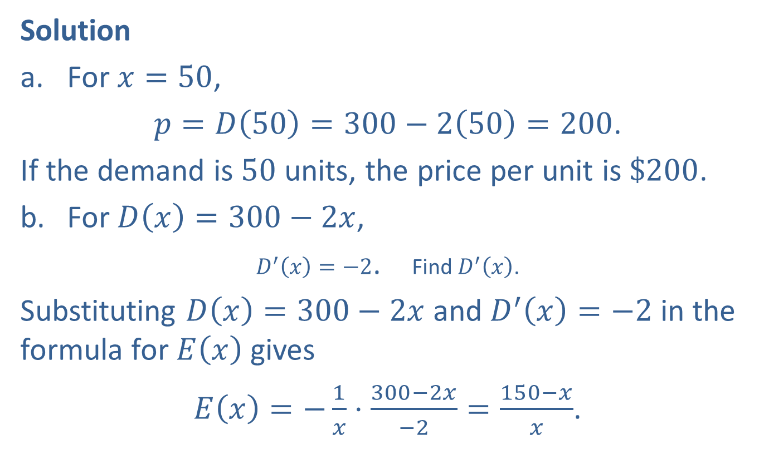
Example 1: Elasticity of Demand (cont.)
Solution
​For $x=50$,
​$p=D\left(50\right)=300−2\left(50\right)=200$.
​If the demand is 50 units, the price per unit is $\$200$.
​For $D\left(x\right)=300−2x$,
​$D^{′}\left(x\right)=−2$. Find $D^{′}⁡\left(x\right)$.
​Substituting $D\left(x\right)=300−2x$ and $D^{′}\left(x\right)=−2$ in the formula for $E⁡\left(x\right)$ gives
​$E\left(x\right)=−\frac{1}{x}⋅\frac{300−2x}{−2}=\frac{150−x}{x}$.

Slide 6
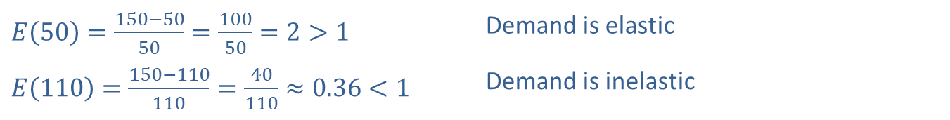
Example 1: Elasticity of Demand (cont.)
​
​$E\left(50\right)=\frac{150−50}{50}=\frac{100}{50}=2>1$ | Demand is elastic
​$E\left(110\right)=\frac{150−110}{110}=\frac{40}{110}≈0.36<1$ | Demand is inelastic
​When the demand level is at 50 units, a change in the quantity sold will result in a relatively small change in price, and revenue will be increasing. When the demand level reaches 110, the revenue will be decreasing.

Slide 7

Example 1: Elasticity of Demand (cont.)
$R=xD\left(x\right)=x\left(300−2x\right)=300x−2x^{2}$
$$R^{′}=300−4x$$
​If $R^{′}=0$, $x=75$.
​Since $R^{″}=−4$, $R$ is concave down so $x=75$ gives a maximum for $R$. This is consistent with part c.

Slide 8

Example 2: Elasticity of Demand
A product is known to have a demand function $p=D\left(x\right)=100e^{−0.5x}$.
​Find the value of $x$ for which $E=1$.
​Find the value for $x$ that maximizes the revenue.

Slide 9
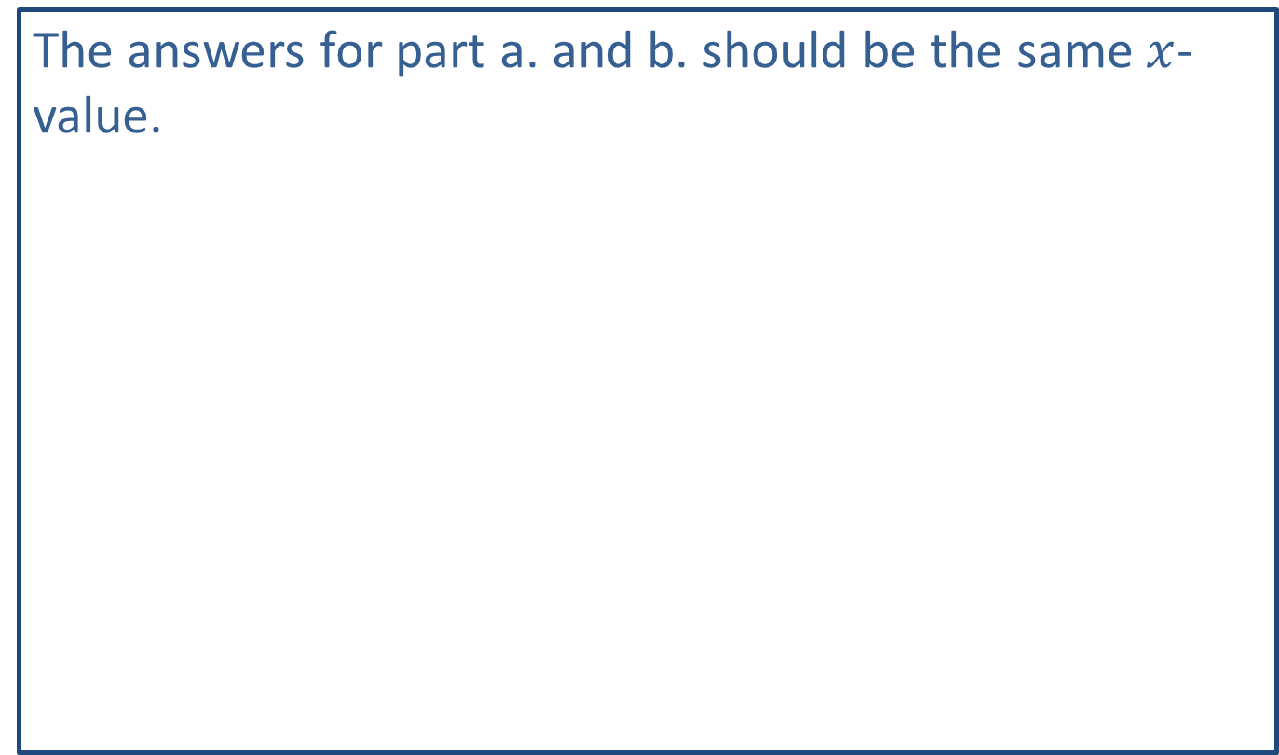
Note:
The answers for part a. and b. should be the same $x$-value.

Slide 10
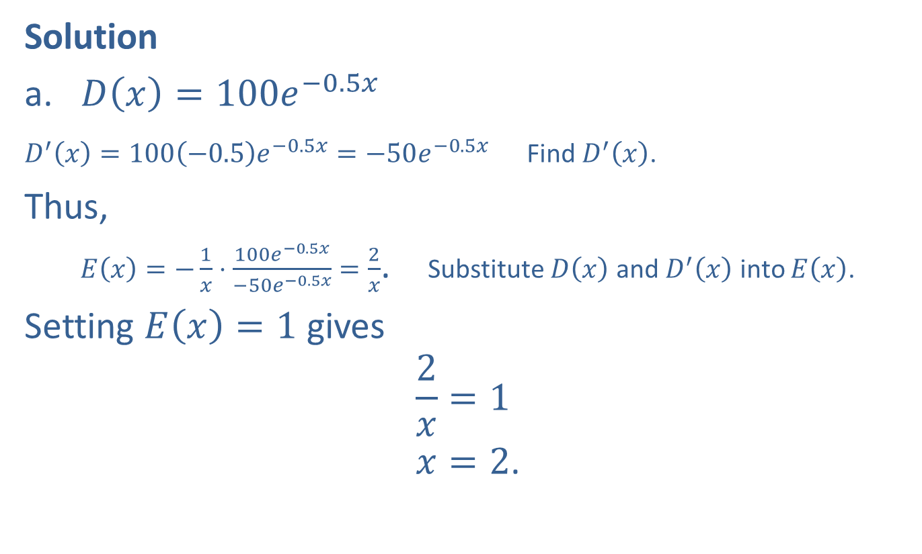
Example 2: Elasticity of Demand (cont.)
Solution
​$D\left(x\right)=100e^{−0.5x}$
​$D^{′}\left(x\right)=100\left(−0.5\right)e^{−0.5x}=−50e^{−0.5x}$ Find $D^{′}\left(x\right)$.
​Thus,
​$E\left(x\right)=−\frac{1}{x}⋅\frac{100e^{−0.5x}}{−50e^{−0.5x}}=\frac{2}{x}$. Substitute $D⁡\left(x\right)$ and $D^{′}⁡\left(x\right)$ into $E⁡\left(x\right)$.
​Setting $E\left(x\right)=1$ gives
2𝑥=1.𝑥=2.

Slide 11

Example 2: Elasticity of Demand (cont.)
​The revenue function is $R\left(x\right)=x⋅p=x⋅100e^{−0.5x}=100xe^{−0.5x}$.
​Find $R^{′}⁡\left(x\right)$ and set $R^{′}\left(x\right)=0$ to find the value of $x$ that gives the maximum revenue.
​.

Slide 12
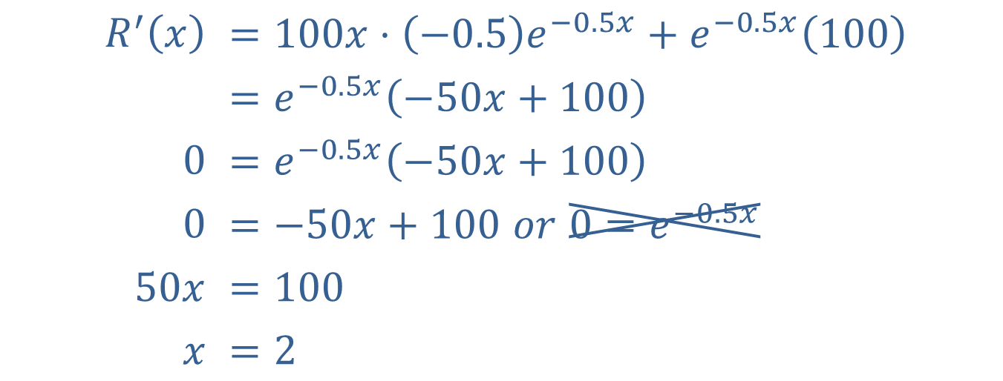

Example 2: Elasticity of Demand (cont.)
Thus $x=2$ gives the maximum revenue
$$R^{′}⁡\left(x\right)$$ | $$=100x⋅\left(−0.5\right)e^{−0.5x}+e^{−0.5x}\left(100\right)$$
 | $$=e^{−0.5x}\left(−50x+100\right)$$
$$0$$ | $$=e^{−0.5x}\left(−50x+100\right)$$
$$0$$ | $$=−50x+100 or 0=e^{−0.5x}$$
$$50x$$ | $$=100$$
$$x$$ | $$=2$$

Slide 13
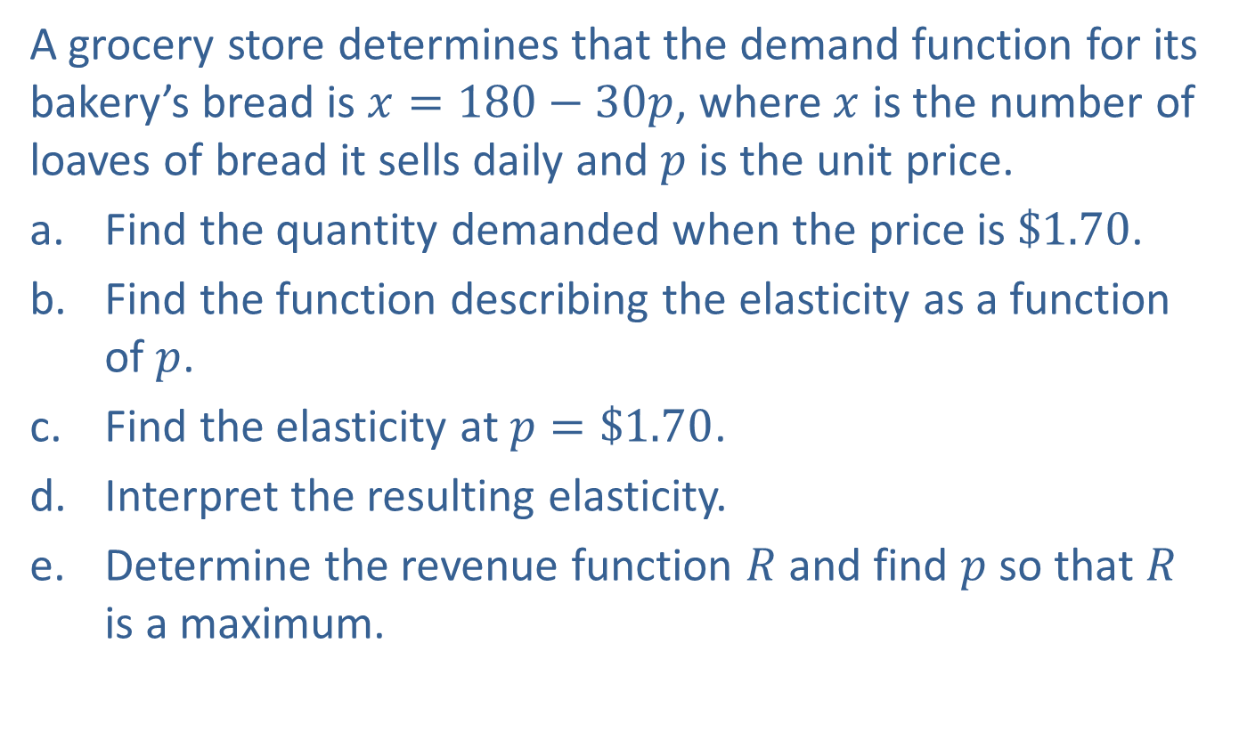
Example 3: Alternative Approach to Elasticity of Demand
A grocery store determines that the demand function for its bakery’s bread is $x=180−30p$, where $x$ is the number of loaves of bread it sells daily and $p$ is the unit price.
​Find the quantity demanded when the price is $\$1.70$.
​Find the function describing the elasticity as a function of $p$.
​Find the elasticity at $p=\$1.70$.
​Interpret the resulting elasticity.
​Determine the revenue function $R$ and find $p$ so that $R$ is a maximum.

Slide 14
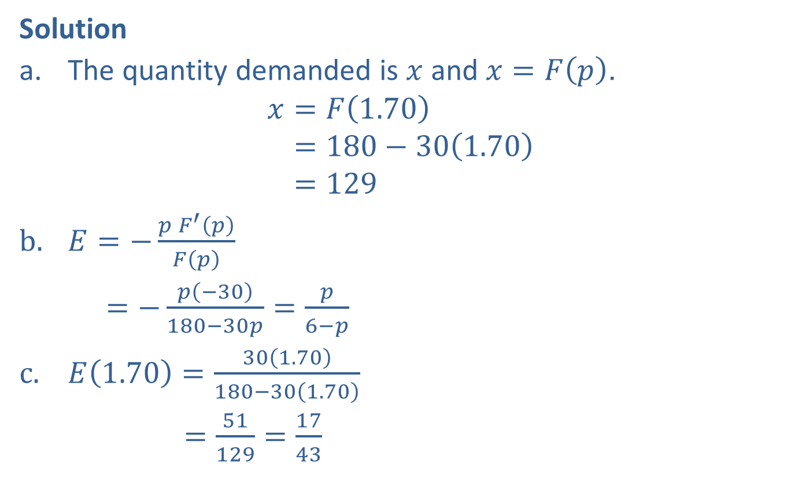
Example 3: Alternative Approach to Elasticity of Demand (cont.)
Solution
​The quantity demanded is $x$ and $x=F\left(p\right)$.
𝑥=𝐹1.70𝑥=180−301.70𝑥=129
$E=−\frac{pF^{′}\left(p\right)}{F\left(p\right)}$
$=−\frac{p\left(−30\right)}{180−30p}=\frac{p}{6−p}$
$E\left(1.70\right)=\frac{30\left(1.70\right)}{180−30\left(1.70\right)}$
$=\frac{51}{129}=\frac{17}{43}$

Slide 15
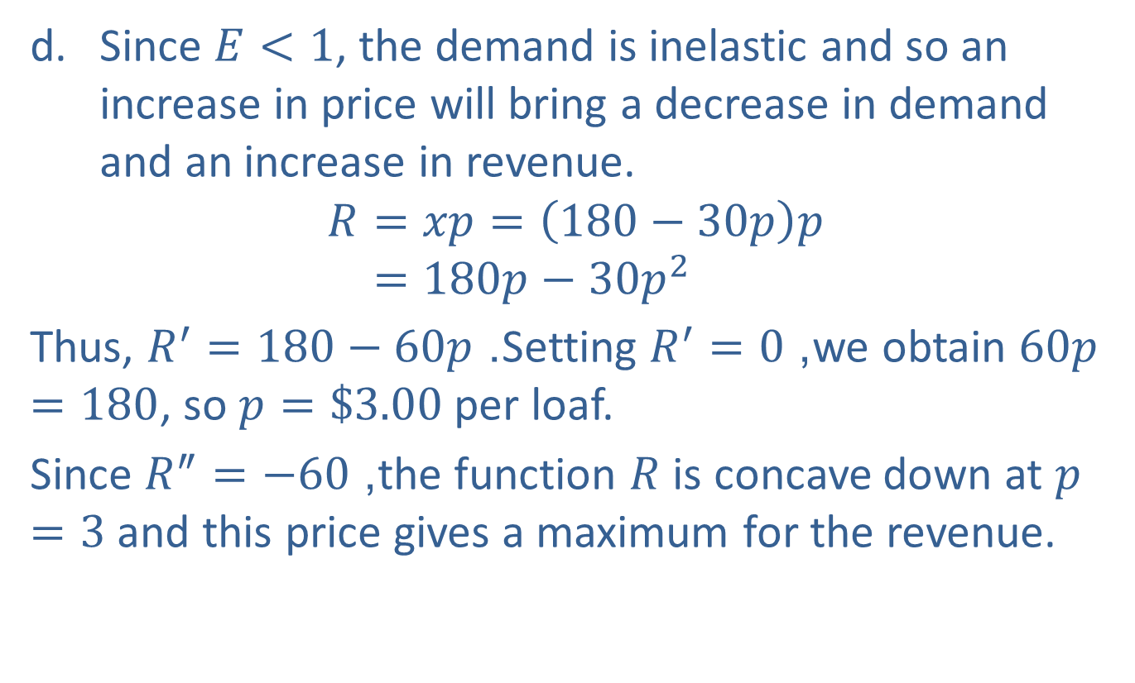
Example 3: Alternative Approach to Elasticity of Demand (cont.)
​Since $E<1$, the demand is inelastic and so an increase in price will bring a decrease in demand and an increase in revenue.
𝑅=𝑥𝑝=180−30𝑝𝑝𝑅=180𝑝−30𝑝2
​Thus, $R^{′}=180−60p$. Setting $R^{′}=0$, we obtain $60p=180$, so $p=\$3.00$ per loaf.
​Since $R^{″}=−60$, the function $R$ is concave down at $p=3$ and this price gives a maximum for the revenue.

