Slide 1
Section 6.1
The Indefinite Integral

Slide 2
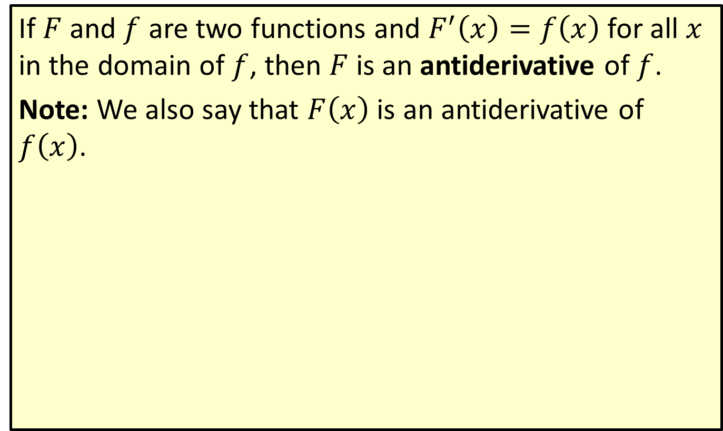
Antiderivative
If $F$ and $f$ are two functions and $F^{′}\left(x\right)=f\left(x\right)$ for all $x$ in the domain of $f$, then $F$ is an antiderivative of $f$.
Note: We also say that $F⁡\left(x\right)$ is an antiderivative of $f⁡\left(x\right)$.

Slide 3
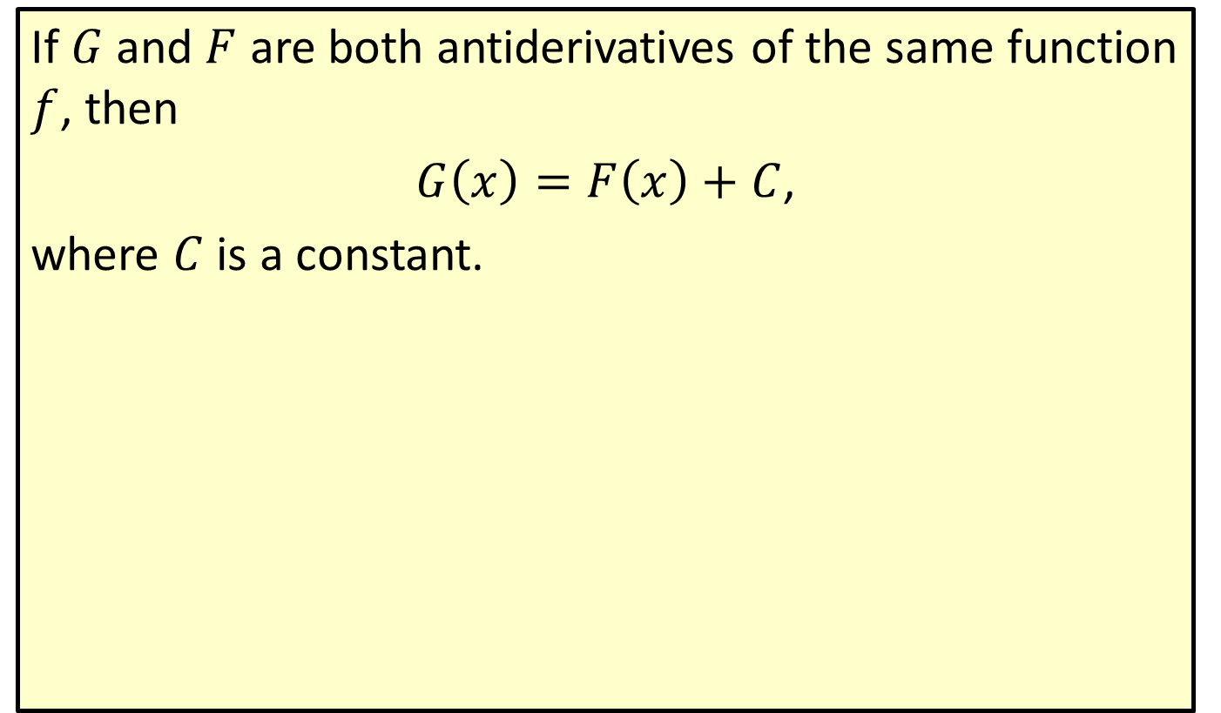
Antiderivatives Differ by a Constant
If $G$ and $F$ are both antiderivatives of the same function $f$, then
$G\left(x\right)=F\left(x\right)+C$,
where $C$ is a constant.

Slide 4

Example 1: Antiderivatives
Show that both $F\left(x\right)=x^{3}+x^{2}+50$ and $G\left(x\right)=x^{3}+x^{2}−80$ are antiderivatives of $f\left(x\right)=3x^{2}+2x$.

Slide 5
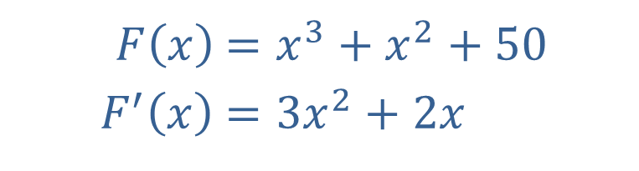
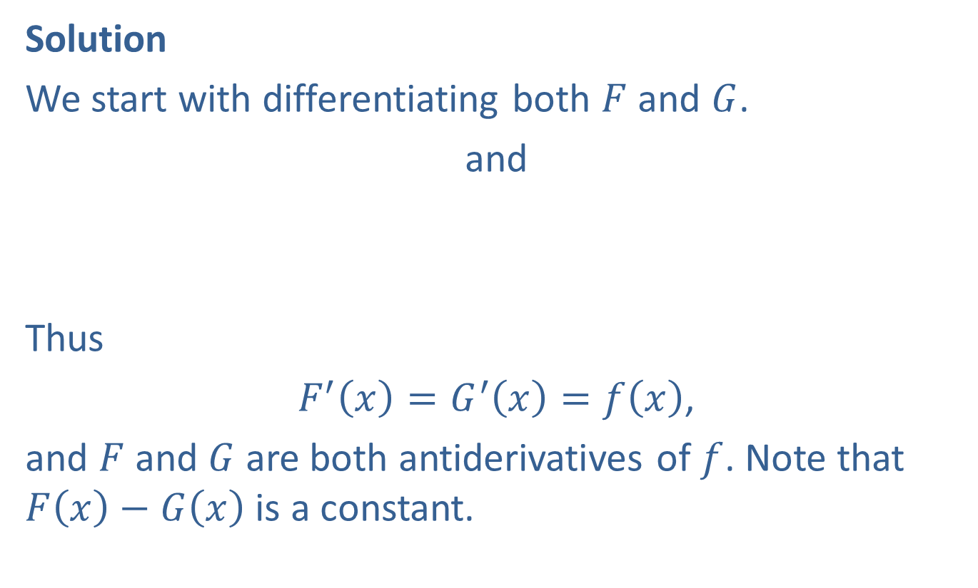
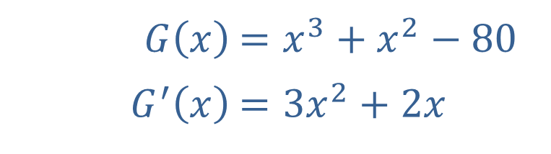
Example 1: Antiderivatives (cont.)
Solution
We start with differentiating both $F$ and $G$.
​and
Thus
$F^{′}\left(x\right)=G^{′}\left(x\right)=f\left(x\right)$,
and $F$ and $G$ are both antiderivatives of $f$. Note that $F\left(x\right)−G\left(x\right)$ is a constant.
​$F⁡\left(x\right)$ | ​$=x^{3}+x^{2}+50$
​$F^{′}⁡\left(x\right)$ | ​$=3x^{2}+2x$
​$G⁡\left(x\right)$ | ​$=x^{3}+x^{2}−80$
​$G^{′}⁡\left(x\right)$ | ​$=3x^{2}+2x$

Slide 6
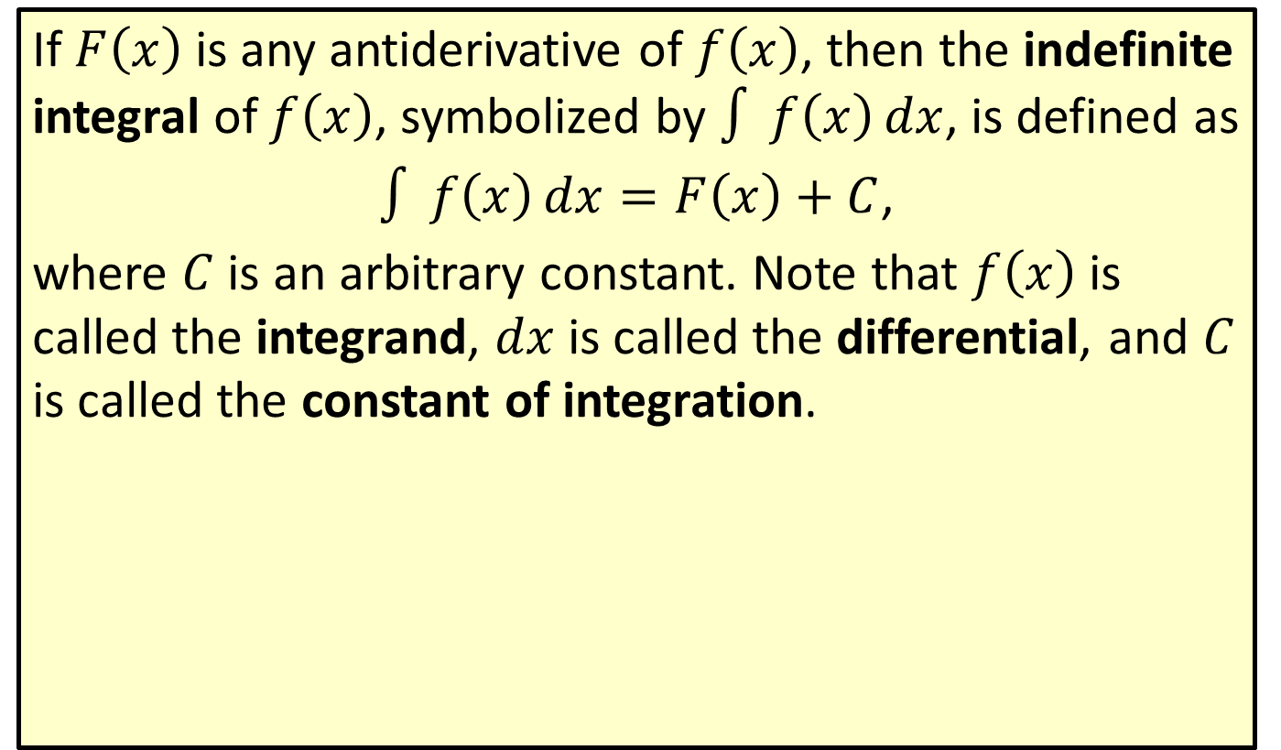
The Indefinite Integral
If $F⁡\left(x\right)$ is any antiderivative of $f⁡\left(x\right)$, then the indefinite integral of $f⁡\left(x\right)$, symbolized by $∫f\left(x\right)dx$, is defined as
$∫f\left(x\right)dx=F\left(x\right)+C$,
where $C$ is an arbitrary constant. Note that $f⁡\left(x\right)$ is called the integrand, $dx$ is called the differential, and $C$ is called the constant of integration.

Slide 7
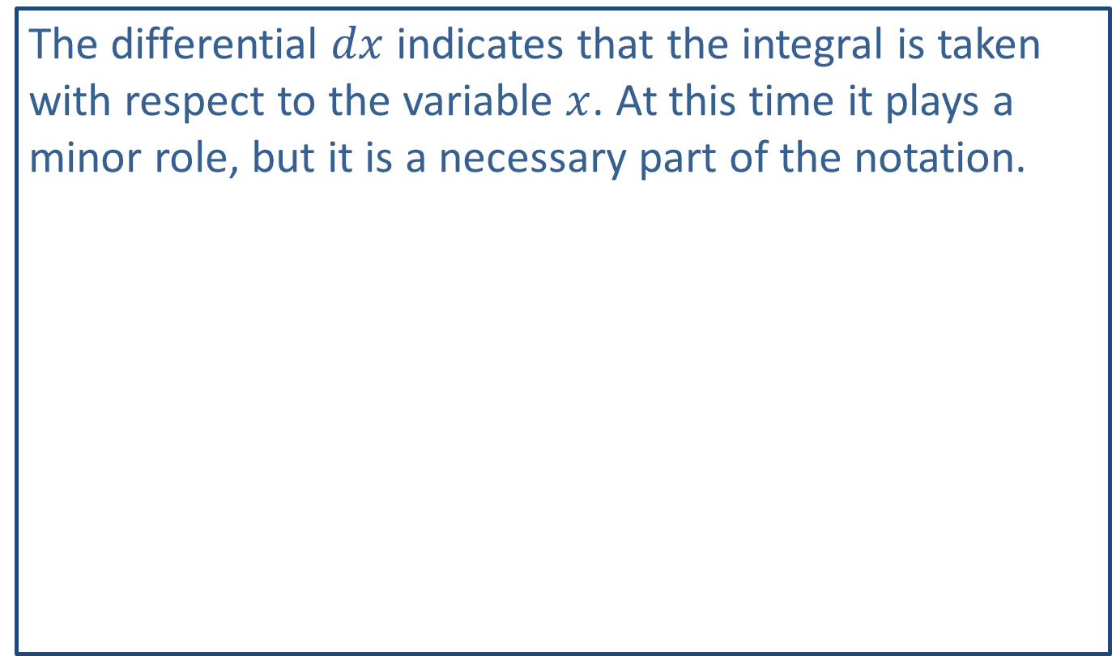
Note:
The differential $dx$ indicates that the integral is taken with respect to the variable $x$. At this time it plays a minor role, but it is a necessary part of the notation.

Slide 8
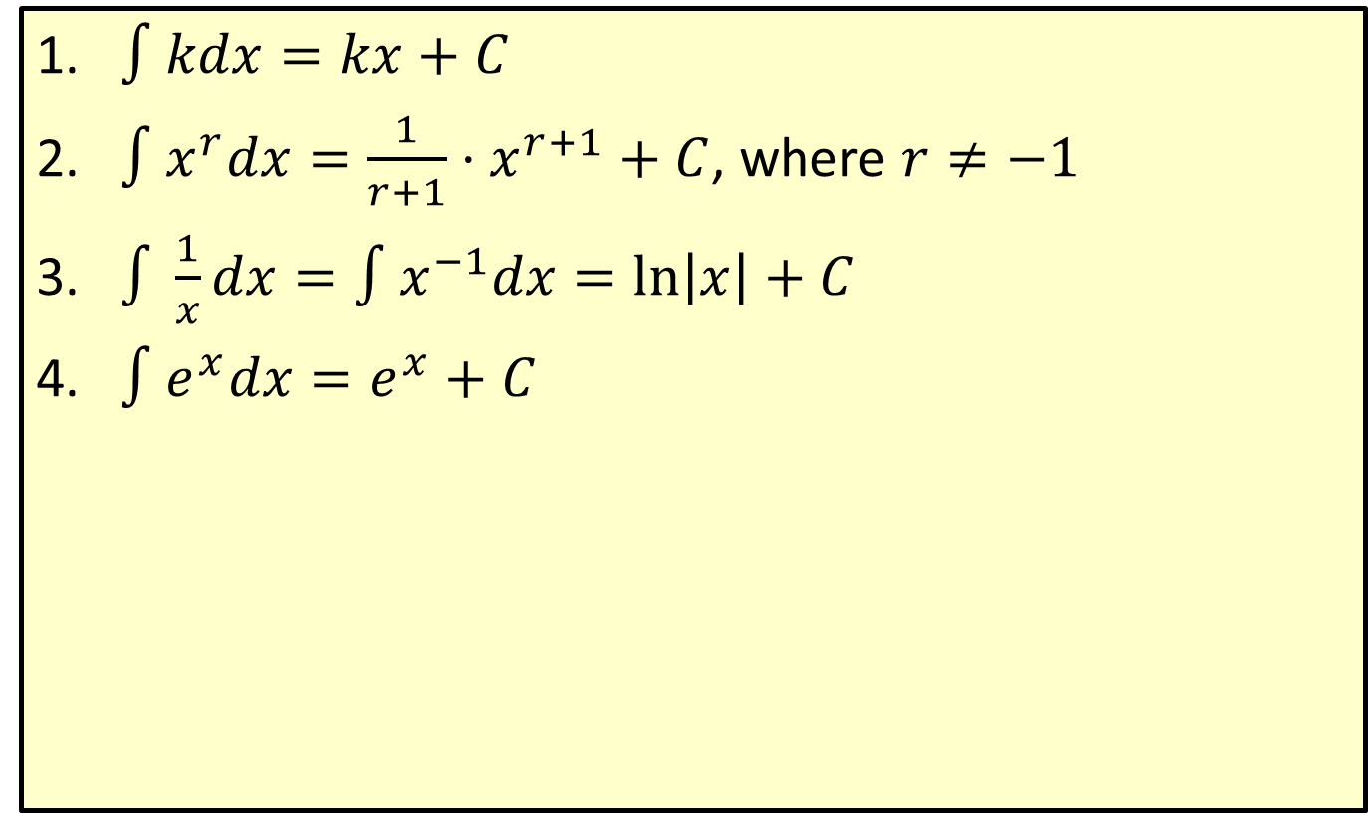
Formulas of Integration
​$∫kdx=kx+C$
​$∫x^{r}dx=\frac{1}{r+1}⋅x^{r+1}+C$, where $r≠−1$
​$∫\frac{1}{x}dx=∫x^{−1}dx=ln⁡\left|x\right|+C$
​$∫e^{x}dx=e^{x}+C$

Slide 9
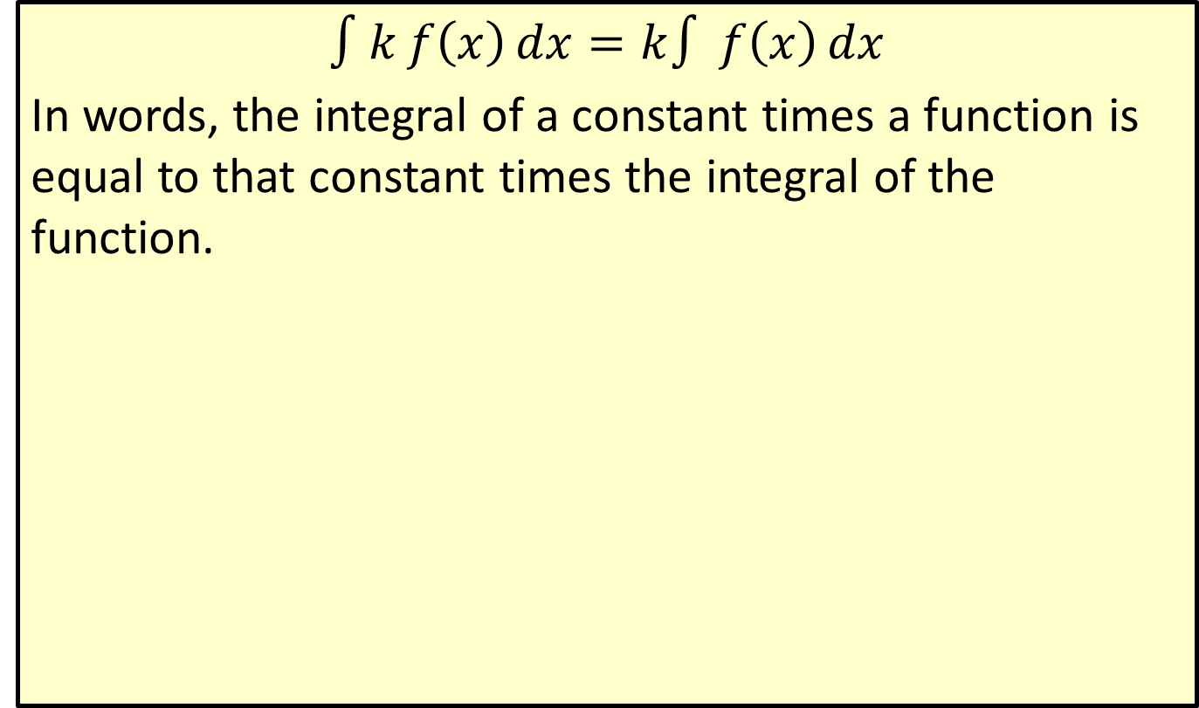
Constant Multiple Rule
$$∫kf\left(x\right)dx=k∫f\left(x\right)dx$$
In words, the integral of a constant times a function is equal to that constant times the integral of the function.

Slide 10
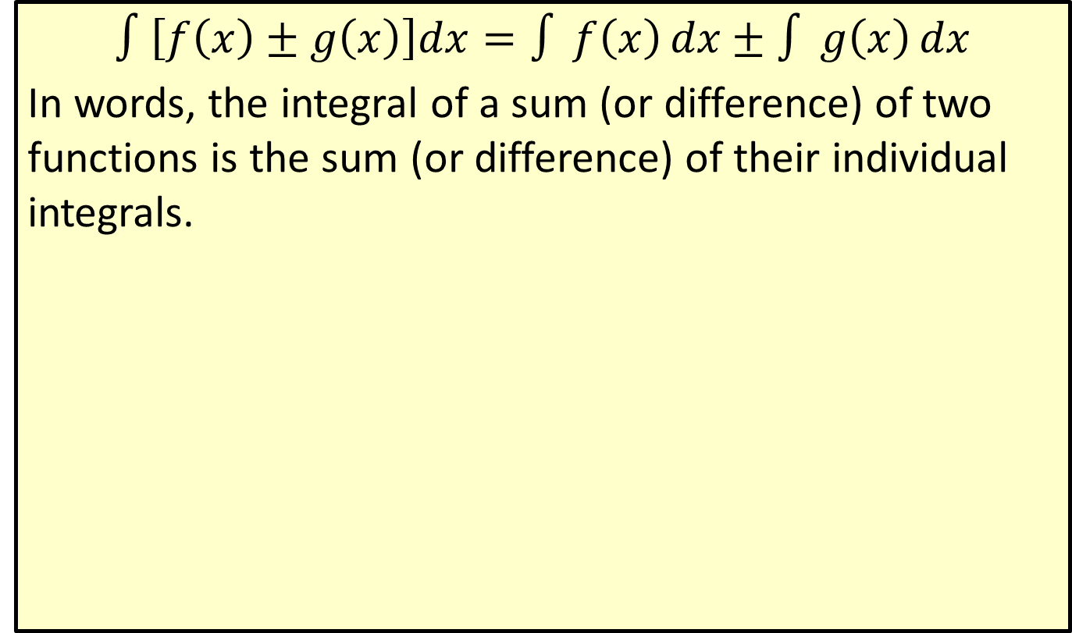
Sum and Difference Rule
$$∫\left[f\left(x\right)±g\left(x\right)\right]dx=∫f\left(x\right)dx±∫g\left(x\right)dx$$
In words, the integral of a sum (or difference) of two functions is the sum (or difference) of their individual integrals.

Slide 11
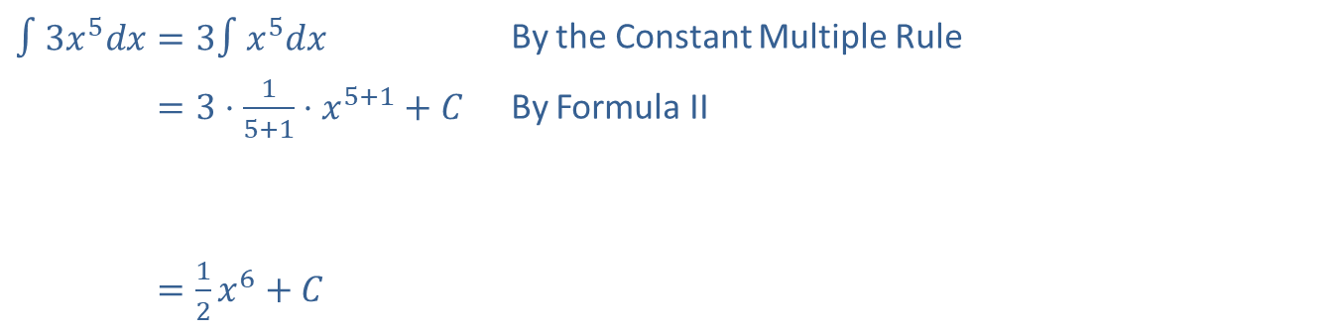

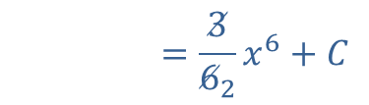
Example 2: Finding the Indefinite Integral
Find $∫3x^{5}dx$.
Solution
​$∫3x^{5}dx=3∫x^{5}dx$ | By the Constant Multiple Rule
​∫3𝑥5𝑑𝑥=3⋅15+1⋅𝑥5+1+𝐶 | By Formula II
​
​∫3𝑥5𝑑𝑥=12𝑥6+𝐶
∫3𝑥5𝑑𝑥=362𝑥6+𝐶

Slide 12

Example 2: Finding the Indefinite Integral (cont.)
Check
Each integral can be checked by differentiation. Its derivative must be the integrand.
$$\frac{d}{dx}\left[\frac{1}{2}x^{6}+C\right]=\frac{1}{2}⋅6x^{5}+0=3x^{5}$$

Slide 13
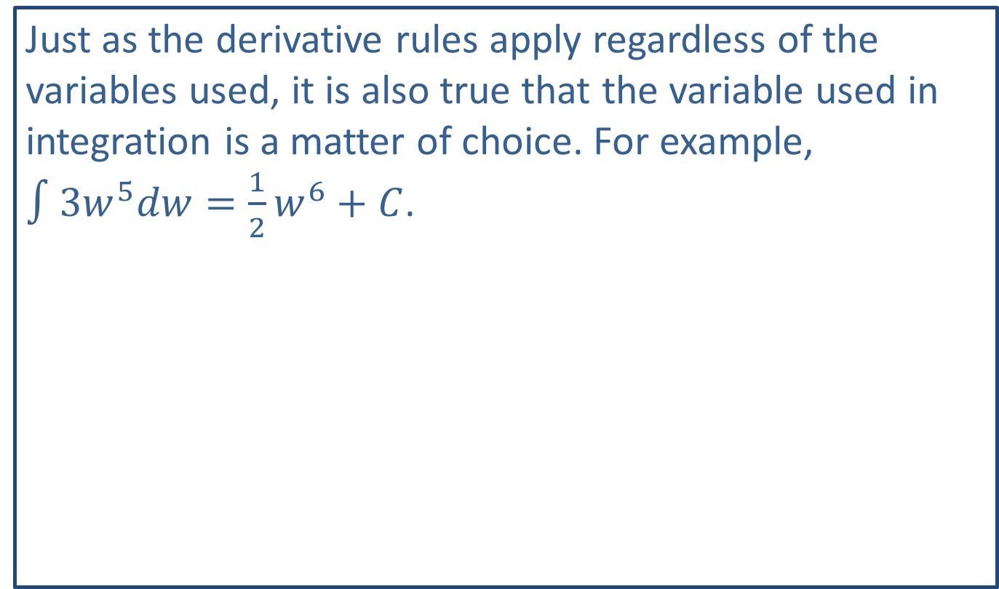
Note:
Just as the derivative rules apply regardless of the variables used, it is also true that the variable used in integration is a matter of choice. For example, $∫3w^{5}dw=\frac{1}{2}w^{6}+C$.

Slide 14
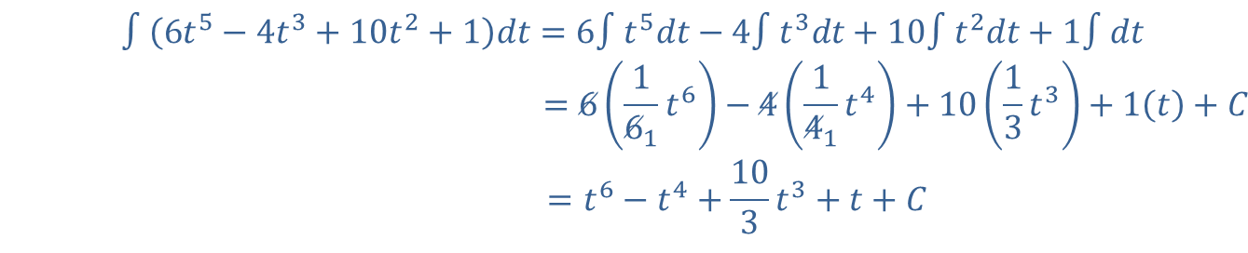

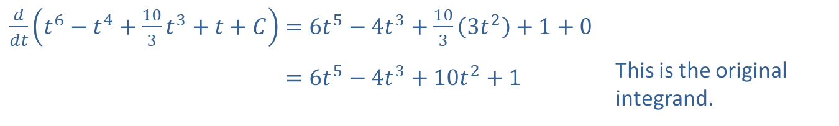
Example 3: Finding the Indefinite Integral of Polynomial Expressions
Find $∫\left(6t^{5}−4t^{3}+10t^{2}+1\right)dt$.
Solution
∫6𝑡5−4𝑡3+10𝑡2+1𝑑𝑡=6∫𝑡5𝑑𝑡−4∫𝑡3𝑑𝑡+10∫𝑡2𝑑𝑡+1∫𝑑𝑡 ∫6𝑡5−4𝑡3+10𝑡2+1 𝑑𝑡=6161𝑡6−4141𝑡4+1013𝑡3+1𝑡+𝐶 𝑑𝑡=𝑡6−𝑡4+103𝑡3+𝑡+𝐶
Check
​$\frac{d}{dt}\left(t^{6}−t^{4}+\frac{10}{3}t^{3}+t+C\right)=6t^{5}−4t^{3}+\frac{10}{3}\left(3t^{2}\right)+1+0$
​𝑑𝑑𝑡𝑡6−𝑡4+103𝑡3+𝑡+𝐶=6𝑡5−4𝑡3+10𝑡2+1 | This is the original integrand.

Slide 15
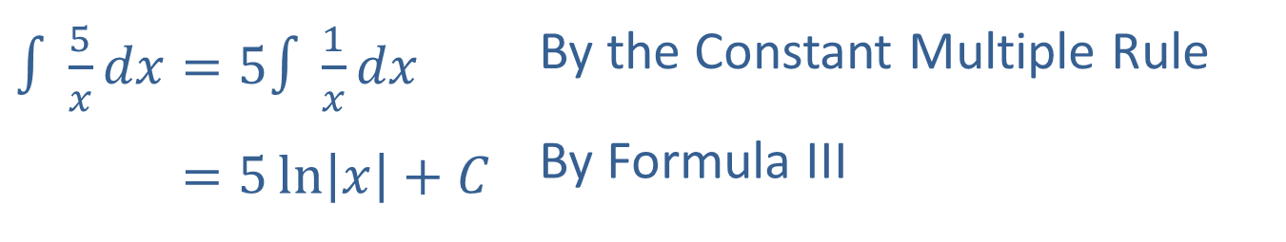

Example 4: Finding the Indefinite Integral
Find $∫\frac{5}{x}dx$.
Solution
​$∫\frac{5}{x}dx=5∫\frac{1}{x}dx$ | By the Constant Multiple Rule
​∫5𝑥𝑑𝑥=5ln𝑥+𝐶 | By Formula III

Slide 16
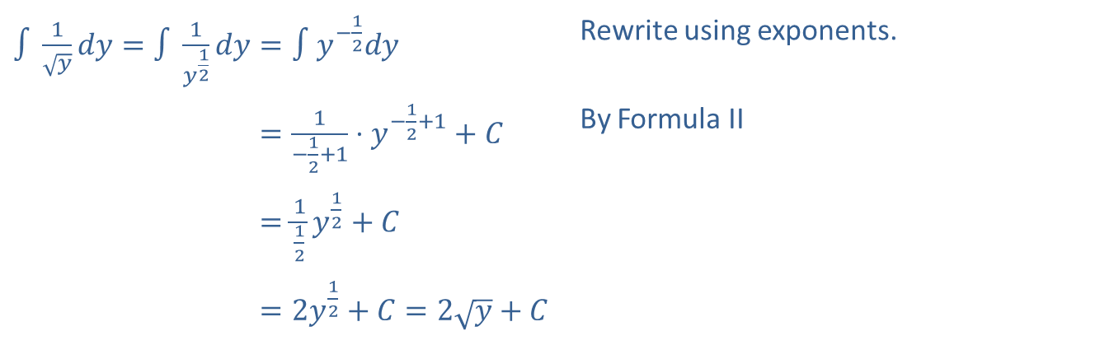

Example 5: Finding the Indefinite Integral
Find $∫\frac{1}{\sqrt{y}}dy$.
Solution
​$∫\frac{1}{\sqrt{y}}dy=∫\frac{1}{y^{\frac{1}{2}}}dy=∫y^{−\frac{1}{2}}dy$ | Rewrite using exponents.
​∫1𝑦𝑑𝑦=∫1𝑦12𝑑𝑦=1−12+1⋅𝑦−12+1+𝐶 | By Formula II
​∫1𝑦𝑑𝑦=∫1𝑦12𝑑𝑦=112𝑦12+𝐶
​∫1𝑦𝑑𝑦=∫1𝑦12𝑑𝑦=2𝑦12+𝐶=2𝑦+𝐶

Slide 17
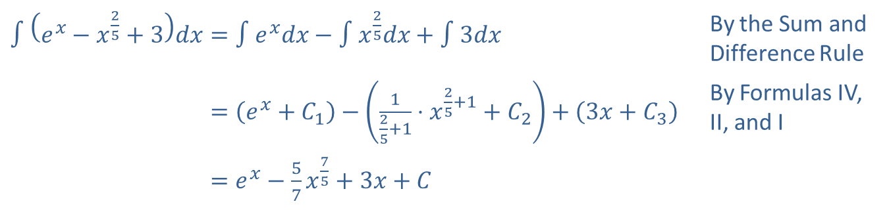

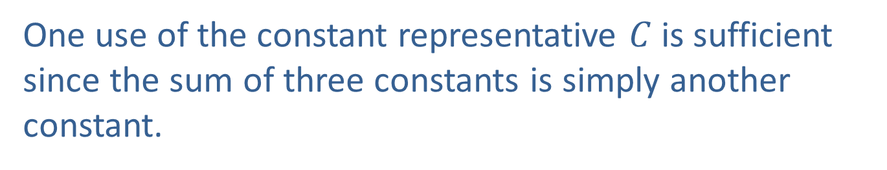
Example 6: Using Several Formulas for Integration
Find $∫\left(e^{x}−x^{\frac{2}{5}}+3\right)dx$.
Solution
​$∫\left(e^{x}−x^{\frac{2}{5}}+3\right)dx=∫e^{x}dx−∫x^{\frac{2}{5}}dx+∫3dx$ | By the Sum and Difference Rule
​∫𝑒𝑥−𝑥25+3𝑑𝑥=𝑒𝑥+𝐶1−125+1⋅𝑥25+1+𝐶2+3𝑥+𝐶3 | By Formulas IV, II, and I
​∫𝑒𝑥−𝑥25+3𝑑𝑥=𝑒𝑥−57𝑥75+3𝑥+𝐶
One use of the constant representative $C$ is sufficient since the sum of three constants is simply another constant.

Slide 18

Example 7: Finding the Indefinite Integral of a Rational Function
Find $∫\frac{t^{3}+t+1}{t^{2}}dt$.

Slide 19
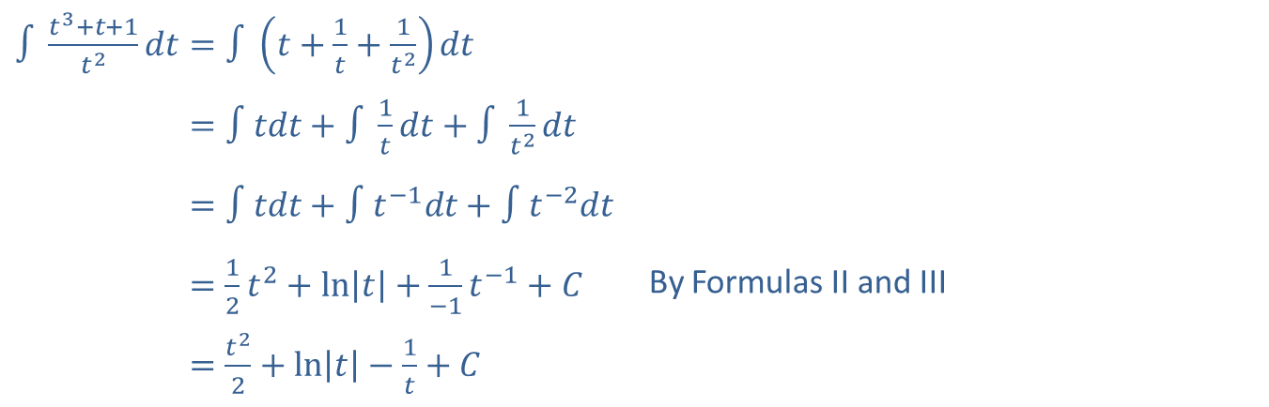
Example 7: Finding the Indefinite Integral of a Rational Function (cont.)
Solution
The general approach is to replace a quotient with a polynomial-like expression whenever the denominator is a single term.
​$∫\frac{t^{3}+t+1}{t^{2}}dt=∫\left(t+\frac{1}{t}+\frac{1}{t^{2}}\right)dt$
​∫𝑡3+𝑡+1𝑡2𝑑𝑡=∫𝑡𝑑𝑡+∫1𝑡𝑑𝑡+∫1𝑡2𝑑𝑡
​∫𝑡3+𝑡+1𝑡2𝑑𝑡=∫𝑡𝑑𝑡+∫𝑡−1𝑑𝑡+∫𝑡−2𝑑𝑡
​∫𝑡3+𝑡+1𝑡2𝑑𝑡=12𝑡2+ln𝑡+1−1𝑡−1+𝐶 | By Formulas II and III
​∫𝑡3+𝑡+1𝑡2𝑑𝑡=𝑡22+ln𝑡−1𝑡+𝐶

Slide 20
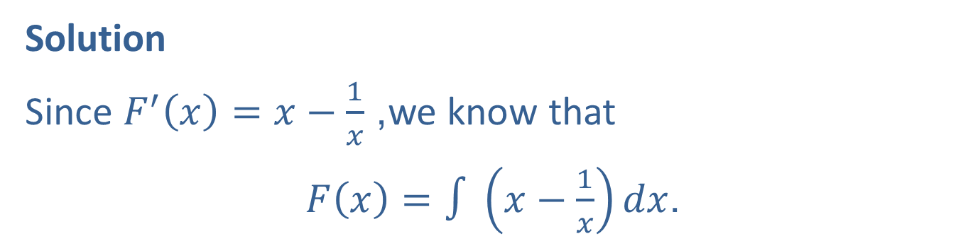

Example 8: Finding the Constant of Integration
If $F^{′}\left(x\right)=x−\frac{1}{x}$ and $F\left(1\right)=\frac{3}{2}$, find $F⁡\left(x\right)$.
Solution
Since $F^{′}\left(x\right)=x−\frac{1}{x}$, we know that
$F\left(x\right)=∫\left(x−\frac{1}{x}\right)dx$.

Slide 21
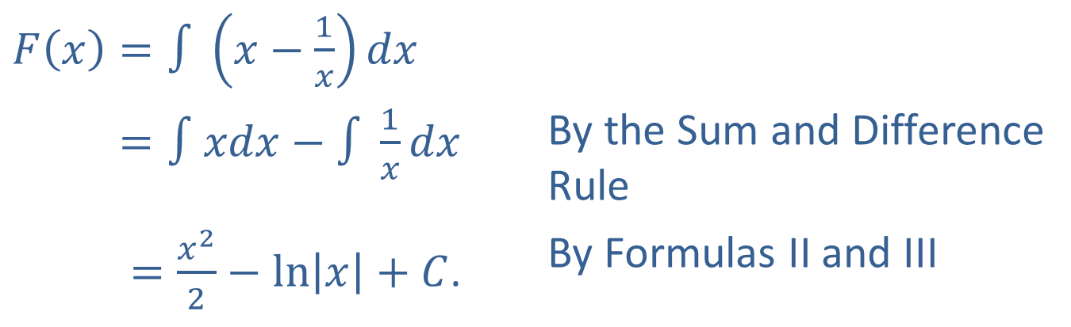
Example 8: Finding the Constant of Integration (cont.)
Thus,
​$F\left(x\right)=∫\left(x−\frac{1}{x}\right)dx$
​𝐹𝑥=∫𝑥𝑑𝑥−∫1𝑥𝑑𝑥 | By the Sum and Difference Rule
𝐹𝑥=𝑥22−ln𝑥+𝐶. | By Formulas II and III

Slide 22
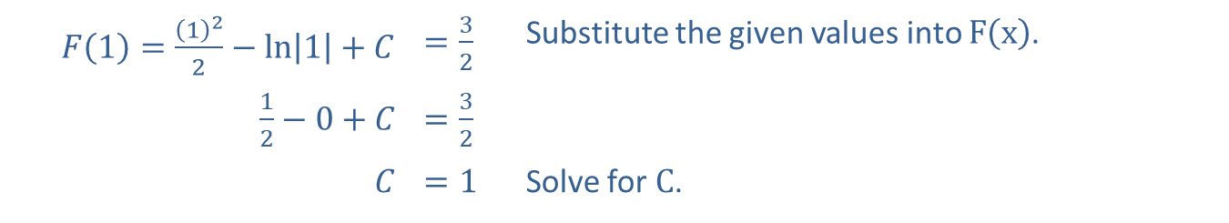


Example 8: Finding the Constant of Integration (cont.)
Now we use the fact that $F\left(1\right)=\frac{3}{2}$ to find the value of $C$.
​$F⁡\left(1\right)=\frac{{\left(1\right)}^{2}}{2}−\ln\left|1\right|+C$ | ​$=\frac{3}{2}$ | Substitute the given values into $F⁡\left(x\right)$.
​$\frac{1}{2}−0+C$ | ​$=\frac{3}{2}$
$$C$$ | ​$=1$ | Solve for $C$.
Therefore,
$F\left(x\right)=\frac{x^{2}}{2}−\ln\left|x\right|+1$.

Slide 23
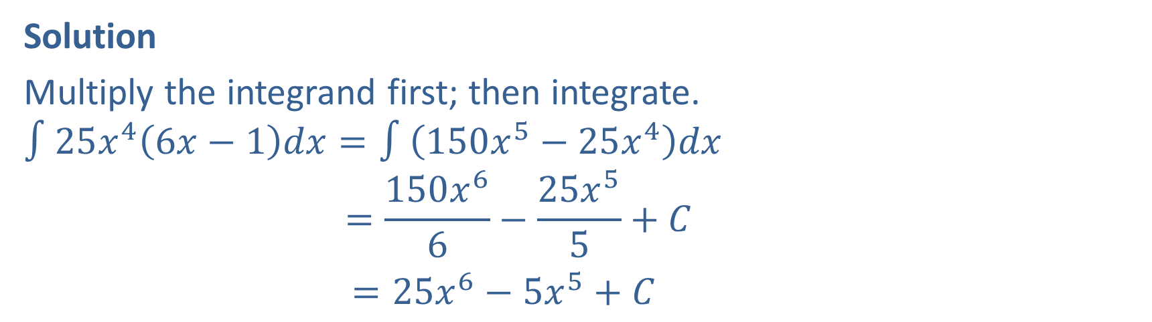

Example 9: Finding the Indefinite Integral
Find $∫25x^{4}\left(6x−1\right)dx$.
Solution
Multiply the integrand first; then integrate.
∫25𝑥46𝑥−1𝑑𝑥=∫150𝑥5−25𝑥4𝑑𝑥∫25𝑥46𝑥−1𝑑𝑥=150𝑥66−25𝑥55+𝐶
$=25x^{6}−5x^{5}+C$

Slide 24

Example 10: Cost Function
A company’s marginal cost function is given as $f\left(x\right)=3x+4$, and fixed costs are known to be $\$5000$. What is the cost function?

Slide 25
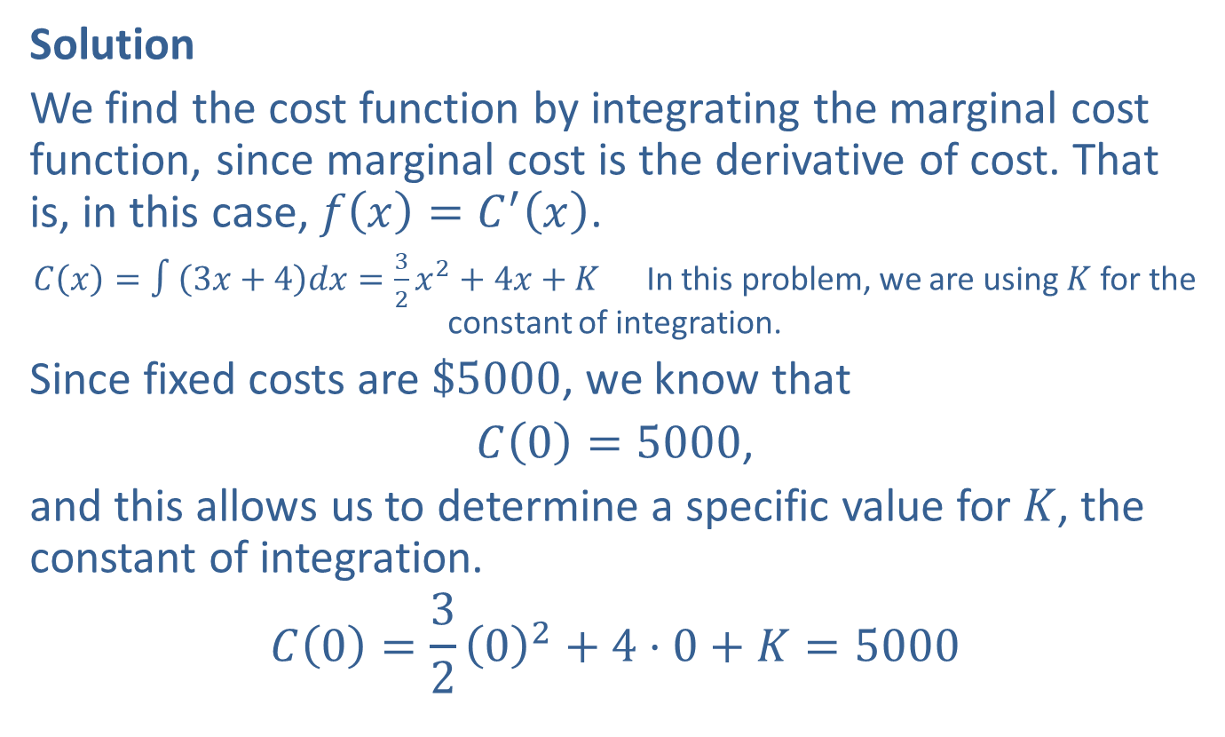
Example 10: Cost Function (cont.)
Solution
We find the cost function by integrating the marginal cost function, since marginal cost is the derivative of cost. That is, in this case, $f\left(x\right)=C^{′}\left(x\right)$.
$C\left(x\right)=∫\left(3x+4\right)dx=\frac{3}{2}x^{2}+4x+K$ In this problem, we are using $K$ for the constant of integration.
Since fixed costs are $\$5000$, we know that
$C\left(0\right)=5000$,
and this allows us to determine a specific value for $K$, the constant of integration.
$$C\left(0\right)=\frac{3}{2}{\left(0\right)}^{2}+4⋅0+K=5000$$

Slide 26

Example 10: Cost Function (cont.)
Therefore,
$$K=5000$$
and
$C\left(x\right)=\frac{3}{2}x^{2}+4x+5000$.

