Slide 1
Section 6.2
Integration by Substitution

Slide 2
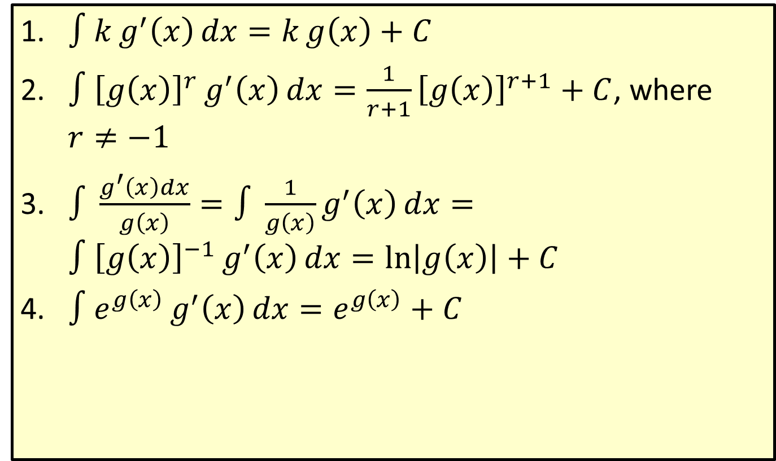
Formulas of Integration with Function Notation
​$∫kg^{′}\left(x\right)dx=kg\left(x\right)+C$
​$∫{\left[g\left(x\right)\right]}^{r}g^{′}\left(x\right)dx=\frac{1}{r+1}{\left[g\left(x\right)\right]}^{r+1}+C$, where $r≠−1$
​$∫\frac{g^{′}\left(x\right)dx}{g\left(x\right)}=∫\frac{1}{g\left(x\right)}g^{′}\left(x\right)dx=∫{\left[g\left(x\right)\right]}^{−1}g^{′}\left(x\right)dx=\ln\left|g\left(x\right)\right|+C$
​$∫e^{g\left(x\right)}g^{′}\left(x\right)dx=e^{g\left(x\right)}+C$

Slide 3
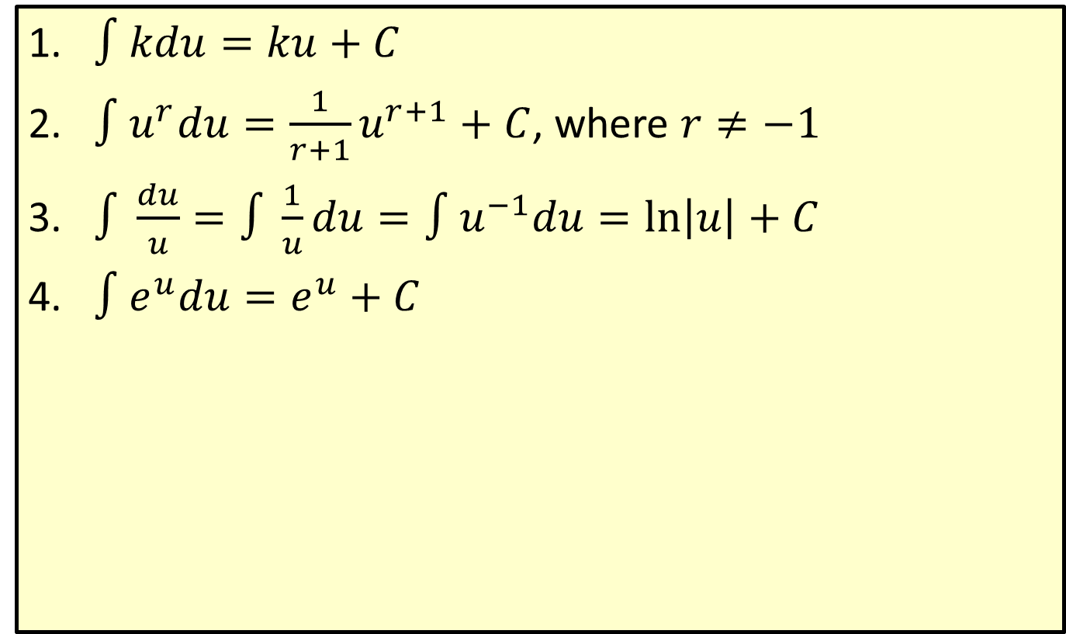

Formulas of Integration with $u$-Substitution
​$∫kdu=ku+C$
​$∫u^{r}du=\frac{1}{r+1}u^{r+1}+C$, where $r≠−1$
​$∫\frac{du}{u}=∫\frac{1}{u}du=∫u^{−1}du=\ln\left|u\right|+C$
​$∫e^{u}du=e^{u}+C$

Slide 4
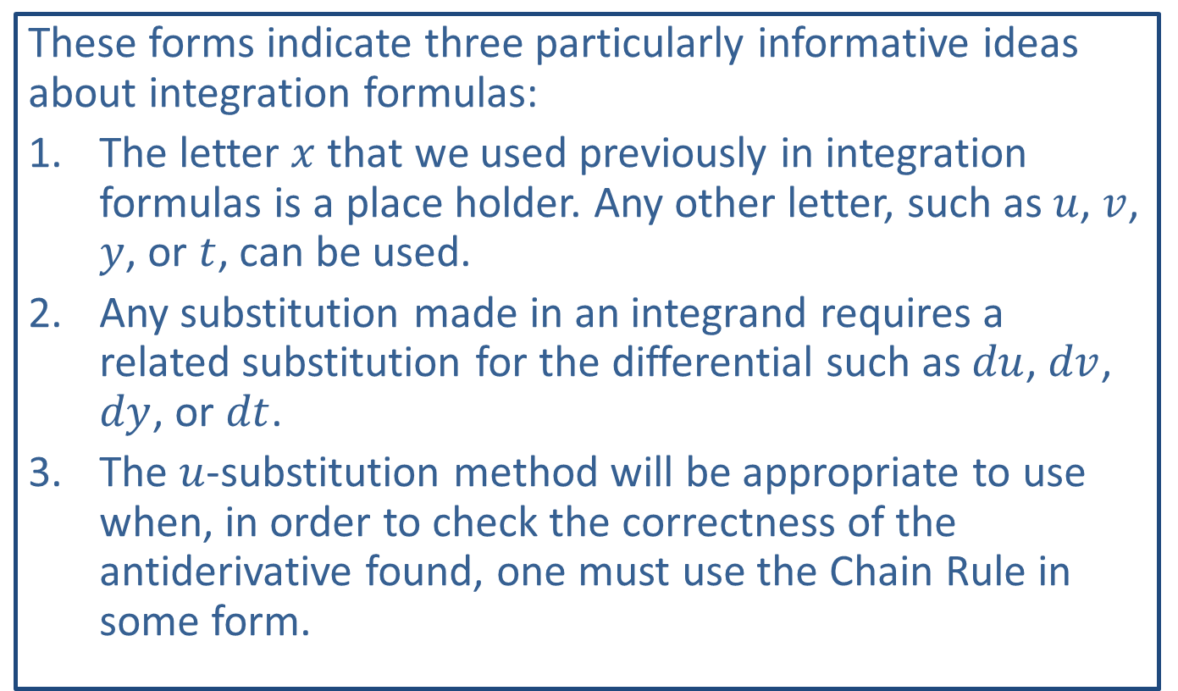
Note:
These forms indicate three particularly informative ideas about integration formulas:
​The letter $x$ that we used previously in integration formulas is a place holder. Any other letter, such as $u$, $v$, $y$, or $t$, can be used.
​Any substitution made in an integrand requires a related substitution for the differential such as $du$, $dv$, $dy$, or $dt$.
​The $u$-substitution method will be appropriate to use when, in order to check the correctness of the antiderivative found, one must use the Chain Rule in some form.

Slide 5
CAUTION!
There is no product rule for integration.

Slide 6
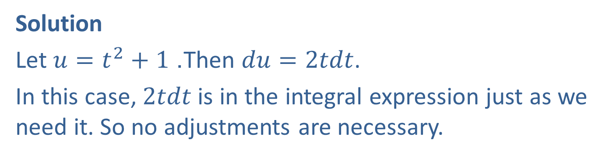

Example 1: Integration by Substitution with Rational Expressions
Find $∫\frac{2t}{t^{2}+1}dt$.
Solution
Let $u=t^{2}+1$. Then $du=2tdt$.
In this case, $2tdt$ is in the integral expression just as we need it. So no adjustments are necessary.

Slide 7
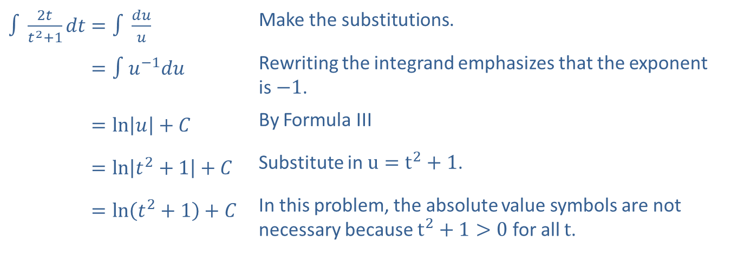
Example 1: Integration by Substitution with Rational Expressions (cont.)
​$∫\frac{2t}{t^{2}+1}dt=∫\frac{du}{u}$ | Make the substitutions.
​∫2𝑡𝑡2+1𝑑𝑡=∫𝑢−1𝑑𝑢 | Rewriting the integrand emphasizes that the exponent is $−1$.
​∫2𝑡𝑡2+1𝑑𝑡=ln𝑢+𝐶 | By Formula III
​∫2𝑡𝑡2+1𝑑𝑡=ln𝑡2+1+𝐶 | Substitute in $u=t^{2}+1$.
​∫2𝑡𝑡2+1𝑑𝑡=ln𝑡2+1+𝐶 | In this problem, the absolute value symbols are not necessary because $t^{2}+1>0$ for all $t$.

Slide 8


Example 2: Integration by Substitution with Radicals
Find $∫\sqrt{5x+1}dx$.
Solution
Choose $u=5x+1$. Then $\frac{du}{dx}=5$ and, multiplying by $dx$ on both sides, we get $du=5dx$.
Since $du=5dx$ and the constant factor 5 is not part of the original integrand, multiply the integrand by 1 in the form $\frac{1}{5}⋅5$ as follows.

Slide 9
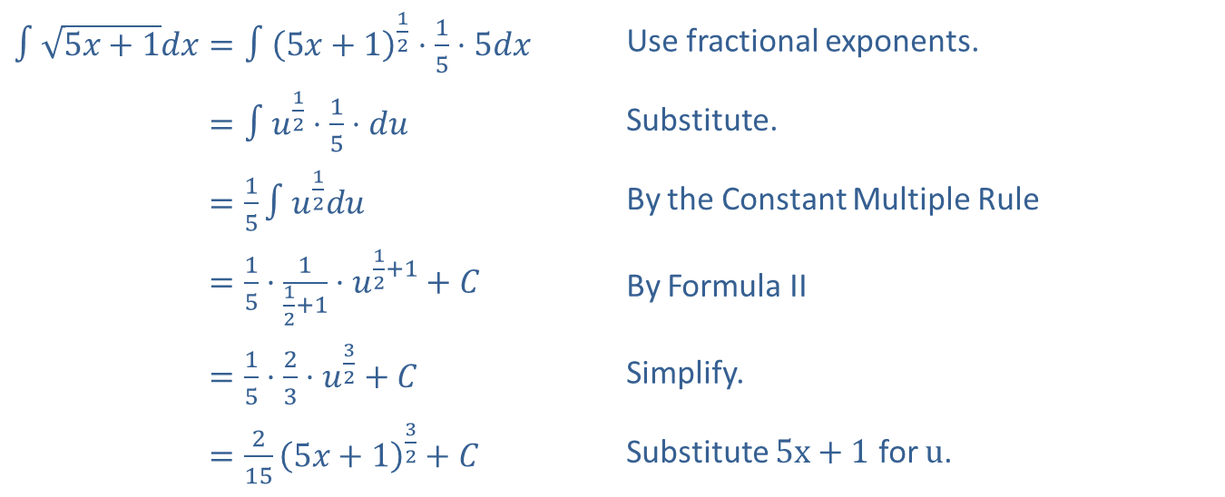
Example 2: Integration by Substitution with Radicals (cont.)
​$∫\sqrt{5x+1}dx=∫{\left(5x+1\right)}^{\frac{1}{2}}⋅\frac{1}{5}⋅5dx$ | Use fractional exponents.
​∫5𝑥+1𝑑𝑥=∫𝑢12⋅15⋅𝑑𝑢 | Substitute.
​∫5𝑥+1𝑑𝑥=15∫𝑢12𝑑𝑢 | By the Constant Multiple Rule
​∫5𝑥+1𝑑𝑥=15⋅112+1⋅𝑢12+1+𝐶 | By Formula II
​∫5𝑥+1𝑑𝑥=15⋅23⋅𝑢32+𝐶 | Simplify.
​∫5𝑥+1𝑑𝑥=2155𝑥+132+𝐶 | Substitute $5x+1$ for $u$.

Slide 10
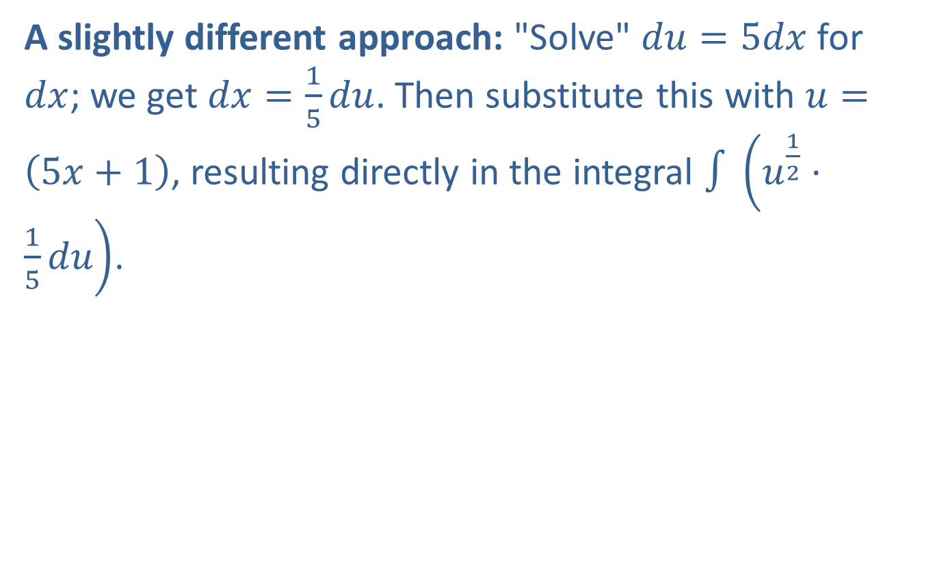
Example 2: Integration by Substitution with Radicals (cont.)
A slightly different approach: "Solve" $du=5dx$ for $dx$; we get $dx=\frac{1}{5}du$. Then substitute this with $u=\left(5x+1\right)$, resulting directly in the integral $∫\left(u^{\frac{1}{2}}⋅\frac{1}{5}du\right)$.

Slide 11
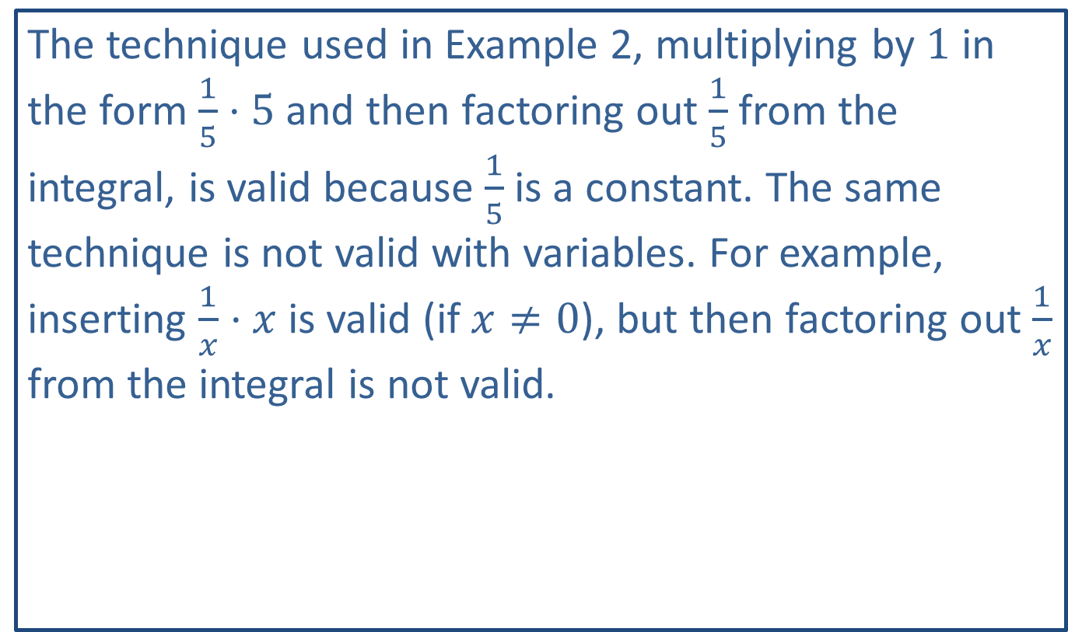
CAUTION!
The technique used in Example 2, multiplying by 1 in the form $\frac{1}{5}⋅5$ and then factoring out $\frac{1}{5}$ from the integral, is valid because $\frac{1}{5}$ is a constant. The same technique is not valid with variables. For example, inserting $\frac{1}{x}⋅x$ is valid (if $x≠0$), but then factoring out $\frac{1}{x}$ from the integral is not valid.

Slide 12


Example 3: Integration by Substitution with $e$
Find $∫7xe^{x^{2}+3}dx$.

Slide 13


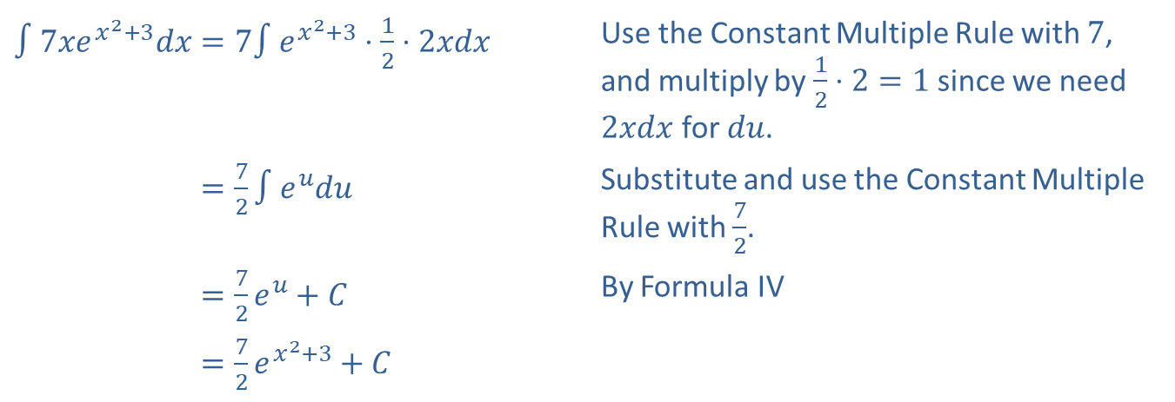
Example 3: Integration by Substitution with $e$ (cont.)
Solution
Let $u=x^{2}+3$. Then $du=2xdx$.
We adjust for the 2 by introducing $\frac{1}{2}⋅2$ into the integrand.
​$∫7xe^{x^{2}+3}dx=7∫e^{x^{2}+3}⋅\frac{1}{2}⋅2xdx$ | Use the Constant Multiple Rule with 7, and multiply by $\frac{1}{2}⋅2=1$ since we need $2xdx$ for $du$.
​∫7𝑥𝑒𝑥2+3𝑑𝑥=72∫𝑒𝑢𝑑𝑢 | Substitute and use the Constant Multiple Rule with $\frac{7}{2}$.
​∫7𝑥𝑒𝑥2+3𝑑𝑥=72𝑒𝑢+𝐶 | By Formula IV
​∫7𝑥𝑒𝑥2+3𝑑𝑥=72𝑒𝑥2+3+𝐶

Slide 14


Example 4: Integration by Substitution
Find $∫\frac{x^{2}}{{\left(x^{3}−1\right)}^{5}}dx$.
Solution
Choose $u=x^{3}−1$. Then $du=3x^{2}dx$.

Slide 15
Example 4: Integration by Substitution (cont.)

Slide 16
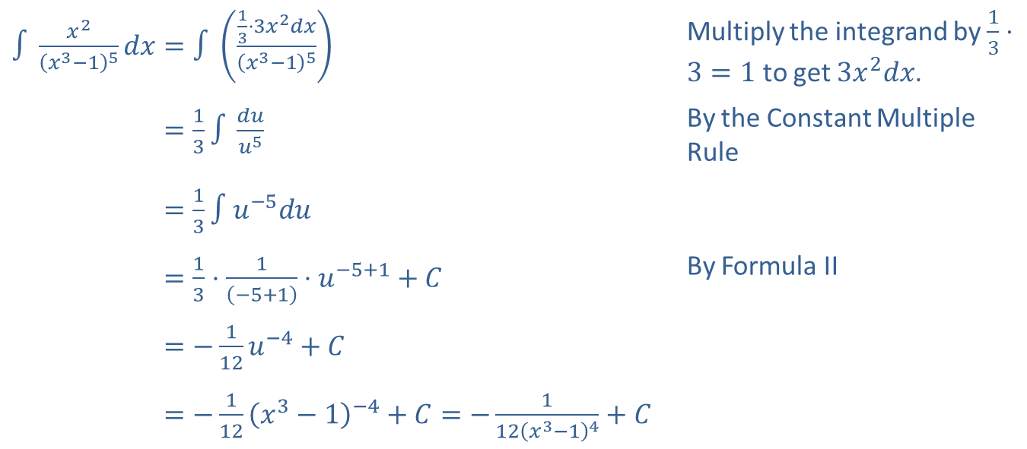
Example 4: Integration by Substitution (cont.)
​$∫\frac{x^{2}}{{\left(x^{3}−1\right)}^{5}}dx=∫\left(\frac{\frac{1}{3}⋅3x^{2}dx}{{\left(x^{3}−1\right)}^{5}}\right)$ | Multiply the integrand by $\frac{1}{3}⋅3=1$ to get $3x^{2}dx$.
​∫𝑥2𝑥3−15𝑑𝑥=13∫𝑑𝑢𝑢5 | By the Constant Multiple Rule
​∫𝑥2𝑥3−15𝑑𝑥=13∫𝑢−5𝑑𝑢
​∫𝑥2𝑥3−15𝑑𝑥=13⋅1−5+1⋅𝑢−5+1+𝐶 | By Formula II
​∫𝑥2𝑥3−15𝑑𝑥=−112𝑢−4+𝐶
​∫𝑥2𝑥3−15𝑑𝑥=−112𝑥3−1−4+𝐶=−112𝑥3−14+𝐶

Slide 17
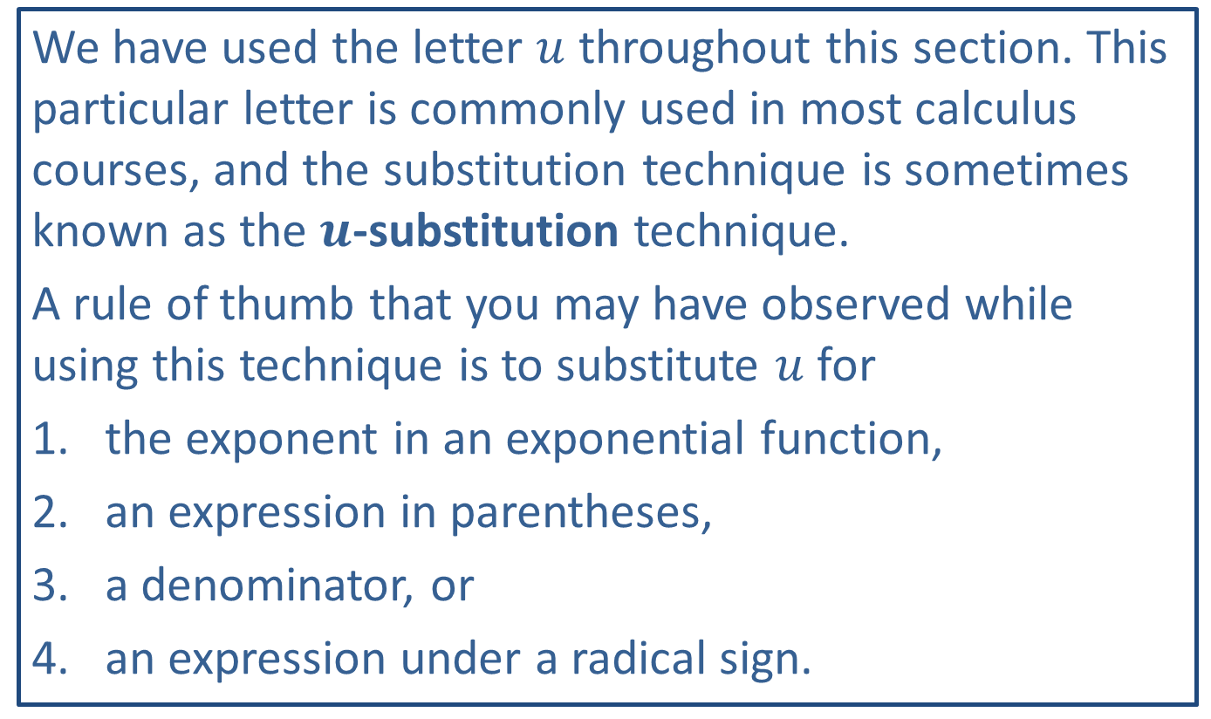
Note:
We have used the letter $u$ throughout this section. This particular letter is commonly used in most calculus courses, and the substitution technique is sometimes known as the $u$-substitution technique.
A rule of thumb that you may have observed while using this technique is to substitute $u$ for
​the exponent in an exponential function,
​an expression in parentheses,
​a denominator, or
​an expression under a radical sign.

Slide 18


Example 5: Incorrect Integration by Substitution
Find $∫3x^{2}\sqrt{x^{3}+1}dx$.
Solution
Let $u=3x^{2}$. Then $du=6xdx$.
This substitution will not work because the expression $\sqrt{x^{3}+1}dx$ is not $du$.
A better substitution is to let $u$ represent the expression under the radical sign. Let $u=x^{3}+1$. Then $du=3x^{2}dx$. Now substitution gives a familiar form.

Slide 19
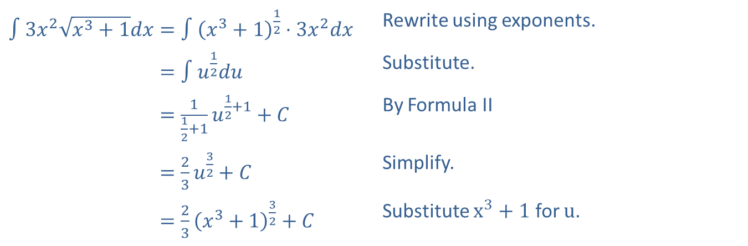
Example 5: Incorrect Integration by Substitution (cont.)
​$∫3x^{2}\sqrt{x^{3}+1}dx=∫{\left(x^{3}+1\right)}^{\frac{1}{2}}⋅3x^{2}dx$ | Rewrite using exponents.
​∫3𝑥2𝑥3+1𝑑𝑥=∫𝑢12𝑑𝑢 | Substitute.
​∫3𝑥2𝑥3+1𝑑𝑥=112+1𝑢12+1+𝐶 | By Formula II
​∫3𝑥2𝑥3+1𝑑𝑥=23𝑢32+𝐶 | Simplify.
​∫3𝑥2𝑥3+1𝑑𝑥=23𝑥3+132+𝐶 | Substitute $x^{3}+1$ for $u$.

Slide 20
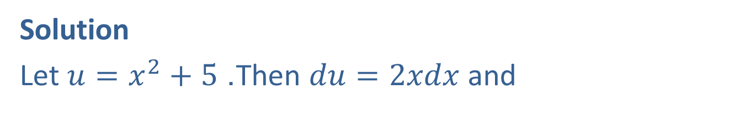


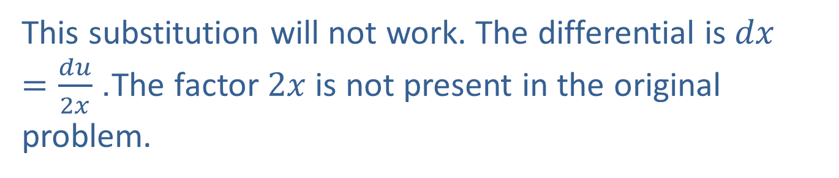
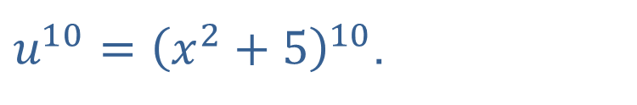
Example 6: Incorrect Integration by Substitution
Find $∫{\left(x^{2}+5\right)}^{10}dx$.
Solution
Let $u=x^{2}+5$. Then $du=2xdx$ and
$u^{10}={\left(x^{2}+5\right)}^{10}$.
This substitution will not work. The differential is $dx=\frac{du}{2x}$. The factor $2x$ is not present in the original problem.
Actually, in this example, the method cannot be made to work by any $u$-substitution.

