Slide 1
Section 6.3
Area and Riemann Sums

Slide 2

Example 1: Using the Fundamental Theorem of Calculus
Use the Fundamental Theorem of Calculus to determine the area under the graph of $f\left(x\right)=30−20x+x^{5}$ and over the $x$-axis interval $\left[1\text{, }2\right]$.

Slide 3

Example 1: Using the Fundamental Theorem of Calculus (cont.)
Solution
First, we must find the antiderivative, $F⁡\left(x\right)$.
𝑑𝑑𝑥𝐹𝑥=𝑑𝑑𝑥30𝑥−10𝑥2+16𝑥6𝑑𝑑𝑥𝐹𝑥=30−20𝑥+𝑥5𝑑𝑑𝑥𝐹𝑥=𝑓𝑥

Slide 4
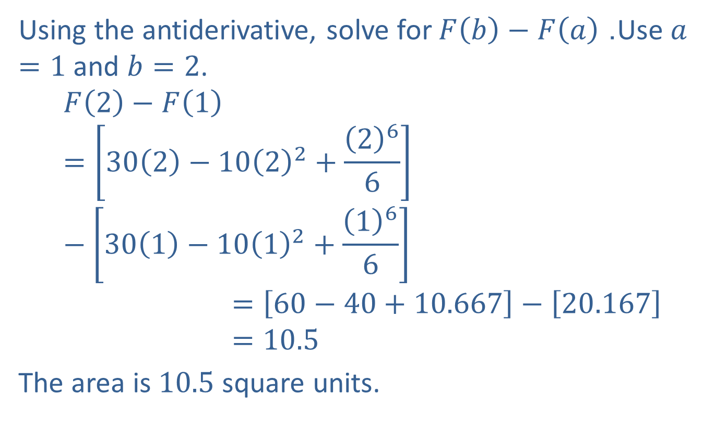
Example 1: Using the Fundamental Theorem of Calculus (cont.)
Using the antiderivative, solve for $F\left(b\right)−F\left(a\right)$. Use $a=1$ and $b=2$.
𝐹2−𝐹1=302−1022+266−301−1012+166𝐹2−𝐹1=60−40+10.667−20.167𝐹2−𝐹1=10.5
The area is 10.5 square units.

Slide 5
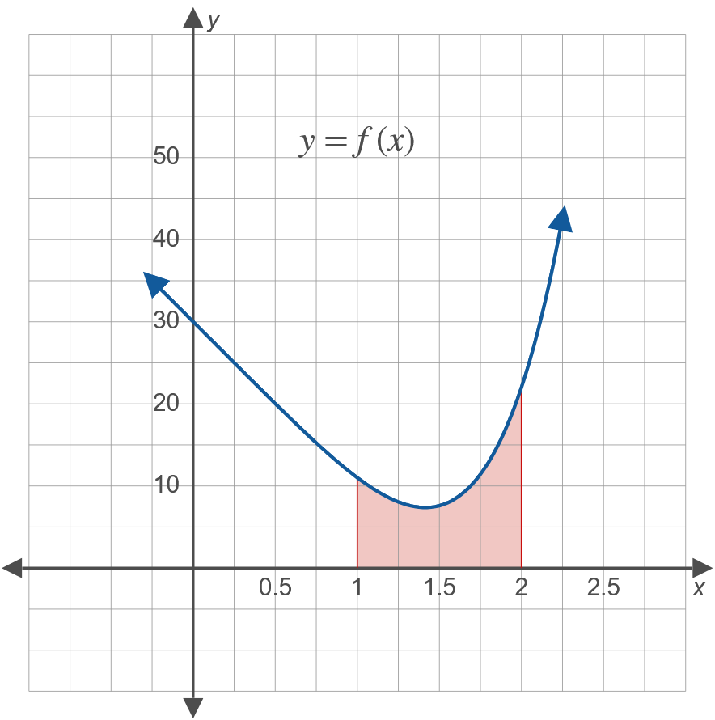
Example 1: Using the Fundamental Theorem of Calculus (cont.)

Slide 6
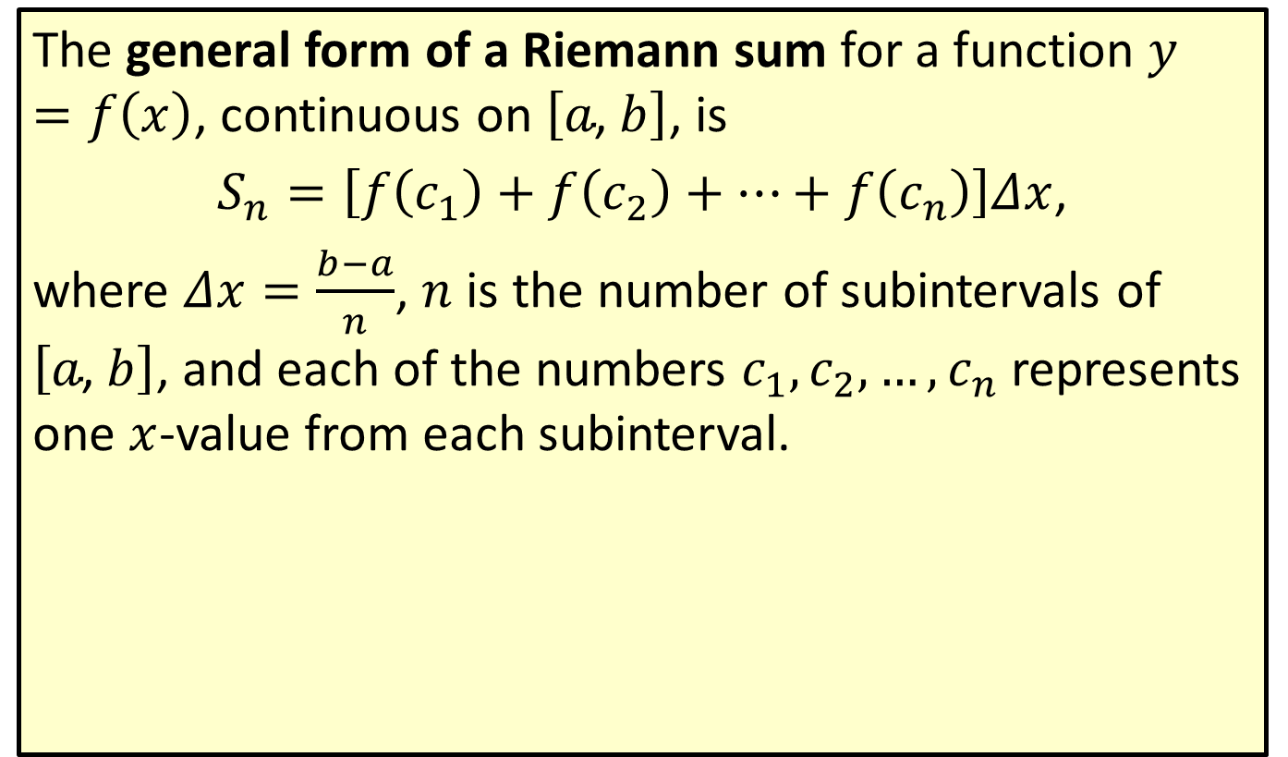
General Form of a Riemann Sum
The general form of a Riemann sum for a function $y=f\left(x\right)$, continuous on $\left[a\text{, }b\right]$, is
$S_{n}=\left[f\left(c_{1}\right)+f\left(c_{2}\right)+⋯+f\left(c_{n}\right)\right]Δx$,
where $Δx=\frac{b−a}{n}$, $n$ is the number of subintervals of $\left[a\text{, }b\right]$, and each of the numbers $c_{1},c_{2},…,c_{n}$ represents one $x$-value from each subinterval.

Slide 7

Example 2: Riemann Sum
Use a Riemann sum to estimate the area between $f\left(x\right)=\frac{1}{x}$ and the $x$-axis on the interval $\left[a\text{, }b\right]=\left[1\text{, }5\right]$ with $n=4$.

Slide 8
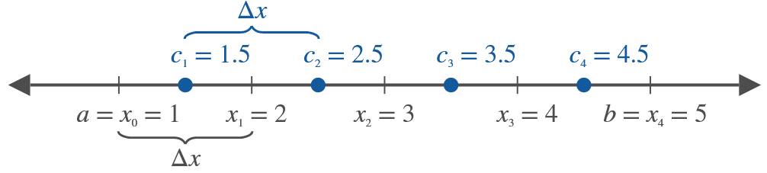
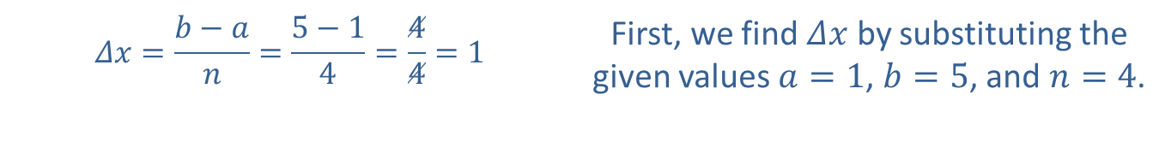

Example 2: Riemann Sum (cont.)
Solution
In this example, we use the midpoint of each subinterval for the values of $c_{1}$, $c_{2}$, $c_{3}$, and $c_{4}$.
$$Δx=\frac{b−a}{n}=\frac{5−1}{4}=\frac{4}{4}=1$$ | First, we find $Δx$ by substituting the given values $a=1$, $b=5$, and $n=4$.

Slide 9
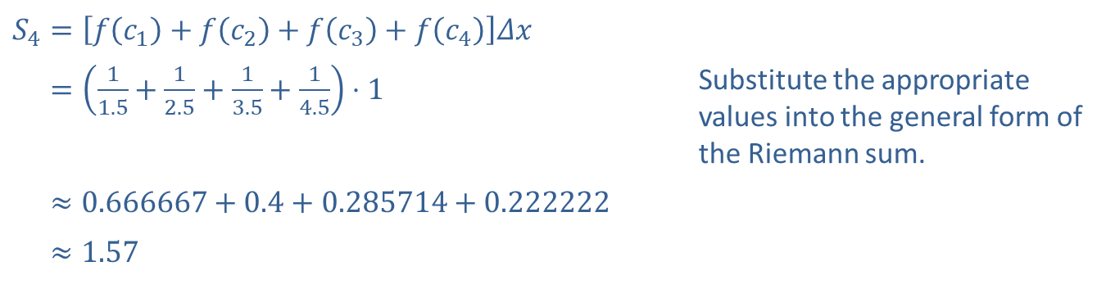
Example 2: Riemann Sum (cont.)
​$S_{4}=\left[f⁡\left(c_{1}\right)+f⁡\left(c_{2}\right)+f⁡\left(c_{3}\right)+f⁡\left(c_{4}\right)\right]Δx$
​𝑆4=11.5+12.5+13.5+14.5⋅1 | Substitute the appropriate values into the general form of the Riemann sum.
​𝑆4≈0.666667+0.4+0.285714+0.222222
​𝑆4≈1.57

Slide 10
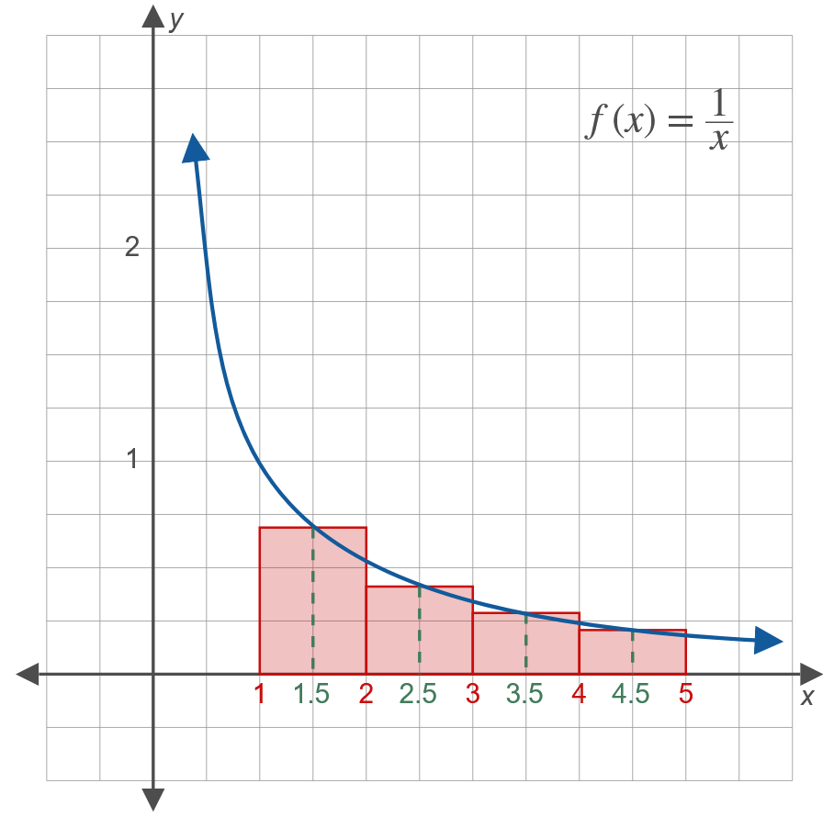
Example 2: Riemann Sum (cont.)

Slide 11
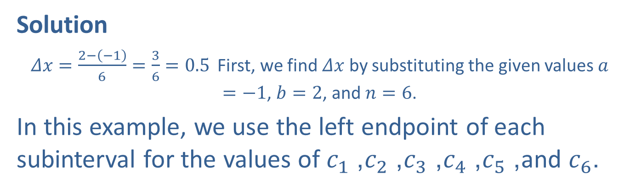

Example 3: Riemann Sum
Use a Riemann sum to estimate the area between $y=x^{2}+1$ and the $x$-axis on the interval $\left[a\text{, }b\right]=\left[−1\text{, }2\right]$ with $n=6$.
Solution
$Δx=\frac{2−\left(−1\right)}{6}=\frac{3}{6}=0.5$ First, we find $Δx$ by substituting the given values $a=−1$, $b=2$, and $n=6$.
In this example, we use the left endpoint of each subinterval for the values of $c_{1}$, $c_{2}$, $c_{3}$, $c_{4}$, $c_{5}$, and $c_{6}$.

Slide 12
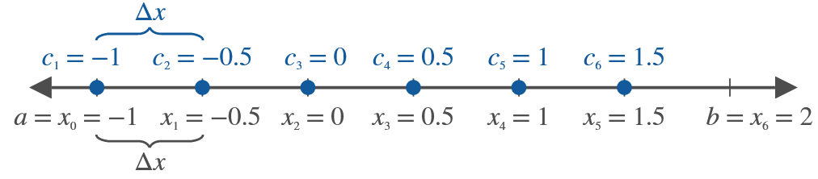
Example 3: Riemann Sum (cont.)

Slide 13
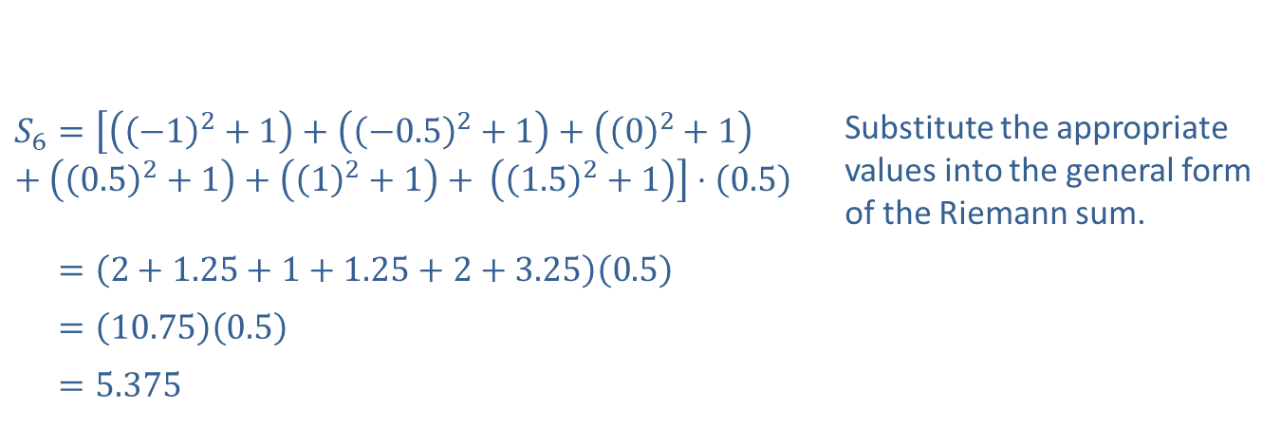
Example 3: Riemann Sum (cont.)
​$S_{6}=\left[\left({\left(−1\right)}^{2}+1\right)+\left({\left(−0.5\right)}^{2}+1\right)+\left({\left(0\right)}^{2}+1\right)+\left({\left(0.5\right)}^{2}+1\right)+\left({\left(1\right)}^{2}+1\right)+ \left({\left(1.5\right)}^{2}+1\right)\right]⋅\left(0.5\right)$ | Substitute the appropriate values into the general form of the Riemann sum.
​𝑆6=2+1.25+1+1.25+2+3.250.5
​𝑆6=10.750.5
​𝑆6=5.375

Slide 14
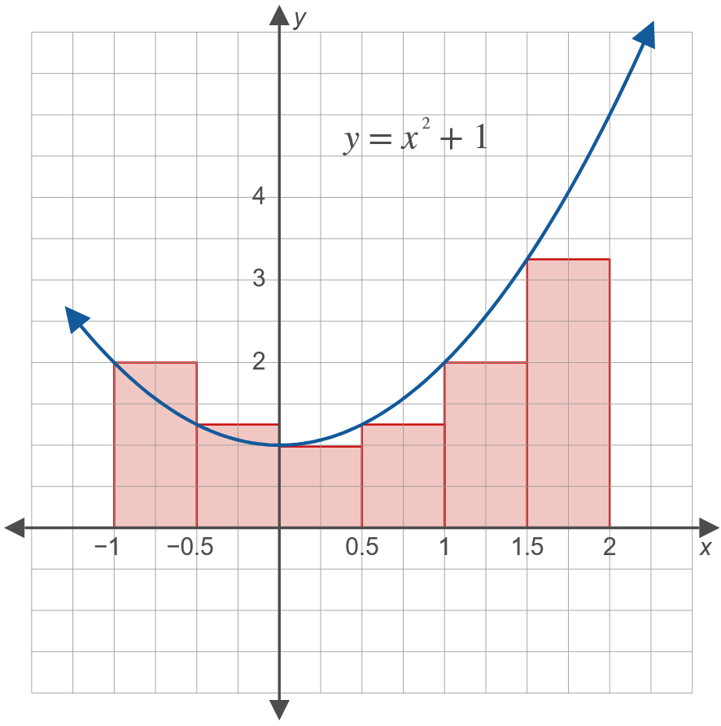
Example 3: Riemann Sum (cont.)

Slide 15
Note:
Programmable graphing calculators (like the TI-84 Plus) will calculate various types of Riemann sums directly using a menu. We do not include such problems in this course.

