Slide 1
Section 6.4
The Definite Integral and the Fundamental Theorem of Calculus

Slide 2
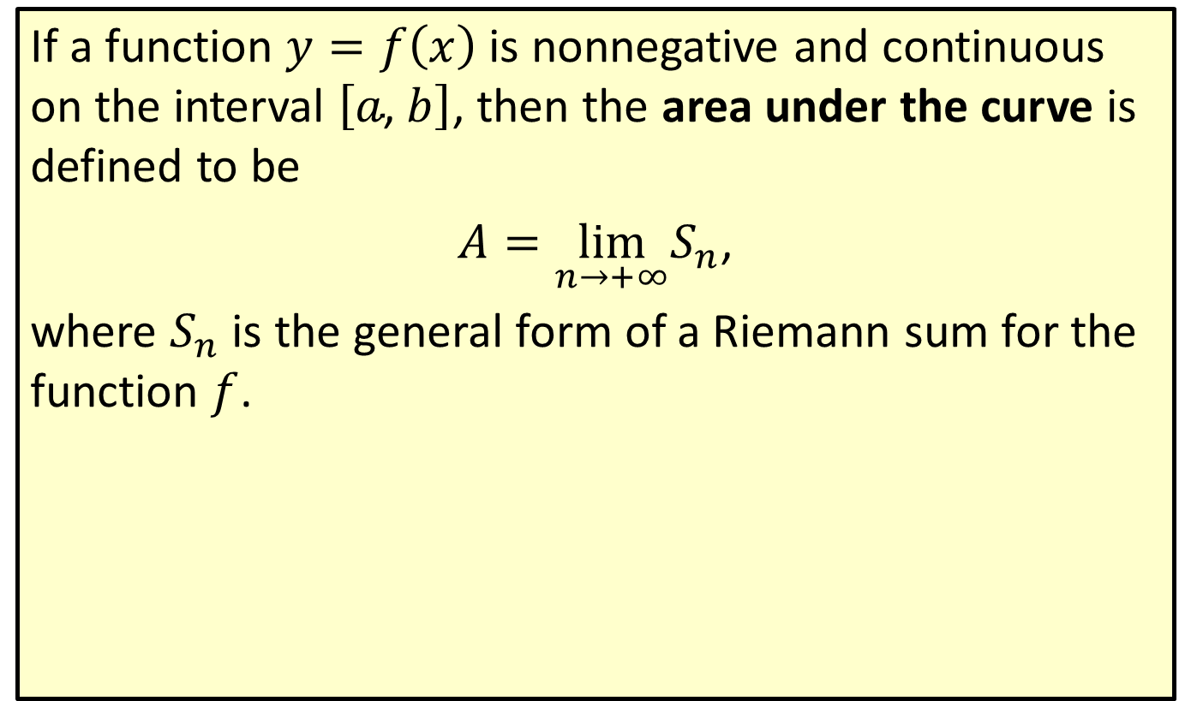
Area under a Curve
If a function $y=f\left(x\right)$ is nonnegative and continuous on the interval $\left[a\text{, }b\right]$, then the area under the curve is defined to be
$A=\lim_{n→+∞}S_{n}$,
where $S_{n}$ is the general form of a Riemann sum for the function $f$.

Slide 3
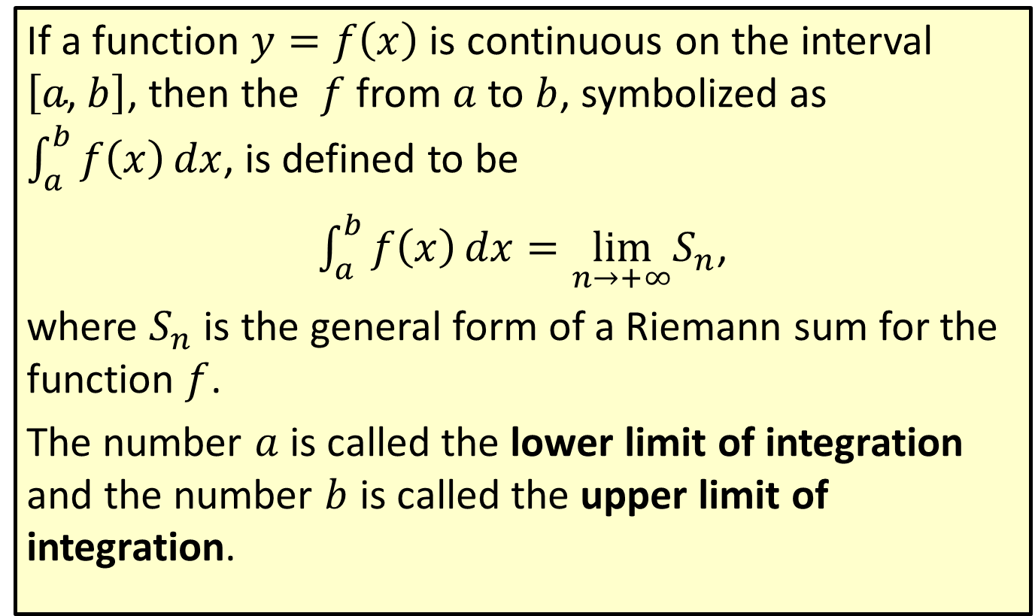
The Definite Integral
If a function $y=f\left(x\right)$ is continuous on the interval $\left[a\text{, }b\right]$, then the $f$ from $a$ to $b$, symbolized as $\int_{a}^{b}{f\left(x\right)}dx$, is defined to be
$\int_{a}^{b}{f\left(x\right)}dx=\lim_{n→+∞}S_{n}$,
where $S_{n}$ is the general form of a Riemann sum for the function $f$.
The number $a$ is called the lower limit of integration and the number $b$ is called the upper limit of integration.

Slide 4
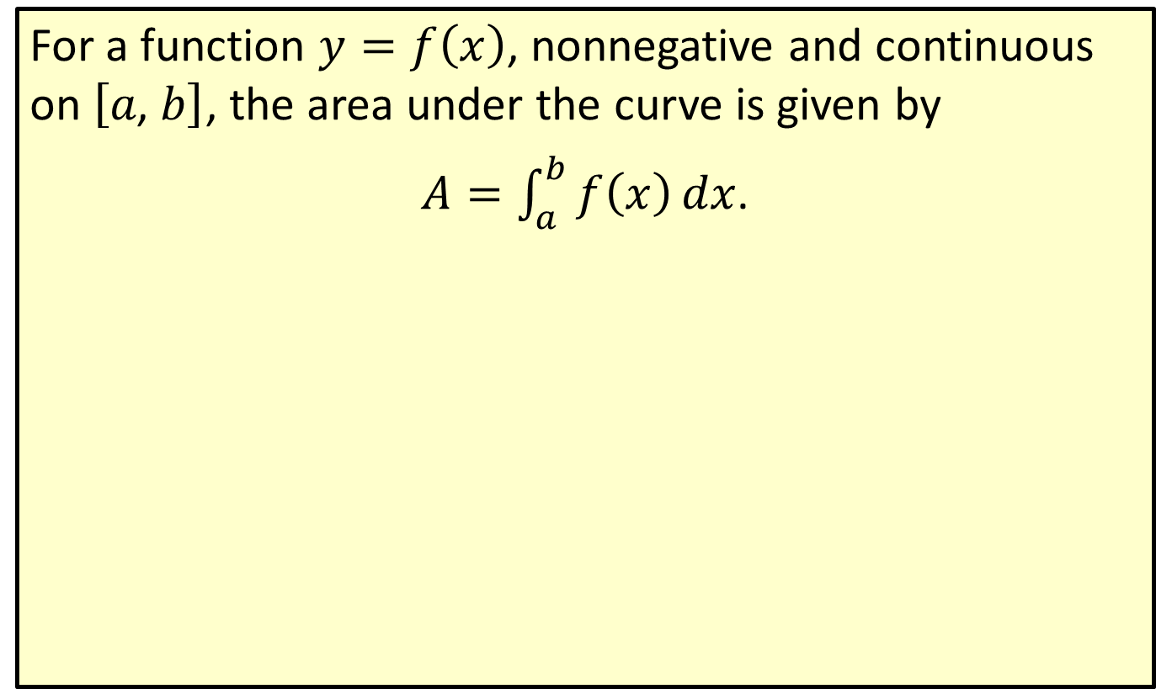
Formula for Area under a Curve
For a function $y=f\left(x\right)$, nonnegative and continuous on $\left[a\text{, }b\right]$, the area under the curve is given by
$A=\int_{a}^{b}{f\left(x\right)}dx$.

Slide 5
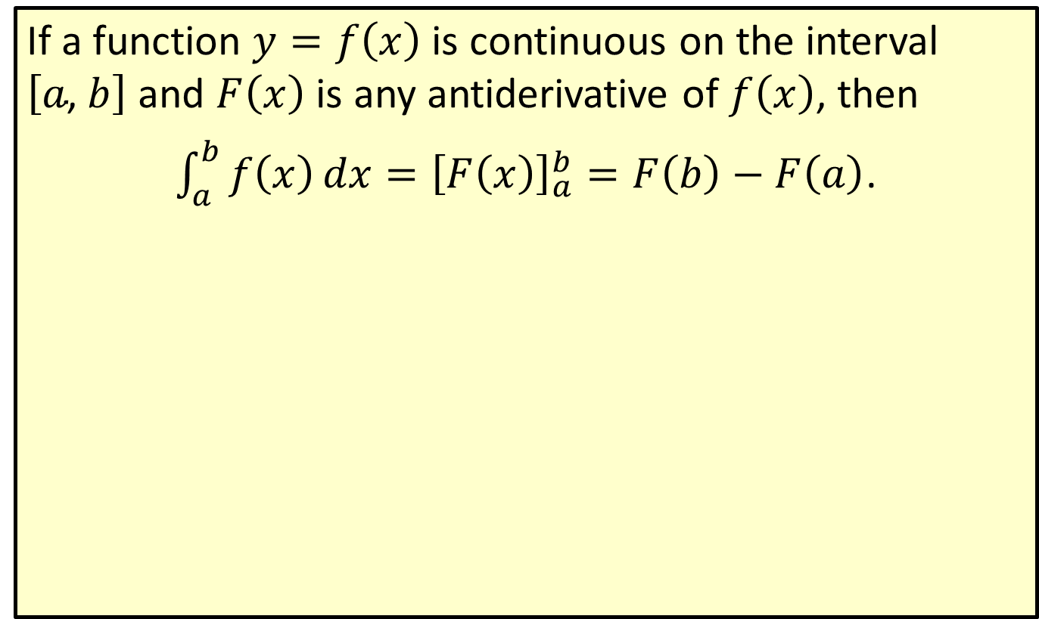
The Fundamental Theorem of Calculus
If a function $y=f\left(x\right)$ is continuous on the interval $\left[a\text{, }b\right]$ and $F⁡\left(x\right)$ is any antiderivative of $f⁡\left(x\right)$, then
$\int_{a}^{b}{f\left(x\right)}dx={\left[F\left(x\right)\right]}_{a}^{b}=F\left(b\right)−F\left(a\right)$.

Slide 6
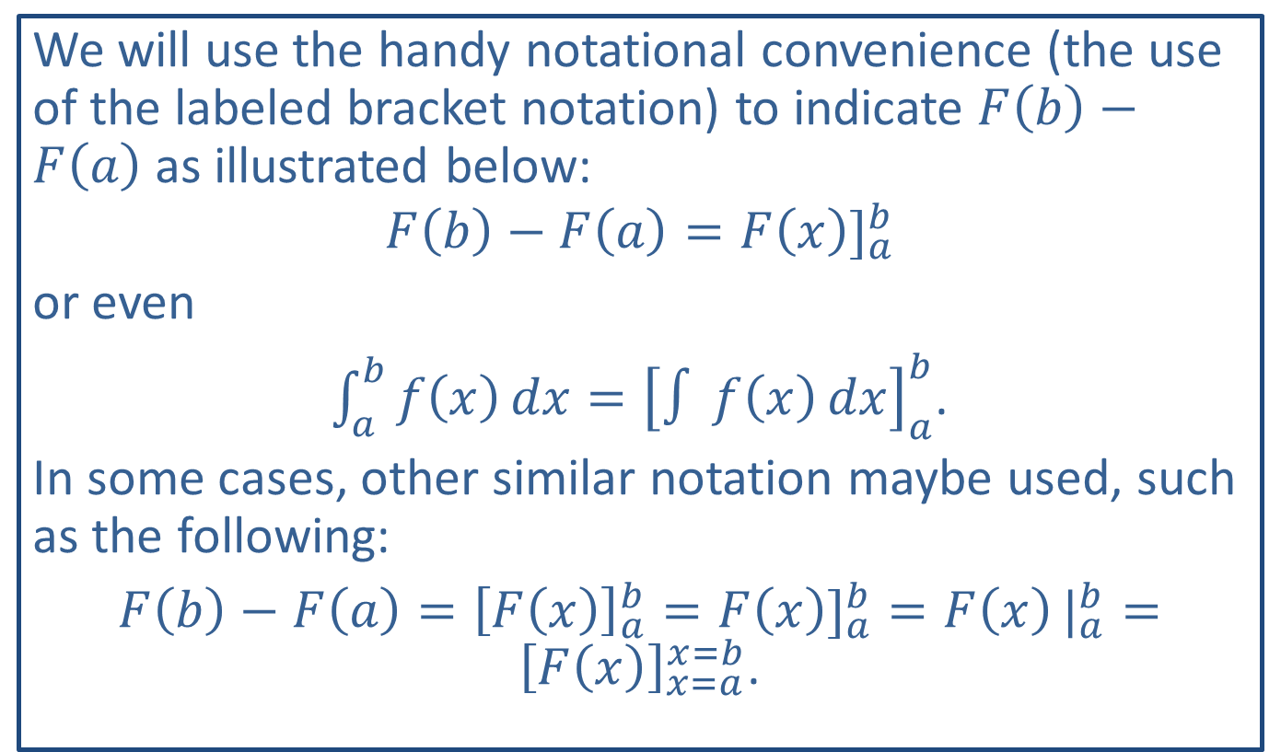
Note:
We will use the handy notational convenience (the use of the labeled bracket notation) to indicate $F\left(b\right)−F\left(a\right)$ as illustrated below:
$$F\left(b\right)−F\left(a\right)={F\left(x\right)]}_{a}^{b}$$
or even
$\int_{a}^{b}{f\left(x\right)}dx={\left[∫f\left(x\right)dx\right]}_{a}^{b}$.
In some cases, other similar notation maybe used, such as the following:
$F\left(b\right)−F\left(a\right)={\left[F\left(x\right)\right]}_{a}^{b}={F\left(x\right)]}_{a}^{b}={F\left(x\right)|}_{a}^{b}={\left[F\left(x\right)\right]}_{x=a}^{x=b}$.

Slide 7

Example 1: Definite Integrals
​Evaluate $\int_{1}^{2}{2x}dx$.
​Find the value of $\int_{1}^{4}{\frac{1}{\sqrt{x}}}\frac{1}{\sqrt{x}}dx$.
​Evaluate $\int_{0}^{1}{e^{x}}e^{x}dx$.

Slide 8
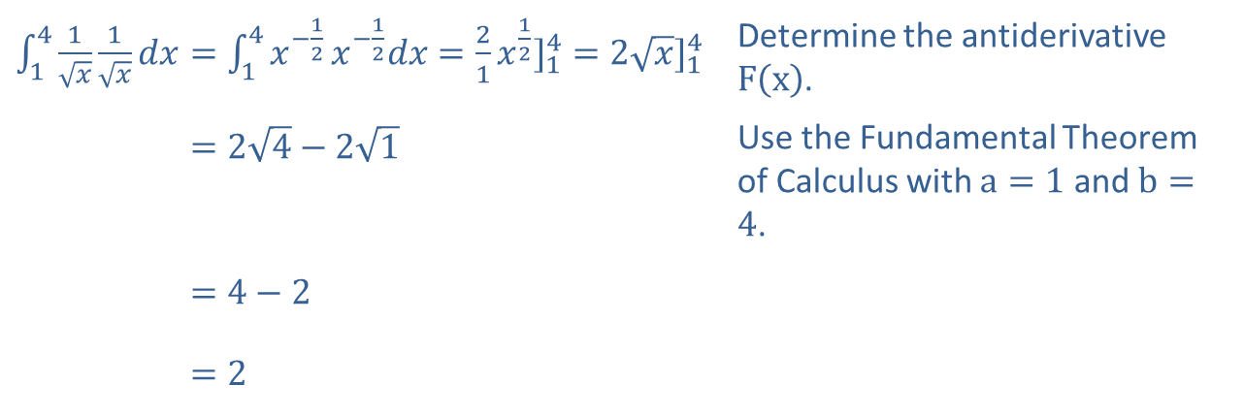
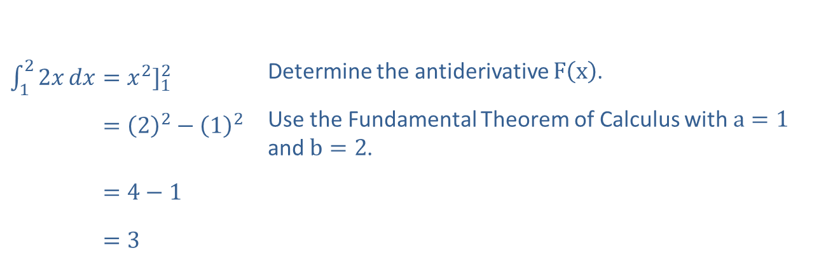
Example 1: Definite Integrals (cont.)
Solution
​
​$\int_{1}^{2}{2x}dx={x^{2}]}_{1}^{2}$ | Determine the antiderivative $F⁡\left(x\right)$.
​122𝑥𝑑𝑥=22−12 | Use the Fundamental Theorem of Calculus with $a=1$ and $b=2$.
​122𝑥𝑑𝑥=4−1
​122𝑥𝑑𝑥=3
​$\int_{1}^{4}{\frac{1}{\sqrt{x}}}\frac{1}{\sqrt{x}}dx=\int_{1}^{4}{x^{−\frac{1}{2}}}x^{−\frac{1}{2}}dx={\frac{2}{1}x^{\frac{1}{2}}]}_{1}^{4}={2\sqrt{x}]}_{1}^{4}$ | Determine the antiderivative $F⁡\left(x\right)$.
​141𝑥1𝑥𝑑𝑥=24−21 | Use the Fundamental Theorem of Calculus with $a=1$ and $b=4$.
​141𝑥1𝑥𝑑𝑥=4−2
​141𝑥1𝑥𝑑𝑥=2

Slide 9
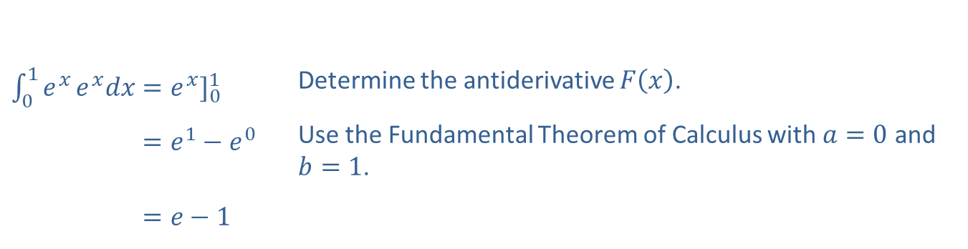
Example 1: Definite Integrals (cont.)
​
​$\int_{0}^{1}{e^{x}}e^{x}dx={e^{x}]}_{0}^{1}$ | Determine the antiderivative $F⁡\left(x\right)$.
​01𝑒𝑥𝑒𝑥𝑑𝑥=𝑒1−𝑒0 | Use the Fundamental Theorem of Calculus with $a=0$ and $b=1$.
​01𝑒𝑥𝑒𝑥𝑑𝑥=𝑒−1

Slide 10
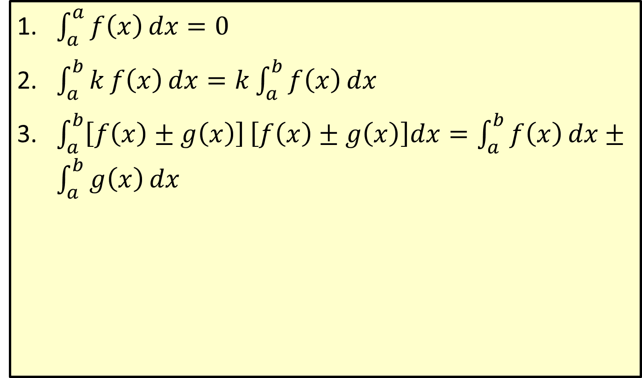
Properties of Definite Integrals
​$\int_{a}^{a}{f\left(x\right)}dx=0$
​$\int_{a}^{b}{kf\left(x\right)dx}=k\int_{a}^{b}{f\left(x\right)}dx$
​$\int_{a}^{b}{\left[f\left(x\right)±g\left(x\right)\right]}\left[f\left(x\right)±g\left(x\right)\right]dx=\int_{a}^{b}{f\left(x\right)}dx±\int_{a}^{b}{g\left(x\right)}dx$

Slide 11

Example 2: Using Properties of Definite Integrals
​Evaluate $\int_{1}^{2}{\left(x^{2}+\frac{1}{x}−3e^{x}\right)}\left(x^{2}+\frac{1}{x}−3e^{x}\right)dx$.
​Find the value of $\int_{0}^{1}{x\sqrt{x^{2}+1}}dx$.

Slide 12
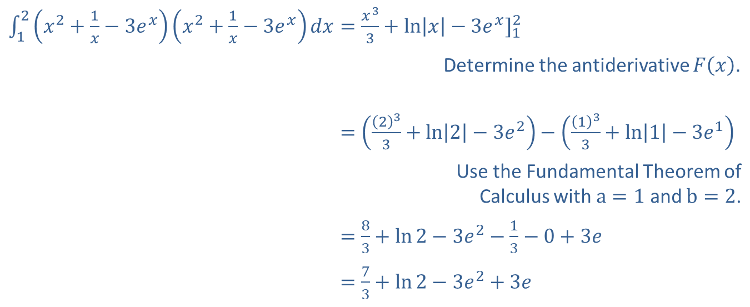
Example 2: Using Properties of Definite Integrals (cont.)
Solution
​
​$\int_{1}^{2}{\left(x^{2}+\frac{1}{x}−3e^{x}\right)}\left(x^{2}+\frac{1}{x}−3e^{x}\right)dx={\frac{x^{3}}{3}+\ln\left|x\right|−3e^{x}]}_{1}^{2}$
Determine the antiderivative $F⁡\left(x\right)$.
​12𝑥2+1𝑥−3𝑒𝑥𝑥2+1𝑥−3𝑒𝑥𝑑𝑥=233+ln2−3𝑒2−133+ln1−3𝑒1
Use the Fundamental Theorem of Calculus with $a=1$ and $b=2$.
​12𝑥2+1𝑥−3𝑒𝑥𝑥2+1𝑥−3𝑒𝑥𝑑𝑥=83+ln2−3𝑒2−13−0+3𝑒
​12𝑥2+1𝑥−3𝑒𝑥𝑥2+1𝑥−3𝑒𝑥𝑑𝑥=73+ln2−3𝑒2+3𝑒

Slide 13
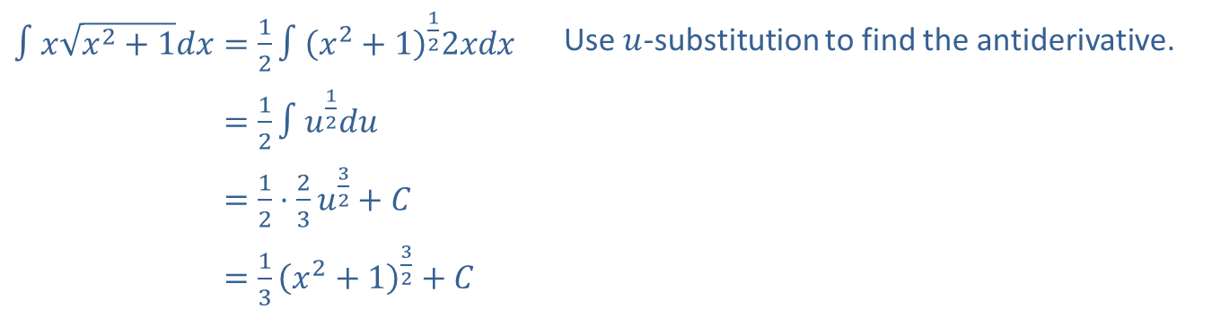

Example 2: Using Properties of Definite Integrals (cont.)
​Use the $u$-substitution technique with $u=x^{2}+1$ and $du=2xdx$ to find the antiderivative. Then replace $u$ with $x^{2}+1$ before evaluating the definite integral.
​$∫x\sqrt{x^{2}+1}dx=\frac{1}{2}∫{\left(x^{2}+1\right)}^{\frac{1}{2}}2xdx$ | Use $u$-substitution to find the antiderivative.
​∫𝑥𝑥2+1𝑑𝑥=12∫𝑢12𝑑𝑢
​∫𝑥𝑥2+1𝑑𝑥=12⋅23𝑢32+𝐶
​∫𝑥𝑥2+1𝑑𝑥=13𝑥2+132+𝐶

Slide 14
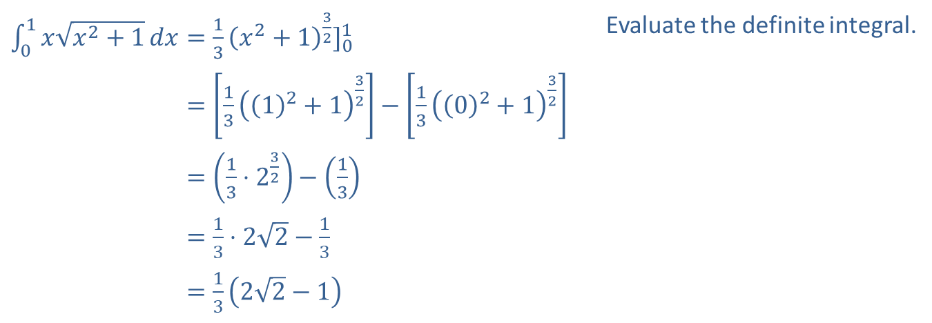
Example 2: Using Properties of Definite Integrals (cont.)
​$\int_{0}^{1}{x\sqrt{x^{2}+1}}dx={\frac{1}{3}{\left(x^{2}+1\right)}^{\frac{3}{2}}]}_{0}^{1}$ | Evaluate the definite integral.
​01𝑥𝑥2+1𝑑𝑥=1312+132−1302+132
​01𝑥𝑥2+1𝑑𝑥=13⋅232−13
​01𝑥𝑥2+1𝑑𝑥=13⋅22−13
​01𝑥𝑥2+1𝑑𝑥=1322−1

Slide 15
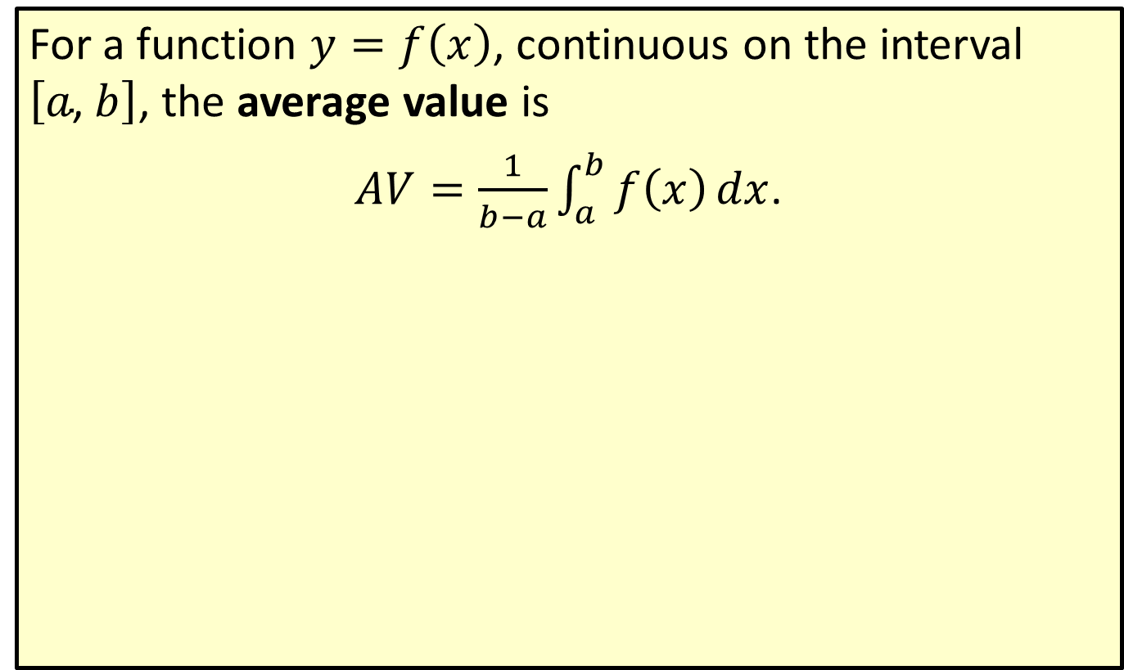
Average Value
For a function $y=f\left(x\right)$, continuous on the interval $\left[a\text{, }b\right]$, the average value is
$AV=\frac{1}{b−a}\int_{a}^{b}{f\left(x\right)}dx$.

Slide 16
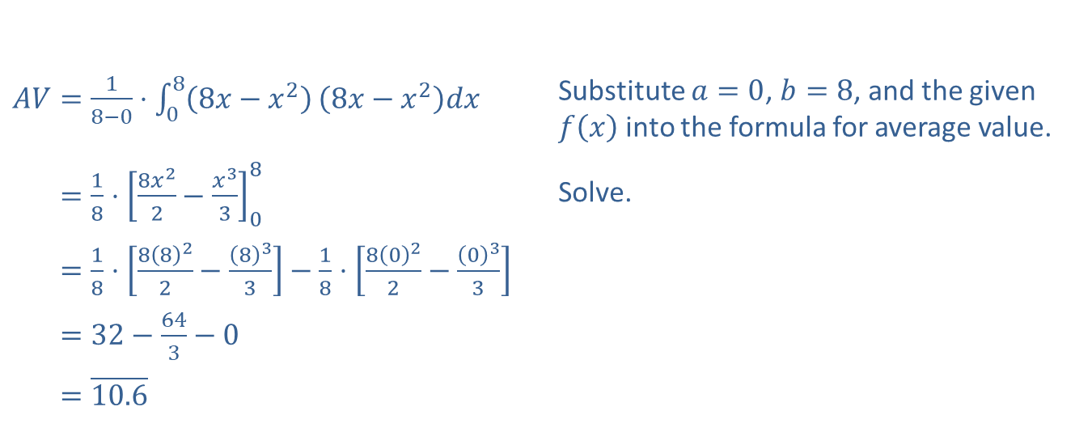

Example 3: Average Value
​Find the average value of $f\left(x\right)=8x−x^{2}$ on the interval $\left[0\text{, }8\right]$.
​Solution
​
​$AV=\frac{1}{8−0}⋅\int_{0}^{8}{\left(8x−x^{2}\right)}\left(8x−x^{2}\right)dx$ | Substitute $a=0$, $b=8$, and the given $f⁡\left(x\right)$ into the formula for average value.
​𝐴𝑉=18⋅8𝑥22−𝑥3308 | Solve.
​𝐴𝑉=18⋅8822−833−18⋅8022−033
​𝐴𝑉=32−643−0
​𝐴𝑉=10.6
Note that this is between 10 and 11 as estimated earlier.

Slide 17
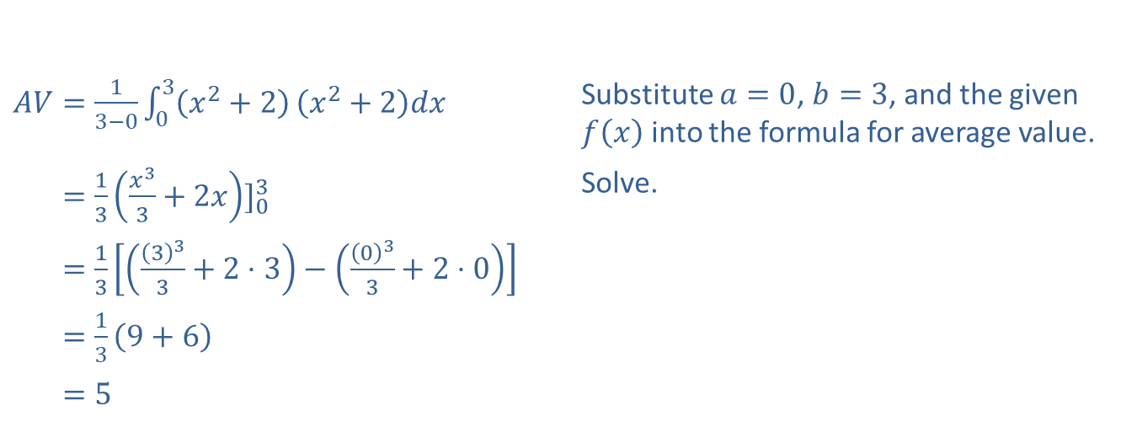

Example 3: Average Value (cont.)
​Find the average value of $f\left(x\right)=x^{2}+2$ on the interval $\left[0\text{, }3\right]$.
Solution
​$AV=\frac{1}{3−0}\int_{0}^{3}{\left(x^{2}+2\right)}\left(x^{2}+2\right)dx$ | Substitute $a=0$, $b=3$, and the given $f⁡\left(x\right)$ into the formula for average value.
​𝐴𝑉=13𝑥33+2𝑥]03 | Solve.
​𝐴𝑉=13333+2⋅3−033+2⋅0
​𝐴𝑉=139+6
​𝐴𝑉=5

Slide 18
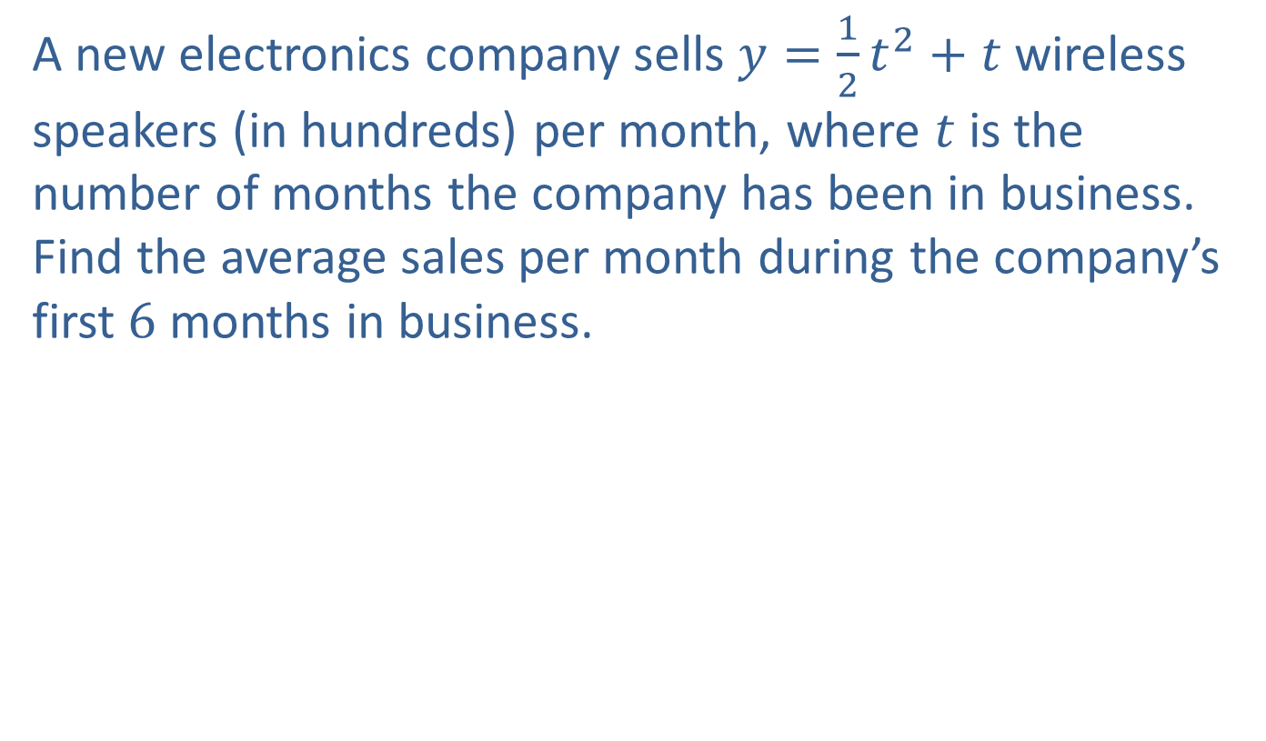
Example 4: Average Sales
A new electronics company sells $y=\frac{1}{2}t^{2}+t$ wireless speakers (in hundreds) per month, where $t$ is the number of months the company has been in business. Find the average sales per month during the company’s first 6 months in business.

Slide 19
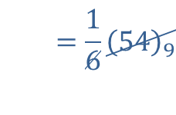
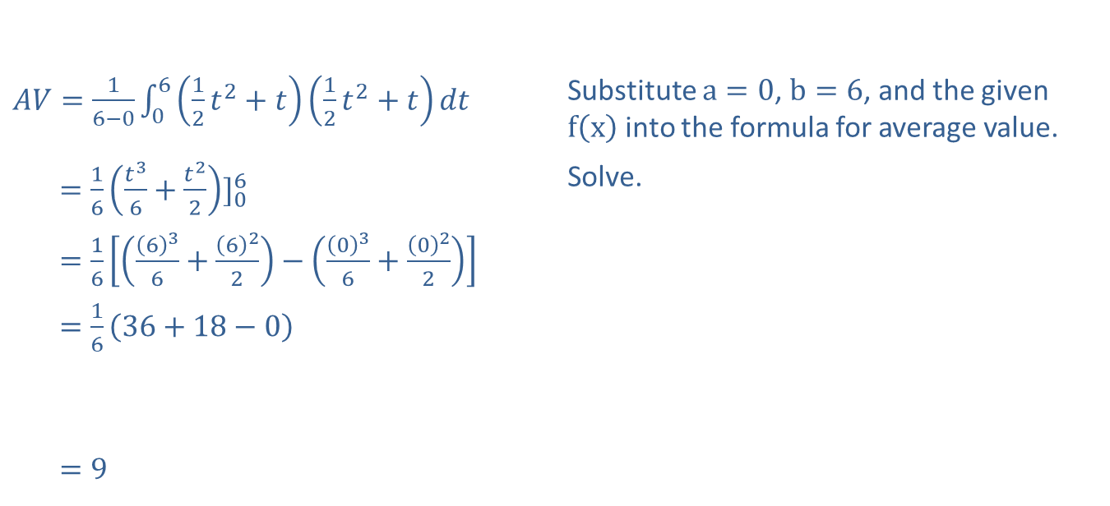
Example 4: Average Sales (cont.)
Solution
​$AV=\frac{1}{6−0}\int_{0}^{6}{\left(\frac{1}{2}t^{2}+t\right)}\left(\frac{1}{2}t^{2}+t\right)dt$ | Substitute $a=0$, $b=6$, and the given $f⁡\left(x\right)$ into the formula for average value.
​AV=16𝑡36+𝑡22]06 | Solve.
​AV=16636+622−036+022
​AV=1636+18−0
​
​AV=9
AV=16549
The company averaged sales of 900 wireless speakers per month during its first 6 months in business.

