Slide 1
Section 6.5
Area under a Curve (with Applications)

Slide 2
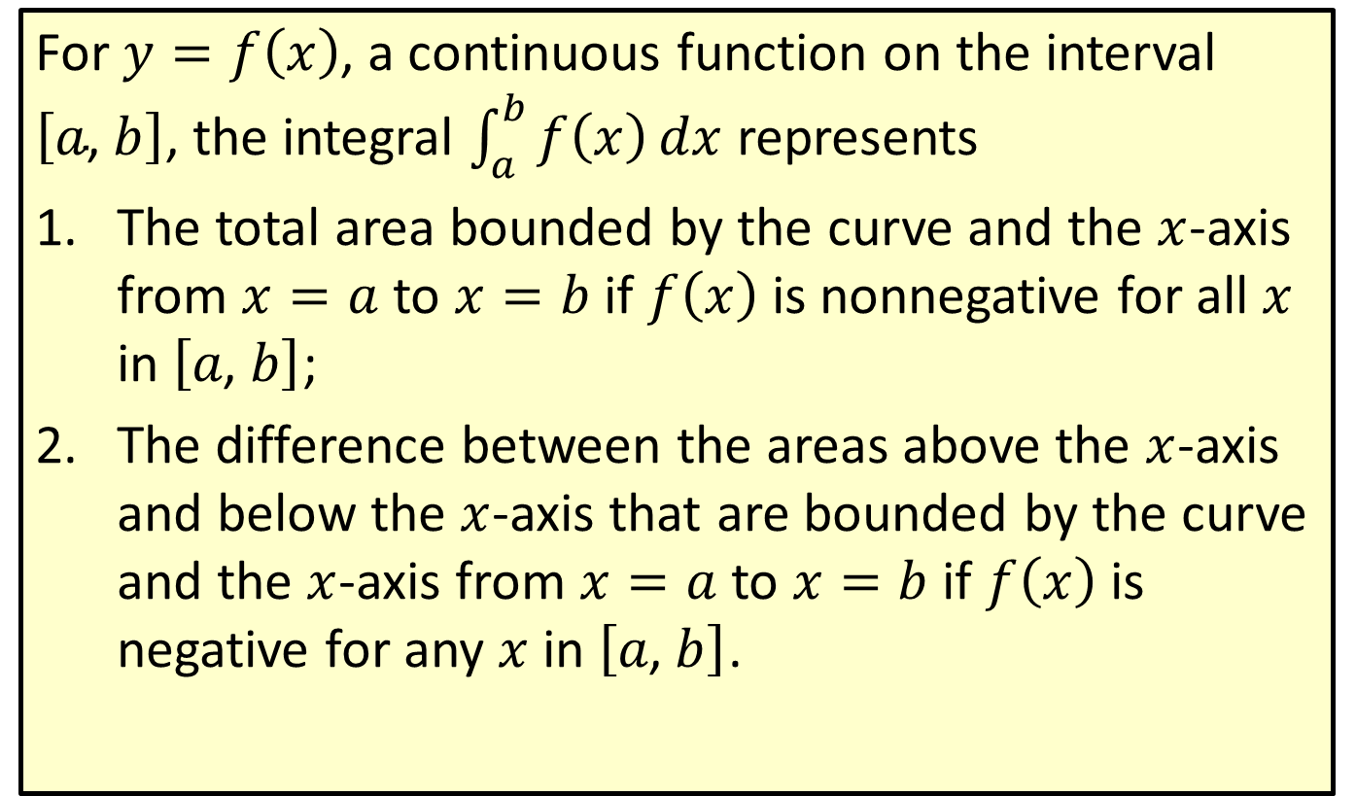
The Integral as Area
For $y=f\left(x\right)$, a continuous function on the interval $\left[a\text{, }b\right]$, the integral $\int_{a}^{b}{f\left(x\right)}dx$ represents
​The total area bounded by the curve and the $x$-axis from $x=a$ to $x=b$ if $f⁡\left(x\right)$ is nonnegative for all $x$ in $\left[a\text{, }b\right]$;
​The difference between the areas above the $x$-axis and below the $x$-axis that are bounded by the curve and the $x$-axis from $x=a$ to $x=b$ if $f⁡\left(x\right)$ is negative for any $x$ in $\left[a\text{, }b\right]$.

Slide 3
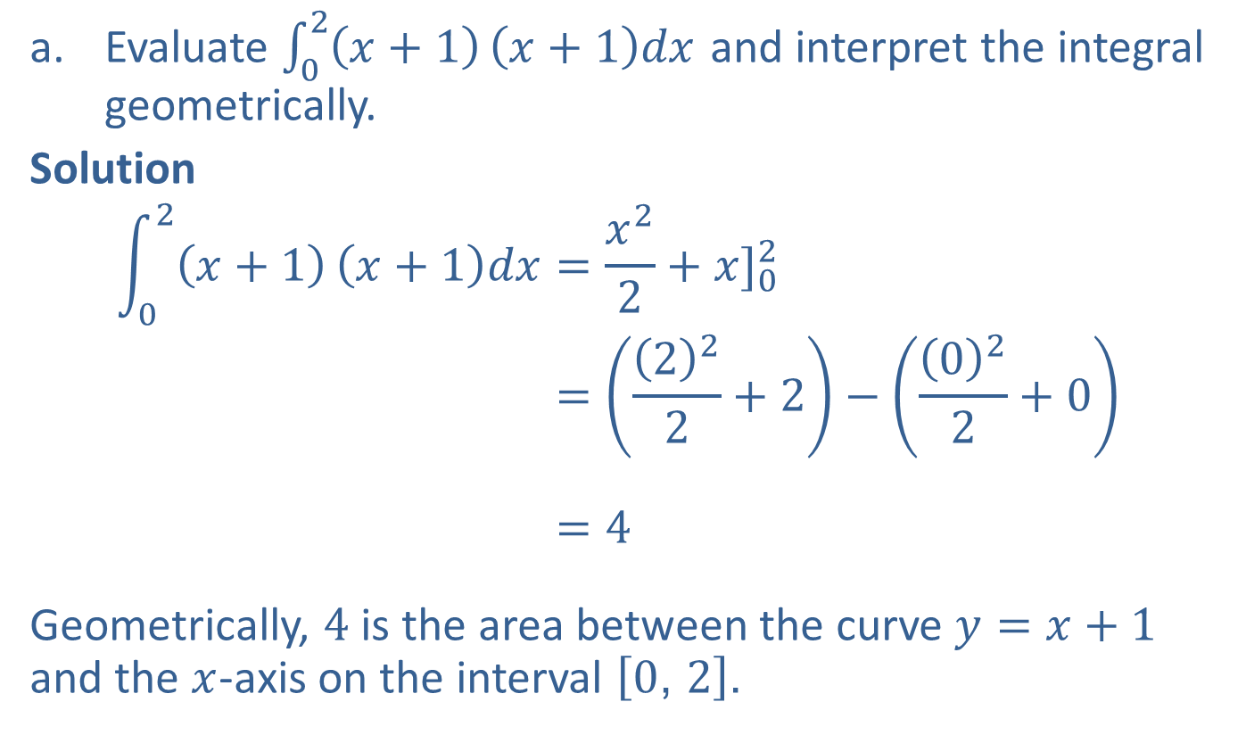
Example 1: Interpreting the Integral
​Evaluate $\int_{0}^{2}{\left(x+1\right)}\left(x+1\right)dx$ and interpret the integral geometrically.
​Solution
02𝑥+1𝑥+1𝑑𝑥=𝑥22+𝑥]0202𝑥+1𝑥+1𝑑𝑥=222+2−022+002𝑥+1𝑥+1𝑑𝑥=4
Geometrically, 4 is the area between the curve $y=x+1$ and the $x$-axis on the interval $\left[0\text{, }2\right]$.

Slide 4
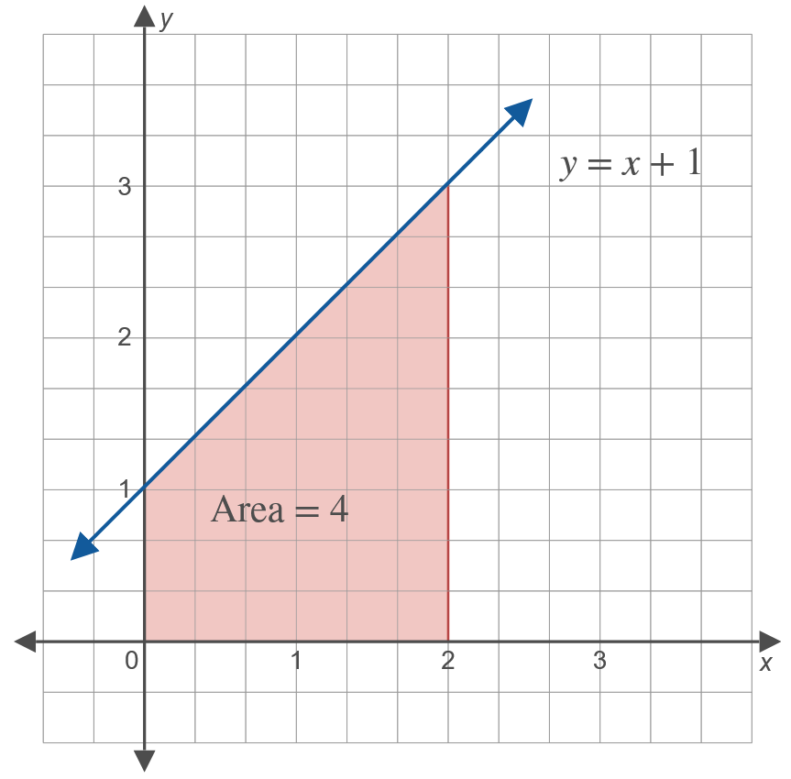
Example 1: Interpreting the Integral (cont.)

Slide 5
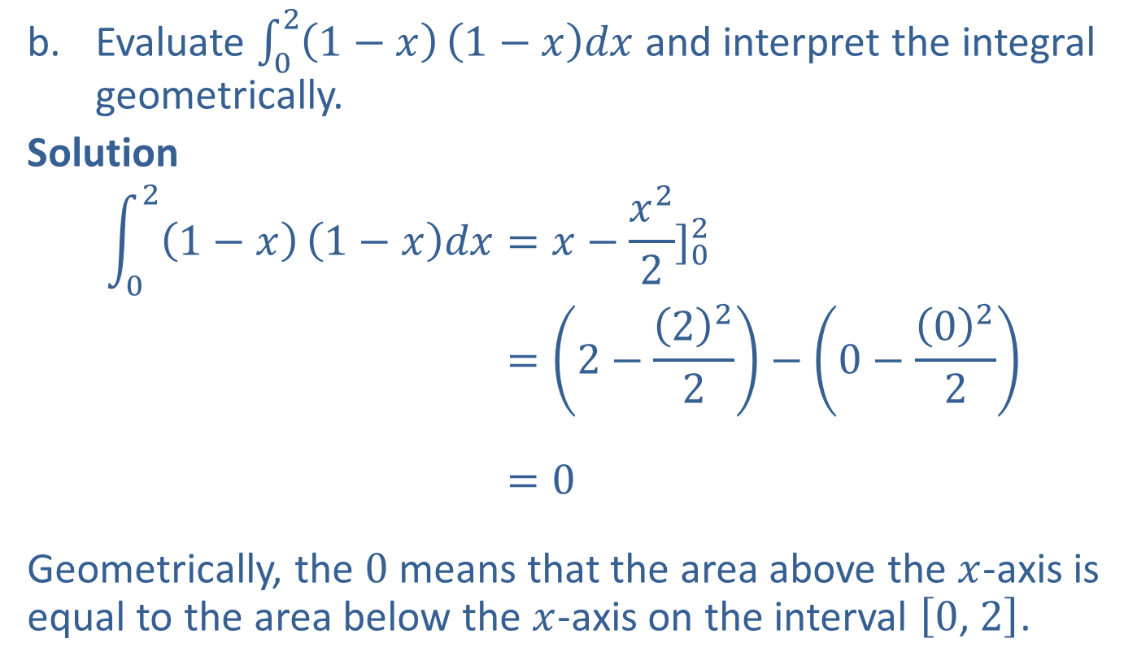
Example 1: Interpreting the Integral (cont.)
​Evaluate $\int_{0}^{2}{\left(1−x\right)}\left(1−x\right)dx$ and interpret the integral geometrically.
Solution
021−𝑥1−𝑥𝑑𝑥=𝑥−𝑥22]02021−𝑥1−𝑥𝑑𝑥=2−222−0−022021−𝑥1−𝑥𝑑𝑥=0
Geometrically, the 0 means that the area above the $x$-axis is equal to the area below the $x$-axis on the interval $\left[0\text{, }2\right]$.

Slide 6
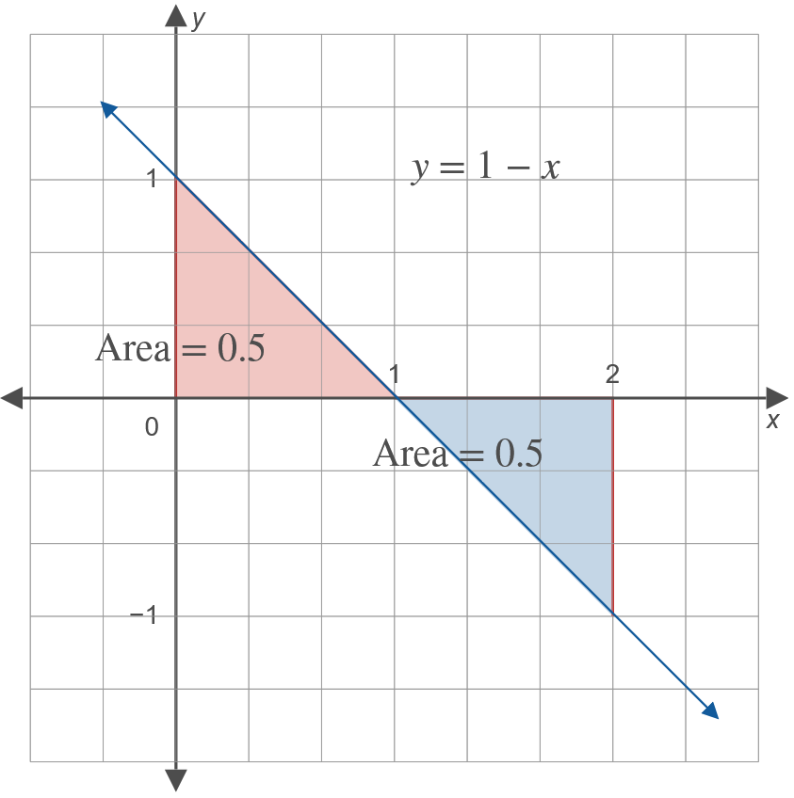
Example 1: Interpreting the Integral (cont.)

Slide 7
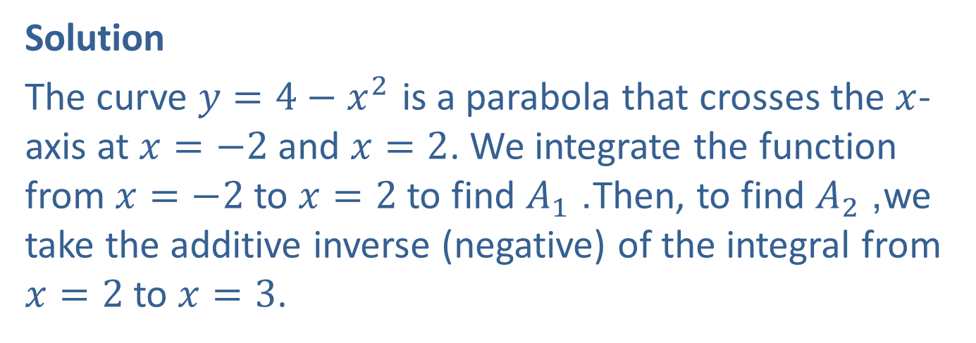

Example 2: Total Area
Find the total area bounded by the $x$-axis and the curve $y=4−x^{2}$ on the interval $\left[−2\text{, }3\right]$.
Solution
The curve $y=4−x^{2}$ is a parabola that crosses the $x$-axis at $x=−2$ and $x=2$. We integrate the function from $x=−2$ to $x=2$ to find $A_{1}$. Then, to find $A_{2}$, we take the additive inverse (negative) of the integral from $x=2$ to $x=3$.

Slide 8
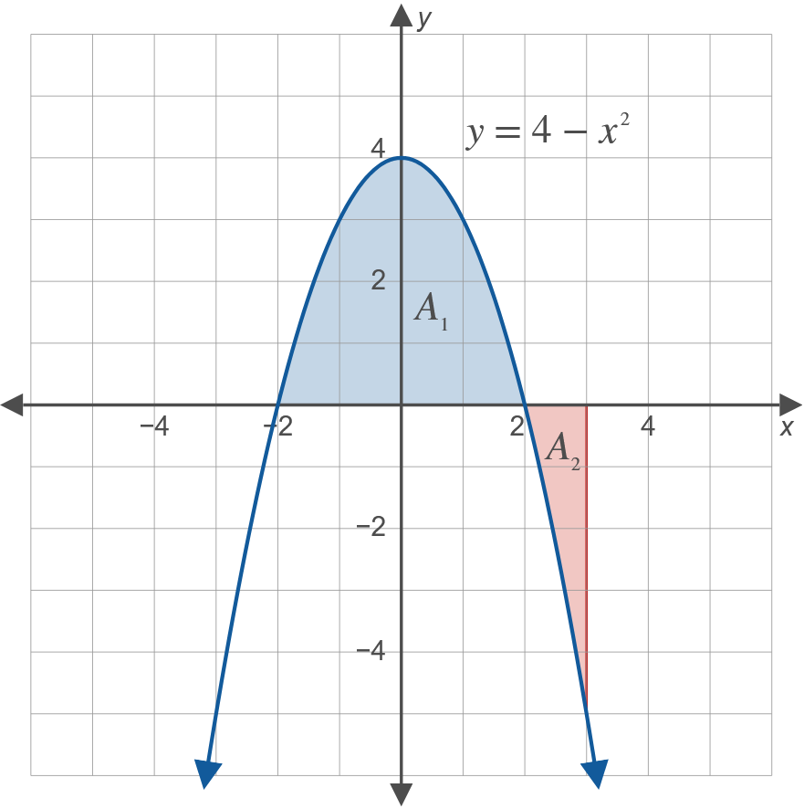
Example 2: Total Area (cont.)

Slide 9
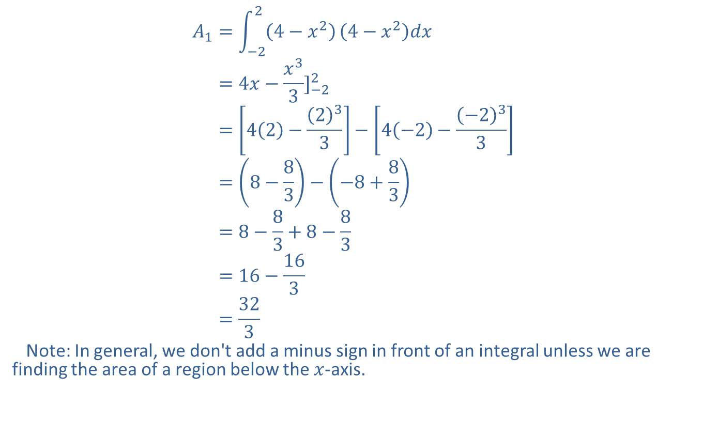
Example 2: Total Area (cont.)
𝐴1=−224−𝑥24−𝑥2𝑑𝑥𝐴1=4𝑥−𝑥33]−22𝐴1=42−233−4−2−−233𝐴1=8−83−−8+83𝐴1=8−83+8−83𝐴1=16−163𝐴1=323
Note: In general, we don't add a minus sign in front of an integral unless we are finding the area of a region below the $x$-axis.

Slide 10
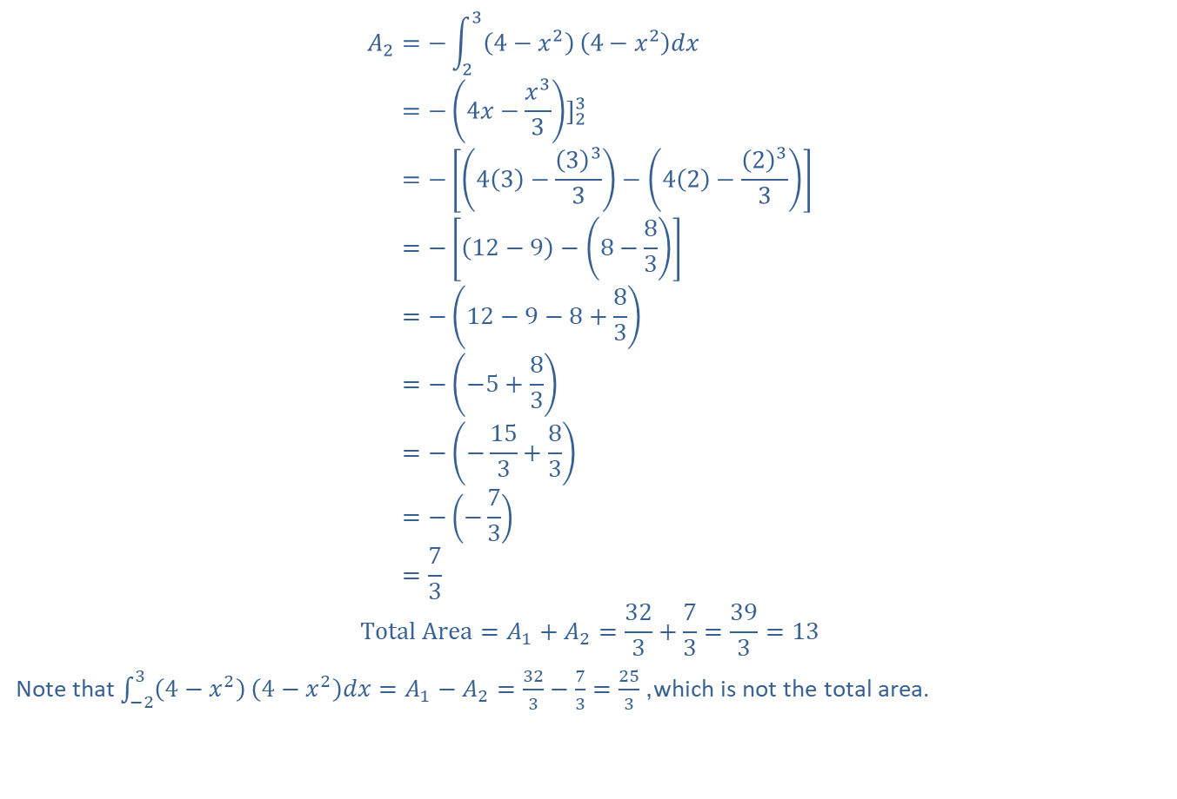
Example 2: Total Area (cont.)
𝐴2=−234−𝑥24−𝑥2𝑑𝑥𝐴2=−4𝑥−𝑥33]23𝐴2=−43−333−42−233𝐴2=−12−9−8−83𝐴2=−12−9−8+83𝐴2=−−5+83𝐴2=−−153+83𝐴2=−−73𝐴2=73
$$Total Area=A_{1}+A_{2}=\frac{32}{3}+\frac{7}{3}=\frac{39}{3}=13$$
Note that $\int_{−2}^{3}{\left(4−x^{2}\right)}\left(4−x^{2}\right)dx=A_{1}−A_{2}=\frac{32}{3}−\frac{7}{3}=\frac{25}{3}$, which is not the total area.

Slide 11
Note:
Graphs, as shown in Examples 1 and 2, are valuable visual aids in understanding definite integrals. A sketch of the graph of the function being integrated should be made whenever possible.

Slide 12
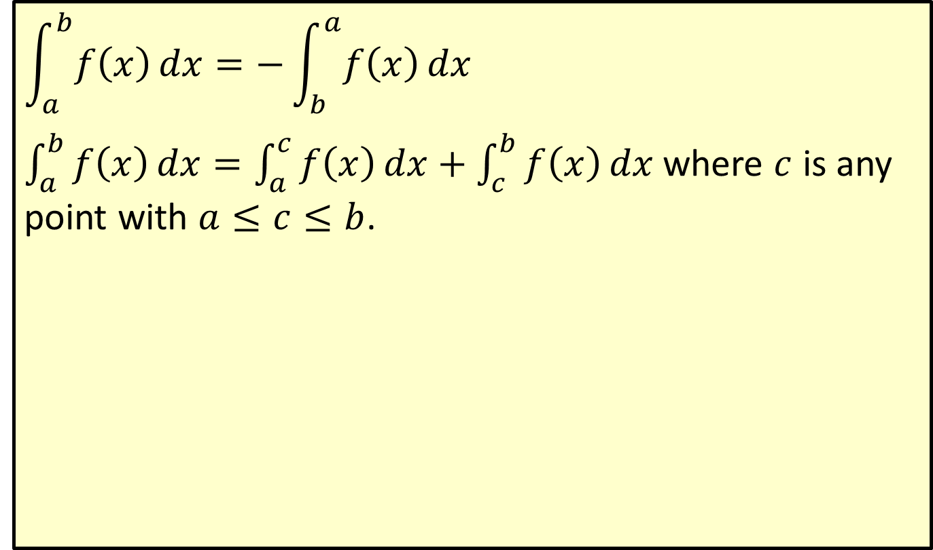
Additional Properties of the Definite Integral
$$\int_{a}^{b}{f\left(x\right)dx}=−\int_{b}^{a}{f\left(x\right)dx}$$
$\int_{a}^{b}{f\left(x\right)dx}=\int_{a}^{c}{f\left(x\right)dx}+\int_{c}^{b}{f\left(x\right)dx}$ where $c$ is any point with $a≤c≤b$.

Slide 13

Example 3: Bounded Area
Find the area of the region bounded by the function
$$f\left(x\right)=\left\{\begin{aligned}x+2 \\ 5−2x\end{aligned}\right.\begin{matrix} & \text{if} x≤1 \\ & \text{if} x>1\end{matrix}$$
and the $x$-axis from $x=−1$ to $x=2$.
Solution
The graph of the function consists of two rays.

Slide 14
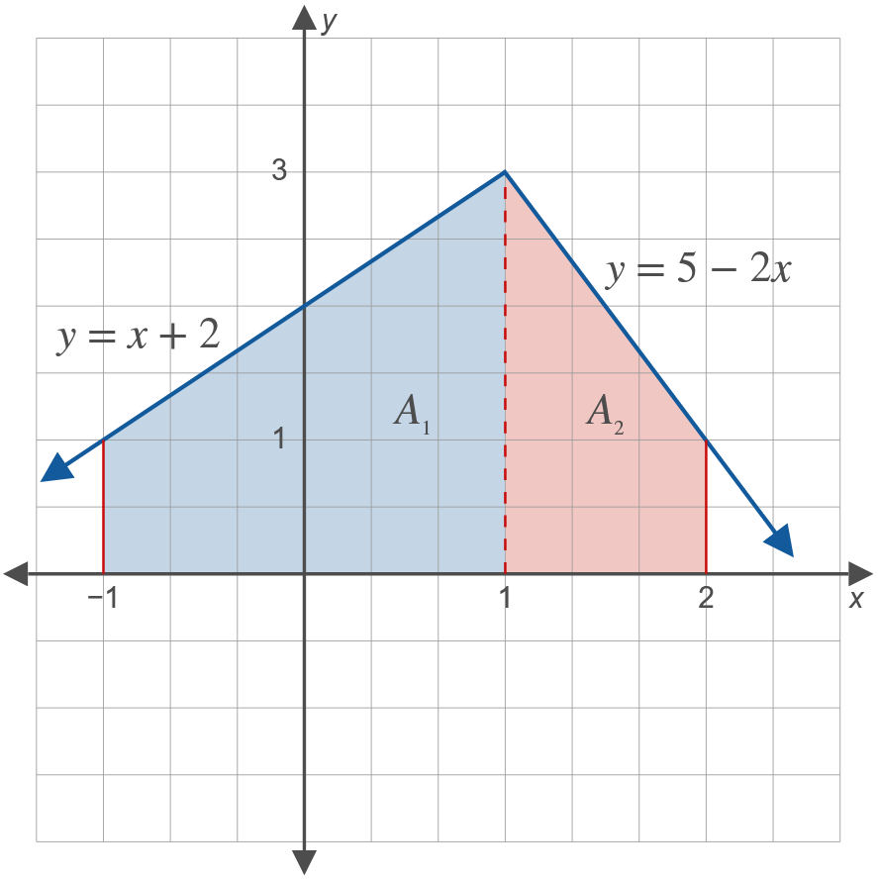
Example 3: Bounded Area (cont.)

Slide 15
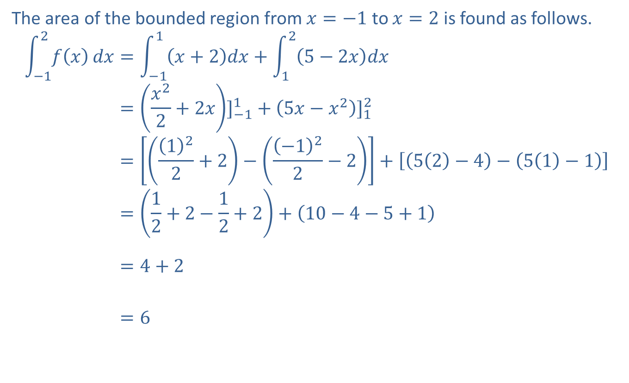
Example 3: Bounded Area (cont.)
The area of the bounded region from $x=−1$ to $x=2$ is found as follows.
−12𝑓𝑥𝑑𝑥=−11𝑥+2𝑑𝑥+125−2𝑥𝑑𝑥−12𝑓𝑥𝑑𝑥=𝑥22+2𝑥]−11+5𝑥−𝑥2]12−12𝑓𝑥𝑑𝑥=122+2−−122−2+52−4−51−1−12𝑓𝑥𝑑𝑥=12+2−12+2+10−4−5+1−12𝑓𝑥𝑑𝑥=4+2−12𝑓𝑥𝑑𝑥=6

Slide 16
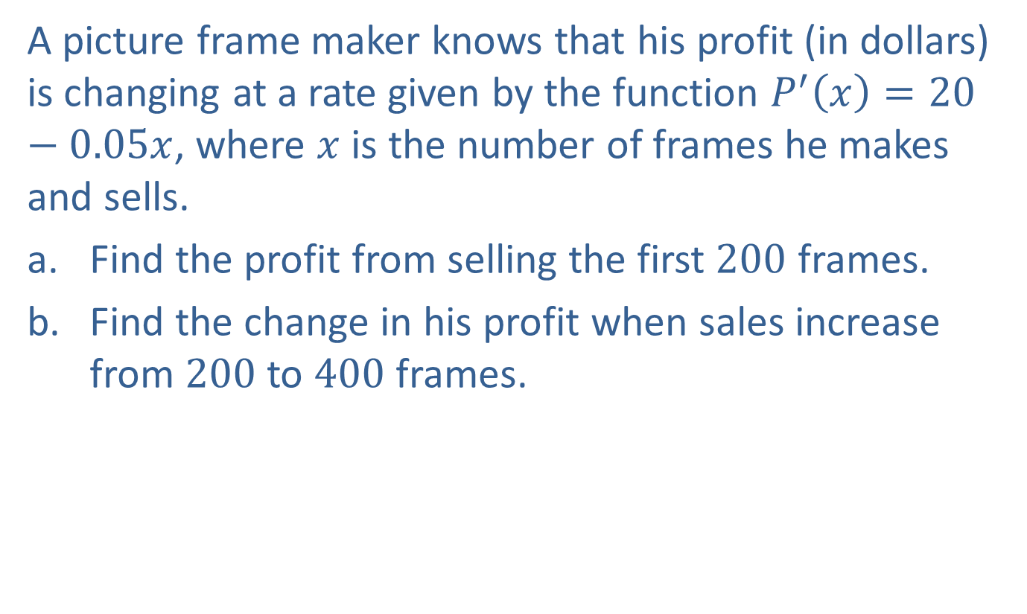
Example 4: Marginal Analysis
A picture frame maker knows that his profit (in dollars) is changing at a rate given by the function $P^{′}\left(x\right)=20−0.05x$, where $x$ is the number of frames he makes and sells.
​Find the profit from selling the first 200 frames.
​Find the change in his profit when sales increase from 200 to 400 frames.

Slide 17
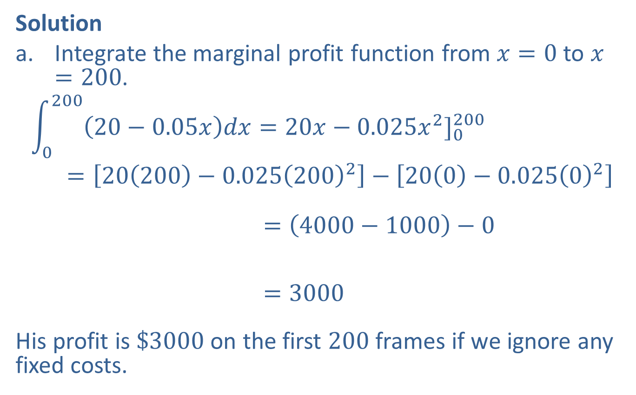
Example 4: Marginal Analysis (cont.)
Solution
​Integrate the marginal profit function from $x=0$ to $x=200$.
020020−0.05𝑥𝑑𝑥=20𝑥−0.025𝑥2]0200𝑑𝑥=20200−0.0252002−200−0.02502020020−0.05𝑥𝑑𝑥=4000−1000−0020020−0.05𝑥𝑑𝑥=3000
​His profit is $\$3000$ on the first 200 frames if we ignore any fixed costs.

Slide 18


Example 4: Marginal Analysis (cont.)
​Integrate from $x=200$ to $x=400$.
20040020−0.05𝑥𝑑𝑥=20𝑥−0.025𝑥2]200400 =20400−0.0254002−20200−0.025200220040020−0.05𝑥𝑑𝑥=8000−4000−4000−100020040020−0.05𝑥𝑑𝑥=1000
His profit changes by $\$1000$ when sales increase from 200 to 400 frames.

Slide 19
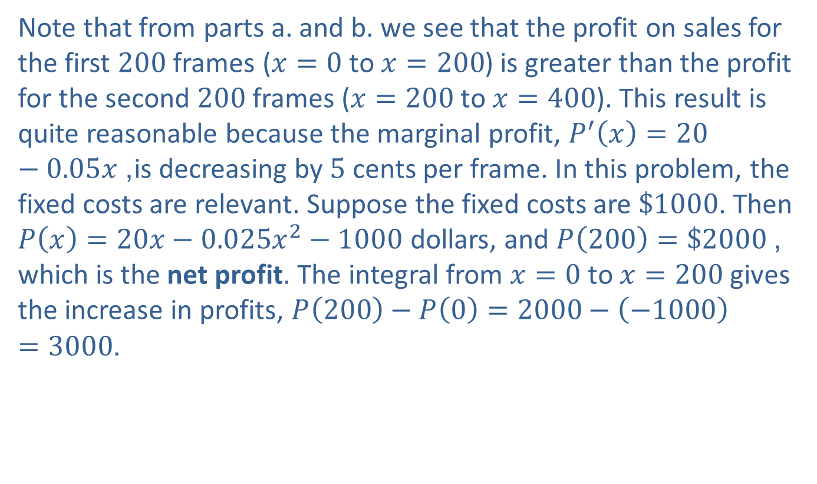
Example 4: Marginal Analysis (cont.)
Note that from parts a. and b. we see that the profit on sales for the first 200 frames ($x=0$ to $x=200$) is greater than the profit for the second 200 frames ($x=200$ to $x=400$). This result is quite reasonable because the marginal profit, $P^{′}\left(x\right)=20−0.05x$, is decreasing by 5 cents per frame. In this problem, the fixed costs are relevant. Suppose the fixed costs are $\$1000$. Then $P\left(x\right)=20x−0.025x^{2}−1000$ dollars, and $P\left(200\right)=\$2000$, which is the net profit. The integral from $x=0$ to $x=200$ gives the increase in profits, $P\left(200\right)−P\left(0\right)=2000−\left(−1000\right)=3000$.

