Slide 1
Section 6.6
Area between Two Curves (with Applications)

Slide 2
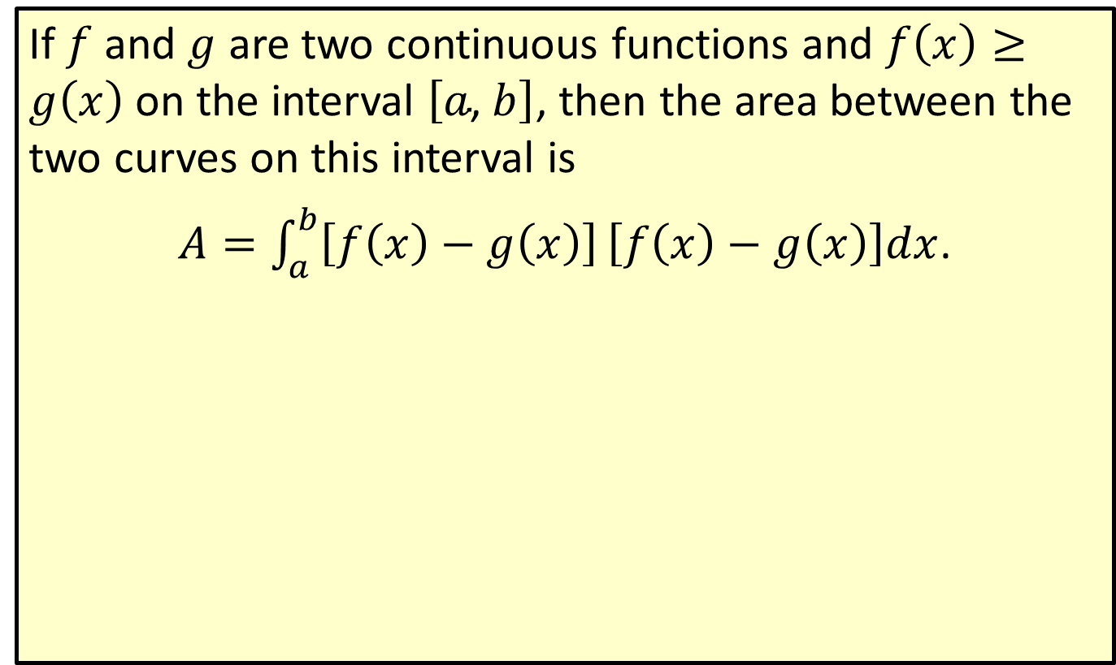
Area between Two Curves
If $f$ and $g$ are two continuous functions and $f\left(x\right)≥g\left(x\right)$ on the interval $\left[a\text{, }b\right]$, then the area between the two curves on this interval is
$A=\int_{a}^{b}{\left[f\left(x\right)−g\left(x\right)\right]}\left[f\left(x\right)−g\left(x\right)\right]dx$.

Slide 3
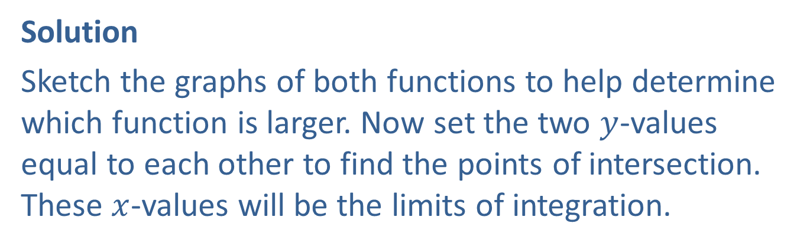

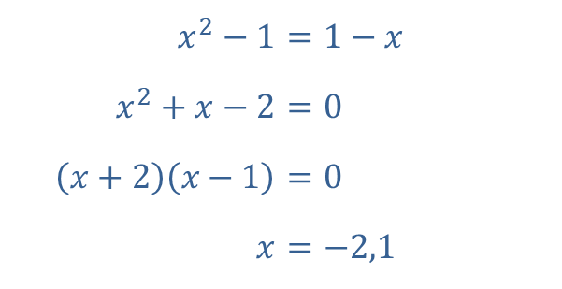
Example 1: Finding the Area between Two Curves
Find the area enclosed by the curves $y=x^{2}−1$ and $y=1−x$.
Solution
Sketch the graphs of both functions to help determine which function is larger. Now set the two $y$-values equal to each other to find the points of intersection. These $x$-values will be the limits of integration.
​$x^{2}−1$ | ​$=1−x$
​$x^{2}+x−2$ | ​$=0$
​$\left(x+2\right)\left(x−1\right)$ | ​$=0$
​$x$ | ​$=−2,1$

Slide 4
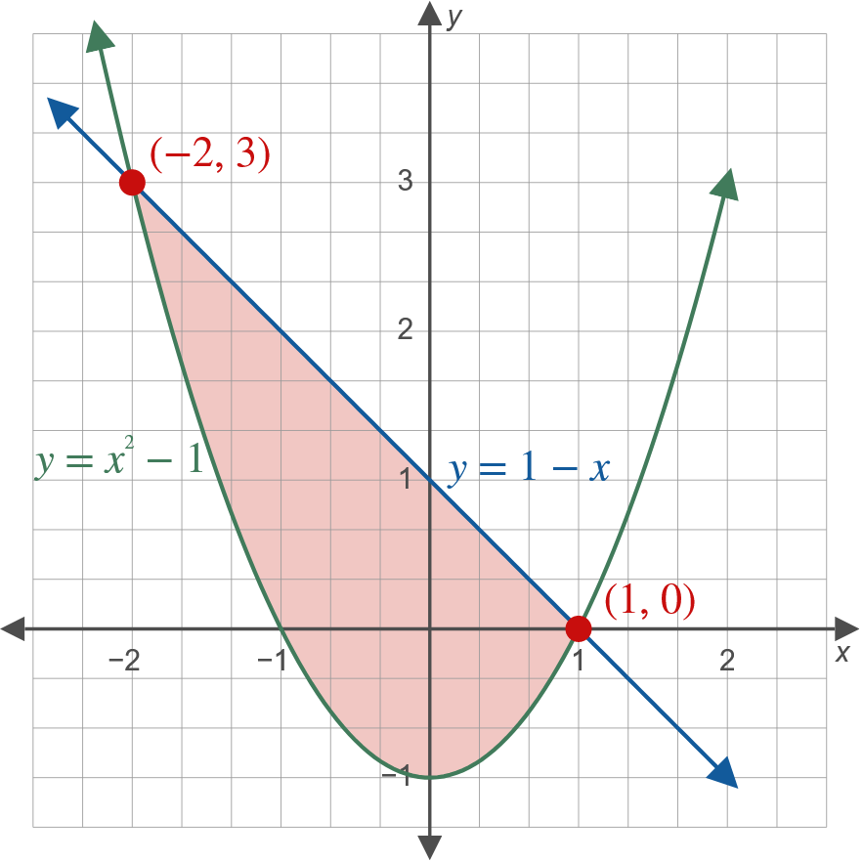
Example 1: Finding the Area between Two Curves (cont.)

Slide 5
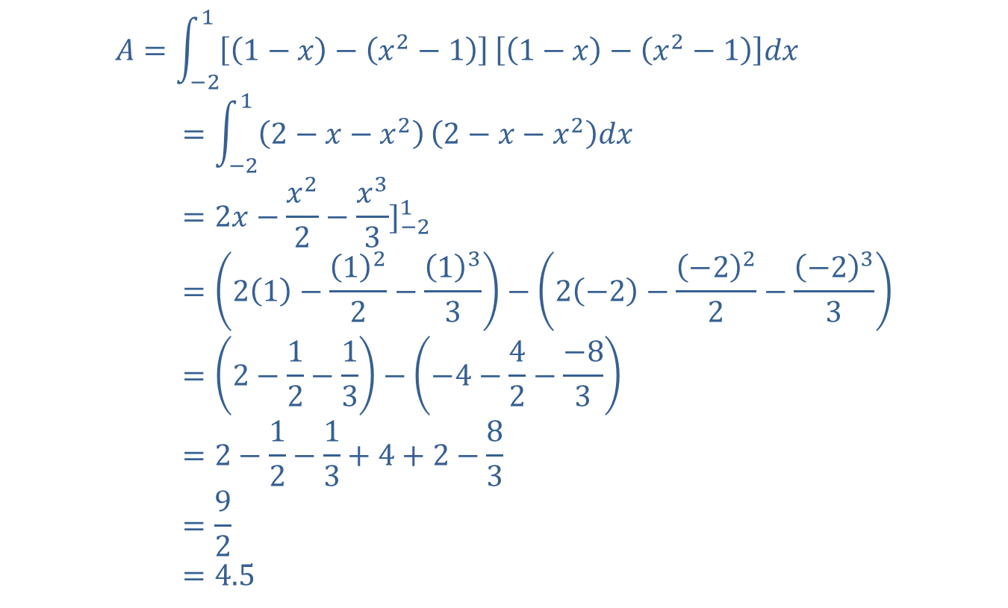
Example 1: Finding the Area between Two Curves (cont.)
𝐴=−211−𝑥−𝑥2−11−𝑥−𝑥2−1𝑑𝑥area=−212−𝑥−𝑥22−𝑥−𝑥2𝑑𝑥area=2𝑥−𝑥22−𝑥33]−21area=21−122−133−2−2−−222−−233area=2−12−13−−4−42−−83area=2−12−13+4+2−83area=92area=4.5

Slide 6
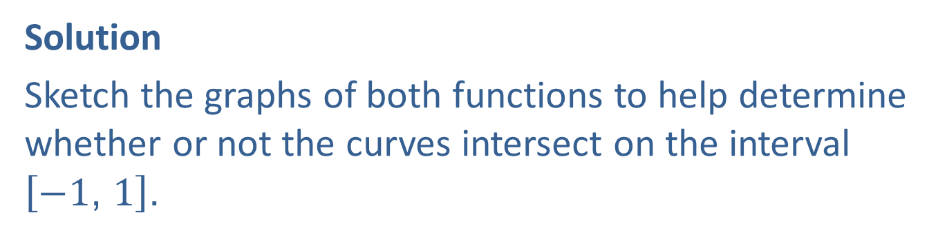

Example 2: Finding the Area between Two Curves
Find the area between the curves $y=x^{3}$ and $y=x^{2}+1$ on the interval $\left[−1\text{, }1\right]$.
Solution
Sketch the graphs of both functions to help determine whether or not the curves intersect on the interval $\left[−1\text{, }1\right]$.

Slide 7
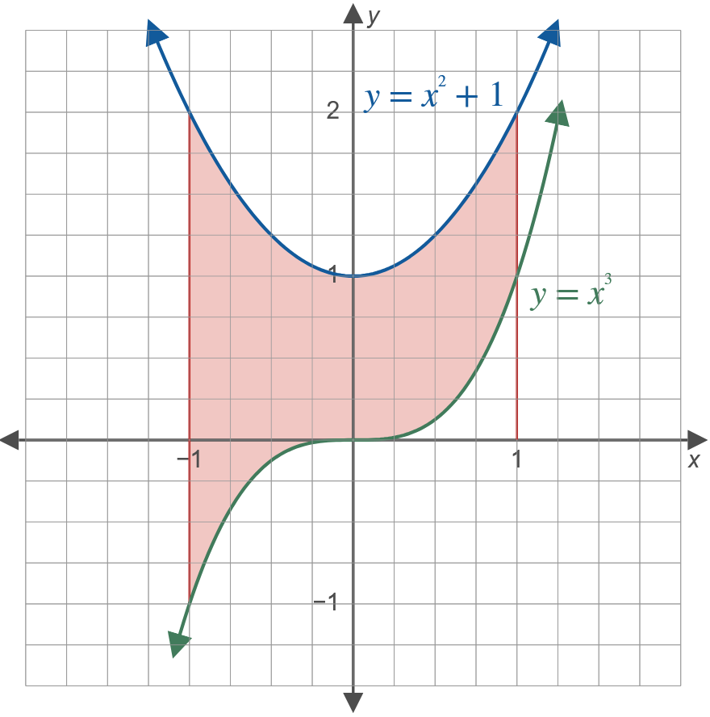
Example 2: Finding the Area between Two Curves (cont.)

Slide 8
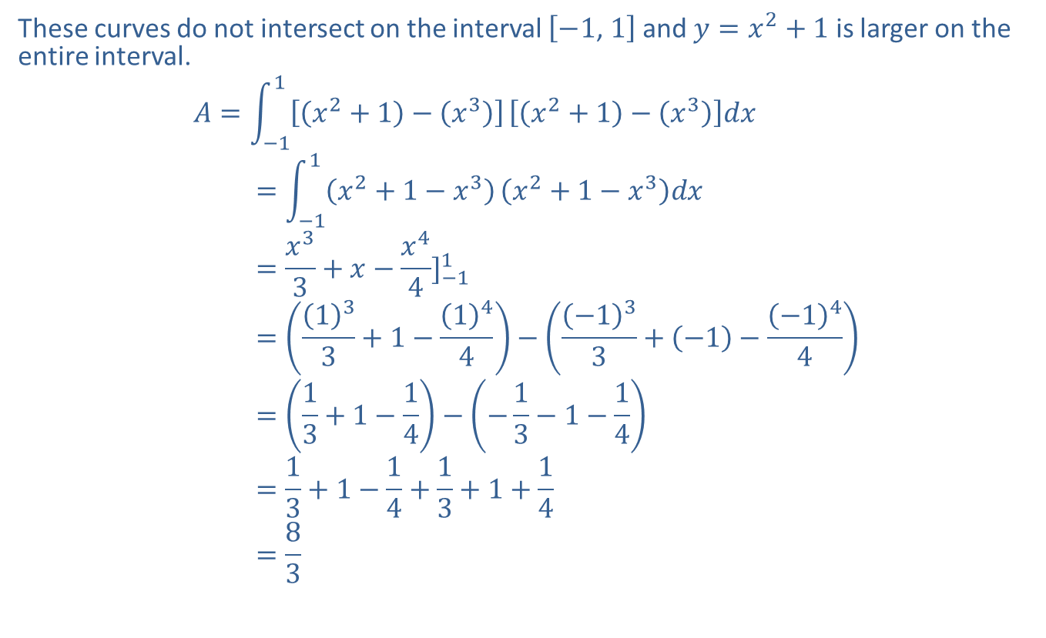
Example 2: Finding the Area between Two Curves (cont.)
These curves do not intersect on the interval $\left[−1\text{, }1\right]$ and $y=x^{2}+1$ is larger on the entire interval.
𝐴=−11𝑥2+1−𝑥3𝑥2+1−𝑥3𝑑𝑥area=−11𝑥2+1−𝑥3𝑥2+1−𝑥3𝑑𝑥area=𝑥33+𝑥−𝑥44]−11area=133+1−144−−133+−1−−144area=13+1−14−−13−1−14area=13+1−14+13+1+14area=83

Slide 9
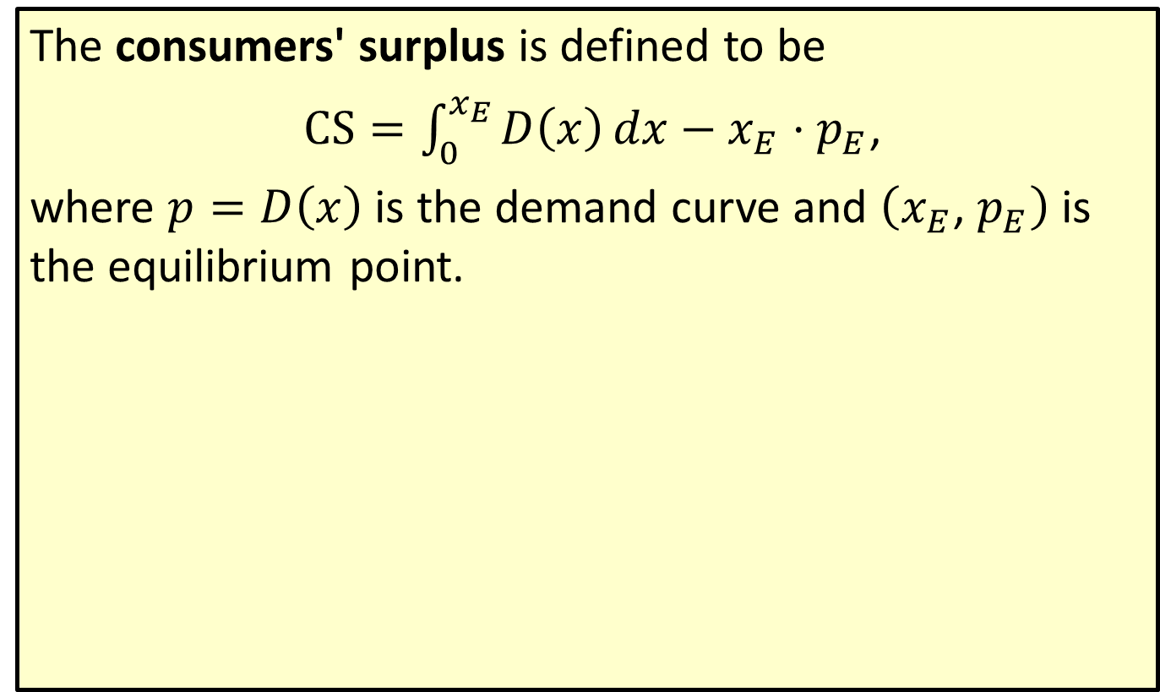
Consumers' Surplus
The consumers' surplus is defined to be
$CS=\int_{0}^{x_{Ε}}{D\left(x\right)}dx−x_{Ε}⋅p_{Ε}$,
where $p=D\left(x\right)$ is the demand curve and $\left(x_{Ε}\text{, }p_{Ε}\right)$ is the equilibrium point.

Slide 10
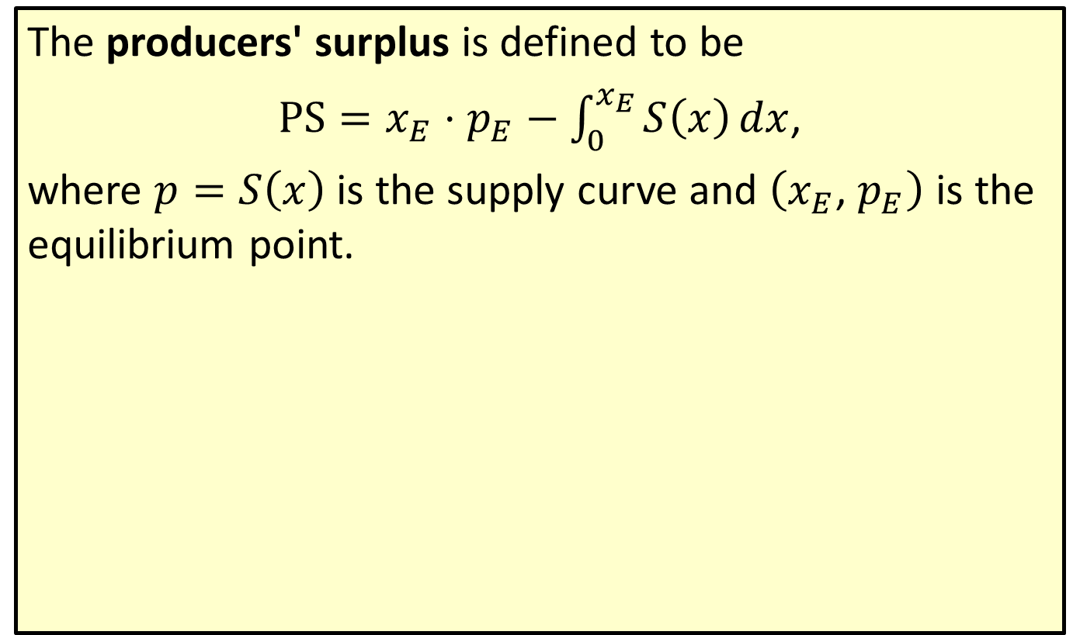
Producers' Surplus
The producers' surplus is defined to be
$PS=x_{Ε}⋅p_{Ε}−\int_{0}^{x_{Ε}}{S\left(x\right)}dx$,
where $p=S\left(x\right)$ is the supply curve and $\left(x_{Ε}\text{, }p_{Ε}\right)$ is the equilibrium point.

Slide 11
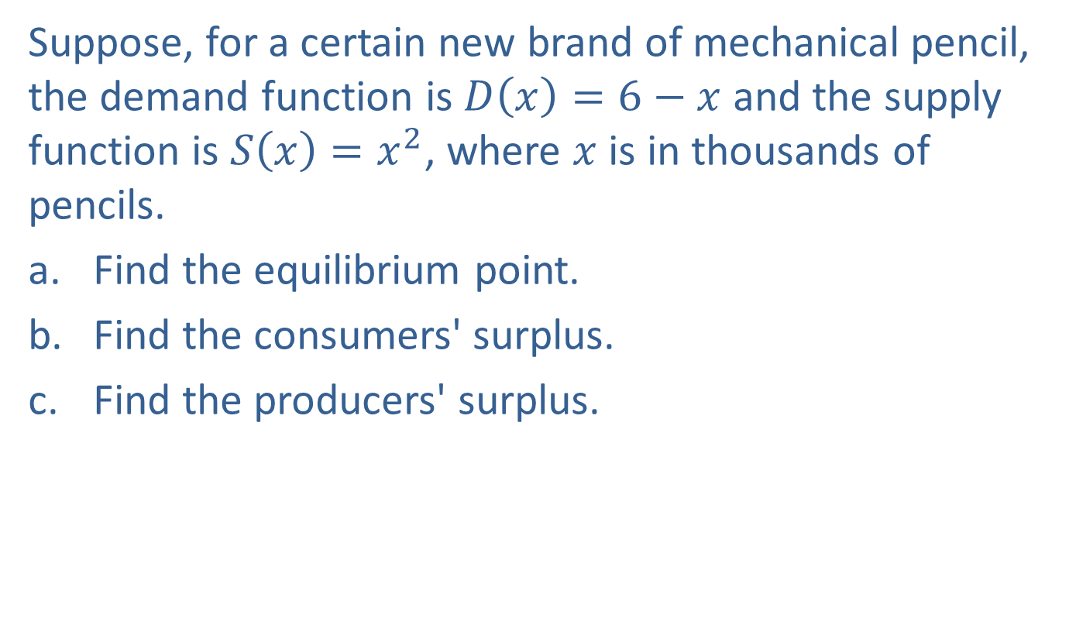
Example 3: Determining Surpluses
Suppose, for a certain new brand of mechanical pencil, the demand function is $D\left(x\right)=6−x$ and the supply function is $S\left(x\right)=x^{2}$, where $x$ is in thousands of pencils.
​Find the equilibrium point.
​Find the consumers' surplus.
​Find the producers' surplus.

Slide 12
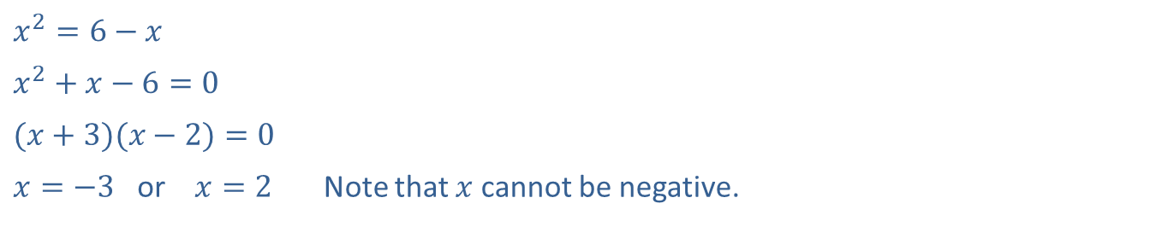

Example 3: Determining Surpluses (cont.)
Solution
Therefore, $x_{Ε}=2{ and p}_{Ε}=6−2=4$. The equilibrium point is $(2, 4)$. ​
​$x^{2}=6−x$
​$x^{2}+x−6=0$
​$(x+3)(x−2)=0$
​$x=−3$ or $x=2$ | Note that $x$ cannot be negative.

Slide 13
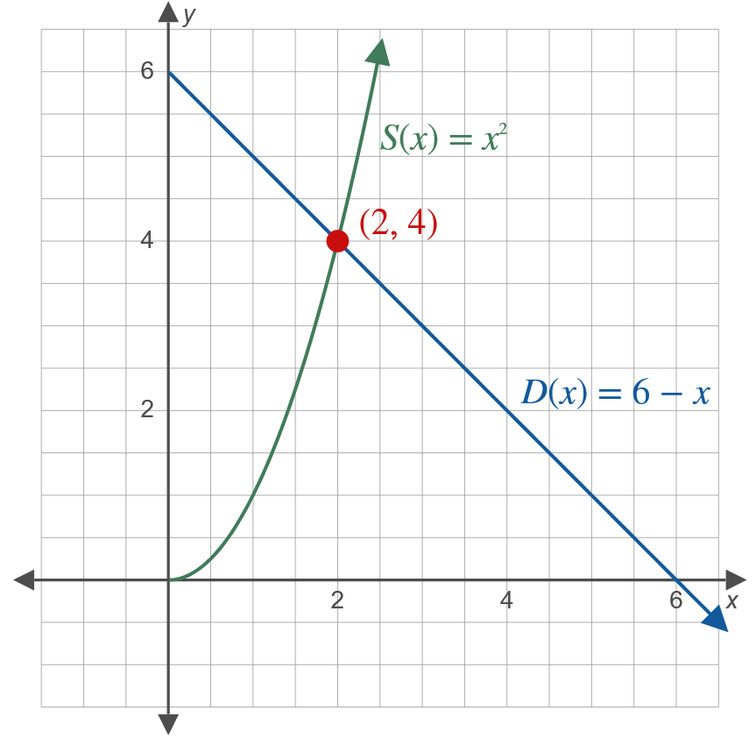
Example 3: Determining Surpluses (cont.)

Slide 14
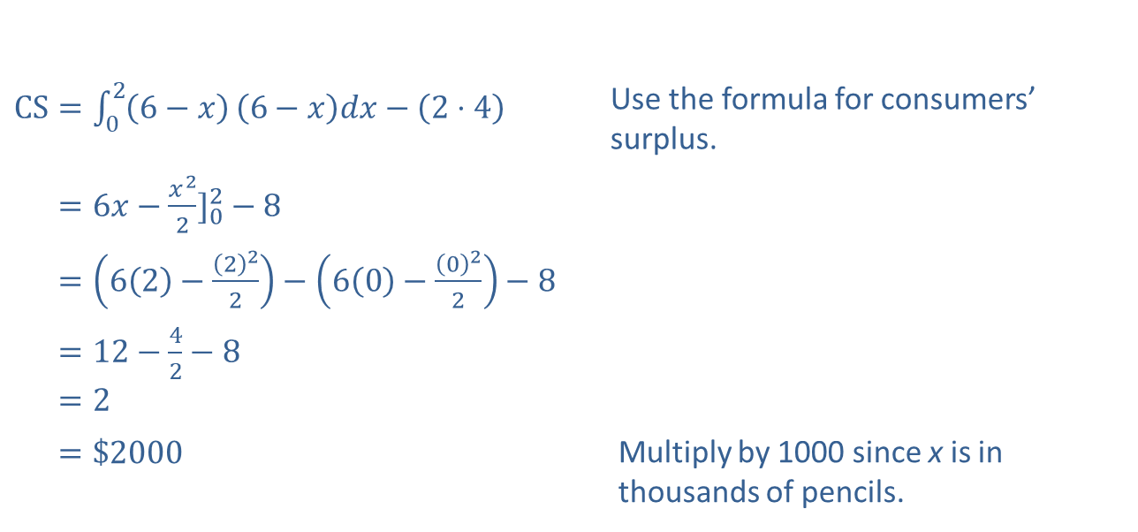
Example 3: Determining Surpluses (cont.)
​
​$CS=\int_{0}^{2}{\left(6−x\right)}\left(6−x\right)dx−\left(2⋅4\right)$ | Use the formula for consumers’ surplus.
​CS=6𝑥−𝑥22]02−8
​CS=62−222−60−022−8
​CS=12−42−8 ​CS=2
​CS=$2000 | Multiply by 1000 since x is in thousands of pencils.

Slide 15
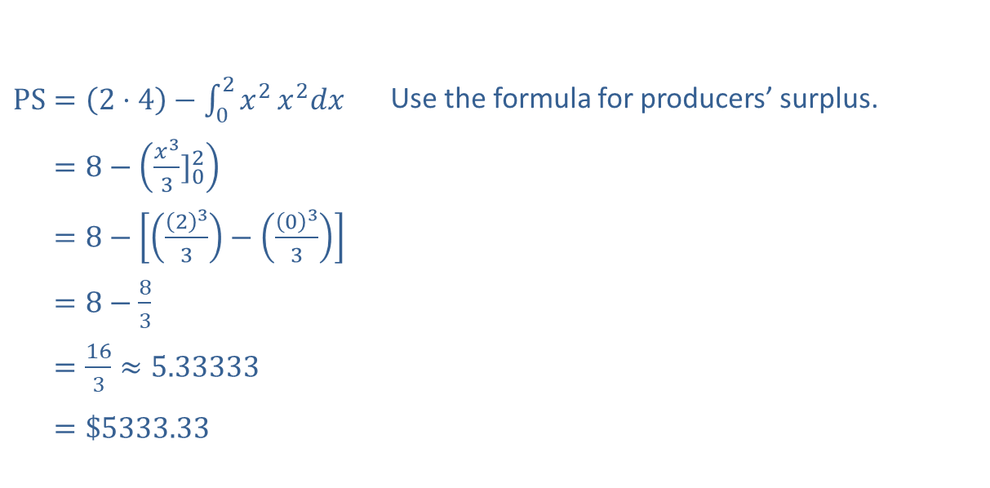
Example 3: Determining Surpluses (cont.)
​$PS=\left(2⋅4\right)−\int_{0}^{2}{x^{2}}x^{2}dx$ | Use the formula for producers’ surplus.
​PS=8−𝑥33]02
​PS=8−233−033
​PS=8−83
​PS=163≈5.33333 ​PS=$5333.33
Multiply by 1000 since x is in thousands of pencils.

Slide 16
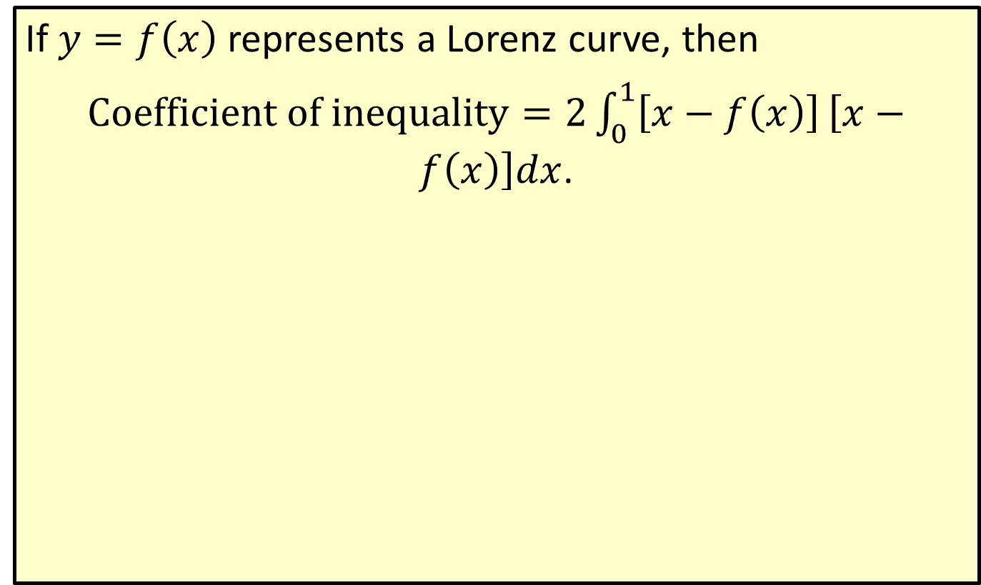
Coefficient of Inequality for a Lorenz Curve
If $y=f\left(x\right)$ represents a Lorenz curve, then
$Coefficient of inequality=2\int_{0}^{1}{\left[x−f\left(x\right)\right]}\left[x−f\left(x\right)\right]dx$.

Slide 17
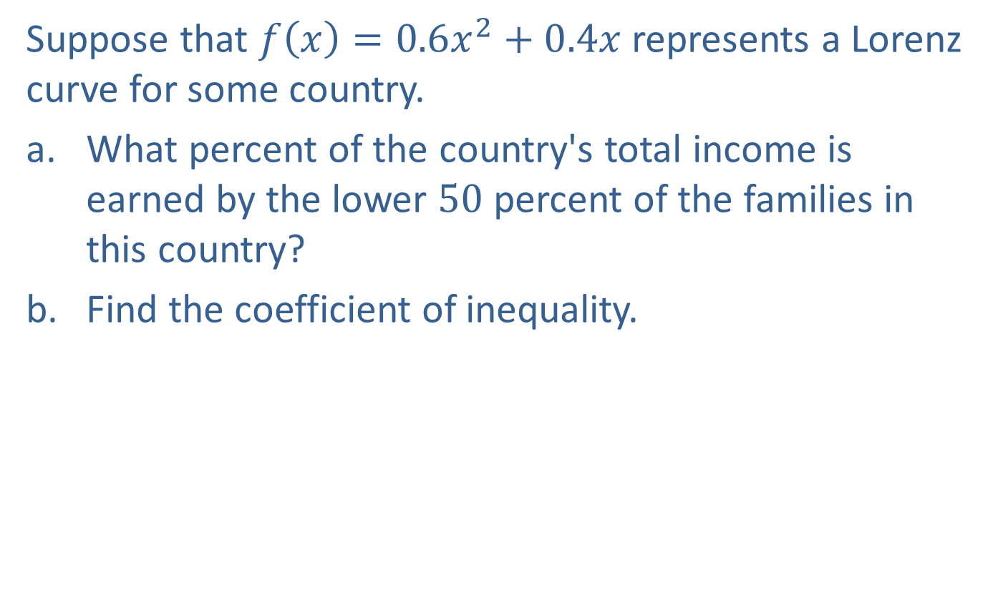
Example 4: Using a Lorenz Curve
Suppose that $f\left(x\right)=0.6x^{2}+0.4x$ represents a Lorenz curve for some country.
​What percent of the country's total income is earned by the lower 50 percent of the families in this country?
​Find the coefficient of inequality.

Slide 18

Example 4: Using a Lorenz Curve (cont.)
Solution
​$f\left(0.5\right)=0.6{\left(0.5\right)}^{2}+0.4\left(0.5\right)=0.35$ Since we want the lower $50\%$ of families, set $x=0.5$.
​The lower 50 percent of the families earn 35 percent of the country's total income.

Slide 19
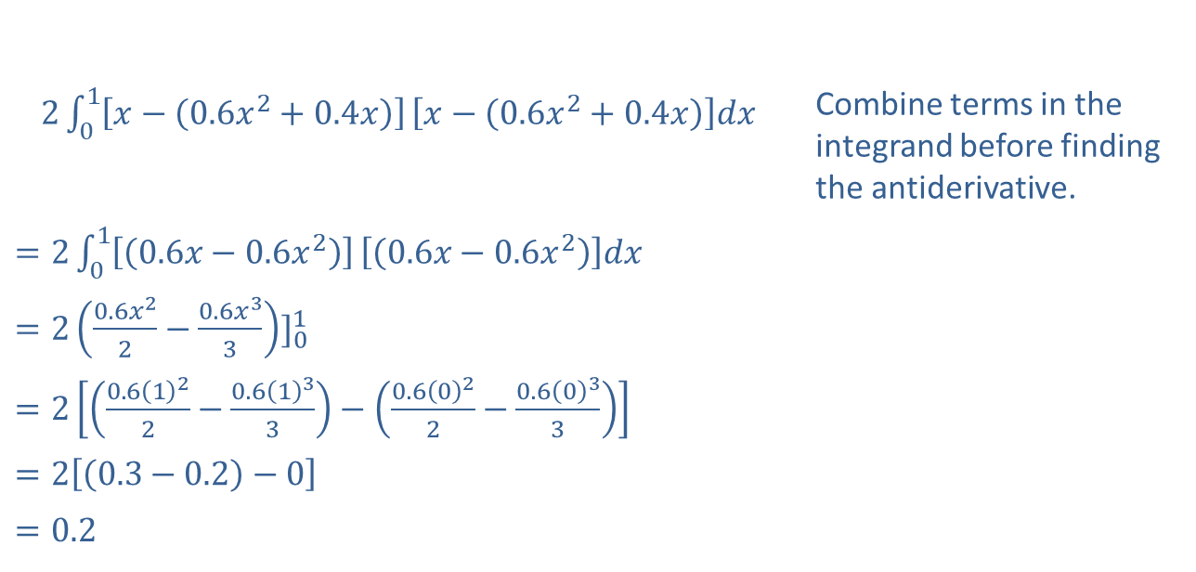
Example 4: Using a Lorenz Curve (cont.)
​=201𝑥−0.6𝑥2+0.4𝑥𝑥−0.6𝑥2+0.4𝑥𝑑𝑥= | Combine terms in the integrand before finding the antiderivative.
​$=2\int_{0}^{1}{\left[\left(0.6x−0.6x^{2}\right)\right]}\left[\left(0.6x−0.6x^{2}\right)\right]dx$
​$=2{\left(\frac{0.6x^{2}}{2}−\frac{0.6x^{3}}{3}\right)]}_{0}^{1}$
​$=2\left[\left(\frac{0.6{\left(1\right)}^{2}}{2}−\frac{0.6{\left(1\right)}^{3}}{3}\right)−\left(\frac{0.6{\left(0\right)}^{2}}{2}−\frac{0.6{\left(0\right)}^{3}}{3}\right)\right]$
​$=2\left[\left(0.3−0.2\right)−0\right]$
​$=0.2$
The coefficient of inequality is 0.2.

