Slide 1
Section 6.7
Differential Equations

Slide 2
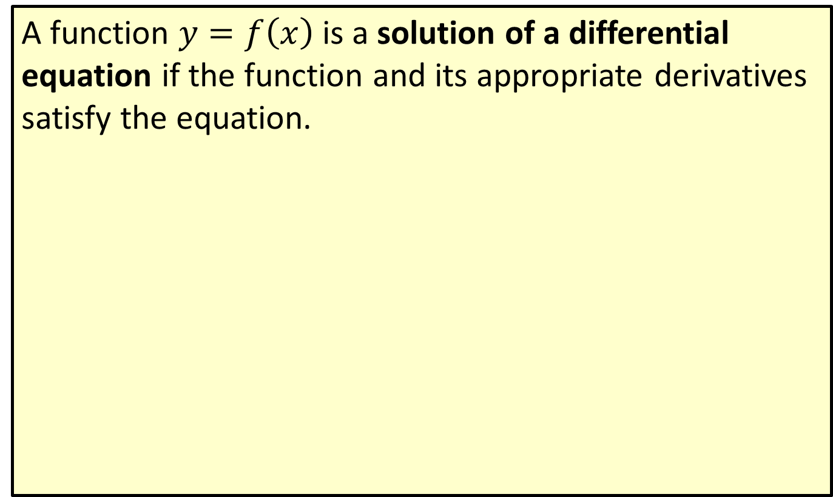
Solution of a Differential Equation
A function $y=f\left(x\right)$ is a solution of a differential equation if the function and its appropriate derivatives satisfy the equation.

Slide 3
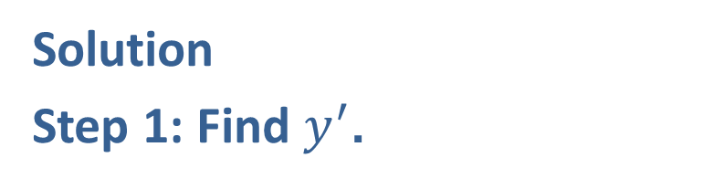

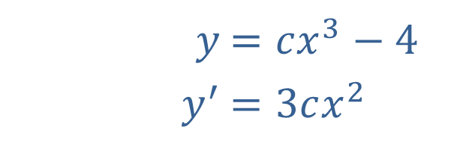
Example 1: Solutions of Differential Equations
Verify that the function $y=cx^{3}−4$ is a general solution of the differential equation $xy^{′}−3y=12$.
Solution
Step 1: Find $y^{′}$.
​$y$ | ​$=cx^{3}−4$
​$y^{′}$ | ​$=3cx^{2}$

Slide 4
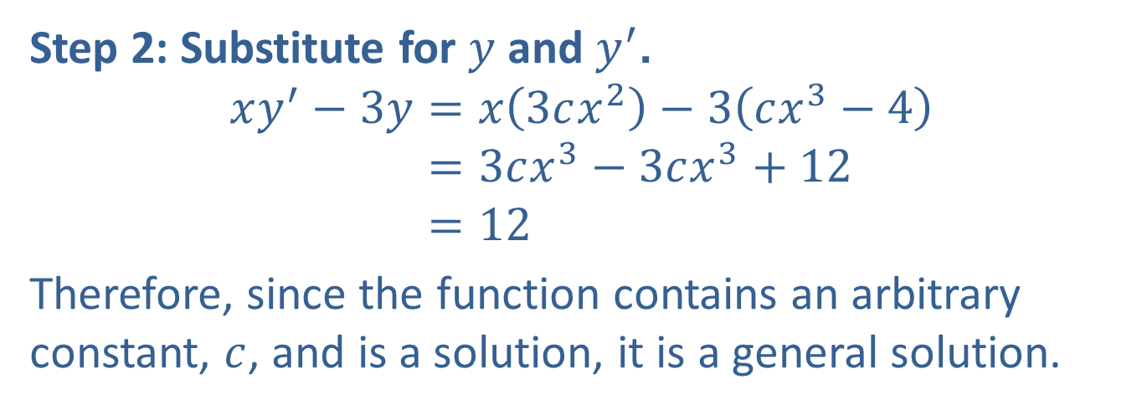
Example 1: Solutions of Differential Equations (cont.)
​
Step 2: Substitute for $y$ and $y^{′}$.
𝑥𝑦′−3𝑦=𝑥3𝑐𝑥2−3𝑐𝑥3−4𝑥𝑦′−3𝑦=3𝑐𝑥3−3𝑐𝑥3+12𝑥𝑦′−3𝑦=12
Therefore, since the function contains an arbitrary constant, $c$, and is a solution, it is a general solution.

Slide 5
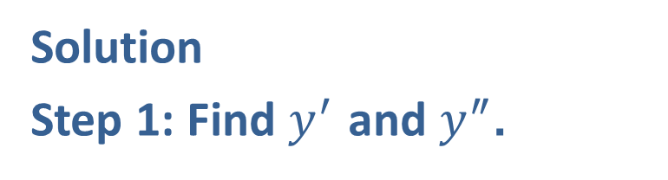

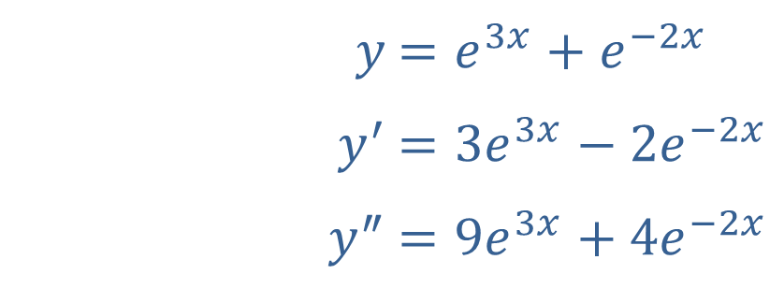
Example 2: Solutions of Differential Equations
Verify that the function $y=e^{3x}+e^{−2x}$ satisfies the second-order differential equation $y^{″}−y^{′}−6y=0$ and is, therefore, a particular solution.
Solution
Step 1: Find $y^{′}$ and $y^{″}$.
​$y$ | ​$=e^{3x}+e^{−2x}$
​$y^{′}$ | ​$=3e^{3x}−2e^{−2x}$
​$y^{″}$ | ​$=9e^{3x}+4e^{−2x}$

Slide 6
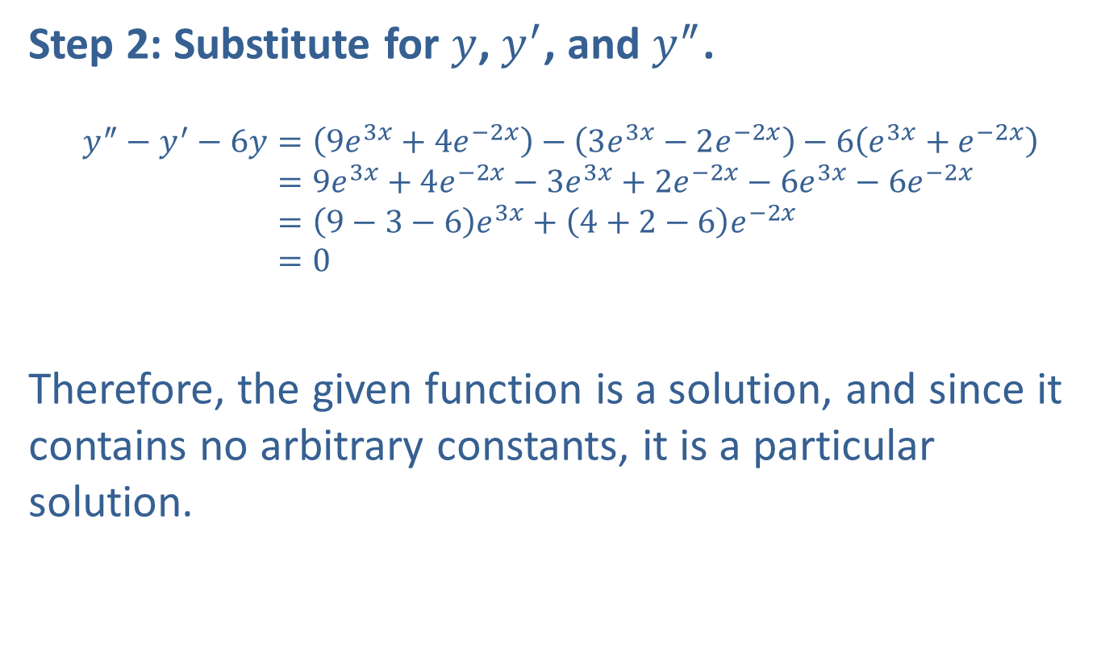
Example 2: Solutions of Differential Equations (cont.)
Step 2: Substitute for $y$, $y^{′}$, and $y^{″}$.
𝑦″−𝑦′−6𝑦=9𝑒3𝑥+4𝑒−2𝑥−3𝑒3𝑥−2𝑒−2𝑥−6𝑒3𝑥+𝑒−2𝑥𝑦″−𝑦′−6𝑦=9𝑒3𝑥+4𝑒−2𝑥−3𝑒3𝑥+2𝑒−2𝑥−6𝑒3𝑥−6𝑒−2𝑥𝑦″−𝑦′−6𝑦=9−3−6𝑒3𝑥+4+2−6𝑒−2𝑥𝑦″−𝑦′−6𝑦=0
Therefore, the given function is a solution, and since it contains no arbitrary constants, it is a particular solution.

Slide 7
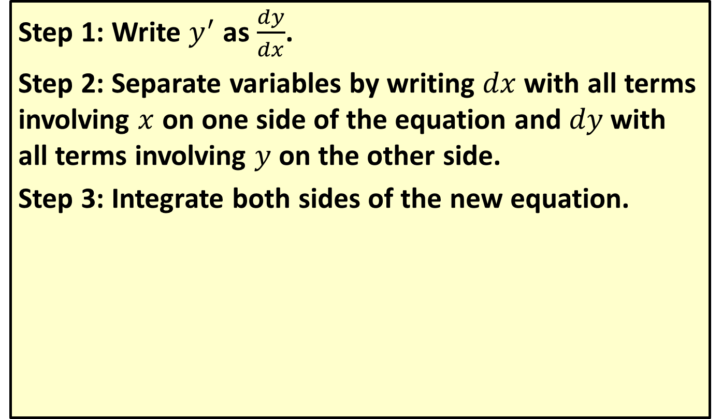
To Solve a First-Order Separable Differential Equation
Step 1: Write $y^{′}$ as $\frac{dy}{dx}$.
Step 2: Separate variables by writing $dx$ with all terms involving $x$ on one side of the equation and $dy$ with all terms involving $y$ on the other side.
Step 3: Integrate both sides of the new equation.

Slide 8
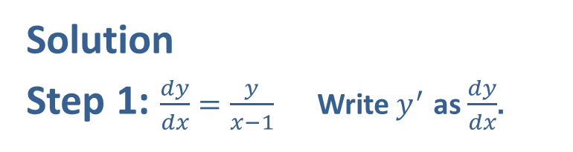

Example 3: Using the Method of Separating Variables
Solve the differential equation $y^{′}=\frac{y}{x−1}$ where $x>1$ and $y>0$.
Solution
Step 1: $\frac{dy}{dx}=\frac{y}{x−1}$ Write $y^{′}$ as $\frac{dy}{dx}$.
Step 2: $\frac{dy}{y}=\frac{dx}{x−1}$ Separate the variables.

Slide 9
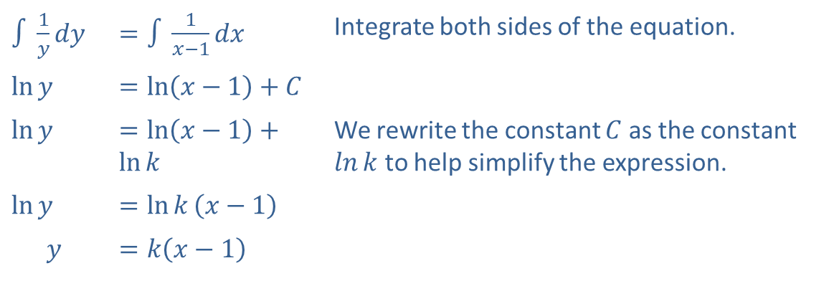
Example 3: Using the Method of Separating Variables (cont.)
Step 3:
​$∫\frac{1}{y}dy$ | ​$=∫\frac{1}{x−1}dx$ | Integrate both sides of the equation.
​$ln⁡y$ | ​$=\ln\left(x−1\right)+C$
​$ln⁡y$ | ​$=\ln\left(x−1\right)+ln⁡k$ | We rewrite the constant $C$ as the constant $ln⁡k$ to help simplify the expression.
​$ln⁡y$ | ​$=\ln{k}\left(x−1\right)$
$$y$$ | ​$=k\left(x−1\right)$

Slide 10
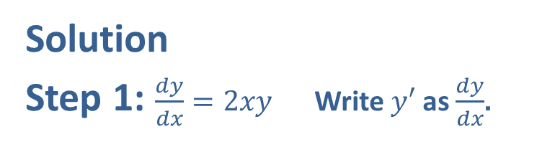

Example 4: Using the Method of Separating Variables
Solve the differential equation $y^{′}=2xy$, where $y>0$.
Solution
Step 1: $\frac{dy}{dx}=2xy$ Write $y′$ as $\frac{dy}{dx}$.
Step 2: $\frac{dy}{y}=2xdx$ Separate the variables.

Slide 11
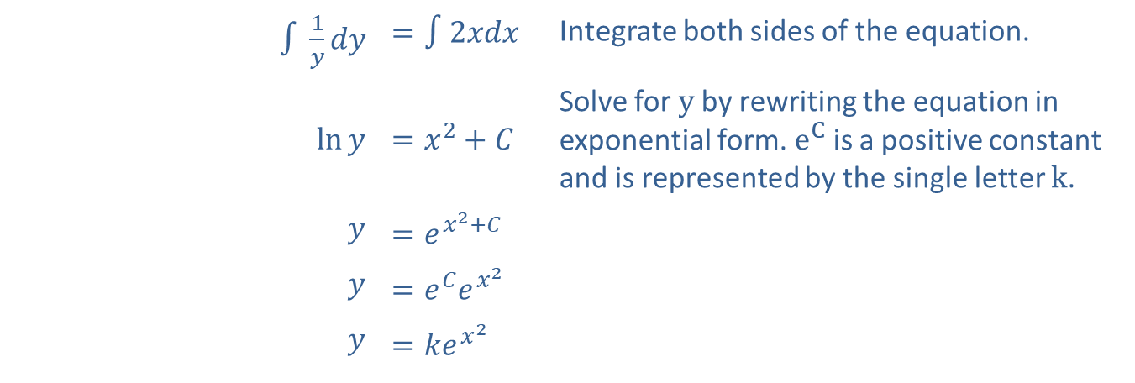
Example 4: Using the Method of Separating Variables (cont.)
​$∫\frac{1}{y}dy$ | ​$=∫2xdx$ | Integrate both sides of the equation.
​$ln⁡y$ | ​$=x^{2}+C$ | Solve for $y$ by rewriting the equation in exponential form. $e^{C}$ is a positive constant and is represented by the single letter $k$.
$$y$$ | ​$=e^{x^{2}+C}$
$$y$$ | ​$=e^{C}e^{x^{2}}$
$$y$$ | ​$=ke^{x^{2}}$
Step 3:

Slide 12
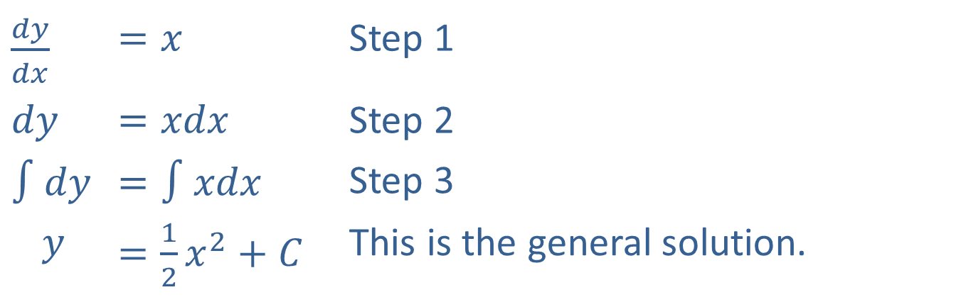

Example 5: Initial-Value Problem
Solve the initial-value problem $y^{′}=x$ with initial condition $f\left(0\right)=1$. (That is, $y=1$ when $x=0$.)
Solution
​$\frac{dy}{dx}$ | ​$=x$ | Step 1
​$dy$ | ​$=xdx$ | Step 2
​$∫dy$ | ​$=∫xdx$ | Step 3
$$y$$ | ​$=\frac{1}{2}x^{2}+C$ | This is the general solution.

Slide 13

Example 5: Initial-Value Problem (cont.)
Since $f\left(0\right)=1$, we have
$$1=\frac{1}{2}⋅0^{2}+C \\ 1=C$$
Therefore, the particular solution is $y=\frac{1}{2}x^{2}+1$.

Slide 14

Example 6: Elasticity of Demand
Find the demand function $p=D\left(x\right)$ given that the elasticity of demand $E=3$ for all positive $x$.

Slide 15
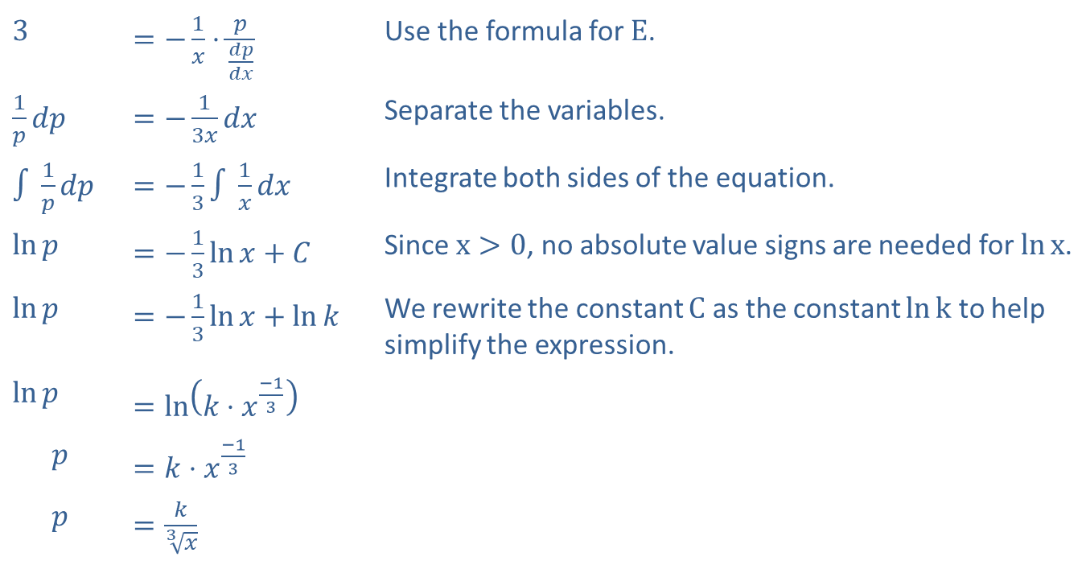
Example 6: Elasticity of Demand (cont.)
Solution
​3 | ​$=−\frac{1}{x}⋅\frac{p}{\frac{dp}{dx}}$ | Use the formula for $E$.
​$\frac{1}{p}dp$ | ​$=−\frac{1}{3x}dx$ | Separate the variables.
​$∫\frac{1}{p}dp$ | ​$=−\frac{1}{3}∫\frac{1}{x}dx$ | Integrate both sides of the equation.
​$ln⁡p$ | ​$=−\frac{1}{3}\ln{x}+C$ | Since $x>0$, no absolute value signs are needed for $ln⁡x$.
​$ln⁡p$ | ​$=−\frac{1}{3}\ln{x}+ln⁡k$ | We rewrite the constant $C$ as the constant $ln⁡k$ to help simplify the expression.
​$ln⁡p$ | ​$=\ln\left(k⋅x^{\frac{−1}{3}}\right)$
$$p$$ | ​$=k⋅x^{\frac{−1}{3}}$
$$p$$ | ​$=\frac{k}{\sqrt[3]{x}}$

Slide 16
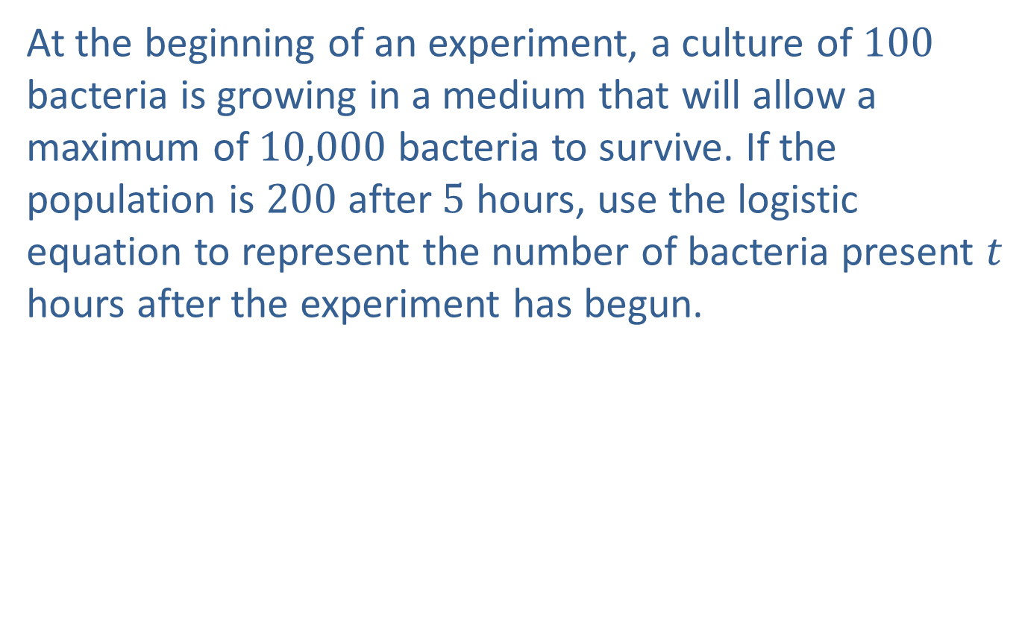
Example 7: Population of Bacteria
At the beginning of an experiment, a culture of 100 bacteria is growing in a medium that will allow a maximum of 10,000 bacteria to survive. If the population is 200 after 5 hours, use the logistic equation to represent the number of bacteria present $t$ hours after the experiment has begun.

Slide 17
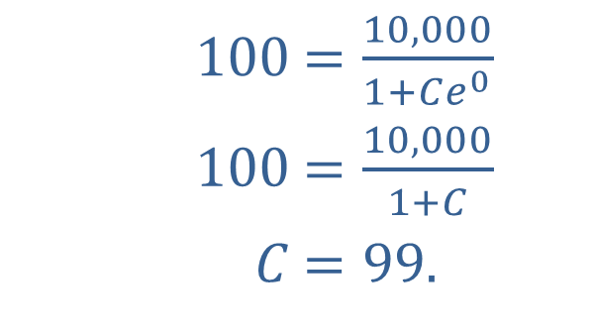
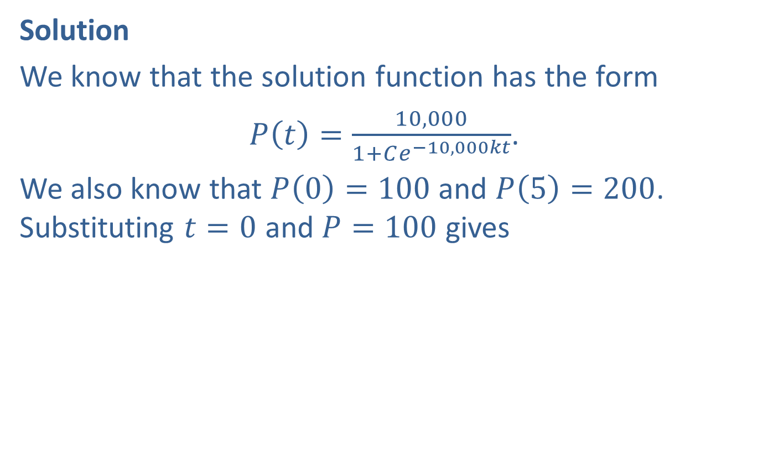
Example 7: Population of Bacteria (cont.)
Solution
We know that the solution function has the form
$P\left(t\right)=\frac{10,000}{1+Ce^{−10,000kt}}$.
We also know that $P\left(0\right)=100$ and $P\left(5\right)=200$. Substituting $t=0$ and $P=100$ gives
​
​$100$ | ​$=\frac{10,000}{1+Ce^{0}}$
​$100$ | ​$=\frac{10,000}{1+C}$
​$C$ | ​$=99\text{.}$

Slide 18
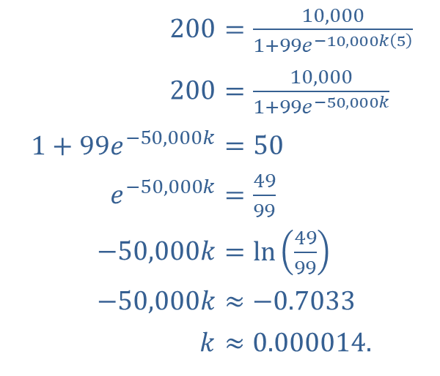

Example 7: Population of Bacteria (cont.)
Substituting $t=5$ and $P=200$ gives
​
Thus the final form for $P⁡\left(t\right)$ is $P\left(t\right)=\frac{10,000}{1+99e^{−0.14t}}$.
​$200$ | ​$=\frac{10,000}{1+99e^{−10,000k\left(5\right)}}$
​$200$ | ​$=\frac{10,000}{1+99e^{−50,000k}}$
​$1+99e^{−50,000k}$ | ​$=50$
​$e^{−50,000k}$ | ​$=\frac{49}{99}$
​$−50,000k$ | ​$=\ln\left(\frac{49}{99}\right)$
​$−50,000k$ | ​$≈−0.7033$
​$k$ | ​$≈0.000014\text{.}$

