Slide 1
Section 7.1
Integration by Parts

Slide 2
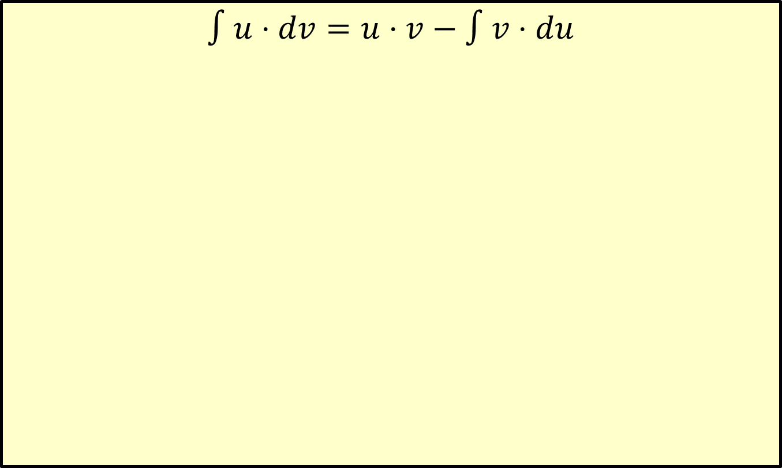
Formula for Integration by Parts
$$∫u⋅dv=u⋅v−∫v⋅du$$

Slide 3
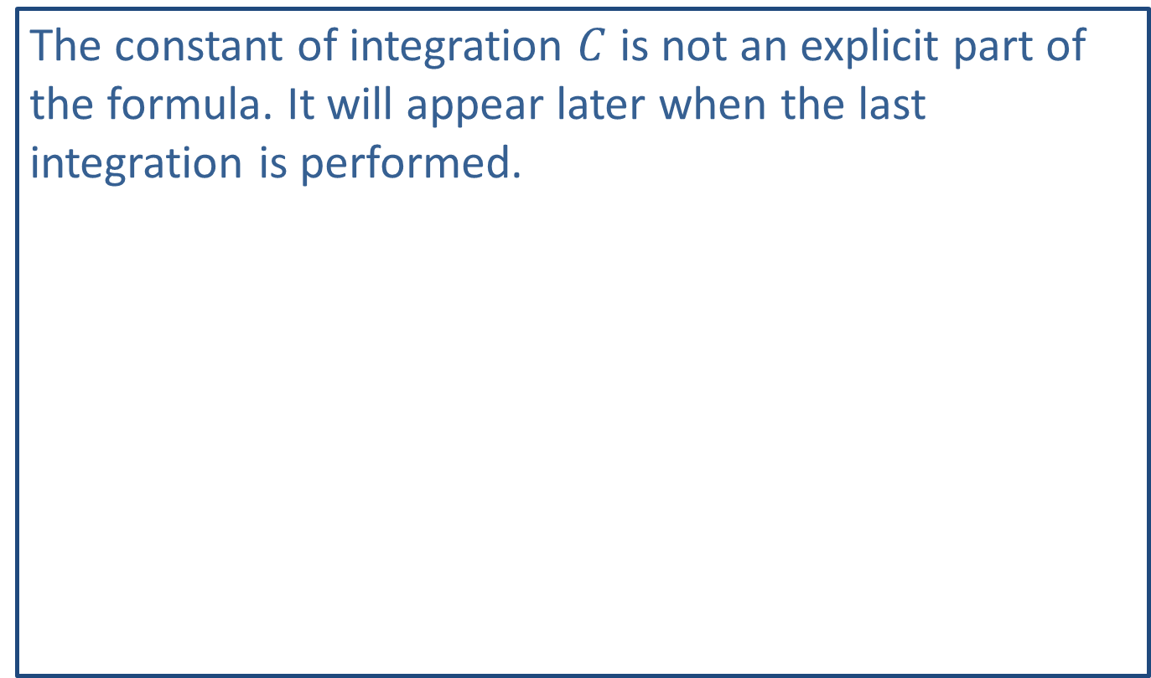
Note:
The constant of integration $C$ is not an explicit part of the formula. It will appear later when the last integration is performed.

Slide 4
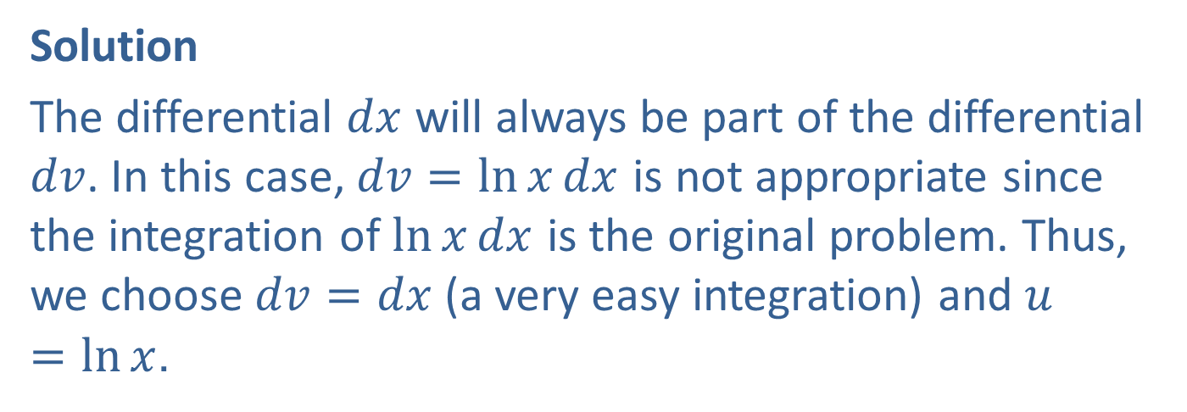

Example 1: Integration by Parts
Find $∫\ln{x}dx$.
Solution
The differential $dx$ will always be part of the differential $dv$. In this case, $dv=\ln{x}dx$ is not appropriate since the integration of $\ln{x}dx$ is the original problem. Thus, we choose $dv=dx$ (a very easy integration) and $u=\ln{x}$.

Slide 5
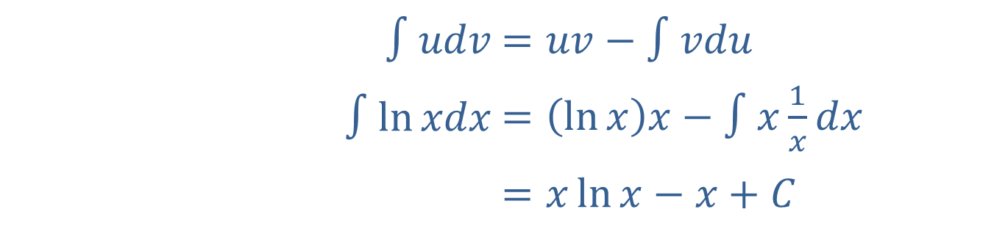
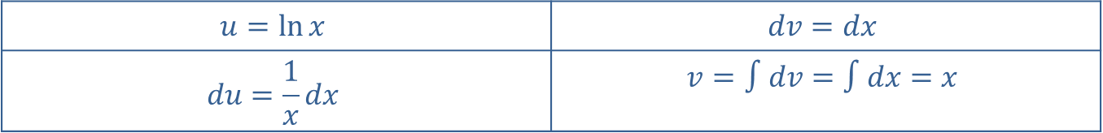
Example 1: Integration by Parts (cont.)
$$u=\ln{x}$$ | $$dv=dx$$
$$du=\frac{1}{x}dx$$ | $$v=∫dv=∫dx=x$$
Now we substitute in the parts for our formula.
​$∫udv$ | ​$=uv−∫vdu$
​$∫ln⁡xdx$ | ​$=\left(\ln{x}\right)x−∫x\frac{1}{x}dx$
​ | ​$=x\ln{x}−x+C$

Slide 6
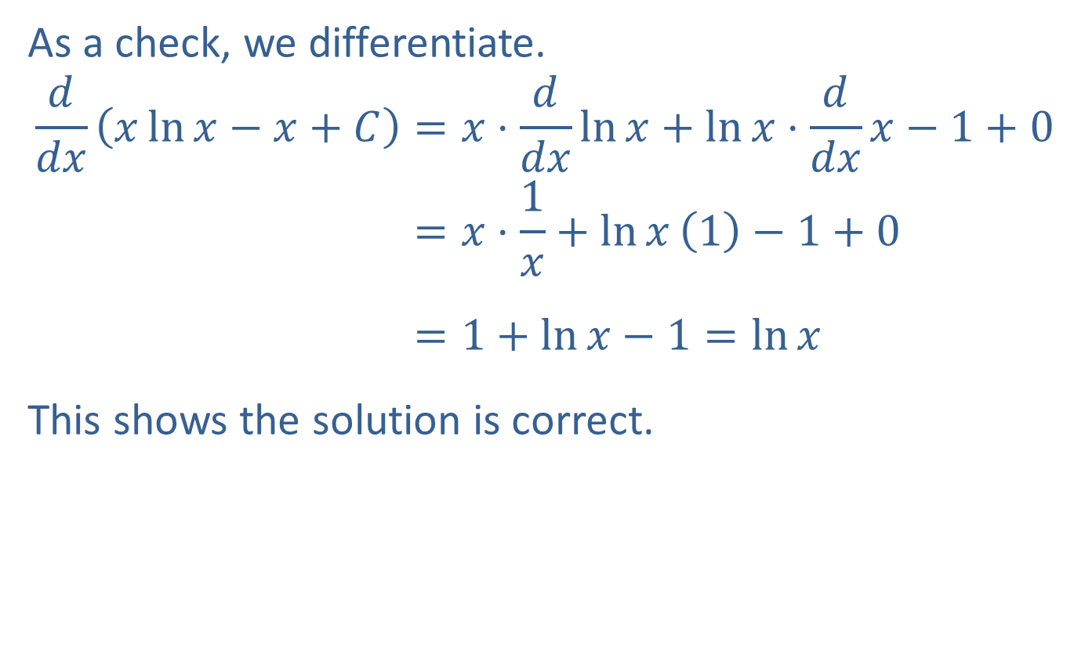
Example 1: Integration by Parts (cont.)
As a check, we differentiate.
𝑑𝑑𝑥𝑥ln𝑥−𝑥+𝐶=𝑥⋅𝑑𝑑𝑥ln𝑥+ln𝑥⋅𝑑𝑑𝑥𝑥−1+0𝑑𝑑𝑥𝑥ln𝑥−𝑥+𝐶=𝑥⋅1𝑥+ln𝑥1−1+0𝑑𝑑𝑥𝑥ln𝑥−𝑥+𝐶=1+ln𝑥−1=ln𝑥
This shows the solution is correct.

Slide 7


Example 2: Integration by Parts
Find $∫x\ln{x}dx$.
Solution
Since we differentiate the choice for $u$, we could let $u=x$ (with $dv=\ln{x}dx$) or $u=\ln{x}$ (with $dv=xdx$). However, we integrate the choice for $dv$, so that we do not choose $dv=\ln{x}dx$ because we do not have a standard way to integrate this choice of $dv$ directly (in theory we could use Example 1, but this is not as easy as the choice we will make).

Slide 8
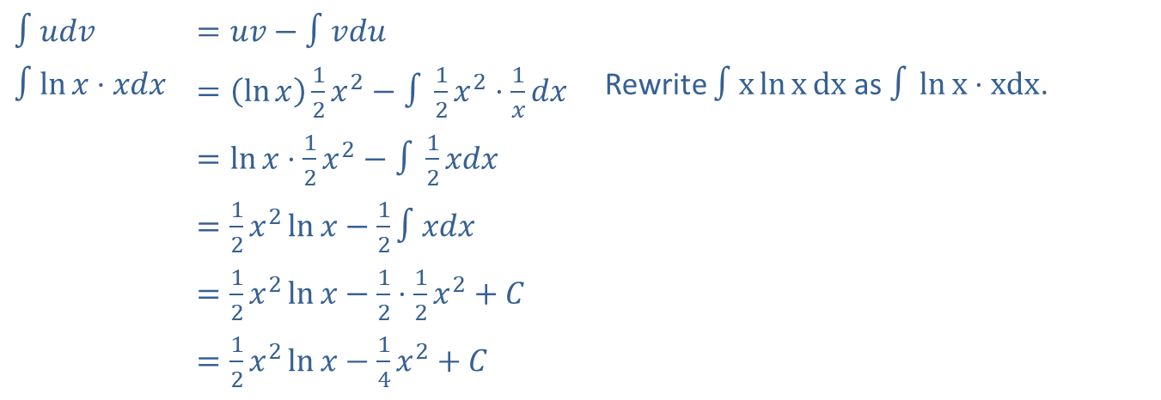
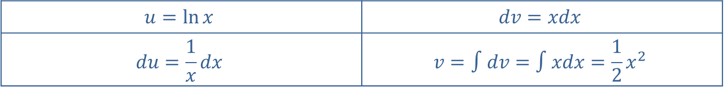

Example 2: Integration by Parts (cont.)
$$u=\ln{x}$$ | $$dv=xdx$$
$$du=\frac{1}{x}dx$$ | $$v=∫dv=∫xdx=\frac{1}{2}x^{2}$$
Now we apply the formula for integration by parts.
​$∫udv$ | ​$=uv−∫vdu$
​$∫ln⁡x⋅xdx$ | ​$=\left(\ln{x}\right)\frac{1}{2}x^{2}−∫\frac{1}{2}x^{2}⋅\frac{1}{x}dx$ | Rewrite $∫x\ln{x}dx$ as $∫\ln{x}⋅xdx$.
 | ​$=\ln{x}⋅\frac{1}{2}x^{2}−∫\frac{1}{2}xdx$
 | ​$=\frac{1}{2}x^{2}\ln{x}−\frac{1}{2}∫xdx$
 | ​$=\frac{1}{2}x^{2}\ln{x}−\frac{1}{2}⋅\frac{1}{2}x^{2}+C$
 | ​$=\frac{1}{2}x^{2}\ln{x}−\frac{1}{4}x^{2}+C$
The cancellation that occurs when we multiply $v$ times $du$ tells us that the choice for $u$ and $dv$ was excellent!

Slide 9
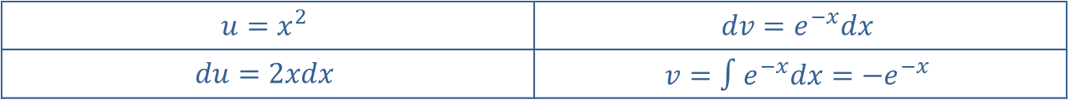

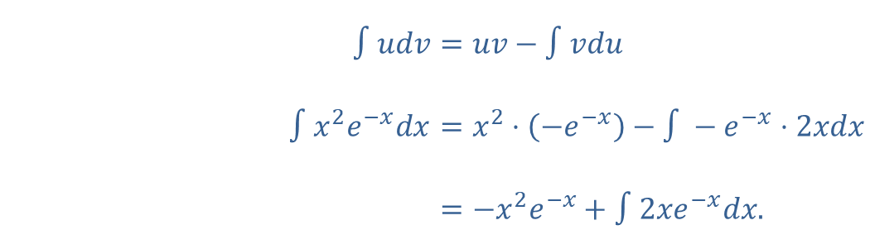
Example 3: Integration by Parts
Find $∫x^{2}e^{−x}dx$.
Solution
In this problem, we apply integration by parts twice.
$$u=x^{2}$$ | $$dv=e^{−x}dx$$
$$du=2xdx$$ | $$v=∫e^{−x}dx=−e^{−x}$$
Therefore,
​$∫udv$ | ​$=uv−∫vdu$
​$∫x^{2}e^{−x}dx$ | ​$=x^{2}⋅\left(−e^{−x}\right)−∫−e^{−x}⋅2xdx$
​ | ​$=−x^{2}e^{−x}+∫2xe^{−x}dx\text{.}$

Slide 10
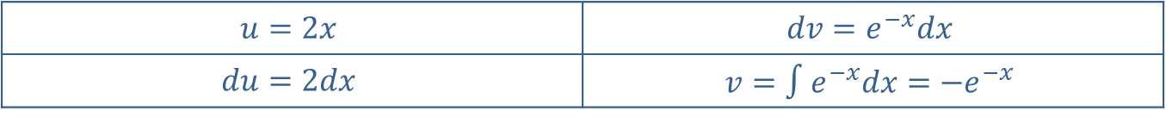

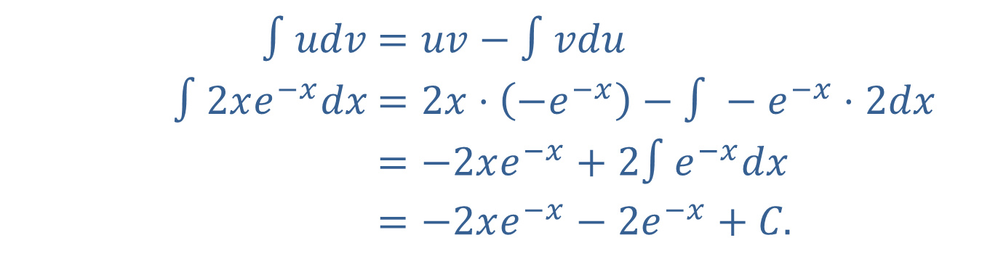
Example 3: Integration by Parts (cont.)
Now integrate $∫2xe^{−x}dx$ by parts.
$$u=2x$$ | $$dv=e^{−x}dx$$
$$du=2dx$$ | $$v=∫e^{−x}dx=−e^{−x}$$
Therefore,
​$∫udv$ | ​$=uv−∫vdu$
​$∫2xe^{−x}dx$ | ​$=2x⋅\left(−e^{−x}\right)−∫−e^{−x}⋅2dx$
​ | ​$=−2xe^{−x}+2∫e^{−x}dx$
​ | ​$=−2xe^{−x}−2e^{−x}+C\text{.}$

Slide 11

Example 3: Integration by Parts (cont.)
​Putting all the results together, we have
$∫x^{2}e^{−x}dx=−x^{2}e^{−x}−2xe^{−x}−2e^{−x}+C$.

Slide 12
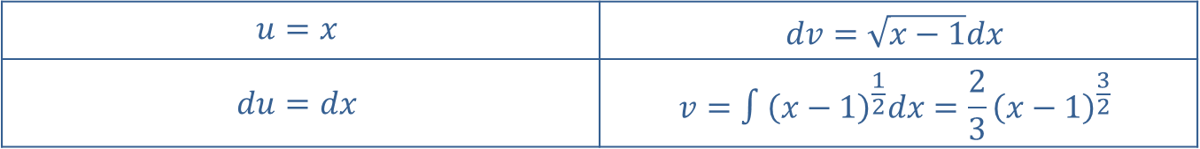

Example 4: Integration by Parts
Evaluate the definite integral $\int_{1}^{5}{x\sqrt{x−1}dx}$.
Solution
$$u=x$$ | $$dv=\sqrt{x−1}dx$$
$$du=dx$$ | $$v=∫{\left(x−1\right)}^{\frac{1}{2}}dx=\frac{2}{3}{\left(x−1\right)}^{\frac{3}{2}}$$

Slide 13
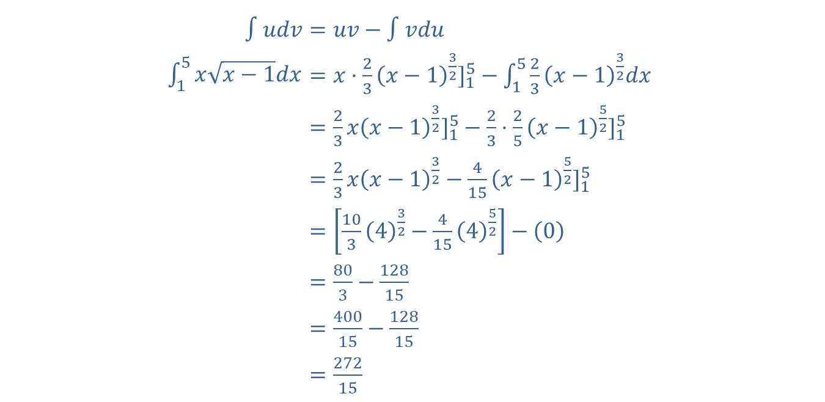
Example 4: Integration by Parts (cont.)
Now we evaluate the definite integral using the formula for integration by parts.
​
​$∫udv$ | ​$=uv−∫vdu$
​$\int_{1}^{5}{x\sqrt{x−1}dx}$ | ​$=x⋅{\frac{2}{3}{\left(x−1\right)}^{\frac{3}{2}}]}_{1}^{5}−\int_{1}^{5}{\frac{2}{3}{\left(x−1\right)}^{\frac{3}{2}}dx}$
​ | ​$={\frac{2}{3}x{\left(x−1\right)}^{\frac{3}{2}}]}_{1}^{5}−{\frac{2}{3}⋅\frac{2}{5}{\left(x−1\right)}^{\frac{5}{2}}]}_{1}^{5}$
​ | ​$=\frac{2}{3}x{\left(x−1\right)}^{\frac{3}{2}}−{\frac{4}{15}{\left(x−1\right)}^{\frac{5}{2}}]}_{1}^{5}$
​ | ​$=\left[\frac{10}{3}{\left(4\right)}^{\frac{3}{2}}−\frac{4}{15}{\left(4\right)}^{\frac{5}{2}}\right]−\left(0\right)$
​ | ​$=\frac{80}{3}−\frac{128}{15}$
​ | ​$=\frac{400}{15}−\frac{128}{15}$
​ | ​$=\frac{272}{15}$

