Slide 1
Section 7.2
Annuities and Income Streams

Slide 2
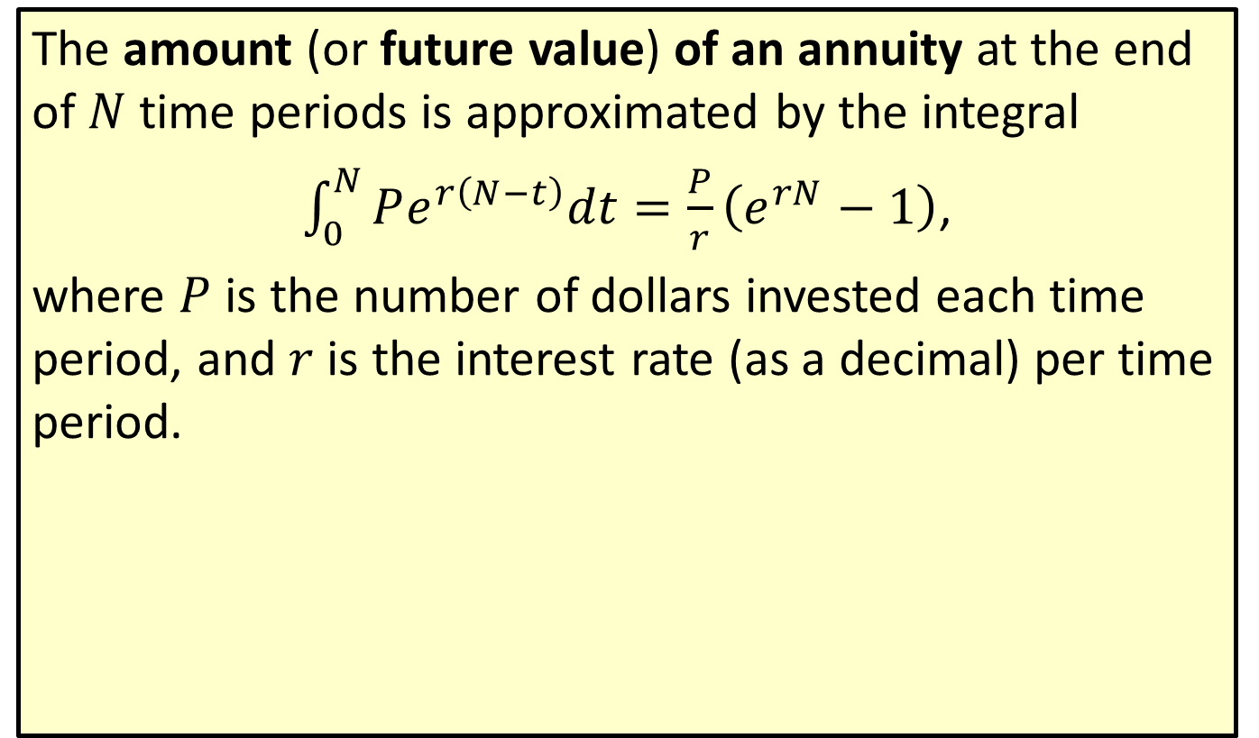
Future Value of an Annuity
The amount (or future value) of an annuity at the end of $N$ time periods is approximated by the integral
$\int_{0}^{N}{Pe^{r\left(N−t\right)}dt}=\frac{P}{r}\left(e^{rN}−1\right)$,
where $P$ is the number of dollars invested each time period, and $r$ is the interest rate (as a decimal) per time period.

Slide 3

Example 1: Future Value of an Annuity
Suppose that the parents of a child set up an annuity account paying 10 percent compounded continuously for the child’s college education. They deposit $\$500$ each year for 20 years. What will be the approximate amount of the annuity in 20 years?

Slide 4

Example 1: Future Value of an Annuity (cont.)
Solution
Since the deposits are made yearly, $r=0.10$, $N=20$, and $P=500$.

Slide 5
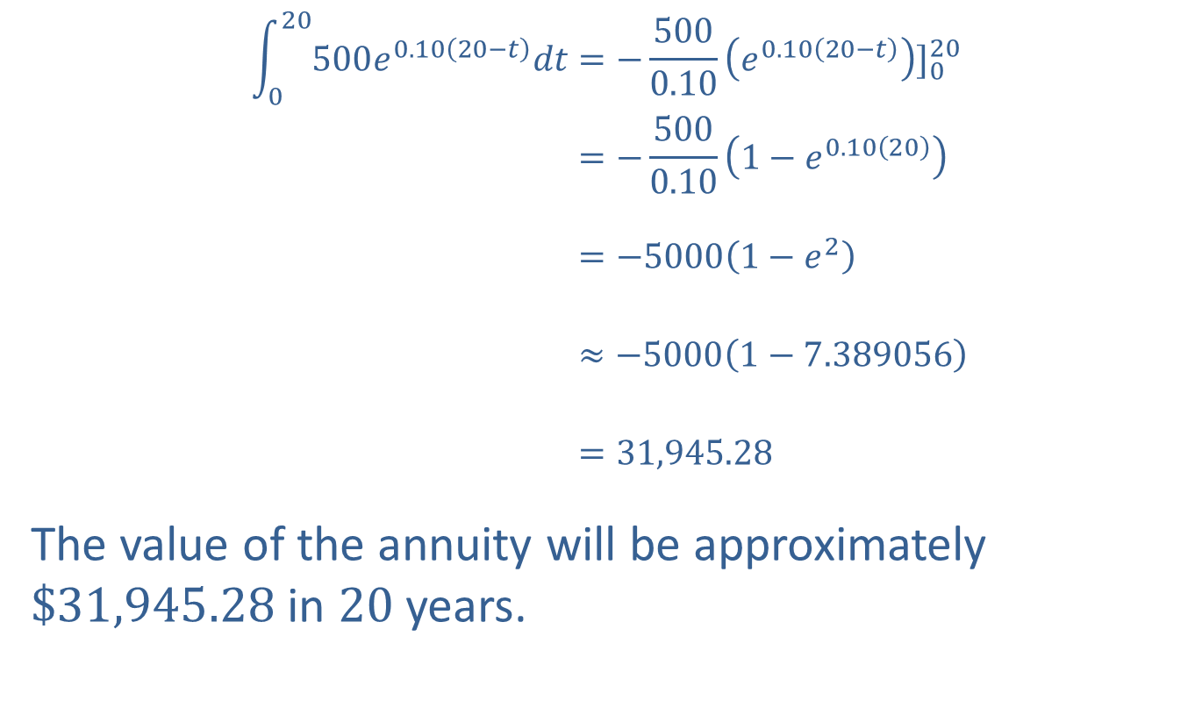
Example 1: Future Value of an Annuity (cont.)
020500𝑒0.1020−𝑡𝑑𝑡=−5000.10𝑒0.1020−𝑡]020020500𝑒0.1020−𝑡𝑑𝑡=−5000.101−𝑒0.1020020500𝑒0.1020−𝑡𝑑𝑡=−50001−𝑒2020500𝑒0.1020−𝑡𝑑𝑡≈−50001−7.389056020500𝑒0.1020−𝑡𝑑𝑡=31,945.28
The value of the annuity will be approximately $\$31,945.28$ in 20 years.

Slide 6
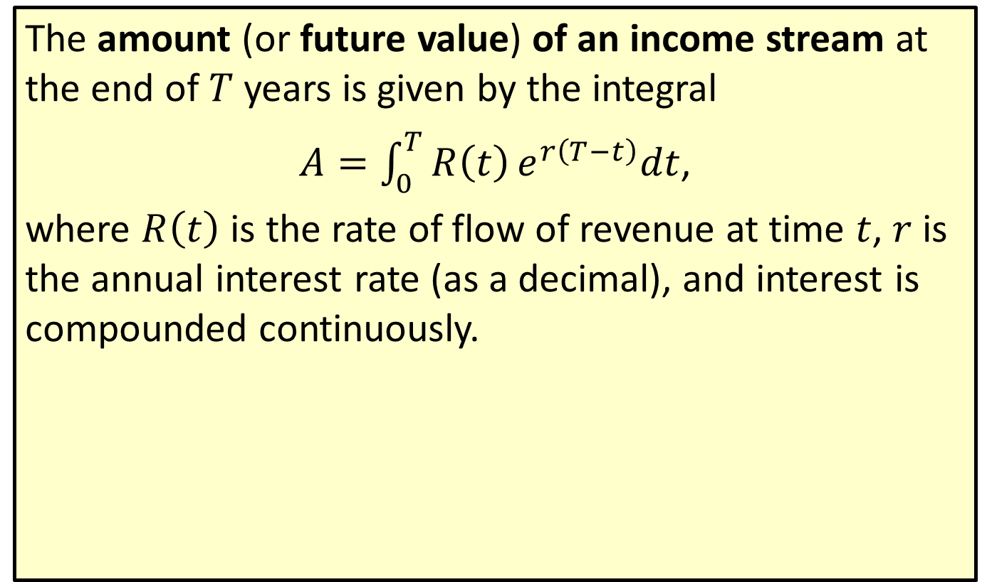
Future Value of an Income Stream
The amount (or future value) of an income stream at the end of $T$ years is given by the integral
$A=\int_{0}^{T}{R\left(t\right)e^{r\left(T−t\right)}dt}$,
where $R⁡\left(t\right)$ is the rate of flow of revenue at time $t$, $r$ is the annual interest rate (as a decimal), and interest is compounded continuously.

Slide 7
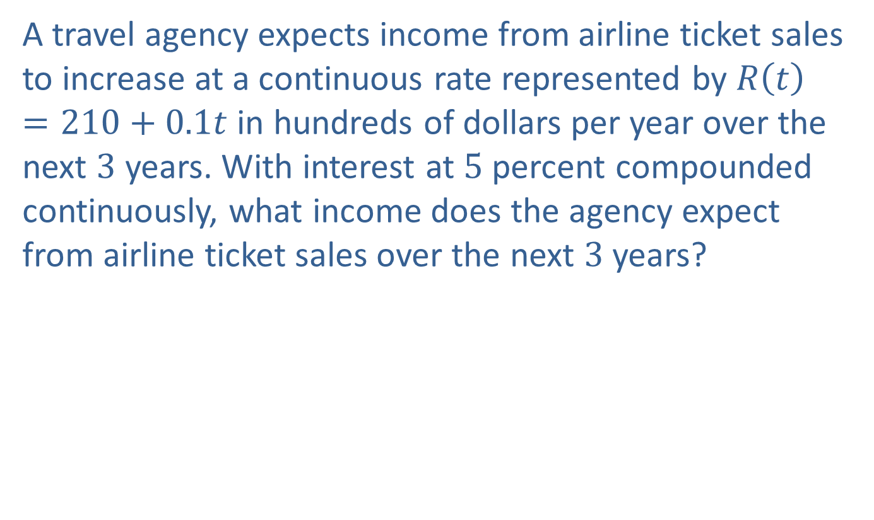
Example 2: Future Value of an Income Stream
A travel agency expects income from airline ticket sales to increase at a continuous rate represented by $R\left(t\right)=210+0.1t$ in hundreds of dollars per year over the next 3 years. With interest at 5 percent compounded continuously, what income does the agency expect from airline ticket sales over the next 3 years?

Slide 8
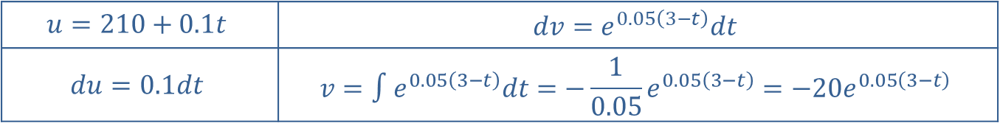
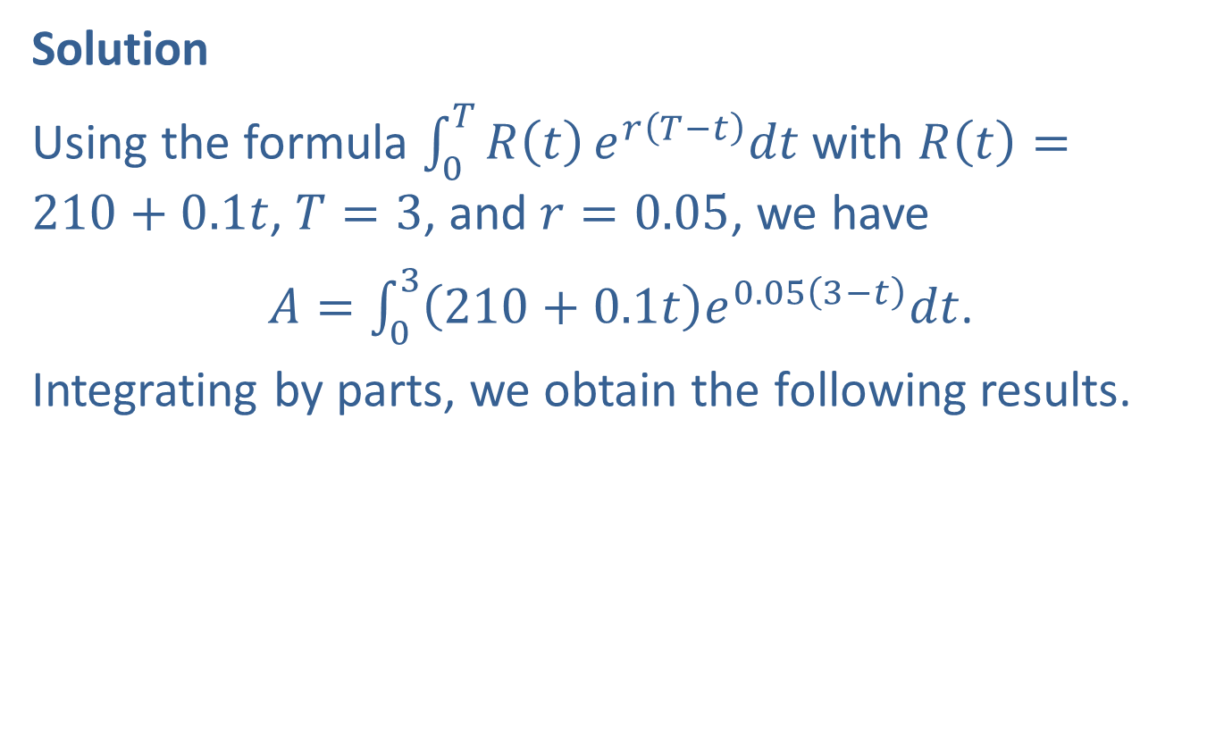
Example 2: Future Value of an Income Stream (cont.)
Solution
Using the formula $\int_{0}^{T}{R\left(t\right)e^{r\left(T−t\right)}dt}$ with $R\left(t\right)=210+0.1t$, $T=3$, and $r=0.05$, we have
$A=\int_{0}^{3}{\left(210+0.1t\right)e^{0.05\left(3−t\right)}dt}$.
Integrating by parts, we obtain the following results.
$$u=210+0.1t$$ | $$dv=e^{0.05\left(3−t\right)}dt$$
$$du=0.1dt$$ | $$v=∫e^{0.05\left(3−t\right)}dt=−\frac{1}{0.05}e^{0.05\left(3−t\right)}=−20e^{0.05\left(3−t\right)}$$

Slide 9
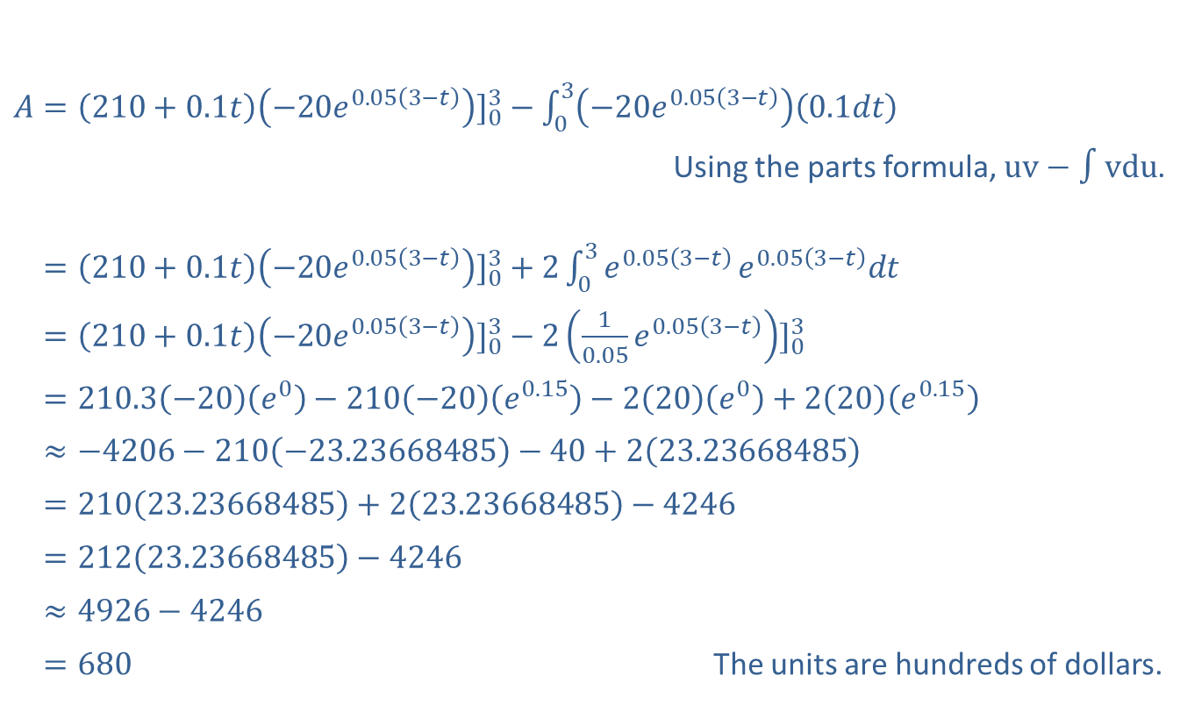
Example 2: Future Value of an Income Stream (cont.)
​$A={\left(210+0.1t\right)\left(−20e^{0.05\left(3−t\right)}\right)]}_{0}^{3}−\int_{0}^{3}{\left(−20e^{0.05\left(3−t\right)}\right)\left(0.1dt\right)}$
Using the parts formula, $uv−∫vdu$.
​𝐴=210+0.1𝑡−20𝑒0.053−𝑡]03+203𝑒0.053−𝑡𝑒0.053−𝑡𝑑𝑡
​𝐴=210+0.1𝑡−20𝑒0.053−𝑡]03−210.05𝑒0.053−𝑡]03
​𝐴=210.3−20𝑒0−210−20𝑒0.15−220𝑒0+220𝑒0.15
​𝐴≈−4206−210−23.23668485−40+223.23668485
​𝐴=21023.23668485+223.23668485−4246
​𝐴=21223.23668485−4246
​𝐴≈4926−4246
​𝐴=680 The units are hundreds of dollars.

Slide 10

Example 2: Future Value of an Income Stream (cont.)
The agency expects approximately $\$68,000$ from airline ticket sales over the next 3 years.

Slide 11
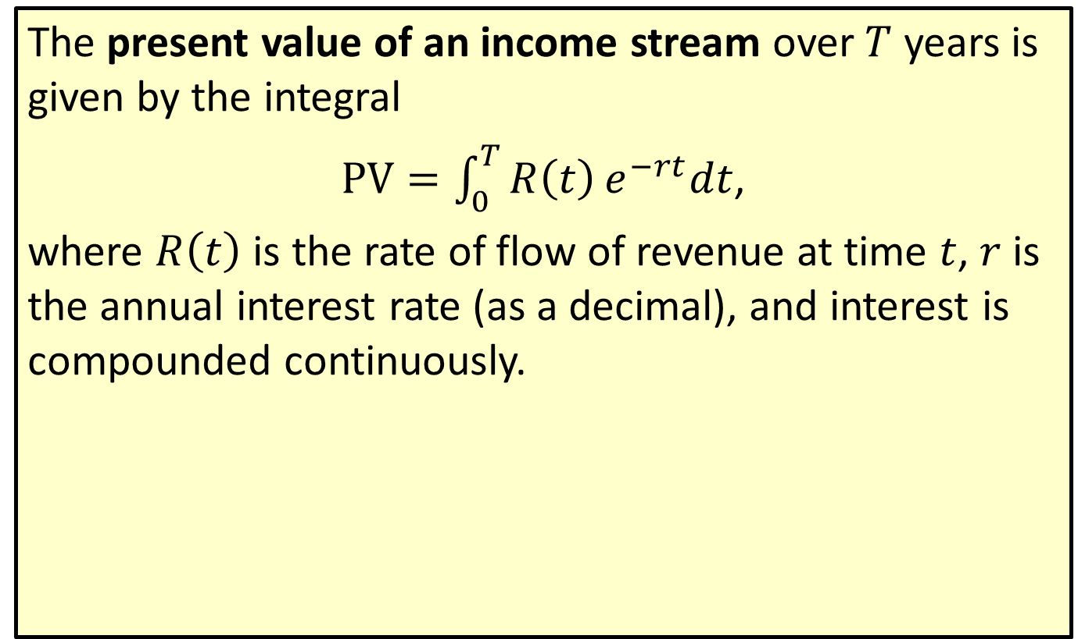
Present Value of an Income Stream
The present value of an income stream over $T$ years is given by the integral
$PV=\int_{0}^{T}{R\left(t\right)e^{−rt}dt}$,
where $R⁡\left(t\right)$ is the rate of flow of revenue at time $t$, $r$ is the annual interest rate (as a decimal), and interest is compounded continuously.

Slide 12
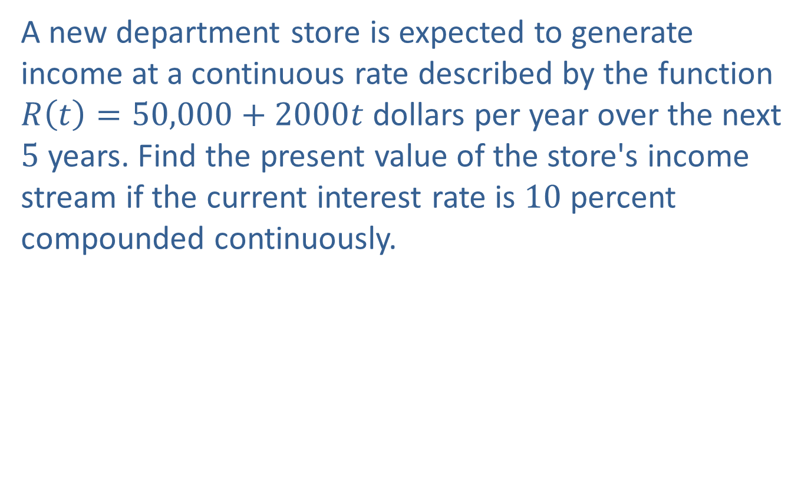
Example 3: Present Value of an Income Stream
A new department store is expected to generate income at a continuous rate described by the function $R\left(t\right)=50,000+2000t$ dollars per year over the next 5 years. Find the present value of the store's income stream if the current interest rate is 10 percent compounded continuously.

Slide 13
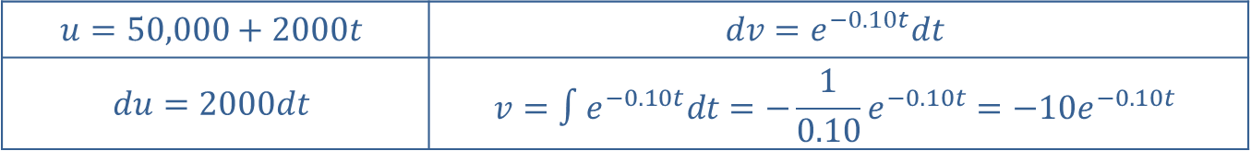
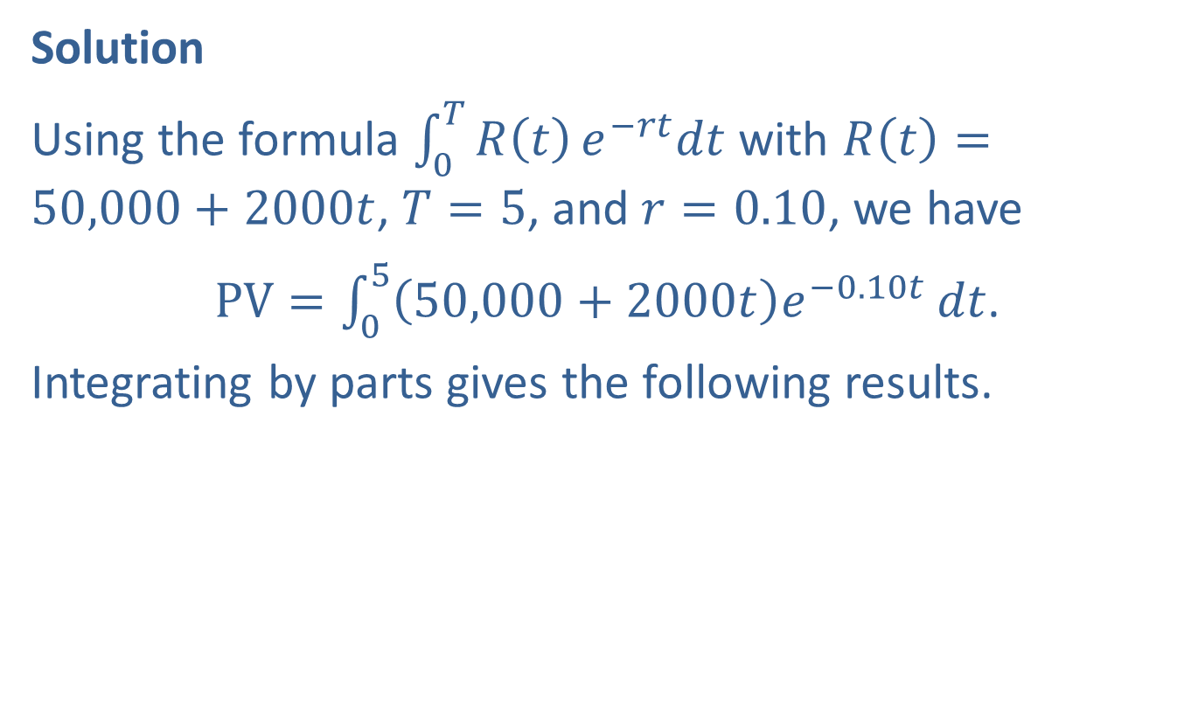
Example 3: Present Value of an Income Stream (cont.)
Solution
Using the formula $\int_{0}^{T}{R\left(t\right)e^{−rt}dt}$ with $R\left(t\right)=50,000+2000t$, $T=5$, and $r=0.10$, we have
$PV=\int_{0}^{5}{\left(50,000+2000t\right)e^{−0.10t}}dt$.
Integrating by parts gives the following results.
$$u=50,000+2000t$$ | $$dv=e^{−0.10t}dt$$
$$du=2000dt$$ | $$v=∫e^{−0.10t}dt=−\frac{1}{0.10}e^{−0.10t}=−10e^{−0.10t}$$

Slide 14

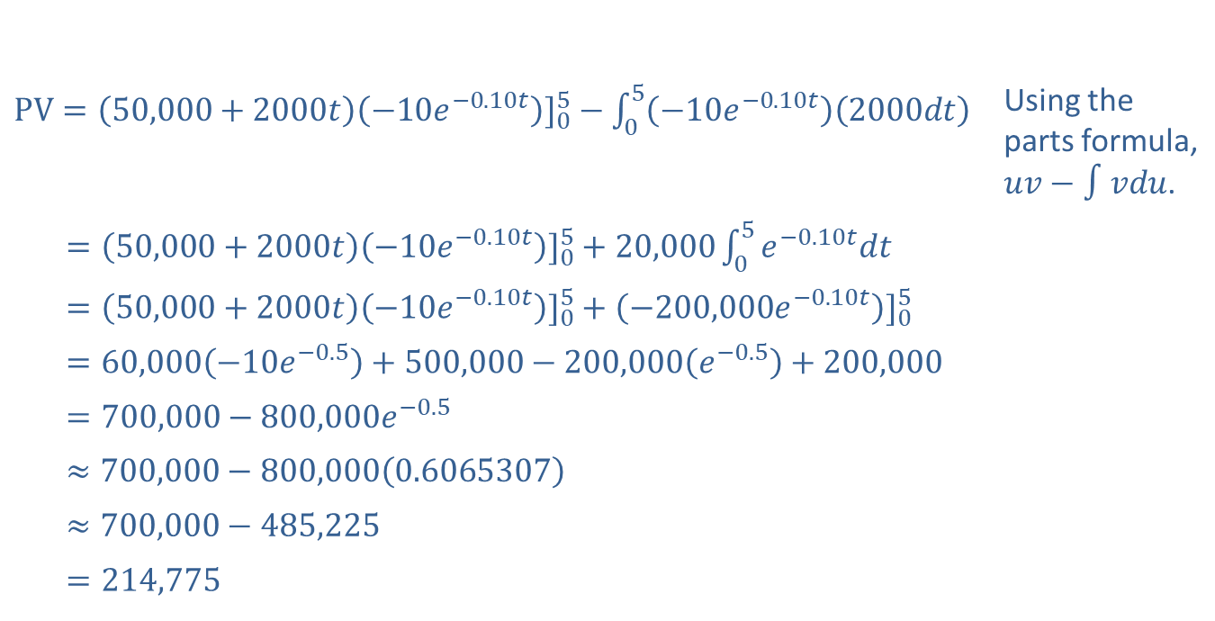
Example 3: Present Value of an Income Stream (cont.)
​$PV={\left(50,000+2000t\right)\left(−10e^{−0.10t}\right)]}_{0}^{5}−\int_{0}^{5}{\left(−10e^{−0.10t}\right)\left(2000dt\right)}$ | Using the parts formula, $uv−∫vdu$.
​𝑃𝑉=50,000+2000𝑡−10𝑒−0.10𝑡]05+20,00005𝑒−0.10𝑡𝑑𝑡
​𝑃𝑉=50,000+2000𝑡−10𝑒−0.10𝑡]05+−200,000𝑒−0.10𝑡]05
​𝑃𝑉=60,000−10𝑒−0.5+500,000−200,000𝑒−0.5+200,000
​𝑃𝑉=700,000−800,000𝑒−0.5
​𝑃𝑉≈700,000−800,0000.6065307
​𝑃𝑉≈700,000−485,225
​𝑃𝑉=214,775
The present value of the new store's income stream is approximately $\$214,775$.

