Slide 1
Section 7.3
Tables of Integrals

Slide 2
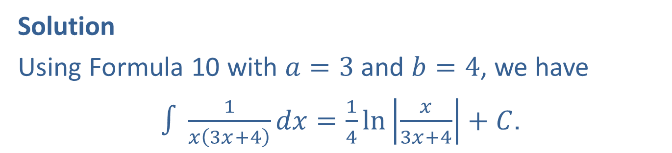

Example 1: Using the Integral Table
Find $∫\frac{1}{x\left(3x+4\right)}dx$.
Solution
Using Formula 10 with $a=3$ and $b=4$, we have
$∫\frac{1}{x\left(3x+4\right)}dx=\frac{1}{4}\ln\left|\frac{x}{3x+4}\right|+C$.

Slide 3
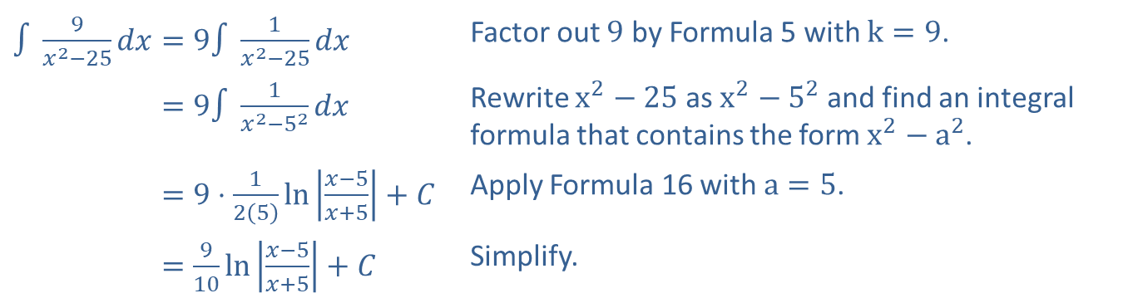

Example 2: Using the Integral Table
Evaluate $∫\frac{9}{x^{2}−25}dx$.
Solution
​$∫\frac{9}{x^{2}−25}dx=9∫\frac{1}{x^{2}−25}dx$ | Factor out 9 by Formula 5 with $k=9$.
​∫9𝑥2−25𝑑𝑥=9∫1𝑥2−52𝑑𝑥 | Rewrite $x^{2}−25$ as $x^{2}−5^{2}$ and find an integral formula that contains the form $x^{2}−a^{2}$.
​∫9𝑥2−25𝑑𝑥=9⋅125ln𝑥−5𝑥+5+𝐶 | Apply Formula 16 with $a=5$.
​∫9𝑥2−25𝑑𝑥=910ln𝑥−5𝑥+5+𝐶 | Simplify.

Slide 4

Example 3: Using a Reduction Formula
Find $∫x^{2}e^{−3x}dx$.
Solution
We will use Formula 20 twice and then use Formula 19.

Slide 5
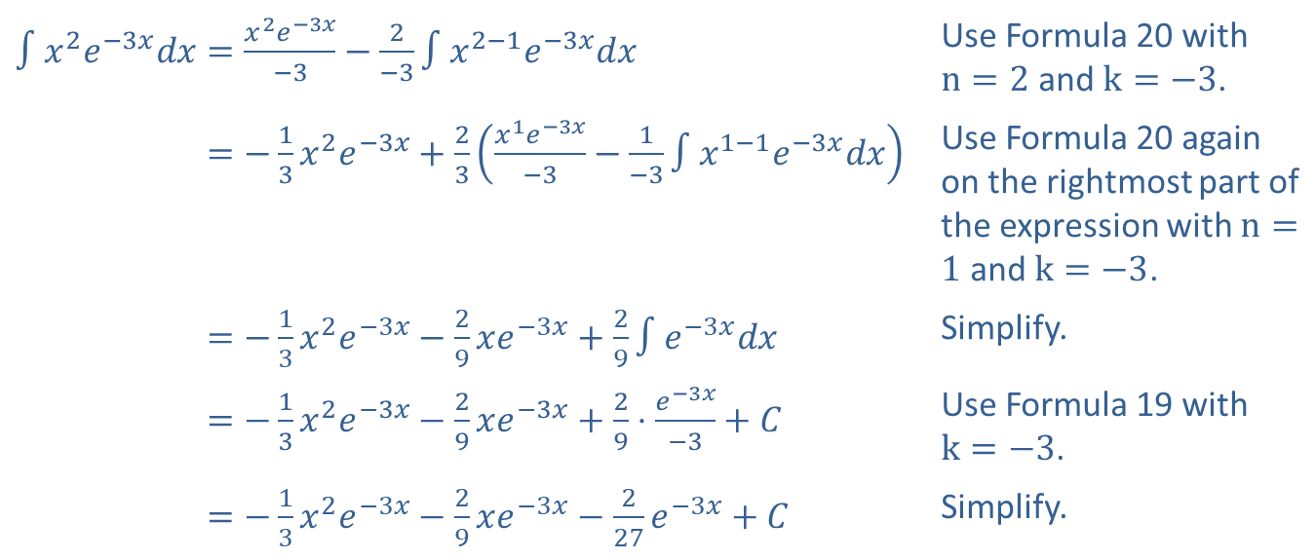
Example 3: Using a Reduction Formula (cont.)
​$∫x^{2}e^{−3x}dx=\frac{x^{2}e^{−3x}}{−3}−\frac{2}{−3}∫x^{2−1}e^{−3x}dx$ | Use Formula 20 with $n=2$ and $k=−3$.
​∫𝑥2𝑒−3𝑥𝑑𝑥=−13𝑥2𝑒−3𝑥+23𝑥1𝑒−3𝑥−3−1−3∫𝑥1−1𝑒−3𝑥𝑑𝑥 | Use Formula 20 again on the rightmost part of the expression with $n=1$ and $k=−3$.
​∫𝑥2𝑒−3𝑥𝑑𝑥=−13𝑥2𝑒−3𝑥−29𝑥𝑒−3𝑥+29∫𝑒−3𝑥𝑑𝑥 | Simplify.
​∫𝑥2𝑒−3𝑥𝑑𝑥=−13𝑥2𝑒−3𝑥−29𝑥𝑒−3𝑥+29⋅𝑒−3𝑥−3+𝐶 | Use Formula 19 with $k=−3$.
​∫𝑥2𝑒−3𝑥𝑑𝑥=−13𝑥2𝑒−3𝑥−29𝑥𝑒−3𝑥−227𝑒−3𝑥+𝐶 | Simplify.

Slide 6
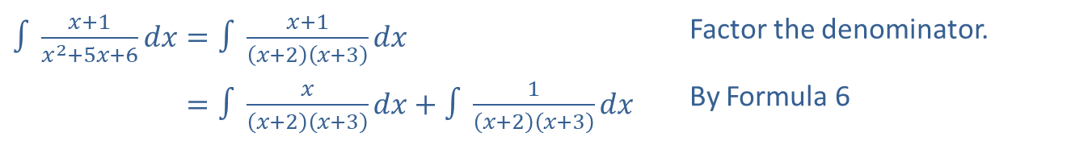

Example 4: Rewriting the Integrand
Find $∫\frac{x+1}{x^{2}+5x+6}dx$.
Solution
​$∫\frac{x+1}{x^{2}+5x+6}dx=∫\frac{x+1}{\left(x+2\right)\left(x+3\right)}dx$ | Factor the denominator.
​∫𝑥+1𝑥2+5𝑥+6𝑑𝑥=∫𝑥𝑥+2𝑥+3𝑑𝑥+∫1𝑥+2𝑥+3𝑑𝑥 | By Formula 6

Slide 7
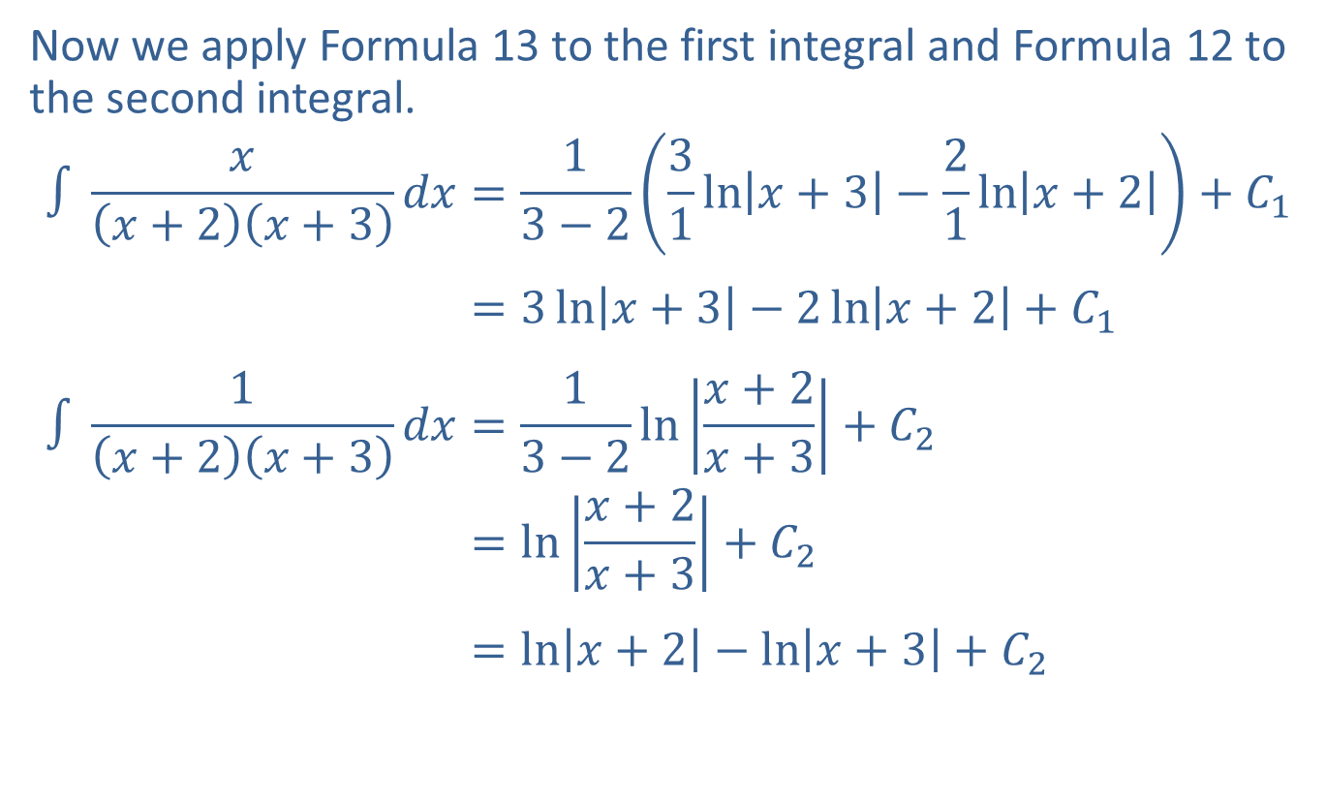
Example 4: Rewriting the Integrand (cont.)
Now we apply Formula 13 to the first integral and Formula 12 to the second integral.
∫𝑥𝑥+2𝑥+3𝑑𝑥=13−231ln𝑥+3−21ln𝑥+2+𝐶1∫𝑥𝑥+2𝑥+3𝑑𝑥=3ln𝑥+3−2ln𝑥+2+𝐶1∫1𝑥+2𝑥+3𝑑𝑥=13−2ln𝑥+2𝑥+3+𝐶2∫𝑥𝑥+2𝑥+3𝑑𝑥=ln𝑥+2𝑥+3+𝐶2∫𝑥𝑥+2𝑥+3𝑑𝑥=ln𝑥+2−ln𝑥+3+𝐶2

Slide 8
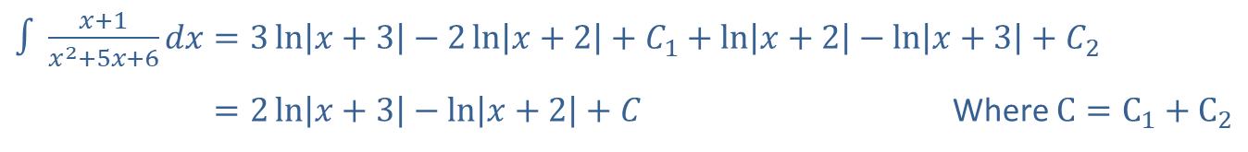
Example 4: Rewriting the Integrand (cont.)
Now combining the parts gives the result.
​$∫\frac{x+1}{x^{2}+5x+6}dx=3\ln\left|x+3\right|−2\ln\left|x+2\right|+C_{1}+\ln\left|x+2\right|−\ln\left|x+3\right|+C_{2}$
​∫𝑥+1𝑥2+5𝑥+6𝑑𝑥=2ln𝑥+3−ln𝑥+2+𝐶 Where $C=C_{1}+C_{2}$

