Slide 1
Section 7.4
Improper Integrals

Slide 2
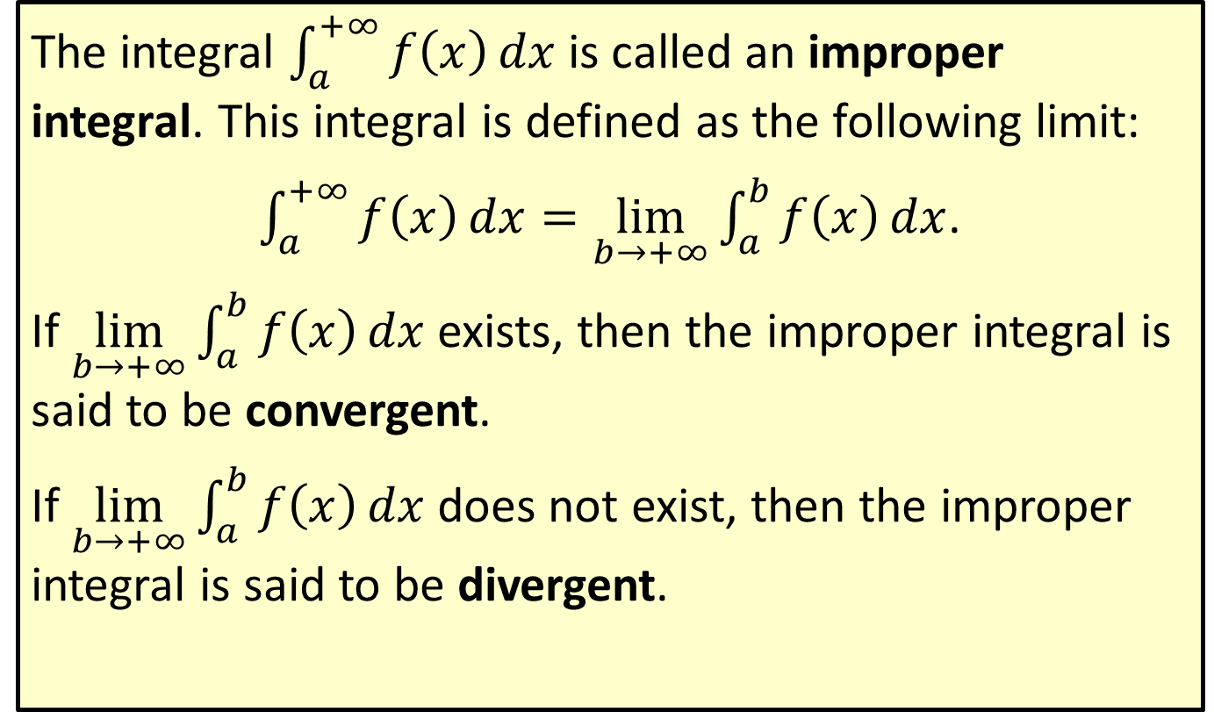
Improper Integral
The integral $\int_{a}^{+∞}{f\left(x\right)dx}$ is called an improper integral. This integral is defined as the following limit:
$\int_{a}^{+∞}{f\left(x\right)dx}=\lim_{b→+∞}\int_{a}^{b}{f\left(x\right)}dx$.
If $\lim_{b→+∞}\int_{a}^{b}{f\left(x\right)dx}$ exists, then the improper integral is said to be convergent.
If $\lim_{b→+∞}\int_{a}^{b}{f\left(x\right)dx}$ does not exist, then the improper integral is said to be divergent.

Slide 3


Example 1: Evaluating an Improper Integral
Evaluate $\int_{1}^{+∞}{\frac{1}{x^{2}}}\frac{1}{x^{2}}dx$.
Solution
First, evaluate the integral from $x=1$ to $x=b$.
1𝑏1𝑥2𝑑𝑥=1𝑏𝑥−2𝑑𝑥1𝑏1𝑥2𝑑𝑥=𝑥−1−1]1𝑏=−1𝑥]1𝑏1𝑏1𝑥2𝑑𝑥=−1𝑏+1

Slide 4
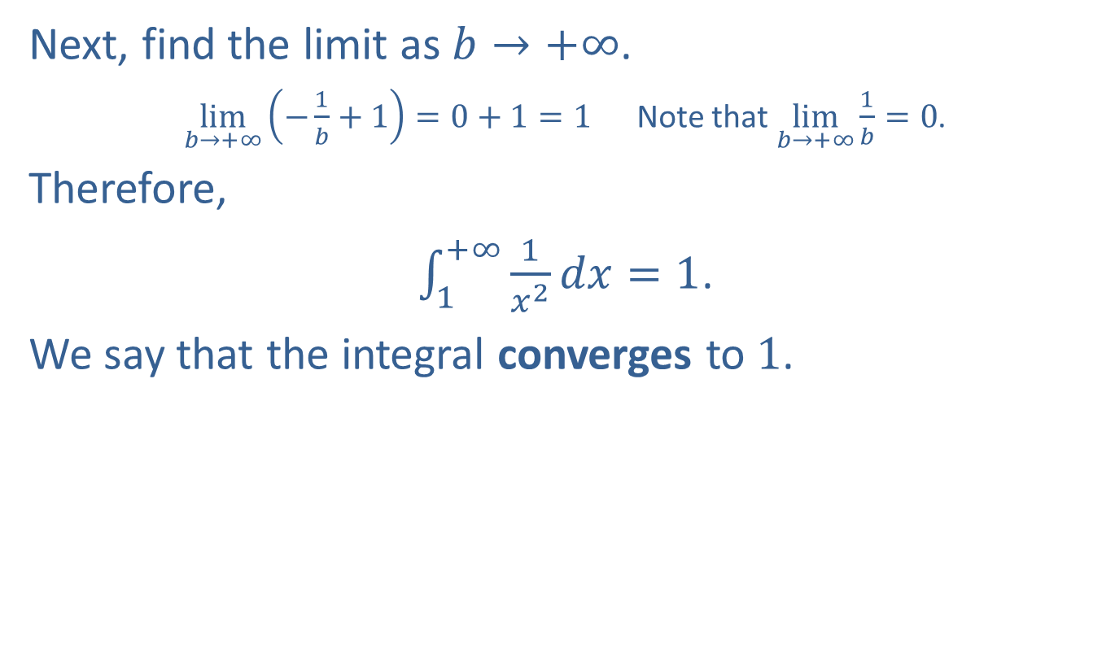
Example 1: Evaluating an Improper Integral (cont.)
Next, find the limit as $b→+∞$.
$\lim_{b→+∞}\left(−\frac{1}{b}+1\right)=0+1=1$ Note that $\lim_{b→+∞}\frac{1}{b}=0$.
Therefore,
$\int_{1}^{+∞}{\frac{1}{x^{2}}dx}=1$.
We say that the integral converges to 1.

Slide 5

Example 2: Determining Integral Convergence
Determine whether the improper integral $\int_{0}^{+∞}{e^{−3x}}e^{−3x}dx$ is convergent or divergent. Evaluate it if it is convergent.

Slide 6
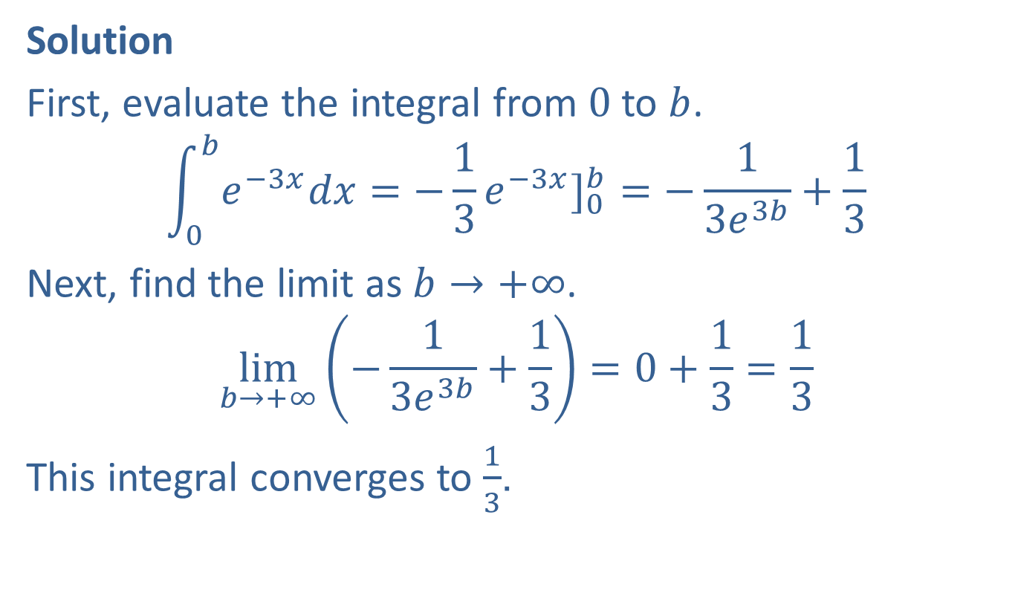
Example 2: Determining Integral Convergence (cont.)
Solution
First, evaluate the integral from 0 to $b$.
$$\int_{0}^{b}{e^{−3x}dx}=−\frac{1}{3}e^{−3x}]_{0}^{b}=−\frac{1}{3e^{3b}}+\frac{1}{3}$$
Next, find the limit as $b→+∞$.
$$\lim_{b→+∞}\left(−\frac{1}{3e^{3b}}+\frac{1}{3}\right)=0+\frac{1}{3}=\frac{1}{3}$$
This integral converges to $\frac{1}{3}$.

Slide 7
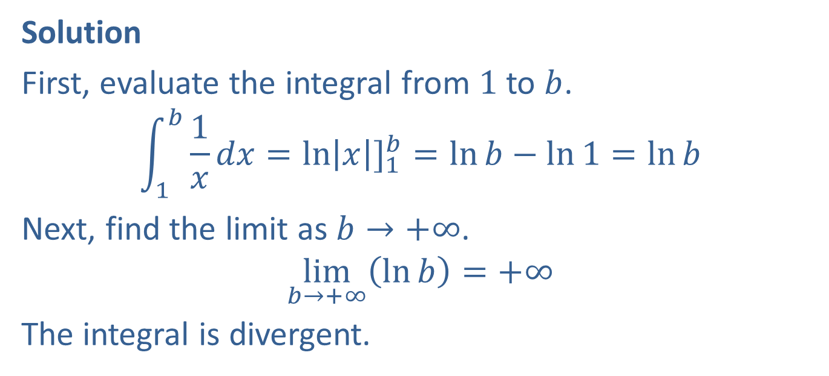

Example 3: Determining Integral Convergence
Determine whether the improper integral $\int_{1}^{+∞}{\frac{1}{x}dx}$ is convergent or divergent. Evaluate it if it is convergent.
Solution
First, evaluate the integral from 1 to $b$.
$$\int_{1}^{b}{\frac{1}{x}dx}=\ln\left|x\right|]_{1}^{b}=\ln{b}−\ln{1}=\ln{b}$$
Next, find the limit as $b→+∞$.
$$\lim_{b→+∞}\left(\ln{b}\right)=+∞$$
The integral is divergent.

Slide 8

Example 4: Determining Integral Convergence
Find the value of the integral $\int_{4}^{+∞}{\frac{1}{\sqrt{x}}dx}$ if it is convergent.

Slide 9
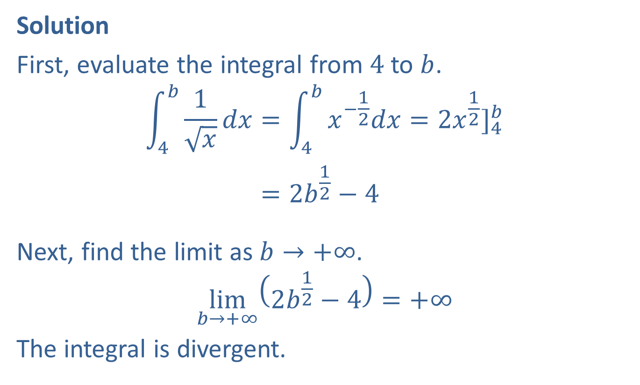
Example 4: Determining Integral Convergence (cont.)
Solution
First, evaluate the integral from 4 to $b$.
4𝑏1𝑥𝑑𝑥=4𝑏𝑥−12𝑑𝑥=2𝑥12]4𝑏4𝑏1𝑥𝑑𝑥=2𝑏12−4
Next, find the limit as $b→+∞$.
$$\lim_{b→+∞}\left(2b^{\frac{1}{2}}−4\right)=+∞$$
The integral is divergent.

Slide 10


Example 5: Determining Integral Convergence
Find the value of the integral $\int_{1}^{+∞}{\frac{1}{x^{\frac{3}{2}}}dx}$ if it is convergent.
Solution
First, evaluate the integral from 1 to $b$.
1𝑏1𝑥32𝑑𝑥=1𝑏𝑥−32𝑑𝑥=−2𝑥−12]1𝑏1𝑏1𝑥32𝑑𝑥=−2𝑏−12+2=−2𝑏12+2

Slide 11

Example 5: Determining Integral Convergence (cont.)
Next, find the limit as $b→+∞$.
$$\lim_{b→+∞}\left(−\frac{2}{b^{\frac{1}{2}}}+2\right)=0+2=2$$
The integral converges to 2.

Slide 12

Example 6: Area Bounded by an Asymptote
Find the value of $\int_{0}^{1}{\frac{1}{x^{2}}dx}$.
Solution
Since the integrand is not defined at the lower limit, we must use a limit to evaluate the integral.

Slide 13
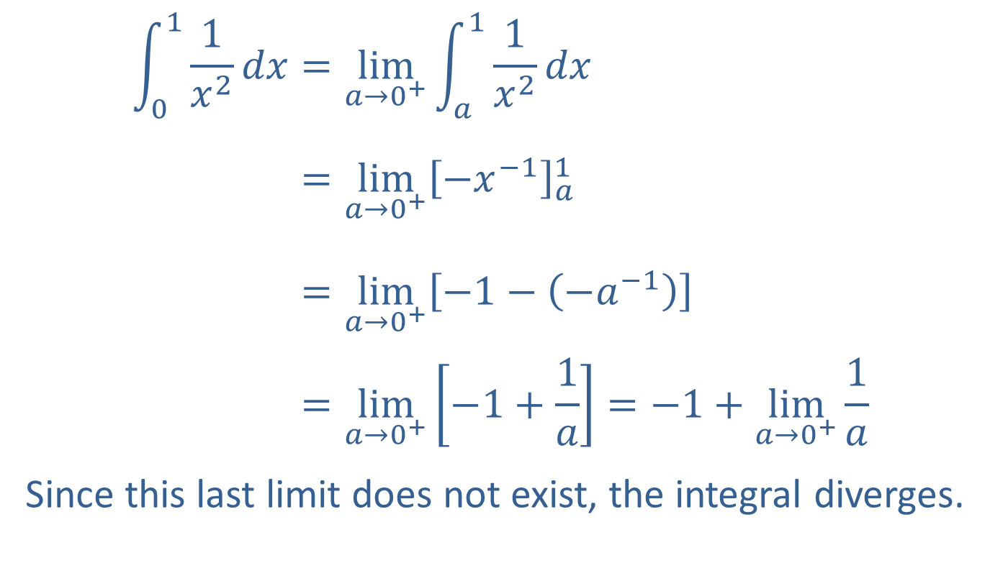
Example 6: Area Bounded by an Asymptote (cont.)
011𝑥2𝑑𝑥=lim𝑎→0+𝑎11𝑥2𝑑𝑥011𝑥2𝑑𝑥=lim𝑎→0+−𝑥−1𝑎1011𝑥2𝑑𝑥=lim𝑎→0+−1−−𝑎−1011𝑥2𝑑𝑥=lim𝑎→0+−1+1𝑎=−1+lim𝑎→0+1𝑎
Since this last limit does not exist, the integral diverges.

