Slide 1
Section 7.5
Probability

Slide 2
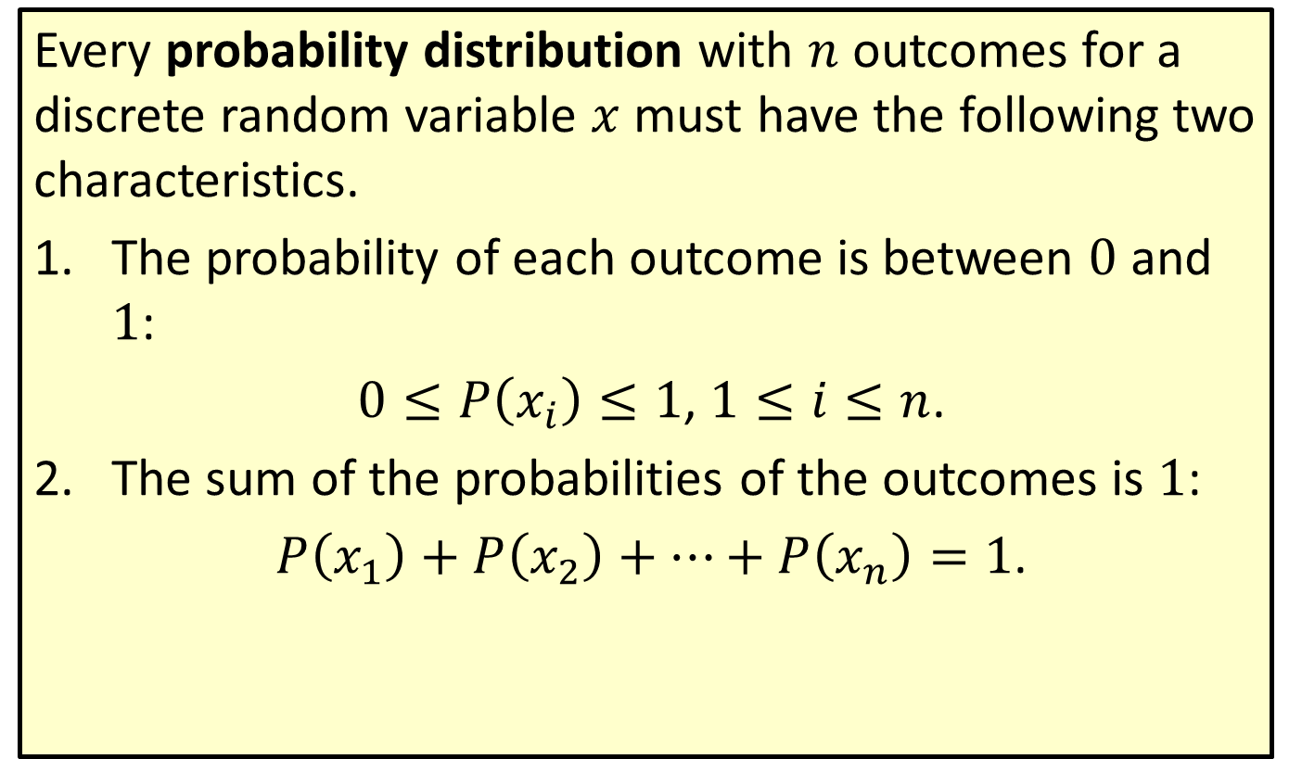
Probability Distribution
Every probability distribution with $n$ outcomes for a discrete random variable $x$ must have the following two characteristics.
​The probability of each outcome is between 0 and 1:
​ $0≤P\left(x_{i}\right)≤1$, $1≤i≤n$.
​The sum of the probabilities of the outcomes is 1:
​ $P\left(x_{1}\right)+P\left(x_{2}\right)+…+P\left(x_{n}\right)=1$.

Slide 3
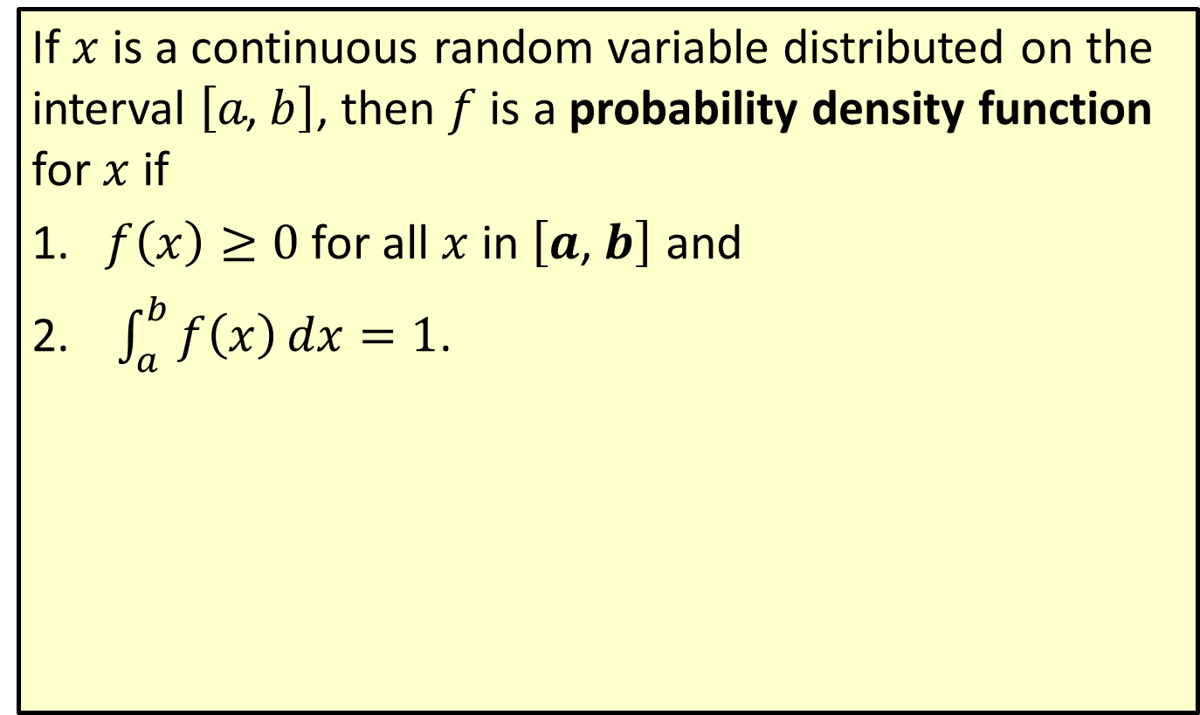
Probability Density Function
If $x$ is a continuous random variable distributed on the interval $\left[a\text{, }b\right]$, then $f$ is a probability density function for $x$ if
​$f\left(x\right)≥0$ for all $x$ in $\left[a\text{, }b\right]$ and
​ $\int_{a}^{b}{f\left(x\right)dx}=1$.

Slide 4


Example 1: Probability Density Function
Show that $f\left(x\right)=\frac{3}{10}\left(3x−x^{2}\right)$ is a probability density function on the interval $\left[0\text{, }2\right]$.
Solution
First, we note that $f\left(x\right)≥0$ for all $x$ in $\left[0\text{, }2\right]$. Then we evaluate the integral.

Slide 5
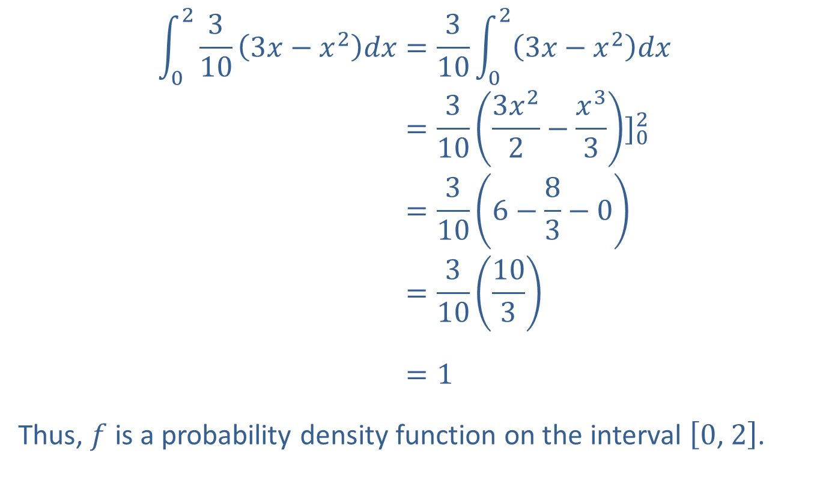
Example 1: Probability Density Function (cont.)
023103𝑥−𝑥2𝑑𝑥=310023𝑥−𝑥2𝑑𝑥023103𝑥−𝑥2𝑑𝑥=3103𝑥22−𝑥33]02023103𝑥−𝑥2𝑑𝑥=3106−83−0023103𝑥−𝑥2𝑑𝑥=310103023103𝑥−𝑥2𝑑𝑥=1
Thus, $f$ is a probability density function on the interval $\left[0\text{, }2\right]$.

Slide 6

Example 2: Probability Density Function
The function $f\left(x\right)=\frac{1}{12}x$ is a probability density function on the interval $\left[1\text{, }5\right]$.
​Find the probability that $x$ is between 1 and 2.
​Show that the probability at $x=3$ is 0.

Slide 7
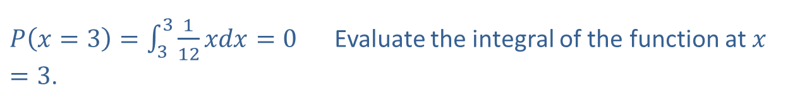
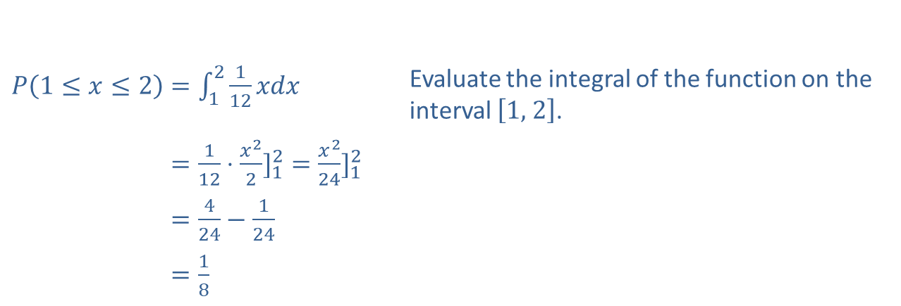
Example 2: Probability Density Function (cont.)
Solution
​
​$P\left(1≤x≤2\right)=\int_{1}^{2}{\frac{1}{12}xdx}$ | Evaluate the integral of the function on the interval $\left[1\text{, }2\right]$.
​𝑃⁡1≤𝑥≤2=112⋅𝑥22]12=𝑥224]12
​𝑃⁡1≤𝑥≤2=424−124
​𝑃⁡1≤𝑥≤2=18
​$P\left(x=3\right)=\int_{3}^{3}{\frac{1}{12}xdx}=0$ Evaluate the integral of the function at $x=3$.

Slide 8
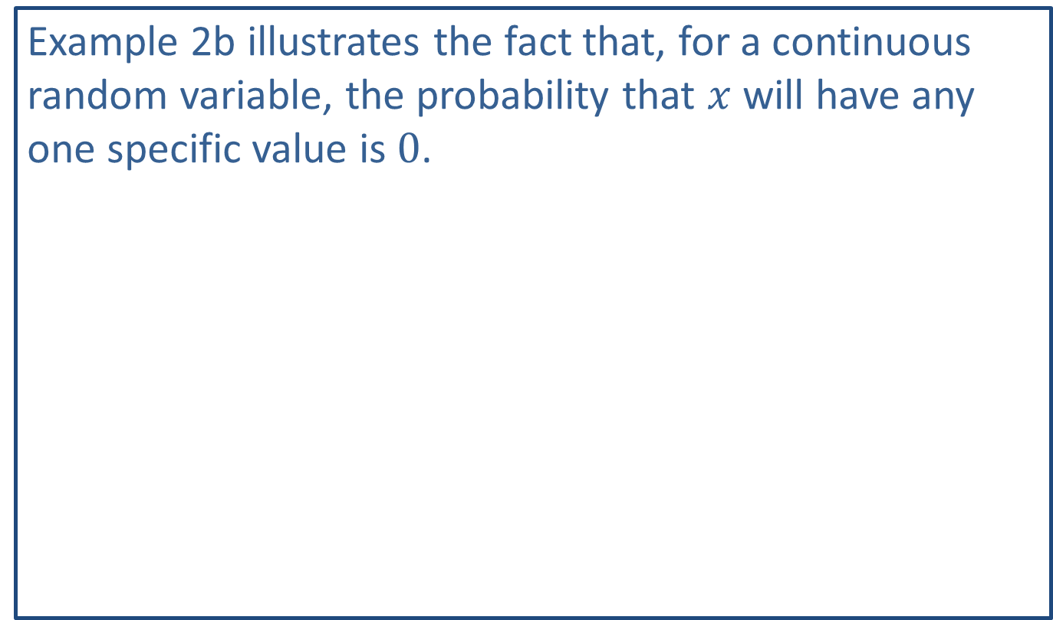
NOTE
Example 2b illustrates the fact that, for a continuous random variable, the probability that $x$ will have any one specific value is 0.

Slide 9
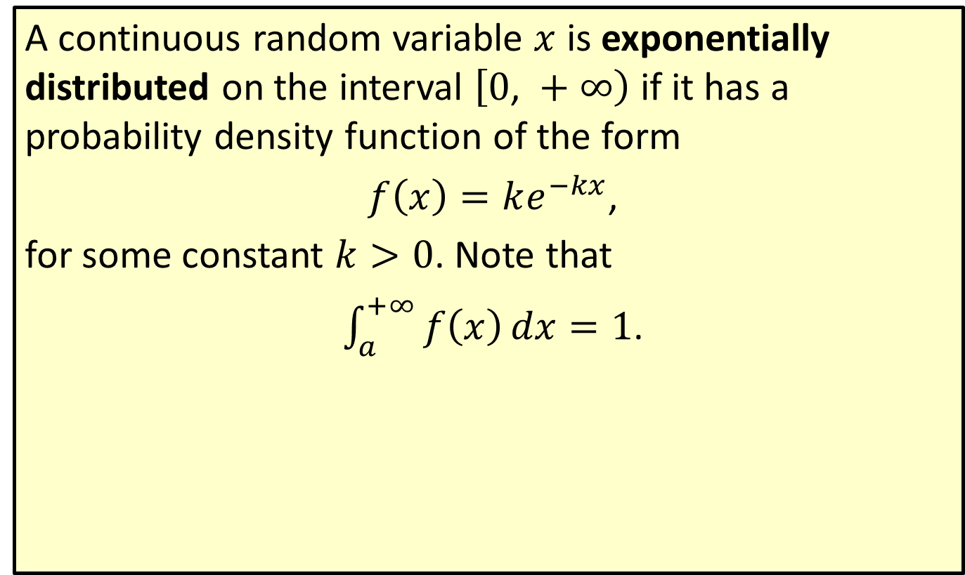
Exponential Distribution
A continuous random variable $x$ is exponentially distributed on the interval $\left[0\text{, }+∞\right)$ if it has a probability density function of the form
$f\left(x\right)=ke^{−kx}$,
for some constant $k>0$. Note that
$\int_{a}^{+∞}{f\left(x\right)dx}=1$.

Slide 10
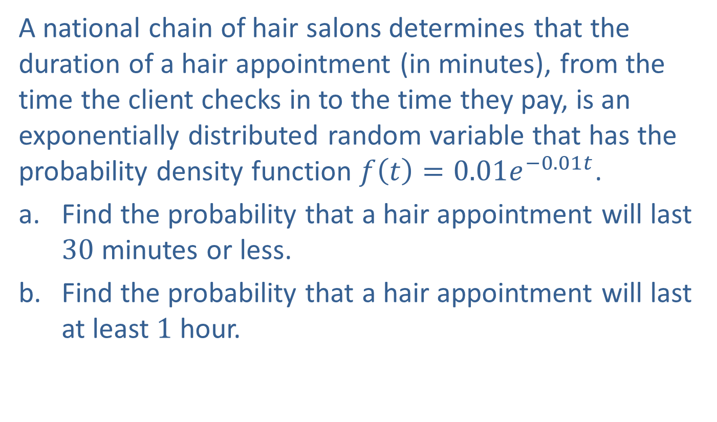
Example 3: Exponential Distribution
A national chain of hair salons determines that the duration of a hair appointment (in minutes), from the time the client checks in to the time they pay, is an exponentially distributed random variable that has the probability density function $f\left(t\right)=0.01e^{−0.01t}$.
​Find the probability that a hair appointment will last 30 minutes or less.
​Find the probability that a hair appointment will last at least 1 hour.

Slide 11
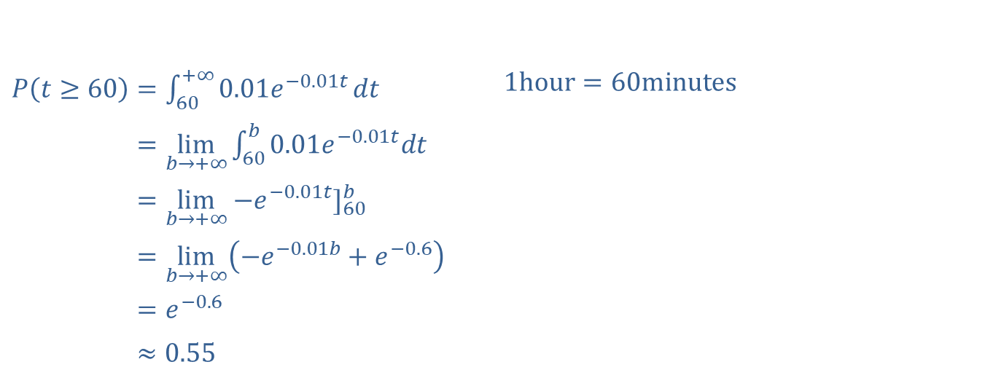

Example 3: Exponential Distribution (cont.)
Solution
$P\left(0≤t≤30\right)=\int_{0}^{30}{0.01e^{−0.01t}dt}$ 𝑃⁡0≤𝑡≤30=−𝑒−0.01𝑡]030 𝑃⁡0≤𝑡≤30=−𝑒−0.3+1 𝑃⁡0≤𝑡≤30≈0.26
​
​$P\left(t≥60\right)=\int_{60}^{+∞}{0.01e^{−0.01t}}dt$ | $$1\text{hour}=60\text{minutes}$$
​𝑃⁡𝑡≥60=lim𝑏→+∞60𝑏0.01𝑒−0.01𝑡𝑑𝑡
​𝑃⁡𝑡≥60=lim𝑏→+∞−𝑒−0.01𝑡]60𝑏
​𝑃⁡𝑡≥60=lim𝑏→+∞−𝑒−0.01𝑏+𝑒−0.6
​𝑃⁡𝑡≥60=𝑒−0.6
​𝑃⁡𝑡≥60≈0.55

Slide 12
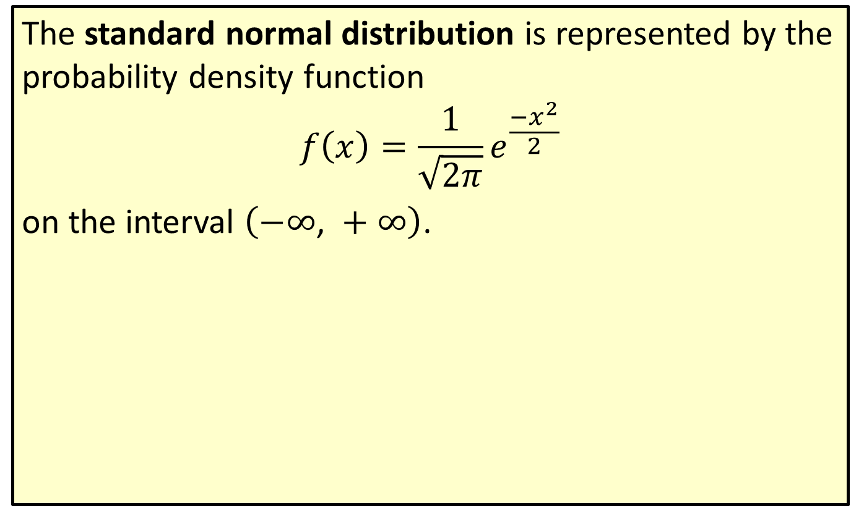
Standard Normal Distribution
The standard normal distribution is represented by the probability density function
$$f\left(x\right)=\frac{1}{\sqrt{2π}}e^{\frac{{−x}^{2}}{2}}$$
on the interval $\left(−∞\text{, }+∞\right)$.

Slide 13
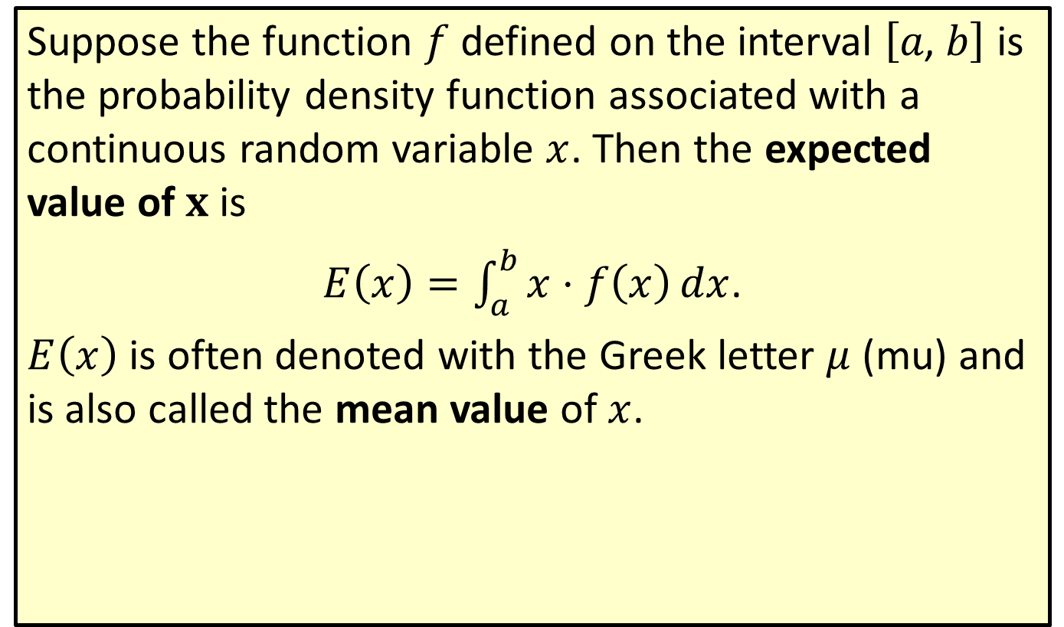
Expected Value
Suppose the function $f$ defined on the interval $\left[a\text{, }b\right]$ is the probability density function associated with a continuous random variable $x$. Then the expected value of $x$ is
$E\left(x\right)=\int_{a}^{b}{x⋅f\left(x\right)dx}$.
$E⁡\left(x\right)$ is often denoted with the Greek letter $μ$ (mu) and is also called the mean value of $x$.

Slide 14

Example 4: Calculating Expected Value
For the function $f\left(x\right)=\frac{3x^{2}}{64}$,
​verify that $f⁡\left(x\right)$ is a probability density function on the interval $\left[0\text{, }4\right]$ and
​determine the expected value of $x$.

Slide 15
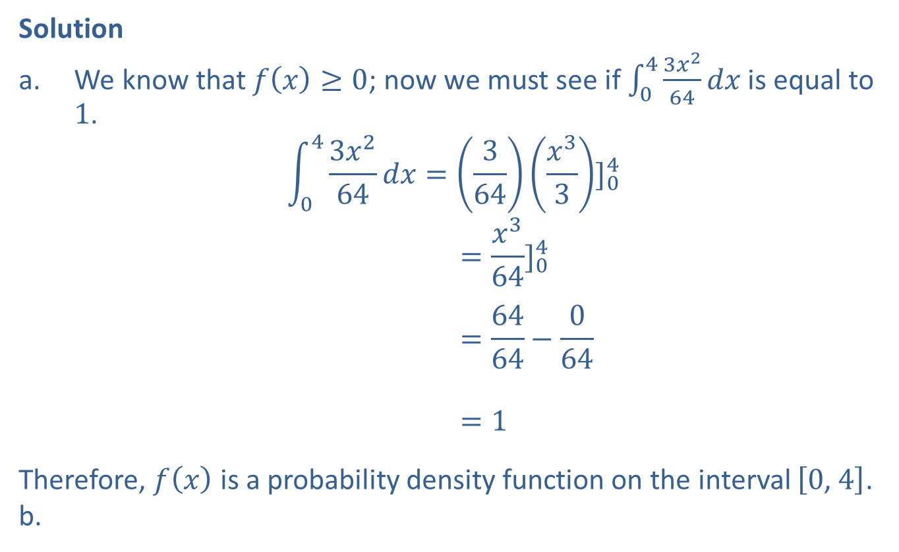
Example 4: Calculating Expected Value (cont.)
Solution
​We know that $f\left(x\right)≥0$; now we must see if $\int_{0}^{4}{\frac{3x^{2}}{64}dx}$ is equal to 1.
043𝑥264𝑑𝑥=364𝑥33]04043𝑥264𝑑𝑥=𝑥364]04043𝑥264𝑑𝑥=6464−064043𝑥264𝑑𝑥=1
​Therefore, $f⁡\left(x\right)$ is a probability density function on the interval $\left[0\text{, }4\right]$.
​

Slide 16
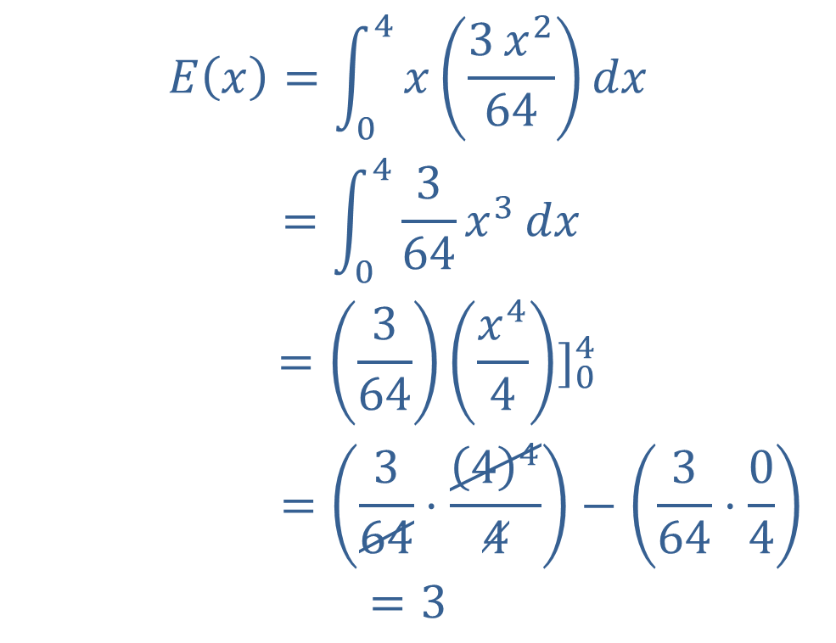
Example 4: Calculating Expected Value (cont.)
𝐸𝑥=04𝑥3𝑥264𝑑𝑥𝐸⁡=04364𝑥3𝑑𝑥=364𝑥44]04𝐸⁡𝑥 =364⋅444−364⋅04=3

Slide 17
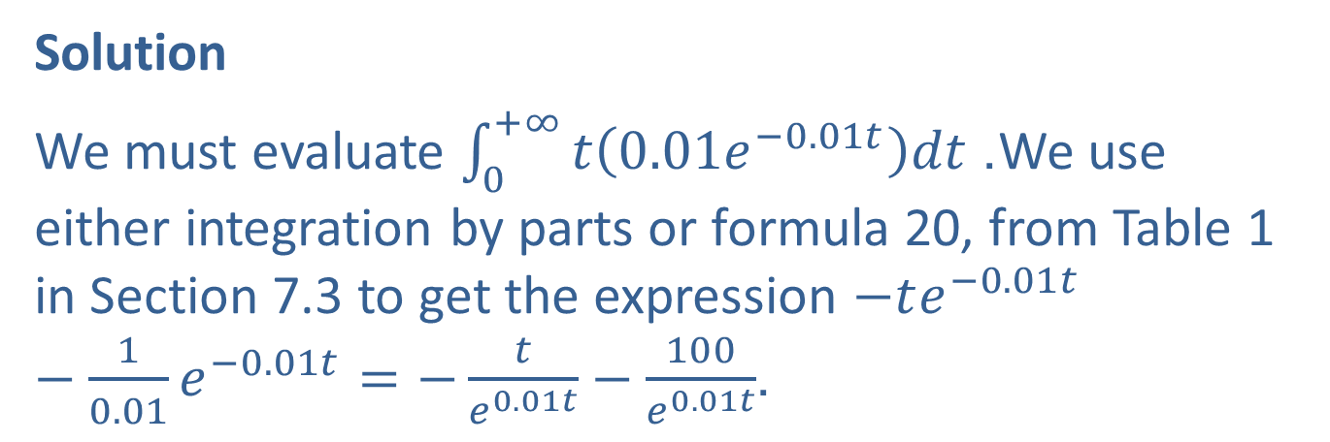
Example 5: Calculating Expected Value
For the scenario described in Example 3, determine the average duration of ahair appointment.
Solution
We must evaluate $\int_{0}^{+∞}{t\left(0.01e^{−0.01t}\right)dt}$. We use either integration by parts or formula 20, from Table 1 in Section 7.3 to get the expression $−te^{−0.01t}−\frac{1}{0.01}e^{−0.01t}=−\frac{t}{e^{0.01t}}−\frac{100}{e^{0.01t}}$.

Slide 18
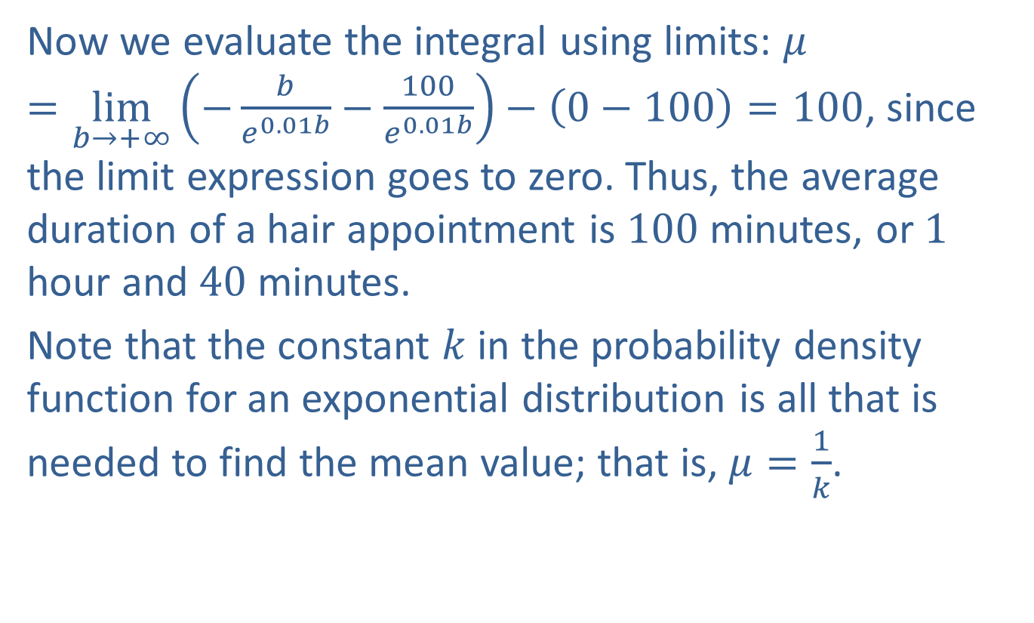
Example 5: Calculating Expected Value (cont.)
Now we evaluate the integral using limits: $μ=\lim_{b→+∞}\left(−\frac{b}{e^{0.01b}}−\frac{100}{e^{0.01b}}\right)−\left(0−100\right)=100$, since the limit expression goes to zero. Thus, the average duration of a hair appointment is 100 minutes, or 1 hour and 40 minutes.
Note that the constant $k$ in the probability density function for an exponential distribution is all that is needed to find the mean value; that is, $μ=\frac{1}{k}$.

