Slide 1
Section 7.6
Volume

Slide 2
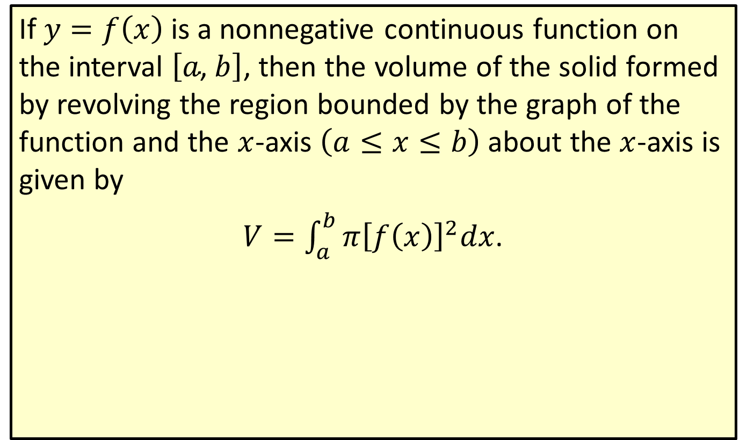
Volume of a Solid of Revolution
If $y=f\left(x\right)$ is a nonnegative continuous function on the interval $\left[a\text{, }b\right]$, then the volume of the solid formed by revolving the region bounded by the graph of the function and the $x$-axis $\left(a≤x≤b\right)$ about the $x$-axis is given by
$V=\int_{a}^{b}{π{\left[f\left(x\right)\right]}^{2}dx}$.

Slide 3

Example 1: Finding the Volume of a Solid of Revolution
Find the volume of the solid of revolution generated by revolving the region under the curve $y=\sqrt{x}$ from $x=0$ to $x=4$ about the $x$-axis.

Slide 4
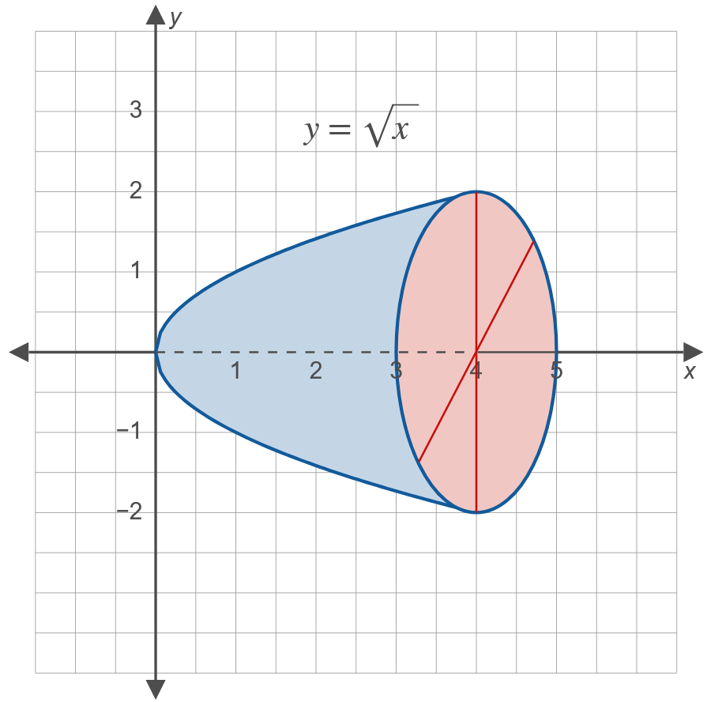
Example 1: Finding the Volume of a Solid of Revolution (cont.)
Solution

Slide 5

Example 1: Finding the Volume of a Solid of Revolution (cont.)
𝑉=04𝜋𝑓𝑥2𝑑𝑥𝑉=04𝜋𝑥2𝑑𝑥𝑉=𝜋04𝑥𝑑𝑥𝑉=𝜋𝑥22]04𝑉=8𝜋
The volume is $8π$ cubic units.

Slide 6

Example 2: Finding the Volume of a Solid of Revolution
If the region under the line $y=\frac{r}{h}x$ from $x=0$ to $x=h$ is revolved about the $x$-axis, a circular cone is formed. Find the volume of this cone.

Slide 7
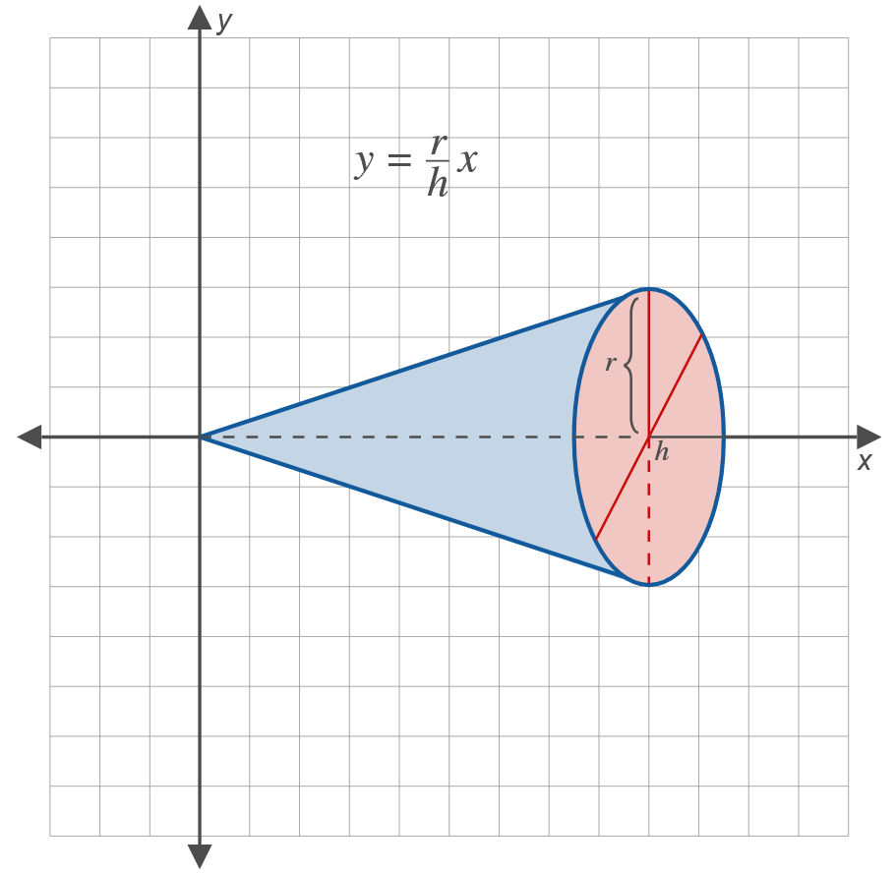
Example 2: Finding the Volume of a Solid of Revolution (cont.)
Solution

Slide 8

Example 2: Finding the Volume of a Solid of Revolution (cont.)
𝑉=0h𝜋𝑓𝑥2𝑑𝑥𝑉=𝜋0h𝑟h𝑥2𝑑𝑥𝑉=𝜋𝑟2h20h𝑥2𝑑𝑥𝑉=𝜋𝑟2h2𝑥33]0h𝑉=𝜋𝑟2h2h33𝑉=13𝜋𝑟2h
Thus the volume is given by the standard formula $\frac{1}{3}πr^{2}h$.

Slide 9

Example 3: Finding the Volume of a Solid of Revolution
The region bounded by the parabola $y=9−x^{2}$ and the $x$-axis is revolved about the $x$-axis. Find the volume of the solid of revolution that is generated.

Slide 10
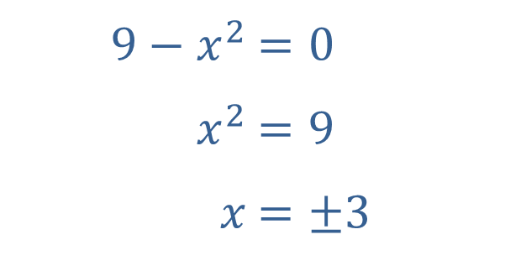

Example 3: Finding the Volume of a Solid of Revolution (cont.)
Solution
Set $y=0$ to find the points where the parabola intersects the $x$-axis.
​
​$9−x^{2}$ | ​$=0$
​$x^{2}$ | ​$=9$
​$x$ | ​$=±3$

Slide 11
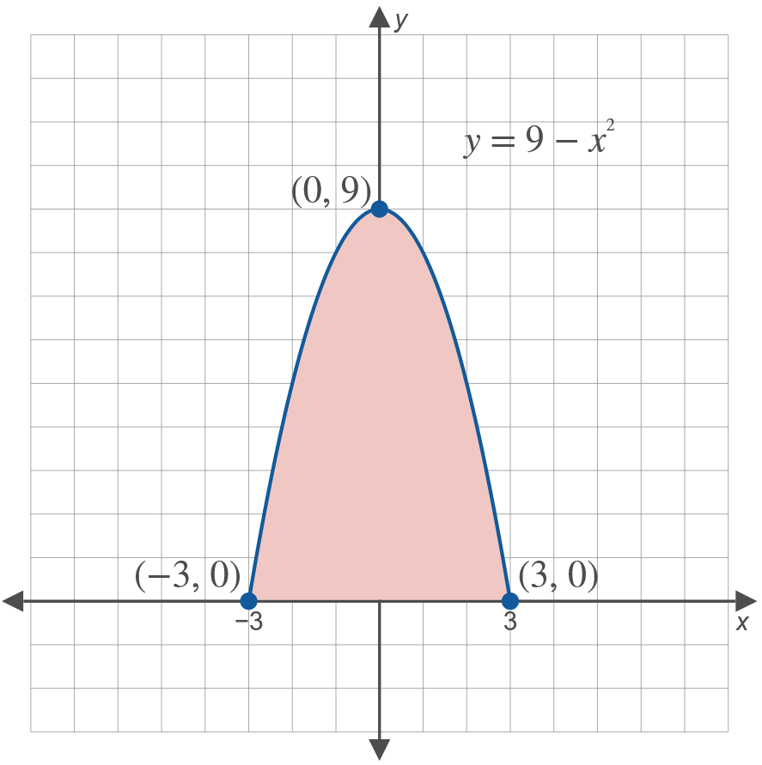
Example 3: Finding the Volume of a Solid of Revolution (cont.)

Slide 12
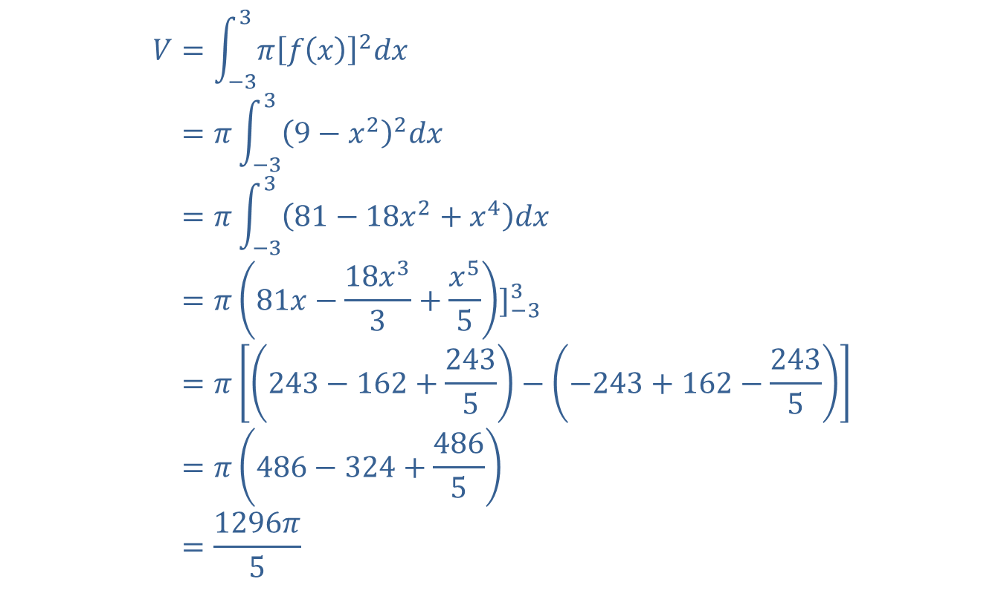
Example 3: Finding the Volume of a Solid of Revolution (cont.)
𝑉=−33𝜋𝑓𝑥2𝑑𝑥𝑉=𝜋−339−𝑥22𝑑𝑥𝑉=𝜋−3381−18𝑥2+𝑥4𝑑𝑥𝑉=𝜋81𝑥−18𝑥33+𝑥55]−33𝑉=𝜋243−162+2435−−243+162−2435𝑉=𝜋486−324+4865𝑉=1296𝜋5

Slide 13
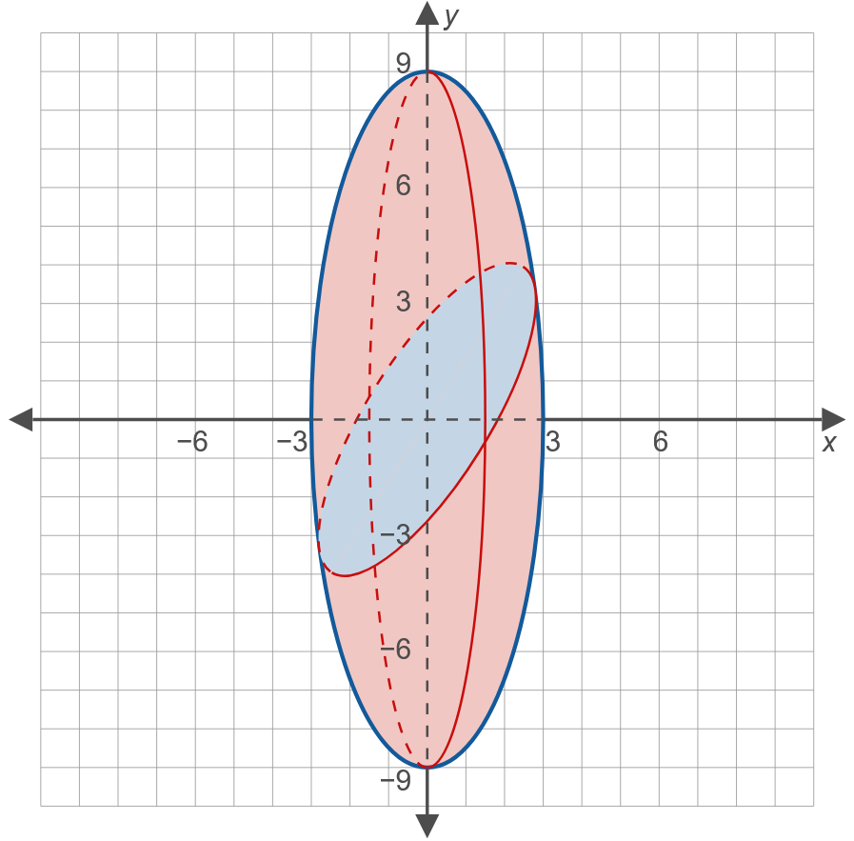
Example 3: Finding the Volume of a Solid of Revolution (cont.)

Slide 14

Example 3: Finding the Volume of a Solid of Revolution (cont.)
The volume is $\frac{1296π}{5}$ cubic units.

