Slide 1
Section 8.1
Functions of Several Variables

Slide 2
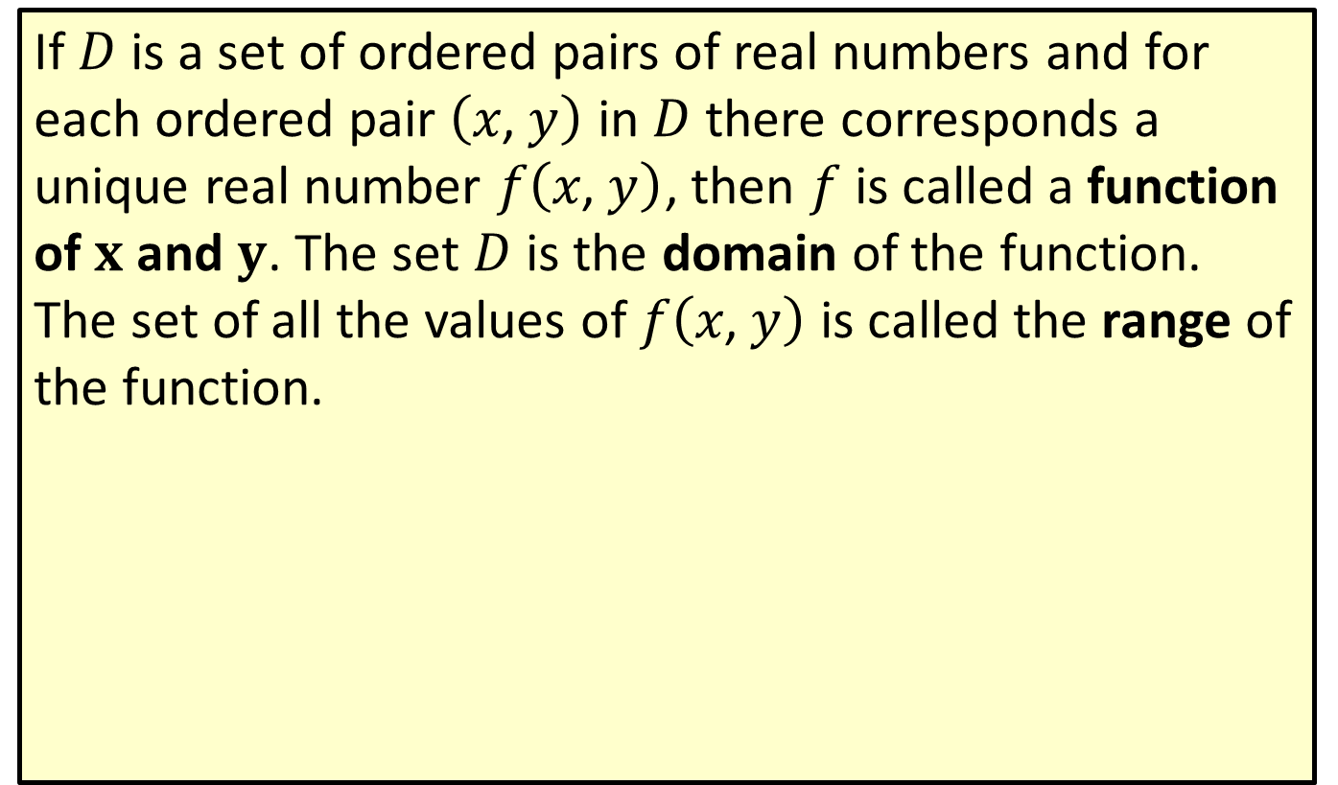

Domain and Range of $f⁡\left(x\text{, }y\right)$
If $D$ is a set of ordered pairs of real numbers and for each ordered pair $\left(x\text{, }y\right)$ in $D$ there corresponds a unique real number $f⁡\left(x\text{, }y\right)$, then $f$ is called a function of $x$ and $y$. The set $D$ is the domain of the function. The set of all the values of $f⁡\left(x\text{, }y\right)$ is called the range of the function.

Slide 3


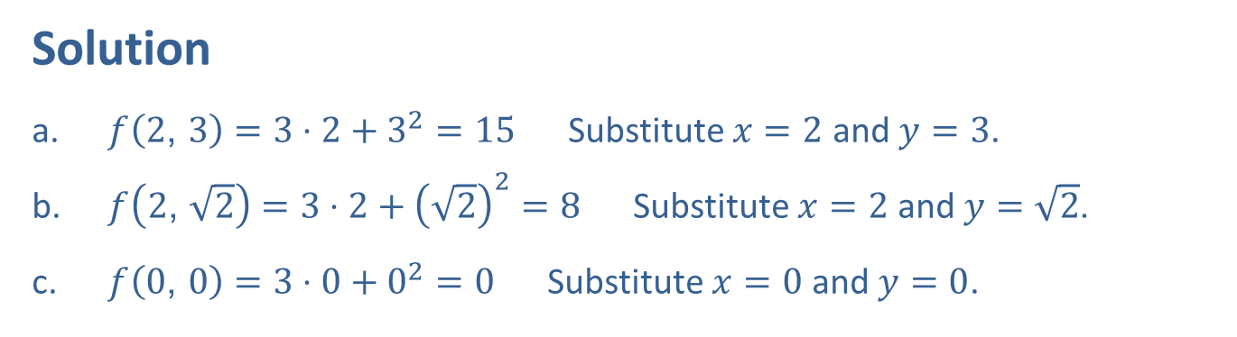
Example 1: Evaluating $f$ ($x$, $y$)
For $f\left(x\text{, }y\right)=3x+y^{2}$ find the following.
​$f⁡\left(2\text{, }3\right)$
​$f⁡\left(2\text{, }\sqrt{2}\right)$
​$f⁡\left(0\text{, }0\right)$
Solution
​$f\left(2\text{, }3\right)=3⋅2+3^{2}=15$ Substitute $x=2$ and $y=3$.
​$f\left(2\text{, }\sqrt{2}\right)=3⋅2+{\left(\sqrt{2}\right)}^{2}=8$ Substitute $x=2$ and $y=\sqrt{2}$.
​$f\left(0\text{, }0\right)=3⋅0+0^{2}=0$ Substitute $x=0$ and $y=0$.

Slide 4


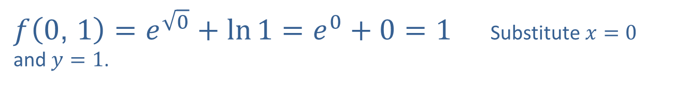

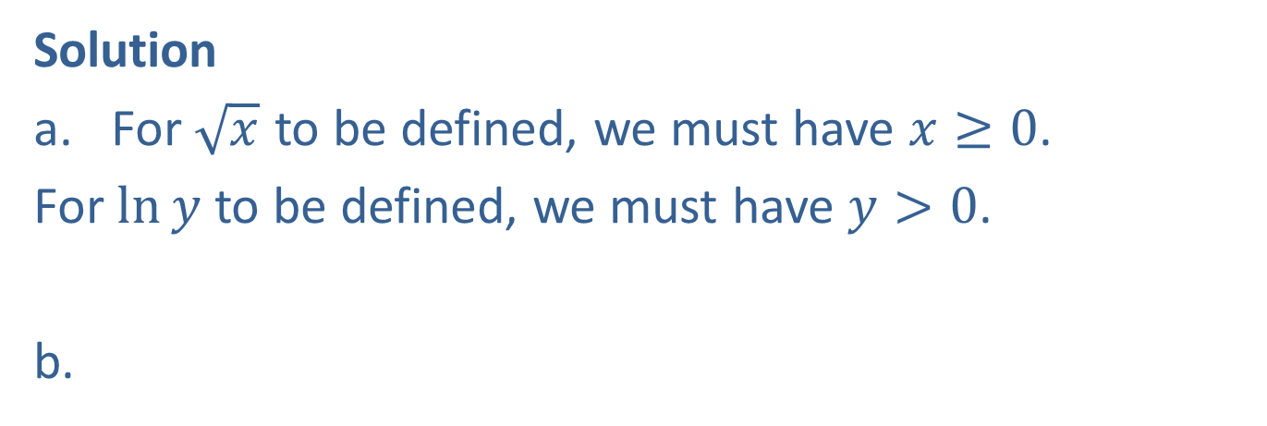
Example 2: Evaluating $f$ ($x$, $y$)
For $f\left(x\text{, }y\right)=e^{\sqrt{x}}+\ln{y}$,
​find the domain and
​find $f⁡\left(0\text{, }1\right)$.
Solution
​For $\sqrt{x}$ to be defined, we must have $x≥0$.
​For $ln⁡y$ to be defined, we must have $y>0$.
So, the domain is
$\left\{\left(x\text{, }y\right)\text{, }x≥0 and y>0\right\}$.
$f\left(0\text{, }1\right)=e^{\sqrt{0}}+\ln{1}=e^{0}+0=1$ Substitute $x=0$ and $y=1$.

Slide 5

Example 3: Evaluating Revenue Influenced by Two Variables
A store sells two brands of soda. Brand A sells for $\$1.25$ per bottle and Brand B sells for $\$1.50$ per bottle.
​What is the revenue function for soda?
​What is the revenue for soda if 100 bottles of Brand A and 150 bottles of Brand B are sold?

Slide 6
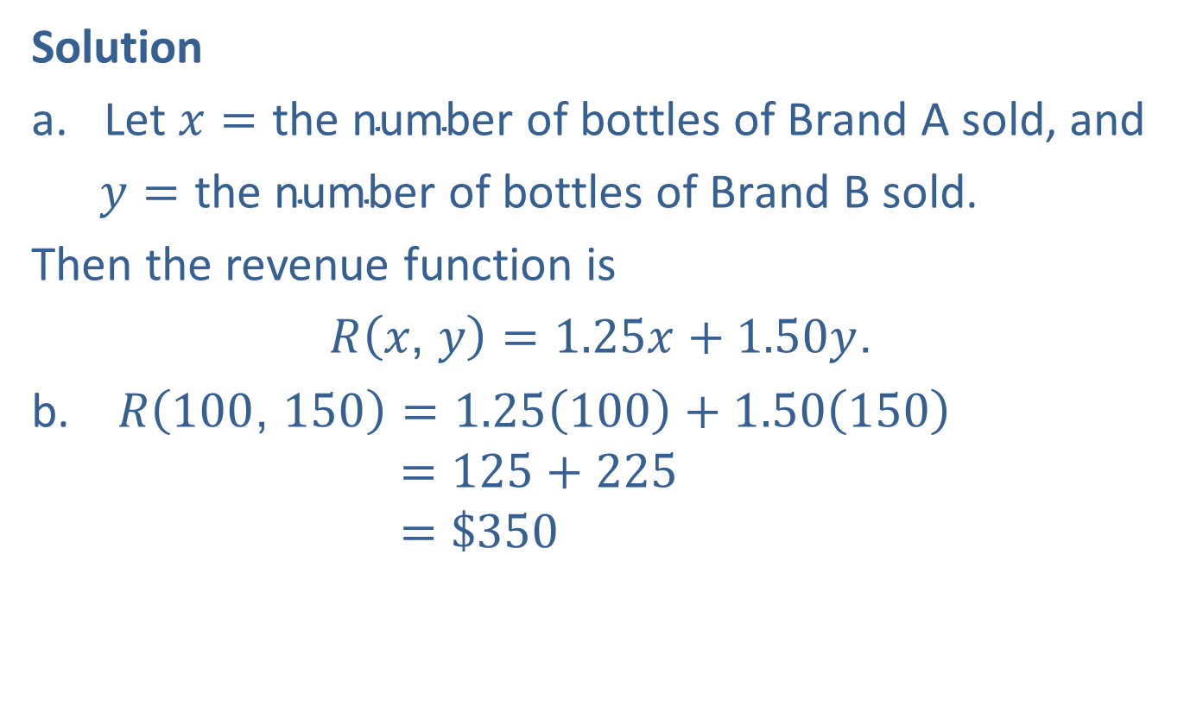
Example 3: Evaluating Revenue Influenced by Two Variables (cont.)
Solution
​Let $x=\text{the} \text{number} \text{of} \text{bottles} \text{of} \text{Brand} \text{A} \text{sold}$, and
​Let𝑦=the number of bottles of Brand B sold.
​Then the revenue function is
​$R\left(x\text{, }y\right)=1.25x+1.50y$.
$R\left(100\text{, }150\right)=1.25\left(100\right)+1.50\left(150\right)$ 𝑅⁡100, 150 =125+225 𝑅⁡100, 150 =$350

Slide 7
Example 4: Characteristics of a Box
Suppose that a box has a square base and an open top.
​Write a function of two variables that represents the volume of the box.
​Write a function of two variables that represents the surface area of the box.
​Determine the surface area if the dimensions of the box are 4 by 4 by 5.

Slide 8
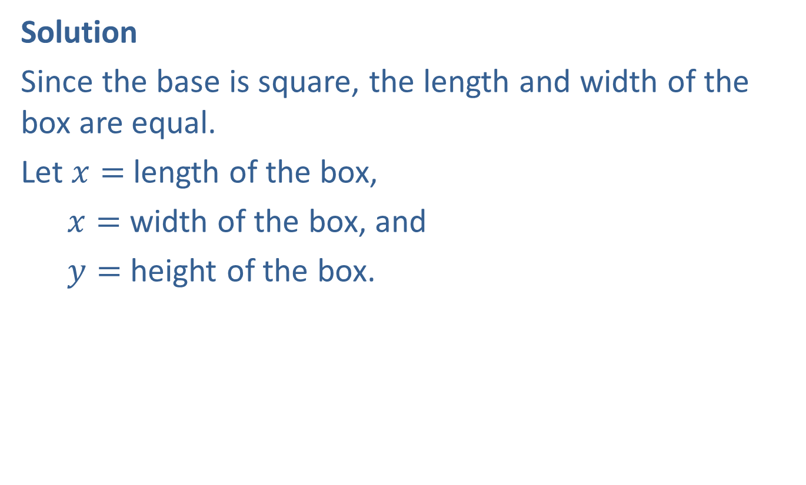
Example 4: Characteristics of a Box (cont.)
Solution
Since the base is square, the length and width of the box are equal.
Let $x=$ length of the box,
Let𝑥= width of the box, and
Let𝑦= height of the box.

Slide 9
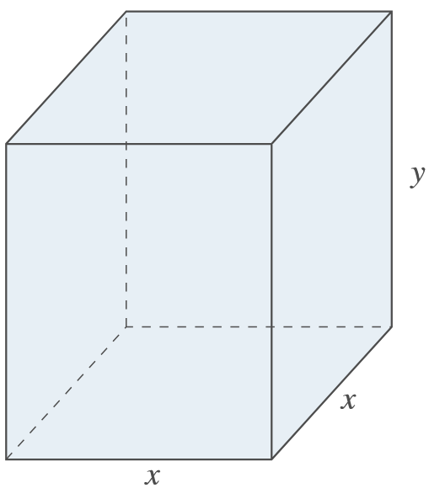
Example 4: Characteristics of a Box (cont.)

Slide 10

Example 4: Characteristics of a Box (cont.)
​The formula for the volume of a rectangular solid is $V=l⋅w⋅h$ where $l=length$, $w=width$, and $h=height$. Thus, the function that represents the volume of this box is as follows.
​$V\left(x\text{, }y\right)=x⋅x⋅y=x^{2}y$

Slide 11
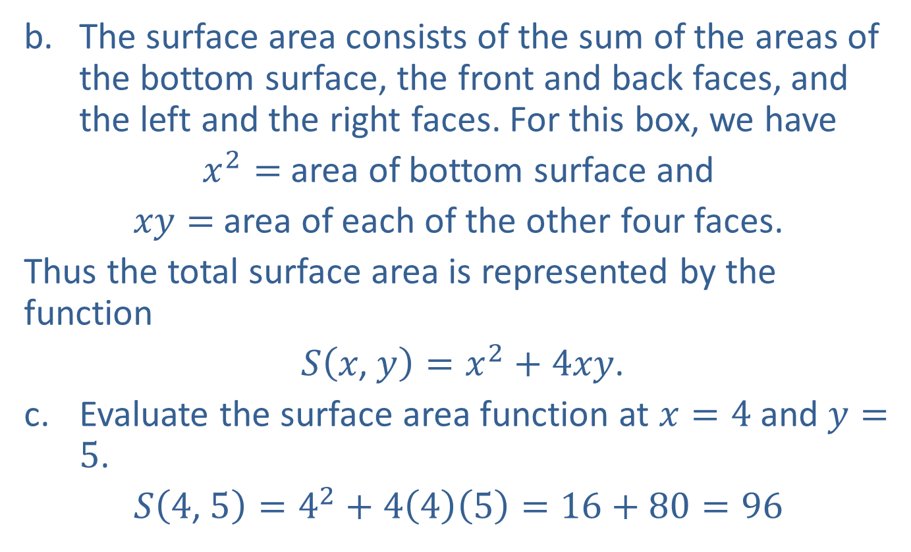
Example 4: Characteristics of a Box (cont.)
​The surface area consists of the sum of the areas of the bottom surface, the front and back faces, and the left and the right faces. For this box, we have
​$x^{2}=$ area of bottom surface and
​$xy=$ area of each of the other four faces.
​Thus the total surface area is represented by the function
​ $S\left(x\text{, }y\right)=x^{2}+4xy$.
​Evaluate the surface area function at $x=4$ and $y=5$.
​$S\left(4\text{, }5\right)=4^{2}+4\left(4\right)\left(5\right)=16+80=96$

Slide 12
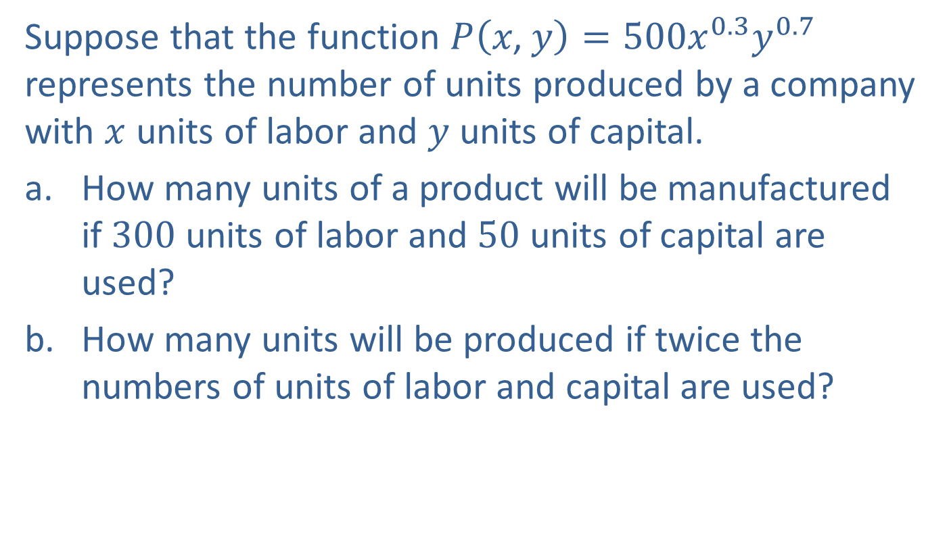
Example 5: Using the Cobb-Douglas Production Formula
Suppose that the function $P\left(x\text{, }y\right)=500x^{0.3}y^{0.7}$ represents the number of units produced by a company with $x$ units of labor and $y$ units of capital.
​How many units of a product will be manufactured if 300 units of labor and 50 units of capital are used?
​How many units will be produced if twice the numbers of units of labor and capital are used?

Slide 13
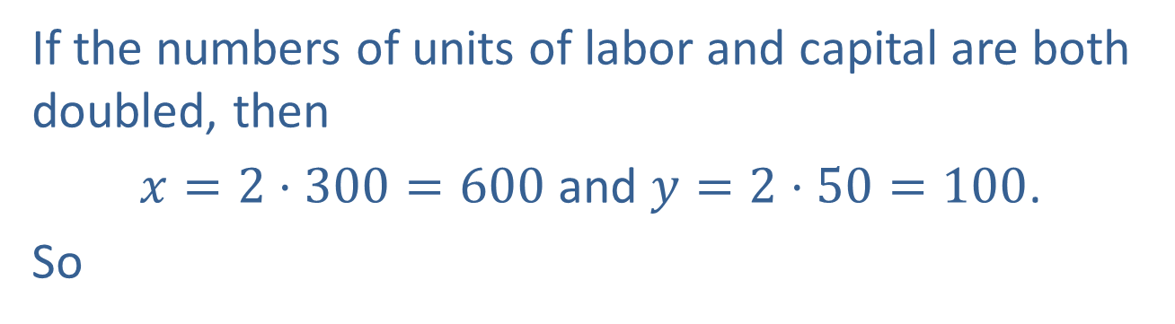
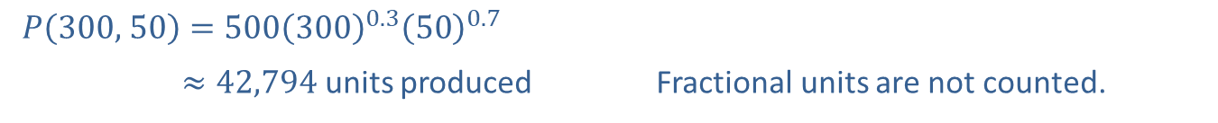
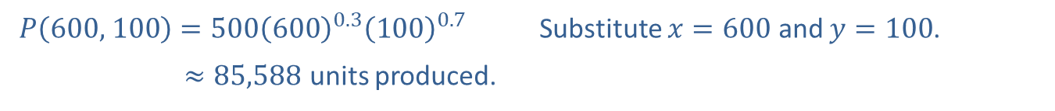
Example 5: Using the Cobb-Douglas Production Formula (cont.)
Solution
​
$P\left(300\text{, }50\right)=500{\left(300\right)}^{0.3}{\left(50\right)}^{0.7}$
​𝑃⁡300, 50≈42,794 units produced | Fractional units are not counted.
​If the numbers of units of labor and capital are both doubled, then
​$x=2⋅300=600$ and $y=2⋅50=100$.
​So
$P\left(600\text{, }100\right)=500{\left(600\right)}^{0.3}{\left(100\right)}^{0.7}$ | Substitute $x=600$ and $y=100$.
​𝑃⁡600, 100 ≈85,588 units produced.
Thus we see that production is doubled if both labor and capital are doubled.

Slide 14

Example 6: Graphing 3D Points
Draw a three-dimensional coordinate system; then graph and label the following points.
$A⁡\left(1\text{, }−2\text{, }3\right)$, $B⁡\left(0\text{, }0\text{, }4\right)$, $C⁡\left(0\text{, }3\text{, }2\right)$, and $D⁡\left(2\text{, }2\text{, }−1\right)$

Slide 15
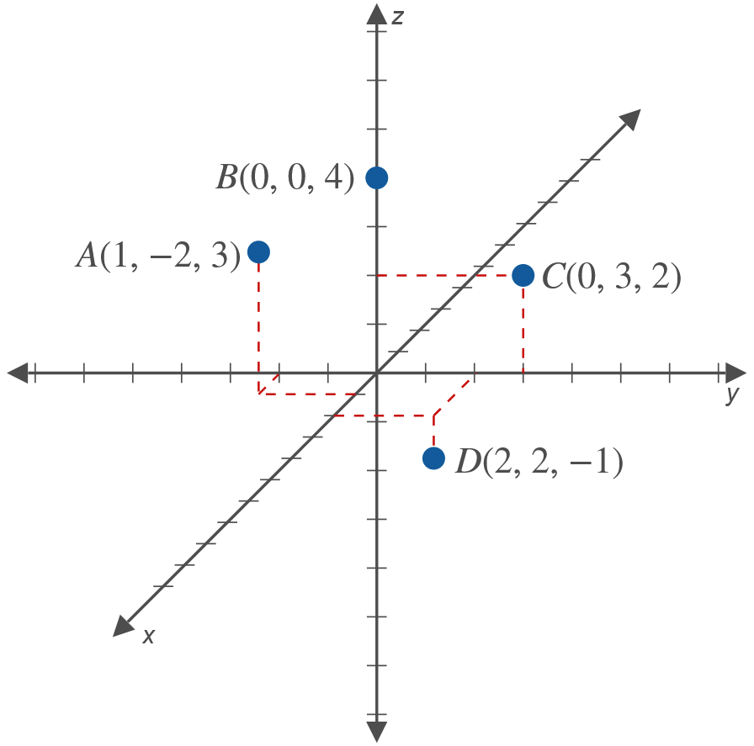
Example 6: Graphing 3D Points (cont.)
Solution

Slide 16

Example 7: Graphing 3D Planes
Set up a three-dimensional coordinate system to graph each of the following planes.
​$x=5$
​$y=−2$

Slide 17
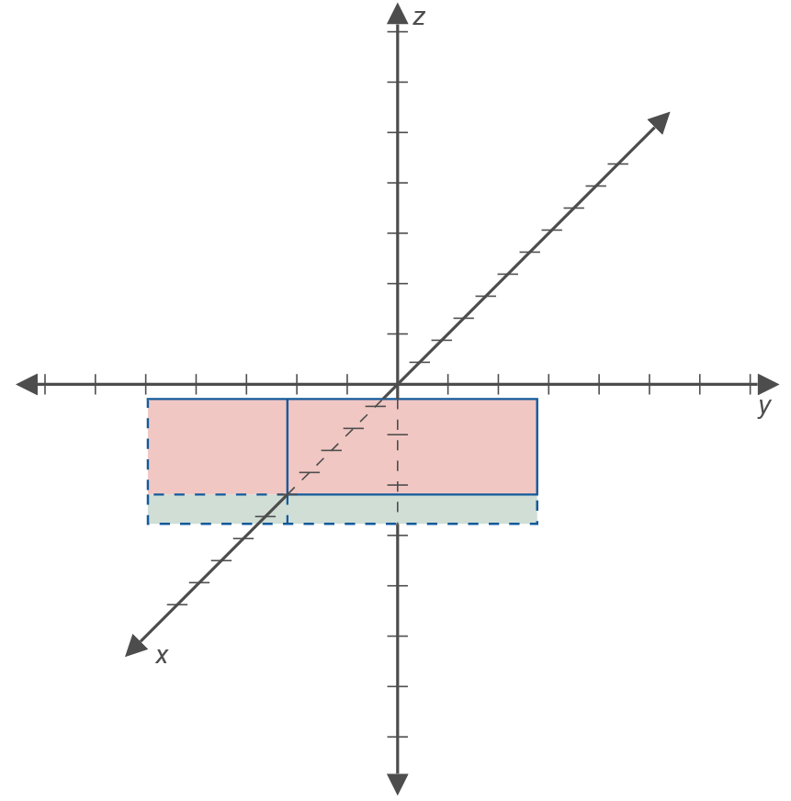
Example 7: Graphing 3D Planes (cont.)
Solution
​
Note that $x=5$ is a plane parallel to the $yz$-plane.

Slide 18
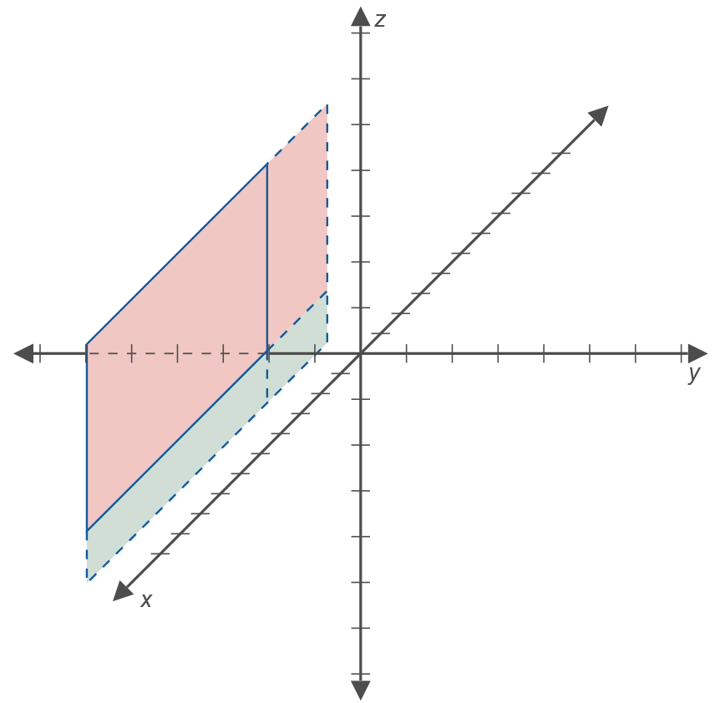
Example 7: Graphing 3D Planes (cont.)
​
Note that $y=−2$ is a plane parallel to the $xz$-plane.

Slide 19
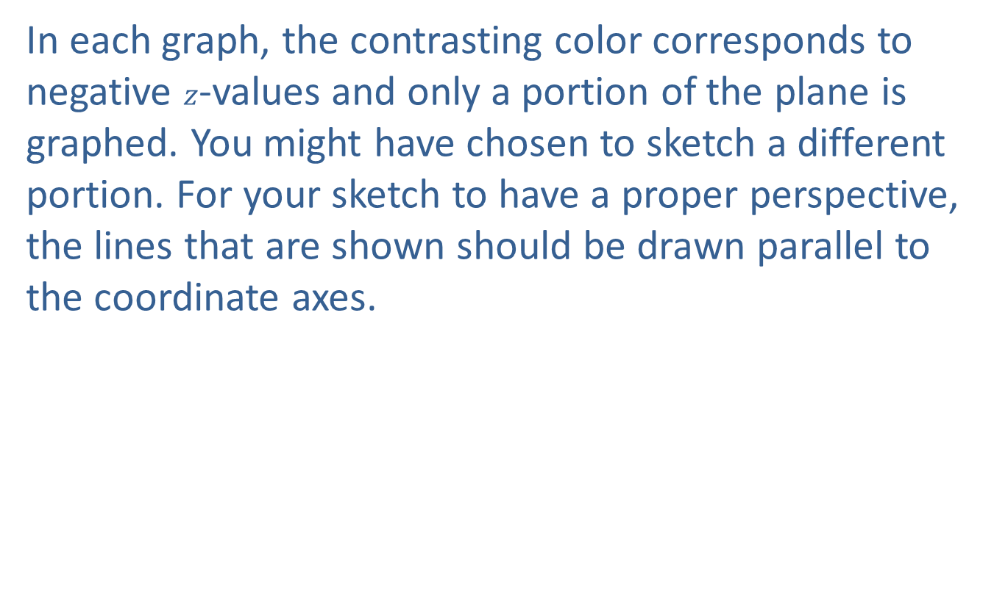
Example 7: Graphing 3D Planes (cont.)
In each graph, the contrasting color corresponds to negative $z$-values and only a portion of the plane is graphed. You might have chosen to sketch a different portion. For your sketch to have a proper perspective, the lines that are shown should be drawn parallel to the coordinate axes.

