Slide 1
Section 8.2
Partial Derivatives

Slide 2
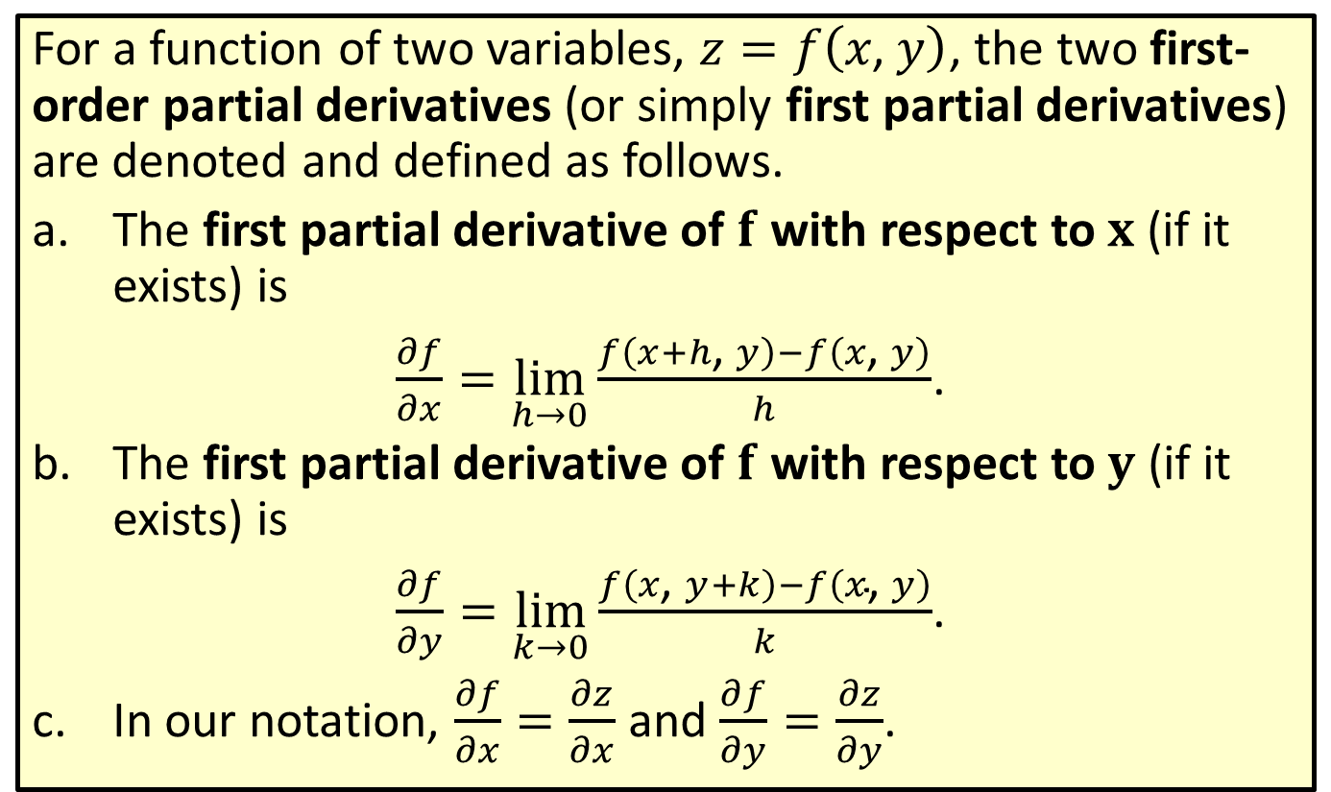
First-Order Partial Derivatives
For a function of two variables, $z=f\left(x\text{, }y\right)$, the two first-order partial derivatives (or simply first partial derivatives) are denoted and defined as follows.
​The first partial derivative of $f$ with respect to $x$ (if it exists) is
​ $\frac{∂f}{∂x}=\lim_{h→0}\frac{f\left(x+h\text{, }y\right)−f\left(x\text{, }y\right)}{h}$.
​The first partial derivative of $f$ with respect to $y$ (if it exists) is
​ $\frac{∂f}{∂y}=\lim_{k→0}\frac{f\left(x\text{, }y+k\right)−f\left(x\text{, }y\right)}{k}$.
​In our notation, $\frac{∂f}{∂x}=\frac{∂z}{∂x}$ and $\frac{∂f}{∂y}=\frac{∂z}{∂y}$.

Slide 3

Example 1: Finding a Partial Derivative
For the function $f\left(x\text{, }y\right)=4x^{2}−3xy+5y^{2}$, find
​$\frac{∂f}{∂x}$ and
​$\frac{∂f}{∂y}$.

Slide 4
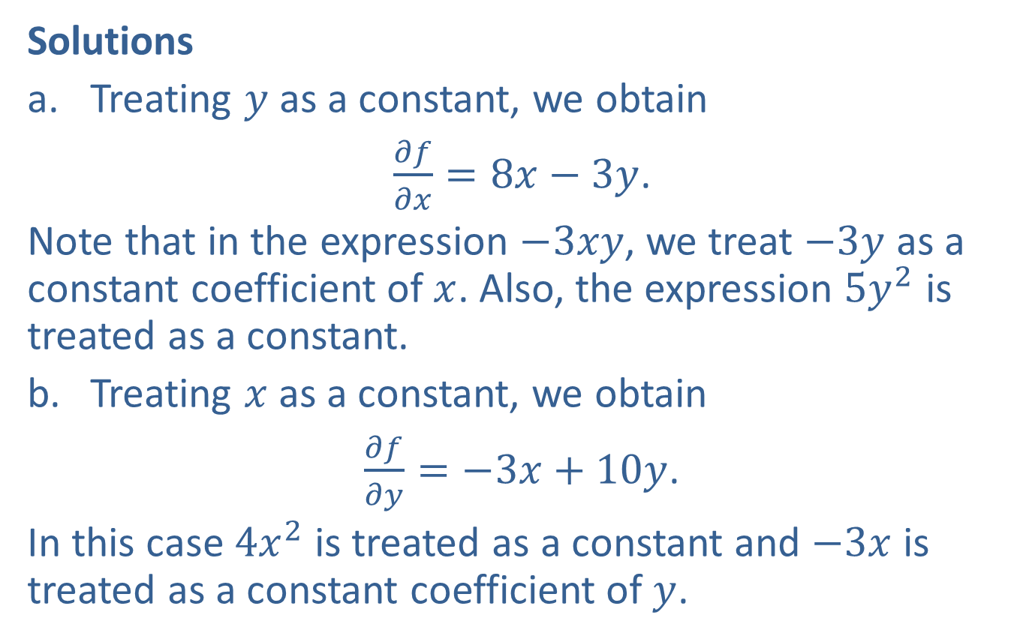
Example 1: Finding a Partial Derivative (cont.)
Solutions
​Treating $y$ as a constant, we obtain
​$\frac{∂f}{∂x}=8x−3y$.
​Note that in the expression $−3xy$, we treat $−3y$ as a constant coefficient of $x$. Also, the expression $5y^{2}$ is treated as a constant.
​Treating $x$ as a constant, we obtain
​$\frac{∂f}{∂y}=−3x+10y$.
​In this case $4x^{2}$ is treated as a constant and $−3x$ is treated as a constant coefficient of $y$.

Slide 5

Example 2: Finding a Partial Derivative
For the function $f\left(x\text{, }y\right)=e^{xy}−\ln{x}+y^{3}$, find the following.
​$f_{x}$
​$f_{y}$

Slide 6
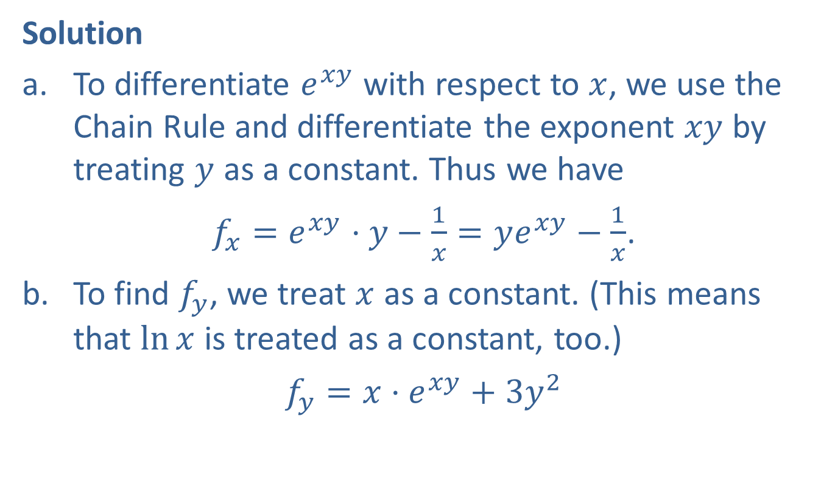
Example 2: Finding a Partial Derivative (cont.)
Solution
​To differentiate $e^{xy}$ with respect to $x$, we use the Chain Rule and differentiate the exponent $xy$ by treating $y$ as a constant. Thus we have
​$f_{x}=e^{xy}⋅y−\frac{1}{x}=ye^{xy}−\frac{1}{x}$.
​To find $f_{y}$, we treat $x$ as a constant. (This means that $ln⁡x$ is treated as a constant, too.)
​$f_{y}=x⋅e^{xy}+3y^{2}$

Slide 7

Example 3: Finding a Partial Derivative
For the function $f\left(x\text{, }y\right)=xe^{xy}+y^{2}$, find
​$f_{x}⁡\left(1\text{, }2\right)$ and
​ $f_{y}⁡\left(1\text{, }2\right)$.

Slide 8
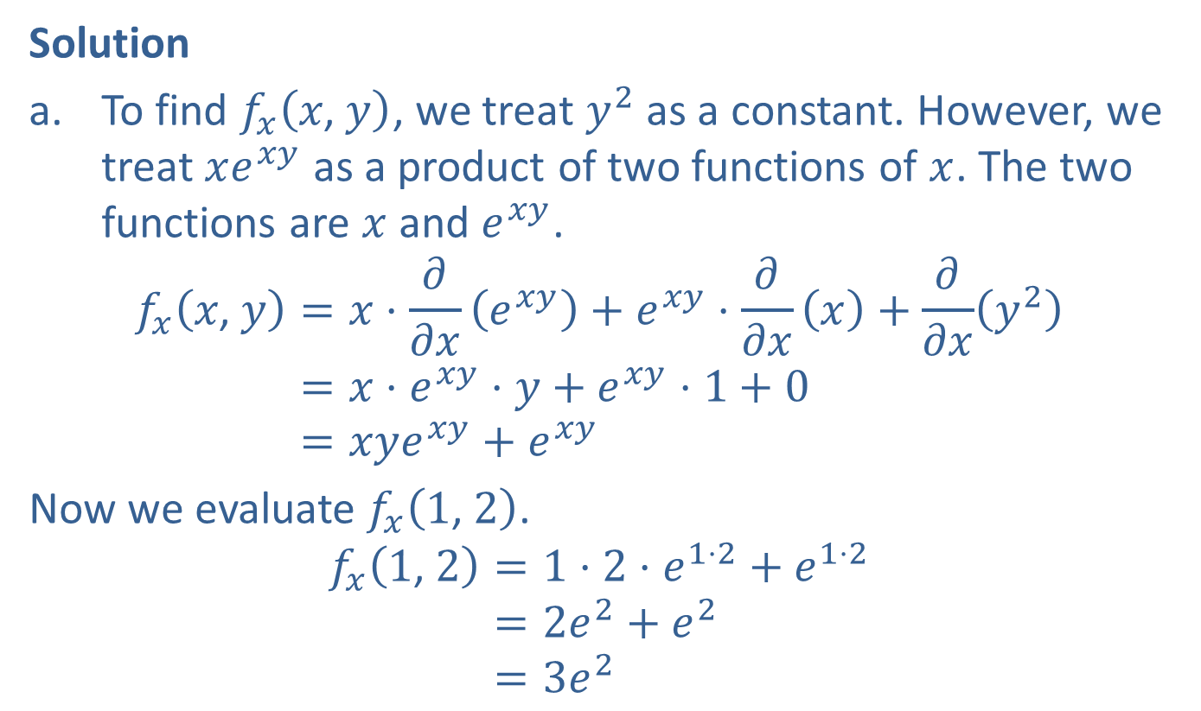
Example 3: Finding a Partial Derivative (cont.)
Solution
​To find $f_{x}⁡\left(x\text{, }y\right)$, we treat $y^{2}$ as a constant. However, we treat $xe^{xy}$ as a product of two functions of $x$. The two functions are $x$ and $e^{xy}$.
𝑓𝑥𝑥, 𝑦=𝑥⋅𝜕𝜕𝑥⁡𝑒𝑥𝑦+𝑒𝑥𝑦⋅𝜕𝜕𝑥⁡𝑥+𝜕𝜕𝑥𝑦2𝑓𝑥⁡𝑥, 𝑦=𝑥⋅𝑒𝑥𝑦⋅𝑦+𝑒𝑥𝑦⋅1+0𝑓𝑥⁡𝑥, 𝑦=𝑥𝑦𝑒𝑥𝑦+𝑒𝑥𝑦
​Now we evaluate $f_{x}⁡\left(1\text{, }2\right)$.
𝑓𝑥1, 2=1⋅2⋅𝑒1⋅2+𝑒1⋅2𝑓𝑥⁡1, 2=2𝑒2+𝑒2𝑓𝑥⁡1, 2=3𝑒2

Slide 9
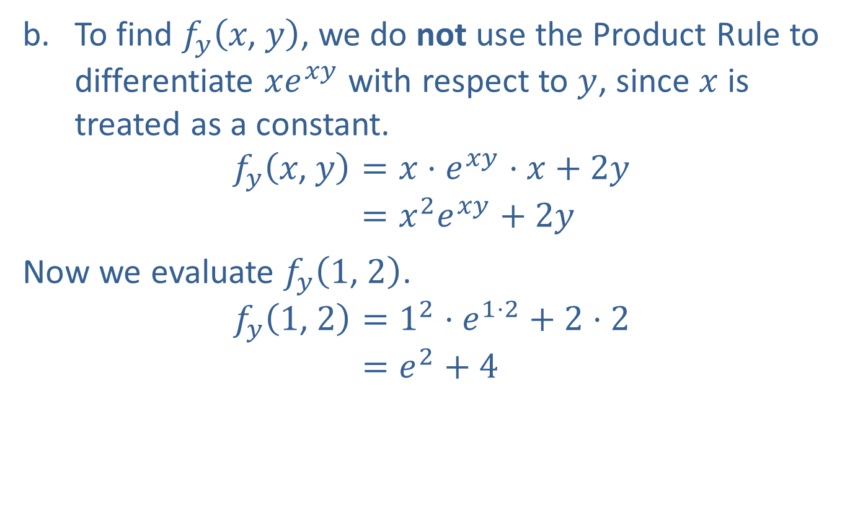
Example 3: Finding a Partial Derivative (cont.)
​To find $f_{y}⁡\left(x\text{, }y\right)$, we do not use the Product Rule to differentiate $xe^{xy}$ with respect to $y$, since $x$ is treated as a constant.
𝑓𝑦𝑥, 𝑦=𝑥⋅𝑒𝑥𝑦⋅𝑥+2𝑦𝑓𝑦⁡𝑥, 𝑦=𝑥2𝑒𝑥𝑦+2𝑦
​Now we evaluate $f_{y}⁡\left(1\text{, }2\right)$.
𝑓𝑦1, 2=12⋅𝑒1⋅2+2⋅2𝑓𝑦⁡1, 2=𝑒2+4

Slide 10

Example 4: Using the Partial Derivatives
Given the function $z=x^{2}+xy+y^{2}−7x−8y+1$, find all the ordered pairs $\left(x\text{, }y\right)$ where both $\frac{∂z}{∂x}=0$ and $\frac{∂z}{∂y}=0$.

Slide 11
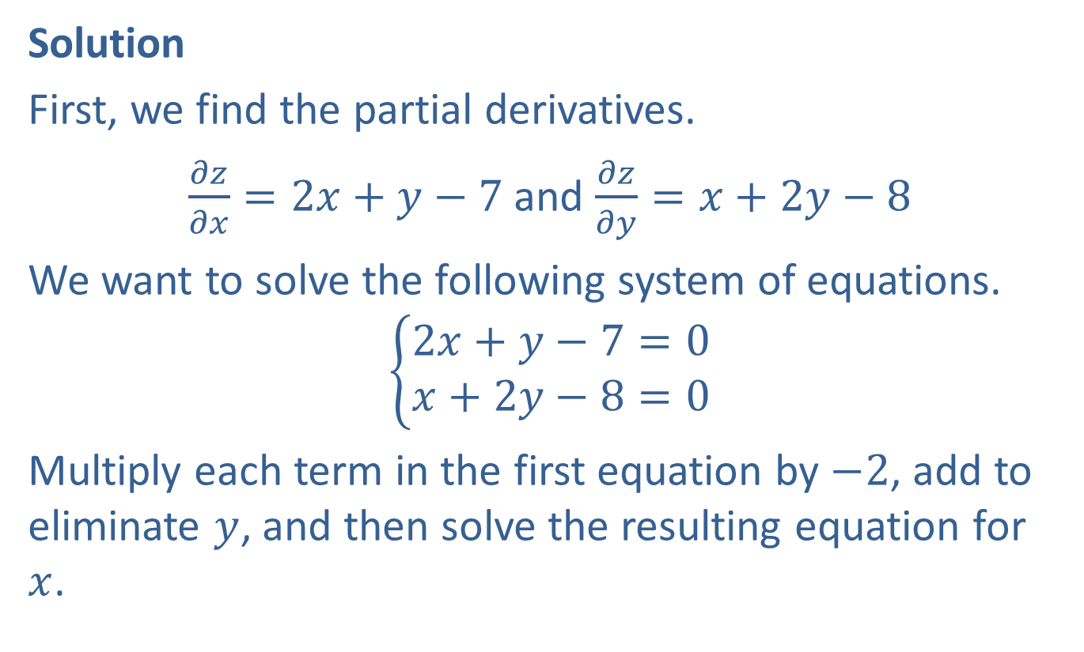
Example 4: Using the Partial Derivatives (cont.)
Solution
First, we find the partial derivatives.
$\frac{∂z}{∂x}=2x+y−7$ and $\frac{∂z}{∂y}=x+2y−8$
We want to solve the following system of equations.
$$\left\{\begin{aligned}2x+y−7=0 \\ x+2y−8=0\end{aligned}\right.$$
Multiply each term in the first equation by $−2$, add to eliminate $y$, and then solve the resulting equation for $x$.

Slide 12
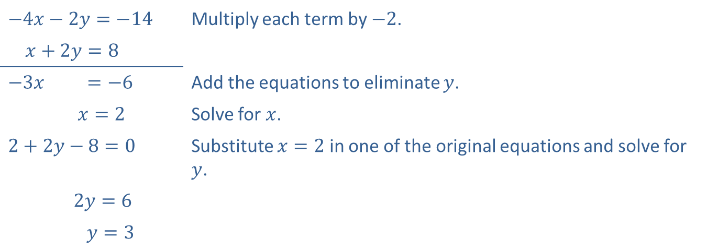
Example 4: Using the Partial Derivatives (cont.)
​$−4x−2y=−14$ | Multiply each term by $−2$.
​$x+2y=8$
​−3𝑥+2𝑦=−64 | Add the equations to eliminate $y$.
​𝑥=214. | Solve for $x$.
​2+2𝑦−8=014. | Substitute $x=2$ in one of the original equations and solve for $y$.
​2+2𝑦 2𝑦=614.
​2+2𝑦 𝑦=314.
Thus both partial derivatives are 0 at $\left(2\text{, }3\right)$.

Slide 13

Example 5: Using the Cobb-Douglas Production Formula
Suppose that the production function $P\left(x\text{, }y\right)=2000x^{0.5}y^{0.5}$ is known. Determine the marginal productivity of labor and the marginal productivity of capital when 16 units of labor and 144 units of capital are used.

Slide 14
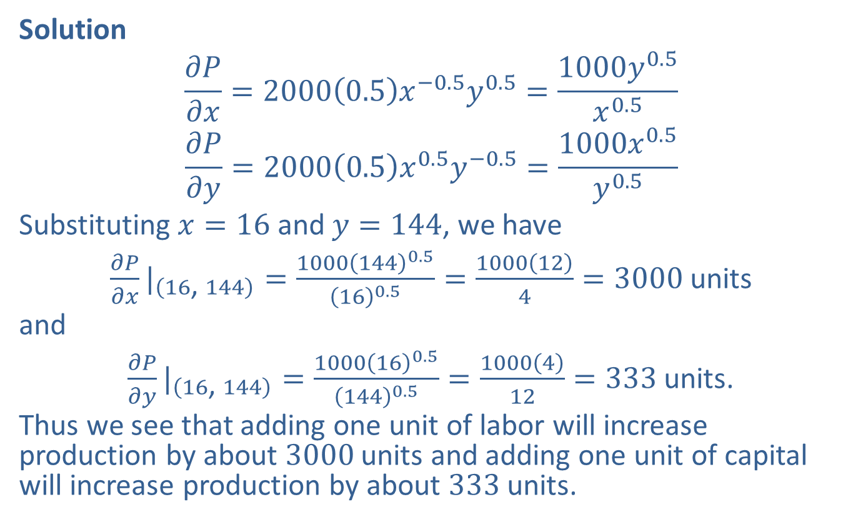
Example 5: Using the Cobb-Douglas Production Formula (cont.)
Solution
$$\frac{∂P}{∂x}=2000\left(0.5\right)x^{−0.5}y^{0.5}=\frac{1000y^{0.5}}{x^{0.5}}$$
$$\frac{∂P}{∂y}=2000\left(0.5\right)x^{0.5}y^{−0.5}=\frac{1000x^{0.5}}{y^{0.5}}$$
Substituting $x=16$ and $y=144$, we have
${\frac{∂P}{∂x}|}_{\left(16\text{, }144\right)}=\frac{1000{\left(144\right)}^{0.5}}{{\left(16\right)}^{0.5}}=\frac{1000\left(12\right)}{4}=3000$ units
and
${\frac{∂P}{∂y}|}_{\left(16\text{, }144\right)}=\frac{1000{\left(16\right)}^{0.5}}{{\left(144\right)}^{0.5}}=\frac{1000\left(4\right)}{12}=333$ units.
Thus we see that adding one unit of labor will increase production by about 3000 units and adding one unit of capital will increase production by about 333 units.

Slide 15


Example 6: Finding Second Partial Derivatives
​Find all four second partial derivatives of $f\left(x\text{, }y\right)=\ln\left(x^{2}+4y\right)$.
​Find $f_{x⁣x}⁡\left(2\text{, }\frac{1}{2}\right)$.
Solutions
​We must find the first partial derivatives $f_{x}$ and $f_{y}$ before we can find the second partial derivatives.
$$f_{x}=\frac{1}{x^{2}+4y}\left(2x\right)=\frac{2x}{x^{2}+4y} \\ f_{y}=\frac{1}{x^{2}+4y}\left(4\right)=\frac{4}{x^{2}+4y}$$

Slide 16
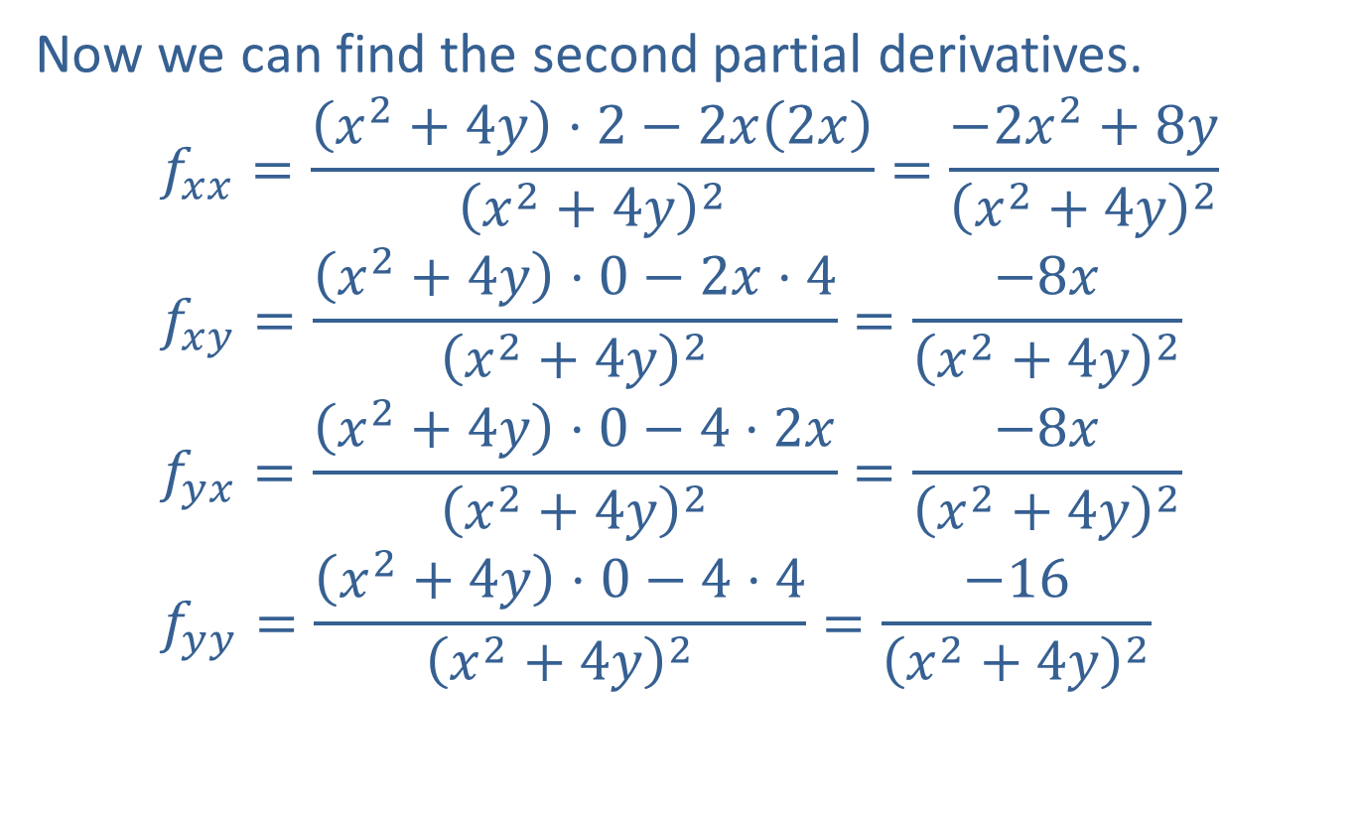
Example 6: Finding Second Partial Derivatives (cont.)
​Now we can find the second partial derivatives.
$$f_{x⁣x}=\frac{\left(x^{2}+4y\right)⋅2−2x\left(2x\right)}{{\left(x^{2}+4y\right)}^{2}}=\frac{−2x^{2}+8y}{{\left(x^{2}+4y\right)}^{2}} \\ f_{x⁣y}=\frac{\left(x^{2}+4y\right)⋅0−2x⋅4}{{\left(x^{2}+4y\right)}^{2}}=\frac{−8x}{{\left(x^{2}+4y\right)}^{2}} \\ f_{y⁣x}=\frac{\left(x^{2}+4y\right)⋅0−4⋅2x}{{\left(x^{2}+4y\right)}^{2}}=\frac{−8x}{{\left(x^{2}+4y\right)}^{2}} \\ f_{y⁣y}=\frac{\left(x^{2}+4y\right)⋅0−4⋅4}{{\left(x^{2}+4y\right)}^{2}}=\frac{−16}{{\left(x^{2}+4y\right)}^{2}}$$

Slide 17

Example 6: Finding Second Partial Derivatives (cont.)
​$f_{x⁣x}\left(2\text{, }\frac{1}{2}\right)=\frac{−2⋅2^{2}+8\left(\frac{1}{2}\right)}{{\left[2^{2}+4\left(\frac{1}{2}\right)\right]}^{2}}=\frac{−8+4}{{\left(4+2\right)}^{2}}=\frac{−4}{36}=−\frac{1}{9}$

Slide 18

Example 7: Finding Partial Derivatives with Three Variables
For $w=2ye^{xy}+z^{2}$, find
​ $\frac{∂w}{∂x}$,
​ $\frac{∂w}{∂y}$, and
​ $\frac{∂w}{∂z}$.

Slide 19
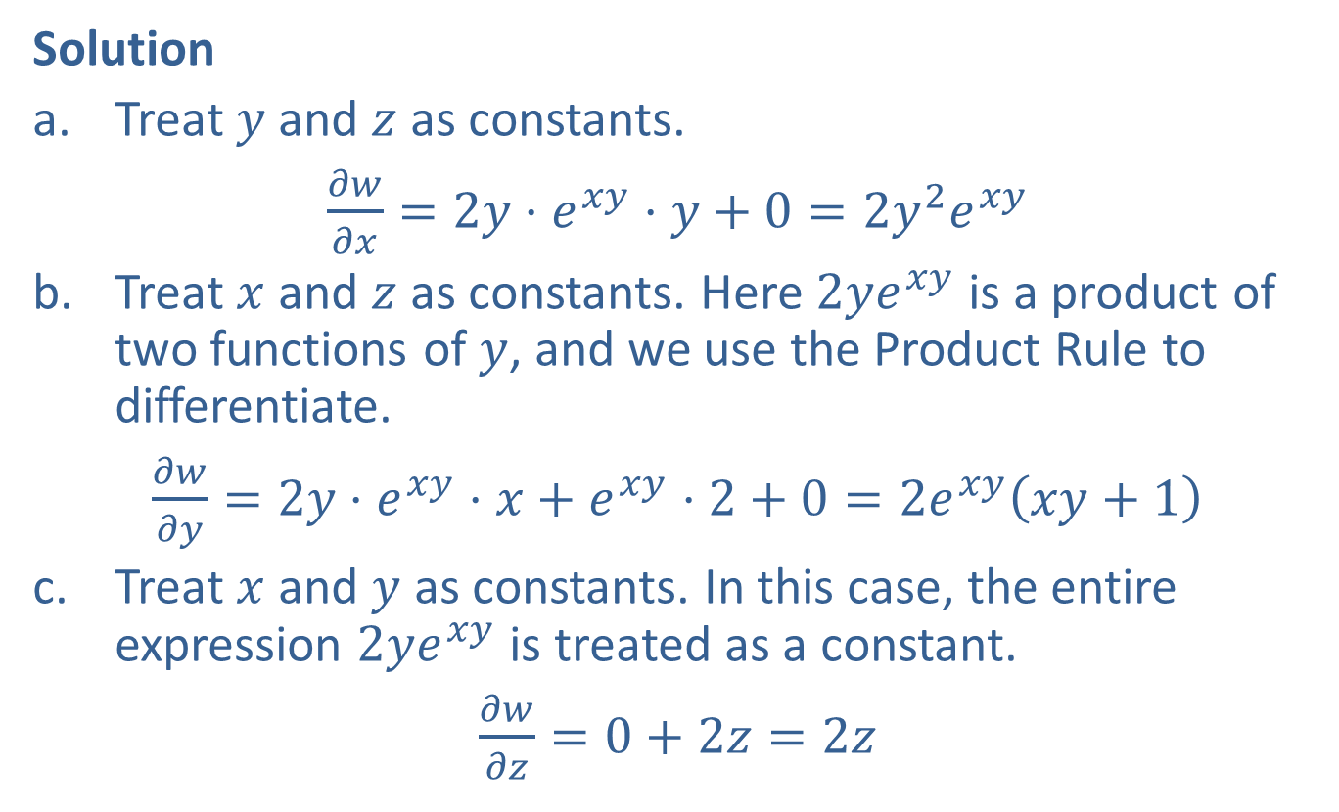
Example 7: Finding Partial Derivatives with Three Variables (cont.)
Solution
​Treat $y$ and $z$ as constants.
​$\frac{∂w}{∂x}=2y⋅e^{xy}⋅y+0=2y^{2}e^{xy}$
​Treat $x$ and $z$ as constants. Here $2ye^{xy}$ is a product of two functions of $y$, and we use the Product Rule to differentiate.
​$\frac{∂w}{∂y}=2y⋅e^{xy}⋅x+e^{xy}⋅2+0=2e^{xy}\left(xy+1\right)$
​Treat $x$ and $y$ as constants. In this case, the entire expression $2ye^{xy}$ is treated as a constant.
​$\frac{∂w}{∂z}=0+2z=2z$

