Slide 1
Section 8.3
Local Extrema for Functions of Two Variables

Slide 2
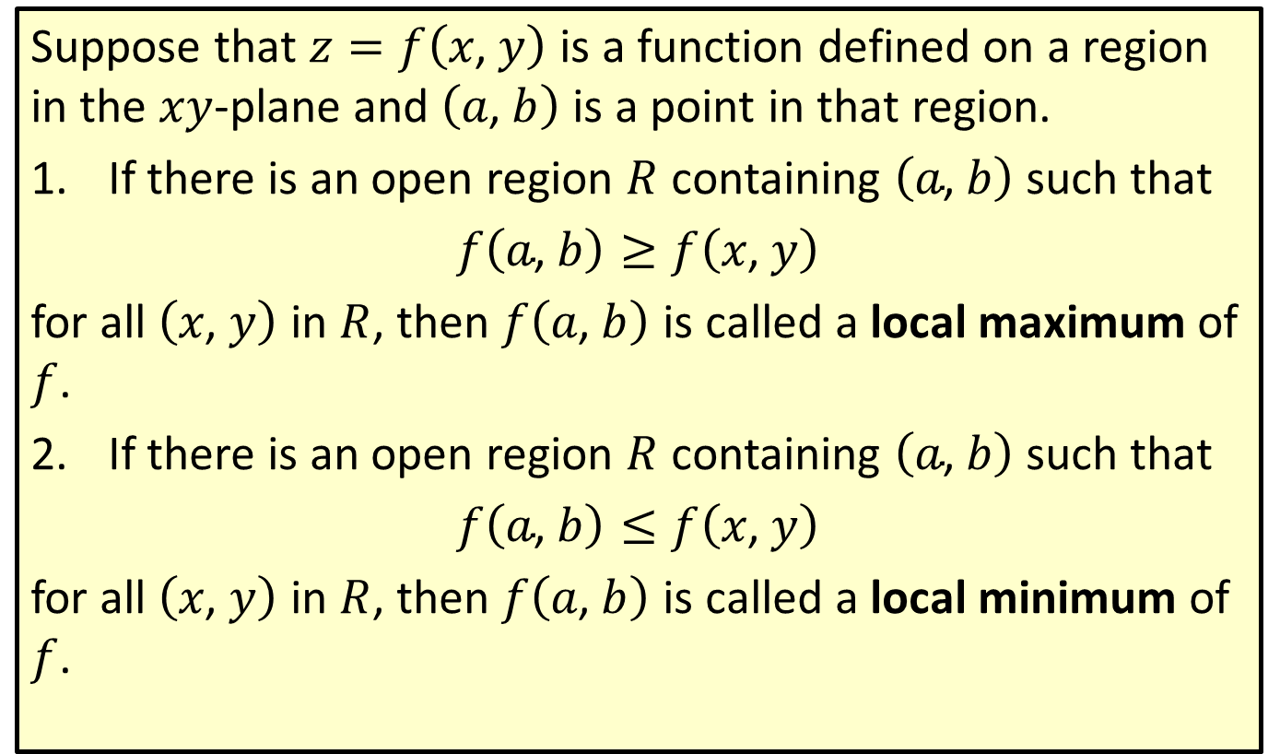

Local Extrema for a Function $z=f\left(x\text{, }y\right)$
Suppose that $z=f\left(x\text{, }y\right)$ is a function defined on a region in the $xy$-plane and $\left(a\text{, }b\right)$ is a point in that region.
​If there is an open region $R$ containing $\left(a\text{, }b\right)$ such that
​$f\left(a\text{, }b\right)≥f\left(x\text{, }y\right)$
​for all $\left(x\text{, }y\right)$ in $R$, then $f⁡\left(a\text{, }b\right)$ is called a local maximum of $f$.
​If there is an open region $R$ containing $\left(a\text{, }b\right)$ such that
​$f\left(a\text{, }b\right)≤f\left(x\text{, }y\right)$
​for all $\left(x\text{, }y\right)$ in $R$, then $f⁡\left(a\text{, }b\right)$ is called a local minimum of $f$.

Slide 3
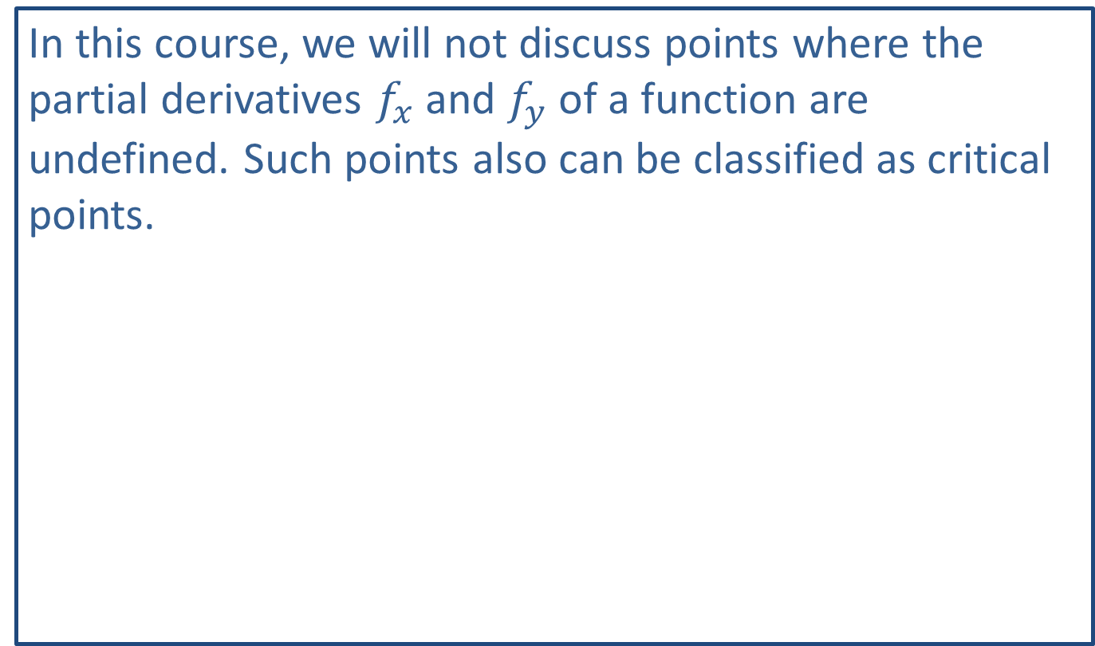
Note:
In this course, we will not discuss points where the partial derivatives $f_{x}$ and $f_{y}$ of a function are undefined. Such points also can be classified as critical points.

Slide 4
Note:
A saddle point for a function of two variables is analogous to a point of inflection for a function of one variable.

Slide 5

Example 1: Locating Critical Points
Locate the critical points for the function $f\left(x\text{, }y\right)=4+{\left(x−3\right)}^{2}+{\left(y+5\right)}^{2}$.

Slide 6
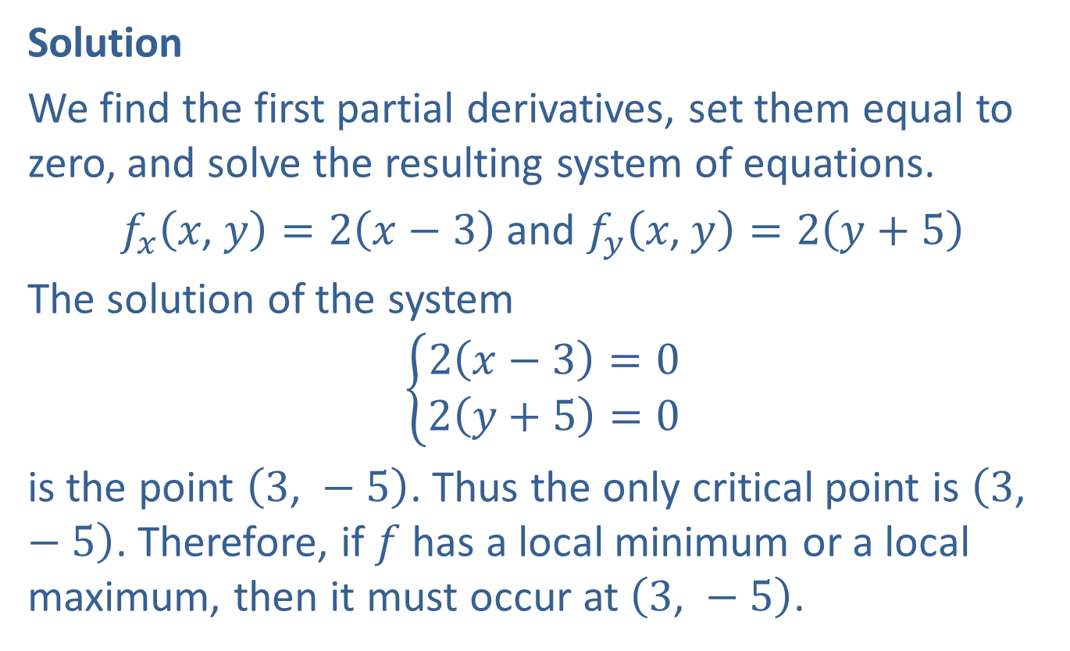
Example 1: Locating Critical Points (cont.)
Solution
We find the first partial derivatives, set them equal to zero, and solve the resulting system of equations.
$f_{x}\left(x\text{, }y\right)=2\left(x−3\right)$ and $f_{y}\left(x\text{, }y\right)=2\left(y+5\right)$
The solution of the system
$$\left\{\begin{aligned}2\left(x−3\right)=0 \\ 2\left(y+5\right)=0\end{aligned}\right.$$
is the point $\left(3\text{, }−5\right)$. Thus the only critical point is $\left(3\text{, }−5\right)$. Therefore, if $f$ has a local minimum or a local maximum, then it must occur at $\left(3\text{, }−5\right)$.

Slide 7
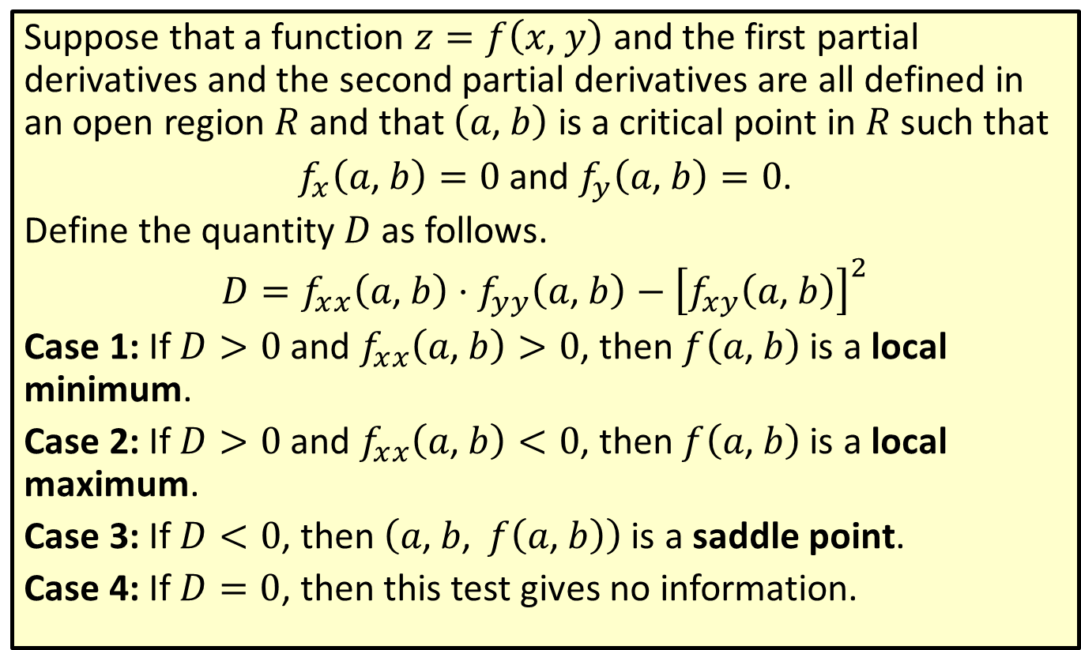

Second Partials Test (or $D$-Test)
Suppose that a function $z=f\left(x\text{, }y\right)$ and the first partial derivatives and the second partial derivatives are all defined in an open region $R$ and that $\left(a\text{, }b\right)$ is a critical point in $R$ such that
$f_{x}\left(a\text{, }b\right)=0$ and $f_{y}\left(a\text{, }b\right)=0$.
Define the quantity $D$ as follows.
$$D=f_{x⁣x}\left(a\text{, }b\right)⋅f_{y⁣y}\left(a\text{, }b\right)−{\left[f_{x⁣y}\left(a\text{, }b\right)\right]}^{2}$$
Case 1: If $D>0$ and $f_{x⁣x}\left(a\text{, }b\right)>0$, then $f⁡\left(a\text{, }b\right)$ is a local minimum.
Case 2: If $D>0$ and $f_{x⁣x}\left(a\text{, }b\right)<0$, then $f⁡\left(a\text{, }b\right)$ is a local maximum.
Case 3: If $D<0$, then $\left(a\text{, }b\text{, }f\left(a\text{, }b\right)\right)$ is a saddle point.
Case 4: If $D=0$, then this test gives no information.

Slide 8



Example 2: Applying the $D$-Test
Find all the local minima, local maxima, and saddle points for the function
$f\left(x\text{, }y\right)=x^{2}−xy+y^{2}−9x+5$.
Solution
Find the first partial derivatives $f_{x}$ and $f_{y}$.
$f_{x}\left(x\text{, }y\right)=2x−y−9$ and $f_{y}\left(x\text{, }y\right)=−x+2y$
Now, to find any critical points, solve the following system.
$$\left\{\begin{aligned}2x−y−9=0 \\ −x+2y=0\end{aligned}\right.$$

Slide 9
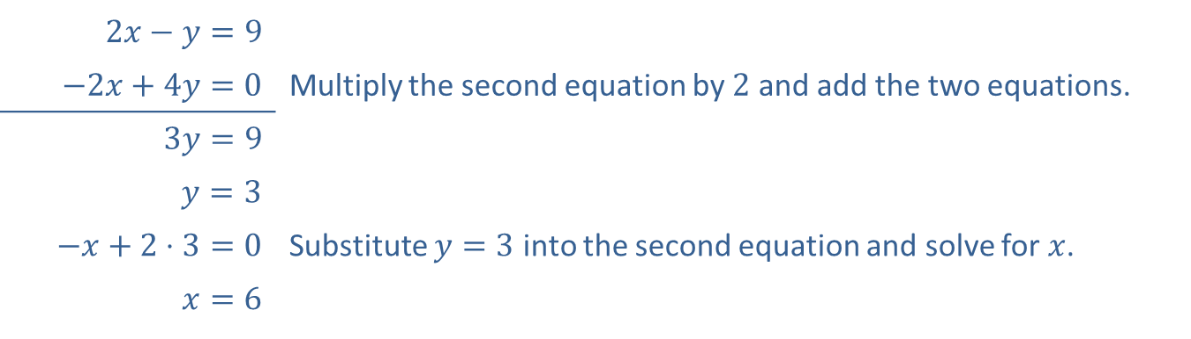

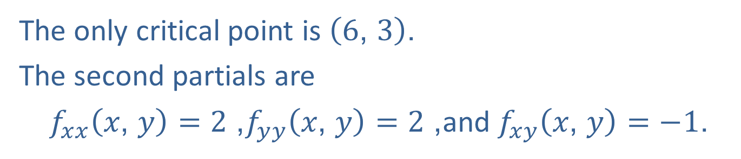
Example 2: Applying the $D$-Test (cont.)
​$2x−y=9$
​​$−2x+4y=0$ | Multiply the second equation by 2 and add the two equations.
​$3y=9$
​$y=3$
​$−x+2⋅3=0$ | Substitute $y=3$ into the second equation and solve for $x$.
​$x=6$
The only critical point is $\left(6\text{, }3\right)$.
The second partials are
$f_{x⁣x}\left(x\text{, }y\right)=2$, $f_{y⁣y}\left(x\text{, }y\right)=2$, and $f_{x⁣y}\left(x\text{, }y\right)=−1$.

Slide 10
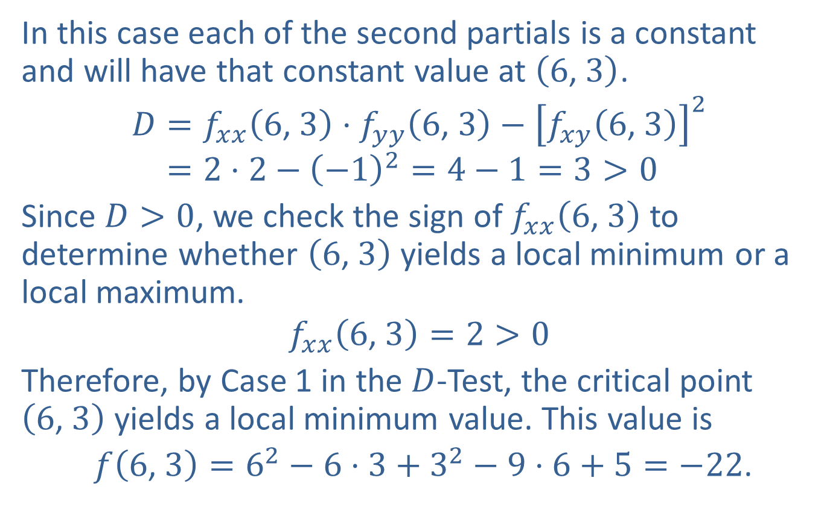
Example 2: Applying the $D$-Test (cont.)
In this case each of the second partials is a constant and will have that constant value at $\left(6\text{, }3\right)$.
𝐷=𝑓𝑥⁣𝑥6, 3⋅𝑓𝑦⁣𝑦6, 3−𝑓𝑥⁣𝑦6, 32𝐷=2⋅2−−12=4−1=3>0
Since $D>0$, we check the sign of $f_{x⁣x}⁡\left(6\text{, }3\right)$ to determine whether $\left(6\text{, }3\right)$ yields a local minimum or a local maximum.
$$f_{x⁣x}\left(6\text{, }3\right)=2>0$$
Therefore, by Case 1 in the $D$-Test, the critical point $\left(6\text{, }3\right)$ yields a local minimum value. This value is
$f\left(6\text{, }3\right)=6^{2}−6⋅3+3^{2}−9⋅6+5=−22$.

Slide 11


Example 3: Locating and Classifying Critical Points
Locate and classify all critical points of the function
$g\left(x\text{, }y\right)=\frac{1}{3}x^{3}−\frac{1}{3}y^{3}+xy$.
Solution
The first partial derivatives are as follows.
$g_{x}=x^{2}+y$ and $g_{y}=−y^{2}+x$
Now solve the following system where $g_{x}=0$ and $g_{y}=0$.
$$\left\{\begin{aligned}x^{2}+y=0 \\ −y^{2}+x=0\end{aligned}\right.$$

Slide 12
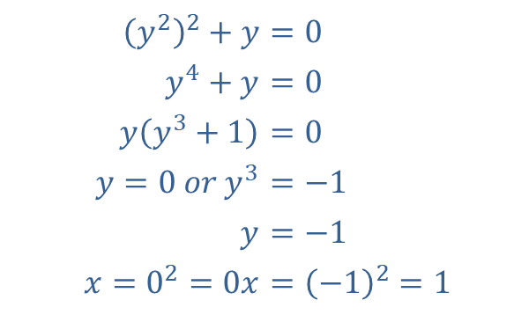
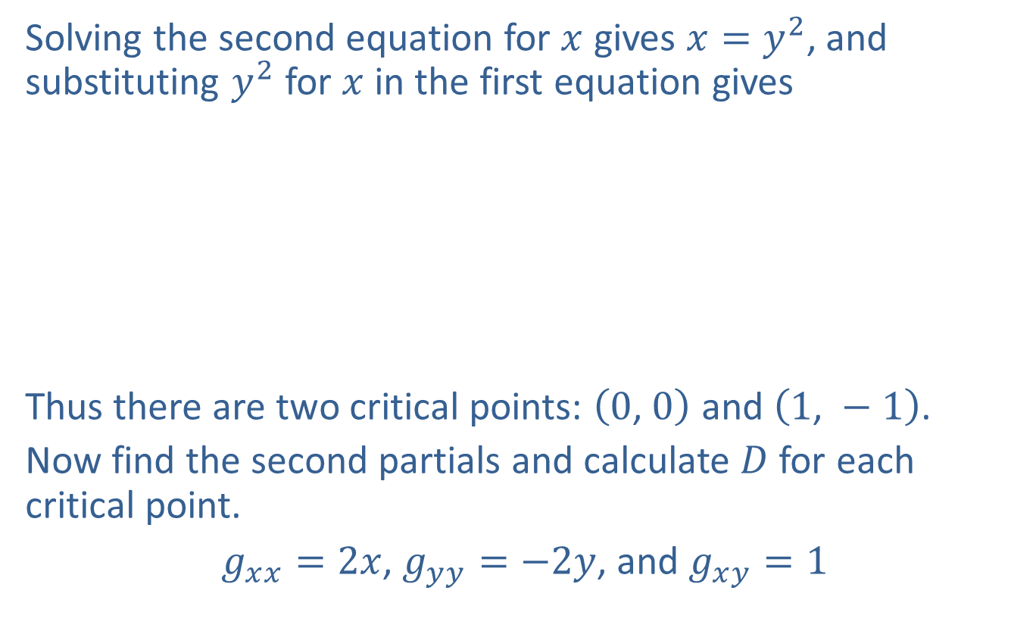
Example 3: Locating and Classifying Critical Points (cont.)
Solving the second equation for $x$ gives $x=y^{2}$, and substituting $y^{2}$ for $x$ in the first equation gives
​
Thus there are two critical points: $\left(0\text{, }0\right)$ and $\left(1\text{, }−1\right)$.
Now find the second partials and calculate $D$ for each critical point.
$g_{x⁣x}=2x$, $g_{y⁣y}=−2y$, and $g_{x⁣y}=1$
​${\left(y^{2}\right)}^{2}+y$ | ​$=0$
​$y^{4}+y$ | ​$=0$
​$y\left(y^{3}+1\right)$ | ​$=0$
​$y=0 or y^{3}$ | ​$=−1$
​$y$ | ​$=−1$
​$x=0^{2}=0x$ | ​$={\left(−1\right)}^{2}=1$

Slide 13
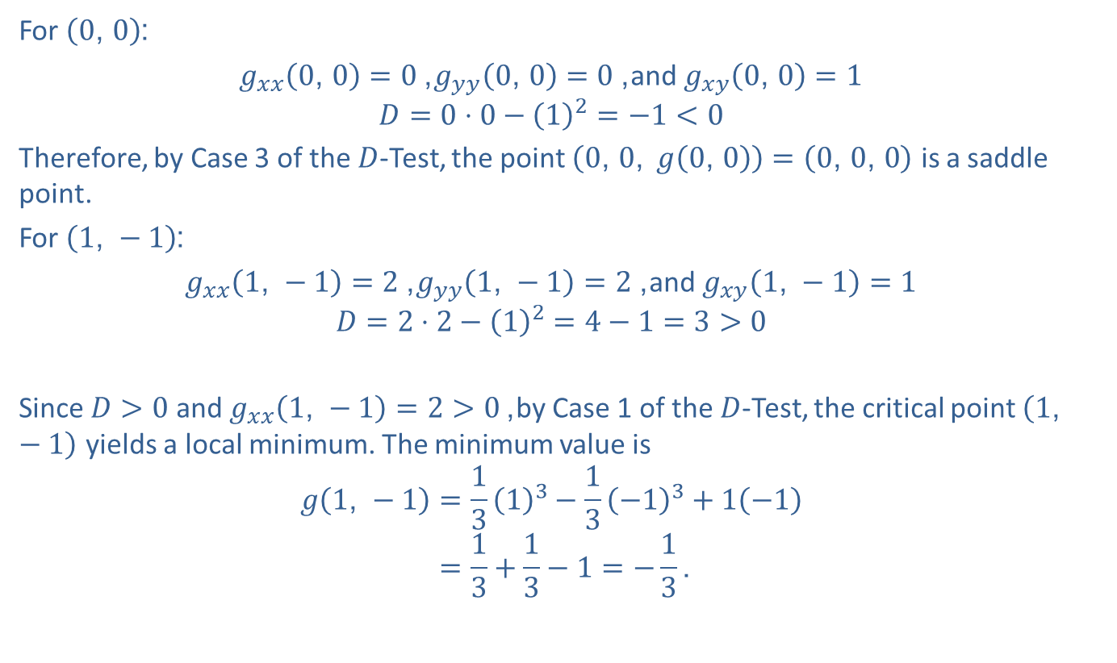
Example 3: Locating and Classifying Critical Points (cont.)
For $\left(0\text{, }0\right)$:
$g_{x⁣x}\left(0\text{, }0\right)=0$, $g_{y⁣y}\left(0\text{, }0\right)=0$, and $g_{x⁣y}\left(0\text{, }0\right)=1$
$$D=0⋅0−{\left(1\right)}^{2}=−1<0$$
Therefore, by Case 3 of the $D$-Test, the point $\left(0\text{, }0\text{, }g\left(0\text{, }0\right)\right)=\left(0\text{, }0\text{, }0\right)$ is a saddle point.
For $\left(1\text{, }−1\right)$:
$g_{x⁣x}\left(1\text{, }−1\right)=2$, $g_{y⁣y}\left(1\text{, }−1\right)=2$, and $g_{x⁣y}\left(1\text{, }−1\right)=1$
$$D=2⋅2−{\left(1\right)}^{2}=4−1=3>0$$
Since $D>0$ and $g_{x⁣x}\left(1\text{, }−1\right)=2>0$, by Case 1 of the $D$-Test, the critical point $\left(1\text{, }−1\right)$ yields a local minimum. The minimum value is
𝑔1, −1=1313−13−13+1−1𝑔⁡1, −1=13+13−1=−13.

Slide 14
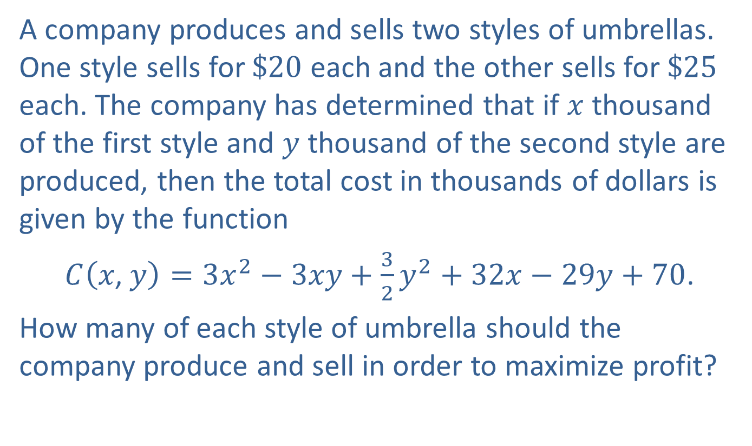
Example 4: Optimizing an Equation in Two Variables
A company produces and sells two styles of umbrellas. One style sells for $\$20$ each and the other sells for $\$25$ each. The company has determined that if $x$ thousand of the first style and $y$ thousand of the second style are produced, then the total cost in thousands of dollars is given by the function
$C\left(x\text{, }y\right)=3x^{2}−3xy+\frac{3}{2}y^{2}+32x−29y+70$.
How many of each style of umbrella should the company produce and sell in order to maximize profit?

Slide 15
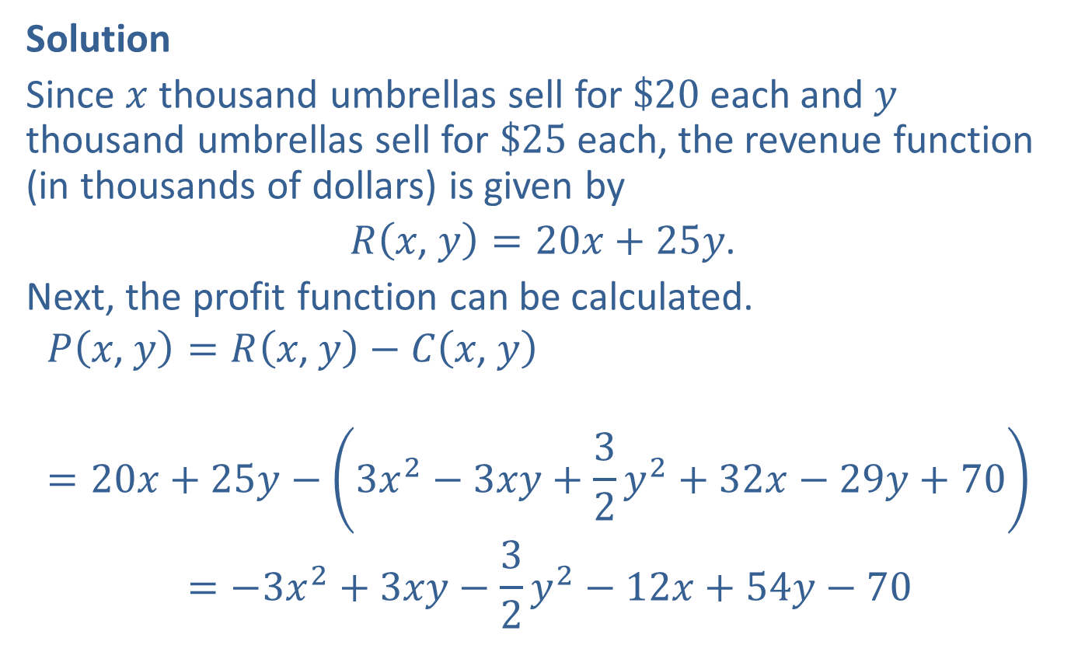
Example 4: Optimizing an Equation in Two Variables (cont.)
Solution
Since $x$ thousand umbrellas sell for $\$20$ each and $y$ thousand umbrellas sell for $\$25$ each, the revenue function (in thousands of dollars) is given by
$R\left(x\text{, }y\right)=20x+25y$.
Next, the profit function can be calculated.
𝑃𝑥, 𝑦=𝑅𝑥, 𝑦−𝐶𝑥, 𝑦𝑃⁡𝑥, 𝑦=20𝑥+25𝑦−3𝑥2−3𝑥𝑦+32𝑦2+32𝑥−29𝑦+70𝑃⁡𝑥, 𝑦=−3𝑥2+3𝑥𝑦−32𝑦2−12𝑥+54𝑦−70

Slide 16
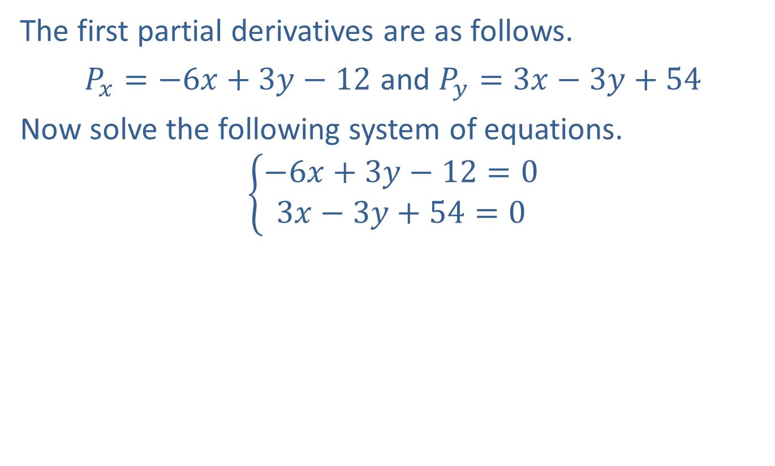
Example 4: Optimizing an Equation in Two Variables (cont.)
The first partial derivatives are as follows.
$P_{x}=−6x+3y−12$ and $P_{y}=3x−3y+54$
Now solve the following system of equations.
$$\left\{\begin{aligned}−6x+3y−12=0 \\ 3x−3y+54=0\end{aligned}\right.$$

Slide 17
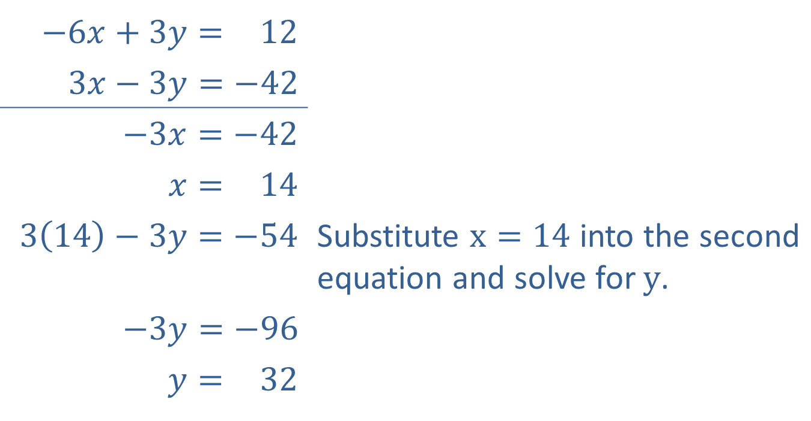
Example 4: Optimizing an Equation in Two Variables (cont.)
​−6𝑥+3𝑦=−12
​​$3x−3y=−42$
​$−3x=−42$
​𝑥=−14
​$3\left(14\right)−3y=−54$ | Substitute $x=14$ into the second equation and solve for $y$.
​$−3y=−96$
​𝑦=−32

Slide 18

Example 4: Optimizing an Equation in Two Variables (cont.)
The company will make the maximum profit if it produces and sells 14,000 of the first style of umbrella and 32,000 of the second style. The student should verify (with the $D$-Test) that the profit is indeed a maximum at $\left(14\text{, }32\right)$.

