Slide 1
Section 8.4
Lagrange Multipliers

Slide 2
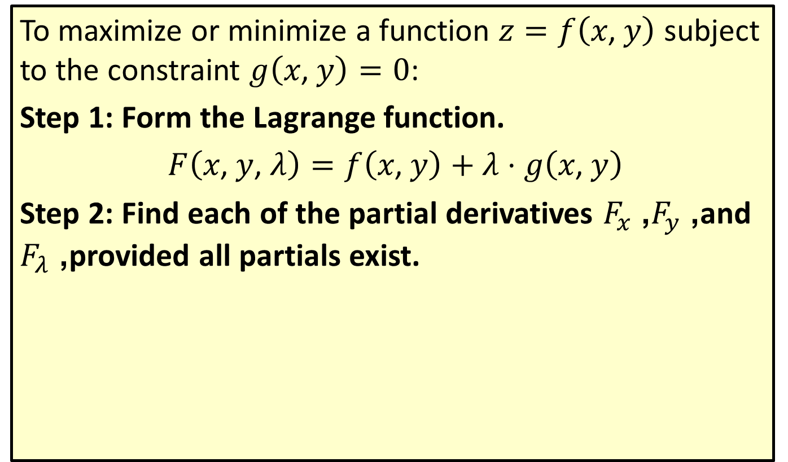
The Method of Lagrange Multipliers
To maximize or minimize a function $z=f\left(x\text{, }y\right)$ subject to the constraint $g\left(x\text{, }y\right)=0$:
Step 1: Form the Lagrange function.
$F\left(x\text{, }y\text{, }λ\right)=f\left(x\text{, }y\right)+λ⋅g\left(x\text{, }y\right)$
Step 2: Find each of the partial derivatives $F_{x}$, $F_{y}$, and $F_{λ}$, provided all partials exist.

Slide 3
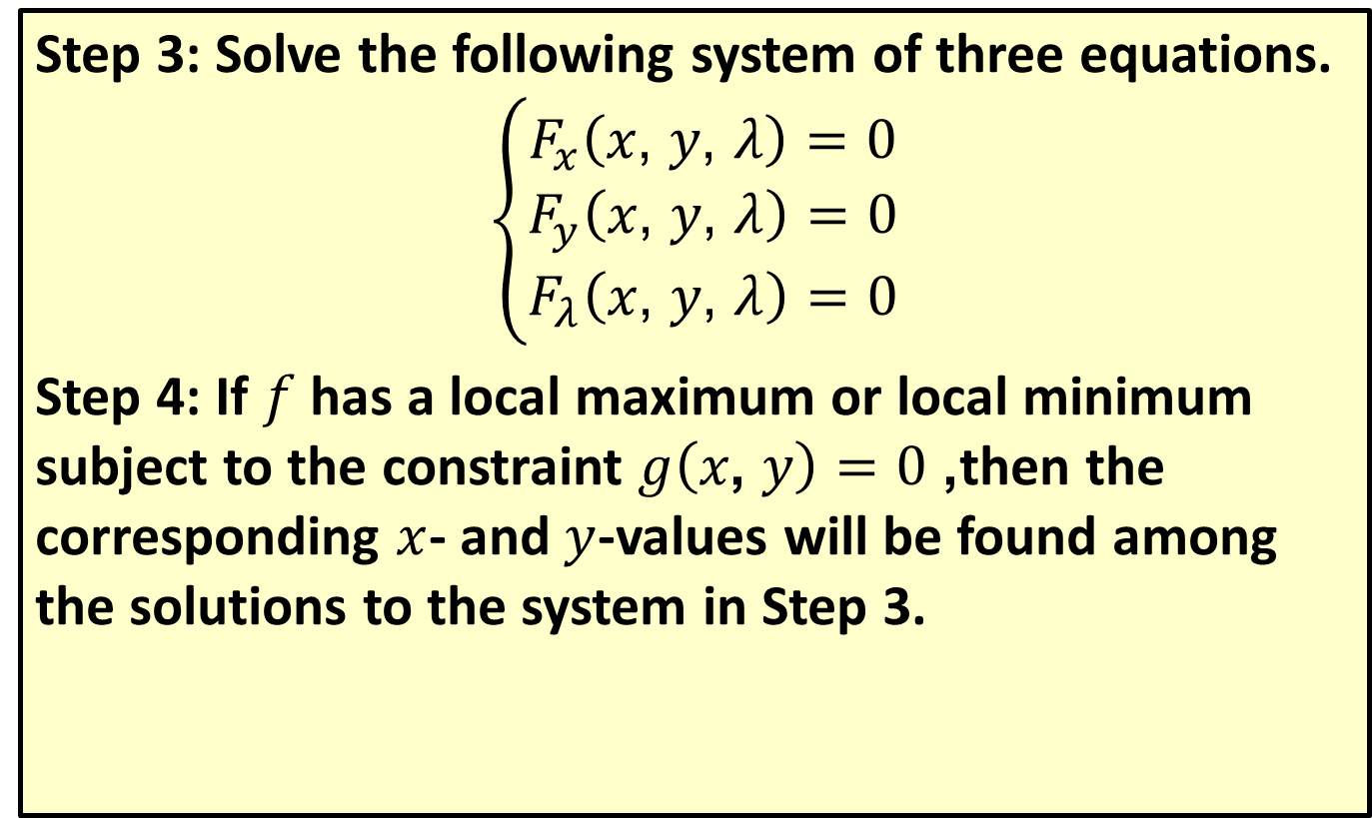
The Method of Lagrange Multipliers (cont.)
Step 3: Solve the following system of three equations.
$$\left\{\begin{aligned}F_{x}\left(x\text{, }y\text{, }λ\right)=0 \\ F_{y}\left(x\text{, }y\text{, }λ\right)=0 \\ F_{λ}\left(x\text{, }y\text{, }λ\right)=0\end{aligned}\right.$$
Step 4: If $f$ has a local maximum or local minimum subject to the constraint $g\left(x\text{, }y\right)=0$, then the corresponding $x$- and $y$-values will be found among the solutions to the system in Step 3.

Slide 4
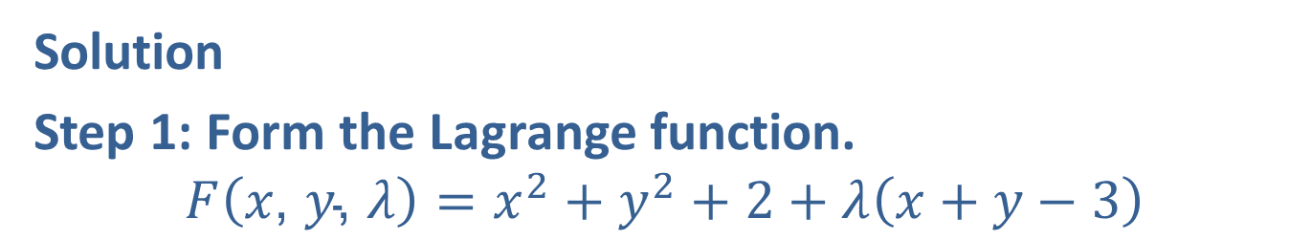

Example 1: Applying the Method of Lagrange Multipliers
Use the method of Lagrange multipliers to find the minimum value of the function $f\left(x\text{, }y\right)=x^{2}+y^{2}+2$ with the constraint $x+y−3=0$.
Solution
Step 1: Form the Lagrange function.
$$F\left(x\text{, }y\text{, }λ\right)=x^{2}+y^{2}+2+λ\left(x+y−3\right)$$

Slide 5
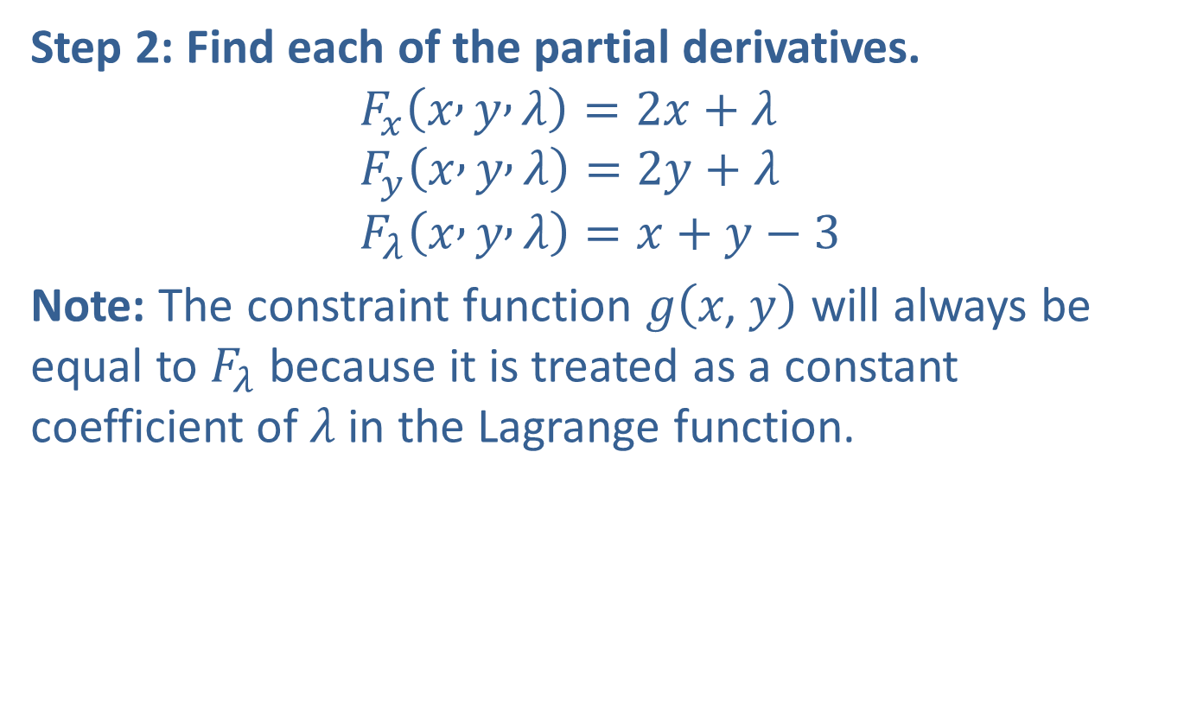
Example 1: Applying the Method of Lagrange Multipliers (cont.)
Step 2: Find each of the partial derivatives.
$$F_{x}\left(x , y , λ\right)=2x+λ \\ F_{y}\left(x , y , λ\right)=2y+λ \\ F_{λ}\left(x , y , λ\right)=x+y−3$$
Note: The constraint function $g⁡\left(x\text{, }y\right)$ will always be equal to $F_{λ}$ because it is treated as a constant coefficient of $λ$ in the Lagrange function.

Slide 6
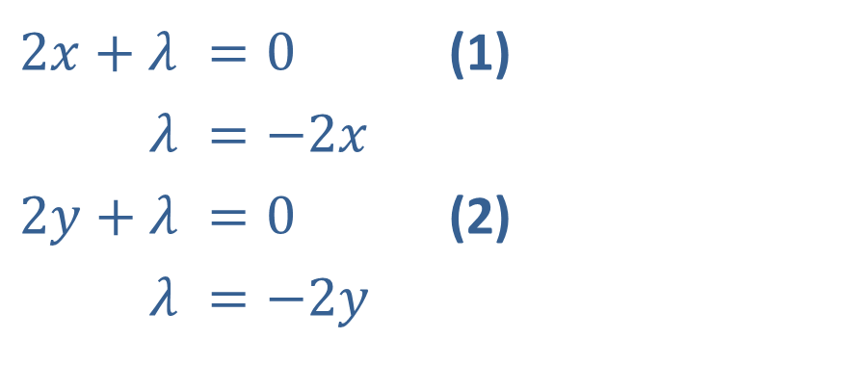
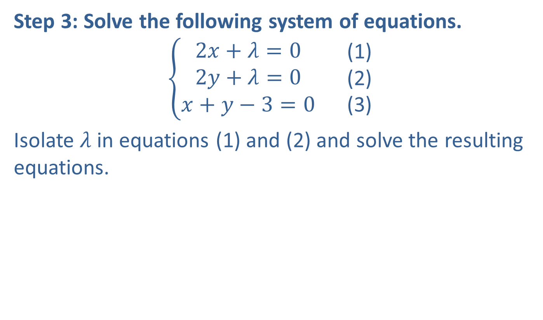
Example 1: Applying the Method of Lagrange Multipliers (cont.)
Step 3: Solve the following system of equations.
$$\left\{\begin{aligned}2x+λ=0 \\ 2y+λ=0 \\ x+y−3=0\end{aligned}\right.\begin{matrix} & \text{(}\text{1}\text{)} \\ & \text{(}\text{2}\text{)} \\ & \text{(}\text{3}\text{)}\end{matrix}$$
Isolate $λ$ in equations (1) and (2) and solve the resulting equations.
​$2x+λ$ | ​$=0$ | (1)
​$λ$ | ​$=−2x$
​$2y+λ$ | ​$=0$ | (2)
​$λ$ | ​$=−2y$

Slide 7
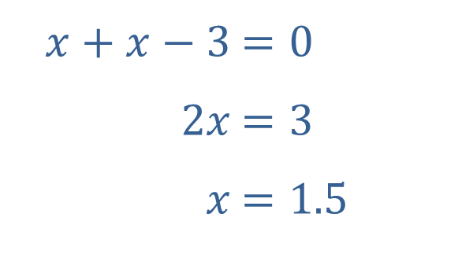

Example 1: Applying the Method of Lagrange Multipliers (cont.)
Thus $−2x=−2y$ and $x=y$. Now substitute $x$ for $y$ in equation (3) and solve for $x$.
​
Since $x=y$, we have $y=1.5$.
​$x+x−3$ | ​$=0$
​$2x$ | ​$=3$
​$x$ | ​$=1.5$

Slide 8
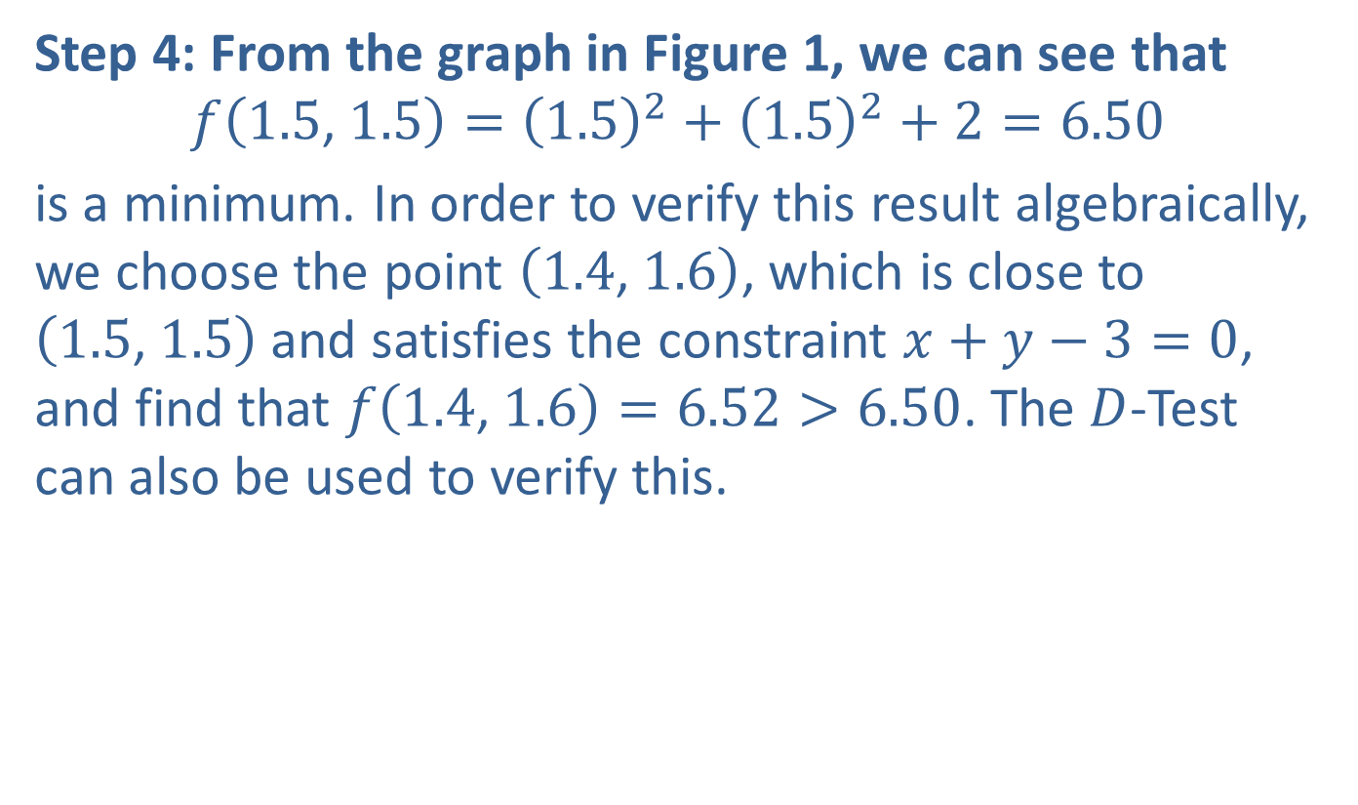
Example 1: Applying the Method of Lagrange Multipliers (cont.)
Step 4: From the graph in Figure 1, we can see that
$$f\left(1.5\text{, }1.5\right)={\left(1.5\right)}^{2}+{\left(1.5\right)}^{2}+2=6.50$$
is a minimum. In order to verify this result algebraically, we choose the point $\left(1.4\text{, }1.6\right)$, which is close to $\left(1.5\text{, }1.5\right)$ and satisfies the constraint $x+y−3=0$, and find that $f\left(1.4\text{, }1.6\right)=6.52>6.50$. The $D$-Test can also be used to verify this.

Slide 9
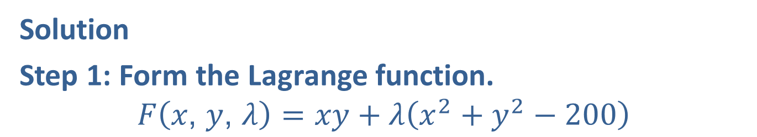

Example 2: Applying the Method of Lagrange Multipliers
Use the method of Lagrange multipliers to find the maximum value of the function $f\left(x\text{, }y\right)=xy$ under the restriction $x^{2}+y^{2}−200=0$, where $x>0$ and $y>0$.
Solution
Step 1: Form the Lagrange function.
$$F\left(x\text{, }y\text{, }λ\right)=xy+λ\left(x^{2}+y^{2}−200\right)$$

Slide 10


Example 2: Applying the Method of Lagrange Multipliers (cont.)
Step 2: Find each of the partial derivatives.
$$F_{x}=y+λ⋅2x \\ F_{y}=x+λ⋅2y \\ F_{λ}=x^{2}+y^{2}−200$$
Step 3: Solve the following system of equations.
$$\left\{\begin{aligned}y+λ⋅2x=0 \\ x+λ⋅2y=0 \\ x^{2}+y^{2}−200=0\end{aligned}\right.\begin{matrix} & \text{(}\text{1}\text{)} \\ & \text{(}\text{2}\text{)} \\ & \text{(}\text{3}\text{)}\end{matrix}$$
Isolate $λ$ in equations (1) and (2) and solve the resulting equations.

Slide 11
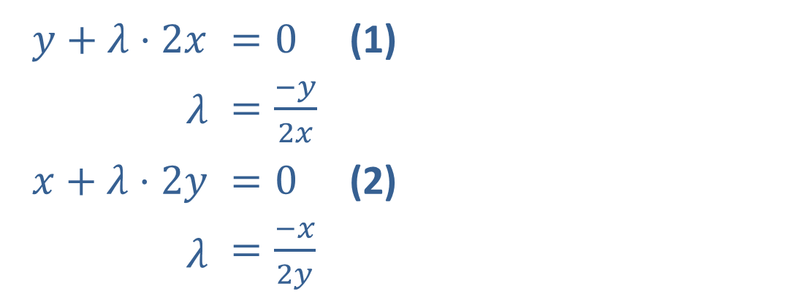
Example 2: Applying the Method of Lagrange Multipliers (cont.)
​$y+λ⋅2x$ | ​$=0$ | (1)
​$λ$ | ​$=\frac{−y}{2x}$
​$x+λ⋅2y$ | ​$=0$ | (2)
​$λ$ | ​$=\frac{−x}{2y}$

Slide 12
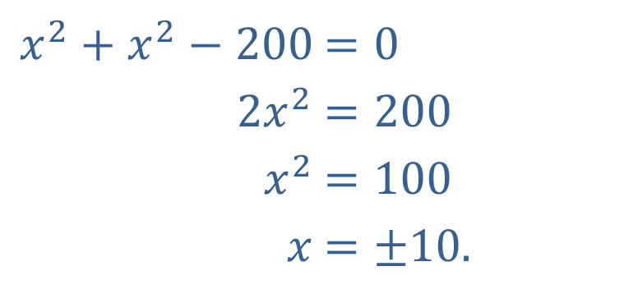

Example 2: Applying the Method of Lagrange Multipliers (cont.)
We have $\frac{−y}{2x}=\frac{−x}{2y}$ which gives $−2x^{2}=−2y^{2}$ and $x^{2}=y^{2}$. Substituting $x^{2}$ for $y^{2}$ in equation (3), we have
​
​$x^{2}+x^{2}−200$ | ​$=0$
​$2x^{2}$ | ​$=200$
​$x^{2}$ | ​$=100$
​$x$ | ​$=±10\text{.}$

Slide 13

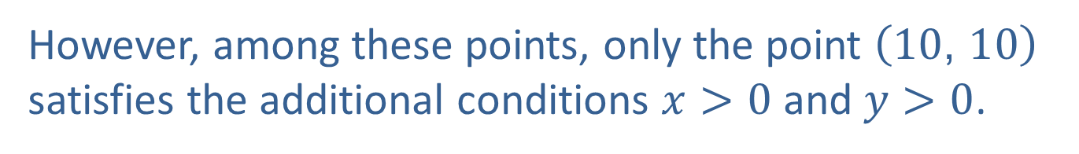
Example 2: Applying the Method of Lagrange Multipliers (cont.)
Since $y^{2}=x^{2}$, $y^{2}=100$, and $y=±10$. Thus there are four points that satisfy the system:
$\left(10\text{, }10\right)$, $\left(10\text{, }−10\right)$, $\left(−10\text{, }10\right)$, and $\left(−10\text{, }−10\right)$.
However, among these points, only the point $\left(10\text{, }10\right)$ satisfies the additional conditions $x>0$ and $y>0$.

Slide 14
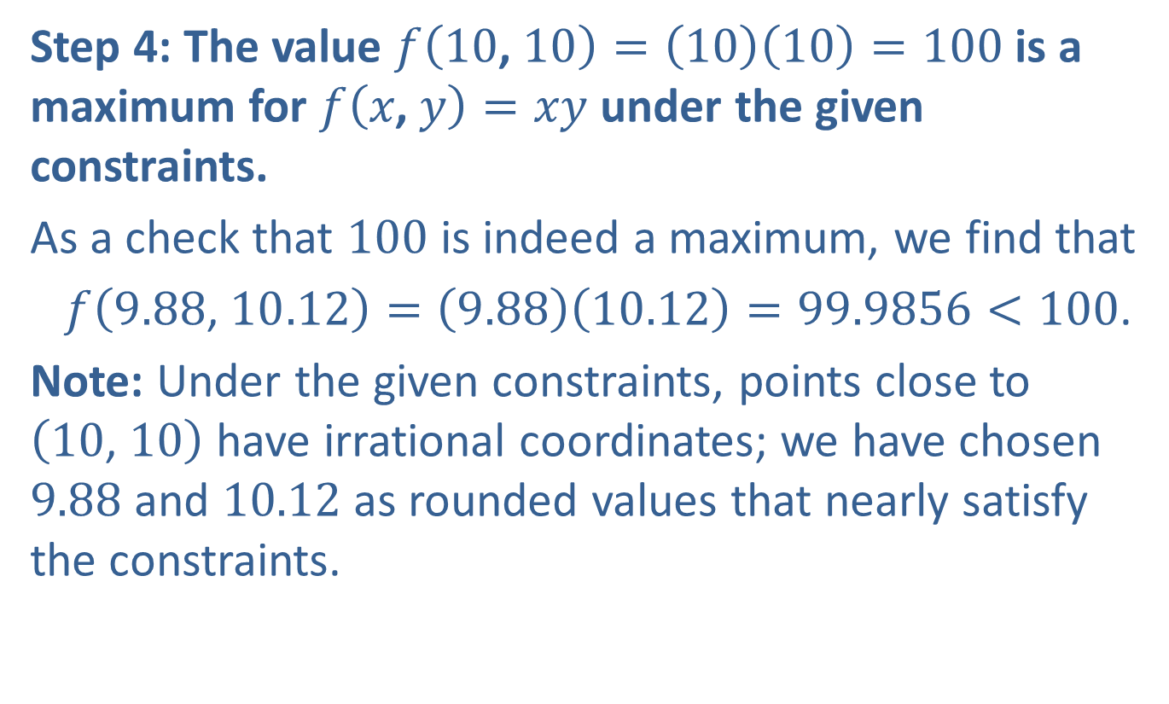
Example 2: Applying the Method of Lagrange Multipliers (cont.)
Step 4: The value $f\left(10\text{, }10\right)=\left(10\right)\left(10\right)=100$ is a maximum for $f\left(x\text{, }y\right)=xy$ under the given constraints.
As a check that 100 is indeed a maximum, we find that
$f\left(9.88\text{, }10.12\right)=\left(9.88\right)\left(10.12\right)=99.9856<100$.
Note: Under the given constraints, points close to $\left(10\text{, }10\right)$ have irrational coordinates; we have chosen 9.88 and 10.12 as rounded values that nearly satisfy the constraints.

Slide 15
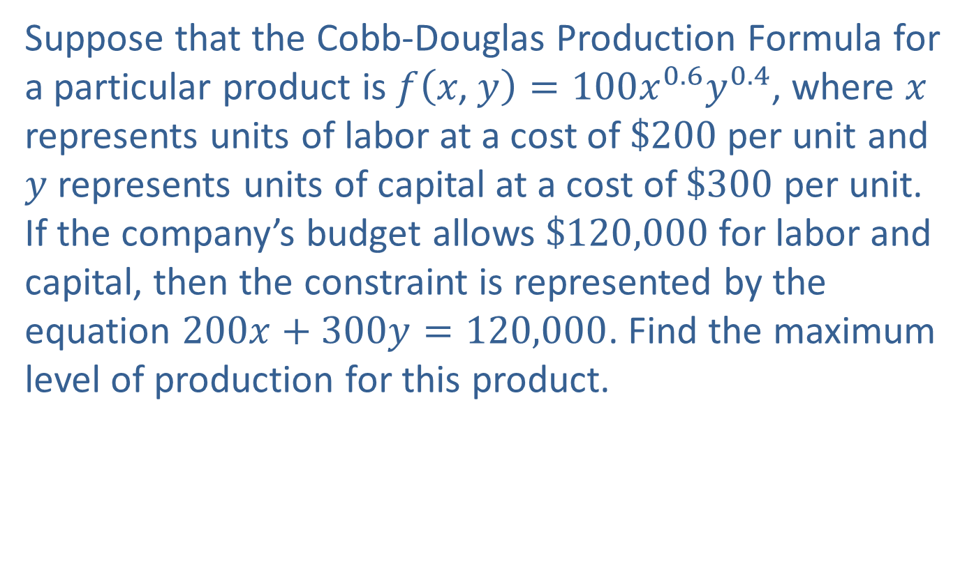
Example 3: Optimization Using the Cobb‐Douglas Production Formula
Suppose that the Cobb-Douglas Production Formula for a particular product is $f\left(x\text{, }y\right)=100x^{0.6}y^{0.4}$, where $x$ represents units of labor at a cost of $\$200$ per unit and $y$ represents units of capital at a cost of $\$300$ per unit. If the company’s budget allows $\$120,000$ for labor and capital, then the constraint is represented by the equation $200x+300y=120,000$. Find the maximum level of production for this product.

Slide 16


Example 3: Optimization Using the Cobb‐Douglas Production Formula (cont.)
Solution
Step 1: Form the Lagrange function.
$$F\left(x\text{, }y\text{, }λ\right)=100x^{0.6}y^{0.4}+λ\left(200x+300y−120,000\right)$$
Step 2: Find each of the partial derivatives.
$$F_{x}=60x^{−0.4}y^{0.4}+200λ \\ F_{y}=40x^{0.6}y^{−0.6}+300λ \\ F_{λ}=200x+300y−120,000$$

Slide 17
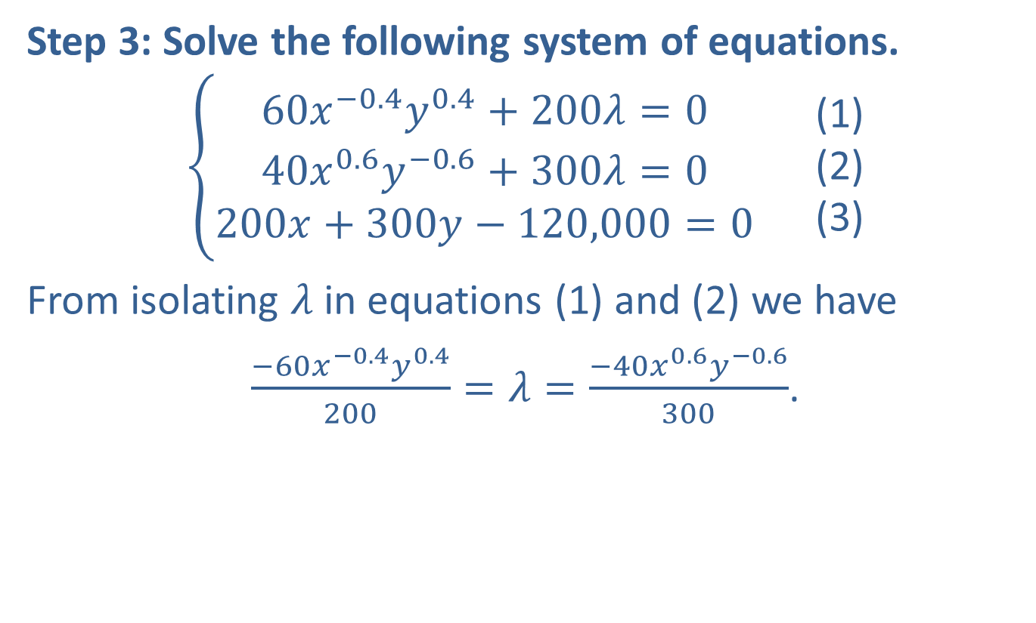
Example 3: Optimization Using the Cobb‐Douglas Production Formula (cont.)
Step 3: Solve the following system of equations.
$$\left\{\begin{aligned}60x^{−0.4}y^{0.4}+200λ=0 \\ 40x^{0.6}y^{−0.6}+300λ=0 \\ 200x+300y−120,000=0\end{aligned}\right.\begin{matrix} & \text{(}\text{1}\text{)} \\ & \text{(}\text{2}\text{)} \\ & \text{(}\text{3}\text{)}\end{matrix}$$
From isolating $λ$ in equations (1) and (2) we have
$\frac{−60x^{−0.4}y^{0.4}}{200}=λ=\frac{−40x^{0.6}y^{−0.6}}{300}$.
​

Slide 18
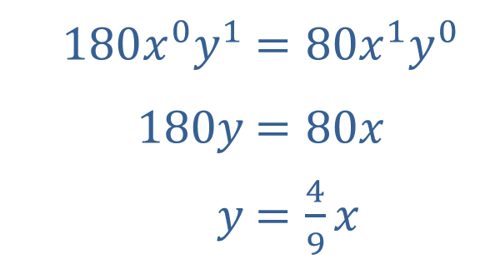

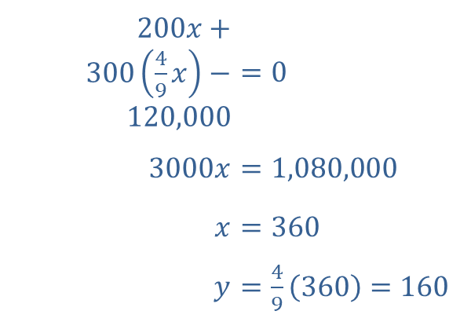
Multiply both sides of the equation by $−600x^{0.4}y^{0.6}$.
​
​$180x^{0}y^{1}$ | ​$=80x^{1}y^{0}$
​$180y$ | ​$=80x$
​$y$ | ​$=\frac{4}{9}x$
Substitute $\frac{4}{9}x$ for $y$ in equation (3).
​$200x+300\left(\frac{4}{9}x\right)−120,000$ | ​$=0$
​$3000x$ | ​$=1,080,000$
​$x$ | ​$=360$
​$y$ | ​$=\frac{4}{9}\left(360\right)=160$

Slide 19
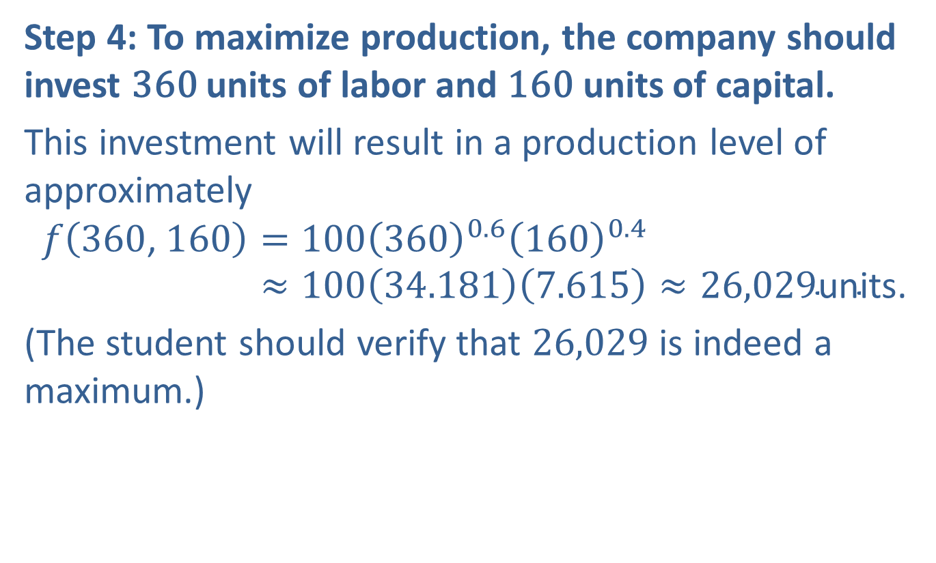
Example 3: Optimization Using the Cobb‐Douglas Production Formula (cont.)
Step 4: To maximize production, the company should invest 360 units of labor and 160 units of capital.
This investment will result in a production level of approximately
𝑓360, 160=1003600.61600.4𝑓⁡360, 160≈10034.1817.615≈26,029units.
(The student should verify that 26,029 is indeed a maximum.)

Slide 20
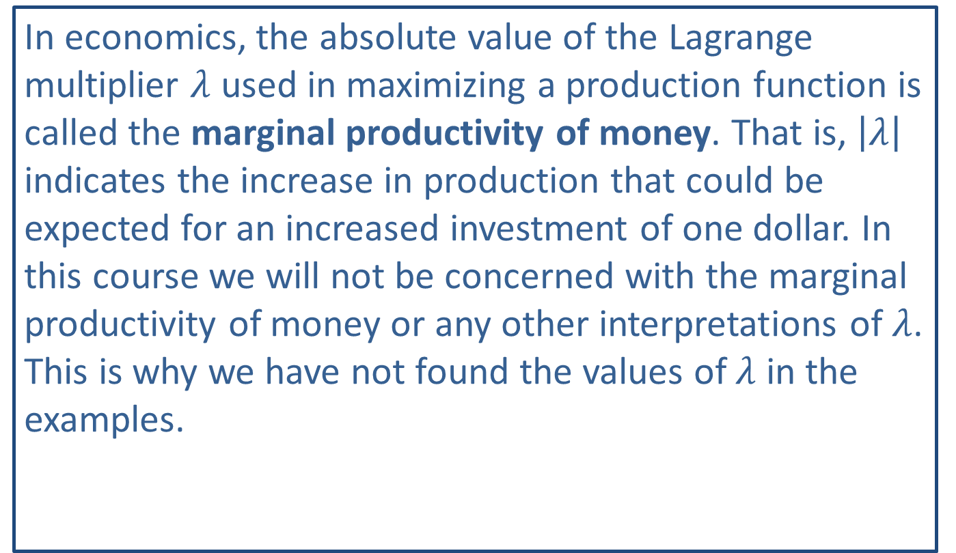
Note:
In economics, the absolute value of the Lagrange multiplier $λ$ used in maximizing a production function is called the marginal productivity of money. That is, $\left|λ\right|$ indicates the increase in production that could be expected for an increased investment of one dollar. In this course we will not be concerned with the marginal productivity of money or any other interpretations of $λ$. This is why we have not found the values of $λ$ in the examples.

