Slide 1
Section 8.5
The Method of Least Squares

Slide 2
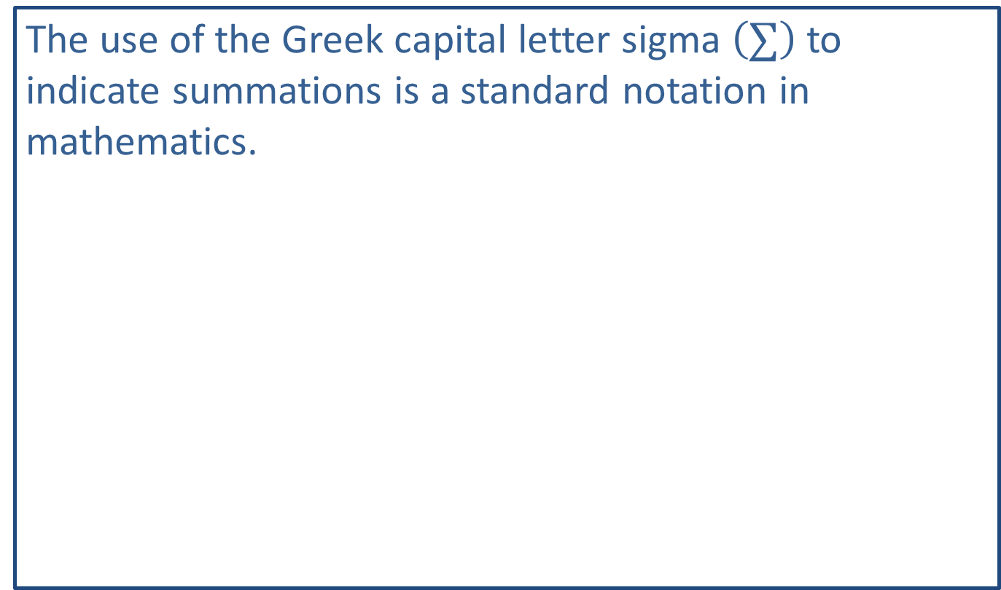
Note:
The use of the Greek capital letter sigma $\left(∑\right)$ to indicate summations is a standard notation in mathematics.

Slide 3
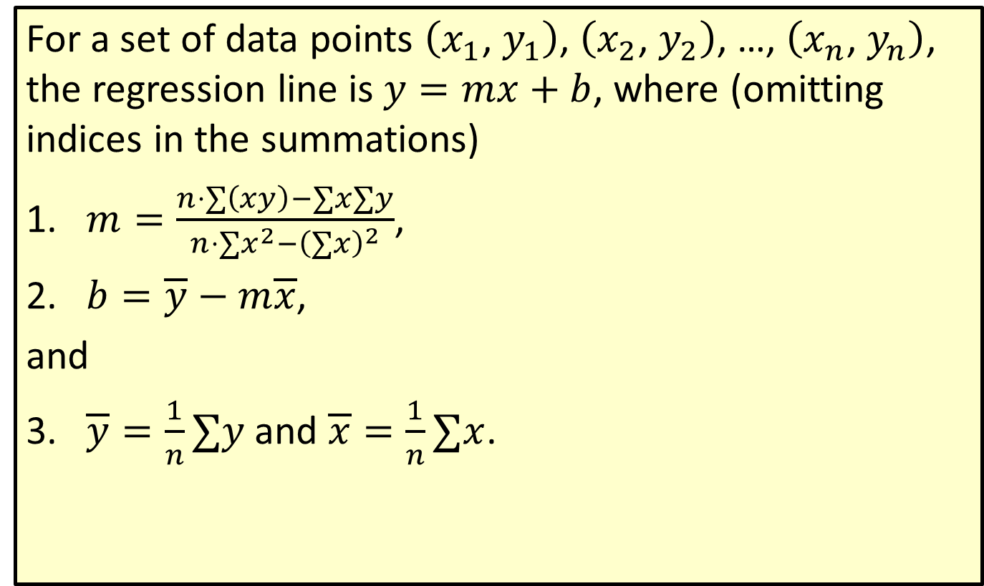
The Least-Squares Regression Line
For a set of data points $\left(x_{1}\text{, }y_{1}\right)$, $\left(x_{2}\text{, }y_{2}\right)$, …, $\left(x_{n}\text{, }y_{n}\right)$, the regression line is $y=mx+b$, where (omitting indices in the summations)
​$m=\frac{n⋅∑\left(xy\right)−∑x∑y}{n⋅∑x^{2}−{\left(∑x\right)}^{2}}$,
​$b=\overline{y}−m\overline{x}$,
​and
​$\overline{y}=\frac{1}{n}∑y$ and $\overline{x}=\frac{1}{n}∑x$.

Slide 4
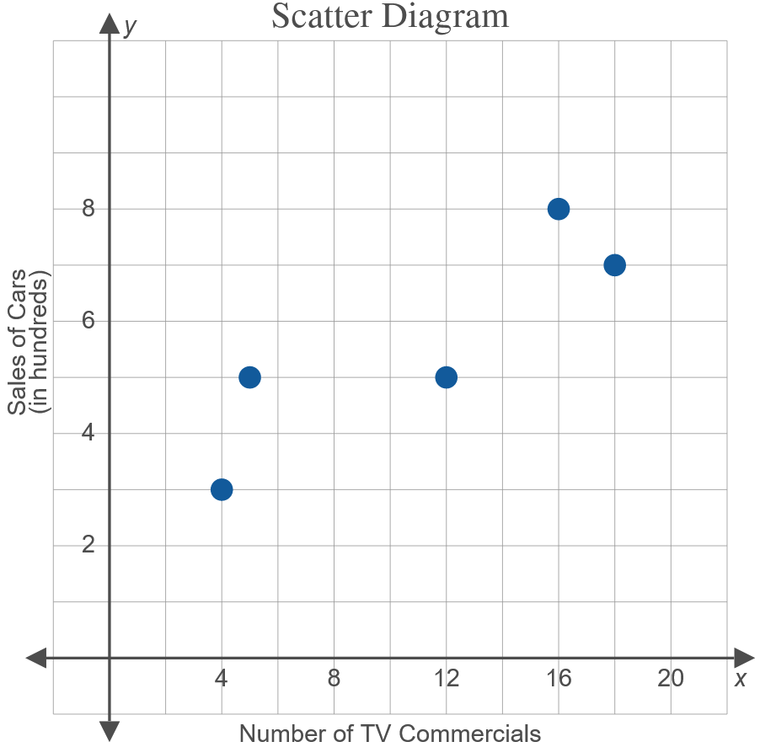
Example 1: Using Linear Regression on Tabular Data
Use the formulas to find the regression line for the data given in the table in Figure 1.
Figure 1

Slide 5
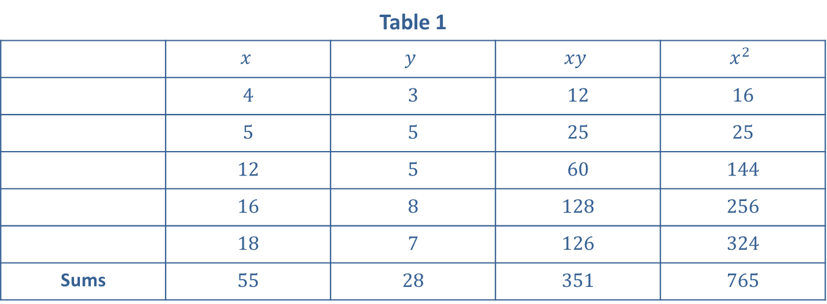
Example 1: Using Linear Regression on Tabular Data (cont.)
Solution
The data are shown and calculations are made in Table 1.
Table 1
 | $$x$$ | $$y$$ | $$xy$$ | $$x^{2}$$
 | 4 | 3 | 12 | 16
 | 5 | 5 | 25 | 25
 | 12 | 5 | 60 | 144
 | 16 | 8 | 128 | 256
 | 18 | 7 | 126 | 324
Sums | 55 | 28 | 351 | 765

Slide 6
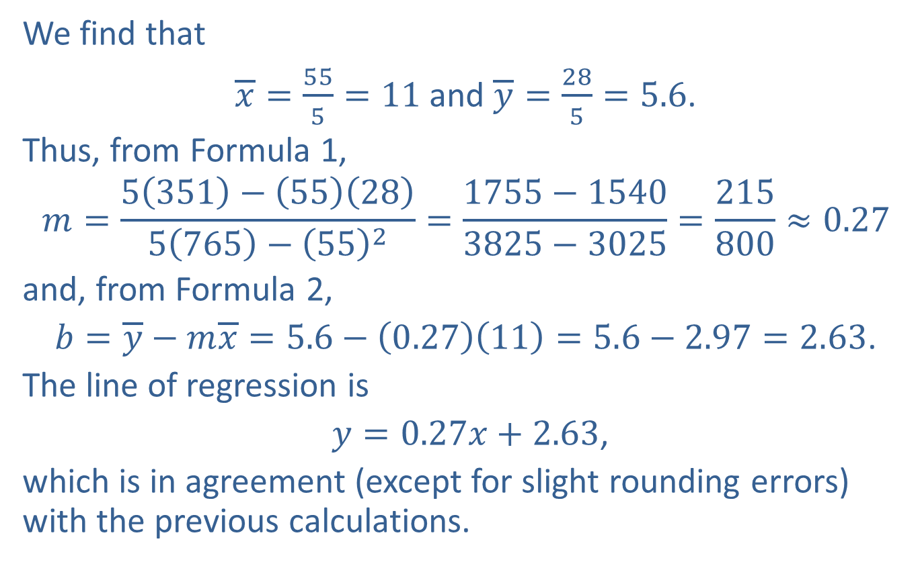
Example 1: Using Linear Regression on Tabular Data (cont.)
We find that
$\overline{x}=\frac{55}{5}=11$ and $\overline{y}=\frac{28}{5}=5.6$.
Thus, from Formula 1,
$$m=\frac{5\left(351\right)−\left(55\right)\left(28\right)}{5\left(765\right)−{\left(55\right)}^{2}}=\frac{1755−1540}{3825−3025}=\frac{215}{800}≈0.27$$
and, from Formula 2,
$b=\overline{y}−m\overline{x}=5.6−\left(0.27\right)\left(11\right)=5.6−2.97=2.63$.
The line of regression is
$y=0.27x+2.63$,
which is in agreement (except for slight rounding errors) with the previous calculations.

Slide 7
Example 2: Forecasting Grade Point Averages with Linear Regression
Table 2 shows the high school grade point averages (HS-GPA) and the college grade point averages (C-GPA) after one year of college for 10 students.
​Find the regression line for the data given in Table 2.
​What would be your best prediction for the C-GPA of a high school student with an HS-GPA of 2.5?
​Graph the data and the regression line on the same set of axes.
​

Slide 8
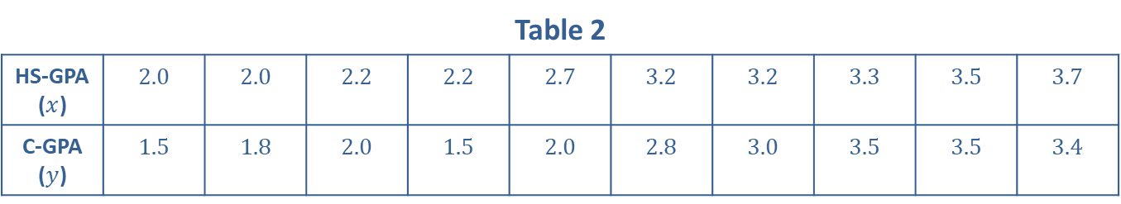
Example 2: Forecasting Grade Point Averages with Linear Regression (cont.)
Table 2
HS-GPA ($x$) | 2.0 | 2.0 | 2.2 | 2.2 | 2.7 | 3.2 | 3.2 | 3.3 | 3.5 | 3.7
C-GPA ($y$) | 1.5 | 1.8 | 2.0 | 1.5 | 2.0 | 2.8 | 3.0 | 3.5 | 3.5 | 3.4
Solution
​In Table 3, we calculate the values needed for Formulas 1 and 2.

Slide 9
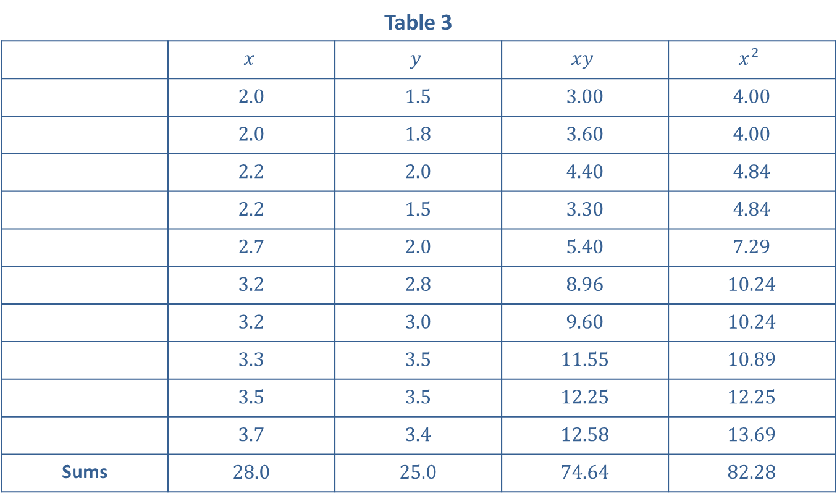
Example 2: Forecasting Grade Point Averages with Linear Regression (cont.)
Table 3
 | $$x$$ | $$y$$ | $$xy$$ | $$x^{2}$$
 | 2.0 | 1.5 | 3.00 | 4.00
 | 2.0 | 1.8 | 3.60 | 4.00
 | 2.2 | 2.0 | 4.40 | 4.84
 | 2.2 | 1.5 | 3.30 | 4.84
 | 2.7 | 2.0 | 5.40 | 7.29
 | 3.2 | 2.8 | 8.96 | 10.24
 | 3.2 | 3.0 | 9.60 | 10.24
 | 3.3 | 3.5 | 11.55 | 10.89
 | 3.5 | 3.5 | 12.25 | 12.25
 | 3.7 | 3.4 | 12.58 | 13.69
Sums | 28.0 | 25.0 | 74.64 | 82.28

Slide 10
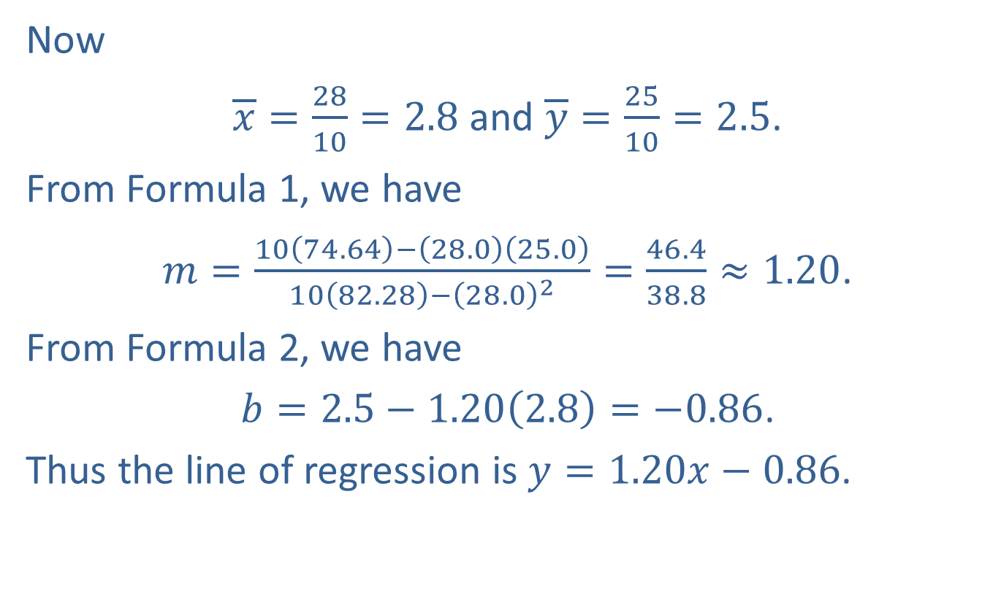
Example 2: Forecasting Grade Point Averages with Linear Regression (cont.)
​Now
​$\overline{x}=\frac{28}{10}=2.8$ and $\overline{y}=\frac{25}{10}=2.5$.
​From Formula 1, we have
​$m=\frac{10\left(74.64\right)−\left(28.0\right)\left(25.0\right)}{10\left(82.28\right)−{\left(28.0\right)}^{2}}=\frac{46.4}{38.8}≈1.20$.
​From Formula 2, we have
​$b=2.5−1.20\left(2.8\right)=−0.86$.
​Thus the line of regression is $y=1.20x−0.86$.

Slide 11

Example 2: Forecasting Grade Point Averages with Linear Regression (cont.)
​The best prediction for the C-GPA of a student with an HS-GPA of 2.5 is found by substituting $x=2.5$ in the equation for the line of regression and solving for $y$:
​$y=1.20\left(2.5\right)−0.86=2.14$.

Slide 12
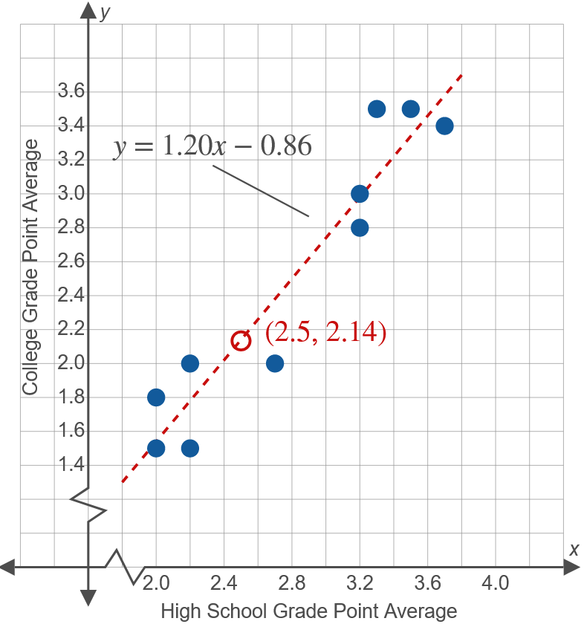
Example 2: Forecasting Grade Point Averages with Linear Regression (cont.)
​

