Slide 1
Section 8.6
Double Integrals

Slide 2
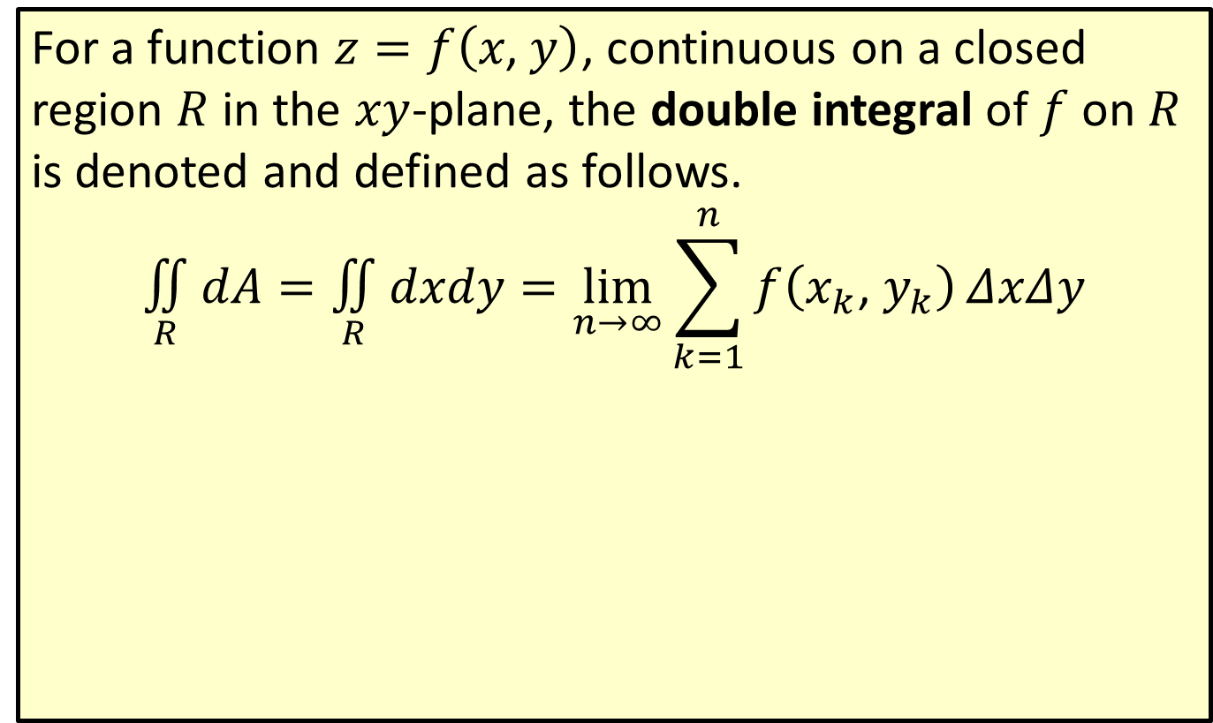
Double Integral
For a function $z=f\left(x\text{, }y\right)$, continuous on a closed region $R$ in the $xy$-plane, the double integral of $f$ on $R$ is denoted and defined as follows.
$$\underset{R}{∬}dA=\underset{R}{∬}dxdy=\lim_{n→∞}\sum_{k=1}^{n}{f\left(x_{k}\text{, }y_{k}\right)}ΔxΔy$$

Slide 3
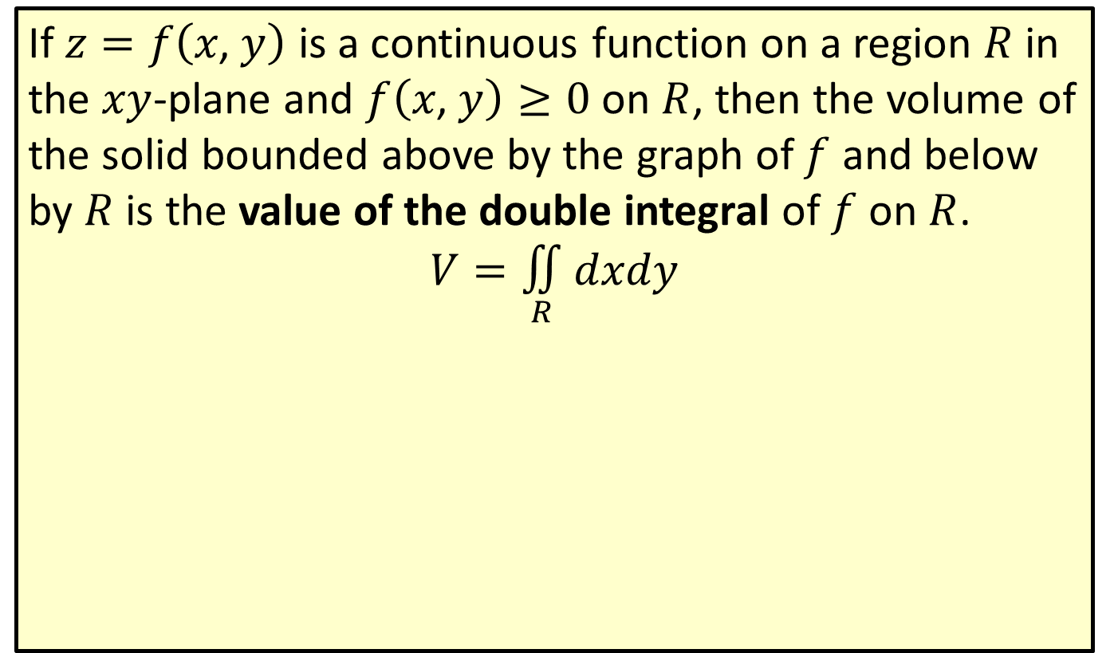
Value of the Double Integral
If $z=f\left(x\text{, }y\right)$ is a continuous function on a region $R$ in the $xy$-plane and $f\left(x\text{, }y\right)≥0$ on $R$, then the volume of the solid bounded above by the graph of $f$ and below by $R$ is the value of the double integral of $f$ on $R$.
$$V=\underset{R}{∬}dxdy$$

Slide 4
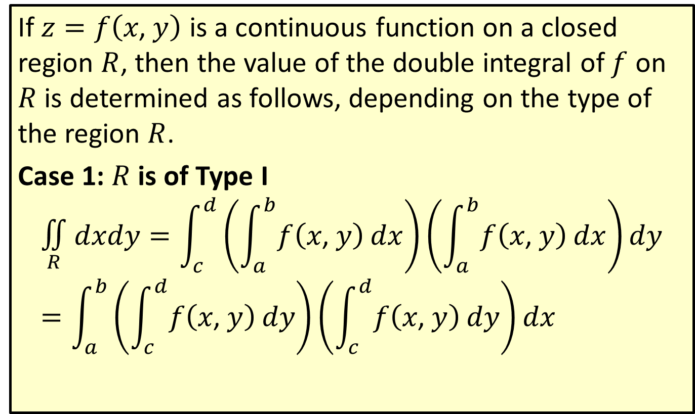
Evaluating Double Integrals
If $z=f\left(x\text{, }y\right)$ is a continuous function on a closed region $R$, then the value of the double integral of $f$ on $R$ is determined as follows, depending on the type of the region $R$.
Case 1: $R$ is of Type I
$$\underset{R}{∬}dxdy=\int_{c}^{d}{\left(\int_{a}^{b}{f\left(x\text{, }y\right)}dx\right)}\left(\int_{a}^{b}{f\left(x\text{, }y\right)}dx\right)dy=\int_{a}^{b}{\left(\int_{c}^{d}{f\left(x\text{, }y\right)}dy\right)}\left(\int_{c}^{d}{f\left(x\text{, }y\right)}dy\right)dx$$

Slide 5
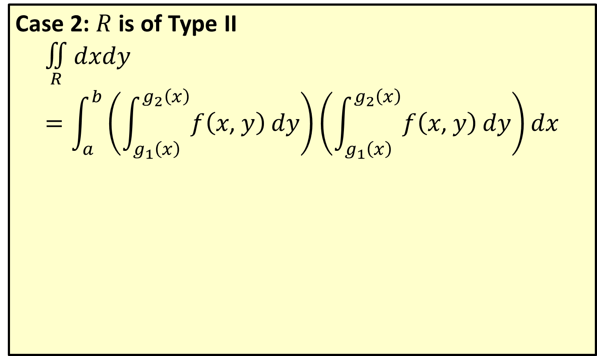
Evaluating Double Integrals (cont.)
Case 2: $R$ is of Type II
$$\underset{R}{∬}dxdy=\int_{a}^{b}{\left(\int_{g_{1}\left(x\right)}^{g_{2}\left(x\right)}{f\left(x\text{, }y\right)}dy\right)}\left(\int_{g_{1}\left(x\right)}^{g_{2}\left(x\right)}{f\left(x\text{, }y\right)}dy\right)dx$$

Slide 6
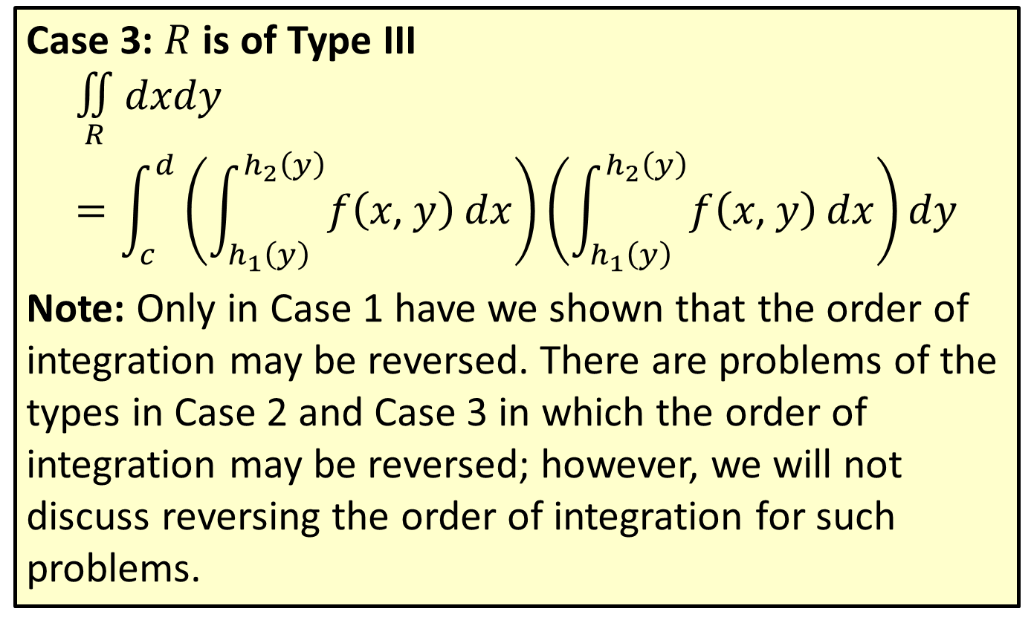
Evaluating Double Integrals (cont.)
Case 3: $R$ is of Type III
$$\underset{R}{∬}dxdy=\int_{c}^{d}{\left(\int_{h_{1}\left(y\right)}^{h_{2}\left(y\right)}{f\left(x\text{, }y\right)}dx\right)}\left(\int_{h_{1}\left(y\right)}^{h_{2}\left(y\right)}{f\left(x\text{, }y\right)}dx\right)dy$$
Note: Only in Case 1 have we shown that the order of integration may be reversed. There are problems of the types in Case 2 and Case 3 in which the order of integration may be reversed; however, we will not discuss reversing the order of integration for such problems.

Slide 7
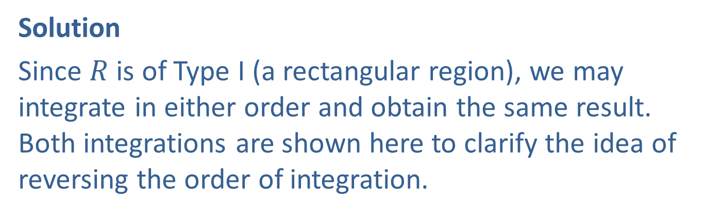

Example 1: Evaluating a Double Integral on a Type I Region
Evaluate the double integral $\int_{1}^{3}{\int_{1}^{e}{\frac{y^{2}}{x}}\frac{y^{2}}{x}dx}dy$.
Solution
Since $R$ is of Type I (a rectangular region), we may integrate in either order and obtain the same result. Both integrations are shown here to clarify the idea of reversing the order of integration.

Slide 8
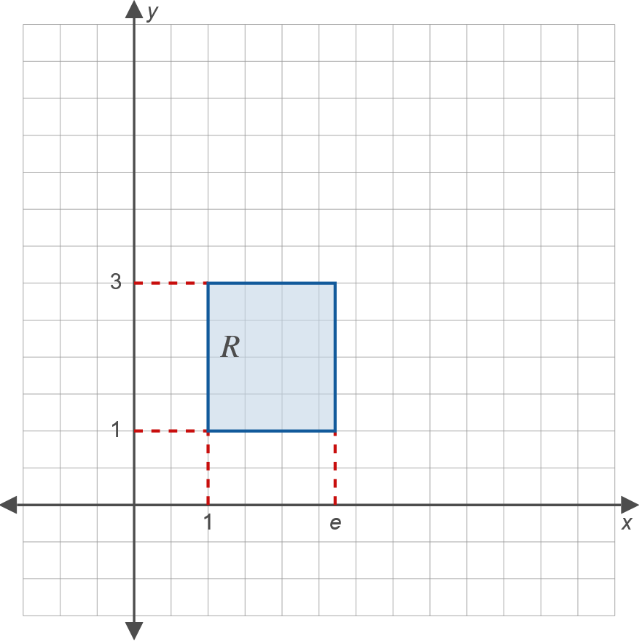
Example 1: Evaluating a Double Integral on a Type I Region (cont.)

Slide 9
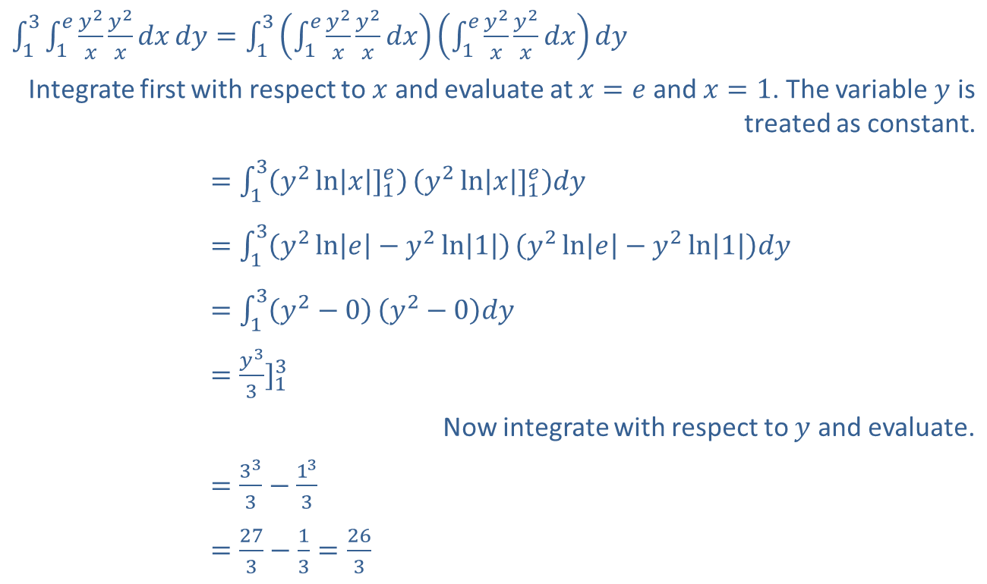
Example 1: Evaluating a Double Integral on a Type I Region (cont.)
​
​$\int_{1}^{3}{\int_{1}^{e}{\frac{y^{2}}{x}}\frac{y^{2}}{x}dx}dy=\int_{1}^{3}{\left(\int_{1}^{e}{\frac{y^{2}}{x}}\frac{y^{2}}{x}dx\right)}\left(\int_{1}^{e}{\frac{y^{2}}{x}}\frac{y^{2}}{x}dx\right)dy$
Integrate first with respect to $x$ and evaluate at $x=e$ and $x=1$. The variable $y$ is treated as constant.
​131𝑒𝑦2𝑥𝑦2𝑥𝑑𝑥𝑑𝑦=13𝑦2ln𝑥]1𝑒𝑦2ln𝑥]1𝑒𝑑𝑦
​131𝑒𝑦2𝑥𝑦2𝑥𝑑𝑥𝑑𝑦=13𝑦2ln𝑒−𝑦2ln1𝑦2ln𝑒−𝑦2ln1𝑑𝑦
​131𝑒𝑦2𝑥𝑦2𝑥𝑑𝑥𝑑𝑦=13𝑦2−0𝑦2−0𝑑𝑦
​131𝑒𝑦2𝑥𝑦2𝑥𝑑𝑥𝑑𝑦=𝑦33]13
Now integrate with respect to $y$ and evaluate.
​131𝑒𝑦2𝑥𝑦2𝑥𝑑𝑥𝑑𝑦=333−133
​131𝑒𝑦2𝑥𝑦2𝑥𝑑𝑥𝑑𝑦=273−13=263

Slide 10
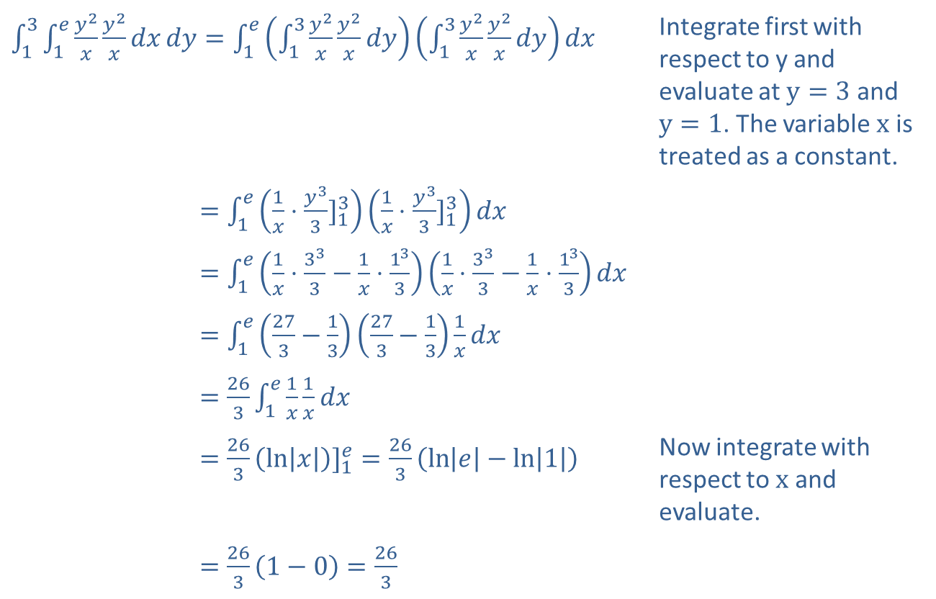
Example 1: Evaluating a Double Integral on a Type I Region (cont.)
​
​$\int_{1}^{3}{\int_{1}^{e}{\frac{y^{2}}{x}}\frac{y^{2}}{x}dx}dy=\int_{1}^{e}{\left(\int_{1}^{3}{\frac{y^{2}}{x}}\frac{y^{2}}{x}dy\right)}\left(\int_{1}^{3}{\frac{y^{2}}{x}}\frac{y^{2}}{x}dy\right)dx$ | Integrate first with respect to y and evaluate at $y=3$ and $y=1$. The variable $x$ is treated as a constant.
​131𝑒𝑦2𝑥𝑦2𝑥𝑑𝑥𝑑𝑦=1𝑒1𝑥⋅𝑦33]131𝑥⋅𝑦33]13𝑑𝑥
​131𝑒𝑦2𝑥𝑦2𝑥𝑑𝑥𝑑𝑦=1𝑒1𝑥⋅333−1𝑥⋅1331𝑥⋅333−1𝑥⋅133𝑑𝑥
​131𝑒𝑦2𝑥𝑦2𝑥𝑑𝑥𝑑𝑦=1𝑒273−13273−131𝑥𝑑𝑥
​131𝑒𝑦2𝑥𝑦2𝑥𝑑𝑥𝑑𝑦=2631𝑒1𝑥1𝑥𝑑𝑥
​131𝑒𝑦2𝑥𝑦2𝑥𝑑𝑥𝑑𝑦=263ln𝑥]1𝑒=263ln𝑒−ln1 | Now integrate with respect to $x$ and evaluate.
​131𝑒𝑦2𝑥𝑦2𝑥𝑑𝑥𝑑𝑦=2631−0=263

Slide 11
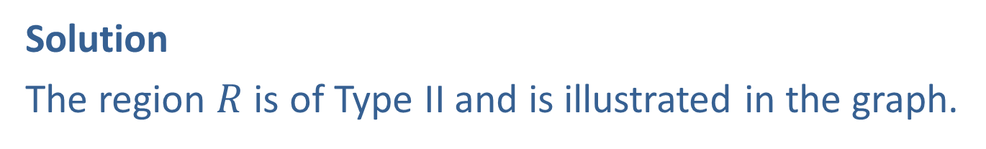

Example 2: Evaluating a Double Integral on a Type II Region
Evaluate the double integral $\int_{0}^{1}{\int_{x^{2}}^{x+1}{2x^{2}y}dy}dx$.
Solution
The region $R$ is of Type II and is illustrated in the graph.

Slide 12
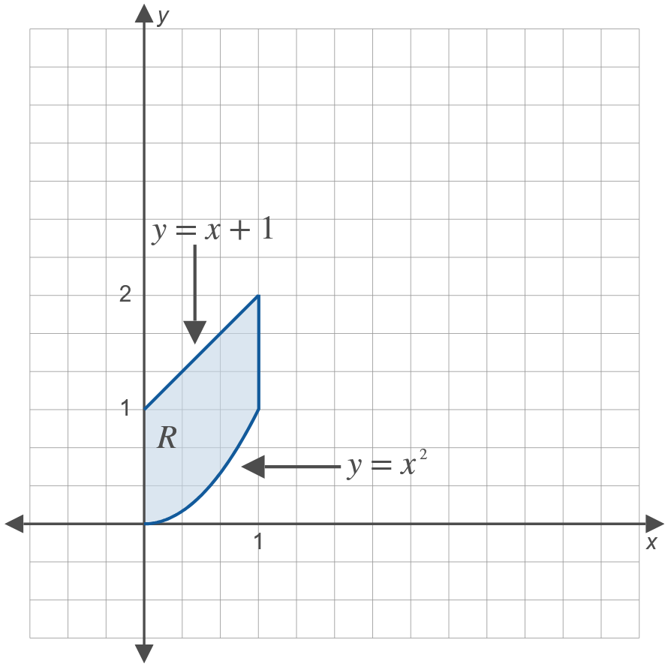
Example 2: Evaluating a Double Integral on a Type II Region (cont.)

Slide 13
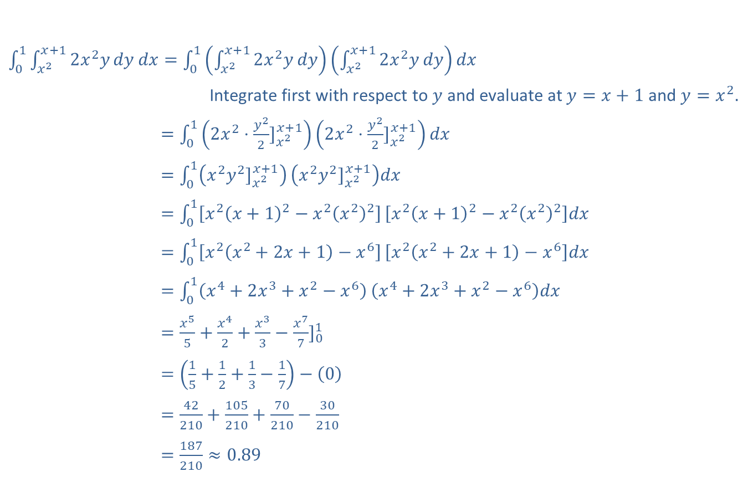
Example 2: Evaluating a Double Integral on a Type II Region (cont.)
​$\int_{0}^{1}{\int_{x^{2}}^{x+1}{2x^{2}y}dy}dx=\int_{0}^{1}{\left(\int_{x^{2}}^{x+1}{2x^{2}y}dy\right)}\left(\int_{x^{2}}^{x+1}{2x^{2}y}dy\right)dx$
Integrate first with respect to $y$ and evaluate at $y=x+1$ and $y=x^{2}$.
​01𝑥2𝑥+12𝑥2𝑦𝑑𝑦𝑑𝑥=012𝑥2⋅𝑦22]𝑥2𝑥+12𝑥2⋅𝑦22]𝑥2𝑥+1𝑑𝑥
​01𝑥2𝑥+12𝑥2𝑦𝑑𝑦𝑑𝑥=01𝑥2𝑦2]𝑥2𝑥+1𝑥2𝑦2]𝑥2𝑥+1𝑑𝑥
​01𝑥2𝑥+12𝑥2𝑦𝑑𝑦𝑑𝑥=01𝑥2𝑥+12−𝑥2𝑥22𝑥2𝑥+12−𝑥2𝑥22𝑑𝑥
​01𝑥2𝑥+12𝑥2𝑦𝑑𝑦𝑑𝑥=01𝑥2𝑥2+2𝑥+1−𝑥6𝑥2𝑥2+2𝑥+1−𝑥6𝑑𝑥
​01𝑥2𝑥+12𝑥2𝑦𝑑𝑦𝑑𝑥=01𝑥4+2𝑥3+𝑥2−𝑥6𝑥4+2𝑥3+𝑥2−𝑥6𝑑𝑥
​01𝑥2𝑥+12𝑥2𝑦𝑑𝑦𝑑𝑥=𝑥55+𝑥42+𝑥33−𝑥77]01
​01𝑥2𝑥+12𝑥2𝑦𝑑𝑦𝑑𝑥=15+12+13−17−0
​01𝑥2𝑥+12𝑥2𝑦𝑑𝑦𝑑𝑥=42210+105210+70210−30210
​01𝑥2𝑥+12𝑥2𝑦𝑑𝑦𝑑𝑥=187210≈0.89

Slide 14

Example 3: Evaluating a Double Integral on a Type III Region
Evaluate the double integral $\int_{0}^{1}{\int_{0}^{\frac{y}{3}}{e^{3x+y}}e^{3x+y}dx}dy$.

Slide 15
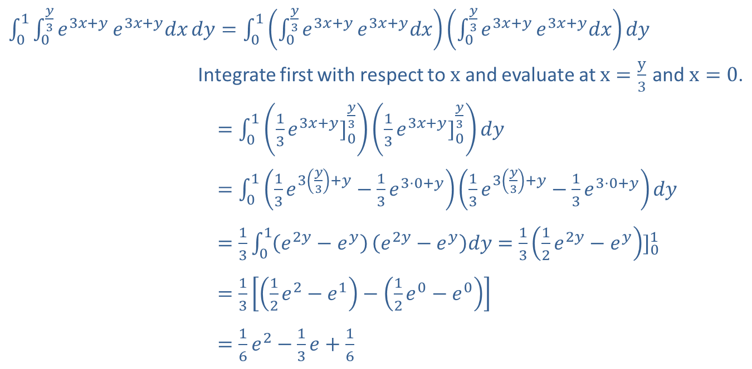
Example 3: Evaluating a Double Integral on a Type III Region (cont.)
Solution
​$\int_{0}^{1}{\int_{0}^{\frac{y}{3}}{e^{3x+y}}e^{3x+y}dx}dy=\int_{0}^{1}{\left(\int_{0}^{\frac{y}{3}}{e^{3x+y}}e^{3x+y}dx\right)}\left(\int_{0}^{\frac{y}{3}}{e^{3x+y}}e^{3x+y}dx\right)dy$
Integrate first with respect to $x$ and evaluate at $x=\frac{y}{3}$ and $x=0$.
​010𝑦3𝑒3𝑥+𝑦𝑒3𝑥+𝑦𝑑𝑥𝑑𝑦=0113𝑒3𝑥+𝑦]0𝑦313𝑒3𝑥+𝑦]0𝑦3𝑑𝑦
​010𝑦3𝑒3𝑥+𝑦𝑒3𝑥+𝑦𝑑𝑥𝑑𝑦=0113𝑒3𝑦3+𝑦−13𝑒3⋅0+𝑦13𝑒3𝑦3+𝑦−13𝑒3⋅0+𝑦𝑑𝑦
​010𝑦3𝑒3𝑥+𝑦𝑒3𝑥+𝑦𝑑𝑥𝑑𝑦=1301𝑒2𝑦−𝑒𝑦𝑒2𝑦−𝑒𝑦𝑑𝑦=1312𝑒2𝑦−𝑒𝑦]01
​010𝑦3𝑒3𝑥+𝑦𝑒3𝑥+𝑦𝑑𝑥𝑑𝑦=1312𝑒2−𝑒1−12𝑒0−𝑒0
​010𝑦3𝑒3𝑥+𝑦𝑒3𝑥+𝑦𝑑𝑥𝑑𝑦=16𝑒2−13𝑒+16

Slide 16

Example 4: Finding the Volume of a Geometric Solid
Find the volume of the solid bounded above by the graph of the function $z=10−x−y$ and below by the triangular region $R$ in the $xy$-plane with vertices at $\left(0\text{, }0\text{, }0\right)$, $\left(4\text{, }0\text{, }0\right)$, and $\left(0\text{, }8\text{, }0\right)$.

Slide 17

Example 4: Finding the Volume of a Geometric Solid (cont.)
Solution
The surface $z=10−x−y$ is a plane, and the region $R$ is a triangle in the $xy$-plane with the given points as vertices. The volume to be found is illustrated in the three-dimensional graph.

Slide 18
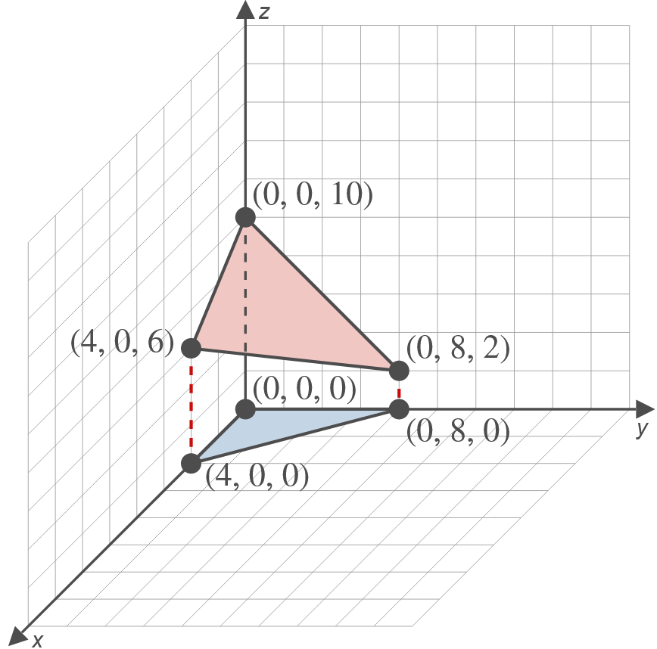
Example 4: Finding the Volume of a Geometric Solid (cont.)

Slide 19
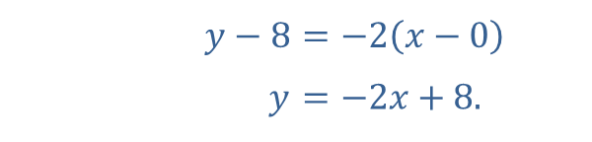
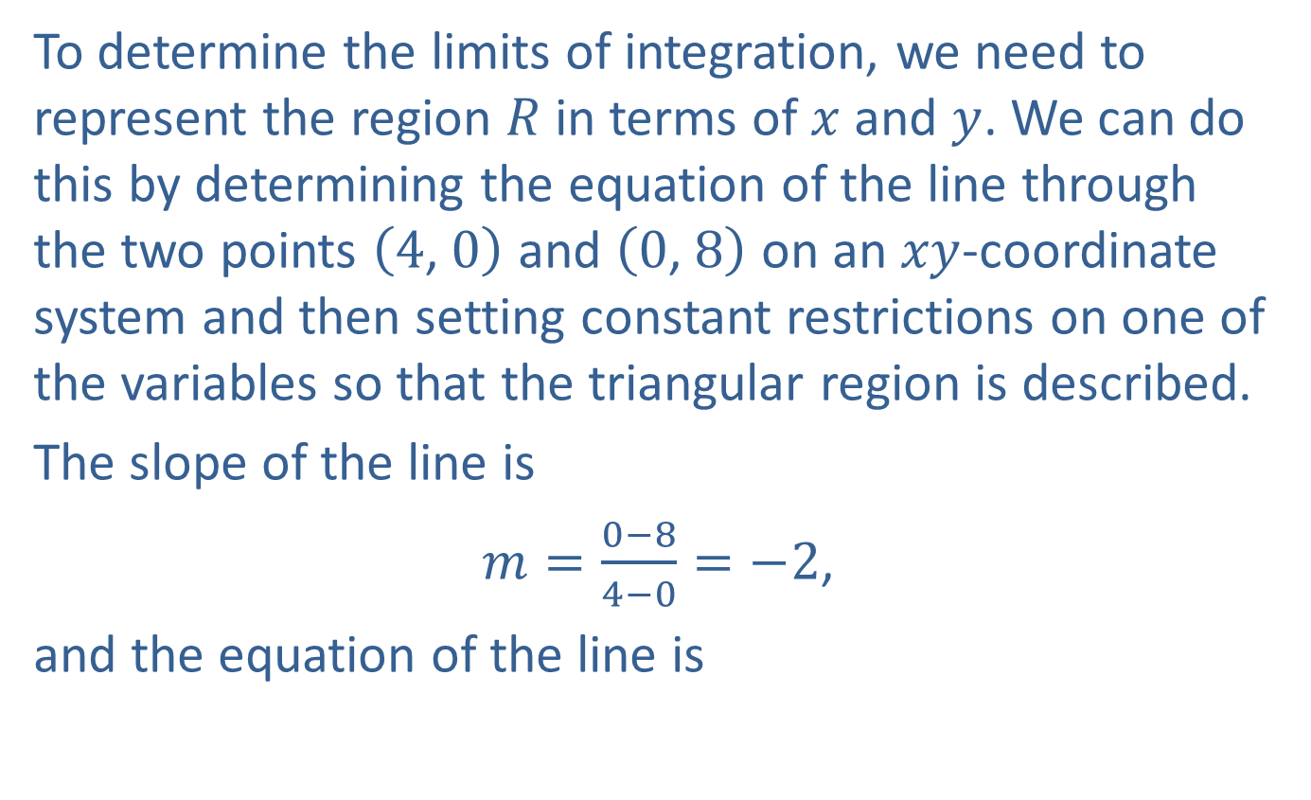
Example 4: Finding the Volume of a Geometric Solid (cont.)
To determine the limits of integration, we need to represent the region $R$ in terms of $x$ and $y$. We can do this by determining the equation of the line through the two points $\left(4\text{, }0\right)$ and $\left(0\text{, }8\right)$ on an $xy$-coordinate system and then setting constant restrictions on one of the variables so that the triangular region is described.
The slope of the line is
$m=\frac{0−8}{4−0}=−2$,
and the equation of the line is
​
​$y−8$ | ​$=−2\left(x−0\right)$
​$y$ | ​$=−2x+8\text{.}$

Slide 20

Example 4: Finding the Volume of a Geometric Solid (cont.)
Thus $R$ can be described by the following restrictions on $x$ and $y$:
$0≤x≤4$ and $0≤y≤−2x+8$.

Slide 21
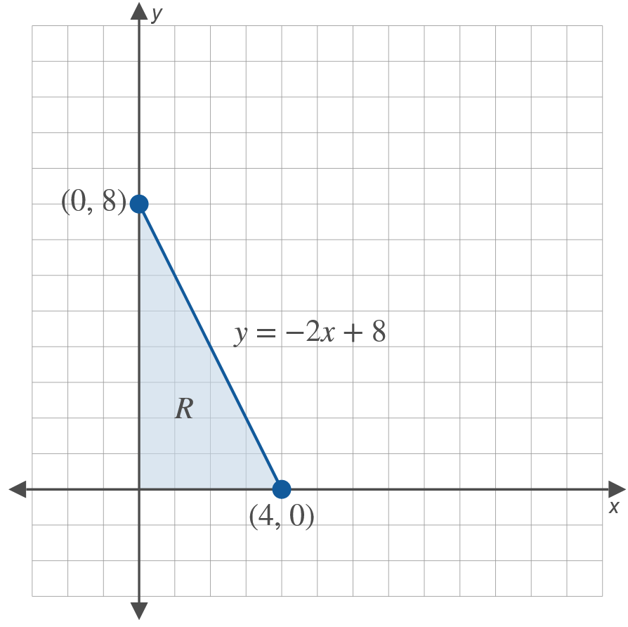
Example 4: Finding the Volume of a Geometric Solid (cont.)

Slide 22
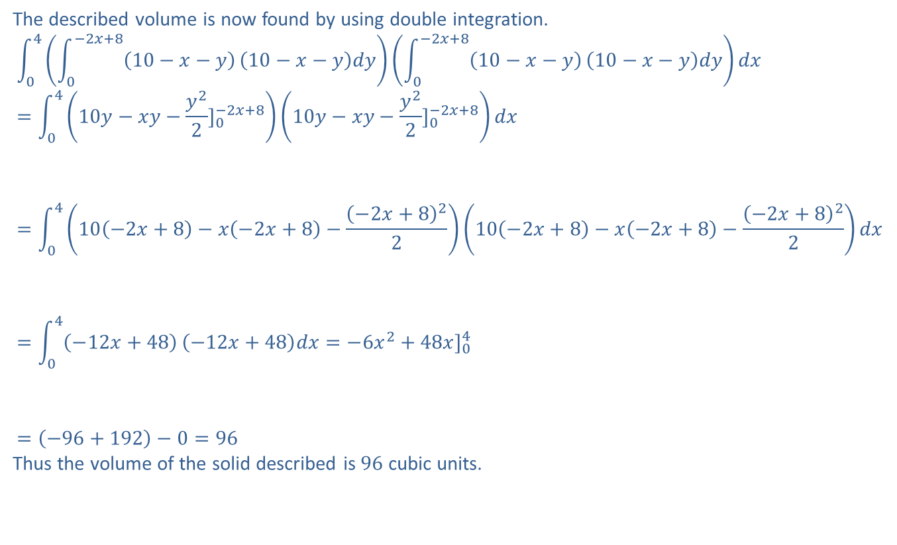
Example 4: Finding the Volume of a Geometric Solid (cont.)
The described volume is now found by using double integration.
040−2𝑥+810−𝑥−𝑦10−𝑥−𝑦𝑑𝑦0−2𝑥+810−𝑥−𝑦10−𝑥−𝑦𝑑𝑦𝑑𝑥=0410𝑦−𝑥𝑦−𝑦22]0−2𝑥+810𝑦−𝑥𝑦−𝑦22]0−2𝑥+8𝑑𝑥040−2𝑥+810−𝑥−𝑦10−𝑥−𝑦𝑑𝑦0−2𝑥+810−𝑥−𝑦10−𝑥−𝑦𝑑𝑦𝑑𝑥=0410−2𝑥+8−𝑥−2𝑥+8−−2𝑥+82210−2𝑥+8−𝑥−2𝑥+8−−2𝑥+822𝑑𝑥040−2𝑥+810−𝑥−𝑦10−𝑥−𝑦𝑑𝑦0−2𝑥+810−𝑥−𝑦10−𝑥−𝑦𝑑𝑦𝑑𝑥=04−12𝑥+48−12𝑥+48𝑑𝑥=−6𝑥2+48𝑥]04040−2𝑥+810−𝑥−𝑦10−𝑥−𝑦𝑑𝑦0−2𝑥+810−𝑥−𝑦10−𝑥−𝑦𝑑𝑦𝑑𝑥=−96+192−0=96
Thus the volume of the solid described is 96 cubic units.

