Slide 1
Section 9.1
Trigonometric Functions

Slide 2
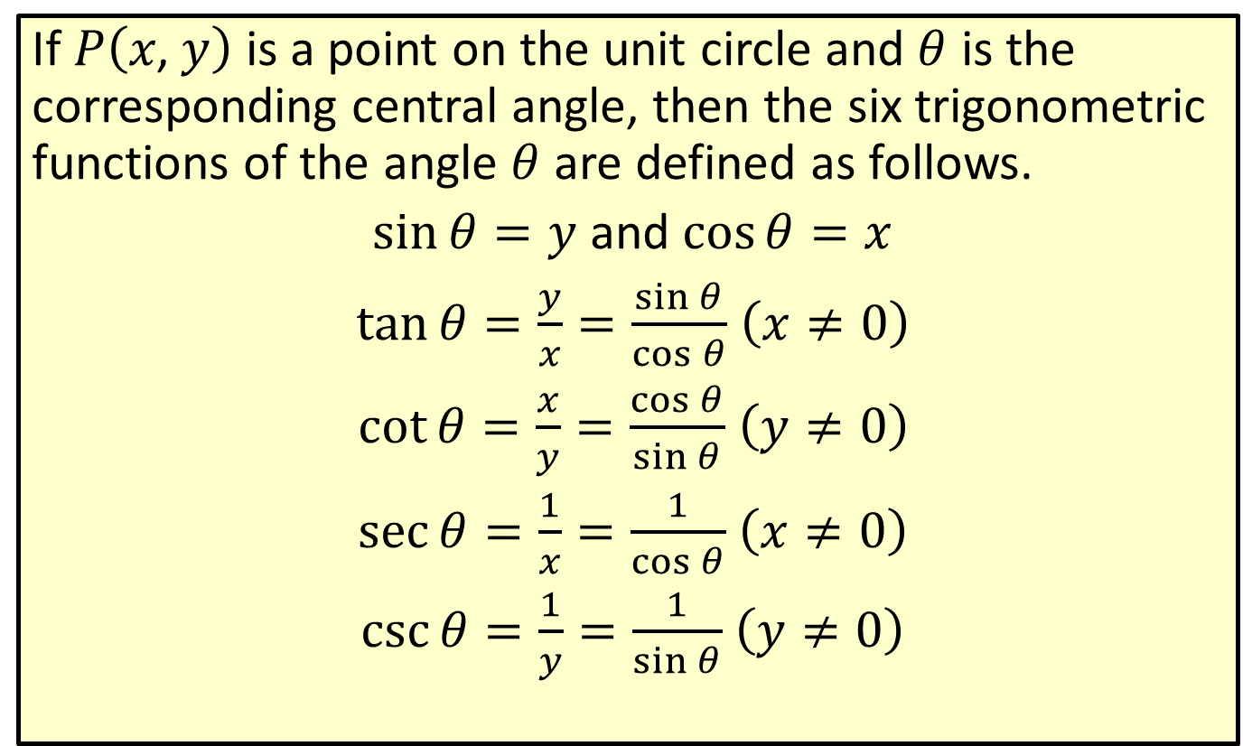
The Trigonometric Functions
If $P⁡\left(x\text{, }y\right)$ is a point on the unit circle and $θ$ is the corresponding central angle, then the six trigonometric functions of the angle $θ$ are defined as follows.
$\sin{θ}=y$ and $\cos{θ}=x$
$\tan{θ}=\frac{y}{x}=\frac{\sin{θ}}{\cos{θ}}$ $\left(x≠0\right)$
$\cot{θ}=\frac{x}{y}=\frac{\cos{θ}}{\sin{θ}}$ $\left(y≠0\right)$
$\sec{θ}=\frac{1}{x}=\frac{1}{\cos{θ}}$ $\left(x≠0\right)$
$\csc{θ}=\frac{1}{y}=\frac{1}{\sin{θ}}$ $\left(y≠0\right)$

Slide 3
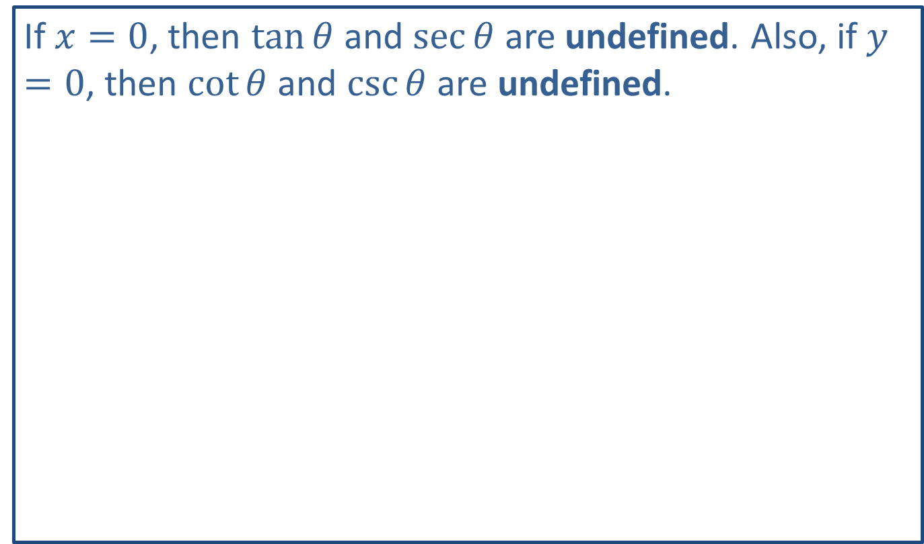
Note
If $x=0$, then $tan⁡θ$ and $sec⁡θ$ are undefined. Also, if $y=0$, then $cot⁡θ$ and $csc⁡θ$ are undefined.

Slide 4

Example 1: Trigonometric Functions
Use the given figure and the definitions to find the values of $sin⁡θ$, $cos⁡θ$, and $tan⁡θ$ for angle $θ$.

Slide 5
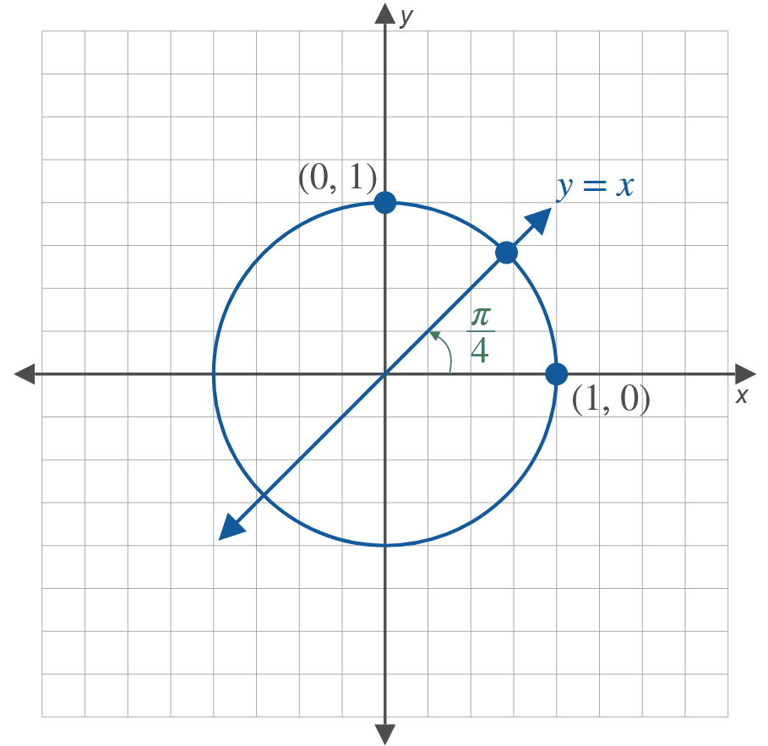
Example 1: Trigonometric Functions (cont.)

Slide 6

Example 1: Trigonometric Functions (cont.)
​$θ=0$
​$θ=\frac{π}{2}$
​$θ=\frac{π}{4}$

Slide 7
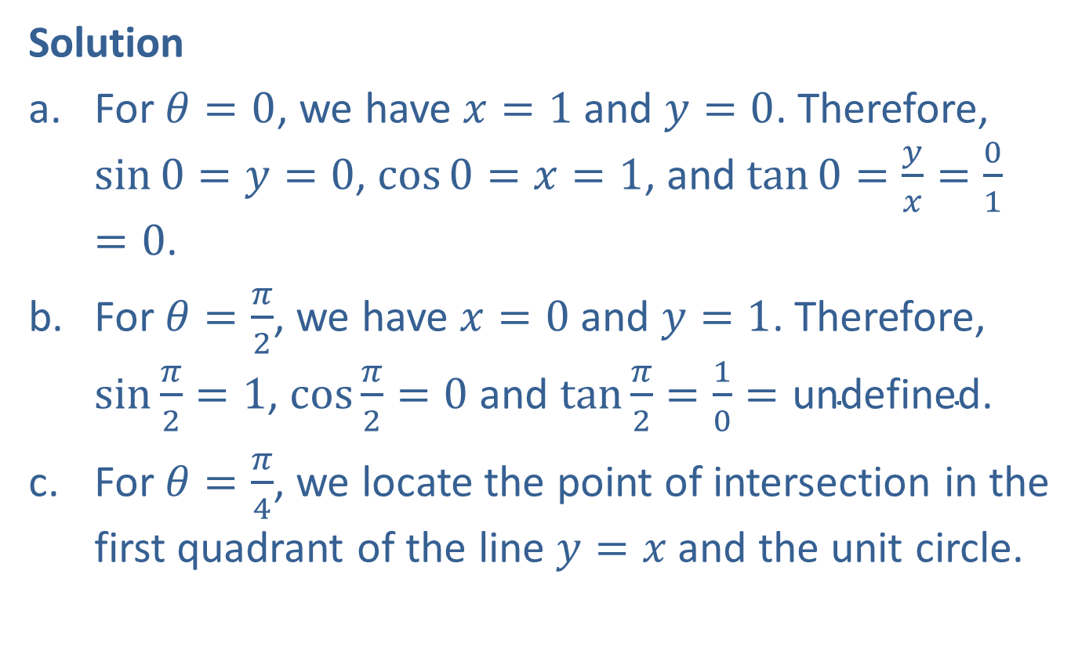
Example 1: Trigonometric Functions (cont.)
Solution
​For $θ=0$, we have $x=1$ and $y=0$. Therefore, $\sin{0}=y=0$, $\cos{0}=x=1$, and $\tan{0}=\frac{y}{x}=\frac{0}{1}=0$.
​For $θ=\frac{π}{2}$, we have $x=0$ and $y=1$. Therefore, $sin⁡\frac{π}{2}=1$, $cos⁡\frac{π}{2}=0$ and $tan⁡\frac{π}{2}=\frac{1}{0}=\text{undefined}$.
​For $θ=\frac{π}{4}$, we locate the point of intersection in the first quadrant of the line $y=x$ and the unit circle.
​

Slide 8
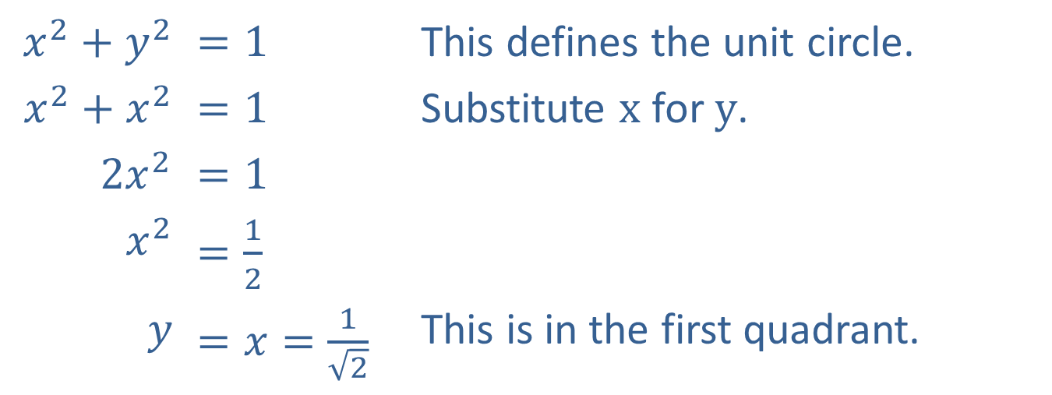
Example 1: Trigonometric Functions (cont.)
​$x^{2}+y^{2}$ | ​$=1$ | This defines the unit circle.
​$x^{2}+x^{2}$ | ​$=1$ | Substitute $x$ for $y$.
​$2x^{2}$ | ​$=1$
​$x^{2}$ | ​$=\frac{1}{2}$
$$y$$ | ​$=x=\frac{1}{\sqrt{2}}$ | This is in the first quadrant.
Therefore, $\sin{\frac{π}{4}}=\cos{\frac{π}{4}}=\frac{1}{\sqrt{2}}$ and $\tan{\frac{π}{4}}=\frac{y}{x}=1$.

Slide 9
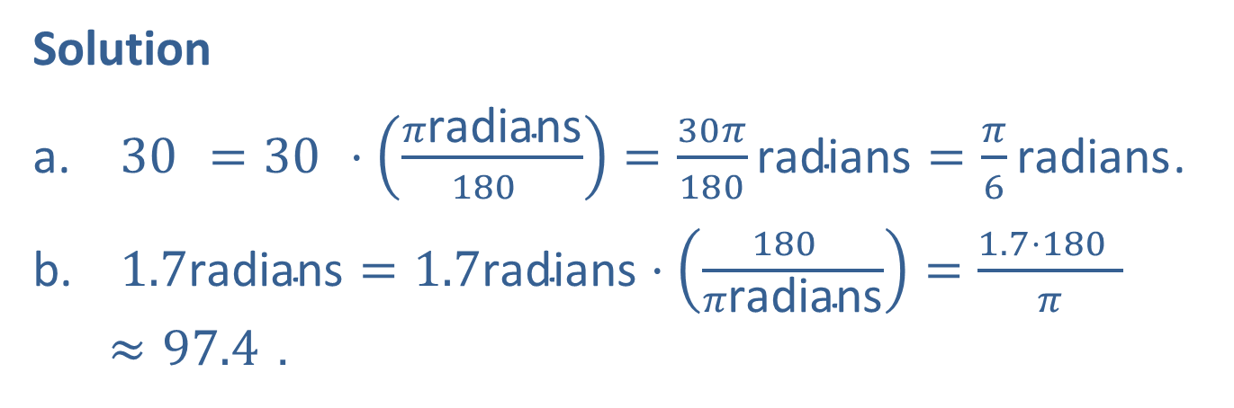

Example 2: Angle Conversion
Convert the following angle measures as directed.
​Convert ${30}^{ }$ to radians.
​Convert 1.7 radians to degrees.
Solution
​ ${30}^{ }={30}^{ }⋅\left(\frac{π\text{radians}}{{180}^{ }}\right)=\frac{30π}{180}\text{radians}=\frac{π}{6}\text{radians}$.
​ $1.7\text{radians}=1.7\text{radians}⋅\left(\frac{{180}^{ }}{π\text{radians}}\right)=\frac{1.7⋅{180}^{ }}{π}≈{97.4}^{ }$.

Slide 10
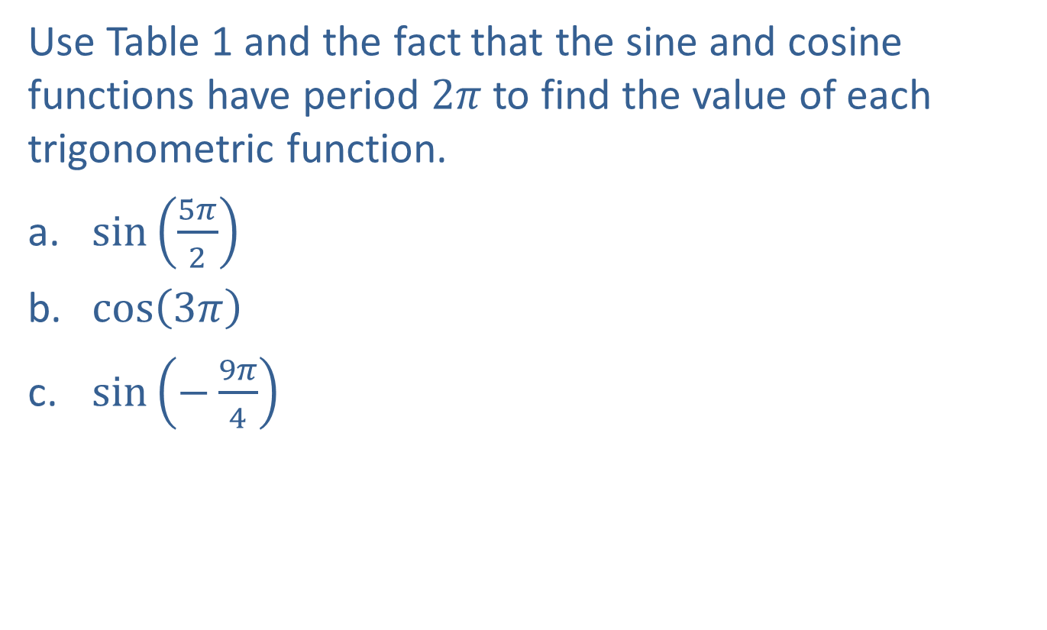
Example 3: Values of Trigonometric Functions
Use Table 1 and the fact that the sine and cosine functions have period $2π$ to find the value of each trigonometric function.
​$sin⁡\left(\frac{5π}{2}\right)$
​$cos⁡\left(3π\right)$
​$sin⁡\left(−\frac{9π}{4}\right)$

Slide 11
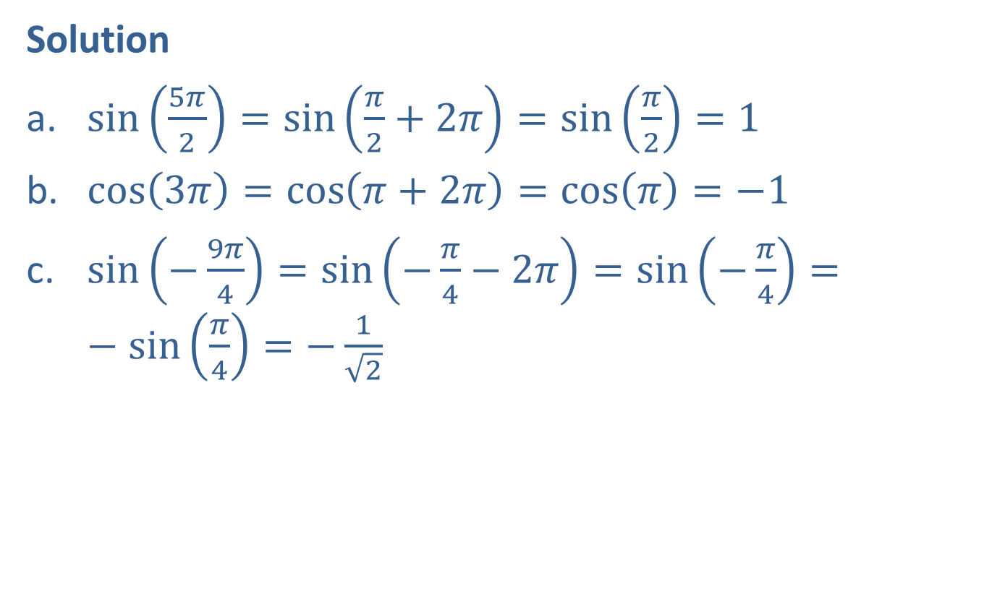
Example 3: Values of Trigonometric Functions (cont.)
Solution
​$\sin\left(\frac{5π}{2}\right)=\sin\left(\frac{π}{2}+2π\right)=\sin\left(\frac{π}{2}\right)=1$
​$\cos\left(3π\right)=\cos\left(π+2π\right)=\cos\left(π\right)=−1$
​$\sin\left(−\frac{9π}{4}\right)=\sin\left(−\frac{π}{4}−2π\right)=\sin\left(−\frac{π}{4}\right)=−\sin\left(\frac{π}{4}\right)=−\frac{1}{\sqrt{2}}$

Slide 12
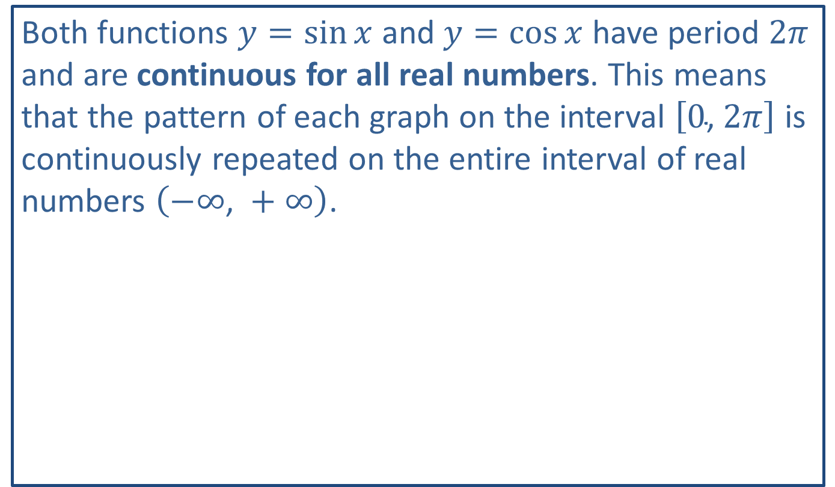
Note
Both functions $y=\sin{x}$ and $y=\cos{x}$ have period $2π$ and are continuous for all real numbers. This means that the pattern of each graph on the interval $\left[0\text{, }2π\right]$ is continuously repeated on the entire interval of real numbers $\left(−∞\text{, }+∞\right)$.

Slide 13
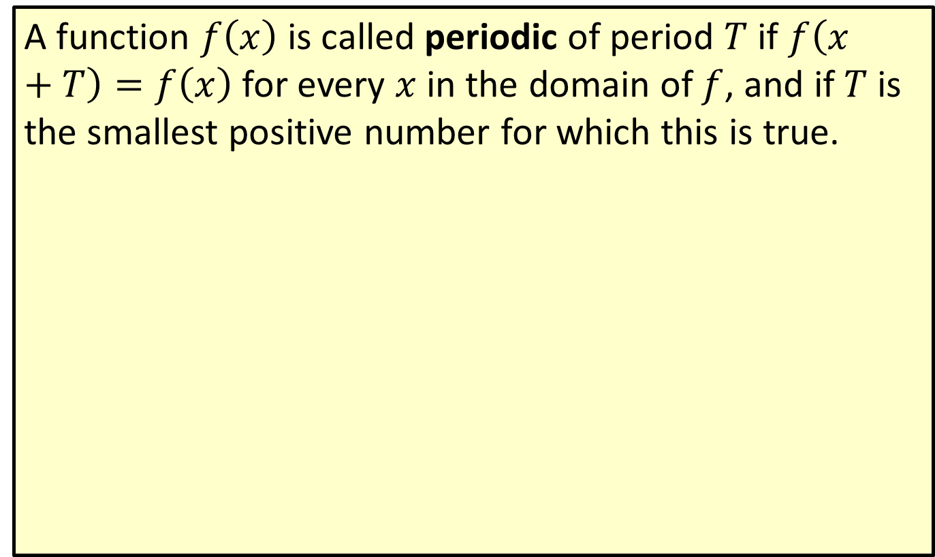
Periodic Function
A function $f⁡\left(x\right)$ is called periodic of period $T$ if $f\left(x+T\right)=f\left(x\right)$ for every $x$ in the domain of $f$, and if $T$ is the smallest positive number for which this is true.

Slide 14
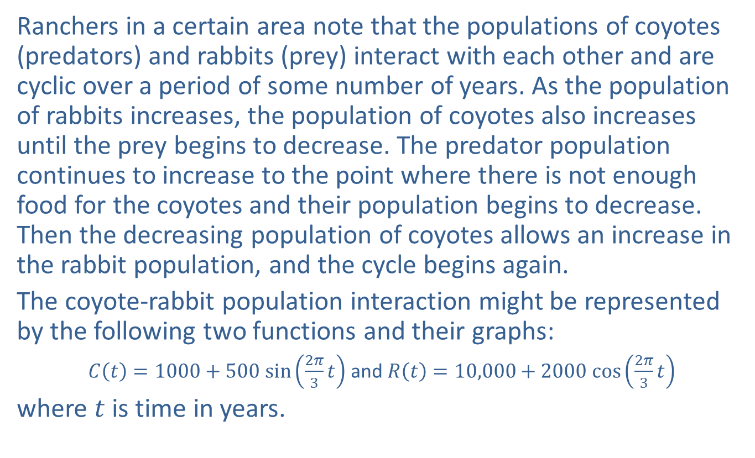
Example 4: The Predator-Prey Model
Ranchers in a certain area note that the populations of coyotes (predators) and rabbits (prey) interact with each other and are cyclic over a period of some number of years. As the population of rabbits increases, the population of coyotes also increases until the prey begins to decrease. The predator population continues to increase to the point where there is not enough food for the coyotes and their population begins to decrease. Then the decreasing population of coyotes allows an increase in the rabbit population, and the cycle begins again.
The coyote-rabbit population interaction might be represented by the following two functions and their graphs:
$C\left(t\right)=1000+500 sin⁡\left(\frac{2π}{3}t\right)$ and $R\left(t\right)=10,000+2000 cos⁡\left(\frac{2π}{3}t\right)$
where $t$ is time in years.

Slide 15
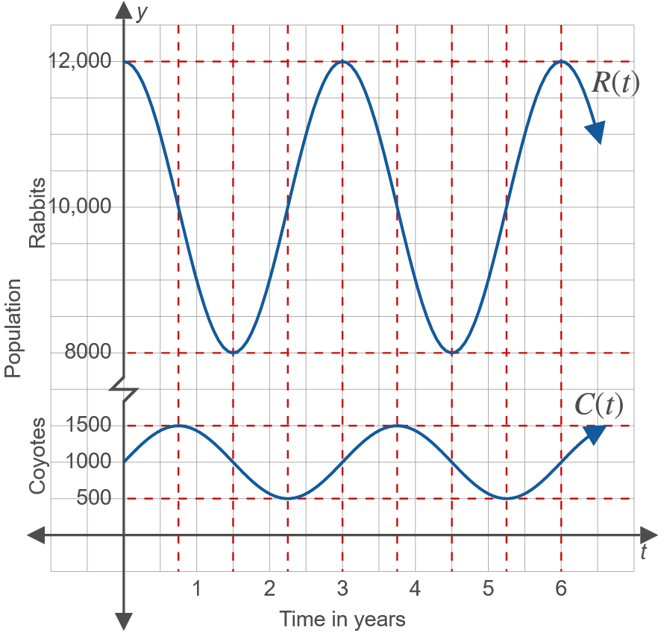
Example 4: The Predator-Prey Model (cont.)

Slide 16

Example 4: The Predator-Prey Model (cont.)
​Calculate the period of the function $C⁡\left(t\right)$ algebraically.
​Calculate the period of the function $R⁡\left(t\right)$ graphically.

Slide 17
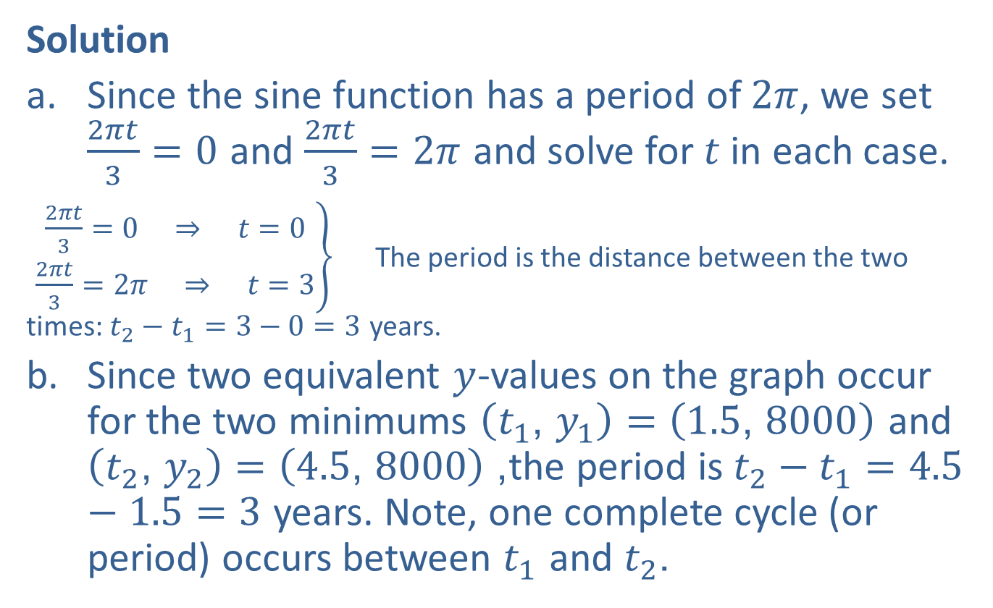
Example 4: The Predator-Prey Model (cont.)
Solution
​Since the sine function has a period of $2π$, we set $\frac{2πt}{3}=0$ and $\frac{2πt}{3}=2π$ and solve for $t$ in each case.
​ $\left.\begin{aligned}\frac{2πt}{3}=0⇒t=0 \\ \frac{2πt}{3}=2π⇒t=3\end{aligned}\right\}$ The period is the distance between the two times: $t_{2}−t_{1}=3−0=3$ years.
​Since two equivalent $y$-values on the graph occur for the two minimums $\left(t_{1}\text{, }y_{1}\right)=\left(1.5\text{, }8000\right)$ and $\left(t_{2}\text{, }y_{2}\right)=\left(4.5\text{, }8000\right)$, the period is $t_{2}−t_{1}=4.5−1.5=3$ years. Note, one complete cycle (or period) occurs between $t_{1}$ and $t_{2}$.

Slide 18
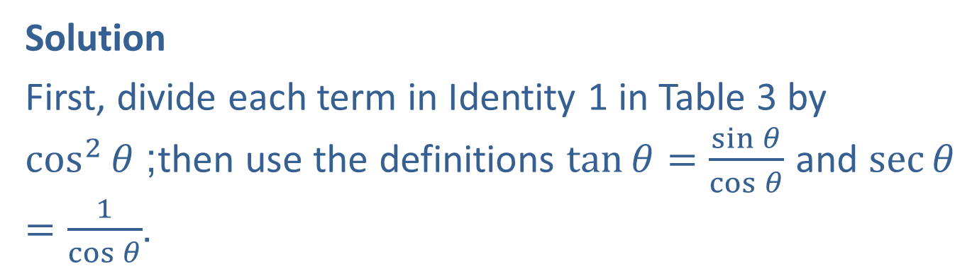

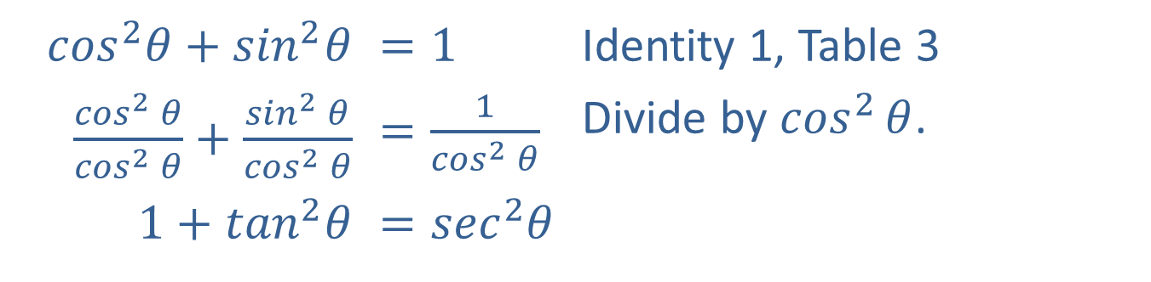
Example 5: Trigonometric Identities
Verify the trigonometric identity $1+{tan⁡}^{2}θ=\sec^{2}{θ}$.
Solution
First, divide each term in Identity 1 in Table 3 by $\cos^{2}⁡θ$; then use the definitions $\tan{θ}=\frac{\sin{θ}}{\cos{θ}}$ and $\sec{θ}=\frac{1}{\cos{θ}}$.
​$\cos^{2}θ+\sin^{2}θ$ | ​$=1$ | Identity 1, Table 3
​$\frac{\cos^{2}{θ}}{\cos^{2}{θ}}+\frac{\sin^{2}{θ}}{\cos^{2}{θ}}$ | ​$=\frac{1}{\cos^{2}{θ}}$ | Divide by $\cos^{2}⁡θ$.
​$1+\tan^{2}θ$ | ​$=\sec^{2}θ$

Slide 19
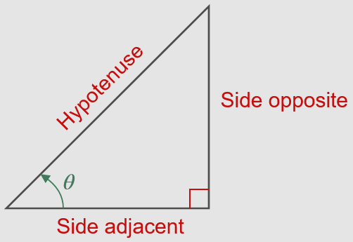



Right-Triangle Definitions of Sine, Cosine, and Tangent
$$\sin{θ}=\frac{\text{side} \text{opposite}θ}{\text{hypotenuse}}$$
$$\cos{θ}=\frac{\text{side} \text{adjacent}θ}{\text{hypotenuse}}$$
$$\tan{θ}=\frac{\text{side} \text{opposite}θ}{\text{side} \text{adjacent}θ}$$

Slide 20
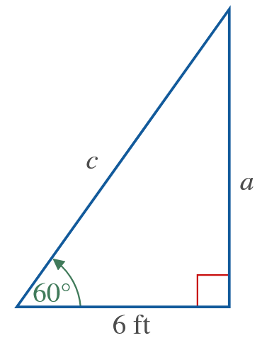

Example 6: Right Triangle Trigonometry
Find the lengths of $c$ and $a$ in the right triangle shown in the figure.

Slide 21
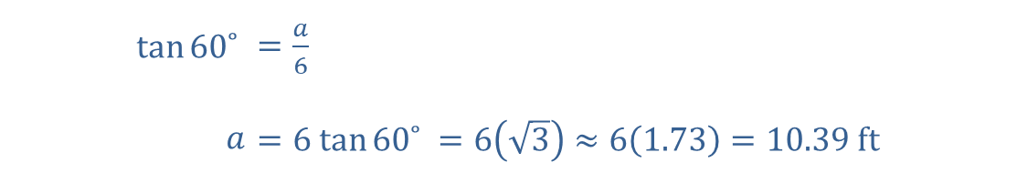
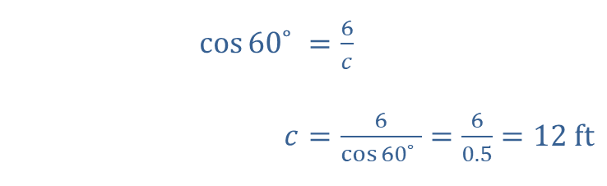


Example 6: Right Triangle Trigonometry (cont.)
Solution
​
​
​$\cos{{60˚}^{ }}$ | ​$=\frac{6}{c}$
​$c$ | ​$=\frac{6}{\cos{{60˚}^{ }}}=\frac{6}{0.5}=12 ft$
$$cos60˚=\cos{\frac{π}{3}}=\frac{1}{2}$$
​$\tan{{60˚}^{ }}$ | ​$=\frac{a}{6}$
​$a$ | ​$=6 tan⁡{60˚}^{ }=6\left(\sqrt{3}\right)≈6\left(1.73\right)=10.39 ft$
$$tan{60˚}^{ }=\tan{\frac{π}{3}}=\sqrt{3}$$

