Slide 1
Section 9.2
Derivatives of Trigonometric Functions

Slide 2
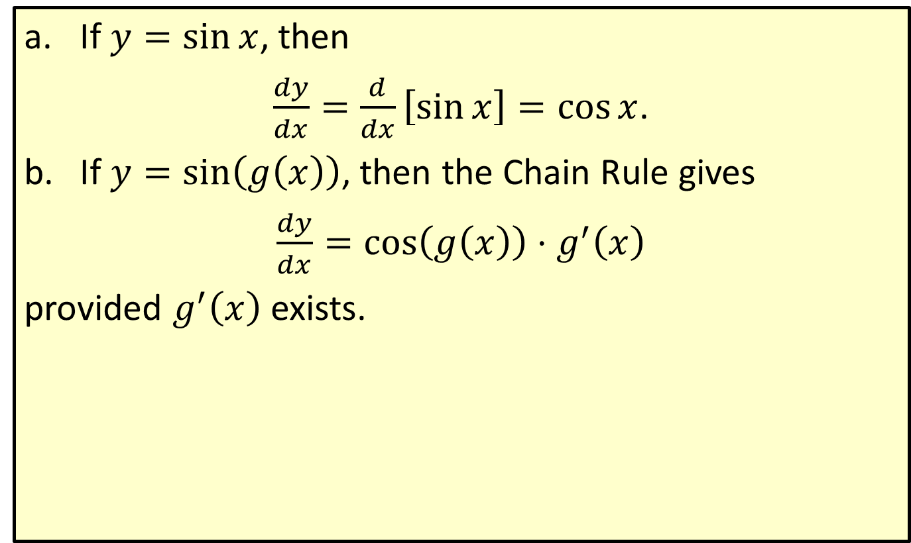
Derivative of Sine
​If $y=\sin{x}$, then
​$\frac{dy}{dx}=\frac{d}{dx}\left[\sin{x}\right]=\cos{x}$.
​If $y=\sin\left(g\left(x\right)\right)$, then the Chain Rule gives
​$\frac{dy}{dx}=\cos\left(g\left(x\right)\right)⋅g^{′}\left(x\right)$
​provided $g^{′}\left(x\right)$ exists.

Slide 3
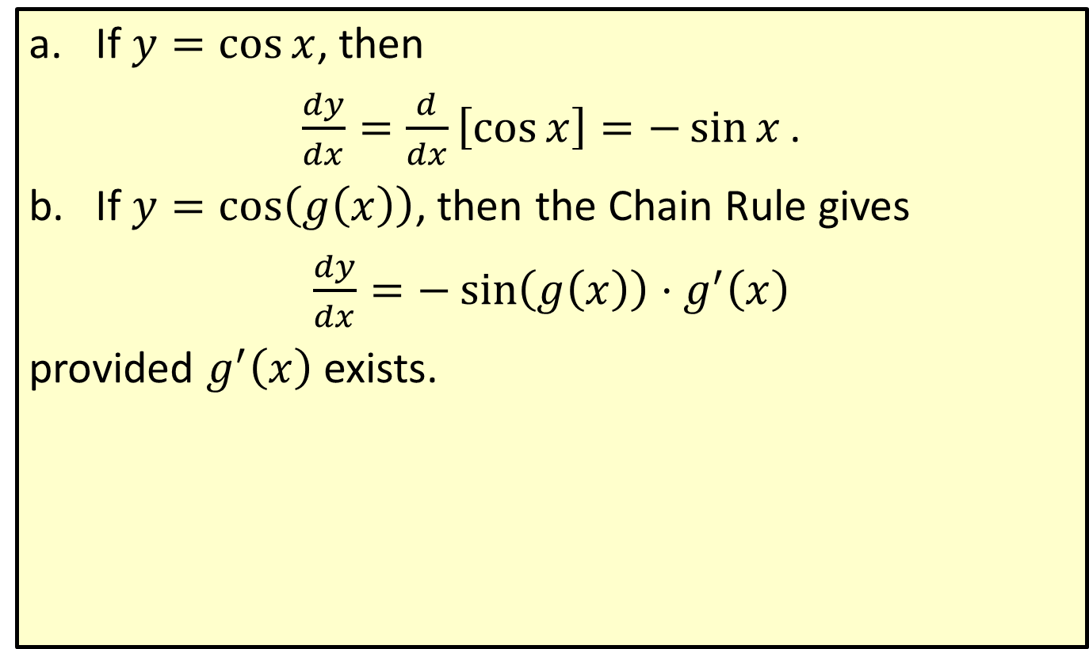
Derivative of Cosine
​If $y=\cos{x}$, then
​$\frac{dy}{dx}=\frac{d}{dx}\left[\cos{x}\right]=−\sin{x}\text{.}$
​If $y=\cos\left(g\left(x\right)\right)$, then the Chain Rule gives
​$\frac{dy}{dx}=−\sin\left(g\left(x\right)\right)⋅g^{′}⁡\left(x\right)$
​provided $g^{′}⁡\left(x\right)$ exists.

Slide 4

Example 1: Derivatives of Trigonometric Functions
Find $f^{′}⁡\left(x\right)$ for each of the following functions.
​$f\left(x\right)=x cos⁡x$
​$f\left(x\right)=\sin\left(e^{x}\right)$
​$f\left(x\right)=\sin^{2}\left(6x\right)$

Slide 5
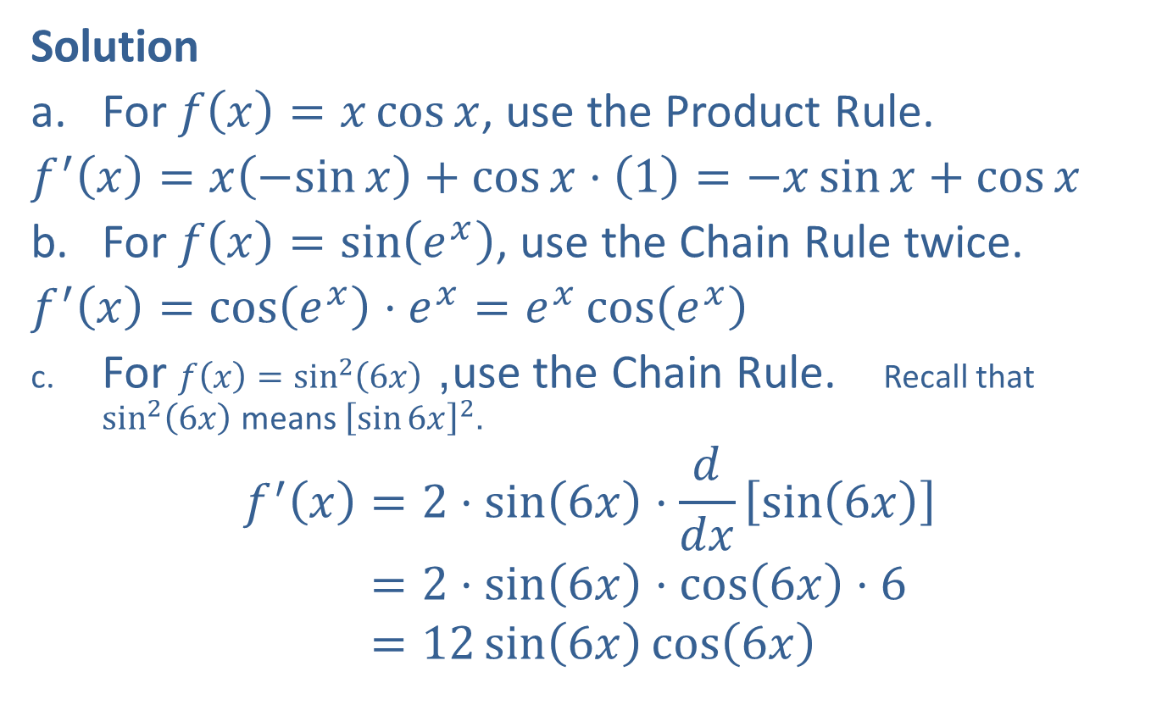
Example 1: Derivatives of Trigonometric Functions (cont.)
Solution
​For $f\left(x\right)=x\cos{x}$, use the Product Rule.
​$f^{′}\left(x\right)=x\left(−sin{x}\right)+\cos{x}⋅\left(1\right)=−x\sin{x}+\cos{x}$
​For $f\left(x\right)=\sin\left(e^{x}\right)$, use the Chain Rule twice.
​$f^{′}\left(x\right)=cos⁡\left(e^{x}\right)⋅e^{x}=e^{x}\cos\left(e^{x}\right)$
​For $f⁡\left(x\right)=\sin^{2}\left(6x\right)$, use the Chain Rule. Recall that $\sin^{2}⁡\left(6x\right)$ means ${\left[\sin{6x}\right]}^{2}$.
𝑓′𝑥=2⋅sin6𝑥⋅𝑑𝑑𝑥⁡sin6𝑥𝑓′𝑥=2⋅sin6𝑥⋅cos6𝑥⋅6𝑓′𝑥=12sin6𝑥cos6𝑥

Slide 6
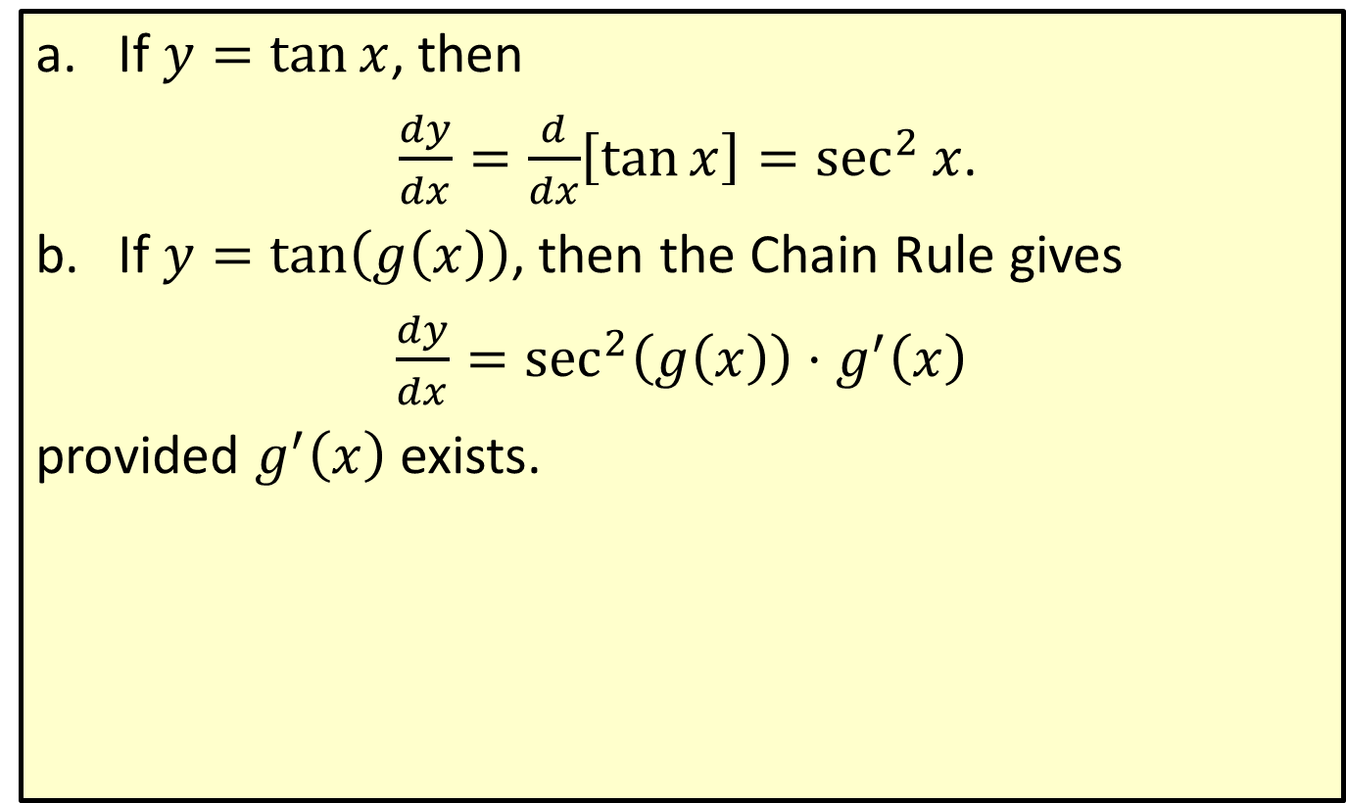
Derivative of Tangent
​If $y=\tan{x}$, then
​ $\frac{dy}{dx}=\frac{d}{dx}\left[\tan{x}\right]=\sec^{2}⁡x$.
​If $y=tan⁡\left(g\left(x\right)\right)$, then the Chain Rule gives
​$\frac{dy}{dx}=\sec^{2}⁡\left(g\left(x\right)\right)⋅g^{′}⁡\left(x\right)$
​provided $g^{′}⁡\left(x\right)$ exists.

Slide 7

Example 2: Derivative of Tangent
Find the equation of the line tangent to the graph of $y=\tan{x}$ at the point where $x=\frac{π}{4}$.

Slide 8
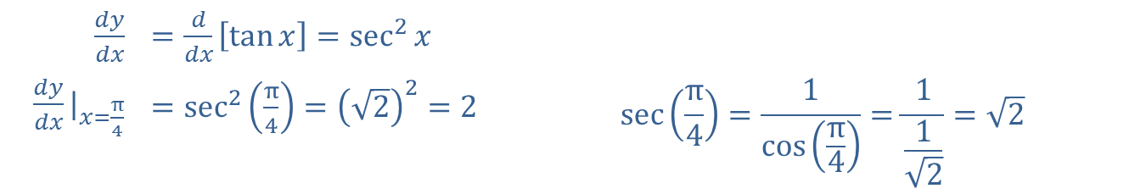
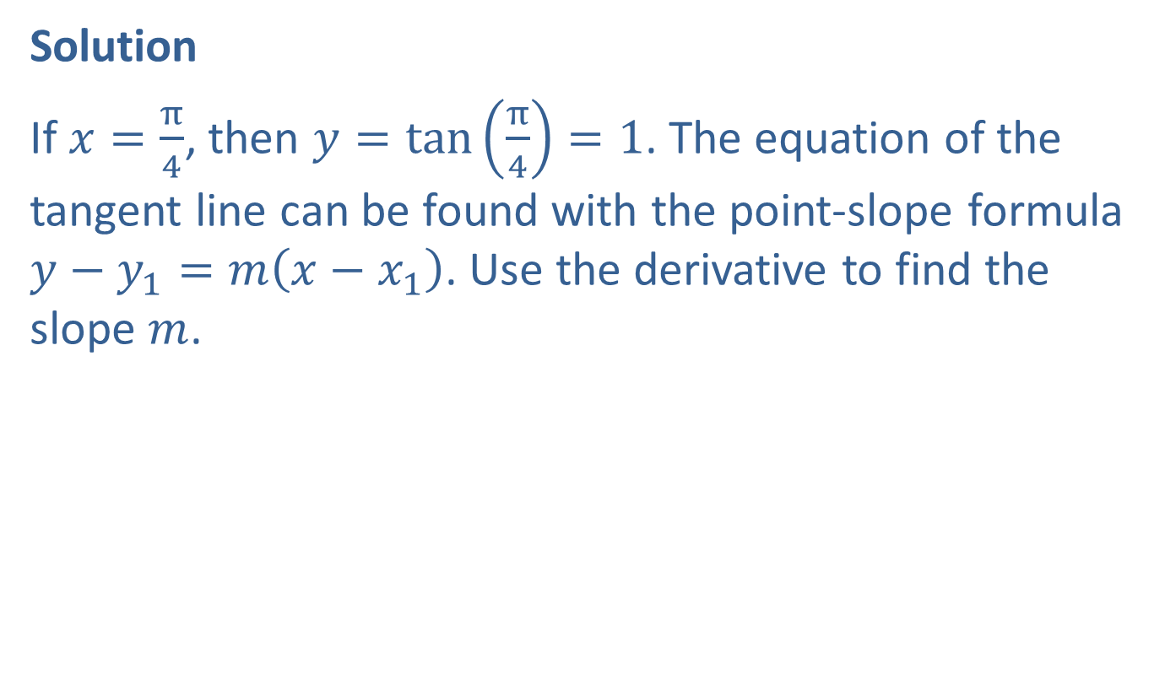
Example 2: Derivative of Tangent (cont.)
Solution
If $x=\frac{π}{4}$, then $y=\tan\left(\frac{π}{4}\right)=1$. The equation of the tangent line can be found with the point-slope formula $y−y_{1}=m\left(x−x_{1}\right)$. Use the derivative to find the slope $m$.
​$\frac{dy}{dx}$ | ​$=\frac{d}{dx}\left[\tan{x}\right]=\sec^{2}{x}$
​${\frac{dy}{dx}|}_{x=\frac{π}{4}}$ | ​$=\sec^{2}\left(\frac{π}{4}\right)={\left(\sqrt{2}\right)}^{2}=2$ | $$\sec\left(\frac{π}{4}\right)=\frac{1}{\cos\left(\frac{π}{4}\right)}=\frac{1}{\frac{1}{\sqrt{2}}}=\sqrt{2}$$

Slide 9
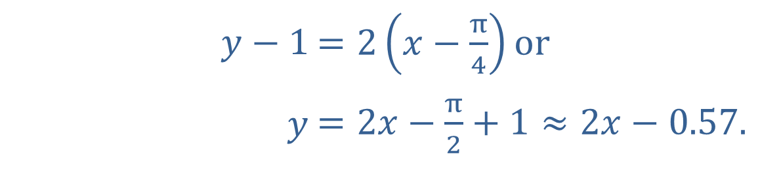

Example 2: Derivative of Tangent (cont.)
This gives $m=2$, $x_{1}=\frac{π}{4}$, and $y_{1}=1$. The equation of the tangent line is
​
​$y−1$ | ​$=2\left(x−\frac{π}{4}\right)\text{or}$
​$y$ | ​$=2x−\frac{π}{2}+1≈2x−0.57\text{.}$

Slide 10
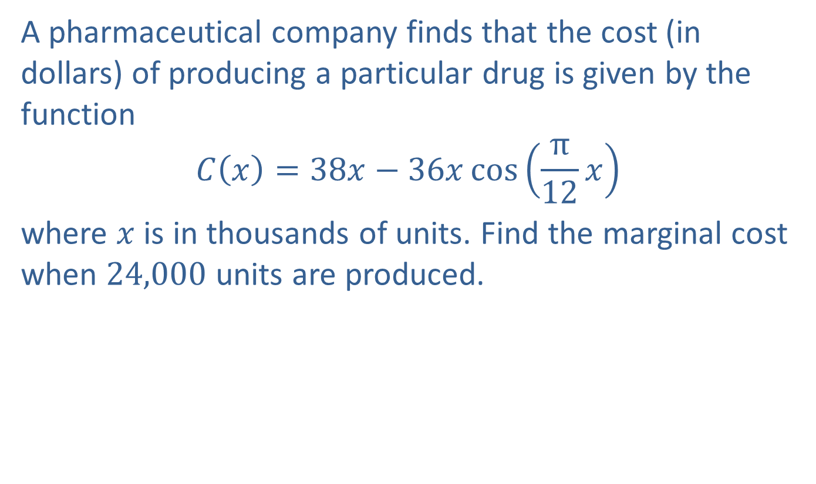
Example 3: Marginal Cost
A pharmaceutical company finds that the cost (in dollars) of producing a particular drug is given by the function
$$C⁡\left(x\right)=38x−36x\cos\left(\frac{π}{12}x\right)$$
where $x$ is in thousands of units. Find the marginal cost when 24,000 units are produced.

Slide 11
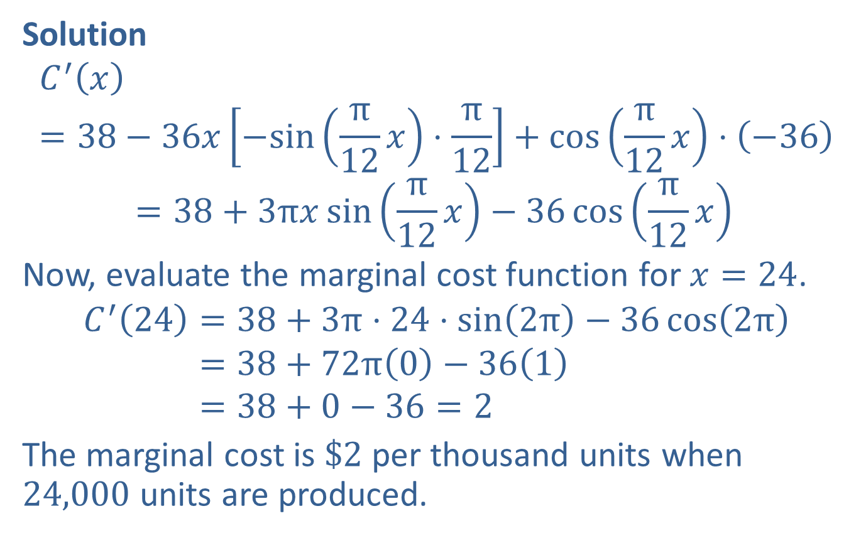
Example 3: Marginal Cost (cont.)
Solution
𝐶′𝑥=38−36𝑥−sin⁡π12𝑥⋅π12+cos⁡π12𝑥⋅−36𝐶′⁡𝑥=38+3π𝑥sinπ12𝑥−36cosπ12𝑥
Now, evaluate the marginal cost function for $x=24$.
𝐶′24=38+3π⋅24⋅sin2π−36cos2π𝐶′⁡24=38+72π0−361𝐶′⁡24=38+0−36=2
The marginal cost is $\$2$ per thousand units when 24,000 units are produced.

Slide 12
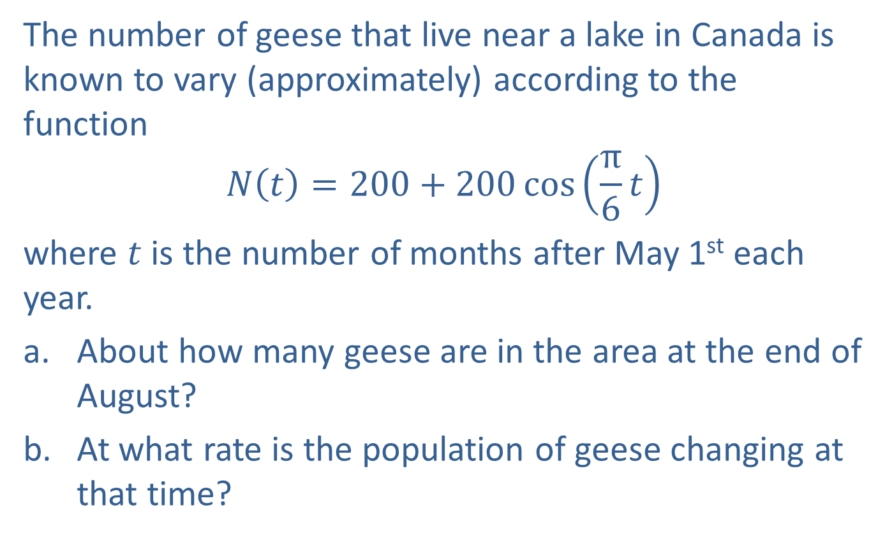
Example 4: Population Rate of Change
The number of geese that live near a lake in Canada is known to vary (approximately) according to the function
$$N\left(t\right)=200+200\cos\left(\frac{π}{6}t\right)$$
where $t$ is the number of months after May 1st each year.
​About how many geese are in the area at the end of August?
​At what rate is the population of geese changing at that time?

Slide 13
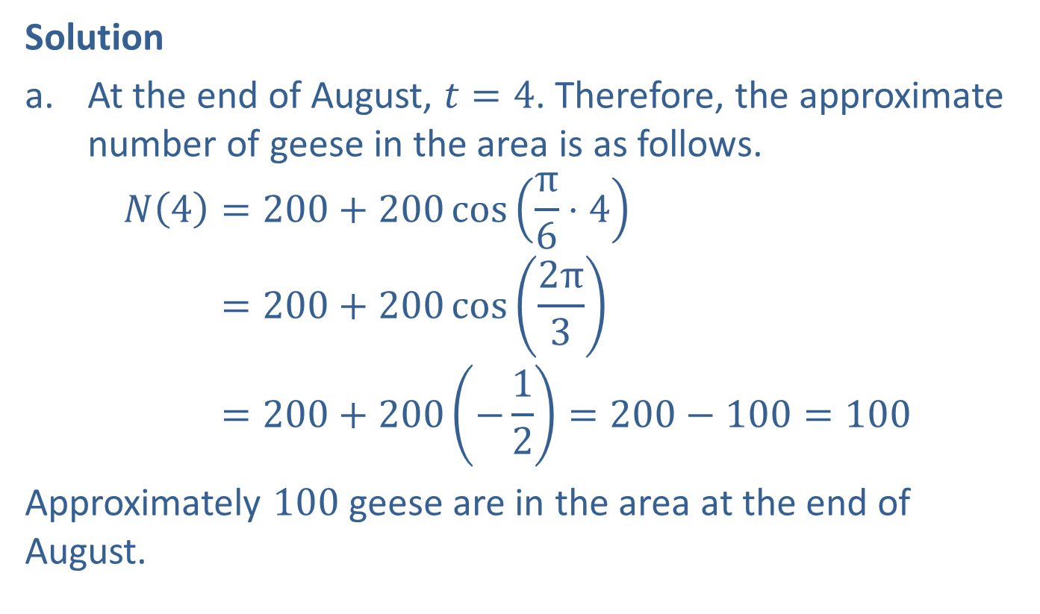
Example 4: Population Rate of Change (cont.)
Solution
​At the end of August, $t=4$. Therefore, the approximate number of geese in the area is as follows.
𝑁4=200+200cosπ6⋅4𝑁⁡4=200+200cos2π3𝑁⁡4=200+200−12=200−100=100
​Approximately 100 geese are in the area at the end of August.

Slide 14
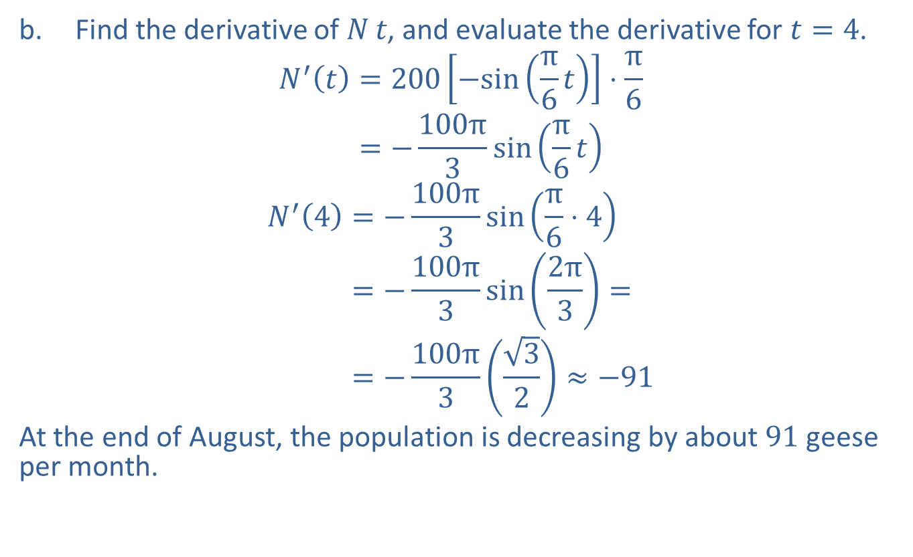
Example 4: Population Rate of Change (cont.)
​Find the derivative of $N⁡t$, and evaluate the derivative for $t=4$.
𝑁′𝑡=200−sinπ6𝑡⋅π6𝑁′⁡𝑡=−100π3sinπ6𝑡
𝑁′4=−100π3sinπ6⋅4𝑁′⁡4=−100π3sin2π3=𝑁′⁡4=−100π332≈−91
​At the end of August, the population is decreasing by about 91 geese per month.

