Slide 1
Section 9.3
Integration of Trigonometric Functions

Slide 2

Example 1: Antiderivatives of Trigonometric Functions
Evaluate each integral.
​$∫\cos\left(5x\right)dx$
​$∫\sin^{3}{x}\cos{x}dx$

Slide 3
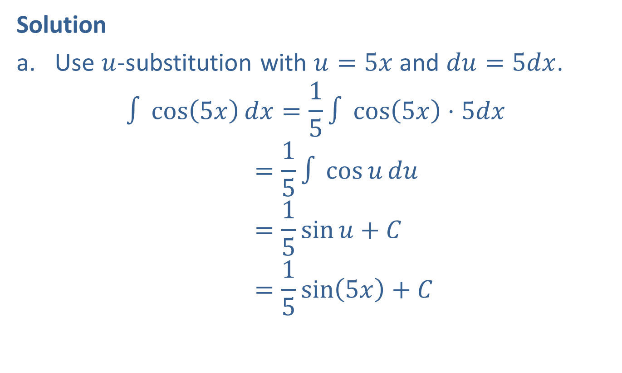
Example 1: Antiderivatives of Trigonometric Functions (cont.)
Solution
​Use $u$-substitution with $u=5x$ and $du=5dx$.
∫cos5𝑥𝑑𝑥=15∫cos5𝑥⋅5𝑑𝑥∫cos⁡5𝑥𝑑𝑥=15∫cos𝑢𝑑𝑢∫cos⁡5𝑥𝑑𝑥=15sin𝑢+𝐶∫cos⁡5𝑥𝑑𝑥=15sin5𝑥+𝐶

Slide 4

Example 1: Antiderivatives of Trigonometric Functions (cont.)
Use $u$-substitution with $u=\sin{x}$ and $du=\cos{x}dx$.
∫sin3𝑥cos𝑥𝑑𝑥=∫𝑢3𝑑𝑢∫sin3𝑥cos𝑥𝑑𝑥=14𝑢4+𝐶∫sin3𝑥cos𝑥𝑑𝑥=14sin4𝑥+𝐶

Slide 5

Example 2: Definite Integrals of Trigonometric Functions
Evaluate each integral.
​$\int_{0}^{\frac{π}{12}}{\sec^{2}\left(3x\right)dx}$
​$\int_{0}^{\frac{π}{2}}{x\sin{x}dx}$

Slide 6
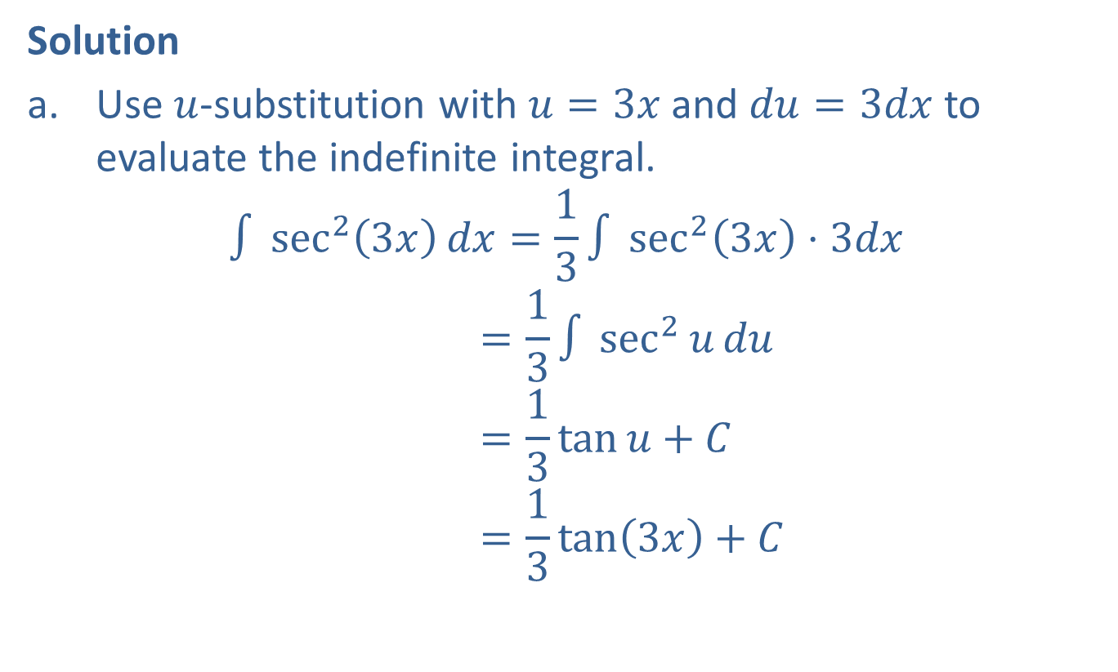
Example 2: Definite Integrals of Trigonometric Functions (cont.)
Solution
​Use $u$-substitution with $u=3x$ and $du=3dx$ to evaluate the indefinite integral.
∫sec23𝑥𝑑𝑥=13∫sec23𝑥⋅3𝑑𝑥∫sec23𝑥𝑑𝑥=13∫sec2𝑢𝑑𝑢∫sec23𝑥𝑑𝑥=13tan𝑢+𝐶∫sec23𝑥𝑑𝑥=13tan3𝑥+𝐶
​

Slide 7
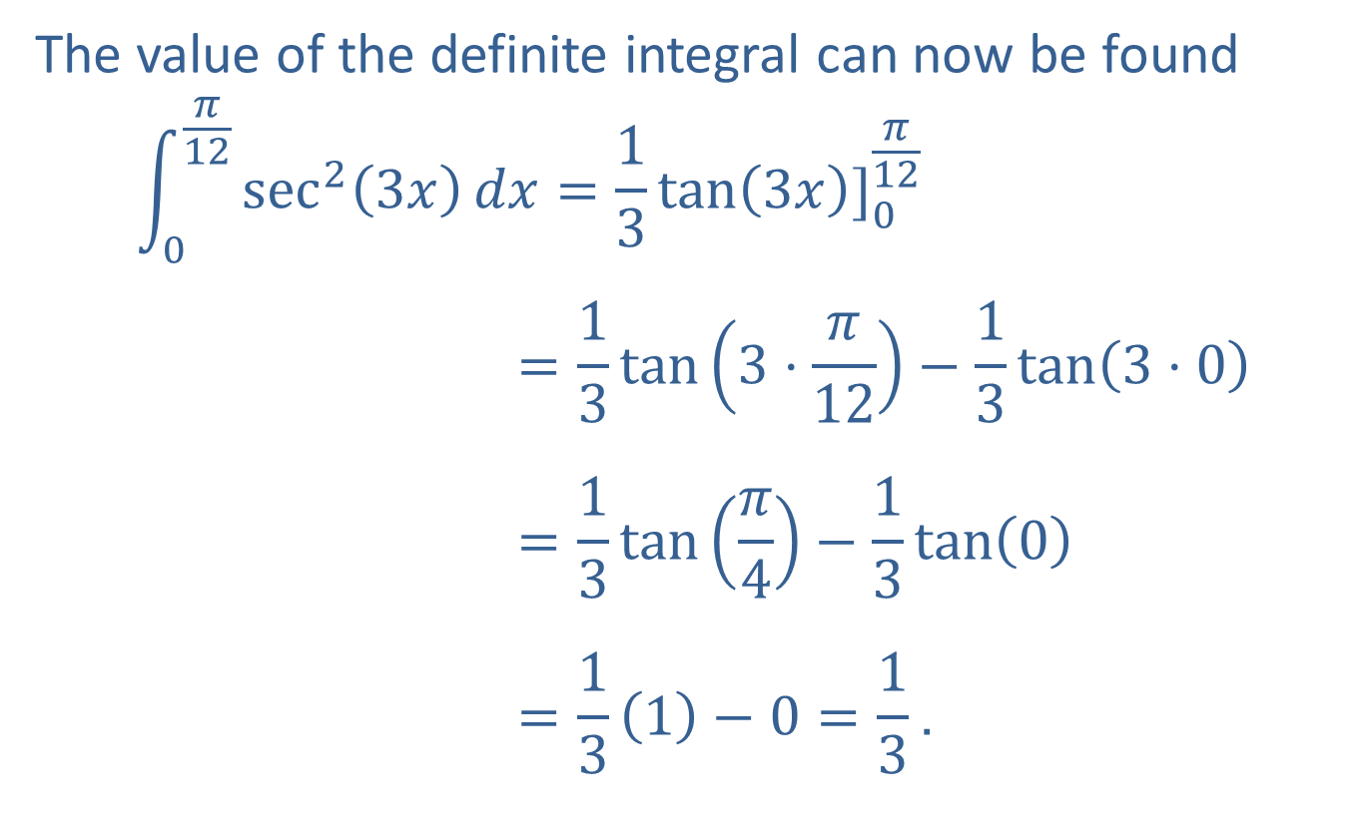
Example 2: Definite Integrals of Trigonometric Functions (cont.)
The value of the definite integral can now be found
0𝜋12sec23𝑥𝑑𝑥=13tan3𝑥]0𝜋120𝜋12sec23𝑥𝑑𝑥=13tan3⋅𝜋12−13tan3⋅00𝜋12sec23𝑥𝑑𝑥=13tan𝜋4−13tan00𝜋12sec23𝑥𝑑𝑥=131−0=13.

Slide 8
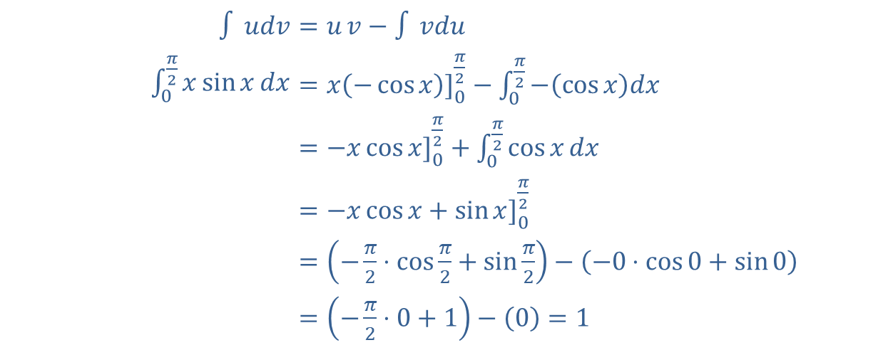
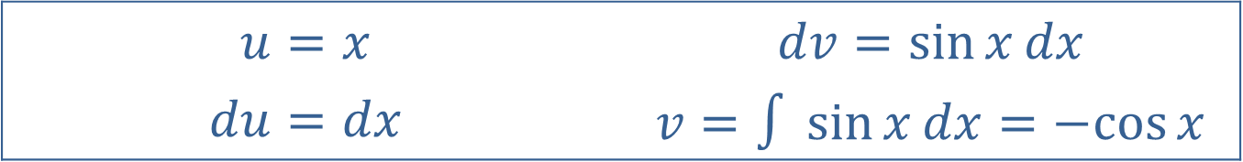
Example 2: Definite Integrals of Trigonometric Functions (cont.)
​Use integration by parts as follows (see Section 7.1).
​
$$u=x$$ | $$dv=\sin{x}dx$$
$$du=dx$$ | $$v=∫\sin{x}dx=−cos⁡x$$
​$∫{udv}$ | ​$=u{v}−∫{vdu}$
​$\int_{0}^{\frac{π}{2}}{x\sin{x}dx}$ | ​$=x\left(−\cos{x}\right)]_{0}^{\frac{π}{2}}−\int_{0}^{\frac{π}{2}}{−\left(\cos{x}\right)dx}$
​ | ​$=−x\cos{x}]_{0}^{\frac{π}{2}}+\int_{0}^{\frac{π}{2}}{\cos{x}dx}$
​ | ​$=−x\cos{x}+\sin{x}]_{0}^{\frac{π}{2}}$
​ | ​$=\left(−\frac{π}{2}⋅\cos{\frac{π}{2}}+\sin{\frac{π}{2}}\right)−\left(−0⋅\cos{0}+\sin{0}\right)$
​ | ​$=\left(−\frac{π}{2}⋅0+1\right)−\left(0\right)=1$

Slide 9
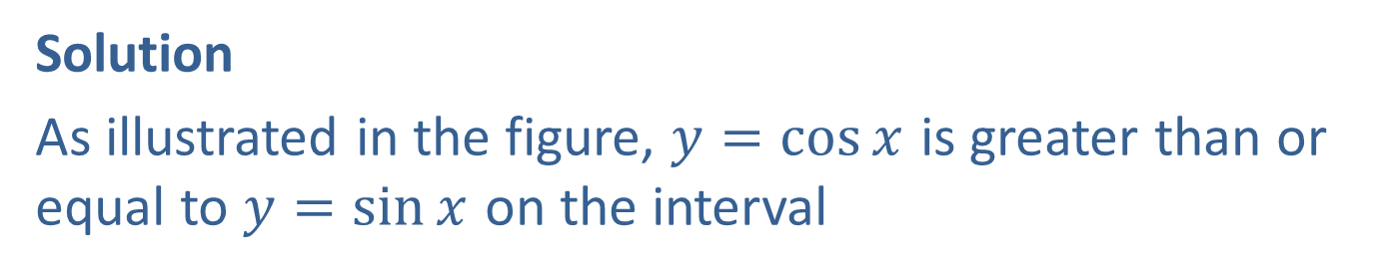

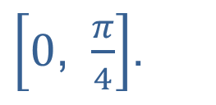
Example 3: Area between Curves
Find the area between the curves $y=\cos{x}$ and $y=\sin{x}$ on the interval $\left[0\text{, }\frac{π}{4}\right]$.
Solution
As illustrated in the figure, $y=\cos{x}$ is greater than or equal to $y=\sin{x}$ on the interval
$\left[0\text{, }\frac{π}{4}\right]$.

Slide 10
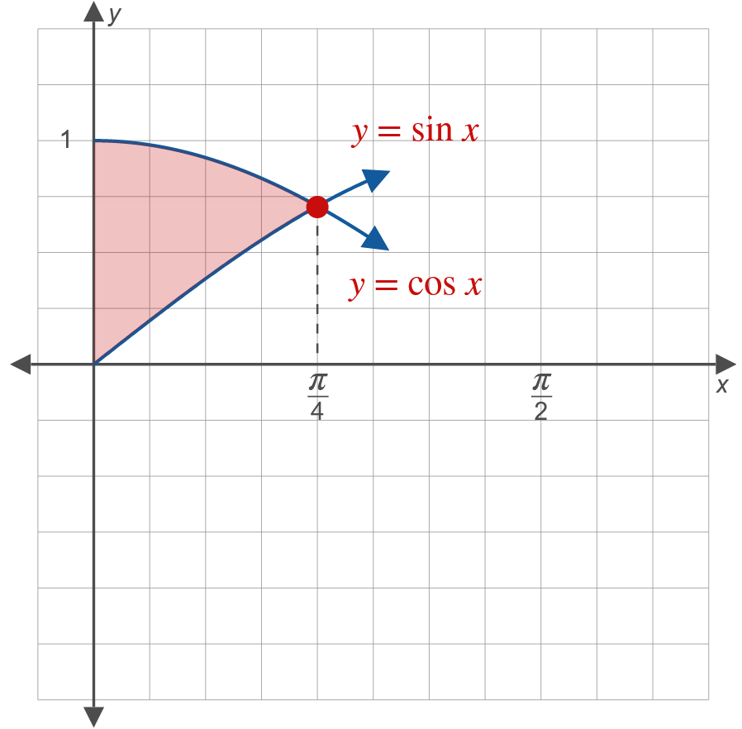
Example 3: Area between Curves (cont.)

Slide 11
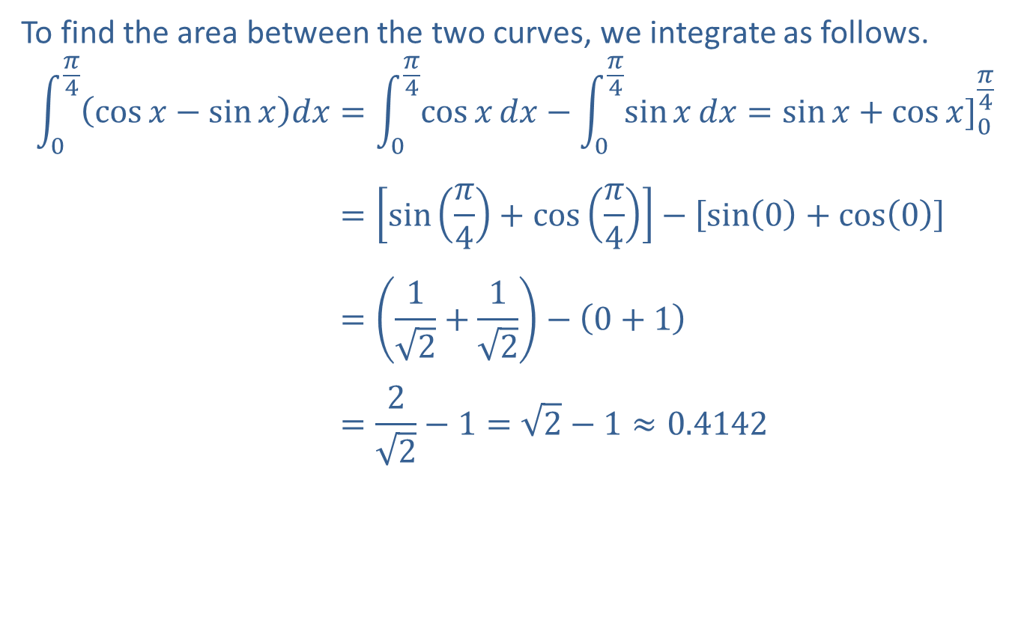
Example 3: Area between Curves (cont.)
To find the area between the two curves, we integrate as follows.
0𝜋4cos𝑥−sin𝑥𝑑𝑥=0𝜋4cos𝑥𝑑𝑥−0𝜋4sin𝑥𝑑𝑥=sin𝑥+cos𝑥]0𝜋40𝜋4cos𝑥−sin𝑥𝑑𝑥=sin𝜋4+cos𝜋4−sin0+cos00𝜋4cos𝑥−sin𝑥𝑑𝑥=12+12−0+10𝜋4cos𝑥−sin𝑥𝑑𝑥=22−1=2−1≈0.4142

Slide 12
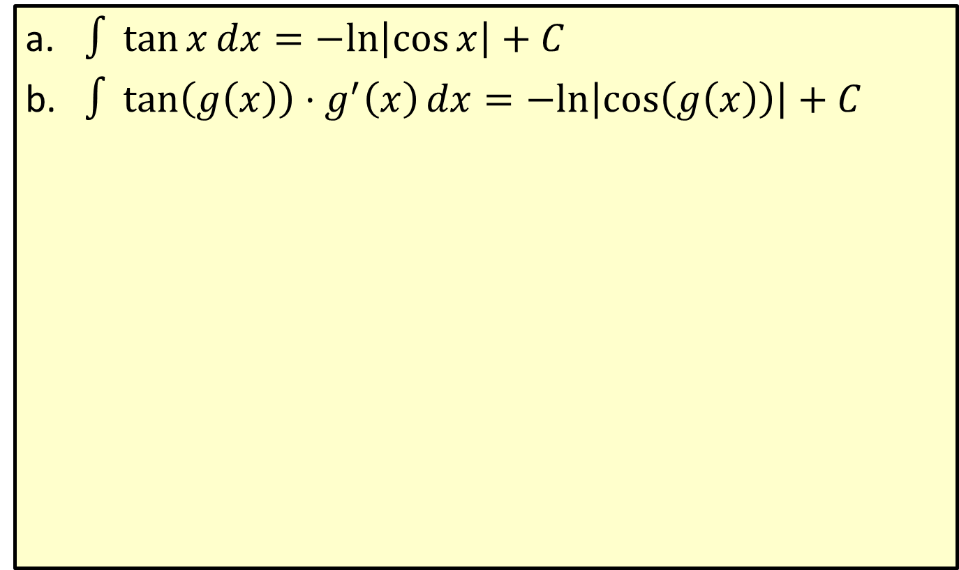
Integration Formula for the Tangent Function
​$∫\tan{x}dx=−ln⁡\left|\cos{x}\right|+C$
​$∫\tan\left(g\left(x\right)\right)⋅g^{′}\left(x\right)dx=−ln⁡\left|\cos\left(g\left(x\right)\right)\right|+C$

Slide 13


Example 4: Integrating the Tangent
Find $∫x^{2}\tan\left(x^{3}\right)dx$.
Solution
Use $u$-substitution with $u=x^{3}$ and $du=3x^{2}dx$.
∫𝑥2tan𝑥3𝑑𝑥=13∫tan𝑥3⋅3𝑥2𝑑𝑥∫𝑥2tan𝑥3𝑑𝑥=13∫tan𝑢𝑑𝑢∫𝑥2tan𝑥3𝑑𝑥=−13lncos𝑢+𝐶∫𝑥2tan𝑥3𝑑𝑥=−13lncos𝑥3+𝐶

Slide 14
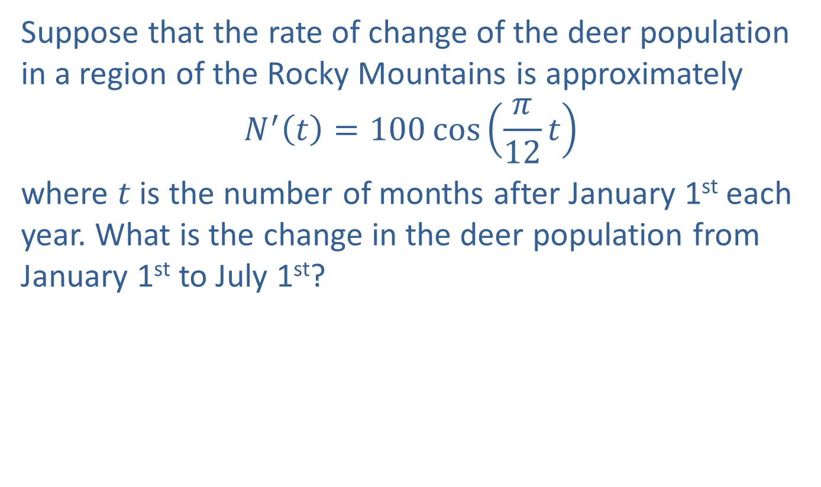
Example 5: Population Growth
Suppose that the rate of change of the deer population in a region of the Rocky Mountains is approximately
$$N^{′}\left(t\right)=100\cos\left(\frac{π}{12}t\right)$$
where $t$ is the number of months after January 1st each year. What is the change in the deer population from January 1st to July 1st?

Slide 15
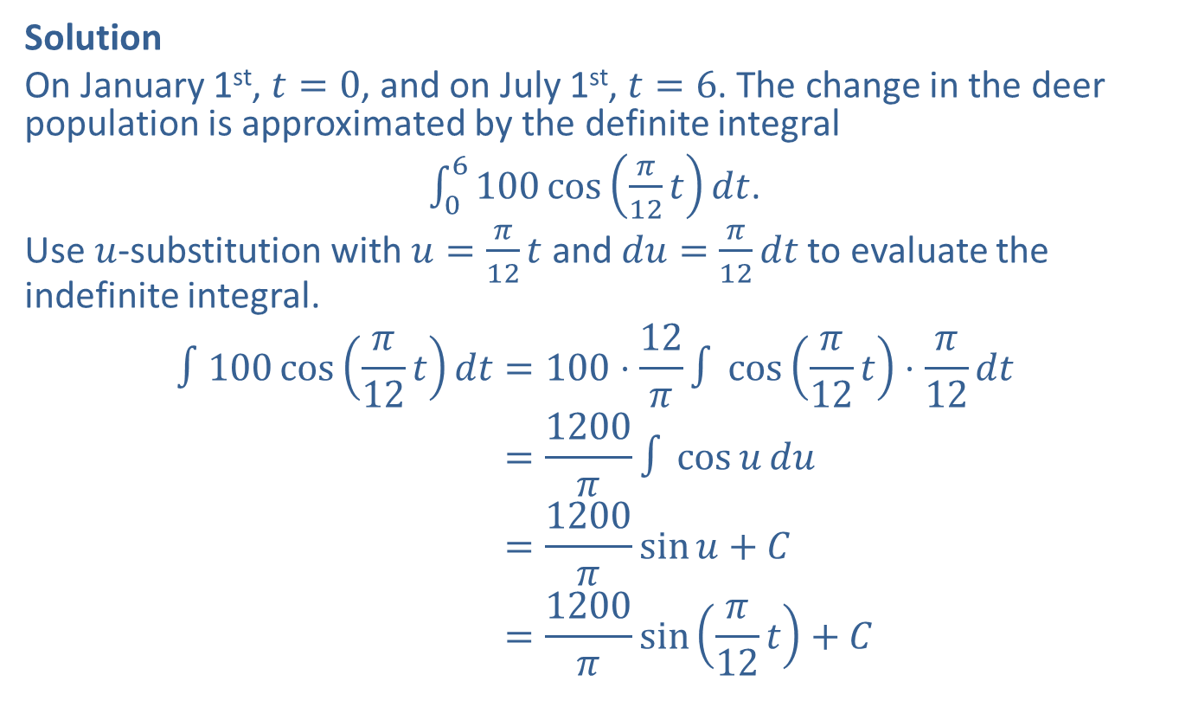
Example 5: Population Growth (cont.)
Solution
On January 1st, $t=0$, and on July 1st, $t=6$. The change in the deer population is approximated by the definite integral
$\int_{0}^{6}{100\cos\left(\frac{π}{12}t\right)dt}$.
Use $u$-substitution with $u=\frac{π}{12}t$ and $du=\frac{π}{12}dt$ to evaluate the indefinite integral.
∫100cos𝜋12𝑡𝑑𝑡=100⋅12𝜋∫cos𝜋12𝑡⋅𝜋12𝑑𝑡∫100cos𝜋12𝑡𝑑𝑡=1200𝜋∫cos𝑢𝑑𝑢∫100cos𝜋12𝑡𝑑𝑡=1200𝜋sin𝑢+𝐶∫100cos𝜋12𝑡𝑑𝑡=1200𝜋sin𝜋12𝑡+𝐶

Slide 16
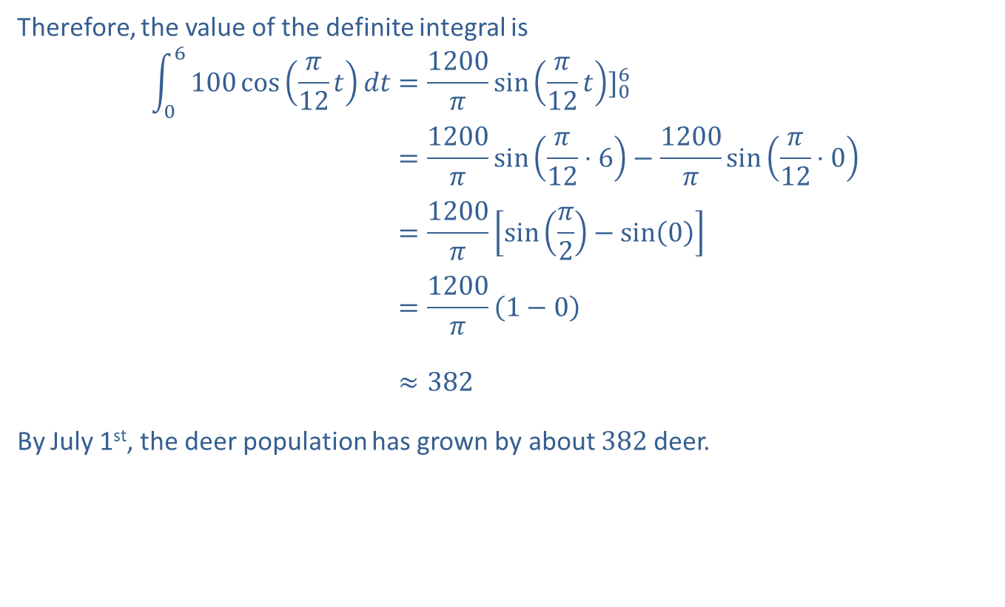
Example 5: Population Growth (cont.)
Therefore, the value of the definite integral is
06100cos𝜋12𝑡𝑑𝑡=1200𝜋sin𝜋12𝑡]0606100cos𝜋12𝑡𝑑𝑡=1200𝜋sin𝜋12⋅6−1200𝜋sin𝜋12⋅006100cos𝜋12𝑡𝑑𝑡=1200𝜋sin𝜋2−sin006100cos𝜋12𝑡𝑑𝑡=1200𝜋1−006100cos𝜋12𝑡𝑑𝑡≈382
By July 1st, the deer population has grown by about 382 deer.

Slide 17
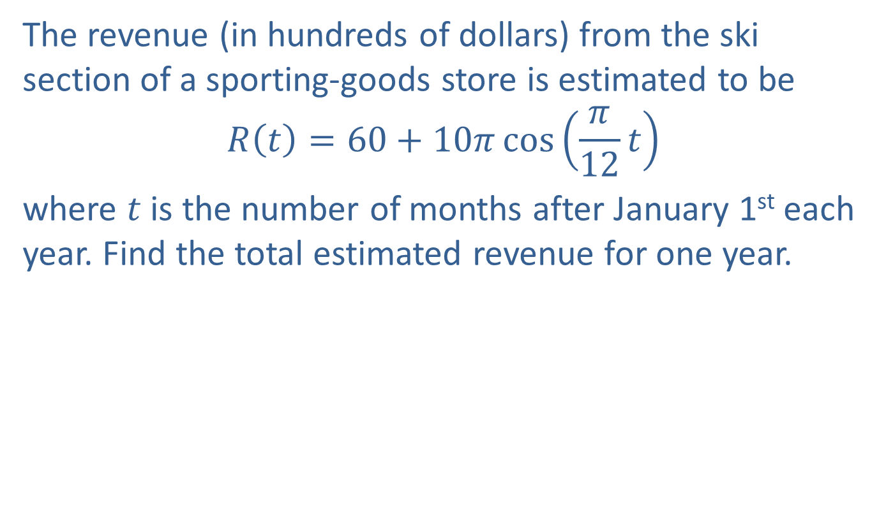
Example 6: Estimating Revenue
The revenue (in hundreds of dollars) from the ski section of a sporting-goods store is estimated to be
$$R\left(t\right)=60+10π\cos\left(\frac{π}{12}t\right)$$
where $t$ is the number of months after January 1st each year. Find the total estimated revenue for one year.

Slide 18
Example 6: Estimating Revenue (cont.)
Solution
The total estimated revenue is the area under the curve as shown in the figure. This area is the value of the following definite integral.

Slide 19
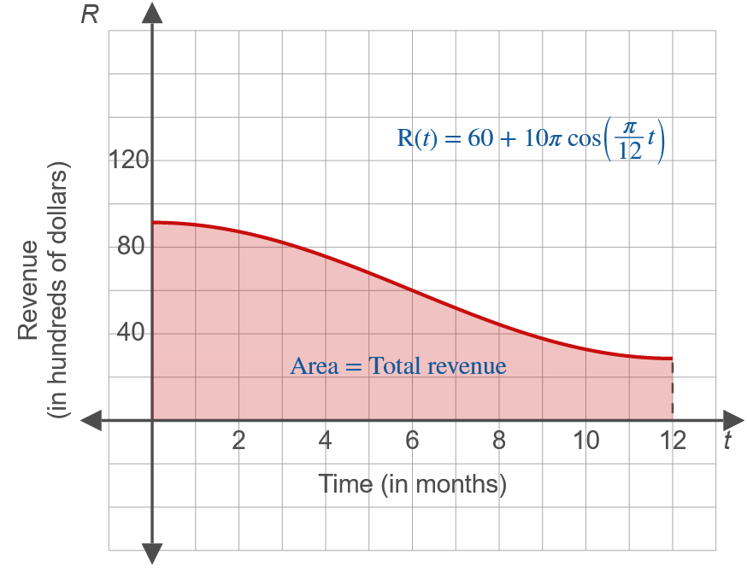
Example 6: Estimating Revenue (cont.)

Slide 20
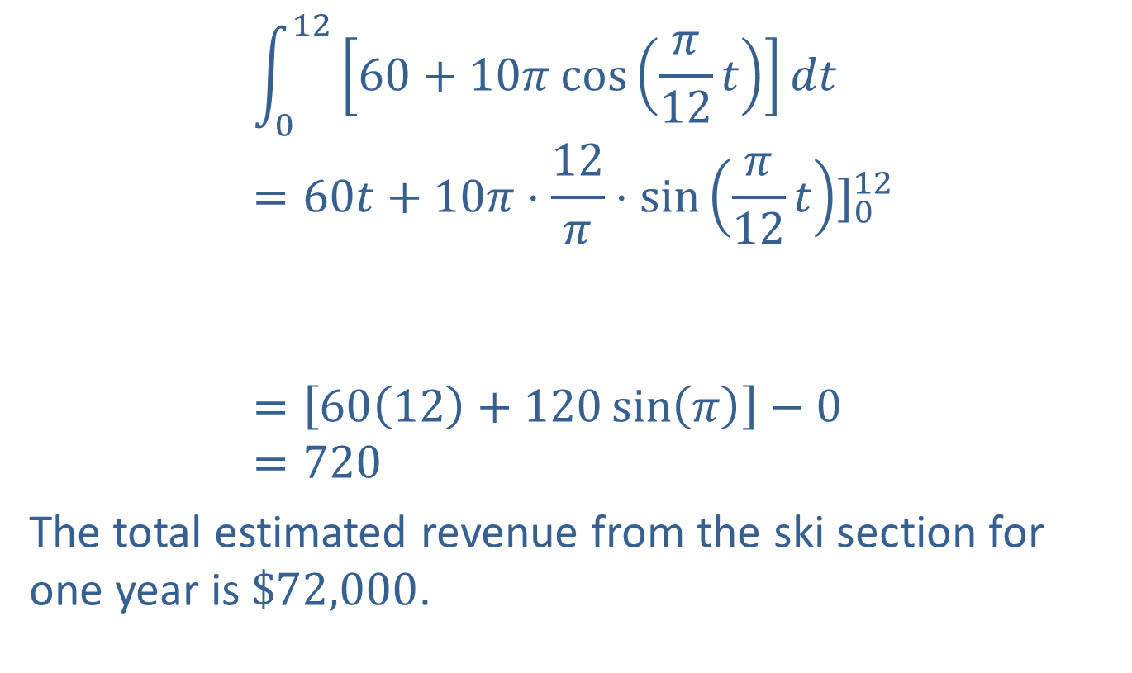
Example 6: Estimating Revenue (cont.)
01260+10𝜋cos𝜋12𝑡𝑑𝑡=60𝑡+10𝜋⋅12𝜋⋅sin𝜋12𝑡]01201260+10𝜋cos𝜋12𝑡𝑑𝑡=6012+120sin𝜋−0=720
The total estimated revenue from the ski section for one year is $\$72,000$.

