Slide 1
Section 9.4
Inverse Trigonometric Functions

Slide 2

Example 1: Inverse Trigonometric Functions
Find the values of $y$.
​$y=\sin^{−1}\left(1\right)$
​$y=\sin^{−1}\left(−\frac{1}{\sqrt{2}}\right)$

Slide 3
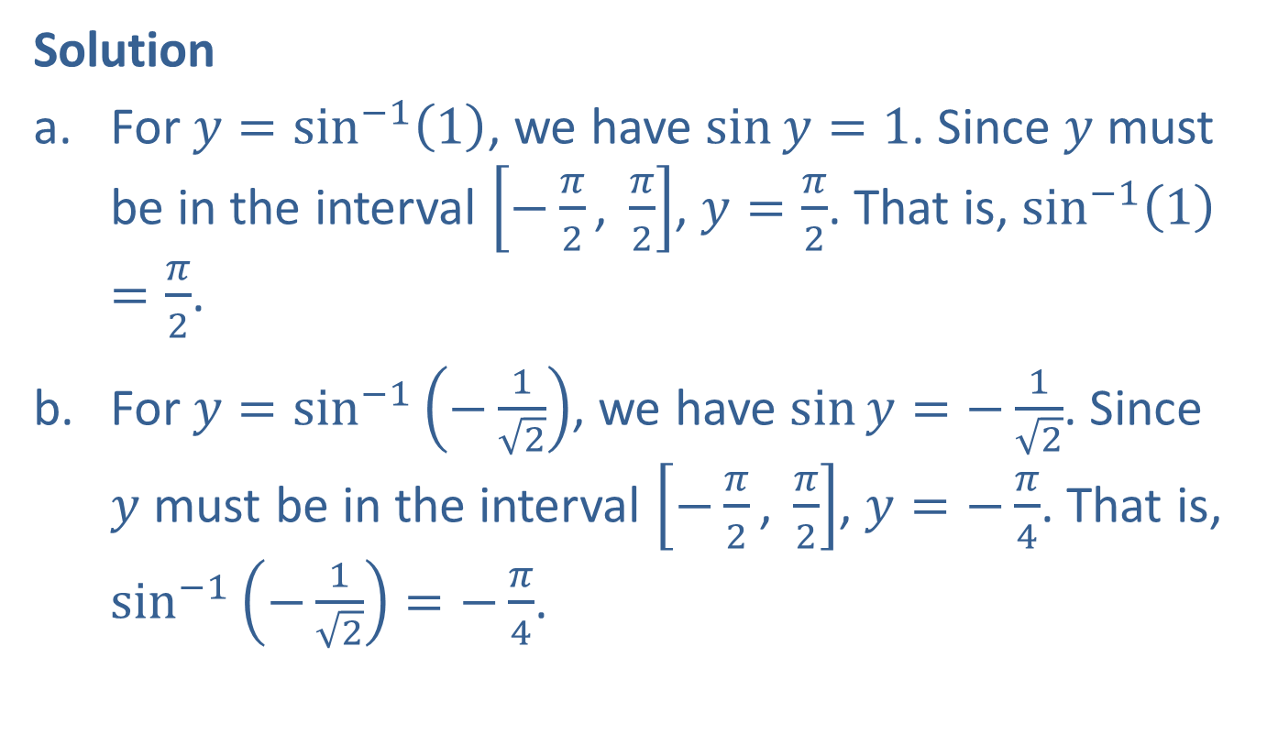
Example 1: Inverse Trigonometric Functions (cont.)
Solution
​For $y=\sin^{−1}\left(1\right)$, we have $\sin{y}=1$. Since $y$ must be in the interval $\left[−\frac{π}{2}\text{, }\frac{π}{2}\right]$, $y=\frac{π}{2}$. That is, $\sin^{−1}\left(1\right)=\frac{π}{2}$.
​For $y=\sin^{−1}\left(−\frac{1}{\sqrt{2}}\right)$, we have $\sin{y}=−\frac{1}{\sqrt{2}}$. Since $y$ must be in the interval $\left[−\frac{π}{2}\text{, }\frac{π}{2}\right]$, $y=−\frac{π}{4}$. That is, $\sin^{−1}\left(−\frac{1}{\sqrt{2}}\right)=−\frac{π}{4}$.

Slide 4


Example 2: Inverse Trigonometric Functions
Find the values of $y$.
​$y=\cos^{−1}\left(\frac{1}{2}\right)$
​$y=\tan^{−1}\left(−1\right)$
Solution
​For $y=\cos^{−1}\left(\frac{1}{2}\right)$, we have $\cos{y}=\frac{1}{2}$. Therefore, since $y$ must be in the interval $\left[0\text{, }π\right]$, $y=\frac{π}{3}$.
​For $y=\tan^{−1}\left(−1\right)$, we have $\tan{y}=−1$ with $y$ in the interval $\left(−\frac{π}{2}\text{, }\frac{π}{2}\right)$. Therefore, $y=−\frac{π}{4}$.

Slide 5
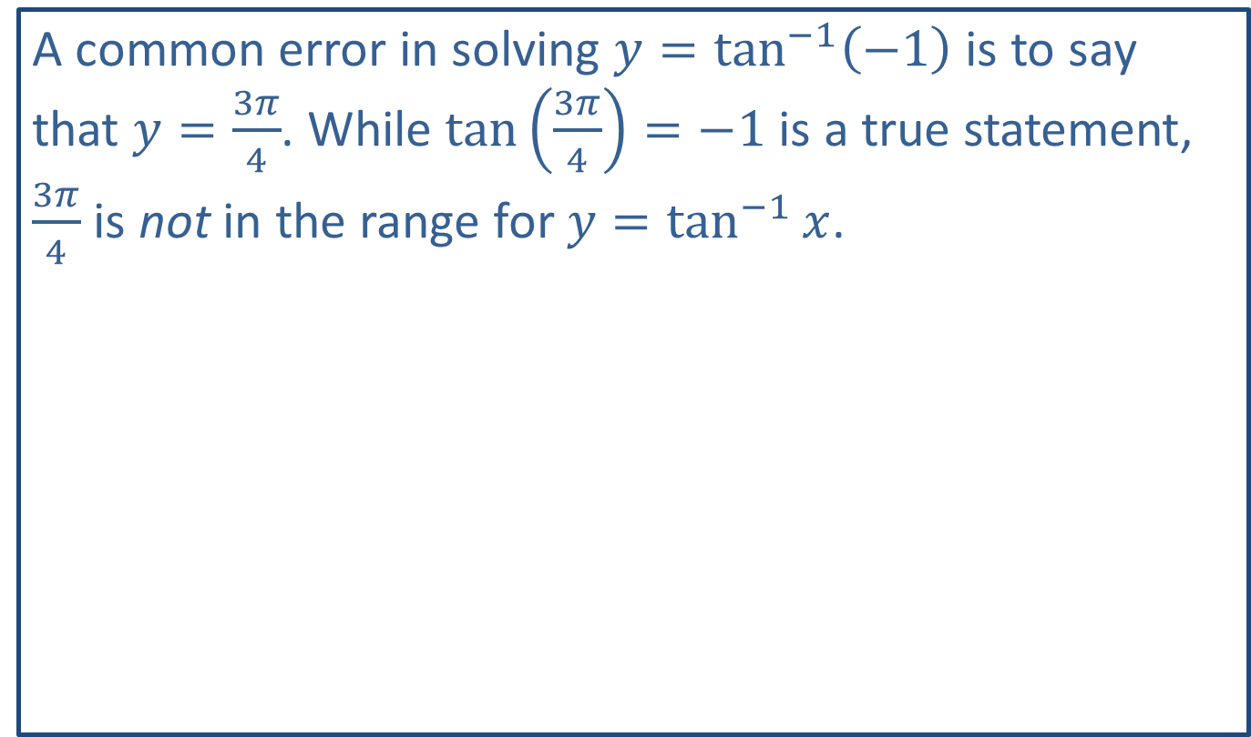
CAUTION!
A common error in solving $y=\tan^{−1}\left(−1\right)$ is to say that $y=\frac{3π}{4}$. While $\tan\left(\frac{3π}{4}\right)=−1$ is a true statement, $\frac{3π}{4}$ is not in the range for $y=\tan^{−1}{x}$.

Slide 6

Example 3: Differentiating Inverse Trigonometric Functions
Find $\frac{dy}{dx}$ for each of the following functions.
​$y=\sin^{−1}\left(e^{x}\right)$
​$y=\tan^{−1}\left(x^{2}\right)$

Slide 7
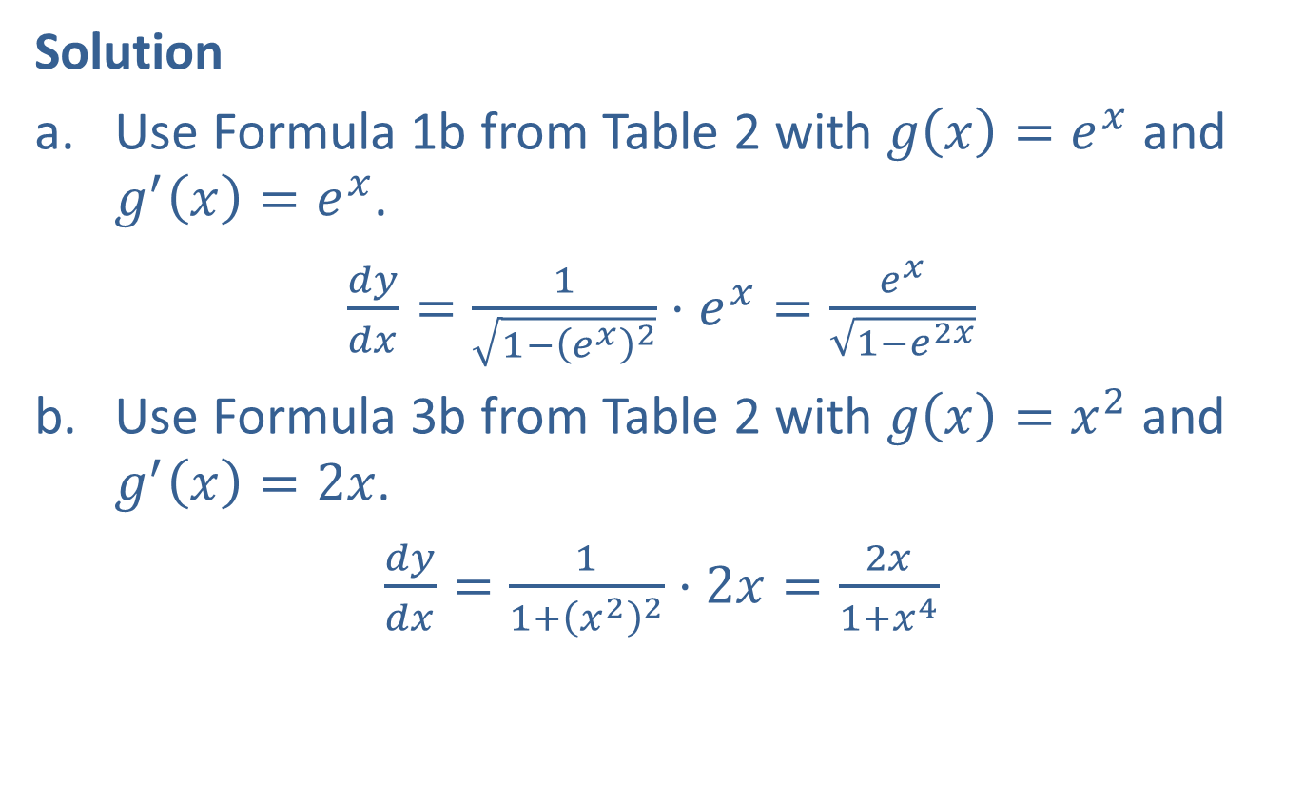
Example 3: Differentiating Inverse Trigonometric Functions (cont.)
Solution
​Use Formula 1b from Table 2 with $g\left(x\right)=e^{x}$ and $g^{′}\left(x\right)=e^{x}$.
​$\frac{dy}{dx}=\frac{1}{\sqrt{1−{\left(e^{x}\right)}^{2}}}⋅e^{x}=\frac{e^{x}}{\sqrt{1−e^{2x}}}$
​Use Formula 3b from Table 2 with $g\left(x\right)=x^{2}$ and $g^{′}\left(x\right)=2x$.
​$\frac{dy}{dx}=\frac{1}{1+{\left(x^{2}\right)}^{2}}⋅2x=\frac{2x}{1+x^{4}}$

Slide 8


Example 4: Differentiating Inverse Trigonometric Functions
Find $f^{′}⁡\left(2\right)$ for $f\left(x\right)=\tan^{−1}\left(2x\right)$.
Solution
First, we find $f^{′}⁡\left(x\right)$
$f^{′}\left(x\right)=\frac{1}{1+{\left(2x\right)}^{2}}⋅2=\frac{2}{1+4x^{2}}$ Formula 3b from Table 2
Now, we evaluate the derivative at $x=2$.
$$f^{′}\left(2\right)=\frac{2}{1+4⋅2^{2}}=\frac{2}{17}$$

Slide 9

Example 5: Integrals Resulting in Inverse Trigonometric Functions
Evaluate the following integrals.
​$∫\frac{1}{\sqrt{1−9x^{2}}}dx$
​$\int_{−1}^{1}{\frac{1}{1+x^{2}}dx}$

Slide 10
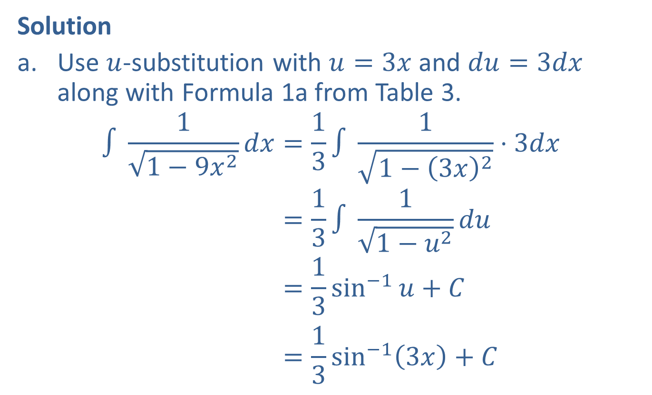
Example 5: Integrals Resulting in Inverse Trigonometric Functions (cont.)
Solution
​Use $u$-substitution with $u=3x$ and $du=3dx$ along with Formula 1a from Table 3.
∫11−9𝑥2𝑑𝑥=13∫11−3𝑥2⋅3𝑑𝑥∫11−9𝑥2𝑑𝑥=13∫11−𝑢2𝑑𝑢∫11−9𝑥2𝑑𝑥=13sin−1𝑢+𝐶∫11−9𝑥2𝑑𝑥=13sin−13𝑥+𝐶

Slide 11

Example 5: Integrals Resulting in Inverse Trigonometric Functions (cont.)
​Use Formula 3a from Table 3 and the definition of $\tan^{−1}⁡x$.
−1111+𝑥2𝑑𝑥=tan−1𝑥]−11−1111+𝑥2𝑑𝑥=tan−11−tan−1−1−1111+𝑥2𝑑𝑥=𝜋4−−𝜋4=𝜋2

