Slide 1
Section 1.5
Lines and Their Graphs

Slide 2
Objectives
Graph ordered pairs.
Graph linear equations.
Find the slope of a line.
Find the equation of a line given two characteristics of the line.

Slide 3
Straight Lines
Notes
Over short ranges of the variable x, a straight line can be a very useful approximation to a graph. Straight lines are simpler to work with algebraically and numerically.

Slide 4
Straight Lines
Slope of a Line

Slide 5
Example 1: Slope of a Line
Find the slope of the line that contains the two points (−2, 3) and (5, −1) and then graph the line.
Solution:
Using (x₁, y₁) = (−2, 3) and (x₂, y₂) = (5, −1),

Slide 6
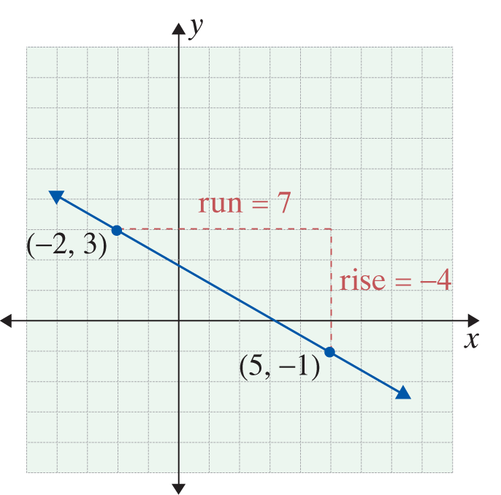
Example 1: Slope of a Line (cont.)
Or, using (x₁, y₁) = (−2, 3) and (x₂, y₂) = (5, −1),
The slope indicates that
y changes −4 units for every change of 7 units in x.

Slide 7
Straight Lines
Forms of Linear Equations
1. Standard form:
Ax + By = C where A and B are not both 0.
2. Slope-intercept form:
y = mx + b
The slope of the line is m. The y-intercept is the point (0, b). The coordinate b is also called the y-­intercept.

Slide 8
Straight Lines
Forms of Linear Equations (cont.)
3. Point-slope form:
y − y₁ = m(x − x₁)
The slope of the line is m, and (x₁, y₁) is a point on the line.

Slide 9
Example 2: Equation of a Line
Find the equation of the line in slope-intercept form containing the two points (1, −5) and (10, 22).
Solution:
First find the slope:
Because y = mx + b and m = 3, we know that y = 3x + b. Now we only need to determine the value of b. To do so, either point can be used.

Slide 10
Example 2: Equation of a Line (cont.)
Choosing the point (10, 22), we have
Therefore, y = 3x − 8.
Slope-intercept form with m = 3.
Using the fact that (x, y) = (10, 22).

Slide 11
Example 2: Equation of a Line (cont.)
Check:
One can check that the other point (1, −5) satisfies this equation:

Slide 12
Example 3: Equation of a Line
Find the equation of the line with slope and passing
through the point (0, 1). Graph the line.
Solution:
The point (0, 1) is the y-intercept. Thus we can use the slope-intercept form.

Slide 13
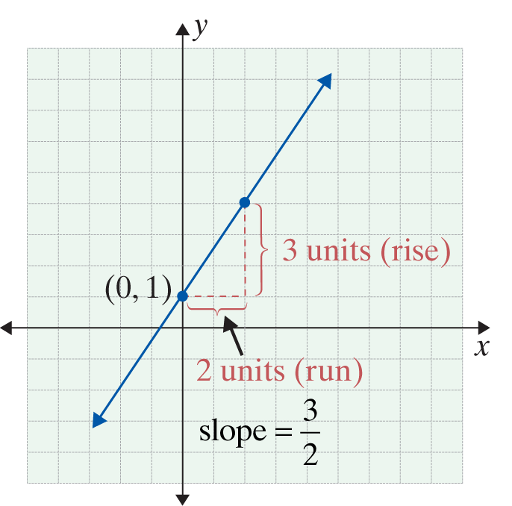
Example 3: Equation of a Line (cont.)
If we start at (0, 1) and move 2 units to the right (run) and 3 units up (rise), we will arrive at another point on the line. Since two points determine a line, the line through these two points is the graph of the given equation.

Slide 14
Example 4: Equation of a Line
Find the equation in slope-intercept form of
y − 5 = 6(x − 1).
Solution:
This is the point-slope form of a line with slope 6 which passes through
(1, 5).
distributive property
add 5 to both sides

Slide 15
Straight Lines
Notes
It is helpful to remember that if a line passes through the origin, which is the point (0, 0), then the y-intercept b = 0; and if b = 0, the line goes through the origin.

