Slide 1
Section 1.6
Functions

Slide 2
Objectives
Evaluate a function.
State the domain of a function.
Find the decomposition of a function.
Find the composition of a function.
Use the vertical line test to determine whether or not a graph represents a function.
Recognize and apply the difference quotient.

Slide 3
Definition of a Function
Function, Domain, and Range
Let D and R be two sets of real numbers. A function f is a rule that matches each number x in D with exactly one number y (or f(x)) in R. D is called the domain of f, and R is called the range of f.
Note: In a function, there is only one y-value
(or f(x)-value) for each value of x.

Slide 4
Example 1: Function Evaluation
For the familiar function f (x) = x², evaluate the following:
a. f (3)
Solution:
b. f (5)
Solution:
c. f (−2)
Solution:
f (3)
= 3²
= 9
Read “f of 3.”
3 is substituted for x.
f (5)
= 5²
= 25
5 is substituted for x.
f (−2)
= (−2)²
= 4
−2 is substituted for x.

Slide 5
Example 2: Function Evaluation
For evaluate the following:
a. f (2)
Solution:
b. f (a)
Solution:

Slide 6
Example 2: Function Evaluation (cont.)
c. f (a + 1)
Solution:
Substitute a + 1 for x.
Expanding and combining like terms, we have:

Slide 7
Example 2: Function Evaluation (cont.)
d. f (a) + 1
Solution:
Add 1 to f (a).

Slide 8
Definition of a Function
NOTES
CAUTION!
As illustrated in Examples 2c and 2d,

Slide 9
Example 3: Function Evaluation
For evaluate the following:
a. F (5) − F (2)
Solution:
We want the difference between the two functional values F (5) and F (2).

Slide 10
Example 3: Function Evaluation (cont.)
b. F (x + h)
Solution:
Substitute x + h for x.

Slide 11
Example 3: Function Evaluation (cont.)
c. F (x + h) − F (x)
Solution:
Find the difference between F(x + h) and F(x).

Slide 12

Example 4: Piecewise Function
A real estate broker charges a commission of 6% on sales valued up to $300,000. For sales valued at more than $300,000, the commission is $6000 plus 4% of the sale price.
a. Represent the commission earned as a function R.
Solution:

Slide 13
Example 4: Piecewise Function (cont.)
b. Find R(200,000).
Solution:
R(200,000)
c. Find R(500,000).
Solution:
R(500,000)
= 0.06(200,000)
= $12,000
Use R(x) = 0.06x since 200,000 ≤ 300,000.
= 0.04(500,000) + 6000
= 20,000 + 6000
= $26,000.
Use R(x) = 0.04x since 500,000 > 300,000.

Slide 14
Example 5: Domain
Find the domain of the following functions.
Solution:
Since no denominator can be 0, x – 2 ≠ 0. Thus the domain consists of all real numbers but 2. We indicate this by writing x ≠ 2.

Slide 15
Example 5: Domain (cont.)
Solution:
Since we are only interested in real numbers, x − 2 must be nonnegative. Thus the domain is indicated by x − 2 ≥ 0 or x ≥ 2.

Slide 16
The Vertical Line Test
Vertical Line Test
If any vertical line intersects a graph at more than one point, then the graph does not represent a function.

Slide 17
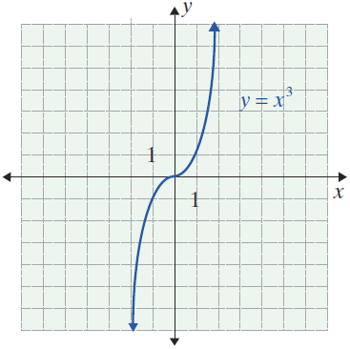
Example 6 : Vertical Line Test
Use the vertical line test to determine whether or not each of the following graphs is a function.
a.

Slide 18
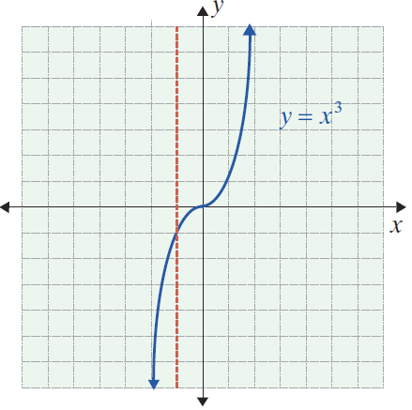
Example 6 : Vertical Line Test (cont.)
Solution:
The equation y = x³ represents a function (which can also be written as f (x) = x³ ). No vertical line can intersect the graph in more than one point.

Slide 19
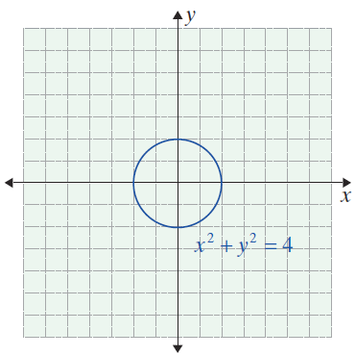
Example 6 : Vertical Line Test (cont.)
b.

Slide 20
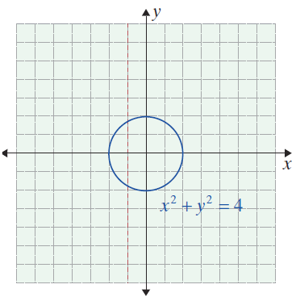
Example 6 : Vertical Line Test (cont.)
Solution:
The graph of x² + y² = 4 is a circle. The graph shows that the equation does not represent a function. Vertical lines can be drawn that intersect the graph in more than one point.

Slide 21
Example 7: Recognizing the Parts of a Function
Given rewrite f (x) as a sum of two functions, one of which is linear.
Solution:
Let h(x) = x² and g(x) = 6x + 8. Then f (x) = h(x) + g(x). The function g(x) is called the “linear part” of f (x) and h(x) is called the “quadratic part” of f (x).

Slide 22
Operations with Functions
New Functions from Old
It is often useful, and simpler, to write f = h + g instead of f (x) = h(x) + g(x). In some texts, one sees
f (x) = (h + g)(x), but we will avoid this notation. The notation h + g denotes the new function formed by addition. It is not an addition of numbers. We sometimes write
for a new function formed from the functions h and g.

Slide 23
Example 8: Decomposition of a Function
Find a decomposition of f (x) into two simpler functions g(x) and h(x). (That is, define new functions g and h and express f in terms of g and h. More than one answer is possible.)
Solution:
Then f (x) = g (x) + h (x).

Slide 24
Example 8: Decomposition of a Function (cont.)
Solution:

Slide 25
Example 8: Decomposition of a Function (cont.)
Solution:

Slide 26
Example 9: Operations with Functions
Given express h(x) in terms of x and simplify if possible.
Solution:

Slide 27
Example 9: Operations with Functions (cont.)
Solution:
Solution:

Slide 28
Example 9: Operations with Functions (cont.)
Solution:

Slide 29
Operations with Functions
Composite Functions
If f and g are two functions, then the composite function f of g is defined to be
The domain of is that part of the domain of g for
which is defined.

Slide 30
Example 10: Composite Functions
For the functions
form the following composite functions.
Solution:
Substitute g(x) for x in the expression for f(x).

Slide 31
Example 10: Composite Functions (cont.)
Solution:
Substitute f(x) for x in the expression for g(x).

Slide 32
Operations with Functions
Notes
Example 10 illustrates that, as a general rule, is not equal to

Slide 33
Example 11: Composite Functions
For the functions
and, find the following composite functions.
Solution:

Slide 34
Example 11: Composite Functions (cont.)
Solution:

Slide 35
Example 12: Composite Functions
In each case identify two functions h(x) and g(x) so that the given function f (x) can be expressed as
f (x) = g(h(x)).
Solution:

Slide 36
Example 12: Composite Functions (cont.)
Solution:
Solution:

Slide 37
Example 13: Evaluating a Function
For each part of Example 12, calculate f (1) by first calculating h(1) and then g(h(1)).
Solution:

Slide 38
Example 13: Evaluating a Function (cont.)
Solution:
Solution:

Slide 39
The Difference Quotient
NOTES
The quotient expressed below will occur repeatedly in later sections, and we wish to emphasize that such quotients are slopes.

Slide 40
Example 14: The Difference Quotient
For calculate, simplify, and interpret the following expressions.
Solution:
This quotient is the slope of the line joining (5, −17) to (3, −1), two points on the graph of f.

Slide 41
Example 14: The Difference Quotient (cont.)
b. Calculate
are two points on the graph of f (x) .
Solution:
The difference is Δy for the two points (a, f (a)) and (a + h, f (a + h)).

Slide 42
Example 14: The Difference Quotient (cont.)
c. Calculate for the two
points in part (b).
Solution:
The quotient is the slope of the line containing the two points in part b since h = Δx. Note: x₁ = a, x₂ = a + h.

