Slide 1
Section 1.7
Functions and Their Graphs: A Calculator Section

Slide 2
Objectives
Use a graphing calculator to:
graph a function,
make a data table of x- and y-values of a function, and
find the minimum, maximum, and zero(s) of a function.

Slide 3



Example 1 : Selecting Window Dimensions with a Calculator
Using a calculator as an aid, draw on a sheet of paper a
sketch of Determine a window of
appropriate dimensions.
Solution:
The steps are, press , (so to clear what might be there from previous work),
.

Slide 4

Example 1 : Selecting Window Dimensions with a Calculator
This enters the formula for the function. Note that the parentheses must be used. Without parentheses, the
calculator will graph The character is
used to denote exponentiation, and the calculator computes exponents first, then division and multiplication, then addition and subtraction (remember "Please Excuse My Dear Aunt Sally").

Slide 5
Example 1 : Selecting Window Dimensions with a Calculator (cont.)
Now we select a window. The standard window, with Xmin = −10, Xmax = 10, Ymin = −10, and Ymax = 10 is rather poor. Most of the screen is just empty space. [See Figure 1.7.1(a).]

Slide 6
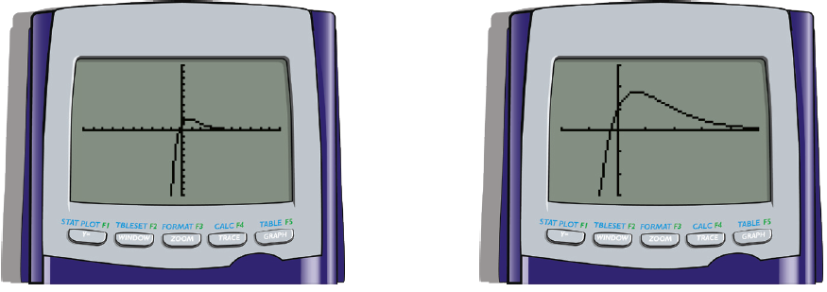
Example 1 : Selecting Window Dimensions with a Calculator (cont.)
(a) First Graph (b) Second Graph
Figure 1.7.1

Slide 7


Example 1 : Selecting Window Dimensions with a Calculator (cont.)
Press and edit Xmin = −2, Xmax = 5,
Xscl = 1, Ymin = −3, Ymax = 3, and Yscl = 1. Press
. The second graph drawn is now very revealing and we do not need to change the window entries any further [see Figure 1.7.1(b).]

Slide 8
Example 2 : Selecting Window Dimensions without a Calculator
Determine a sensible window for
without graphing. Then check by drawing the graph with a graphing utility.
Solution:
For x = 0 we calculate (try it mentally) that the fraction reduces to 20, or that y = 20. So Ymax must be bigger than 20. In general, the numerator for this function will be larger than the denominator, since x³ is bigger than
x². If x = 10, y is greater than

Slide 9
Example 2 : Selecting Window Dimensions without a Calculator (cont.)
Lets make Ymax = 100. For large negative
x, y is close to which will be −60 if x = −10.
Lets make Ymin = −100. We will begin with the estimate that Xmin = −10 and Xmax = 10. This window turns out to be excellent (see screen on the next slide). The key features are illustrated. If a greater range were selected for x or for y, the visual detail near the origin would be less clear. If a more narrow range were selected then the apparent large-scale behavior of the function would not be seen.

Slide 10
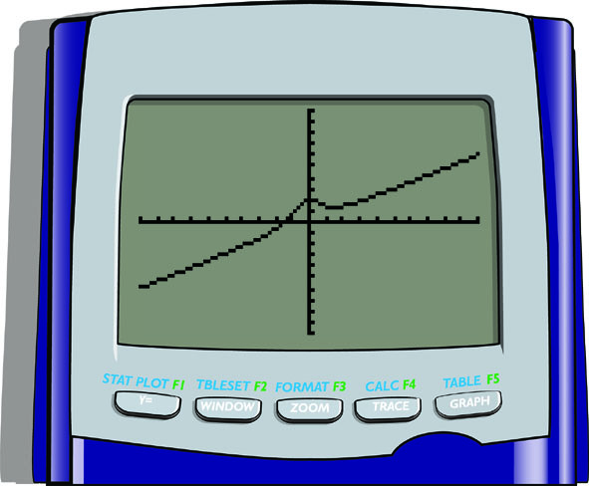
Example 2 : Selecting Window Dimensions without a Calculator (cont.)

Slide 11
Example 3 : Rewriting Functions for
Calculator Use
Rewrite each function in a form suitable for typing into a graphing utility.

Slide 12
Example 3 : Rewriting Functions for
Calculator Use (cont.)
One possible method uses the square root button, followed by “x+1)”. Instead, one could use “(x + 1) ^ (1/2)” or “(x + 1) ^ .5".

Slide 13
Example 4 : Finding the Zero of a Function
Using a Calculator
Solve
Solution:
Type the function into Y₁. The number 4 is greater than any coefficient. Thus, for x more than 4 or less than −4, the y-values will be determined by the x³ term. So, for x to the left of x = −4, y will be a large negative number and for x bigger than x = 4, y will be a large positive number. It follows that any zero of the function
will occur between Xmin = −4 and Xmax = 4.

Slide 14





Example 4 : Finding the Zero of a Function
Using a Calculator (cont.)
The y-values which correspond to x in the range
will be small. If x = 3, y = 24, so let
Ymin = −20 and Ymax = 20. The graph shows there is one zero for f (x) somewhere between x = −2 and x = −1.
Press and, at the left bound prompt,
type and . Then, for the right bound,
type and .

Slide 15

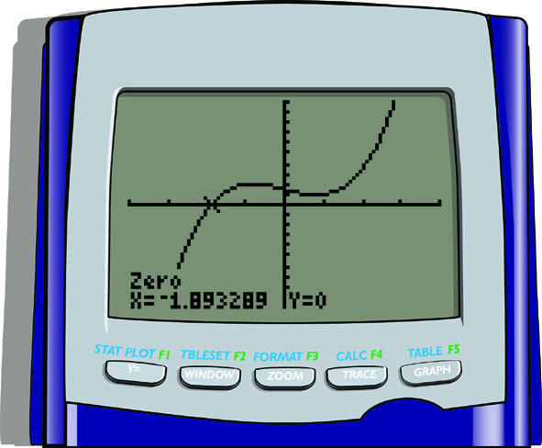
Example 4 : Finding the Zero of a Function
Using a Calculator (cont.)
As a guess, select and . The answer is f (−1.893289) = 0.

