Slide 1
Section 10.1
Infinite Sequences

Slide 2
Objectives
Understand infinite sequences and calculate the corresponding limits.
Understand both convergent and divergent series and calculate sums when they exist.

Slide 3
Example 1: Sequences
Determine a formula for the n^{th} term of the sequence
Solution:
The sequence where b_{n} = 2n + 1 gives the
sequence {1, 3, 5, 7, ...}.
Here b₀ = 2(0) + 1 = 0 + 1 = 1, b₁ = 2(1) + 1 = 2 + 1 = 3, and so on.

Slide 4
Example 2: Expressing a Sequence
Express the sequence {4, 6, 8, 10, ...} as
Solution:
The sequence is the set of even positive integers beginning with 4. We modify the function f(n) = 2n, and note a_{n} = 2n + 2 and b_{n} = 2n − 2 give the same sequence.
a₁ = 2(1) + 2 = 4, a₂ = 2(2) + 2 = 6, and so on.
b₃ = 2(3) − 2 = 6 − 2 = 4, b₄ = 2(4) − 2 = 8 − 2 = 6, and so on.

Slide 5
Example 3: Terms of a Sequence
Write the first five terms of each of the following sequences.

Slide 6
Example 3: Terms of a Sequence (cont.)
Solutions:
c. {−1, 3, −5, 7, −9,...}. When the terms alternate in sign, the sequence is called an alternating sequence. It is possible to factor the minus sign. For example,

Slide 7
Example 3: Terms of a Sequence (cont.)
d. When the domain is not
specified, it is assumed that n = 1 is the first case.
e. {1, −2, 3, −4, 5,...}.

Slide 8
Example 4: Find the Function
Find a function with domain N = {1, 2, 3,...} for each of the following sequences.

Slide 9
Example 4: Find the Function (cont.)
Solutions:
a. Several solutions are possible. All are equally acceptable.

Slide 10
Example 4: Find the Function (cont.)

Slide 11
Limit of a Sequence
Limit of a Sequence
Let be any sequence. If there is a number L
such that then we say L is the limit of
the n^{th} term of the sequence. If f(x) is continuous on the interval (1, ∞), then if and only if

Slide 12
Example 5: Limit of a Sequence
Determine the limit of the n^{th} term of each sequence given below.

Slide 13
Example 5: Limit of a Sequence (cont.)
Solutions:
a. By substituting large values for n, and using a calculator, one might infer the limit is 0.75. One can confirm this by analysis since

Slide 14
Example 5: Limit of a Sequence (cont.)
Taking the limit of the right hand side shows:

Slide 15
Example 5: Limit of a Sequence (cont.)
c. For any fraction with the powers of
are smaller than and are decreasing towards
zero. That is

Slide 16
Example 5: Limit of a Sequence (cont.)
e. Although the terms alternate, they get smaller and smaller in absolute value and “the terms go to zero.” This explains the necessity of the absolute value sign in the definition of sequence convergence.

Slide 17
Example 5: Limit of a Sequence (cont.)
f. is continuous everywhere. By the
remark in the text-box, we need to determine the limit of f(x) as For this f(x), it is easy to see the positive x-axis is an asymptote since f(x) is positive (as ) yet f(x) is decreasing. One way to see this is to use the quotient rule to get y ′.

Slide 18
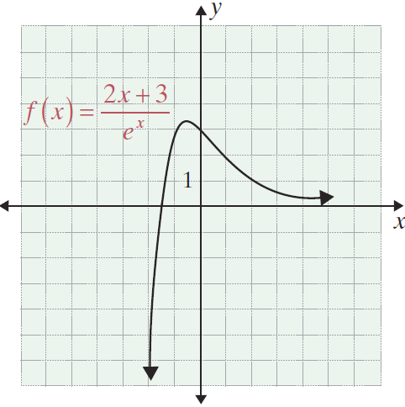
Example 5: Limit of a Sequence (cont.)
Since the numerator is negative (x is positive) and the denominator is positive, the fraction is negative. Therefore, f(x) is decreasing and

Slide 19
Example 5: Limit of a Sequence (cont.)
g. There is no determined pattern so the limit cannot be determined. However, the sequence of digits (so far) consists of the decimal digits of the number π.

Slide 20
Example 6: Fibonacci Sequence
Use a recursive presentation for the following sequence
{1, 1, 2, 3, 5, 8, 13, 21,...}.
Solution:
Let F₁ = 1, F₂ = 1, and for n ≥ 3, F_{n} = F_{n − 1} + F_{n − 2}. This sequence is called the Fibonacci sequence after Leonardo of Pisa (1170 - 1240) “of the family of Bonaccio.”

Slide 21
Example 7 : Define a Sequence
Use recursion to define the sequence
Solution:
Let and for n > 1, let

Slide 22
Example 8 : Sequence of Partial Sums
Given the series define the
sequence of partial sums recursively.
Solution:
Let S₁ = a₁ and for n > 1, let S_{n} = S_{n − 1} + a_{n}.

Slide 23
Example 9: Terms of a Partial Sum Sequence
Write out the first five partial sums of the sequence described by the Merton College Problem (see introduction).
Solution:

Slide 24
Example 9: Terms of a Partial Sum Sequence (cont.)

Slide 25
Infinite Series
Convergence Principle for Infinite Series
An infinite series converges to a
number L if and only if its corresponding sequence
of partial sums converges to L.

Slide 26
Example 10: Converging Series
Determine the number to which the Merton College
series converges.
Solution: In a problem like this, one hopes to see a pattern which clarifies whether or not the sum converges and which also suggests the particular number to which the sum converges. This is not yet clear in the terms calculated in the previous example. However, the next two terms in the sequence of partial sums are

Slide 27
Example 10: Converging Series (cont.)
All of these terms are below 2 and seem to be increasing towards 2. Perhaps 2 is the limit. This suggests seeing how close each term gets to 2. The results can be put into a table for analysis.
Assuming the guess for S_{n} is correct, we have
S₁ | S₂ | S₃ | S₄ | S₅ | S₆ | S₇ | … | S_{n}
 | 2 − 1 |  |  |  |  |  | …

Slide 28
Example 10: Converging Series (cont.)
The last limit expression is very similar to the problem in Example 5(f). In general, using small cases in order to determine an expression like that in the Table for S_{n} involves guesswork and inference. The proof that the format is correct usually involves a formal technique called mathematical induction which we do not discuss in this text. However, the main step in such a proof requires that we show the guess for the formula for S_{n} leads to a correct version for S_{n+1}. That is, one must show, given a formula for S_{n}, that S_{n} + a_{n+1} leads to
S_{n+1}. We illustrate for this example.

Slide 29
Example 10: Converging Series (cont.)

Slide 30
Example 11: Calculating an Infinite Series
Determine the sums of the following infinite series providing they converge.

Slide 31
Example 11: Calculating an Infinite Series (cont.)
Solutions: a. The partial sums converge.

Slide 32
Example 11: Calculating an Infinite Series (cont.)
b. This series diverges. The sequence of partial sums does not converge.
c. The partial sums converge.

Slide 33
Example 11: Calculating an Infinite Series (cont.)
d. This diverges. This is an important infinite series. It seems to converge since the sequence of partial sums is not too large and the terms seem to be getting closer together. Nevertheless, the terms S_{n} increase without bound (“go to infinity”). One can see this with a nice argument by partitioning the terms of the series in a new way.
a₁ | a₂ | a₃ | a₄ | a₅

Slide 34
Example 11: Calculating an Infinite Series (cont.)

Slide 35
Example 11: Calculating an Infinite Series (cont.)
The n^{th} term b_{n} will have 2^{n − 1} fractions all of which will
be greater than or equal to So b_{n} itself will be
greater than That is,

Slide 36
Example 11: Calculating an Infinite Series (cont.)
But then
The given series is greater than any given number
because enough terms of size will surpass any given number.

Slide 37
Example 12: Limits
Show does not exist.
Solution: We use the Fundamental Theorem of Calculus, the results of Example 11d., and a Riemann
sum. The area under the graph is
The shaded area is less than the integral, and the shaded area is given by the Riemann sum
Thus lnx increases without bound.

Slide 38
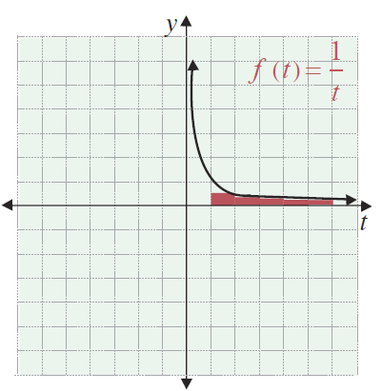
Example 12: Limits (cont.)

Slide 39
Geometric Series
Convergence of a Geometric Series
When −1 < r < 1, the geometric series
is finite and converges to

Slide 40
Example 13: Geometric Series
Determine the sums of the series, if they converge.
Solutions:
a. Here a = 3 and

Slide 41
Example 13: Geometric Series (cont.)
b. Here a = 2 and

Slide 42
Example 13: Geometric Series (cont.)
c. The sequence does not start with n = 0 (using a = 1
and ). We use
Alternatively, multiply by and get a second equation and subtract:

Slide 43
Example 13: Geometric Series (cont.)

Slide 44
Example 14: Merton College Puzzle
We now show Oresme's area solution to the Merton College puzzle (see Introduction). He used two decompositions of the area. (See Figure 10.1.2.) On the left, the rectangles have bases which are decreasing powers of 2 and heights which are the integers
1, 2, 3, ..., and the area is
Recall, this is the original infinite series. On the other hand, the same area is decomposed into rectangles of height 1 and bases which are decreasing powers of 2, and there the area is the sum

Slide 45
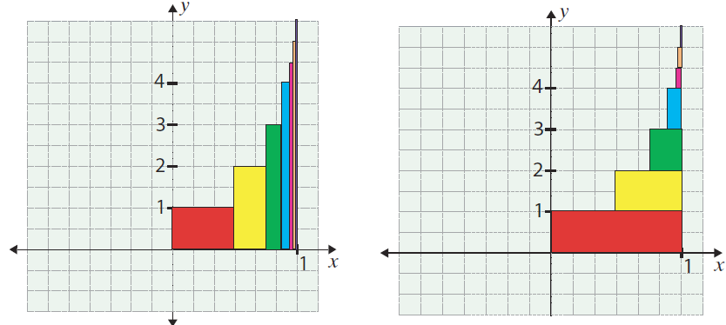
Example 14: Merton College Puzzle (cont.)
Figure 10.1.2

