Slide 1
Section 2.1
Limits

Slide 2
Objectives
Determine left- and right-hand limits of functions.
Determine if a limit of a function exists as x approaches a real number a.

Slide 3
One-Sided Limits
One-Sided Limits Defined Informally
1. Left-hand Limits
If the values of a function y = f(x) get closer and closer to some number K as values of x, that are smaller than some number a, get closer and closer to a, then we say that K is the limit of f (x) as x approaches a from the left. We write

Slide 4
One-Sided Limits
One-Sided Limits Defined Informally (cont.)
2. Right-hand Limits
If the values of a function y = f(x) get closer and closer to some number M as values of x, that are larger than some number a, get closer and closer to a, then we say that M is the limit of f (x) as x approaches a from the right. We write

Slide 5
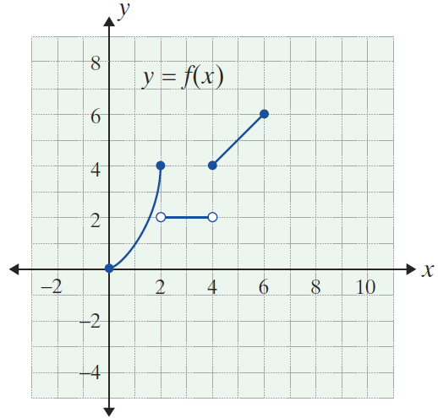
Example 1: Finding One-Sided Limits
The graph of the function
is shown in the figure at the
right. Find the following one-sided limits by inspecting
the graph.

Slide 6
Example 1: Finding One-Sided Limits (cont.)
Remarks concerning the graph:
1. The value of the left and right-hand
limits as x approaches 2 is independent
of the actual y-value at x = 2, if there is one.
2. There is no since the
function is not defined for x-values approaching these numbers from the indicated directions.

Slide 7
Example 1: Finding One-Sided Limits (cont.)

Slide 8
Polynomial Functions
Polynomial Function
A polynomial function is a function of the form
where each exponent is a positive integer and
are real numbers.

Slide 9
Polynomial Functions
One-Sided Limits of Polynomial Functions
If p is a polynomial function and a is a real number, then

Slide 10
Example 2: Finding One-Sided Limits
Find the values of each of the following one-sided limits.
Solutions:
Since each function is a polynomial function, the one-sided limits can be found by substituting a for x.
Substitute a = 3 for x.

Slide 11
Example 2: Finding One-Sided Limits (cont.)
Substitute a = 2 for x.
Substitute a = 0 for x.

Slide 12
Unbounded Limits
Notes
If a limit is indicated to be +∞ or −∞, then it does not exist. These symbols are used only to indicate the direction of unboundedness.

Slide 13
Unbounded Limits
Infinite One-Sided Limits
(Unbounded One-Sided Limits)
1. +∞ Limits
If f(x) increases without bound as x approaches a from the left (or from the right), then we say that f(x) approaches positive infinity, +∞. (See Figure 2.1.5(a) and (b).) We write

Slide 14
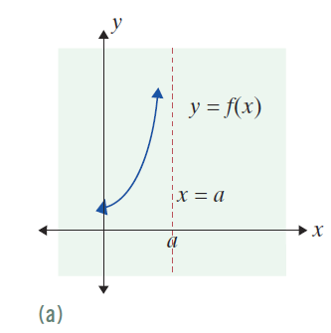
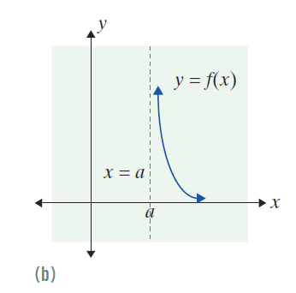
Unbounded Limits
Figure 2.1.5

Slide 15
Unbounded Limits
Infinite One-Sided Limits
(Unbounded One-Sided Limits) (cont.)
2. −∞ Limits
If f(x) decreases without bound as x approaches a from the left (or from the right), then we say that
f(x) approaches negative infinity, −∞. (See Figure 2.1.5(c) and (d).) We write

Slide 16
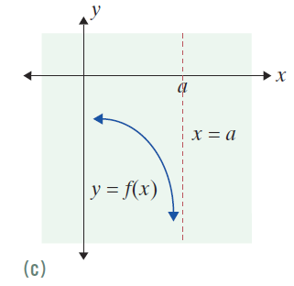
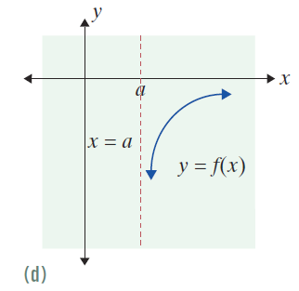
Unbounded Limits
Figure 2.1.5

Slide 17
Example 3: Finding Infinite One-Sided Limits
a. Find
Solution:
As x approaches −3 from the left, the denominator will always be negative but will approach 0; the absolute value of the denominator will get smaller and smaller. For example, −3.1 + 3 = −0.1, −3.01 + 3 = −0.01, and so on. Meanwhile, the numerator will approach
−3 + 5 = 2.

Slide 18
Example 3: Finding Infinite One-Sided Limits (cont.)
Thus the fraction will become very large in the
negative sense (or unbounded in the negative direction). So

Slide 19
Example 3: Finding Infinite One-Sided Limits (cont.)
b. Find
Solution:
Here, as x approaches −3 from the right, x + 3 will always be positive. For example, −2.9 + 3 = +0.1,
−2.99 + 3 = +0.01, and so on. Thus the denominator will approach 0 through positive values, and the numerator will approach −3 + 5 = 2.

Slide 20
Example 3: Finding Infinite One-Sided Limits (cont.)
Therefore, the fraction will become unbounded in
the positive direction, and we have

Slide 21
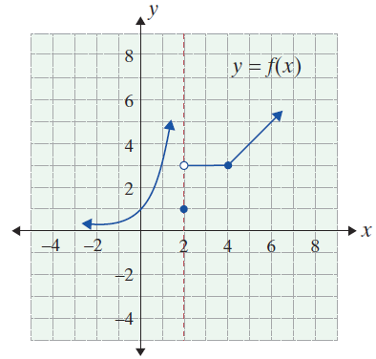
Example 4: Finding One-Sided Limits Using a Graph
Study the graph shown for
y = f(x) and find the following one-sided limits.

Slide 22
Example 4: Finding One-Sided Limits Using a Graph (cont.)
Note: f (2) = 1 according to the graph, but this fact does not affect either the left or right-hand limits in a. and b.

Slide 23
Limits
Limit Defined Informally
If the values of f(x) get closer and closer to some number L as values of x that are smaller than some number t and values of x that are larger than t get closer and closer to t (but not equal to t), then L is the limit of f(x) as x approaches t.

Slide 24
Limits
Limit Defined Symbolically
For a function f and a real number t, if
where L is a real number, then

Slide 25
Limits
Existence of a Limit
1. We say that the limit of a function f as x approaches a real number t exists if and only if where L is a real number.
2. If does not exist
3. If
does not exist.

Slide 26
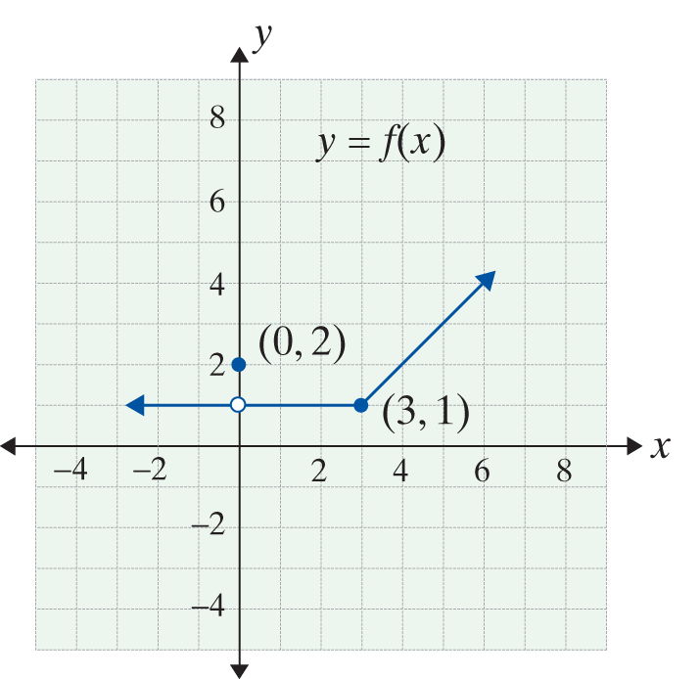
Example 5: Finding a Limit Using a Graph
Use the graph of y = f(x) in the figure to find

Slide 27
Example 5: Finding a Limit Using a Graph (cont.)
Solutions:
a. We see that
Therefore,
b. We see that
So, even though f(0) = 2,

Slide 28
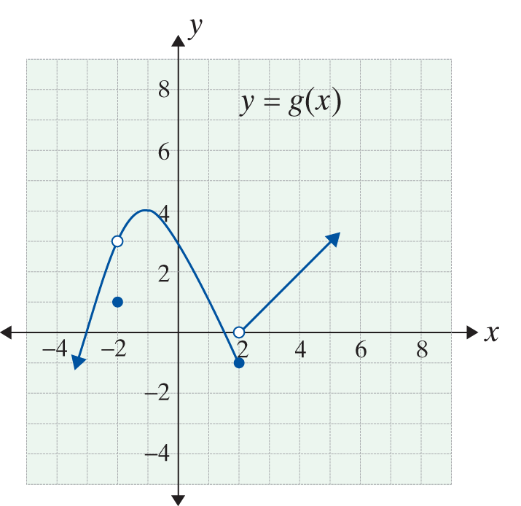
Example 6: Finding a Limit Using a Graph
Use the graph of y = g(x) in the figure to find
if the limits exist.

Slide 29
Example 6: Finding a Limit Using a Graph (cont.)
Solutions:

Slide 30
Example 7: Finding Limits Algebraically
a. Determine by using an
algebraically equivalent expression.
Solution:
We first factor the numerator and
simplify the fraction:
The numerical approach, with a table of x-values converging to 2, suggests a limit exists.

Slide 31
Example 7: Finding Limits Algebraically (cont.)
Since, for any number x (where x ≠ 2), the fractions
and 10(x + 2) will be equal, we may replace the given expression with the simplified one. Thus

Slide 32
Example 7: Finding Limits Algebraically (cont.)
b. Determine algebraically.
Solution: We factor the numerator:
The numerator is a difference of two cubes: that can be factored into

Slide 33
Example 7: Finding Limits Algebraically (cont.)
Then the given limit, if it exists, is equivalent to
However, the numerator does not
have a limit of zero, but the limit of the denominator is zero. Thus the limit fails to exist.

Slide 34
Example 7: Finding Limits Algebraically (cont.)
c. Determine algebraically.
Solution: We factor first:

Slide 35
Indeterminate Forms and Algebraic Solutions
Indeterminate Form
A limit expression of the type is called an
indeterminate form of type if and

