Slide 1
Section 2.3
Slope and Rate of Change Considered Algebraically

Slide 2
Objectives
Use the Three-Step Method to find a derivative.
Determine if a function is or is not differentiable.
Find derivatives of functions by using the Power Rule.
Apply the Constant Times a Function Rule and the Sum and Difference Rule.

Slide 3
Slope and Rate of Change Considered Algebraically
Derivative
For any given function y = f(x), the derivative of f at x is defined to be
provided this limit exists. (Note: )

Slide 4
Slope and Rate of Change Considered Algebraically
The Three-Step Method for Finding a Derivative
1. Form the ratio called the difference
quotient.
2. Simplify the difference quotient algebraically.
3. Calculate if it exists.

Slide 5
Example 1: Finding a Derivative
Use the Three-Step Method to find
Solution:
Step 1:
Form the difference quotient.

Slide 6
Example 1: Finding a Derivative (cont.)
Step 2:
Simplify the difference quotient.

Slide 7
Example 1: Finding a Derivative (cont.)
Step 3:
Find the limit.

Slide 8
Existence of Derivatives
Conditions of a Non-Differentiable Function
A function f(x) is not differentiable at x = a if any of the following is true:
1. f(x) is discontinuous at x = a.
2. The graph of f(x) has a sharp corner at x = a.
3. The tangent line at x = a is a vertical line.

Slide 9
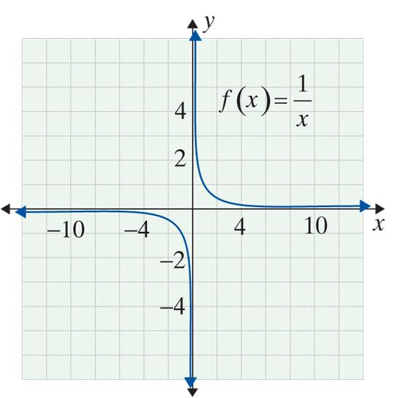
Example 2: Non-Differentiable Functions
a. is not defined at
x = 0. Thus there cannot be a tangent line at x = 0 and similarly the limit does not exist.

Slide 10
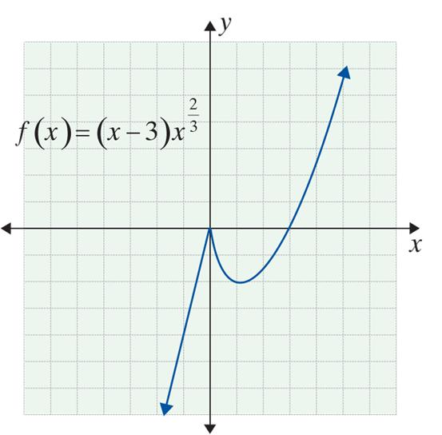
Example 2: Non-Differentiable Functions (cont.)
b. has a sharp point at x = 0, and so is not differentiable at x = 0.
Note: the limit of a set of secant lines from the right of x = 0 will have negative slope, but from the left, the limit will have positive slope.

Slide 11
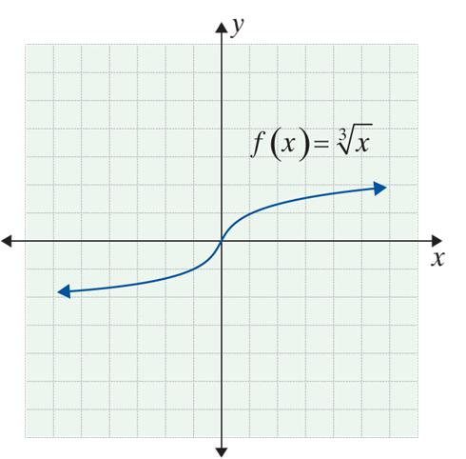
Example 2: Non-Differentiable Functions (cont.)
c. has a vertical
tangent at x = 0. Since
vertical lines have no slope,
f ′(0) is not defined.
For this function, f ′(x) exists at every point except for x = 0. In general, the functions usually studied in introductory and intermediate algebra or college algebra are “well‑behaved” from the calculus point of view. They usually are differentiable except at obvious points.

Slide 12
The Power Rule
Continuity at x = a
The function f is continuous at x = a if and only if

Slide 13
The Power Rule
Note
Informally, continuous functions can be drawn without lifting one’s pencil from the paper. Every differentiable function is continuous, but not every continuous function is differentiable (see Example 2b). Put another way, differentiability is a more restrictive condition − it requires that a function be both continuous, smooth, and without vertical tangents.

Slide 14
The Power Rule
Continuous Function on an Interval
A function f is continuous on an interval (x₁, x₂) provided the function is continuous at x = a for every number a with x₁ < a < x₂.

Slide 15
Example 3: Using the Definition of Derivative
Use the definition of derivative to find
Solution:
Step 1:
Form the difference quotient,
Here we begin with the two points (x, f(x)) and
(x + h, f(x + h)).

Slide 16
Example 3: Using the Definition of Derivative (cont.)
Inserting these expressions into the difference quotient, we get:

Slide 17
Example 3: Using the Definition of Derivative (cont.)
Step 2: Simplify the difference quotient.

Slide 18
Example 3: Using the Definition of Derivative (cont.)
Step 3: Compute or determine the limit as h → 0.
It is easy to see that, at any point on the line y = x, the slope is 1. We now put several results in a table and we see a pattern:
y | y′
x | 1
x² | 2x
x³ | 3x²

Slide 19
Example 3: Using the Definition of Derivative (cont.)
The pattern suggests that if f(x) = x⁴, then f ′(x) = 4x³. This is exactly what happens for y = x⁴. Similarly, if y = x⁵, then y′= 5x⁴. We are now able to state one of the most useful and striking formulas in mathematics.

Slide 20
The Power Rule
The Power Rule
For the function f(x) = x^{r}, where r is any real number, then

Slide 21
The Power Rule
Basic Rule of the Derivative of a Linear Function
For y = mx + b,
y′ = m.

Slide 22
The Power Rule
Two Special Cases of the Basic Rule
1. If f(x) = c, then f ′(x) = 0. Has slope 0 (constant functions are horizontal lines).
2. If f(x) = x, then f ′(x) = 1. Has slope 1.

Slide 23
Polynomial and Polynomial-Like Functions
Polynomial Functions
A polynomial function is a function of the form
where a₀, a₁, a₂, …, a_{n} are real numbers and the exponents are positive integers.
Also, for any real number a, and
therefore, f(x) is continuous everywhere.

Slide 24
Polynomial and Polynomial-Like Functions
Power Rule (General Case)
For the function f(x) = c ⋅ x^{r}, where c and r are any real numbers,

Slide 25
Example 4: Finding the Derivatives of Functions
Find the derivative of each of the following functions.
a. f(x) = 5
Solution:
f(x) = 5 is a constant function, so f ′(x) = 0.
b. f(x) = 5x³
Solution:
This is the first special case of the Basic Rule.
Here we use the general Power Rule, where c = 5 and r = 3.

Slide 26
Example 4: Finding the Derivatives of Functions (cont.)
Solution:
We can use the Power Rule with this
polynomial-like function because is a real number.

Slide 27
Example 5: Rewriting a Fraction to Find the Derivative
Find the derivative of g(x) given that
Solution:
We first rewrite the fraction in a form with a negative exponent and then apply the Power Rule.

Slide 28
Example 6: Using Derivative Notation
Solution:
Rewrite the expression to be a polynomial-like function.
Use the Power Rule where and c = 18 to find the derivative.

Slide 29
The Sum and Difference Rule
Constant Times a Function Rule
If f(x) is a differentiable function, c is a real constant, and y = c ⋅ f(x), then
In words, the derivative of a constant times a function is the constant times the derivative of the function. (The power rule is a special case of this rule.)

Slide 30
The Sum and Difference Rule
The Sum and Difference Rule
If f(x) and g(x) are differentiable functions and y = f(x) ± g(x), then
In words, the derivative of a sum (or difference) of two functions is the sum (or difference) of their derivatives.

Slide 31
Example 7: Using the Rules
Find the derivative of each of the following functions.
a. y = 5x²
Solution:
Rewrite the equation of the derivative by pulling the constant, 5, out in front. By doing so, we have used the Constant Times a Function Rule.
Apply the Power Rule to x².

Slide 32
Example 7: Using the Rules (cont.)
b. y = −4x
Solution:
Rewrite the equation of the derivative by pulling the constant, −4, out in front. By doing so, we have used the Constant Times a Function Rule.
Apply the Power Rule to x¹.

Slide 33
Example 7: Using the Rules (cont.)
c. y = 5x² − 4x
Solution:
Notice that this function is actually the sum of the functions in Examples 7a. and 7b. Therefore, to find the derivative of this function we will use the results from 7a. and 7b.

Slide 34
Example 7: Using the Rules (cont.)
Rewrite the equation of the derivative as a sum of the two differentiable functions so we can use the rule.
Using the Sum and Difference Rule, we can take the sum of the derivatives of the functions (found in Examples 7a. and 7b.).

Slide 35
Example 7: Using the Rules (cont.)
Solution:
First, re-write using exponents. Next, use the Sum and Difference Rule to rewrite the equation of the derivative. Then apply the Constant Times a Function Rule to extract the constants.

Slide 36
Example 7: Using the Rules (cont.)
Lastly, use the Power Rule.

Slide 37
Example 8: Algebraic Manipulations
Solution:
Multiply and simplify.

Slide 38
Example 8: Algebraic Manipulations (cont.)
Use both the Sum and Difference Rule and the Constant Times a Function Rule.
Apply the Power Rule.

Slide 39
Example 8: Algebraic Manipulations (cont.)
Solution:
Simplify by first dividing each
term in the numerator by

Slide 40
Example 8: Algebraic Manipulations (cont.)
Use the Sum and Difference Rule.
Apply the Power Rule.
Or, we can factor and write the answer in fraction form with a single denominator, as shown below:

Slide 41
Example 9: Tangent Lines
For the function f(x) = 8x – x² :
a. Find the slope of the tangent lines at x = 2, x = 4, and x = 5.
b. Find the equation of the tangent lines at x = 2, x = 4, and x = 5.
c. Sketch the curve and the three tangent lines.

Slide 42
Example 9: Tangent Lines (cont.)
Solutions:
a. First, find the derivative of the function:
Then evaluate the derivative at each point to find the slope of the tangent line at that point.
At x = 2 → f ′(2) = 8 − 4 = 4.
At x = 4 → f ′(4) = 8 − 8 = 0.
At x = 5 → f ′(5) = 8 − 10 = −2.

Slide 43
Example 9: Tangent Lines (cont.)
b. To find the equation of the tangent lines at each of the points, use the point-slope formula for the equation of a line, y – y₁ = m(x – x₁). Insert each value of x into the function to find its corresponding y-value.

Slide 44
Example 9: Tangent Lines (cont.)
At x = 2 → x₁ = 2, so y₁ = f(2) = 8 ⋅ 2 – 2² = 12. From part a., we know that f ′(2) = 4 = m.
Putting this information into the point-slope formula, we get:

Slide 45
Example 9: Tangent Lines (cont.)
At x = 4 → x₁ = 4, so y₁ = f(4) = 8 ⋅ 4 – 4² = 16. From part a., we know that f ′(4) = 0 = m.
Putting this information into the point-slope formula, we get:

Slide 46
Example 9: Tangent Lines (cont.)
At x = 5 → x₁ = 5, so y₁ = f(5) = 8 ⋅ 5 – 5² = 15. From part a., we know that f ′(5) = –2 = m.
Putting this information into the point-slope formula, we get:

Slide 47
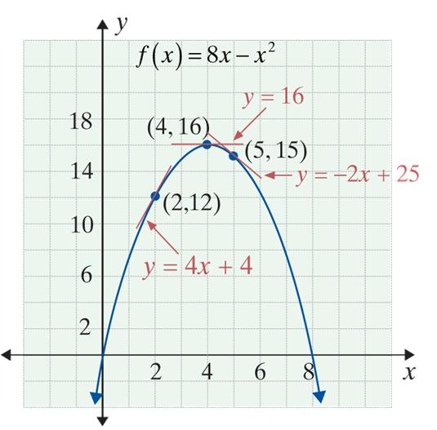
Example 9: Tangent Lines (cont.)
c. The graph is a parabola that opens downward. The vertex of the parabola occurs at (4, 16), where the tangent line has slope 0.

Slide 48
Example 10: Velocity
Suppose that a sailboat is observed, over a period of
5 minutes, to travel a distance from a starting point according to the function where t is time in minutes and s is the distance traveled in meters.
a. How fast is the boat moving at the starting point?
b. How fast is the boat moving at the end of 3 minutes?

Slide 49

Example 10: Velocity (cont.)
Solutions:
a. The velocity at time t is
The boat is at the starting point when t = 0.
b. When t = 3,

Slide 50
Example 11: Identifying Derivatives in Real-Life
Determine which of the following represent (or might represent) the value of a derivative at a point, and if so, give a suitable description of a function f.
a. 30 miles per hour. b. 6 fish per day.
c. 23 ears of corn. d. 19 neutrons per millisecond.
Solutions:
a. 30 miles per hour is a rate of change; therefore, it is a possible derivative. A suitable function is f(x) where f is the total distance from an origin and x is the time of travel.

Slide 51
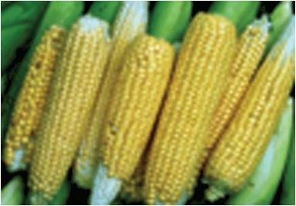
Example 11: Identifying Derivatives in Real-Life (cont.)
b. 6 fish per day is also a rate of change, and therefore is a possible derivative. A suitable function f(x) is the total number of fish sold by a pet store during June and x is the number of days since June 1.
c. 23 ears of corn is a quantity rather than a rate. Thus it is not a derivative.

Slide 52
Example 11: Identifying Derivatives in Real-Life (cont.)
d. 19 neutrons per millisecond is a rate of change; therefore, it is a possible derivative. A suitable function f(x) is the total number of neutrons emitted by a nuclear sample, and x is the time since the sample arrived at the college physics laboratory.

