Slide 1
Section 2.4
Applications: Marginal Analysis

Slide 2
Objectives
Calculate marginal cost, marginal revenue, marginal profit, and marginal average cost.

Slide 3
Marginal Cost
Marginal Cost
Marginal cost is the rate of change of total cost per unit change in quantity x. This concept is illustrated geometrically in Figure 2.4.1.

Slide 4
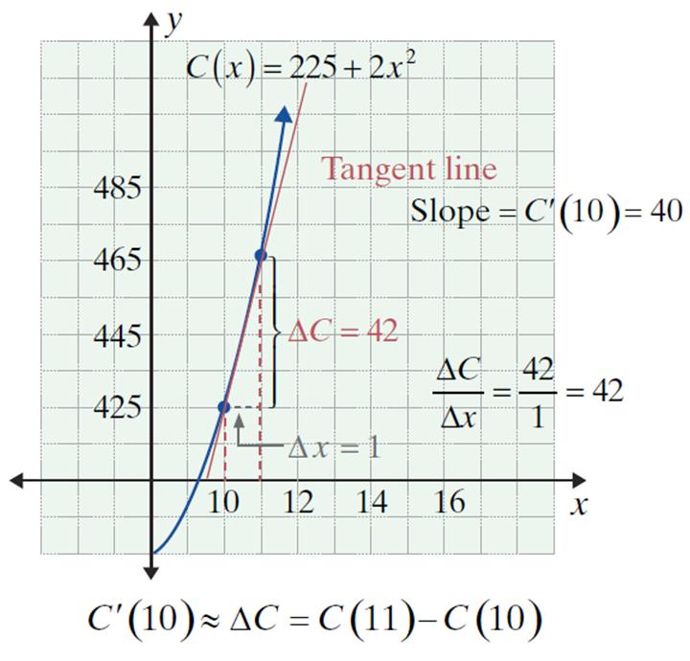
Marginal Cost
Figure 2.4.1

Slide 5
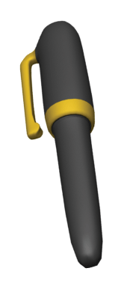
Example 1: Marginal Cost
A specialty item manufacturer determines that the cost of producing x ballpoint pens is C(x) = 500 + 3x in dollars.
a. Find C(101) − C(100), the cost of producing the 101st pen.
b. Find C ′(100), the marginal cost at x = 100 pens.

Slide 6
Example 1: Marginal Cost (cont.)
Solutions:
a. C(101) = 500 + 3(101) = 500 + 303 = 803
C(100) = 500 + 3(100) = 500 + 300 = 800
C(101) − C(100) = 803 − 800 = 3
So, when the production level is increased from 100 to 101 pens, the total cost is increased by $3. Therefore, the cost of producing the 101st pen is $3.

Slide 7
Example 1: Marginal Cost (cont.)
b. C(x) = 500 + 3x The given cost function.
C ′(x) = 3 Marginal cost is the derivative of the cost function.
C ′(100) = $3 The marginal cost at x = 100.

Slide 8
Marginal Revenue
Marginal Revenue
Marginal revenue is the rate of change of the total revenue per unit change in sales when the level of sales is x items.

Slide 9
Example 2: Marginal Revenue
Suppose that a manufacturer has determined that the price of certain custom-made tables he produces can be determined by the demand function
where x is the number of tables produced and sold.
a. Find the revenue function.
b. Determine the marginal revenue when x = 16 tables.

Slide 10

Example 2: Marginal Revenue (cont.)
Solutions:
Thus the revenue is increasing at a rate of $109 per table as the sixteenth table is sold.

Slide 11
Marginal Profit
Marginal Profit
Marginal profit is the rate of change of the profit per unit change in sales when x items are produced and sold.

Slide 12
Example 3: Marginal Profit
If the table manufacturer in Example 2 has a cost function of along with his revenue
function of find
a. All break-even points.
b. The marginal profit when x = 10, x = 20, x = 30.

Slide 13
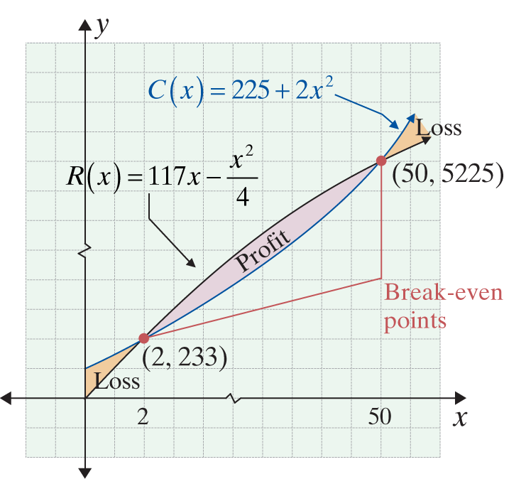
Example 3: Marginal Profit (cont.)
Solutions:
a. Break-even points occur where C(x) = R(x).
Break-even points occur when x = 2 and x = 50.

Slide 14
Example 3: Marginal Profit (cont.)
b.
Marginal profit is rate of change of profit, so first we must find the profit function P(x).
The profit function P(x).

Slide 15
Example 3: Marginal Profit (cont.)
Now we can find the derivative of P(x) to calculate the various marginal profits.

Slide 16
Example 3: Marginal Profit (cont.)
Note that P′(x) is actually getting smaller as x gets larger. Marginal analysis shows that the rate of growth of profit per table is actually decreasing at a rate of $18 per table when 30 tables are manufactured and sold. This does not necessarily mean there is a loss, but as production increases, the profit per table is growing less because costs are increasing faster than revenue.

Slide 17
Marginal Average Cost
Marginal Average Cost
Marginal average cost ′(x) is the rate of change of the average cost per unit change in production. This is an approximation of the change in average cost when one more item is produced.

Slide 18

Example 4: Marginal Average Cost
Suppose represents the cost in dollars of producing x radios.
a. Find the average cost function.
b. Find the average cost of producing 1000 radios.
c. Find the marginal average cost if 1000 radios are produced.

Slide 19
Example 4: Marginal Average Cost (cont.)
Solutions:
a.
b.
Use x = 1000.

Slide 20
Example 4: Marginal Average Cost (cont.)
c.
Rewrite the equation so that there are no fractions.
Find the rate of change of the average cost to find the marginal average cost.

Slide 21
Example 4: Marginal Average Cost (cont.)
The average cost per radio is increasing at a rate of 1.8 cents per radio when 1000 radios are produced.
Use x = 1000 in the function for marginal average cost.

Slide 22
Example 5: Marginal Propensity
If the marginal propensity to save is S′(x) = 0.02x, what is the marginal propensity to consume?
Solution:
Since We replace S′(x) with 0.02x.

