Slide 1
Section 2.5
More About Limits and Continuity

Slide 2
Objectives
Use the properties of limits to determine limits of functions.
Find limits of rational functions.
Identify continuous functions.

Slide 3
Properties of Limits
Properties of Limits as x → a
Suppose that c is any constant, n is a positive integer, a
is a real number,
where L₁ and L₂ are real numbers.
Property | Comments
 | The limit of a constant is the constant itself.

Slide 4
Properties of Limits
Properties of Limits as x → a (cont.)
Property | Comments
 | The limit of a sum (or difference) of two functions is the sum (or difference) of the limits.
 | The limit of a product is the product of the limits provided these limits exist.
 | The limit of a quotient is the quotient of the limits as long as the limit of the denominator is not 0.

Slide 5
Properties of Limits
Properties of Limits as x → a (cont.)
Property | Comments
 | The limit of a constant times a function can be found by first finding the limit of the function and then multiplying this limit by the constant.
 | The limit of the n^{th} root of a function can be found by calculating the limit of the function first and then taking the n^{th} root of the limit. (Note: f(x) must be defined on intervals to the left of a and to the right of a.)

Slide 6
Properties of Limits
Properties of Limits as x → a (cont.)
Property | Comments
 | The limit of a polynomial can be found by substituting a for x. This result is particularly useful and follows directly from Properties 1 through 5.

Slide 7
Example 1: Properties of Limits
Use the properties of limits to find each of the following limits.
Solution:
Solution:
Property 1.
Property 9.
Substitute x = 3.

Slide 8
Example 1: Properties of Limits (cont.)
Solution:
Property 8.
Property 6.
Property 9.
Substitute x = 2.

Slide 9
Example 2: Indeterminate Form
Solution: so we simplify f(x) first and
then find the limit.

Slide 10
Example 3: Undefined Limit
Solution: For which is not
defined, and further, is not of the form The
expression cannot be simplified as the expression
in Example 2 was. When the limit of the denominator is 0 and the limit of the numerator is some number other than 0, then the limit of the function does not exist.

Slide 11
Example 3: Undefined Limit (cont.)
To show this and to determine the nature of the graph of the function near x = 5, we analyze the left- and right-hand limits:
Thus we see that does not exist and that the
graph of the function is unbounded in the negative direction as and unbounded in the positive direction as

Slide 12
Example 4: Piecewise Function
The function f (x) is defined piecewise as follows:
Find if it exists.
Solution:

Slide 13
Example 4: Piecewise Function (cont.)

Slide 14
Limits of Rational Functions as x → +∞ or x → −∞
Rational Function
A rational function is a function of the form
where p(x) and q(x) are polynomials.

Slide 15
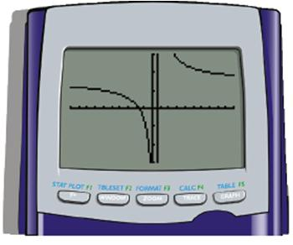
Example 5: Properties of Limits
Solution: Use a graphing utility and graph the function
On the TI-84 Plus, use a window of
[−10, 10] by [−3, 3].
As x gets larger we see the
y-values level off just above the x-axis (see Figure).

Slide 16
Example 5: Properties of Limits (cont.)
There is a natural way to investigate this algebraically.
Individually, both the numerator and denominator get very large. That is, they both approach +∞.
Thus this approach leads to an expression of the form
which is called an indeterminate form. We still do
not know what the limit is or even if the limit exists.

Slide 17
Example 5: Properties of Limits (cont.)
Now, if we divide each term in the numerator and denominator by x, we will have an expression with fractions whose limits we can find.
Divide each term by x.
Simplify.

Slide 18
Example 5: Properties of Limits (cont.)
Use limit Property 6.
Use limit Properties 4 and 7.
Also, use

Slide 19
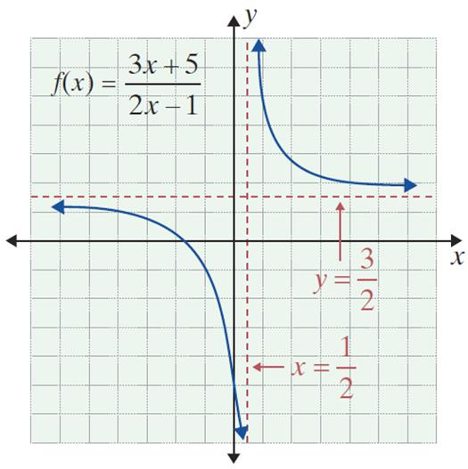
Example 5: Properties of Limits (cont.)
Since the constants +5 and –1 will have little effect on the fraction for very large values of
x (i.e., in the millions), then
is approximately the
same as Thus the limit
of seems quite reasonable
from this point of view. The
graph shows that the line
is indeed a horizontal asymptote.

Slide 20
Example 6: Properties of Limits
Solution:
In Example 5 we divided each term in the numerator and denominator by x. In this example, we will divide each term by x³, since the technique is to divide by the highest power of x present in the function.

Slide 21
Example 6: Properties of Limits (cont.)
Divide each term by x³.
Simplify.
Since the numerator is 0 and the denominator is not 0, the fraction has the value 0.

Slide 22
Example 7: Properties of Limits
Solution:
Divide each by the highest power of x present, which in this function is x³.

Slide 23
Example 7: Properties of Limits (cont.)
Simplify.
Since is undefined, the limit is either
+∞ or −∞. (See Example 3.)

Slide 24
Example 7: Properties of Limits (cont.)
Investigating the expression shows that the highest power is x³. This term will dominate for very large values of x and will be negative for negative values of x. Thus

Slide 25
Limits of Rational Functions as x → +∞ or x → −∞
Summary of Limits for Rational Functions as
x → +∞ or x → −∞
Consider the function

Slide 26
Limits of Rational Functions as x → +∞ or x → −∞
Summary of Limits for Rational Functions as
x → +∞ or x → −∞ (cont.)

Slide 27
Continuity
Continuity
A function y = f(x) is continuous at x = a if all of the following conditions are true:
1. f(a) exists. (f(a) is a real number.)
2. (The limit is a real number.)
3. (The limit is equal to the value of the function at x = a.)

Slide 28
Continuity
Continuity (cont.)
If a function fails to satisfy any one of the three conditions of the definition, then it is not continuous at x = a and is said to be discontinuous at x = a.

Slide 29
Example 8: Continuity
Use the definition of continuity to determine whether
the function is continuous at a. x = 2, and b. x = 3.
Solutions:
a.
Thus f (2) exists, and Condition 1 of the definition is met.
Check Condition 1 by substituting x = 2.

Slide 30
Example 8: Continuity (cont.)
Since all three conditions are met, f(x) is continuous at x = 2.
Check Condition 2 by finding the limit at
x = 2.
The limit exists, so Condition 2 of the definition is met.
Check Condition 3 by seeing if Conditions 1 and 2 equal one another.

Slide 31
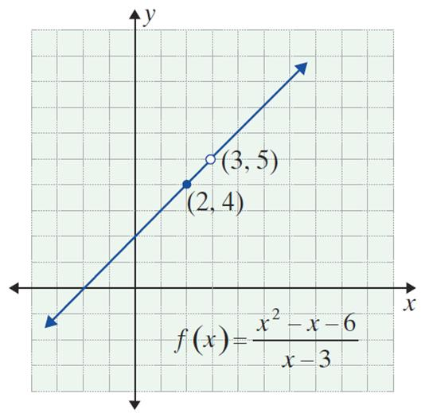
Example 8: Continuity (cont.)
Since is undefined,
f (x) is not continuous at x = 3.
The graph to the right shows a
missing point discontinuity at
x = 3.
Check Condition 1 by substituting x = 3.

Slide 32
Example 9: Graphing a Discontinuous Function
a. Use the definition of continuity to determine
whether the function continuous at x = 0.
Solution: Since is undefined, g is not
continuous at x = 0.
b. Draw the graph of g(x).
Solution: The graph can be found by using the definition of | x | (see Section 1.1) and rewriting the function as follows:

Slide 33
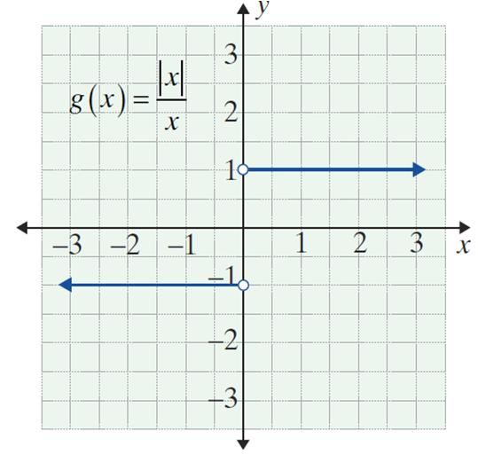
Example 9: Graphing a Discontinuous
Function (cont.)
The graph shows that g(x) has a jump discontinuity at x = 0.

Slide 34
Continuity
NOTES
Analysis shows, polynomial functions have no points of discontinuity. That is, for a polynomial function p,
for every real number a.

Slide 35
Continuity
Greatest-Integer Function
The function h(x) = [x] is called the greatest-integer function and is defined as follows:
h(x) = [x] = the greatest integer ≤ x.
Informally, h(x) = [x] is the integer closest to x but still less than or equal to x.

Slide 36
Example 10: Making a Function Continuous
Find a value for k so that the function
will be continuous at x = 2.
Solution:
f is defined in pieces, and each piece is a polynomial function. We must determine a value for k so that both pieces will have the same value when x = 2.

Slide 37
Example 10: Making a Function Continuous (cont.)
Set x² = −3x + k and substitute x = 2:
Thus the function f is continuous at x = 2.

Slide 38
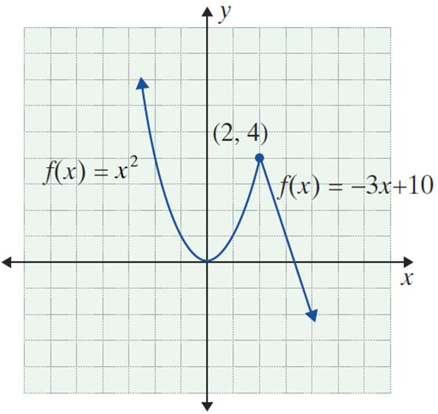
Example 10: Making a Function Continuous (cont.)
Graphically, we see that the two pieces “fit” together at the point (2, 4).

