Slide 1
Section 3.2
The Chain Rule and the General Power Rule

Slide 2
Objectives
Use the Chain Rule to find the derivative of a function.
Use the General Power Rule to find the derivative of a function.
Apply several rules in combination to find the derivative of a complex function.

Slide 3
The Chain Rule
The Chain Rule
If y = f(u) and u = g(x), then

Slide 4
Example 1: Using the Chain Rule
Solution:
Rewrite y using exponents.

Slide 5
Example 1: Using the Chain Rule (cont.)
Find the derivatives of each function by using the Power Rule from Section 2.3.
So, by the Chain Rule,

Slide 6
Example 1: Using the Chain Rule (cont.)
To evaluate this derivative at x = 2, we must first substitute it into the equation for u, and then substitute u and x into the equation of the derivative:
Substitute x = 2 into u.
Substitute u = 25 and x = 2 into the formula for the derivative.

Slide 7
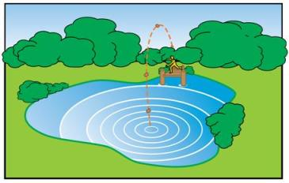
Example 2: Ripples on a Pond
A pebble is tossed into a still pond, and concentric circles are formed on the pond’s surface. The area of each circle depends on the radius of the circle, and each radius depends on the elapsed time. If the radius
is changing at the rate of
how fast is the area of the circle
growing when the radius is
3 feet?

Slide 8
Example 2: Ripples on a Pond (cont.)
Solution:
Recall that the area of a circle is given by the formula A = π r², where π ≈ 3.14. Differentiating A with respect to r gives
Since the radius is changing at the rate of
we have

Slide 9
Example 2: Ripples on a Pond (cont.)
Thus, by the Chain Rule,
Therefore, when r = 3,
The area of the circle is growing at the rate of
3π ft.² /sec (≈ 9.42 ft.²/sec).

Slide 10
The Chain Rule
The Chain Rule (Second Form)

Slide 11
Example 3: Second Form of the Chain Rule
Use the second form of the Chain Rule to find
Solution:
Let g(x) = x² + 3x − 7. Then we can write

Slide 12
Example 3: Second Form of the Chain Rule (cont.)
Using the second form of the Chain Rule, we get

Slide 13
Example 4: Second Form of the Chain Rule
Determine h′(5) if
Solution:

Slide 14
The General Power Rule
The General Power Rule

Slide 15
The General Power Rule
Notes
When using the General Power Rule, remember the order of steps:
1. First apply the Power Rule to
2. Then multiply by the derivative of g(x).

Slide 16
Example 5: The General Power Rule
Using the General Power Rule, find the derivative of each of the following functions.
Solution: Here
Substitute the following values into the General Power Rule:
n = 10,
g(x) = x² + 8x ,
n − 1 = 9,
g′(x) = 2x + 8.

Slide 17
Example 5: The General Power Rule (cont.)
Solution:
Rewrite the radical with a fractional exponent; then apply the General Power Rule.

Slide 18
Example 5: The General Power Rule (cont.)
Substitute the following values into the General Power Rule:

Slide 19
Example 6: The General Power Rule
Use the General Power Rule to find f ′(u) if
Solution:

Slide 20
Example 6: The General Power Rule (cont.)
Substitute the following values into the General Power Rule:

Slide 21
Example 7: Using Multiple Rules
Find
Solution:
Treat y as the product of two functions,
and and use the Product Rule. In using
the Product Rule, differentiate by using the General Power Rule.

Slide 22
Example 7: Using Multiple Rules (cont.)
Product Rule
To find g′(x), substitute the following values into the General Power Rule:

Slide 23
Example 7: Using Multiple Rules (cont.)
Using radical notation we have

Slide 24
Example 8: Using Multiple Rules
Find
Solution:
Apply the General Power Rule and the Quotient Rule.
Rewrite using exponents.
Apply the General
Power Rule.

Slide 25
Example 8: Using Multiple Rules (cont.)

Slide 26
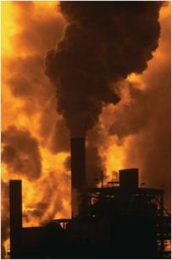
Example 9: Air Pollution
Suppose that the average measure of air
pollution in Sootville is given by the
formula
where t is time in years measured from
1980. How fast was this measure changing in 1988?
Solution: Find the derivative of P(t) by using the Quotient Rule and the General Power Rule.

Slide 27
Example 9: Air Pollution (cont.)
Rewrite using exponents.
Here the Quotient Rule and the General Power Rule are used in combination.
Factor out
Simplify.

Slide 28
Example 9: Air Pollution (cont.)
To find how fast this measure was changing in 1988 (8 years since 1980), evaluate the derivative for t = 8.
In 1988, the air pollution measure was increasing at a rate of 1.088 units per year.

