Slide 1
Section 3.3
Implicit Differentiation and Related Rates

Slide 2
Objectives
Use the method of implicit differentiation to solve for a derivative.
Apply the method of implicit differentiation to solve for real-life rates.

Slide 3
Implicit Differentiation
Notes
There are some cases, such as x² + y² = −1, where there are no real solutions and no function can be implied. However, the process of implicit differentiation may lead to apparently meaningful results. Such cases are not discussed in this text.

Slide 4
Implicit Differentiation
Notes
In general, we do not need to know the explicit
representation for y in order to obtain

Slide 5
Example 1: Derivative at a Point
Given the equation x² + y² = 25, find and then
evaluate the derivative at (4, 3) and (0, 5).
Solution:
Use the Sum and Difference Rule.
Differentiate. Use the Power Rule on the first term, implicit differentiation on the second term, and the rule that the derivative of a constant is 0 on the last term.

Slide 6
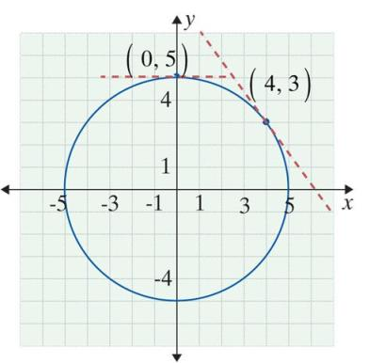
Example 1: Derivative at a Point (cont.)

Slide 7
Example 1: Derivative at a Point (cont.)
Finally, substitute the given x and y values of each point to evaluate the derivative at that point.
Note that is the slope of the tangent line to the
circle at (4, 3).

Slide 8
Example 2: Implicit Differentiation
Solution:
Note that both xy and x²y³ are products and that the Product Rule must be used.

Slide 9
Example 2: Implicit Differentiation (cont.)
Use the Sum and Difference Rule.
Differentiate. Use the Product Rule in combination with the General Power Rule on the first and second terms and the rule that the derivative of a constant is 0 on the remaining terms.

Slide 10
Example 2: Implicit Differentiation (cont.)

Slide 11
Example 3: Implicit Differentiation
Rewrite using exponents.
Use the Sum and Difference Rule.
Differentiate using the General Power Rule and the rule that the derivative of a constant is 0.

Slide 12
Example 3: Implicit Differentiation (cont.)
Rewrite using radicals.

Slide 13
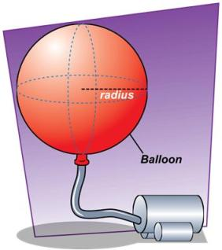
Example 4: Balloon Inflation
Suppose that a spherical balloon is inflated by a continuous flow of air from an air compressor at a rate of 2 in.³/sec. How fast is the radius of the balloon growing when the radius is 3 in.?
Solution:
We know that and
we want to find

Slide 14
Example 4: Balloon Inflation (cont.)
The formula for the volume of a sphere is
Write an equation.
Differentiate both sides of the equation with respect to t.
Use implicit differentiation.

Slide 15
Example 4: Balloon Inflation (cont.)
Now substitute and r = 3.
Therefore,

Slide 16
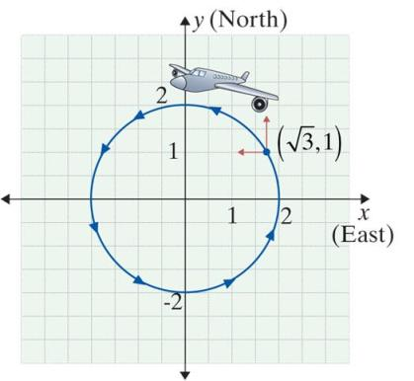
Example 5: Airplane Holding Pattern
An airplane is flying in a circular “holding” pattern with a radius of 2 miles. The path of the plane can be described by the equation
x² + y² = 4. When the plane is
at the point miles and
y = 1 mile, as shown in the
figure, it is traveling north at
300 mph. How fast is it
traveling west?

Slide 17
Example 5: Airplane Holding Pattern (cont.)
Solution:
Differentiating both sides of the equation x² + y² = 4 with respect to t gives
Use the Sum and Difference Rule.
Apply implicit differentiation.

Slide 18
Example 5: Airplane Holding Pattern (cont.)
Substituting
The plane is traveling west (in the negative x direction)
at a rate of

Slide 19
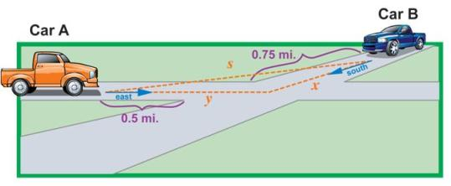
Example 6: Moving Cars
Two cars, A and B, are traveling toward the same intersection, and neither driver plans to stop. Car A is 0.5 miles from the intersection moving east at 40 mph, and Car B is 0.75 miles from the intersection moving south at 60 mph. How fast is the distance between the two cars changing?

Slide 20
Example 6: Moving Cars (cont.)
Solution: From the figure,
Differentiating with respect to t, we obtain
Note: as x and y are decreasing, their velocities are negative.

Slide 21
Example 6: Moving Cars (cont.)
Now, substituting
and
we find
The distance between the cars is decreasing at a rate of approximately 72.2 mph.

Slide 22
Related Rates
Cobb-Douglas Production Formula
where
P = number of units produced,
x = units of labor, and
y = units of capital.
C and a are constants, 0 < a < 1.

Slide 23
Example 7: Production
Suppose that a firm’s level of production is given by
where x represents the units of labor and y
represents the units of capital. Currently, the company is using 16 units of labor and 81 units of capital. If labor is increasing by 4 units per month, what must the change in units of capital per month be to maintain the current level of production?

Slide 24
Example 7: Production (cont.)
Solution:
The current level of production is
Since the current level of production is to be maintained, P is to remain constant at 1080. Thus we have

Slide 25
Example 7: Production (cont.)
We want to find Use implicit differentiation and
differentiate both sides of the simplified equation with respect to t.
Thus

Slide 26
Example 7: Production (cont.)
The Chain Rule gives
so

Slide 27
Example 7: Production (cont.)
We are given that x = 16, y = 81, and
Substituting in these values, we get:

Slide 28
Example 7: Production (cont.)
Because the derivative was negative, the capital must
decrease at a rate of units per month to keep
the current level of production.

