Slide 1
Section 3.4
Local Extrema and the First Derivative Test

Slide 2
Objectives
Define the increasing and decreasing intervals of a function.
Determine the critical values of a function.
Use the First Derivative Test to find local extrema of a function and use this information to sketch a graph of the function.

Slide 3
Increasing and Decreasing Functions
Increasing and Decreasing Intervals of a Function
Suppose that a function f is defined on the interval
(a, b).
1. If implies for every in (a, b), then f(x) is increasing on (a, b).
2. If implies for every in (a, b), then f(x) is decreasing on (a, b).

Slide 4
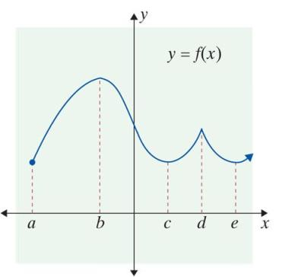
Example 1: Increasing and Decreasing Intervals
The graph of y = f(x) is given. Find the intervals on which a. f is increasing, and b. f is decreasing.
Solutions:
a. f is increasing on the intervals
(a, b), (c, d), and (e, +∞).
b. f is decreasing on the intervals
(b, c) and (d, e).

Slide 5
Increasing and Decreasing Functions
Notes
Positive values for the derivative indicate positive slopes for the tangent lines which in turn imply that the function is increasing. Negative values for the derivative indicate negative slopes for the tangent lines which imply that the function is decreasing.

Slide 6
Increasing and Decreasing Functions
Theorem
Suppose that f(x) is differentiable on the interval (a, b).
If is positive for all x in (a, b), then f is increasing on (a, b).
If is negative for all x in (a, b), then f is decreasing on (a, b).
Note: The values of x for which a function is increasing (or decreasing) are always presented as open intervals. These intervals are part (or all) of the domain of the function.

Slide 7
Example 2: Graphing a Function
For the function
a. Find all values of x that correspond to horizontal tangent lines. These values occur where the derivative is 0.
b. Use the values from part a. to find the open intervals on which the function is increasing and the open intervals on which the function is decreasing.
c. Sketch the graph of the function.

Slide 8
Example 2: Graphing a Function (cont.)
Solutions:
We set f ′(x) = 0 and solve for x:
Horizontal tangent lines occur at x = −2 and x = 2.
Find the derivative of f (x).

Slide 9
Example 2: Graphing a Function (cont.)
b. We can use a number line to help determine the intervals on which f ′(x) > 0 (and so f (x) is increasing) and those on which f ′(x) < 0 (and so f(x) is decreasing).
Mark the values for x where f ′(x) = 0 on a number line. In this case, they are x = 2 and x = −2 (this was determined in part a.). Then select any one test point in each interval and find the sign of f ′(x) at these test points by substituting the value into f ′(x).

Slide 10
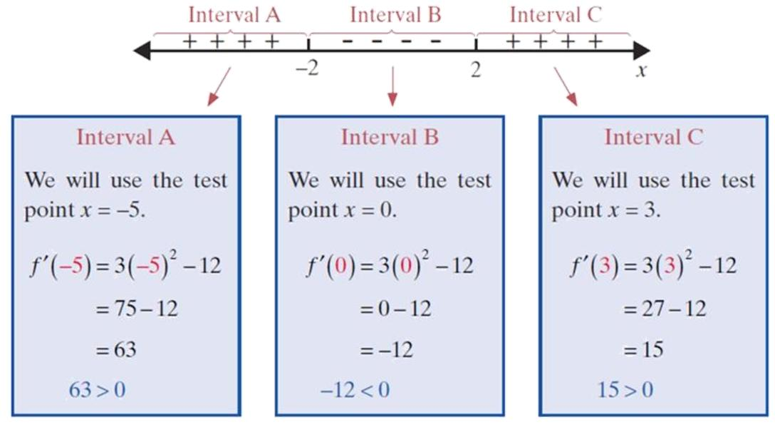
Example 2: Graphing a Function (cont.)

Slide 11
Example 2: Graphing a Function (cont.)
Since f ′(−5) is positive, mark interval A with + signs. Since f ′(0) is negative, mark interval B with − signs. Since f ′(3) is positive, mark interval C with + signs. Note that positive values for the derivative indicate that the function is increasing, and negative values for the derivative indicate that the function is decreasing.

Slide 12
Example 2: Graphing a Function (cont.)
c. The goal for the student is to use the information from parts a. and b. to sketch the curve without using a calculator. A secondary goal is to sketch the graph using as few (x, y)-coordinates as possible. We do need the important y-values corresponding to the maximum and to the minimum points (which have the horizontal tangents). We have f(−2) = 17 and f(2) = −15. We recommend in general that the student note the value of the y-intercept, f(0). Here f(0) = 1. With only these three coordinates, a smooth curve can be drawn (on one's paper).

Slide 13
Example 2: Graphing a Function (cont.)
The analysis shows that f increases left-to-right until
x = −2. At this value f reaches a local maximum of 17. Then f declines until, for x = 2, the value −15 is reached. Then f increases without bound.

Slide 14
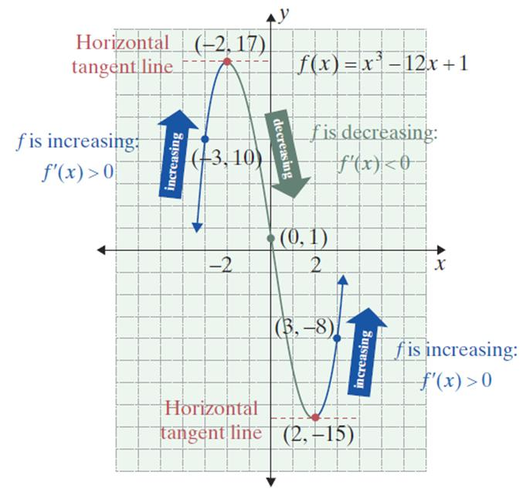
Example 2: Graphing a Function (cont.)
Notice how the pattern of the arrows from the final line graph in part
b. outlines the general shape of the curve sketched in part c.

Slide 15
Example 3: Graphing a Function
For the function
a. Find all values of x where the derivative is 0.
b. Determine where the function is increasing and where it is decreasing.
c. Sketch its graph.

Slide 16
Example 3: Graphing a Function (cont.)
Solutions:
A horizontal tangent line occurs at x = 0.

Slide 17
Example 3: Graphing a Function (cont.)
b. Mark the values for x where on a number
line. In this case, there is only one such point: x = 0 (this was determined in part a.). Select a test point
in each of the two intervals and find the sign of
at these test points by substituting the value into

Slide 18
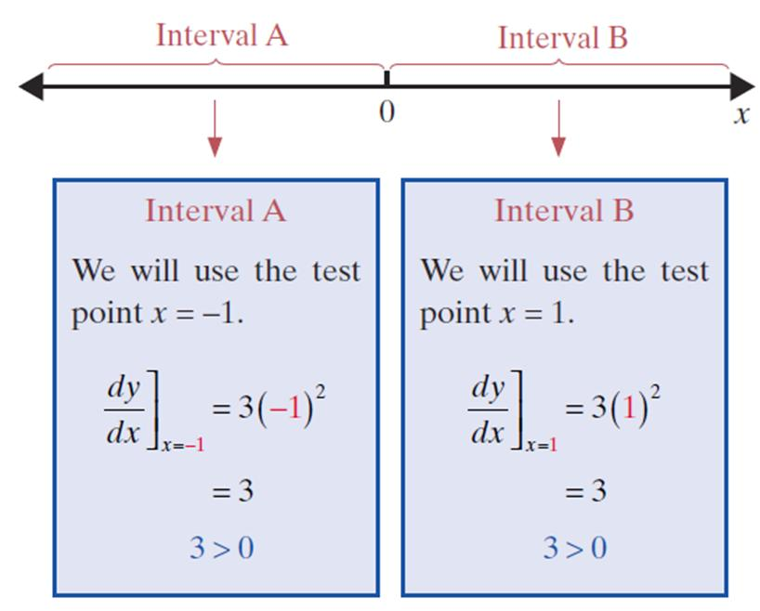
Example 3: Graphing a Function (cont.)

Slide 19
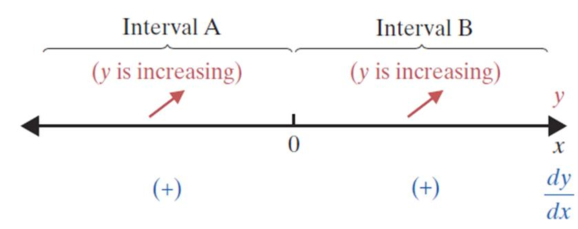
Example 3: Graphing a Function (cont.)

Slide 20
Example 3: Graphing a Function (cont.)
c. Part a. determined a horizontal tangent at x = 0, and part b. showed that y is increasing on the interval (−∞, +∞). (Note: since y is increasing on either side of 0, it is also increasing on any interval that contains 0.)

Slide 21
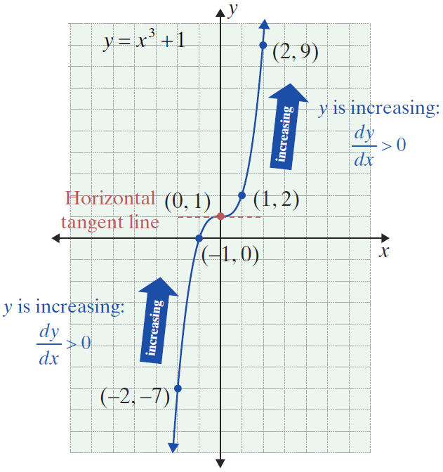
Example 3: Graphing a Function (cont.)

Slide 22
Example 4: Graphing a Function
For the function
a. Find all values of x where the derivative is 0.
b. Determine where the function is increasing and where it is decreasing.
c. Sketch its graph.
Solutions:
Rewrite f(x) using exponents.
Find the derivative of f(x).

Slide 23
Example 4: Graphing a Function (cont.)
There are no horizontal tangent lines. There are no x-values which will make the slope equal to 0 in the formula for f ′. However, we note there is no slope defined for x = 0. It turns out that we need to put on our slope analysis line not only x-values which make
f ′(x) = 0 but also any x-values for which f ′ is not defined. In this problem, x = 0 is the only point in either category, and we put x = 0 as the only point on the analysis line.

Slide 24
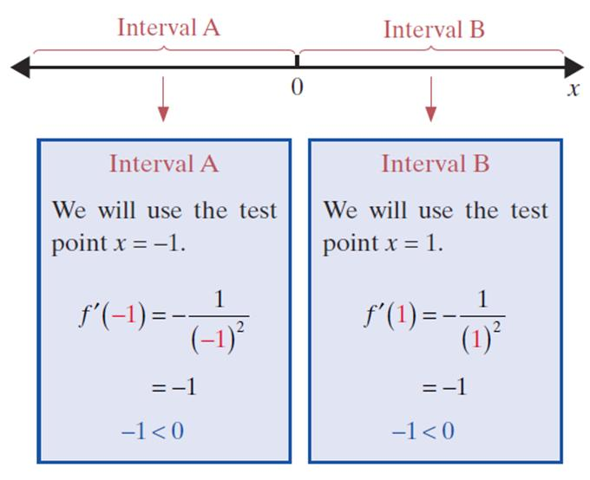
Example 4: Graphing a Function (cont.)
b. Note that we still investigate the derivative on either side of 0 to help determine the nature of the graph.

Slide 25
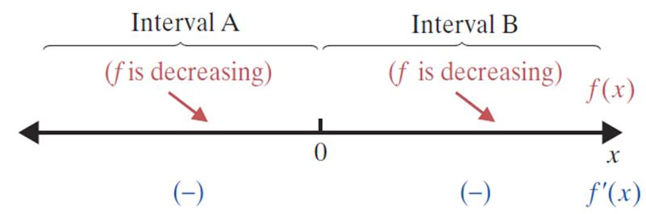
Example 4: Graphing a Function (cont.)

Slide 26
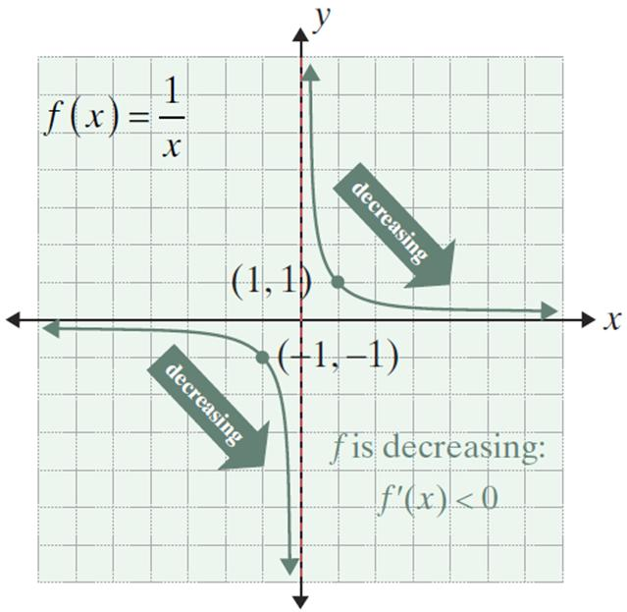
Example 4: Graphing a Function (cont.)
c.
The line x = 0 is a vertical asymptote. The curve approaches this line without touching it. There is also a horizontal asymptote at y = 0.

Slide 27
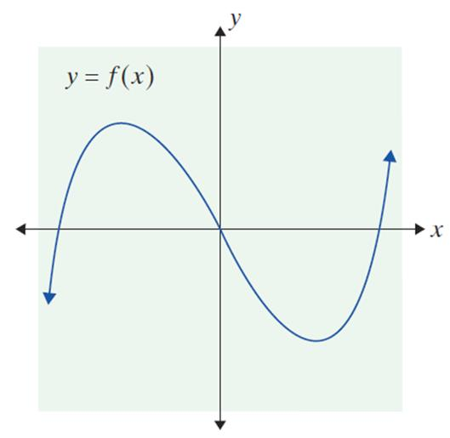
Example 5: Graphing f ’(x)
The graph for y = f(x) is given below. Mark the portions which show where f ′(x) is negative, positive, or zero. Draw a possible f ′(x) by
estimating the absolute values
of the slopes on f(x).

Slide 28
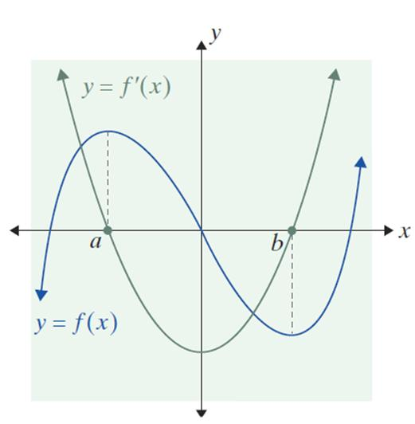
Example 5: Graphing f ’(x) (cont.)
Solution:
Let x = a and x = b (say a < b) denote the two x-values corresponding to the two
local extremes.
Then f ′(a) = f ′(b) = 0.
In between a and b, the y-values
decrease on the interval (a, b);
therefore y′ is negative. At x = b,
the y-values start to increase
(and y′ becomes positive).

Slide 29
Example 5: Graphing f ’(x) (cont.)
Thus the graph of y′ includes points (a, 0) and (b, 0) and lies below the x-axis (as y′ is negative) from x = a to
x = b. For x > b and x < a, the graph of y′ lies above the x-axis. We draw a smooth curve from (a, 0) to (b, 0) and extend it in both directions above the x-axis. The low point for y′ seems to occur near x = 0 because the graph of y is steepest near (0, 0).

Slide 30
Critical Values
Local Maximum and Local Minimum
Let f be a function defined at x = c.
1. f(c) is called a local maximum (or relative maximum) if there exists some interval (a, b) that contains c such that
for all x in (a, b). (We say a local maximum occurs at x = c.)

Slide 31
Critical Values
Local Maximum and Local Minimum (cont.)
2. f(c) is called a local minimum (or relative minimum) if there exists some interval (a, b) that contains c such that
for all x in (a, b). (We say a local minimum occurs at x = c.)

Slide 32
Critical Values
Local Maximum and Local Minimum (cont.)
Note: We also say that a local extremum occurs at the point (c, f(c)) or that the point (c, f(c)) is a local extremum, with the understanding that the y-value, f (c), is actually the local extremum.

Slide 33
Critical Values
Theorem of Local Extrema
If a function f is continuous on the interval (a, b) and c is in (a, b) and f(c) is either a local maximum or a local minimum, then
1. f ′(c) = 0, or
2. f ′(c) does not exist.

Slide 34
Critical Values
Critical Values
Critical values of x are those values c in the domain of f where f ′(c) = 0 (indicating horizontal tangent lines) or
f ′(c) does not exist (indicating vertical tangent lines or sharp points).

Slide 35
The First Derivative Test
The First Derivative Test for Local Extrema
To determine the local extrema for a nonconstant function f continuous on the interval (a, b):
1. Find the critical values, x-values c in (a, b) such that
f ′(c) = 0 or f ′(c) is undefined.

Slide 36
The First Derivative Test
The First Derivative Test for Local Extrema (cont.)
2. Draw an analysis line, and mark all critical x-values on it. Check the sign of f ′(x) on each side of x = c. If the sign changes,
i. from + to −, then f(c) is a local maximum.
ii. from – to +, then f(c) is a local minimum.
3. If there is no sign change for f′(x) from the left side of x = c to the right side, then f(c) is not a local extremum.

Slide 37
Example 6: Using the First Derivative Test
Let
a. Find the critical values of f.
b. Use the First Derivative Test to find any local extrema.
c. Sketch the graph of f.
Solutions:
Find the derivative of f(x).

Slide 38
Example 6: Using the First Derivative Test (cont.)
Set f ′(x) = 0 to find the critical values.
Thus the critical values are x = −1 and x = 3.
Multiply both sides by −1.
Factor.

Slide 39
Example 6: Using the First Derivative Test (cont.)
b. Step 1 of the First Derivative Test was completed in part a. Now we need to check the sign of f ′(x) on either side of the critical values (Step 2). Use the technique developed in Examples 1 − 4.

Slide 40
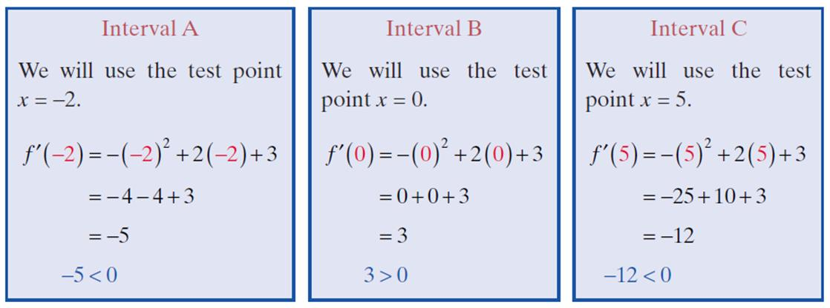
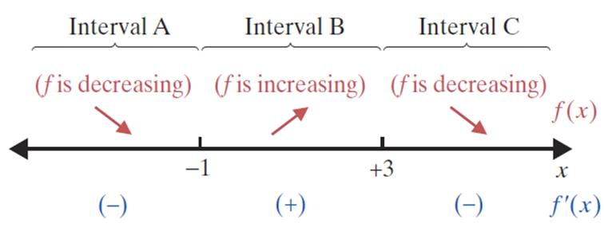
Example 6: Using the First Derivative Test (cont.)

Slide 41
Example 6: Using the First Derivative Test (cont.)
For both of the critical values, there is a sign change from one side of the value to the other. Therefore, local extrema occur at both x = −1 and x = 3 (Step 3).
We compute the y-values:
At x = −1:

Slide 42
Example 6: Using the First Derivative Test (cont.)
At x = 3:
(3, 10) is a local maximum.

Slide 43
Example 6: Using the First Derivative Test (cont.)
c. Use the following summary of information (from parts a. and b.) to sketch the curve.
1. f is decreasing on (−∞, −1).
2. f is increasing on (−1, 3).
3. f is decreasing on (3, +∞).
4. A local minimum occurs at the point
5. A local maximum occurs at the point (3, 10).

Slide 44
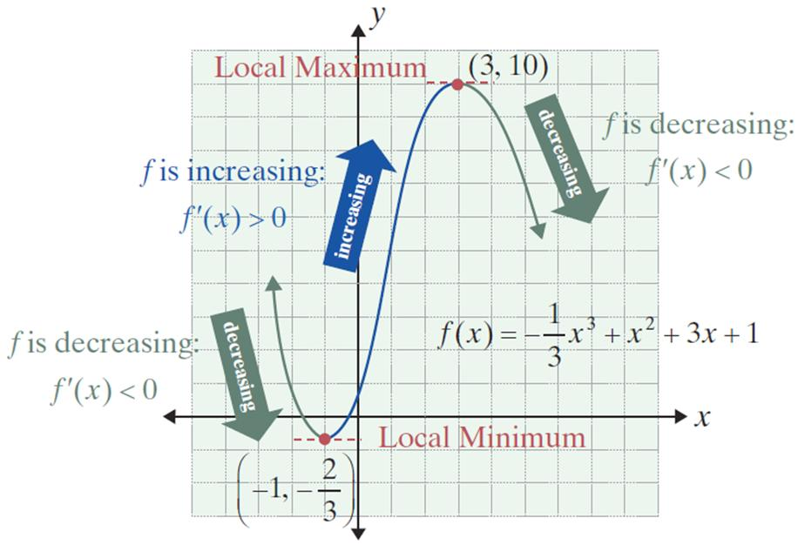
Example 6: Using the First Derivative Test (cont.)

Slide 45
Example 7: Using the First Derivative Test
Let
a. Find the critical values of f.
b. Use the First Derivative Test to find any local extrema.
c. Sketch the graph of f.
Solutions:
Set f ′(x) = 0 to find the critical values.
Find the derivative of f(x).

Slide 46
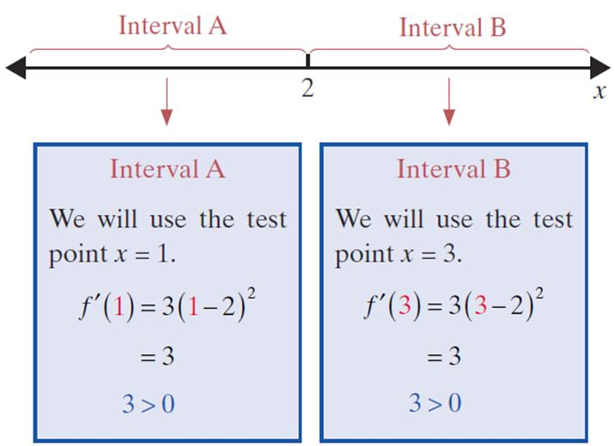
Example 7: Using the First Derivative Test (cont.)
b. Step 1 of the First Derivative Test was completed in part a. Now we need to check the sign of f ′(x) on either side of the critical value (Step 2).

Slide 47
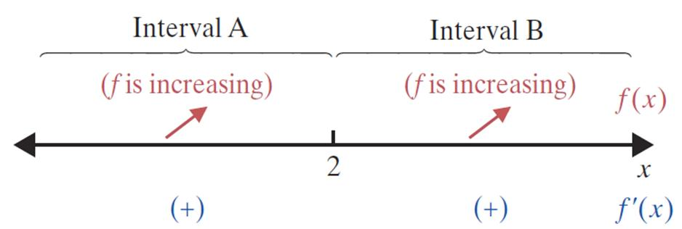
Example 7: Using the First Derivative Test (cont.)
Now we have, for all x. Since there is no sign change from one side of the critical value to the other, x = 2 is not a local extremum (Step 3).

Slide 48
Example 7: Using the First Derivative Test (cont.)
c. Use the following summary of information (from parts a. and b.) to sketch the curve.
1. f is increasing on (−∞, +∞).
2. f ′(2) = 0, but the point (2, 1) is not a local extremum.

Slide 49
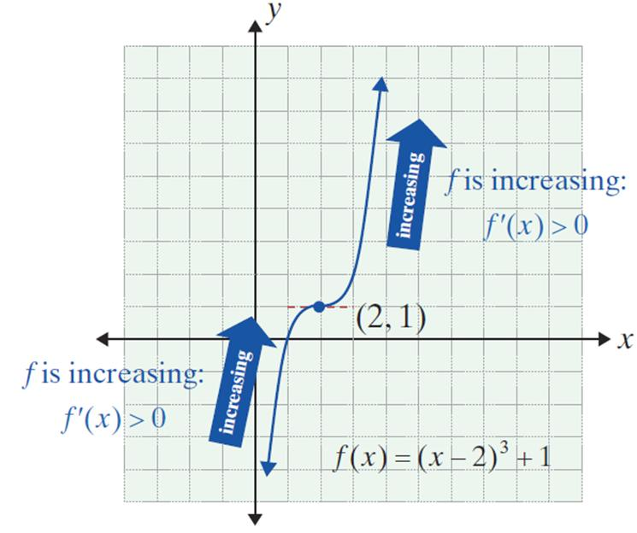
Example 7: Using the First Derivative Test (cont.)

Slide 50
Example 8: Critical Values
Find the critical values for the function
Solution:
Rewrite y using exponents.
Find the derivative of y.
y′ cannot equal 0. Recall, an algebraic fraction can be zero if and only if its numerator is zero.

Slide 51
Example 8: Critical Values (cont.)
Note that is undefined at x = 2 (and defined for all
other values of x). The original function, is also not defined at x = 2.
Therefore, x = 2 is not in the domain of the function and is not a critical value. There are no critical values. However, x = 2 is the only x-value "marked" on the analysis line because the derivative can change signs from positive to negative or vice versa only at x = 2.

Slide 52
Example 9: Critical Values
Find the critical values for the function
Solution:
In this case, y′ is not defined at x = 0. However, since x = 0 is in the domain of the original function, x = 0 is a critical value.
Find the derivative of y. Note: y′ cannot equal 0 since the numerator cannot equal 0.

Slide 53
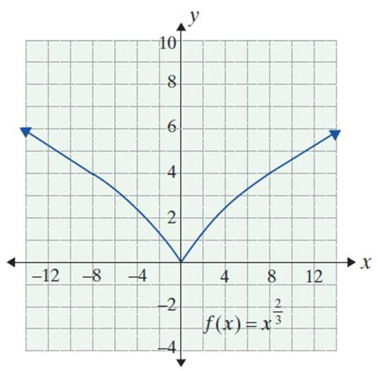
Example 9: Critical Values (cont.)
Also, because y′ is never equal to 0, there are no other critical values; only x = 0.
To the left of x = 0, f ′ is negative (y decreases).
To the right of x = 0, f ′ is positive (y increases). Near x = 0, the absolute values of slope are huge. We conclude there is a sharp point at x = 0, where x = 0 is a critical value.

