Slide 1
Section 4.1
Higher-Order Derivatives: Concavity and the Second Derivative Test

Slide 2
Objectives
Find the second derivative of a function.
Determine the concavity of a function.
Locate the points of inflection of a function by hand and by using a graphing calculator.

Slide 3
Higher-Order Derivatives
Notation for the Second Derivative
The second derivative of the function y = f(x) can be denoted by any of the following symbols:

Slide 4
Higher-Order Derivatives
NOTES
The notation deserves special attention. The
expression is called an operator and is meaningless
by itself. When applied to a function, it means to find the derivative of that function with respect to x.

Slide 5
Higher-Order Derivatives
NOTES (cont.)
Thus
indicates the derivative of This leads to the
following simplified notation:

Slide 6
Example 1: First and Second Derivatives
Find both the first and second derivatives of the function
f (x) = x³ − 12x + 1.
Solution:
Differentiate f (x).
Differentiate f ′(x).

Slide 7
Example 2: First and Second Derivatives
Solution:
Rewrite y using exponents.
Use the General Power Rule to find the first derivative of y.
Simplify.

Slide 8
Example 2: First and Second Derivatives (cont.)
In order to find we must take the derivative of
Since is a product of x and we use the
Product Rule to find When using the Product
Rule, differentiate by using the General Power Rule.
We have

Slide 9
Example 2: First and Second Derivatives (cont.)
f (x)
g′(x)
g(x)
f ′(x)
Use the Product Rule.
Use the General Power Rule to find g′(x).

Slide 10
Example 2: First and Second Derivatives (cont.)
Simplify.

Slide 11
Example 3: First and Second Derivatives
For the function find f ′(u) and f ′′(u).
Solution: In order to find f ′(u), we must use the Quotient Rule.
Denominator
Numerator ′
Numerator
Denominator ′
Numerator = u²
Denominator = u² − 9
Numerator′ = 2u
Denominator′ = 2u
Denominator squared

Slide 12
Example 3: First and Second Derivatives (cont.)
Simplify.
To find f ′′(u), we must again use the Quotient Rule. When using the Quotient Rule to find the derivative of this denominator, use the General Power Rule.

Slide 13
Example 3: First and Second Derivatives (cont.)
Numerator = −18u
Denominator = (u² − 9)²
Numerator′ = −18
Denominator′ = 2(u² − 9)(2u)
Denominator
Numerator ′
Numerator
Denominator ′
Denominator squared

Slide 14
Example 3: First and Second Derivatives (cont.)
Factor out
and cancel the
common factor.
Simplify.

Slide 15
Concavity
Concavity
Suppose that f is differentiable on the interval (a, b).
1. If f ′ is increasing on (a, b), then the graph of f is concave upward on (a, b).
2. If f ′ is decreasing on (a, b), then the graph of f is concave downward on (a, b).

Slide 16
Concavity
NOTES
If the graph is concave upward, we also say that f is concave upward. If the graph is concave downward, we say that f is concave downward. Alternatively, we can think of a function being "cupped up" where it is concave up and we may say a function is "cupped down" where it is concave down.

Slide 17
Concavity
Interpreting f ′′(x) to Determine Concavity
Suppose that f is a function and f ′ and f ′′ both exist on the interval (a, b).
1. If f ′′(x) > 0 for all x in (a, b), then f ′ is increasing and f is concave upward on (a, b).
2. If f ′′(x) < 0 for all x in (a, b), then f ′ is decreasing and f is concave downward on (a, b).

Slide 18
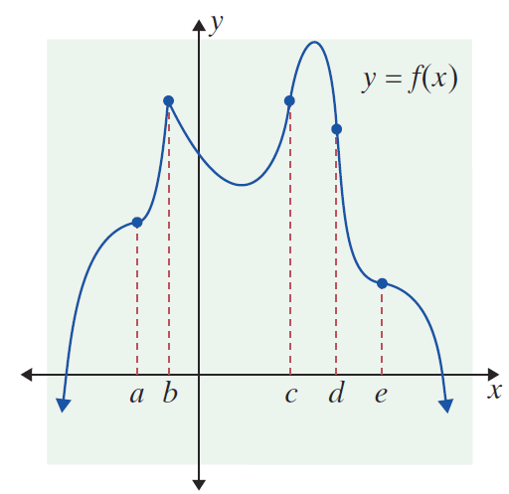
Example 4: Determining Concavity
In the figure shown, the graph of y = f (x) is given.
a. List the intervals on which f is concave upward.
b. List the intervals on which f is concave downward.

Slide 19
Example 4: Determining Concavity (cont.)
Solutions:
a. f is concave upward on the intervals (a, b), (b, c), and (d, e).
b. f is concave downward on the intervals (−∞, a), (c, d), and (e, +∞).

Slide 20
Concavity
NOTES
If one has a graph of y (and possibly y′) on a graphing utility, then one can use them to understand the ideas of this section. If a graphing utility is not accessible, one can use calculus to obtain quite accurate graphs of functions, even those not usually discussed in algebra classes.

Slide 21
Example 5: Sketching a Curve Using Concavity
For the function f (x) = x⁴ − 4x³,
a. Determine the intervals on which the function is concave upward and the intervals on which it is concave downward.
b. Use the information from part a. to draw a rough sketch of the graph of f (x).
Solutions:
a. To determine concavity, we must interpret f′′(x). First, we find the second derivative and then determine the intervals where it is positive and the intervals where it is negative.

Slide 22
Example 5: Sketching a Curve Using Concavity (cont.)
Now that we have determined f′′(x), set f ′′(x) = 0 and solve for x to find the endpoints of the intervals to be tested for concavity.
To find the second derivative, find the first derivative of f (x) and then find its derivative.

Slide 23
Example 5: Sketching a Curve Using Concavity (cont.)
So there are three intervals to be considered:
(−∞, 0), (0, 2), and (2, +∞).
The values of y ′′ in the interval (−∞, 0) are all positive or all negative. (If some were positive and some were negative, then there would have to be some other x-value, say b, such that f ′′(b) = 0. But there is no such x-value in that interval.) Similarly, in each interval, all the values of y ′′ are negative or all are positive. Therefore, for each interval, we choose one test value in the selected interval which seems convenient for calculation.

Slide 24
Example 5: Sketching a Curve Using Concavity (cont.)
We use this x-value, say x = a, to determine whether
f ′′(a) is positive or negative. If f ′′(a) is positive, then
f ′′(x) is positive for all x in that interval, and the graph of y is concave up for that interval. Likewise, if f ′′(a) is negative, then f ′′(x) is negative for all x in that interval, and the graph of y is concave down for that interval.

Slide 25
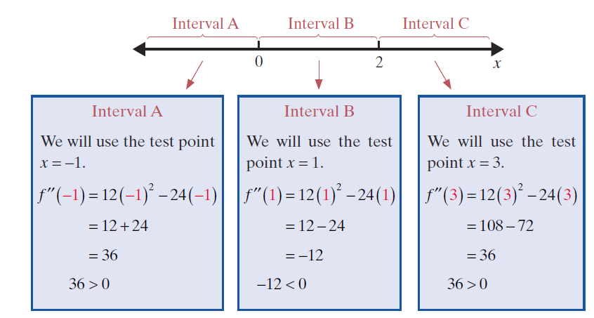
Example 5: Sketching a Curve Using Concavity (cont.)

Slide 26
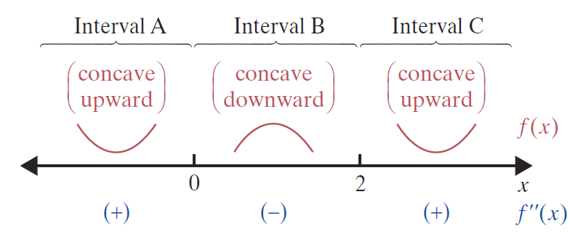
Example 5: Sketching a Curve Using Concavity (cont.)
f is concave upward on intervals (−∞, 0) and (2, +∞).
f is concave downward on interval (0, 2).

Slide 27
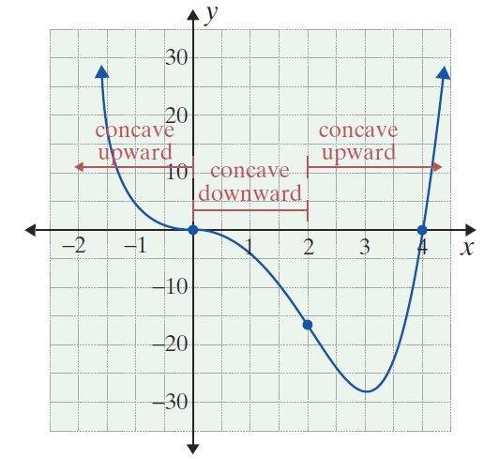
Example 5: Sketching a Curve Using Concavity (cont.)

Slide 28
Example 5: Sketching a Curve Using Concavity (cont.)
b. In making a rough sketch of a function using concavity, one wishes to calculate as few (x, y) points as possible. However, the y-intercept, (0, f(0)), is usually easy to calculate at a glance (without a calculator). Here f (0) = 0, so the origin is a point on the graph. Also, at x = 0, the graph changes concavity from concave up to concave down. Near the origin, the graph of f(x) must look like the sketch provided. We have calculated f (2) = −16, where the concavity changes from down to up.

Slide 29
Example 5: Sketching a Curve Using Concavity (cont.)
From the form of the polynomial f (x) = x⁴ − 4x³, we can say that eventually all the y-values are positive (since the term of largest degree is positive). This means that there is a global minimum to the right of (2, −16); after this point, y increases without further concavity changes. The x-intercept to the right of (2, −16) is easily found since there is no constant term for y.

Slide 30
Example 5: Sketching a Curve Using Concavity (cont.)
We set f (x) = 0 and solve by factoring.
So (4, 0) is a convenient reference point. We have calculated only three (x, y) values.

Slide 31
Points of Inflection
Point of Inflection
If the graph of a continuous function has a tangent line at a point (possibly a vertical line) and the graph changes concavity at that point, then the point is called a point of inflection.

Slide 32
Points of Inflection
NOTES
Hypercritical values of x are those values x = c in the domain of f where f ′′(c) = 0 or f ′′(c) does not exist. As we will see, points of inflection occur only at hypercritical values. It turns out, however, that hypercritical values do not guarantee points of inflection. Remember that at a point of inflection, the function must change concavity from up to down, or vice versa.

Slide 33
Points of Inflection
To Determine Points of Inflection
Suppose that f is a continuous function.
1. Find f ′′(x).
2. Find the hypercritical values of x. That is, find the values x = c where
a. f ′′(c) = 0, or
b. f ′′(c) is undefined.

Slide 34
Points of Inflection
To Determine Points of Inflection (cont.)
3. Using the hypercritical values as endpoints of intervals, determine the intervals where
a. f ′′(x) > 0 and f is concave upward, and
b. f ′′(x) < 0 and f is concave downward.
4. Points of inflection occur at those hypercritical values where f changes concavity. (See Figure 4.1.5.)

Slide 35
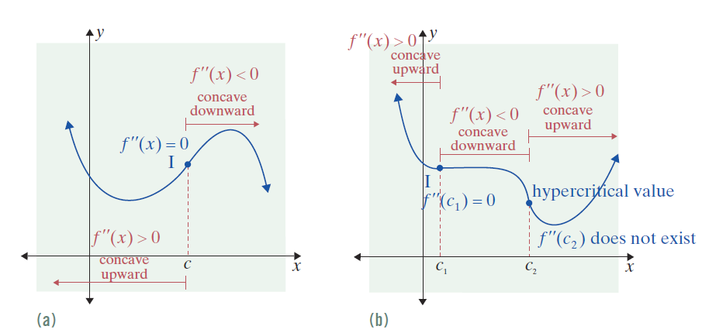
Points of Inflection
Figure 4.1.5

Slide 36
Example 6: Finding Points of Inflection
For the function
a. Determine the intervals on which f is concave upward and the intervals on which it is concave downward.
b. Locate any points of inflection.
Solutions: a. We find the hypercritical values and then determine the concavity on the related intervals.
To find the second derivative, find the first derivative of f (x) and then find its derivative.

Slide 37
Example 6: Finding Points of Inflection (cont.)
Now set f ′′(x) = 0.
There are two intervals to be considered:
Note that there are no values where f ′′(x) is undefined.

Slide 38
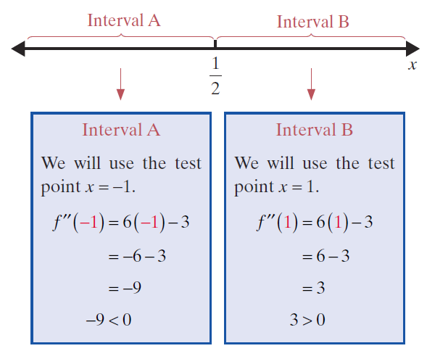
Example 6: Finding Points of Inflection (cont.)

Slide 39
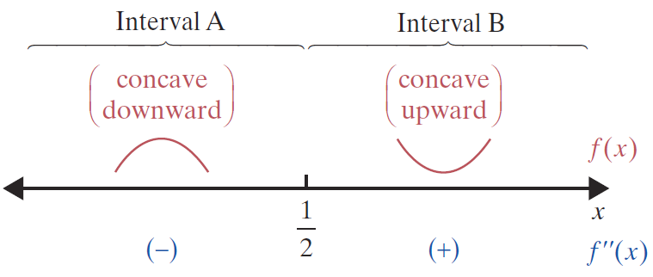
Example 6: Finding Points of Inflection (cont.)
f is concave upward on
f is concave downward on

Slide 40
Example 6: Finding Points of Inflection (cont.)
b. Since we found in part a. that f changes concavity at
there must be a point of inflection there.
Substitute into f (x) to
find the point of the inflection.

Slide 41
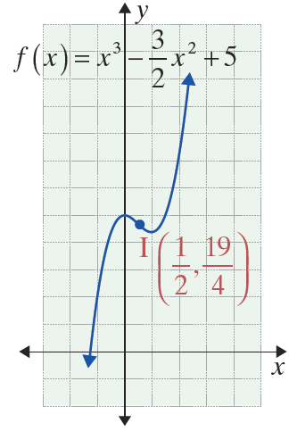
Example 6: Finding Points of Inflection (cont.)

Slide 42
Second Derivative Test for Local Extrema
Second Derivative Test for Local Extrema
Suppose that f is a function, f ′ and f ′′ exist on the interval (a, b), c is in (a, b), and f ′(c) = 0.
1. If f ′′(c) > 0, then f(c) is a local minimum.
(See Figure 4.1.8(a).)
2. If f ′′(c) < 0, then f(c) is a local maximum.
(See Figure 4.1.8(b).)
3. If f ′′(c) = 0, then the test fails to give any information about local extrema.

Slide 43
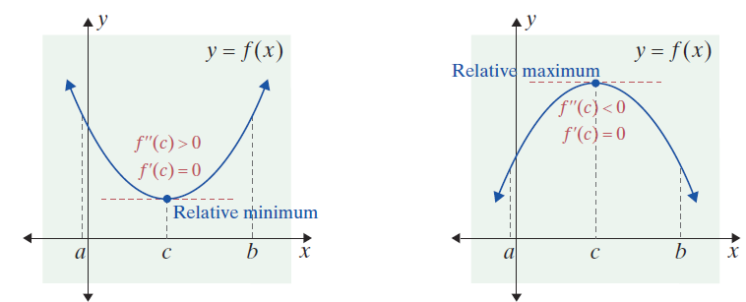
Second Derivative Test for Local Extrema
Figure 4.1.8
(a) Figure 4.1.8(a) suggests that f (x) must be concave upward (f ′′(c) > 0) if it has a relative minimum at x = c.
(b) Similarly, Figure 4.1.8(b) shows that at a relative maximum, x = c, f (x) must be concave downward (f ′′(c) < 0).

Slide 44
Second Derivative Test for Local Extrema
NOTES
The principle being applied in the Second Derivative Test is really very simple. If f ′′(c) is defined at a local maximum (c, f(c)), a curve is concave down. If f ′′(c) is defined at a local minimum (c, f(c)), a curve is concave up.

Slide 45
Example 7: Using the Second Derivative Test
For the function
a. Locate the local extrema.
b. Locate the points of inflection.
Solutions:
a. We will use the Second Derivative Test to find all local extrema of f (x).
First, find all values x = c so that f ′(c) = 0.

Slide 46
Example 7: Using the Second Derivative Test (cont.)
Substituting these x-values into f (x), the corresponding y-values are f (−3) = −81, f (0) = 0, and f (3) = −81.
Find the derivative of f (x).
Set f ′(x) = 0.

Slide 47
Example 7: Using the Second Derivative Test (cont.)
Now we need to determine how f′′(x) responds at these x-values.
Use the method for determining concavity in addition to the Second Derivative Test to interpret these results:
Find f ′′(x).
Substitute each of the values found for c: −3, 0, and 3.

Slide 48
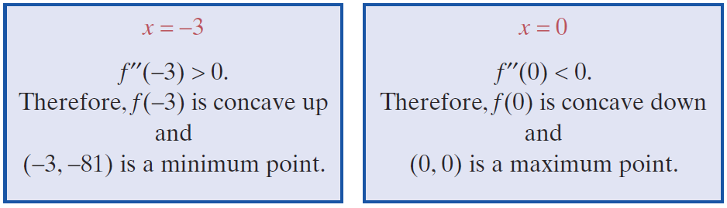
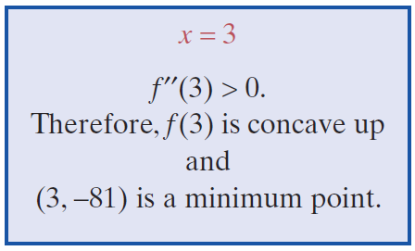
Example 7: Using the Second Derivative Test (cont.)

Slide 49
Example 7: Using the Second Derivative Test (cont.)
b. The points of inflection come from setting f ′′(x) = 0 and solving for x:
Set f ′′(x) = 0.

Slide 50
Example 7: Using the Second Derivative Test (cont.)
The corresponding y-values are
So the points of inflection are

Slide 51
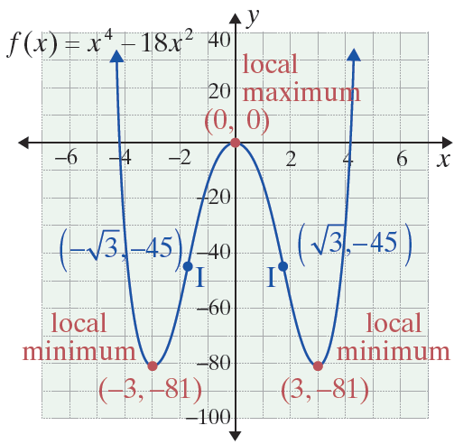
Example 7: Using the Second Derivative Test (cont.)
We point out that it is easy (without a graphing calculator) to sketch y = x⁴ − 18x². We need only the coordinates of the three extreme points, and we may sketch a smooth curve only knowing which is a maximum and/or a minimum. In this example, the potential inflection points occur between a maximum and a minimum point and so we “know” the concavity changes at these points.

Slide 52
Example 8: Locating Local Extrema
Locate the local extrema for the function
and sketch a graph of the function.
Solution:
Find f ′(x) and all values x = c where f ′(c) = 0.

Slide 53
Example 8: Locating Local Extrema (cont.)
Determine the corresponding y-values of x = 0 and x = 2.

Slide 54
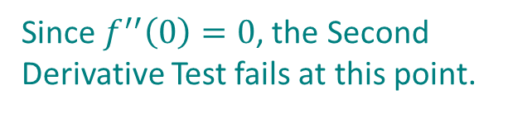

Example 8: Locating Local Extrema (cont.)
Now find f ′′(0) and f ′′(2) and apply the Second Derivative Test to interpret these points.
Substitute x = 0 and x = 2 into $f′′(x)$.
Since $f^{′′}\left(0\right)=0$, the Second Derivative Test fails at this point.

Slide 55
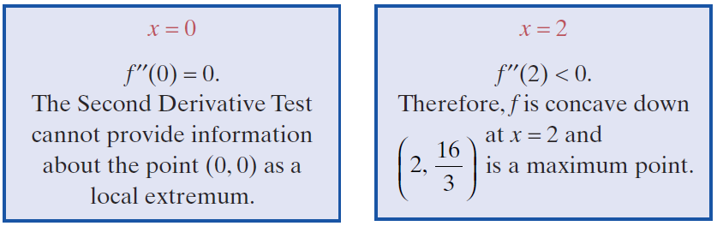
Example 8: Locating Local Extrema (cont.)
A local maximum occurs at the point

Slide 56
Example 8: Locating Local Extrema (cont.)
Because the Second Derivative Test provides no information about the point (0, 0) as a local extremum, we must use the First Derivative Test. Let us check the sign of f ′(x) on either side of 0 (Step 2 and Step 3 of the test). Using x = −1 and x = 1,
f ′(−1) = 12 (positive) and f ′(1) = 4 (also positive).
This shows that f increases to the left of x = 0 as well as to the right. Since there is no sign change from one side of f ′(0) to the other, x = 0 does not give a local minimum or a local maximum.

Slide 57
Example 8: Locating Local Extrema (cont.)
In fact, we have shown that slope is positive to the left of the origin, decreases to zero at the origin, and then increases to the right of the origin. This shows that the concavity changed at (0, 0) which must be a point of inflection.
Since the graph is concave up to the right of (0, 0), and
concave down at the maximum there must be
an inflection point in between these points. Set y′′ = 0 and solve for x.

Slide 58
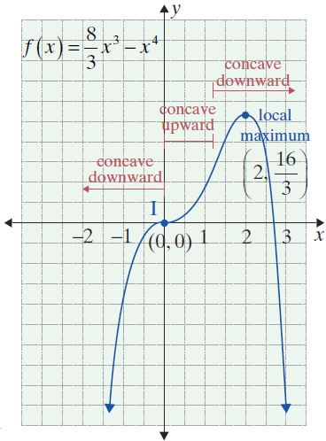
Example 8: Locating Local Extrema (cont.)
So is the other
inflection point. Note as a
check that is between
x = 0 and x = 2, which is already
known.

Slide 59
Second Derivative Test for Local Extrema
NOTES
The Second Derivative Test requires only one number to be checked. The First Derivative Test requires two numbers to be computed. For polynomial functions, the formula for f ′′ is one degree lower than that for f ′, so numbers are easier to calculate. For these reasons, the Second Derivative Test is usually preferred. However, sometimes, as in Example 8, it provides no information, and one must then use the First Derivative Test.

Slide 60
Application: Point of Diminishing Returns
Point of Diminishing Returns
The point of diminishing returns occurs at a point of inflection where the sales curve changes from concave upward to concave downward.

Slide 61
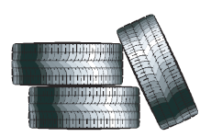
Example 9: Point of Diminishing Returns
Find the point of diminishing returns for the sales function
where x represents thousands of dollars spent on advertising, 0 ≤ x ≤ 80, and S is sales in thousands of dollars for automobile tires.

Slide 62
Example 9: Point of Diminishing Returns (cont.)
Solution:
To find the point at which concavity changes from concave upward to concave downward, we must first find the hypercritical values of x between 0 and 80. Then we determine whether these points are points of inflection.
Find S′(x).
Find S′′(x).

Slide 63
Example 9: Point of Diminishing Returns (cont.)
Note:
Testing shows that
S ′′(x) > 0 for 0 < x < 50
and
S ′′(x) < 0 for 50 < x < 80.
Set S ′′(x) equal to 0 to find the hypercritical values.

Slide 64
Example 9: Point of Diminishing Returns (cont.)
Concavity changes from upward on the left side of S(50) to downward on the other, signifying it is a point of diminishing returns.
Thus the point of diminishing returns is at (50, S(50)) = (50, 5100). At the point of diminishing returns, $50,000 is spent on advertising, and sales in tires are $5,100,000.

