Slide 1
Section 4.2
Curve Sketching: Polynomial Functions

Slide 2
Objectives
Sketch a polynomial function given a list of conditions.
Create your own list of conditions given a polynomial function, and sketch the graph of the function using this list.

Slide 3
Example 1: Curve Sketching
Sketch a continuous function that satisfies all the given conditions.
List of Given Conditions
1. f ′(x) > 0 for all x.
2. f ′′(3) = 0 and f(3) = 4.
3. f ′′(x) < 0 on (−∞, 3).
4. f ′′(x) > 0 on (3, +∞).

Slide 4
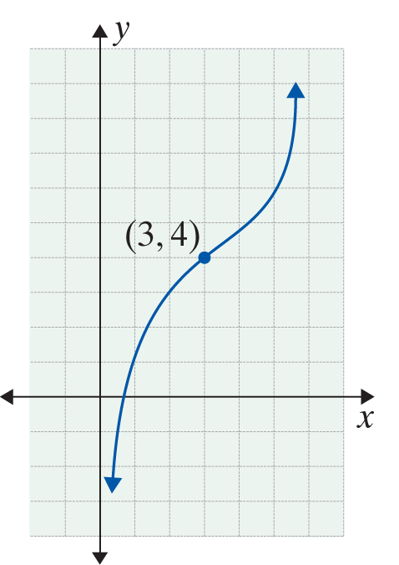
Example 1: Curve Sketching (cont.)
Solution:
Condition 1 means that f is increasing for all x. Conditions 2, 3, and 4 indicate that (3, 4) is a point of inflection and f is concave downward on (−∞, 3) and concave upward on (3, +∞).
One possible curve that satisfies all the given conditions is shown at right.

Slide 5
Example 2: Curve Sketching
Sketch a continuous function that satisfies all the given conditions.
List of Given Conditions
1. g(−1) = 2, g(0) = 1, g(1) = −2.
2. g′(0) = 0, g’(1) = 0.
3. g′′(0) = 0, g(.5) = 0.
4. g′′(x) < 0 if 0 < x < .5.
5. g′′(x) > 0 if x < 0 or x > .5.

Slide 6
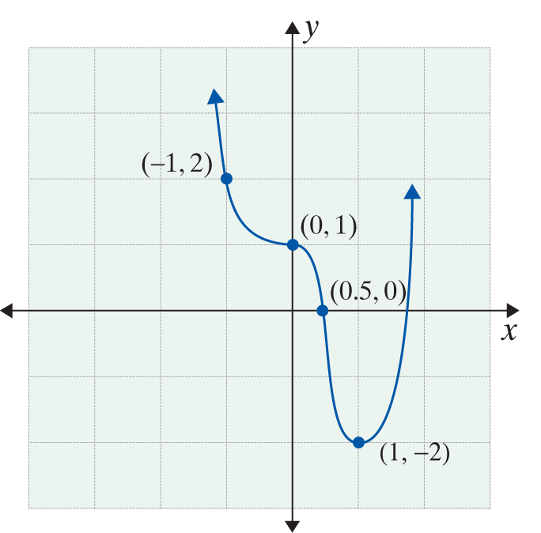
Example 2: Curve Sketching (cont.)
Solution:
In Condition 1, three points are given: (−1, 2), (0, 1), and (1, −2). There are horizontal tangent lines at x = 0 and x = 1 (Condition 2). Due to changes
in concavity inferred from Conditions 3 to 5, points (0, 1) and (0.5, 0) are points of inflection. We also know that a local minimum occurs at the point (1, −2) because the function is concave up by condition 5 but has zero slope by condition 2.

Slide 7
Curve Sketching
Strategy for Curve Sketching Given a Function f
To sketch the graph of a function f :
1. Find f ′(x) and f ′′(x).
2. Find the critical values of f. That is, find the values
x = c where
a. f ′(c) = 0, or
b. f ′(c) is undefined.

Slide 8
Curve Sketching
Strategy for Curve Sketching Given a Function f (cont.)
3. Using the critical values as endpoints, find intervals
a. where f ′(x) > 0 (f is increasing), and
b. where f ′(x) < 0 (f is decreasing).
4. Locate the local extrema using the First Derivative Test or the Second Derivative Test.
5. Find the hypercritical values of f. That is, find the values x = c where
a. f ′′(c) = 0, or
b. f ′′(c) is undefined.

Slide 9
Curve Sketching
Strategy for Curve Sketching Given a Function f (cont.)
6. Using the hypercritical values as endpoints, find intervals
a. where f ′′(x) > 0 (f is concave upward), and
b. where f ′′(x) < 0 (f is concave downward).
7. Locate all points of inflection. These occur at hypercritical values where the curve changes concavity.

Slide 10
Curve Sketching
Strategy for Curve Sketching Given a Function f (cont.)
8. Using the combined information from Steps 1 − 7 and any other specific points that might be helpful, sketch the graph. (A helpful point would usually be the y-intercept (0, f(0)) or an x-intercept: (a, f(a)) if f(a) = 0.)

Slide 11
Polynomial Functions
Notes
We make the following important statement without proof:
The graphs of polynomial functions are smooth, continuous curves, and f ′(x) and f ′′(x) are defined for all real x.

Slide 12
Example 3: Using the Strategy for Curve Sketching
Sketch the graph of the polynomial function
Solution: In this example several steps are listed together because the first and second derivatives are easily found.
Step 1: Find f ′(x) and f ′′(x).

Slide 13
Example 3: Using the Strategy for Curve Sketching (cont.)
Steps 2 and 3: Find the critical values and the intervals where f ′(x) > 0 and where f ′(x) < 0.
The critical value is x = 1.
Now we can determine the following:
If x < 1, then f ′(x) = 2(x − 1) < 0 and f is decreasing.
If x > 1, then f ′(x) = 2(x − 1) > 0 and f is increasing.
Find the critical values of f by setting f ′(x) = 0 and solving for x.

Slide 14
Example 3: Using the Strategy for Curve Sketching (cont.)
Step 4: Find all local extrema.
Find the corresponding y-value of the critical value.
The point (1, −4) is the local minimum.
Evaluate f′′(x) for the critical value to find the local extrema and use the Second Derivative Test.
local minimum

Slide 15
Example 3: Using the Strategy for Curve Sketching (cont.)
Steps 5, 6, and 7: Find the hypercritical values, the intervals where f ′′(x) > 0 and where f ′′(x) < 0, and all points of inflection.
For all x,
Thus f is concave up for all x, and there are no points of inflection.

Slide 16
Example 3: Using the Strategy for Curve Sketching (cont.)
Step 8: Sketch the graph.
Interval or Value | Derivative | Nature of Graph
(−∞, 1) | f ′(x) < 0 | Decreasing
(1, +∞) | f ′(x) > 0 | Increasing
x = 1 | f ′(1) = 0 | Local minimum
(−∞, +∞) | f ′′(x) = 2 > 0 | Concave up

Slide 17
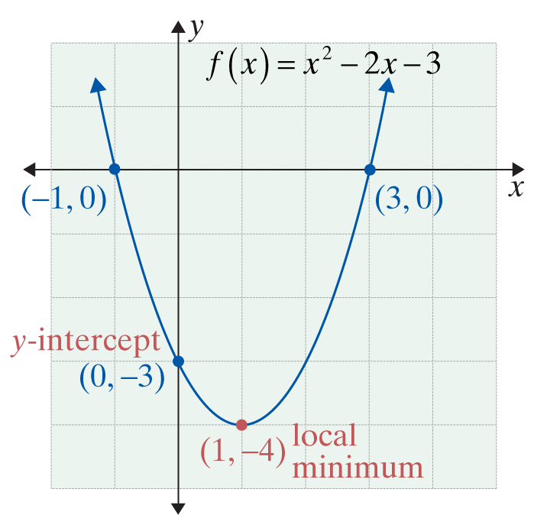
Example 3: Using the Strategy for Curve Sketching (cont.)
The graph is a parabola, which agrees with the fact that the graph of every second-degree polynomial function is a parabola.
Setting
gives (x + 1)(x − 3) = 0. So the x-intercepts are at x = −1 or
x = 3. We can also see from the graph that −4 is the absolute minimum value of f.

Slide 18
Example 4: Using the Strategy for Curve Sketching
Use the curve sketching strategy to sketch the graph of
the function
Solution:
Step 1: Find f ′(x) and f ′′(x).

Slide 19
Example 4: Using the Strategy for Curve Sketching (cont.)
Step 2: Find the critical values
The critical values are x = 1 and x = 3.
Find the critical values of f by setting f ′(x) = 0 and solving for x.

Slide 20
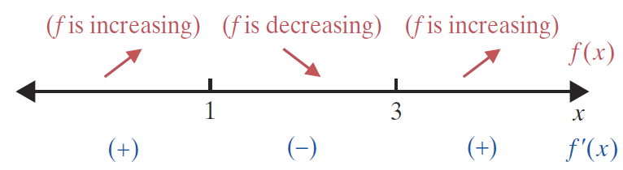
Example 4: Using the Strategy for Curve Sketching (cont.)
Step 3: Use the critical values x = 1 and x = 3 as endpoints of intervals where f ′(x) > 0 and where
f ′(x) < 0.

Slide 21
Example 4: Using the Strategy for Curve Sketching (cont.)
Step 4: Find all local extrema.
Evaluate f ′′(x) for the critical values to find the local extrema and use the Second Derivative Test.
local maximum
local minimum

Slide 22
Example 4: Using the Strategy for Curve Sketching (cont.)
Find the corresponding y-value for each of the critical values.
Therefore, is the local maximum and (3, 1) is the
local minimum.

Slide 23
Example 4: Using the Strategy for Curve Sketching (cont.)
Step 5: Find all hypercritical values.
There is one hypercritical value, x = 2.
Find the hypercritical values of f by setting
f ′′(x) = 0 and solving for x.

Slide 24
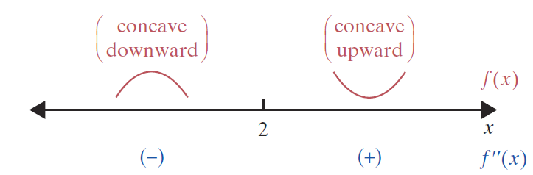
Example 4: Using the Strategy for Curve Sketching (cont.)
Step 6: Using the hypercritical value x = 2 as an endpoint of intervals, find the intervals where f ′′(x) > 0 and where f ′′(x) < 0.
f is concave down on the interval (−∞, 2) and concave up on the interval (2, +∞).

Slide 25
Example 4: Using the Strategy for Curve Sketching (cont.)
Step 7: Find all points of inflection.
Since f changes concavity at x = 2, the point is a point of inflection.
Find the corresponding y‑value of the hypercritical values.

Slide 26
Example 4: Using the Strategy for Curve Sketching (cont.)
Step 8: Sketch the graph. The following table summarizes the information found in Steps 1 − 7.
Interval or Value | Derivative | Nature of Graph
(−∞, 1) or (3, +∞) | f ′(x) > 0 | Increasing
(1, 3) | f ′(x) < 0 | Decreasing
x = 1 | f ′(1) = 0 | Local maximum
x = 3 | f ′(3) = 0 | Local minimum
(−∞, 2) | f ′’(x) < 0 | Concave down
(2, +∞) | f ′’(x) > 0 | Concave up
x = 2 | f ′’(2) = 0 | Point of inflection

Slide 27
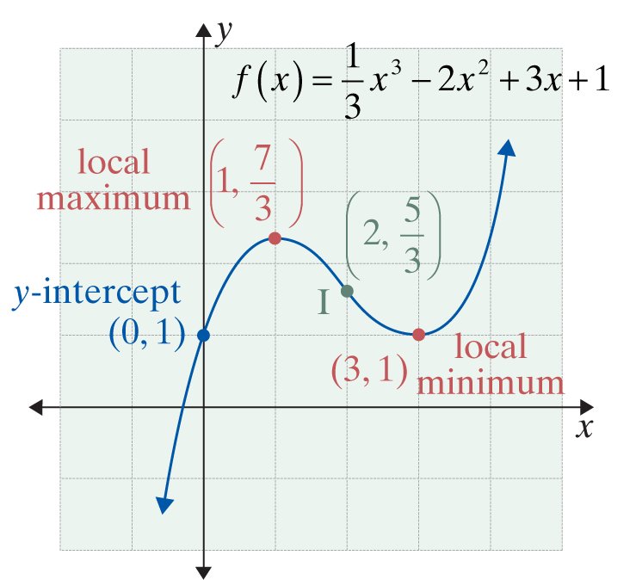
Example 4: Using the Strategy for Curve Sketching (cont.)

Slide 28
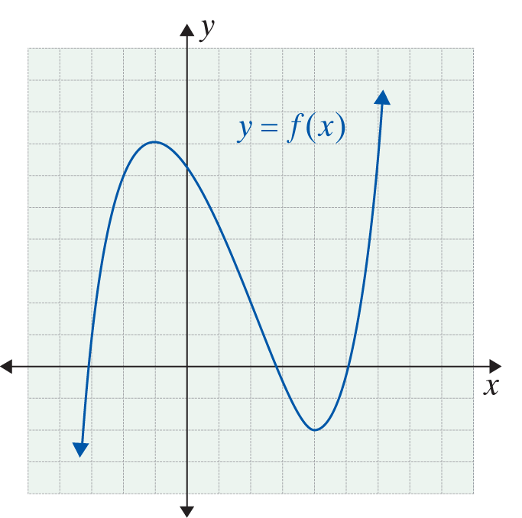
Example 5: Graphing the Derivative
For the function graphed at right:
a. Identify the local extrema and
locate the point(s) of inflection.
b. Determine the intervals on
which f(x) is increasing and on
which f(x) is decreasing, and
identify the intervals on which
f(x) is concave upwards and
concave downwards.
c. Sketch on the same coordinate axis a possible graph of f ′(x).

Slide 29
Example 5: Graphing the Derivative (cont.)
Solutions:
a. A local maximum is located at (−1, 7), and a local minimum is located at (4, −2). There is a point of inflection at about (1.5, 3.5).
b. The function is increasing on the intervals (−∞, −1) and (4, +∞). It is decreasing on the interval (−1, 4). The function is concave downwards on the interval (−∞, 1.5) and concave upwards on (1.5, +∞).

Slide 30
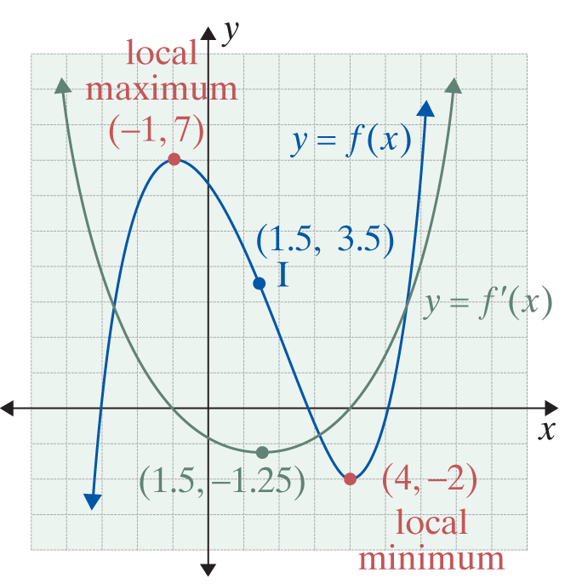
Example 5: Graphing the Derivative (cont.)
c. The slope of f(x) is positive but decreasing from −∞ < x < −1, and is 0 at x = −1. The slope then becomes negative and continues decreasing until x = 1.5, at which point slope is a minimum.
Then the slope starts to increase from some negative value (which we estimate to be −1.25) to 0 (at x = 4). It then becomes positive and continues increasing.

