Slide 1
Section 4.4
Business Applications

Slide 2
Objectives
Minimize inventory costs of a business.
Determine the price a company should charge for their product in order to maximize revenue.
Find a company’s maximum profit assuming the demand function is linear.

Slide 3
Example 1: Minimizing Inventory Costs
A furniture dealer sells 500 desks per year. The desks take up floor space and warehouse space, and the dealer estimates his storage costs at $6 per desk. The distributor charges the dealer a $60 fee for each order. How many times per year and in what lot size should the dealer order to minimize inventory costs?

Slide 4
Example 1: Minimizing Inventory Costs (cont.)
Solution:
Using the given information, we can determine a function for the inventory costs, C(x). Let x = lot size.
Then is the number of orders per year, and is
average inventory.

Slide 5
Example 1: Minimizing Inventory Costs (cont.)
The number of desks ordered is between 1 and 500. At the extremes, one order for 500 desks would cost
and 500 orders for one desk at a time would cost
Now we need to differentiate C(x) so we can determine the local minima.

Slide 6
Example 1: Minimizing Inventory Costs (cont.)
Differentiating C(x) gives the following results.
Rewrite C(x) using exponents.

Slide 7
Example 1: Minimizing Inventory Costs (cont.)
Setting C′(x) = 0 gives

Slide 8
Example 1: Minimizing Inventory Costs (cont.)
x = −100 is not in the interval [1, 500], so x = 100. Substituting this value into the equation for the number of orders per year, we get:

Slide 9
Example 1: Minimizing Inventory Costs (cont.)
To minimize inventory costs, the dealer should order 100 desks at a time, 5 times per year. The minimum inventory costs are
Substitute x = 100 into C(x) to find the minimum inventory costs.

Slide 10
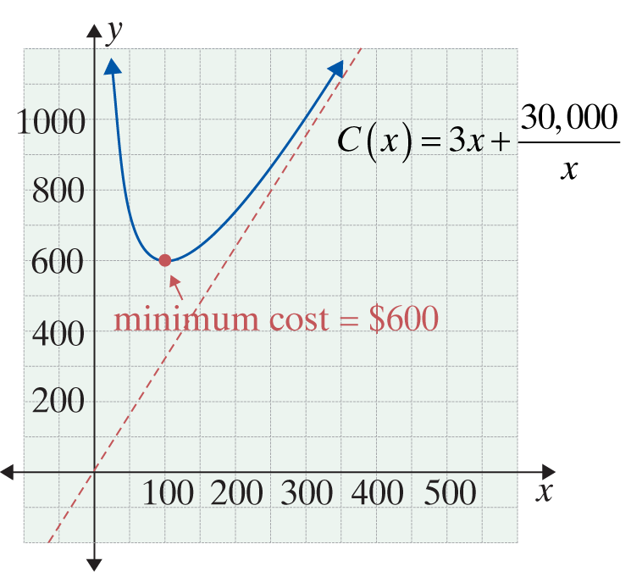
Example 1: Minimizing Inventory Costs (cont.)
Since we are dealing with the closed interval [1, 500] and C(1) = $1560 and C(500) = $30,003,
C(100) = $600 is also the absolute minimum.

Slide 11
Example 2: Maximizing Revenue
Susan knows that she can sell 440 tacos a day at 50 cents per taco. What price should she charge to maximize her revenue if, for every increase of 10 cents in price, she sells 40 fewer tacos? What will this revenue be?

Slide 12
Example 2: Maximizing Revenue (cont.)
Solution:
Let x = number of 10-cent increases in price. (The choice of x here does not represent the unknown price but the number of price increases. This choice for x makes the equation relatively easy to set up.) Then

Slide 13
Example 2: Maximizing Revenue (cont.)
Therefore,

Slide 14
Example 2: Maximizing Revenue (cont.)
Differentiating R(x), we get
R′(x) = 24 − 8x.
Setting R′(x) = 0 gives
We can verify that x = 3 is a maximum by the Second Derivative Test: R′′(x) = −8 < 0 for all x. Therefore, x = 3 does indeed give a maximum revenue.

Slide 15
Example 2: Maximizing Revenue (cont.)
Thus there should be three 10-cent increases in price. The new price should be
$0.50 + $0.10(3) = $0.80 per taco.
The sales will then be
440 − 40(3) = 320 tacos,
and the maximum revenue will be
R(3) = (0.80)(320) = $256.

Slide 16
Example 3: Finding Maximum Revenue With a Linear Demand Function
A company sells 3000 calculators per month when the price is $7 per calculator. When the price is lowered to $4 per calculator, 6000 are sold. The maximum number of calculators the company can manufacture is 7000 per month. Assuming that the demand function is linear, determine how many calculators the company should produce and sell per month in order to maximize revenue.

Slide 17
Example 3: Finding Maximum Revenue With a Linear Demand Function (cont.)
Solution:
The two points (3000, 7) and (6000, 4) can be used to find the linear demand function.
First, we will use these points in the formula for slope,
and then we will use the point-slope
form for the equation of a line, y − y₁ = m(x − x₁). For this example we use the points in the form (x, p) instead of (x, y).

Slide 18
Example 3: Finding Maximum Revenue With a Linear Demand Function (cont.)

Slide 19
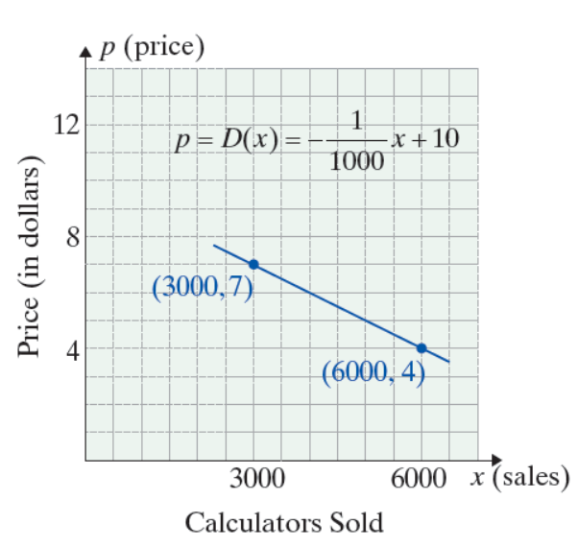
Example 3: Finding Maximum Revenue With a Linear Demand Function (cont.)
D(x) is the demand function where
x = number of calculators sold, and p = price per calculator.

Slide 20
Example 3: Finding Maximum Revenue With a Linear Demand Function (cont.)
The revenue function is then,

Slide 21
Example 3: Finding Maximum Revenue With a Linear Demand Function (cont.)
Differentiating R(x) gives
Setting R′(x) = 0 and solving for x gives

Slide 22
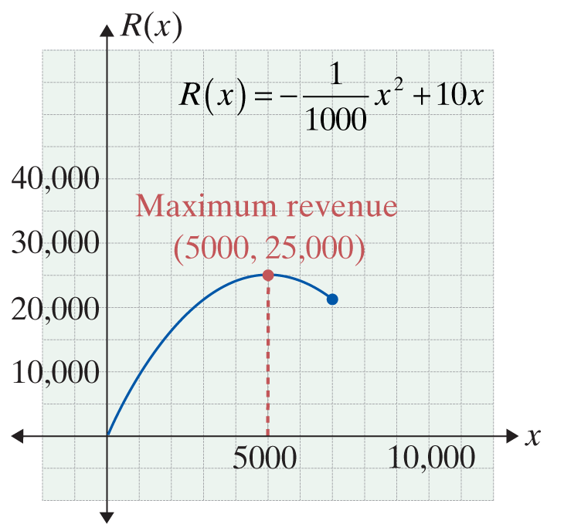
Example 3: Finding Maximum Revenue With a Linear Demand Function (cont.)
The company should produce 5000 calculators and sell them at a price of
for the maximum revenue of
R(5000) = 5000 ⋅ 5
= $25,000 per month.

Slide 23
Example 4: Finding Maximum Profit With a Linear Demand Function
Suppose that the company in Example 3 has a cost function C(x) = 5000 + 3x. How many calculators should the company produce and sell to maximize profit?
Solution:
Find the profit function:

Slide 24
Example 4: Finding Maximum Profit With a Linear Demand Function (cont.)
Differentiate P(x):
Set P′(x) equal to 0, and solve for x:

Slide 25
Example 4: Finding Maximum Profit With a Linear Demand Function (cont.)
Thus, a maximum profit occurs if the company produces and sells 3500 calculators, which is only half its production capabilities. The price for each calculator would be
The graph on the next slide illustrates the relationship between profit, revenue, and cost.

Slide 26
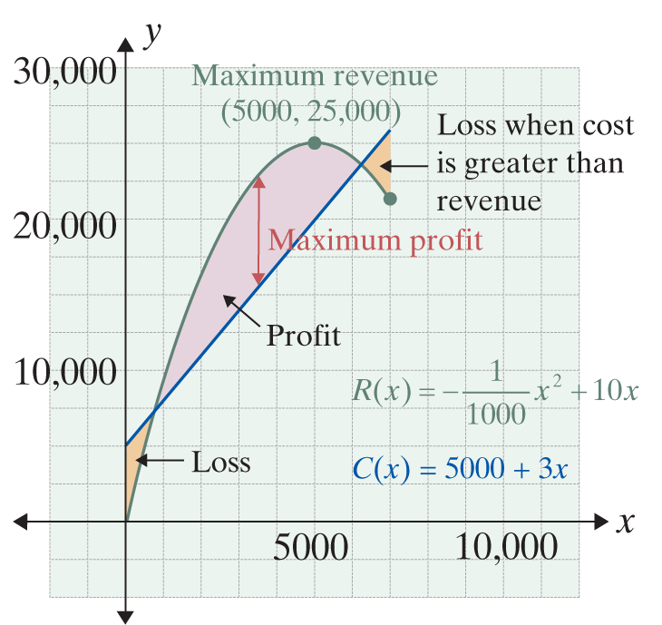
Example 4: Finding Maximum Profit With a Linear Demand Function (cont.)
Note that maximum revenue and maximum profit do not necessarily occur at the same level of production and sales.

