Slide 1
Section 5.1
Exponential Functions

Slide 2
Objectives
Define exponential functions.
Discuss characteristics of exponential functions and their graphs.

Slide 3
Exponential Functions
Exponential Function with Base b
A function of the form
where b is a positive real number, b ≠ 1, and c and r are real constants, is called an exponential function with base b.

Slide 4
Exponential Functions
Properties of Exponential Functions
For any exponential function the following properties are true.
1. The domain is the set of all real numbers.
2. The range is the set of all positive real numbers when c > 0.
3. The y-intercept is the point (0, c).
4. The x-axis is a horizontal asymptote.
5. The function is continuous for all real x.

Slide 5
Exponential Functions
Properties of Exponential Functions (cont.)
6. Suppose the base b is greater than 1. Then, when
c = 1 and r = 1, the slope is positive, and y is increasing and concave up.
7. Suppose the base b satisfies 0 < b < 1. Then, when c = 1 and r = 1, the slope is negative, and y is decreasing and concave up.

Slide 6
Example 1: Graphing an Exponential Function
Suppose
a. Find f(−1), f(0), and f(1).
b. Find g(−1), g(0), and g(1).
c. Sketch the graphs of both functions.
Solution:
Substitute x = −1 into f(x).
Substitute x = 0 into f(x).
Substitute x = 1 into f(x).

Slide 7
Example 1: Graphing an Exponential Function (cont.)
Substitute x = −1 into g(x).
Substitute x = 0 into g(x).
Substitute x = 1 into g(x).

Slide 8
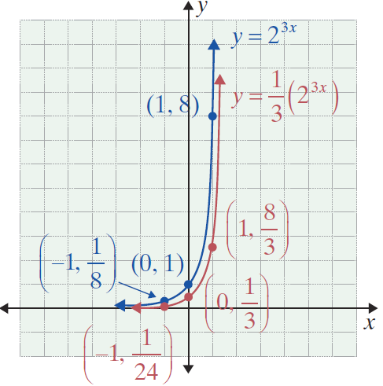
Example 1: Graphing an Exponential Function (cont.)
c.

Slide 9
Compound Interest
Compound Interest Formula
For principal P invested at annual rate r (in decimal form) compounded n times per year for t years, the amount A is given by

Slide 10
Example 2: Compound Interest
Suppose that $1000 is invested at 12 percent compounded quarterly. What will be the value of the investment in a. 1 year? b. 3 years?
Solutions:
a. Use P = 1000, r = 0.12, n = 4, and t = 1.
The amount is $1125.51 at the end of 1 year.

Slide 11
Example 2: Compound Interest (cont.)
b. Use P = 1000, r = 0.12, n = 4, and t = 3.
The amount is $1425.76 at the end of 3 years.

Slide 12
The Number e
Definition of e

Slide 13
The Function f(x) = e^{x}
Continuous Compound Interest Formula
For principal P invested at annual rate r (in decimal form) compounded continuously for t years, the amount A is given by

Slide 14
Example 3: Investment Value
If $5000 is invested at 8 percent, what will be the value of the investment at the end of 5 years if the interest is
a. compounded quarterly?
b. compounded continuously?
Solutions:
Use the compound interest formula.
P = 5000, r = 0.08,
n = 4 (for quarterly compounding), and
t = 5.

Slide 15
Example 3: Investment Value (cont.)
You may find it interesting to note that the difference in interest is only about $30, even after 5 years.
Use the continuous compound interest formula.
P = 5000, r = 0.08, and t = 5.
A calculator can be used to find the value of e^{0.4}.

Slide 16
Example 4: Initial Deposit Amount
Suppose that the grandparents of a child would like to make a one-time investment now so that they can help provide for the child’s college education in 20 years. How much should they deposit in an account earning 10 percent interest compounded continuously so that the value of the account will accumulate to $20,000?
Solution:
We use A = 20,000, r = 0.10, and t = 20.

Slide 17
Example 4: Initial Deposit Amount (cont.)
That is, $2706.71 (invested at 10 percent compounded continuously for 20 years) is the present value of $20,000.

