Slide 1
Section 5.3
Differentiation of Logarithmic Functions

Slide 2
Objectives
Differentiate logarithmic functions.
Use curve sketching techniques to graph logarithmic functions.

Slide 3
The Derivative of y = ln x
Derivative of ln x
If f(x) = ln x, then

Slide 4
Example 1: Finding the Derivative
Solution:
By the Sum and Difference Rule.

Slide 5
Example 2: Finding the Derivative
Solution:
By the Product Rule.

Slide 6
Example 3: Equation of a Tangent Line
Find the equation of the tangent line to y = ln x at the point (5, 1.61). (ln 5 is actually equal to 1.609437912... but round off to two decimal places here.)
Solution:
For f(x) = ln x, the slope we need is In point-slope form, we have
Use the given (x, y)‑coordinate (5, 1.61) in the point‑slope formula as well as

Slide 7
The Derivative of y = ln(g(x))
Derivative of ln (g(x))
If y = ln(g(x)), then

Slide 8
Example 4: Finding the Derivative
Solution:
So

Slide 9
Example 4: Finding the Derivative (cont.)
Solution:
We simplify first to obtain
Now, differentiating with we have

Slide 10
Example 5: Using Logarithmic Differentiation
Use logarithmic differentiation to find f ′(x), given that
Solution:
Take the natural logarithm of both sides and simplify.

Slide 11
Example 5: Using Logarithmic Differentiation (cont.)

Slide 12
Example 5: Using Logarithmic Differentiation (cont.)
Now differentiate both sides.

Slide 13
Example 6: Locating Absolute Extrema
Find the absolute extrema for the function
on the interval [0.1, 2.0].
Solution:
The function is a continuous function over the interval (0, +∞), so it has an absolute maximum and an absolute minimum on the closed interval [0.1, 2.0]. We know from Example 2 that

Slide 14
Example 6: Locating Absolute Extrema (cont.)
Setting f ′(x) = 0 gives
x cannot be 0.
Solve 1 + 2 ln x = 0 for x to find the critical value.

Slide 15
Example 6: Locating Absolute Extrema (cont.)
0.1
0.61
2.0
Evaluate f(x) at the critical values. (Remember, these include the endpoints of the function’s interval.)
The absolute minimum is −0.18 and occurs at x = 0.61. The absolute maximum is 2.77 and occurs at x = 2.0.

Slide 16
Example 7: Graphing Logarithmic Functions
Using the curve sketching techniques discussed in Chapter 4, sketch the graph of the function f(x) = x ln x.
Solution:
The domain is the interval (0, +∞) because ln x is defined only for positive values of x.
Find the critical value(s) by setting f ′(x) equal to 0 and solving for x.

Slide 17
Example 7: Graphing Logarithmic Functions (cont.)
Using the critical value as well as the endpoint
x = 0, we have two intervals to test.
By testing values, we find that f(x) is decreasing on the interval and increasing on the interval
Taking the second derivative of f(x), we find that
for all x on the interval (0, +∞).
Therefore, f(x) is concave upward on the interval
(0, +∞).

Slide 18
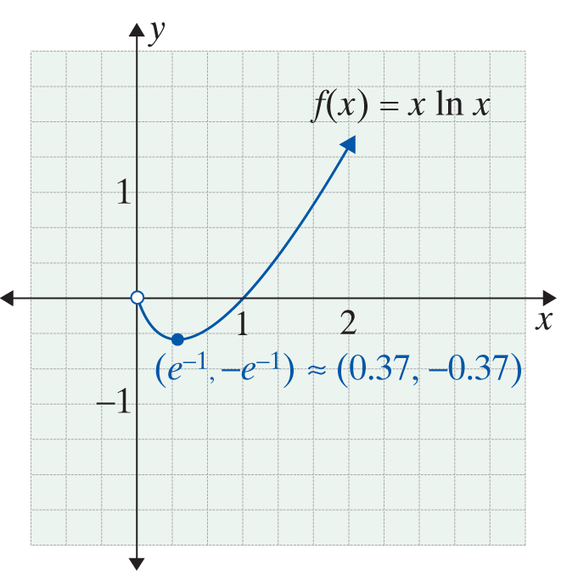
Example 7: Graphing Logarithmic Functions (cont.)
A local (and absolute) minimum occurs at the critical value and
Note: one easy point to get without a calculator is (1 , 0) (the student should recall that ln1 = 0). Therefore, it is possible to notice that 1 ⋅ ln 1 = 0, and (1 , 0) is an x-intercept.

