Slide 1
Section 6.3
The Fundamental Theorem of Calculus and the Definite Integral

Slide 2
Objectives
Have a thorough understanding of the Fundamental Theorem of Calculus.
Evaluate definite integrals.

Slide 3
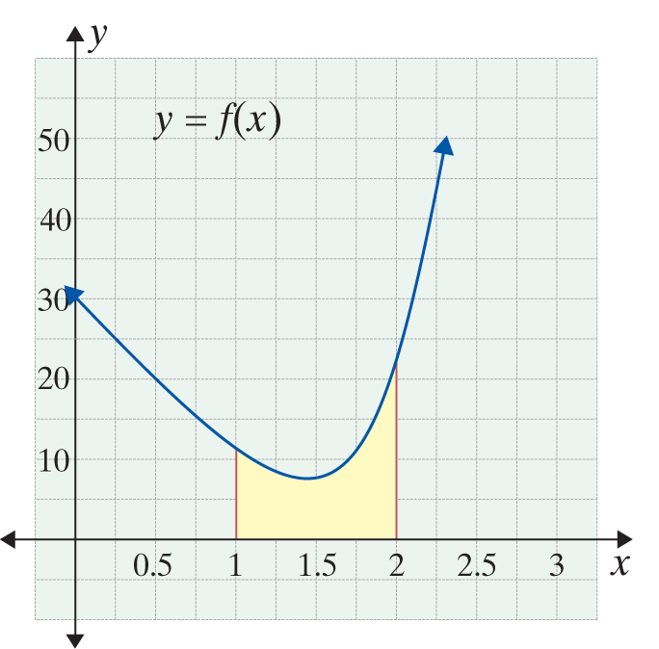
Example 1: Using the Fundamental Theorem of Calculus
Use the Fundamental Theorem of Calculus to determine the area under the graph of
and over the x-axis interval [1, 2].
Solution:
First, we must find the
antiderivative, F(x).

Slide 4
Example 1: Using the Fundamental Theorem of Calculus (cont.)
Using the antiderivative, solve for F(b) − F(a).
Use a = 1 and b = 2.
The area is 10.5 square units.

Slide 5
Riemann Sums
General Form of a Riemann Sum
The general form of a Riemann sum for a function
y = f(x) continuous on [a, b] is
Where n is the number of subintervals of
[a, b] and each of the numbers represents one x-value from each subinterval.

Slide 6
Example 2: Riemann Sum
Use a Riemann sum to estimate the area between
and the x-axis on the interval [a, b] = [1, 5]
with n = 4.
Solution:
In this example we use the midpoint of each subinterval for the values of
First, we find Δx by substituting the given values a = 1, b = 5, and
n = 4.

Slide 7
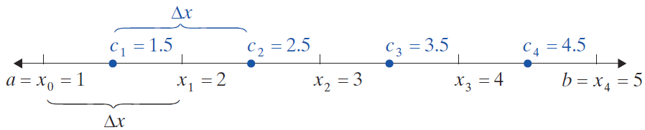
Example 2: Riemann Sum (cont.)
Substitute the appropriate values into the general form of the Riemann sum.

Slide 8
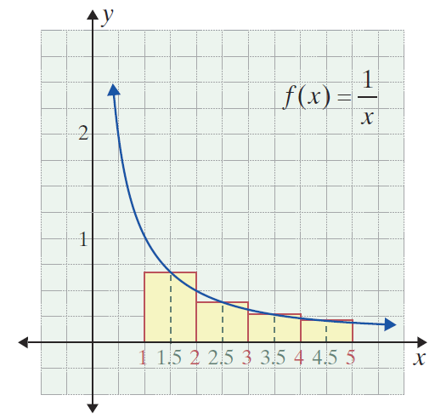
Example 2: Riemann Sum (cont.)

Slide 9
Example 3: Riemann Sum
Use a Riemann sum to estimate the area between
and the x-axis on the interval [a, b] = [−1, 2] with n = 6.
Solution:
In this example we use the left endpoint of each subinterval for the values of
First, we find Δx by substituting the given values a = −1, b = 2, and n = 6.

Slide 10
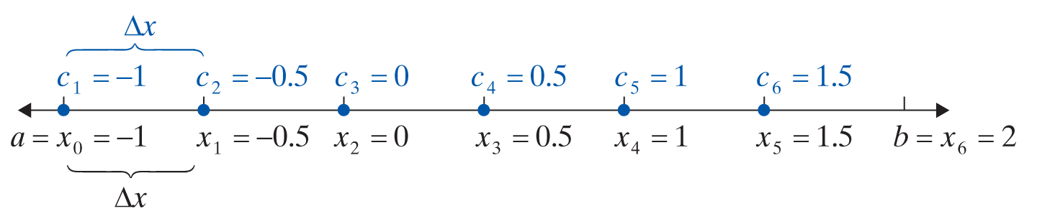
Example 3: Riemann Sum (cont.)
Substitute the appropriate values into the general form of the Riemann sum.

Slide 11
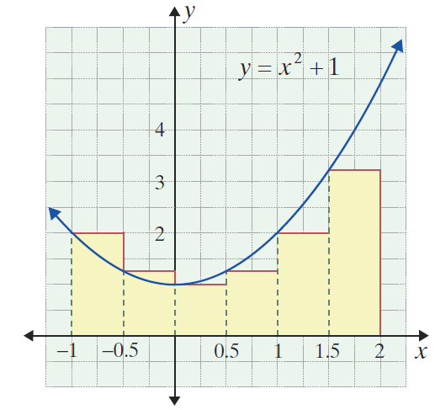
Example 3: Riemann Sum (cont.)

Slide 12
Riemann Sums
Notes
Programmable graphing calculators (like the TI-84 Plus) will calculate various types of Riemann sums directly using a menu. We do not include such problems in this text.

Slide 13
The Definite Integral
Area Under a Curve Defined
If a function y = f(x) is nonnegative and continuous on the interval [a, b] then the area under the curve is defined to be
where is the general form of a Riemann sum for the function f.

Slide 14
The Definite Integral
The Definite Integral
If a function y = f(x) is continuous on the interval [a, b], then the definite integral of f from a to b, symbolized as is defined to be
where is the general form of a Riemann sum for the function f.
The number a is called the lower limit of integration and the number b is called the upper limit of integration.

Slide 15
The Definite Integral
Formula for Area Under a Curve
For a function y = f(x), nonnegative and continuous on [a, b], the area under the curve is given by

Slide 16
The Definite Integral
The Fundamental Theorem of Calculus
If a function y = f(x) is continuous on the interval [a, b] and F(x) is any antiderivative of f(x), then

Slide 17
The Definite Integral
Notes
We will use the handy notational convenience (the use of the labeled bracket notation) to indicate F(b) − F(a) as shown on the previous page and as illustrated below:
or even

Slide 18
The Definite Integral
Notes (cont.)
In some books other similar notation is used such as the following:

Slide 19
Example 4: Definite Integrals
a. Evaluate
Solution:
Determine the antiderivative F(x).
Use the Fundamental Theorem of Calculus with a = 1 and b = 2.

Slide 20
Example 4: Definite Integrals (cont.)
b. Find the value of
Solution:
Determine the antiderivative F(x).
Use the Fundamental Theorem of Calculus with
a = 1 and b = 4.

Slide 21
Example 4: Definite Integrals (cont.)
c. Evaluate
Solution:
Determine the antiderivative F(x).
Use the Fundamental Theorem of Calculus with a = 0 and b = 1.

Slide 22
The Definite Integral
Properties of Definite Integrals

Slide 23
Example 5: Using Properties of Definite Integrals
a. Evaluate
Solution:
Determine the antiderivative F(x).
Use the Fundamental Theorem of Calculus with a = 1 and b = 2.

Slide 24
Example 5: Using Properties of Definite Integrals (cont.)
b. Find the value of
Solution: Use the u-substitution technique with
and du = 2xdx to find the antiderivative. Then replace u with before evaluating the definite integral.
Use u-substitution to find the antiderivative.

Slide 25
Example 5: Using Properties of Definite Integrals (cont.)
Evaluate the definite integral.

Slide 26
Average Value
Average Value
For a function y = f(x), continuous on the interval [a, b], the average value is

Slide 27
Example 6: Average Value
a. Find the average value of on the interval [0, 8].
Solution:
Substitute a = 0, b = 8, and the given f(x) into the formula for average value.
Solve.

Slide 28
Example 6: Average Value (cont.)
Note that this is between 10 and 11 as estimated earlier.

Slide 29
Example 6: Average Value (cont.)
b. Find the average value of on the interval [0, 3].
Solution:
Substitute a = 0, b = 3, and the given f(x) into the formula for average value.
Solve.

Slide 30
Example 6: Average Value (cont.)

Slide 31

Example 7: Average Sales
A new electronics company sells DVD players
(in hundreds) per month, where t is the number of months the company has been in business. Find the average sales per month during the
company’s first 6 months in business.
Solution:
Substitute a = 0, b = 6, and the given f(x) into the formula for average value.
Solve.

Slide 32
Example 7: Average Sales (cont.)
The company averaged sales of 900 DVD players per month during its first 6 months in business.

