Slide 1
Section 6.4
Area (with Applications)

Slide 2
Objectives
Use definite integrals to find area when a function has negative values.
Apply what you have learned about definite integrals to marginal analysis.

Slide 3
Area Bounded by a Curve and the x-Axis
The Integral as Area
For y = f(x), a continuous function on the interval [a, b],
the integral represents:
1. The total area bounded by the curve and the x-axis from x = a to x = b if f(x) is nonnegative for all x in [a, b].
2. The difference between the areas above the x-axis and below the x-axis that are bounded by the curve and the x-axis from x = a to x = b if f(x) is negative for any x in [a, b].

Slide 4
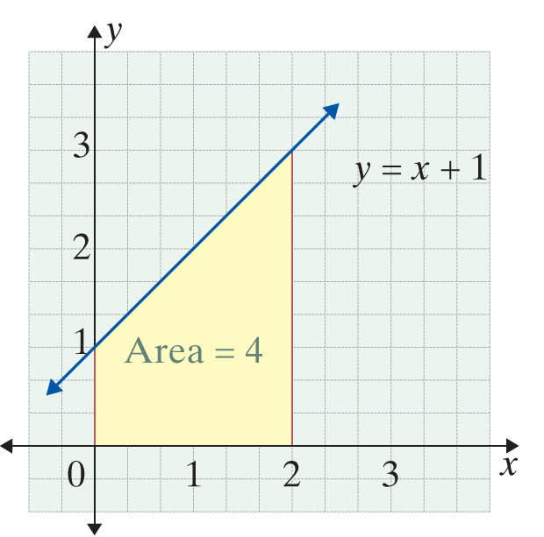
Example 1: Interpreting the Integral
a. Evaluate and interpret the integral geometrically.
Solution:
Geometrically, 4 is the area between the curve y = x + 1 and the x-axis on the interval [0, 2].

Slide 5
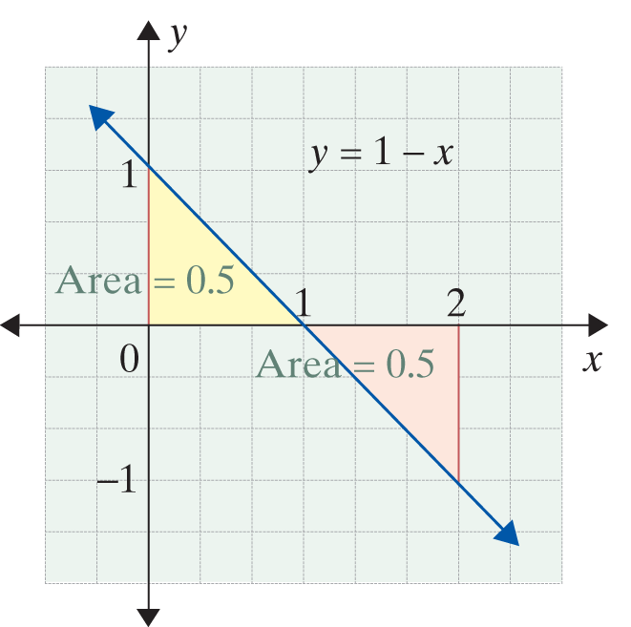
Example 1: Interpreting the Integral (cont.)
b. Evaluate and interpret the integral geometrically.
Solution:

Slide 6
Example 1: Interpreting the Integral (cont.)
Geometrically, the 0 means the area above the x-axis and the area below the x-axis on the given interval are exactly equal.

Slide 7
Example 2: Total Area
Find the total area bounded by the x-axis and the curve on the interval [−2, 3].
Solution:
The curve is a parabola that crosses the x-axis at x = −2 and x = 2. We integrate the function from
x = −2 to x = 2 to find Then, to find we take the additive inverse (negative) of the integral from x = 2 to x = 3.

Slide 8
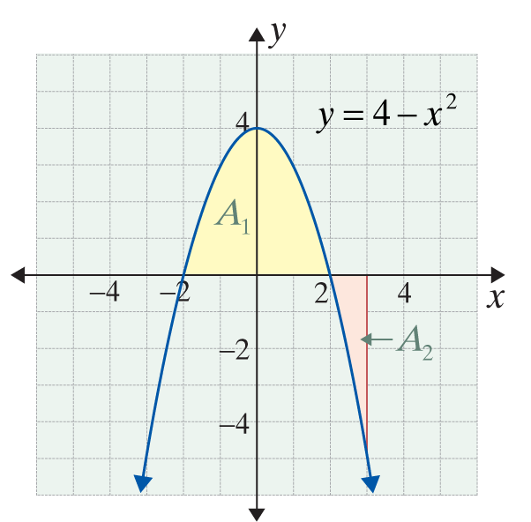
Example 2: Total Area (cont.)

Slide 9
Example 2: Total Area (cont.)

Slide 10
Example 2: Total Area (cont.)
Note: Adding a minus sign will not apply to other examples in this book. In this case the goal was to find the area bounded by the curve and the x-axis.

Slide 11
Example 2: Total Area (cont.)
Total Area =
Note that which is
not the total area.

Slide 12
Area Bounded by a Curve and the x-Axis
Notes
Graphs, as shown in Examples 1 and 2, are valuable visual aids in understanding definite integrals. A sketch of the graph of the function being integrated should be made whenever possible.

Slide 13
Area Bounded by a Curve and the x-Axis
Additional Properties of the Definite Integral
where c is any point with

Slide 14
Example 3: Bounded Area
Find the area of the region bounded by the function
and the x-axis from x = −1 to x = 2.

Slide 15
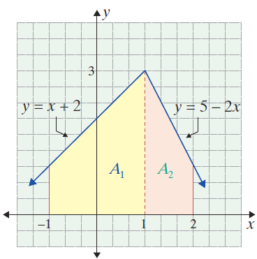
Example 3: Bounded Area (cont.)
Solution:
The graph consists of two line segments.

Slide 16
Example 3: Bounded Area (cont.)

Slide 17
Example 4: Marginal Analysis
A picture frame maker knows that his profit (in dollars) is changing at a rate given by the function where x is the number of frames he makes and sells.
a. Find the profit from selling the first 200 frames.
b. Find the change in his profit when sales increase from 200 to 400 frames.

Slide 18
Example 4: Marginal Analysis (cont.)
Solution:
a. Integrate the marginal profit function from x = 0 to
x =200.
His profit is $3000 on the first 200 frames if we ignore any fixed costs.

Slide 19
Example 4: Marginal Analysis (cont.)
b. Integrate from x = 200 to x = 400.
His profit changes by $1000 when sales increase from 200 to 400 frames.

Slide 20
Example 4: Marginal Analysis (cont.)
Note that from parts a. and b. we see that the profit on sales for the first 200 frames (x = 0 to x = 200) is greater than for the second 200 frames (x = 200 to x = 400). This result is quite reasonable because the marginal profit, is decreasing by 5 percent per frame. In this problem, the fixed costs are relevant. Suppose the fixed costs are $1000. Then
P(x) = 20x − 0.025x² − 1000 dollars, and P(200) = $2000, which is the net profit.
The integral from x = 0 to x = 200 gives the increase in profits, P(200) − P(0) = 2000 − (−1000) = 3000.

