Slide 1
Section 6.5
Area Between Two Curves (with Applications)

Slide 2
Objectives
Find the area bounded by two curves.
Apply the concept of bounded area to business and economic situations.

Slide 3
Area Between Two Curves
Area Between Two Curves
If f and g are two continuous functions and f(x) ≥ g(x) on the interval [a, b], then the area between the two curves on this interval is

Slide 4
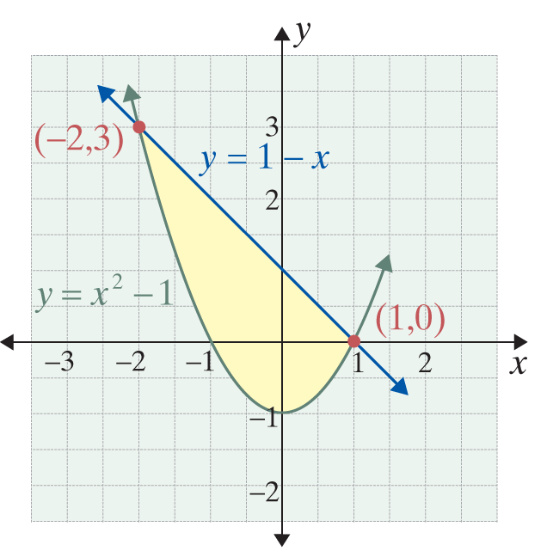
Example 1: Finding the Area Between Two Curves
Find the area enclosed by the curves y = x² − 1 and y = 1 − x.
Solution:
Sketch the graphs of both functions to help determine which function is larger. Now set the two y-values equal to each other to find the points of intersection. These x-values will be the limits of integration.

Slide 5
Example 1: Finding the Area Between Two Curves (cont.)
Thus

Slide 6
Example 1: Finding the Area Between Two Curves (cont.)

Slide 7
Example 2: Finding the Area Between Two Curves
Find the area between the curves y = x³ and y = x² + 1 on the interval [−1, 1].
Solution:
Sketch the graphs of both functions to help determine whether or not the curves intersect on the interval [−1, 1].
These curves do not intersect on the interval [−1, 1] and y = x² + 1 is larger on the entire interval.

Slide 8
Example 2: Finding the Area Between Two Curves (cont.)
Therefore,

Slide 9
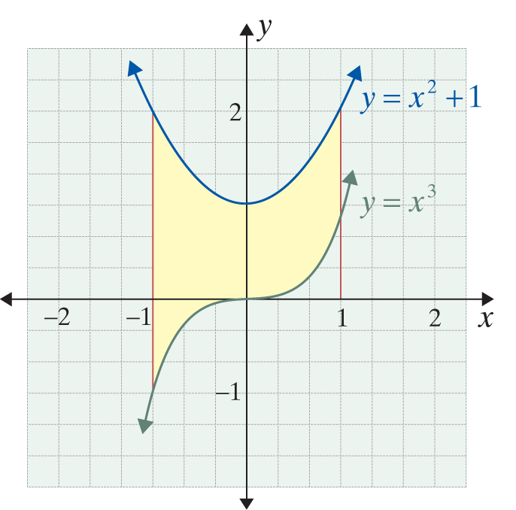
Example 2: Finding the Area Between Two Curves (cont.)

Slide 10
Consumers’ Surplus and Producers’ Surplus
Consumers’ Surplus
The consumers’ surplus is defined to be
where p = D(x) is the demand curve and (x_{E}, p_{E}) is the equilibrium point.

Slide 11
Consumers’ Surplus and Producers’ Surplus
Producers’ Surplus
The producers’ surplus is defined to be
where p = S(x) is the supply curve and (x_{E} , p_{E}) is the equilibrium point.

Slide 12
Example 3: Determining Surpluses
Suppose, for a certain new brand of car stereo, the demand function is D(x) = 6 − x and the supply function is S(x) = x².
a. Find the equilibrium point.
b. Find the consumers’ surplus.
c. Find the producers’ surplus.

Slide 13
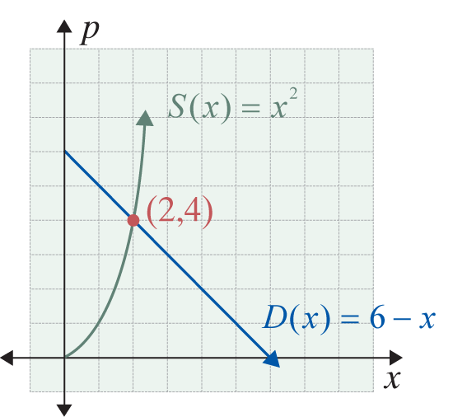
Example 3: Determining Surpluses (cont.)
Solutions:
a. Set S(x) = D(x) and solve for x.
Therefore, x_{E} = 2 and p_{E} = 6 − 2 = 4.
The equilibrium point is (2, 4).

Slide 14
Example 3: Determining Surpluses (cont.)

Slide 15
Example 3: Determining Surpluses (cont.)

Slide 16
Lorenz Curves
Coefficient of Inequality for a Lorenz Curve
If y = f(x) represents a Lorenz curve, then

Slide 17
Example 4: Using a Lorenz Curve
Suppose that f(x) = 0.6x² + 0.4x represents a Lorenz curve for some country.
a. What percent of the country’s total income is earned by the lower 50 percent of the families in this country?
b. Find the coefficient of inequality.

Slide 18
Example 4: Using a Lorenz Curve (cont.)
Solutions:
The lower 50 percent of the families earn 35 percent of the country’s total income.
Since we want the lower 50% of families, set x = 0.5.

Slide 19
Example 4: Using a Lorenz Curve (cont.)
Note: combine terms in the integrand before finding the antiderivative.
The coefficient of inequality is 0.2.

