Slide 1
Section 8.5
The Method of Least Squares

Slide 2
Objectives
Apply the method of least squares to obtain a line of best fit.

Slide 3
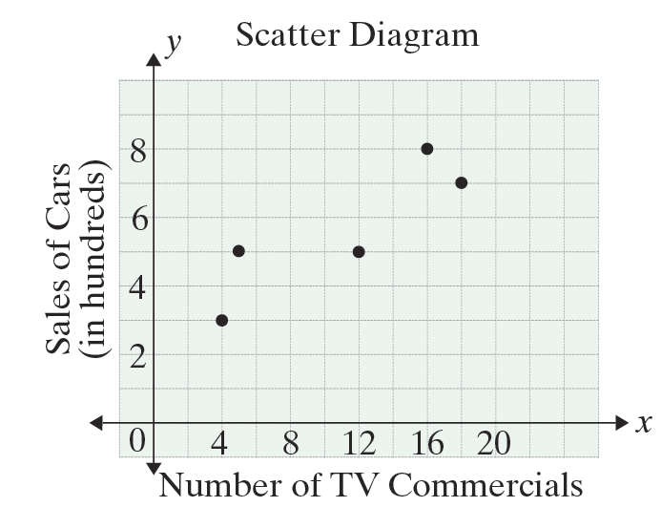
The Method of Least Squares
Number of TV Commercials x | Sales of Cars (in hundreds) y
4 | 3
5 | 5
12 | 5
16 | 8
18 | 7
Figure 8.5.1

Slide 4
The Method of Least Squares
Notes
The use of the Greek capital letter sigma (∑) to indicate summations is a standard notation in mathematics.

Slide 5
The Method of Least Squares
The Least-Squares Regression Line
For a set of data points
the regression line is y = mx + b where (omitting indices in the summations):

Slide 6
Example 1: Using Linear Regression on
Tabular Data
Use the formulas to find the regression line for the data given in the table in Figure 8.5.1.
Solution: The data are exhibited, and calculations are made in table form.
 | x | y | xy | x²
 | 4 | 3 | 12 | 16
 | 5 | 5 | 25 | 25
 | 12 | 5 | 60 | 144
 | 16 | 8 | 128 | 256
 | 18 | 7 | 126 | 324
Sums | 55 | 28 | 351 | 765

Slide 7
Example 1: Using Linear Regression on
Tabular Data (cont.)
We find that
Thus, from Formula 1,

Slide 8
Example 1: Using Linear Regression on
Tabular Data (cont.)
and, from Formula 2,
The line of regression is
which is in agreement (except for slight round-off errors) with the previous calculations.

Slide 9
Example 2: Forecasting Grade Point Averages with Linear Regression
The following table shows the high school grade-point averages (HS-GPA) and the college grade-point averages (C-GPΑ) after 1 year of college for 10 students.
a. Find the regression line for the data given in the table.
b. What would be your best prediction for the C-GPA of a high school student with an HS-GPA of 2.5?
c. Graph the data and the regression line on the same set of axes.

Slide 10
Example 2: Forecasting Grade Point Averages with Linear Regression (cont.)
HS-GPA(x) | 2.0 | 2.0 | 2.2 | 2.2 | 2.7 | 3.2 | 3.2 | 3.3 | 3.5 | 3.7
C-GPA(y) | 1.5 | 1.8 | 2.0 | 1.5 | 2.0 | 2.8 | 3.0 | 3.5 | 3.5 | 3.4
Solutions:
a. Set up a table to calculate the values needed for Formulas 1 and 2.

Slide 11
Example 2: Forecasting Grade Point Averages with Linear Regression (cont.)
 | x | y | xy | x²
 | 2.0 | 1.5 | 3.00 | 4.00
 | 2.0 | 1.8 | 3.60 | 4.00
 | 2.2 | 2.0 | 4.40 | 4.84
 | 2.2 | 1.5 | 3.30 | 4.84
 | 2.7 | 2.0 | 5.40 | 7.29
 | 3.2 | 2.8 | 8.96 | 10.24
 | 3.2 | 3.0 | 9.60 | 10.24
 | 3.3 | 3.5 | 11.55 | 10.89
 | 3.5 | 3.5 | 12.25 | 12.25
 | 3.7 | 3.4 | 12.58 | 13.69
Sums | 28.0 | 25.0 | 74.64 | 82.28

Slide 12
Example 2: Forecasting Grade Point Averages with Linear Regression (cont.)
Now
From Formula 1, we have
From Formula 2, we have
Thus the line of regression is y = 1.20x − 0.86.

Slide 13
Example 2: Forecasting Grade Point Averages with Linear Regression (cont.)
b. The best prediction for HS-GPA of 2.5 is found by substituting x = 2.5 in the equation for the line of regression and solving for y:

Slide 14
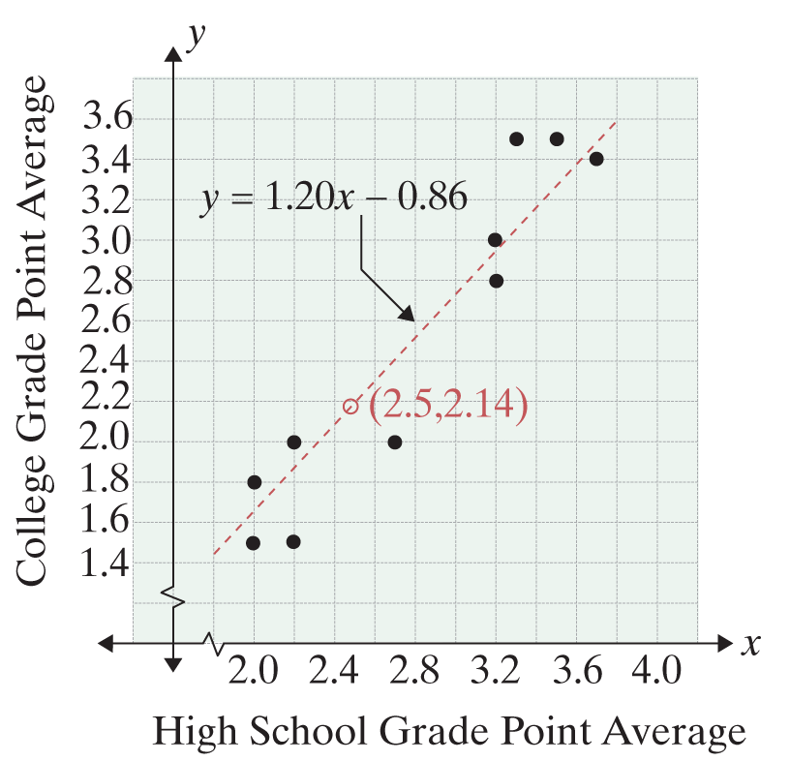
Example 2: Forecasting Grade Point Averages with Linear Regression (cont.)
c.

