Slide 1
Section 8.6
Double Integrals

Slide 2
Objectives
Evaluate double integrals on regions of type I, II, and III.

Slide 3
Double Integrals
Definition of Double Integral
For a function z = f(x, y) continuous on a region R in the xy-plane

Slide 4
Double Integrals
Value of the Double Integral
If z = f (x, y) is a continuous function on a region R in the xy-plane and on R, then the volume of the solid bounded above by the graph of f and below by R is the value of the double integral of f on R:

Slide 5
Double Integrals
Theorem for Evaluating Double Integrals
If z = f (x, y) is a continuous function on a closed region R, and
Case 1: R is of Type I, then
Case 2: R is of Type II, then

Slide 6
Double Integrals
Theorem for Evaluating Double Integrals (cont.)
Case 3: R is of Type III, then
Note: Only in Case 1 have we shown that the order of integration may be reversed. There are problems of the types in Case 2 and Case 3 in which the order of integration may be reversed; however, we will not discuss reversing the order of integration for such problems in this text.

Slide 7
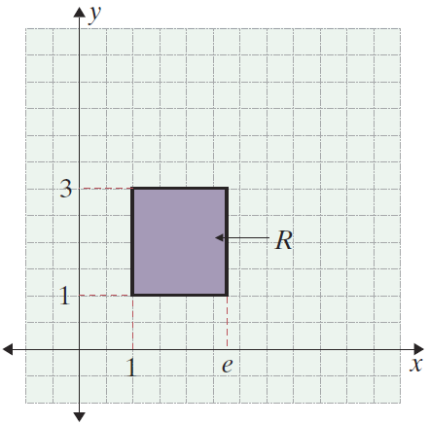
Example 1: Evaluating a Double Integral on a Type I Region
Evaluate the double integral
Solution:
Since R is of Type I (a rectangular region), we may integrate in either order and obtain the same result. Both integrations are shown here to clarify the idea of reversing the order of integration.

Slide 8
Example 1: Evaluating a Double Integral on a Type I Region (cont.)
Integrate first with respect to x and evaluate at x = e and x = 1. The variable y is treated as constant.
1.
Now integrate with respect to y and evaluate.

Slide 9
Example 1: Evaluating a Double Integral on a Type I Region (cont.)
Integrate first with respect to y and evaluate at y = 3 and y = 1. The variable x is treated as constant.
2.

Slide 10
Example 1: Evaluating a Double Integral on a Type I Region (cont.)
Now integrate with respect to x and evaluate.

Slide 11
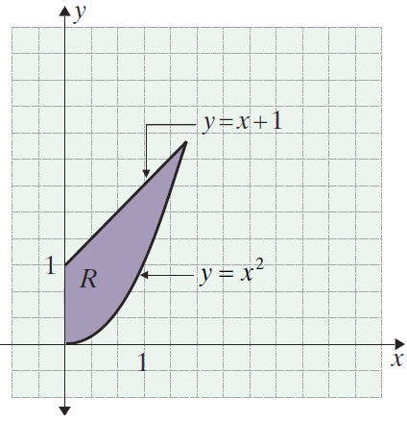
Example 2: Evaluating a Double Integral on a Type II Region
Evaluate the double integral
Solution:
The region R is of Type II and is illustrated in the figure at the right.

Slide 12
Example 2: Evaluating a Double Integral on a Type II Region (cont.)
Integrate first with respect to y and evaluate at y = x + 1 and y = x².

Slide 13
Example 2: Evaluating a Double Integral on a Type II Region (cont.)

Slide 14
Example 3: Evaluating a Double Integral on a Type III Region
Evaluate the double integral
Solution:
Integrate first with respect to x
and evaluate at and x = 0.

Slide 15
Example 3: Evaluating a Double Integral on a Type III Region (cont.)

Slide 16
Example 4: Finding the Volume of a
Geometric Solid
Find the volume of the solid bounded above by the graph of the function z = 10 − x − y and below by the triangular region R in the xy-plane with vertices at
(0, 0, 0), (4, 0, 0), and (0, 8, 0).
Solution:
The surface z = 10 − x − y is a plane, and the region R is a triangle in the xy-plane with the given points as vertices. The volume to be found is illustrated in the figure on the next slide.

Slide 17
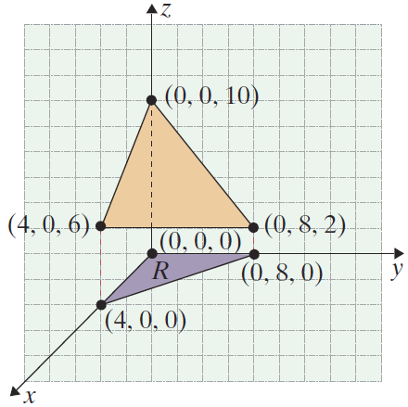
Example 4: Finding the Volume of a
Geometric Solid (cont.)
To set the limits of integration, we need to represent the region R in terms of x and y. We can do this by determining the equation of the line through the two points (4, 0) and (0, 8) on an
xy-­coordinate system and then setting constant restrictions on one of the variables so that the triangular region is described.

Slide 18
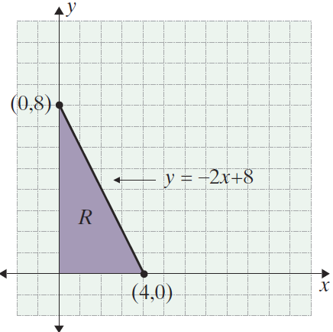
Example 4: Finding the Volume of a
Geometric Solid (cont.)
The slope of the line is
and the equation of the line is
Thus R can be described by the following restrictions on x and y:

Slide 19
Example 4: Finding the Volume of a
Geometric Solid (cont.)
The described volume is now found by using double integration.
Thus the volume of the solid described is 96 cubic units.

