Slide 1
Section 9.1
The Trigonometric Functions

Slide 2
Objectives
Sketch and evaluate trigonometric functions.
Verify basic trigonometric identities.

Slide 3
Definitions of the Trigonometric Functions
Table 9.1.1 The Trigonometric Functions
If P(x, y) is a point on the unit circle and θ is the corresponding central angle, then

Slide 4
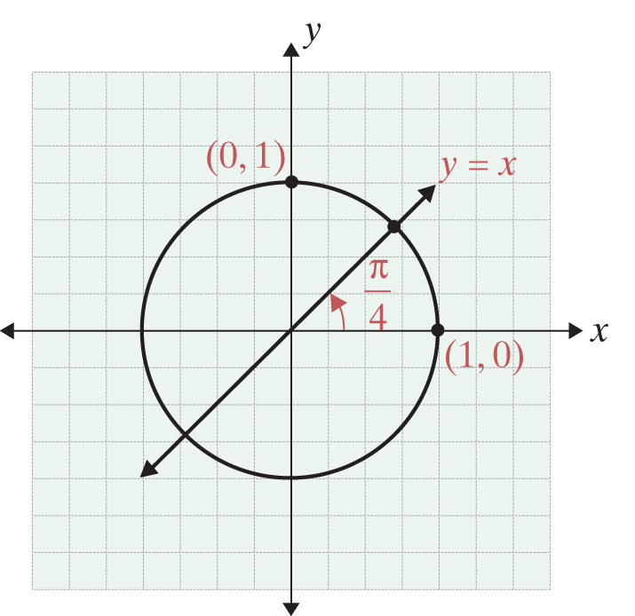
Example 1: Trigonometric Functions
Use the given figure and the definitions to find sinθ, cosθ , and tanθ for each of the following values of θ.

Slide 5
Example 1: Trigonometric Functions (cont.)
Solutions:
a. For θ = 0, we have x = 1 and y = 0. Therefore,
sin0 = y = 0, cos0 = x = 1, and
b. For we have x = 0 and y = 1. Therefore,
c. For we locate the point of intersection in the
first quadrant of the line y = x and the unit circle.

Slide 6
Example 1: Trigonometric Functions (cont.)
This defines the unit circle.
Next, substitute x for y.
This is in the first quadrant.

Slide 7
Degree Measure of Angles
Table 9.1.2
θ in radians | 0
sinθ | 0 |  |  |  | 1
cosθ | 1 |  |  |  | 0
tanθ | 0 |  | 1 |  | −

Slide 8
Degree Measure of Angles
Table 9.1.2 (cont.)
θ in radians
sinθ |  |  |  | 0 | −1 | 0
cosθ |  |  |  | −1 | 0 | 1
tanθ |  | −1 |  | 0 | − | 0

Slide 9
Example 2: Angle Conversion
Convert between radians and degrees as requested:
a. convert 30° to radian measure.
b. convert 1.7 radians to degree measure.
Solutions:
a. 30° corresponds to
b. 1.7 radians corresponds to

Slide 10
Example 3: Trigonometric Values
Use the fact that the sine and cosine functions have period 2π and Table 9.1.2 to find the following functional values.
Solutions:

Slide 11
Example 3: Trigonometric Values (cont.)

Slide 12
Graphing Trigonometric Functions
Notes
We have used θ to represent angles and angle measure and x and y to represent coordinates on the unit circle, and we will continue to do so whenever it is convenient and the context is clear. However, for the purposes of graphing trigonometric functions and developing the related calculus concepts in Sections 9.2 through 9.4, we will return to the standard notation of using x for values of the domain and y for the values of the range.

Slide 13
Graphing Trigonometric Functions
Notes (cont.)
Thus the trigonometric functions for sine, cosine, and tangent can be represented in the forms
y = sinx, y = cosx, and y = tanx.
The graphs of these functions can be sketched by using values from Table 9.1.2 and a calculator. Also, both the functions y = sinx and y = cosx have period 2π and are continuous for all real numbers. This means that the pattern of each graph on the interval [0, 2π ] is continuously repeated on the entire interval of real numbers (−∞, +∞).

Slide 14
Example 4: The Predator-Prey Model
Ranchers in a certain area note that the populations of coyotes (predators) and rabbits (prey) interact with each other and are cyclic over a period of 3 years. As the population of rabbits increases, the population of coyotes also increases until the prey begins to decrease. The predator population continues to increase to the point where there is not enough food for the coyotes and their population begins to decrease. Then the decreasing population of coyotes allows an increase in the rabbit population, and the cycle begins again.

Slide 15
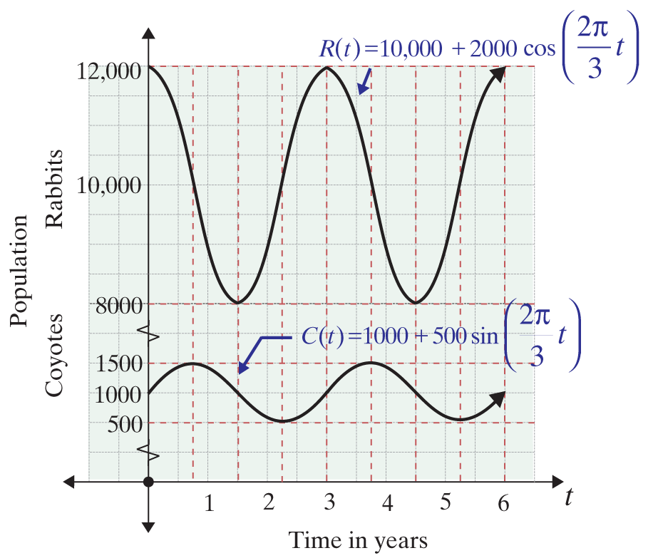
Example 4: The Predator-Prey Model (cont.)
The coyote-rabbit population interaction might be represented by the following two functions and their graphs:

Slide 16
Example 4: The Predator-Prey Model (cont.)
where t is time in years.
a. Calculate the period of the function C(t) algebraically.
b. Calculate the period of the function R(t) graphically.

Slide 17
Example 4: The Predator-Prey Model (cont.)
Solutions:
a. Since the sine function has a period of 2π, we set
and solve for t in each case.

Slide 18
Example 4: The Predator-Prey Model (cont.)
b. Since two corresponding y-values on the graph occur for the two minimums (x₁, y₁) = (1.5, 8000) and (x₂, y₂) = (4.5, 8000), the period is x₂ − x₁ = 4.5 − 1.5 = 3. Note, one complete cycle (or period) occurs between x₁ and x₂.

Slide 19
Some Basic Trigonometric Identities
Table 9.1.3 Basic Trigonometric Identities
Sum and difference identities

Slide 20
Some Basic Trigonometric Identities
Table 9.1.3 Basic Trigonometric Identities (cont.)

Slide 21
Some Basic Trigonometric Identities
Table 9.1.3 Basic Trigonometric Identities (cont.)

Slide 22
Example 5: Trigonometric Identities
Verify the trigonometric identity
Solution:
Divide each term in Identity 1 in Table 9.1.3 by
and then refer to the definitions in Table 9.1.1 for
By Identity 1, Table 9.1.3.
Divide by
Use the definitions in Table 9.1.1.

Slide 23
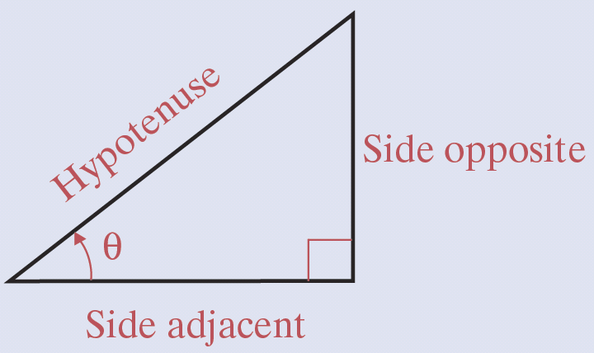
Right Triangle Trigonometry
Table 9.1.4 Right Triangle Trigonometry

Slide 24
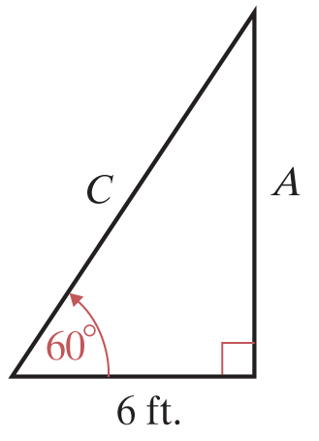
Example 6: Right Triangle Trigonometry
Find the lengths of C and A in the right triangle shown in the figure.
Solutions:

