Slide 1
Section 9.3
Integration of the Trigonometric Functions

Slide 2
Objectives
Find the antiderivative for a trigonometric function.
Calculate definite integrals for trigonometric functions.

Slide 3
Example 1: Antiderivatives of Trigonometric Functions
Evaluate each integral.
Solutions:
a. Use u-substitution with u = 5x and du = 5 dx.

Slide 4
Example 1: Antiderivatives of Trigonometric Functions (cont.)
b. Use u-substitution with u = sinx and du = cosxdx.

Slide 5
Example 2: Definite Integrals of Trigonometric Functions
Evaluate each integral.
Solutions:
a. Use u-substitution with u = 3x and du = 3dx

Slide 6
Example 2: Definite Integrals of Trigonometric Functions (cont.)
The value of the definite integral is

Slide 7
Example 2: Definite Integrals of Trigonometric Functions (cont.)
b. Use integration by parts as follows (see also Section 7.1):
Thus
u = x | dv = sinxdx
du = dx

Slide 8
Example 2: Definite Integrals of Trigonometric Functions (cont.)

Slide 9
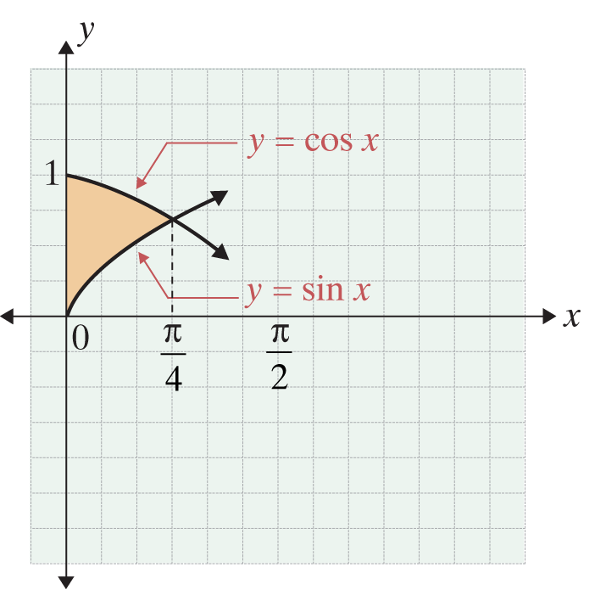
Example 3: Area Between Curves
Find the area between the curves y = cosx and y = sinx
on the interval
Solution:
As illustrated in the figure at the right, y = cosx is greater than or equal to y = sinx on
the interval

Slide 10
Example 3: Area Between Curves (cont.)
To find the area between the two curves, we integrate as follows:

Slide 11
Integration Formula for the Tangent Function
Integration Formula for the Tangent Function

Slide 12
Example 4: Integrating the Tangent
Solution:
Use u-substitution with and Then

Slide 13
Example 5: Population Rate of Change
Suppose that the rate of change of the deer population in a region of the Rocky Mountains is approximately
where t is the number of months after January 1 each year. What is the change in the deer population from January 1 to July 1?

Slide 14
Example 5: Population Rate of Change (cont.)
Solution:
On January 1, t = 0, and on July 1, t = 6. The change in the deer population is approximated by the definite integral
Use u-substitution with

Slide 15
Example 5: Population Rate of Change (cont.)
Then

Slide 16
Example 5: Population Rate of Change (cont.)
Therefore, the value of the definite integral is
By July 1, the deer population has grown by about 382 deer.

Slide 17
Example 6: Estimating Revenue
The revenue (in hundreds of dollars) from the ski section of a sporting goods store is estimated to be
where t is the number of months after January 1 each year. Find the total estimated revenue for one year.

Slide 18
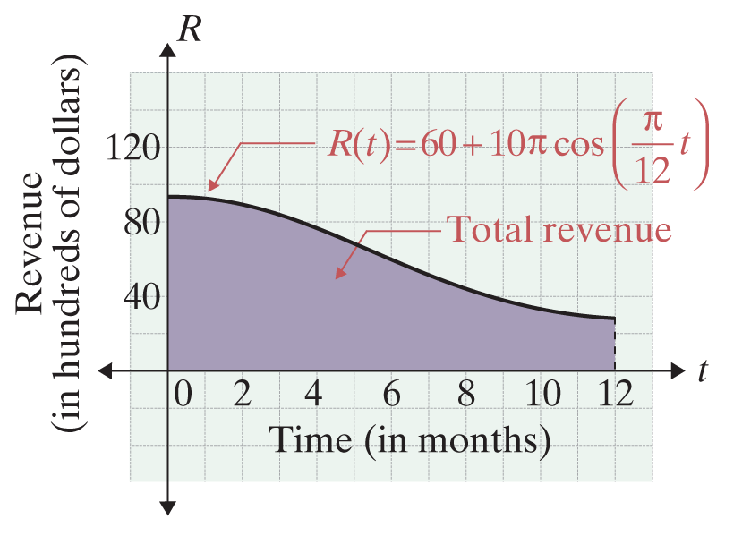
Example 6: Estimating Revenue (cont.)
Solution:
The total estimated revenue is the area under the curve as shown in the figure below. This area is the value of the definite integral.

Slide 19
Example 6: Estimating Revenue (cont.)
The total estimated revenue from the ski department is $72,000.

