Slide 1
Section 10.1
Quadratic Equations: The Square Root Method

Slide 2
Objectives
Solve quadratic equations using the definition of square root.
Solve applications related to right triangles and the Pythagorean Theorem.

Slide 3
Example 1: Factoring Method
Simplify the following expressions
Solution:
The solutions are −9 and 2.

Slide 4
Example 1: Factoring Method (cont.)
Solution:
The solutions are and −1.

Slide 5
Solving Quadratic Equations Using the Square Root Method
Square Root Method
For a quadratic equation in the form where c is nonnegative,
This can be written as

Slide 6
Solving Quadratic Equations Using the Square Root Method
Notes
In this method, we do not set a polynomial expression equal to 0. Instead we set a squared expression equal to a nonnegative real number.

Slide 7
Example 2: The Square Root Method
Solve the following quadratic equations by using the square root method. Write the radicals in simplest form.
Solution:

Slide 8
Example 2: The Square Root Method (cont.)
Solution:

Slide 9
Example 2: The Square Root Method (cont.)
Solution:

Slide 10
Example 2: The Square Root Method (cont.)
Solution:

Slide 11
Example 2: The Square Root Method (cont.)

Slide 12
Example 2: The Square Root Method (cont.)
Solution:
There is no real solution. The square of a real number cannot be negative.

Slide 13
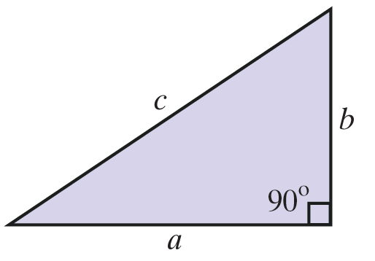
The Pythagorean Theorem
The Pythagorean Theorem
In a right triangle, the square of the hypotenuse is equal to the sum of the squares of the two legs.

Slide 14
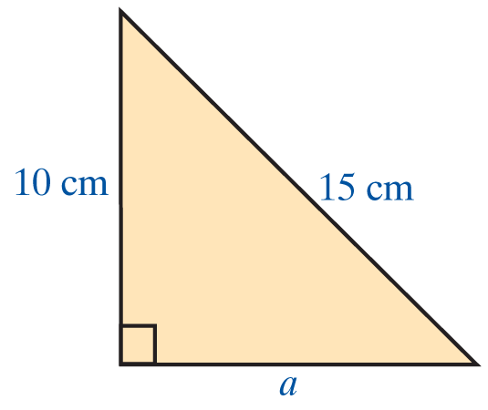
Example 3: The Square Root Method
a. If the hypotenuse of a right triangle is 15 cm long and one leg is 10 cm long, what is the length of the other leg?
Solution: Using the Pythagorean Theorem,

Slide 15
Example 3: The Square Root Method (cont.)
The other leg is long (or approximately 11.18 cm long).
(The negative solution to the quadratic equation is not considered because length is not negative.)

Slide 16
Example 3: The Square Root Method (cont.)
b. The diagonal of a rectangle is twice the width. The length of the rectangle is 6 feet. Find the width of the rectangle.
Solution:
Let x = width of the rectangle
and 2x = length of the diagonal.

Slide 17
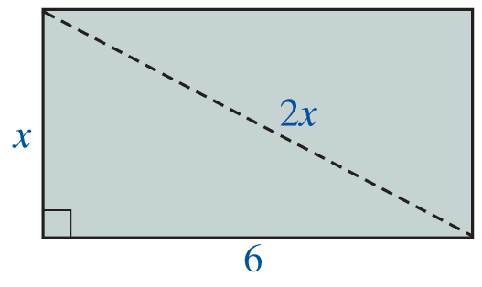
Example 3: The Square Root Method (cont.)
Then, by using the Pythagorean Theorem, we have

Slide 18
Example 3: The Square Root Method (cont.)
The width of the rectangle is feet or approximately 3.46 feet. (The negative solution to the quadratic equation is not considered because length is not negative.)

Slide 19
Example 3: The Square Root Method (cont.)
c. Use the Pythagorean Theorem to decide if a triangle with sides of length 8 in., 12 in., and 14 in. is a right triangle.
Solution:
If the triangle is a right triangle, then the sum of the squares of the two shorter sides must equal the square of the longest side.

Slide 20
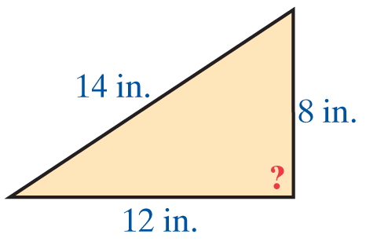
Example 3: The Square Root Method (cont.)
So and the triangle is not a right triangle.

Slide 21
Practice Problems
Solve the following quadratic equations by using the square root method. Write the radicals in simplest form.

Slide 22
Practice Problem Answers

